Slide 1

WPSA PPM technical information
Dániel Dunai
Head of Local Organizing Committee
Fusion Plasma Physics Department

Slide 2
Welcome here FINALLY
Rome Wasn’t Built in a Day
2019. January 10. 15:53
Dear Gerardo,
During your last visit at Wigner the question was raised, if we could host the 7th Project Planning Meeting in 2020 in Budapest.
Tamás and me discussed this possibility, and agreed that it would be a good idea.
After 3 Years, 7 Months, 3 Weeks, 4 Days –
We can finally greet you in person in Budapest

Slide 3
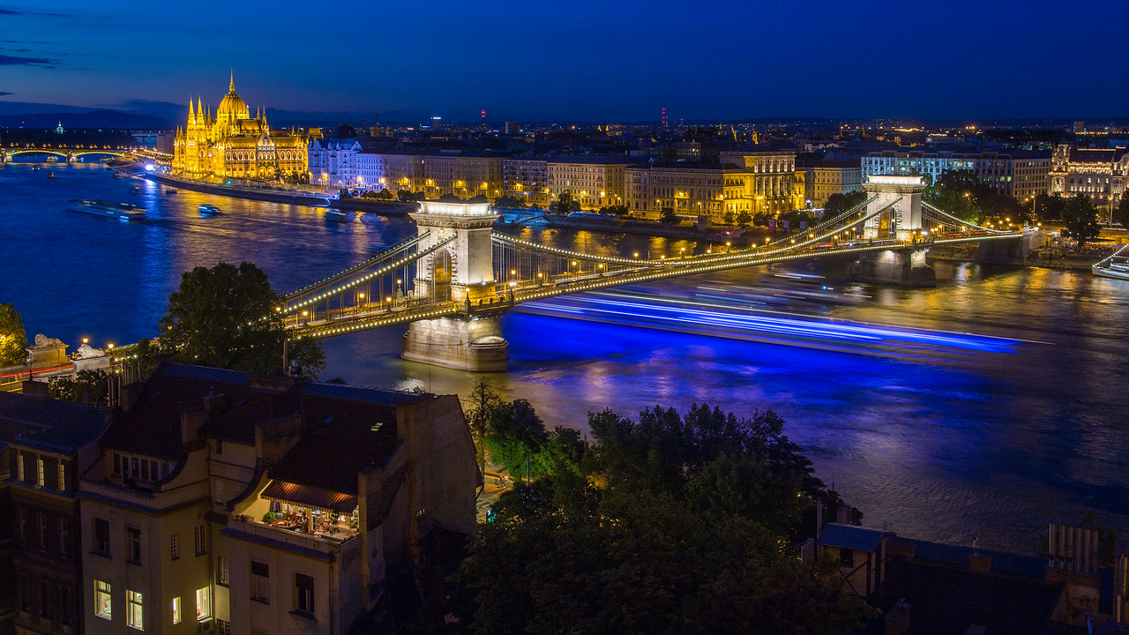
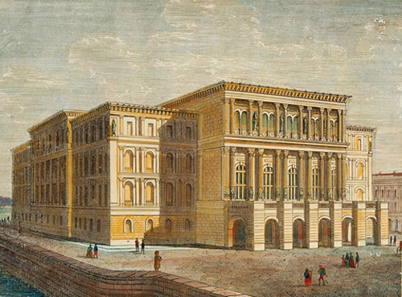
And where is here?
Hungarian Academy Sciences
(1869)
More details on history of the building Wednesday 18:00

Slide 4
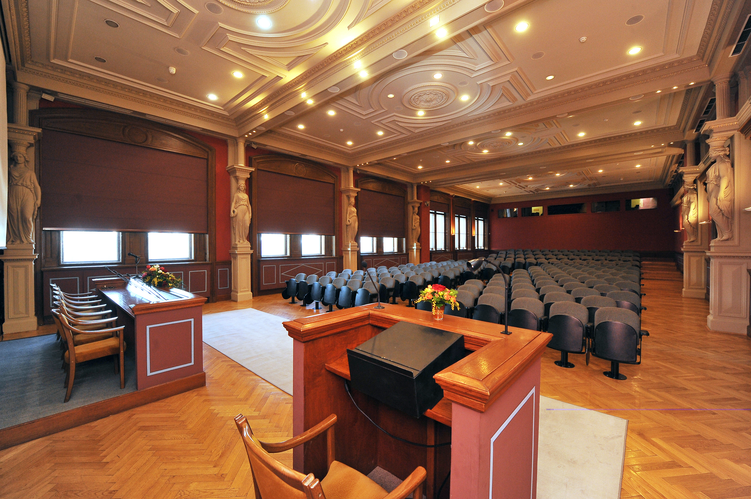
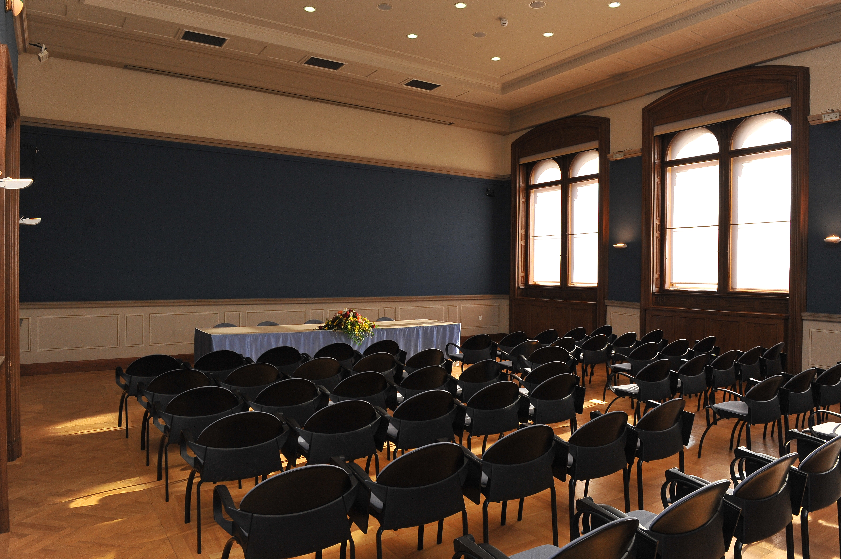
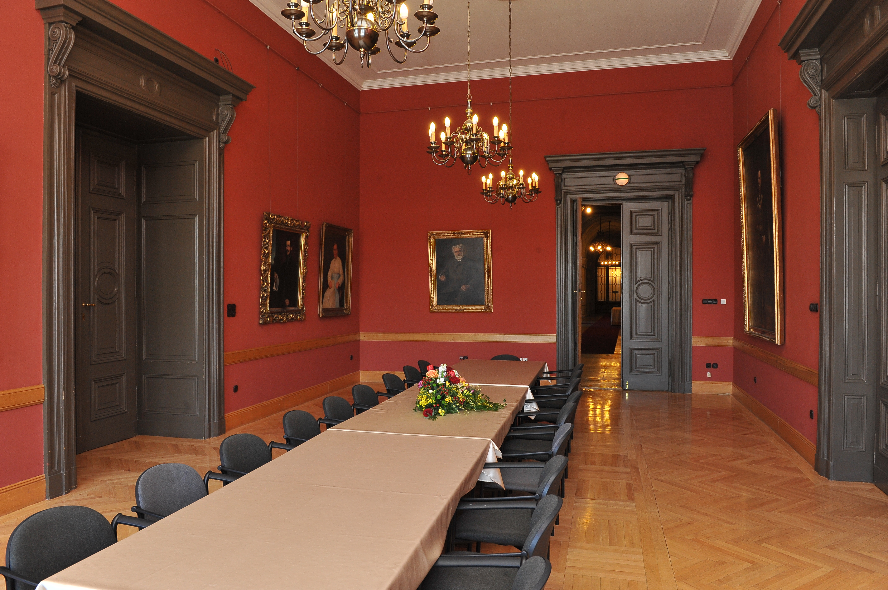
Venue – Main building of HAS
Small Conference
Room – 2nd floor
Thursday parallel
Large Conference Room – 2nd floor
All plenary
Galery Room –
1st floor
Ad Hoc meetings
Booking is needed

Slide 5
Wifi connection
Wifi connection details are shown in multiple locations
The same Wifi connection is available in the entire building
Connection details are valid until Friday afternoon
Wifi Network: Mars
Password: S10hSL9W

Slide 6

Covid-19
There are no travel restrictions into Hungary and wearing a mask is not compulsory.
If someone experiences covid-like syndromes (coughing, headache, weakness, ...) he/she should perform a test.
(And start to wear mask, if it was not the case previously)
Test kits and masks are provided in limited number, which can be used by participants free of charge.
If you feel any symptoms during the meeting, please contact the organizers.

Slide 7
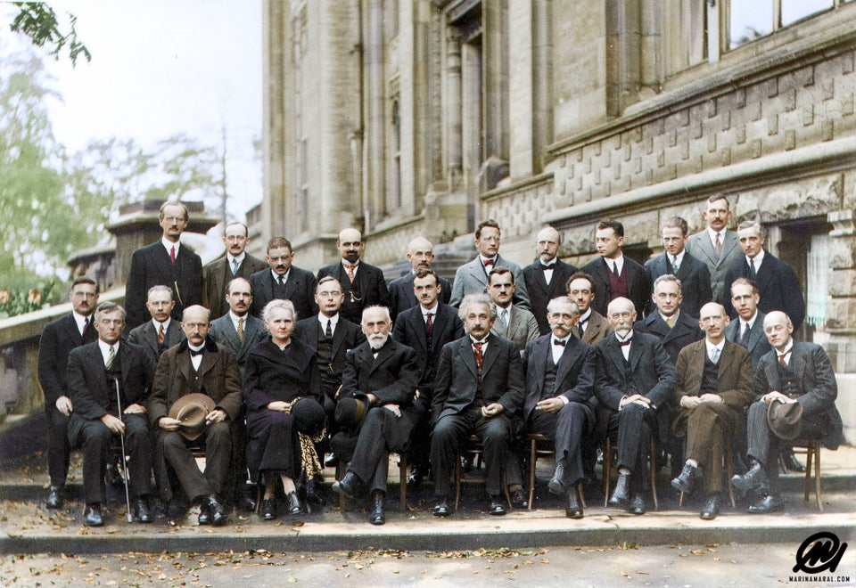
Group Photo
A nice tradition is that group photo is taken
Immediately after the last talk of the morning session ~12.30 (today)
In the main staircase between
1st and 2nd floors

Slide 8
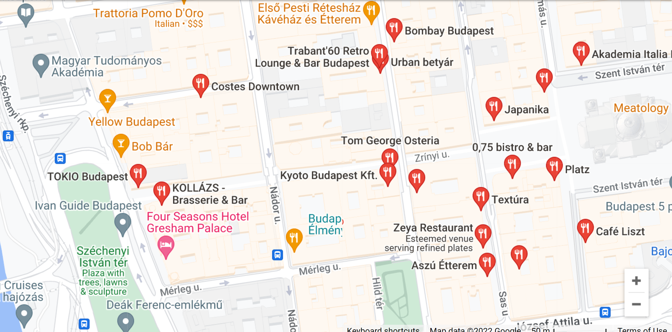
Energy demand – Lunch times
The conference venue is in the heart of Budapest. This area is packed with small restaurants, coffees and bars of all kinds and representing kitchens from all over the world.
We have collected some restaurants nearby, but it does not mean, that the non-listed restaurants are not recommended.
As the lunch break is limited please ask the expected time of the service before ordering. The service is generally fast if you order the daily menu, where available.
https://wpsappm2022.ek-cer.hu/travel-info/

Slide 9
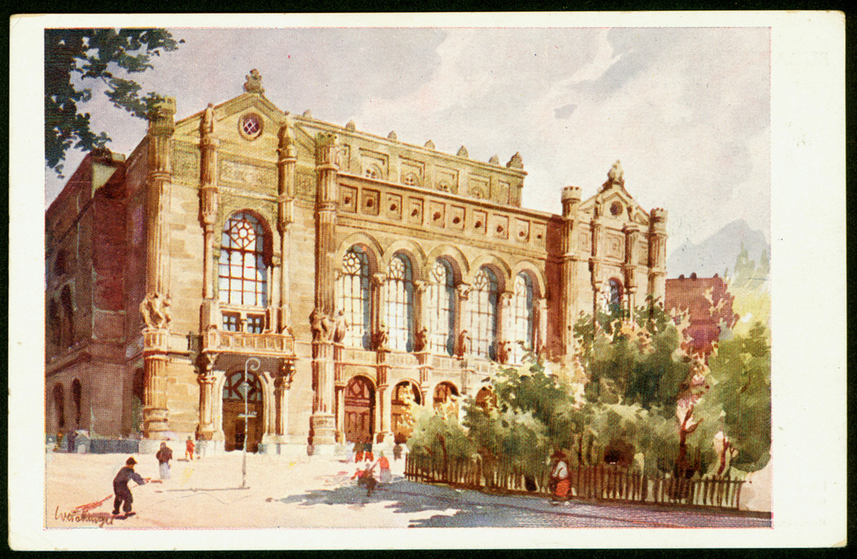
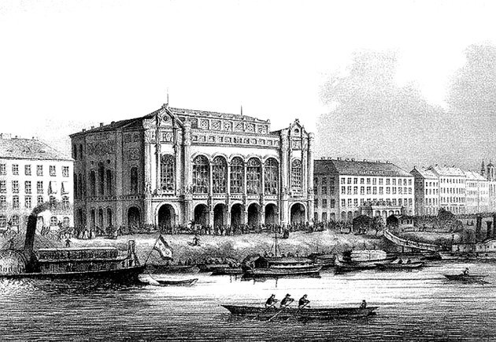
Energy demand – Conference Dinner
For those, who wisely registered for conference dinner:
https://wpsappm2022.ek-cer.hu/wp-content/uploads/2022/08/Conference_dinner_menu_2022.pdf
The restaurant is located in the historic building of the Vigadó (1833)
usually translated as "Place for Merriment"

Slide 10
Laboratory visit
Please sign up for laboratory visit at the Centre for Energy Research on Friday
IF possible today:
ITER SPI laboratory
3D printed ITER model
EDICAM demo
ITER Optical Pellet Diagnostic
APDCAM demo
Fast shutter development
You will need a Photo ID for the admission

Slide 11
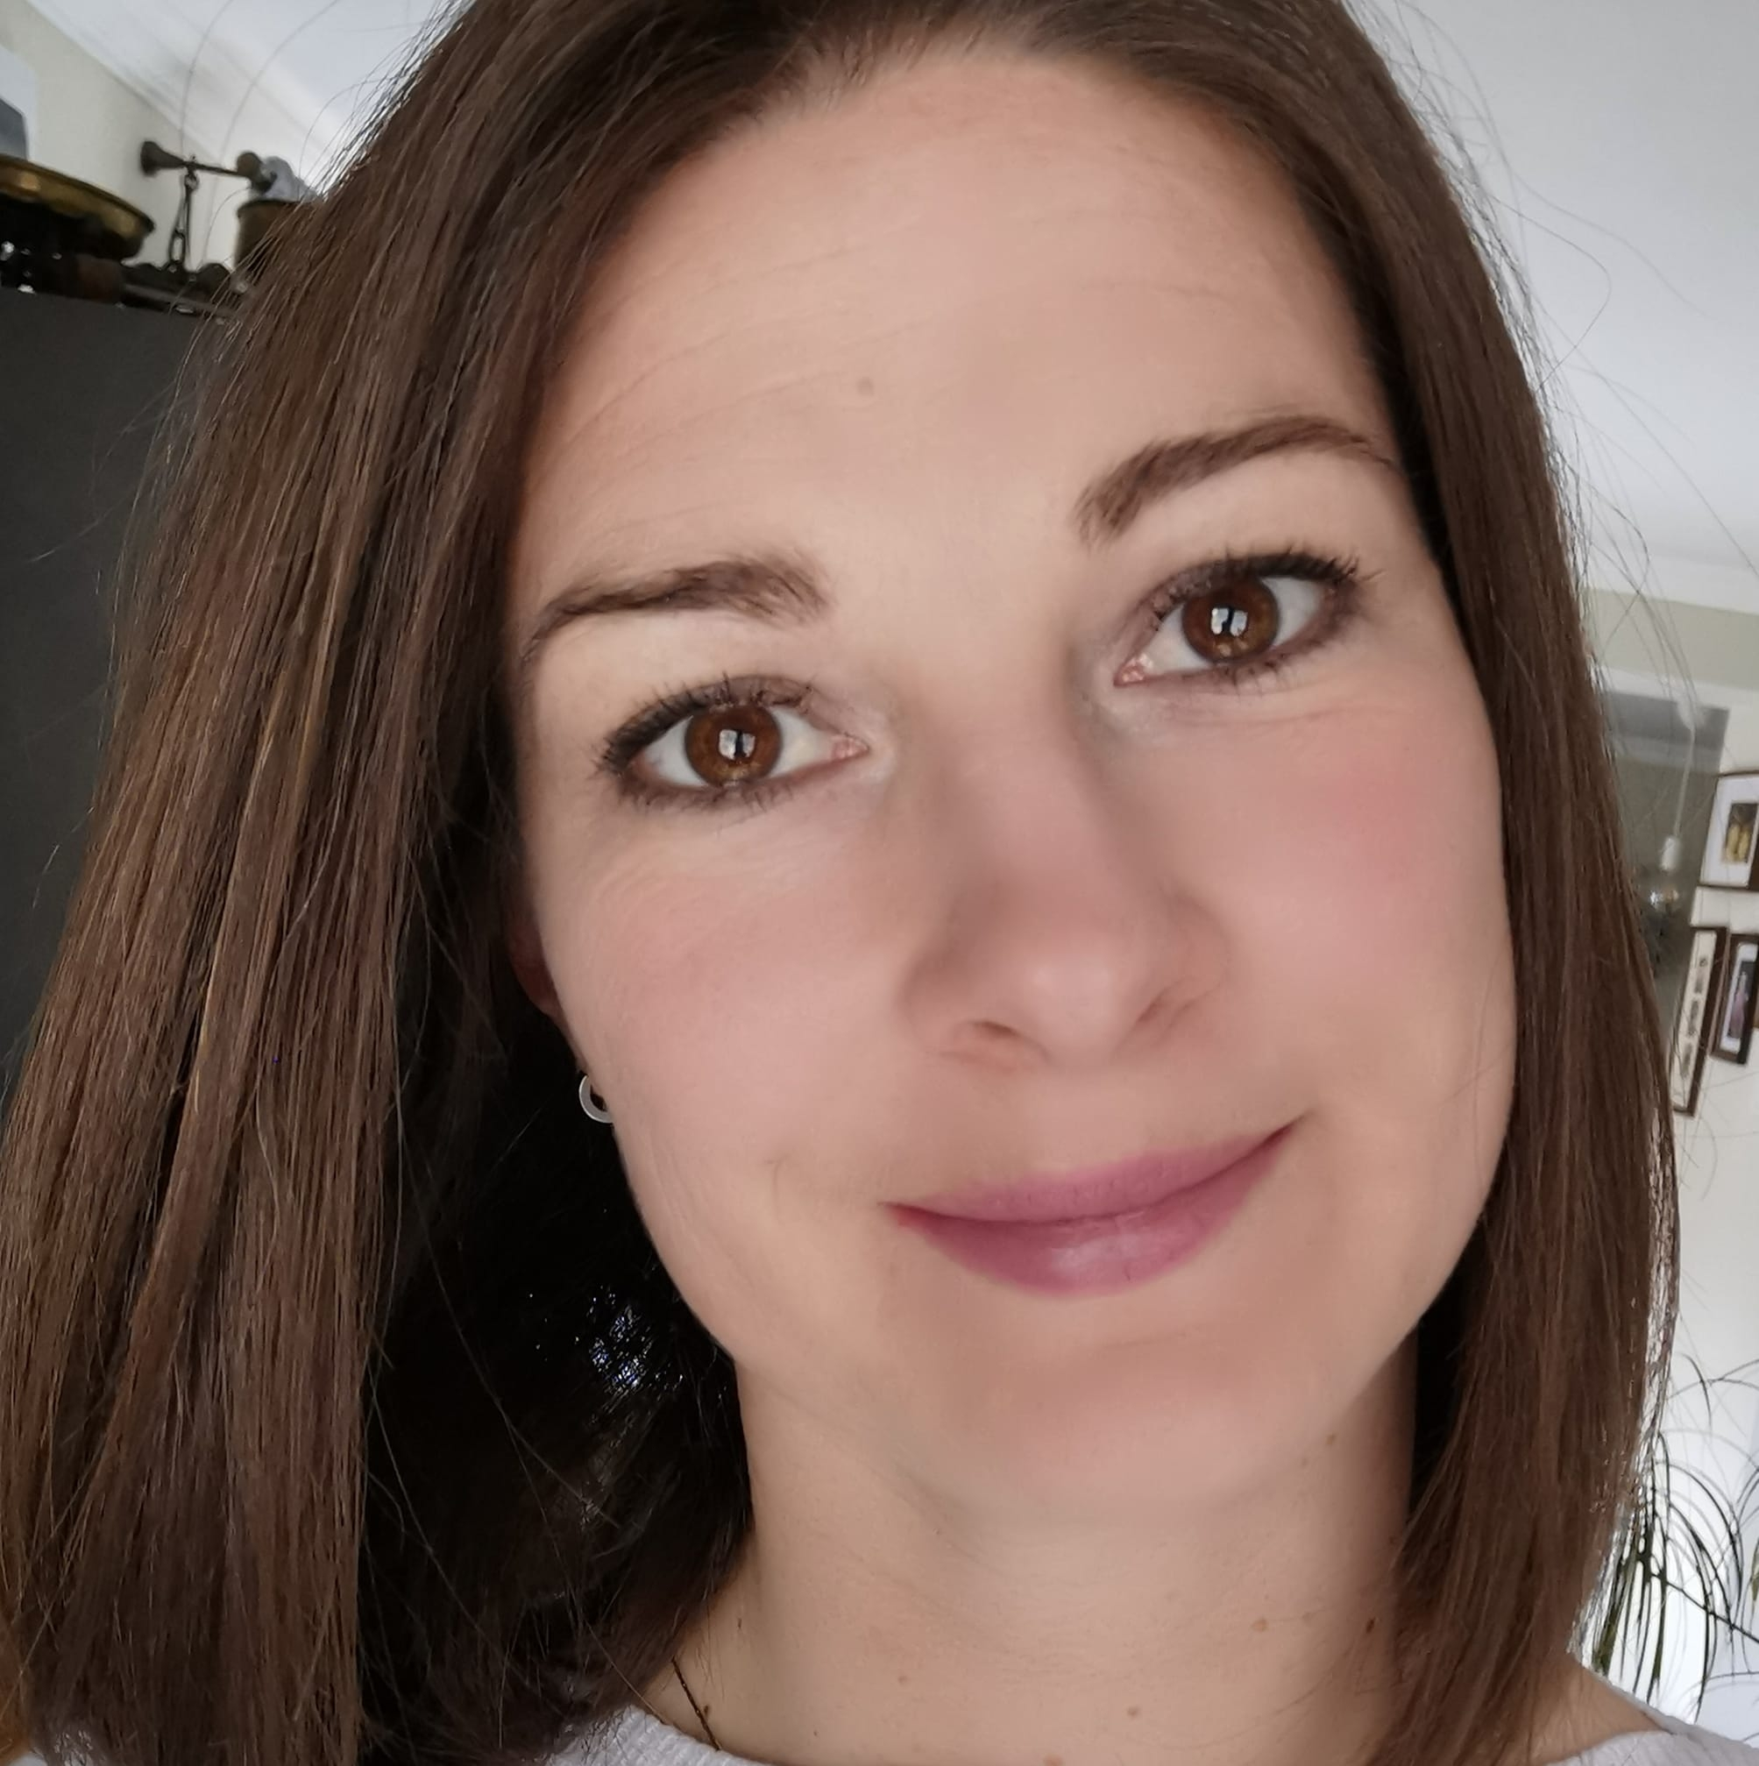
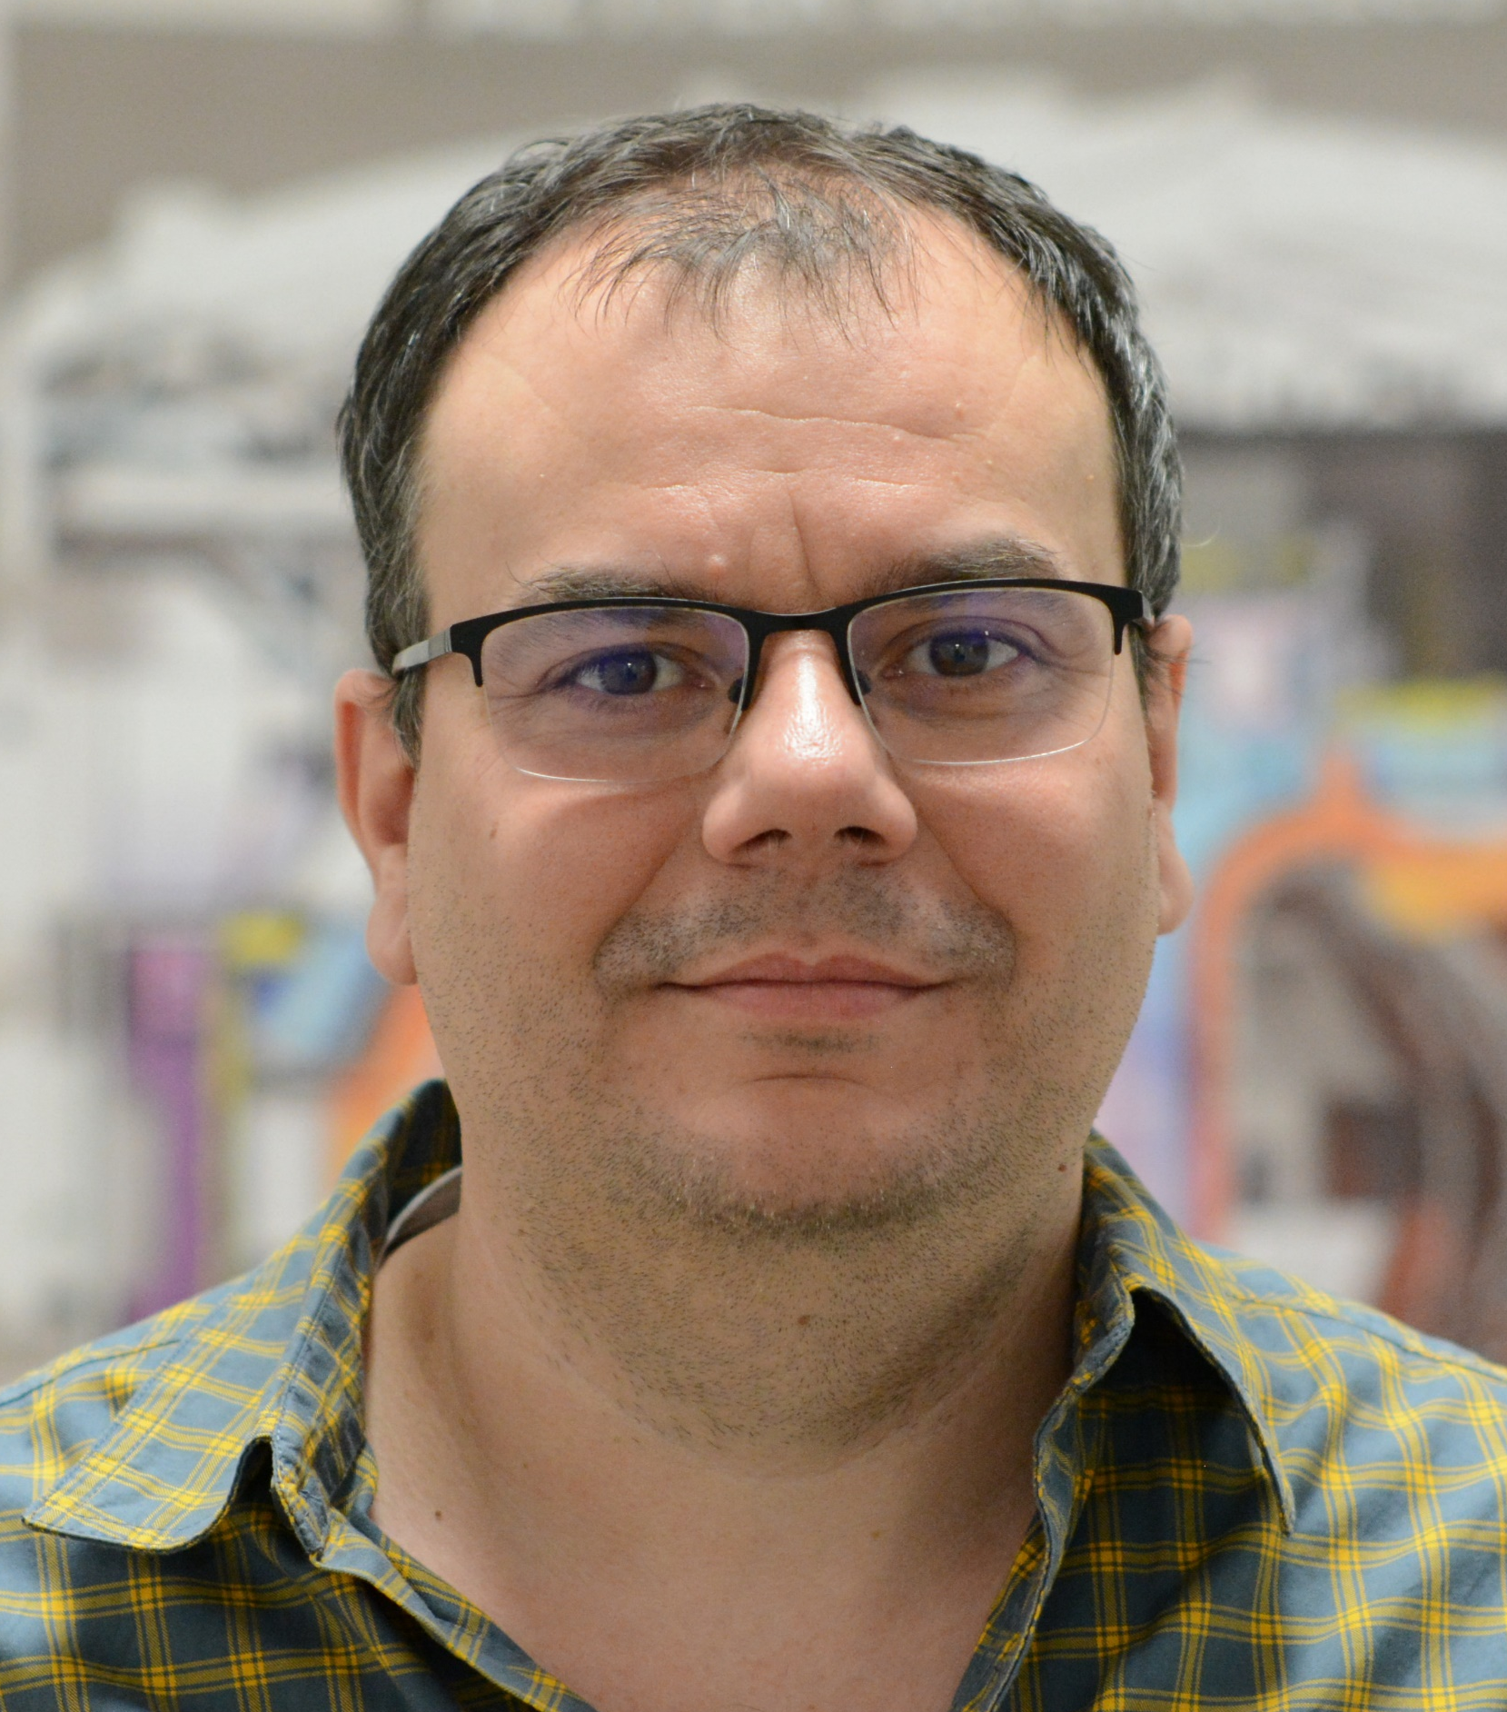
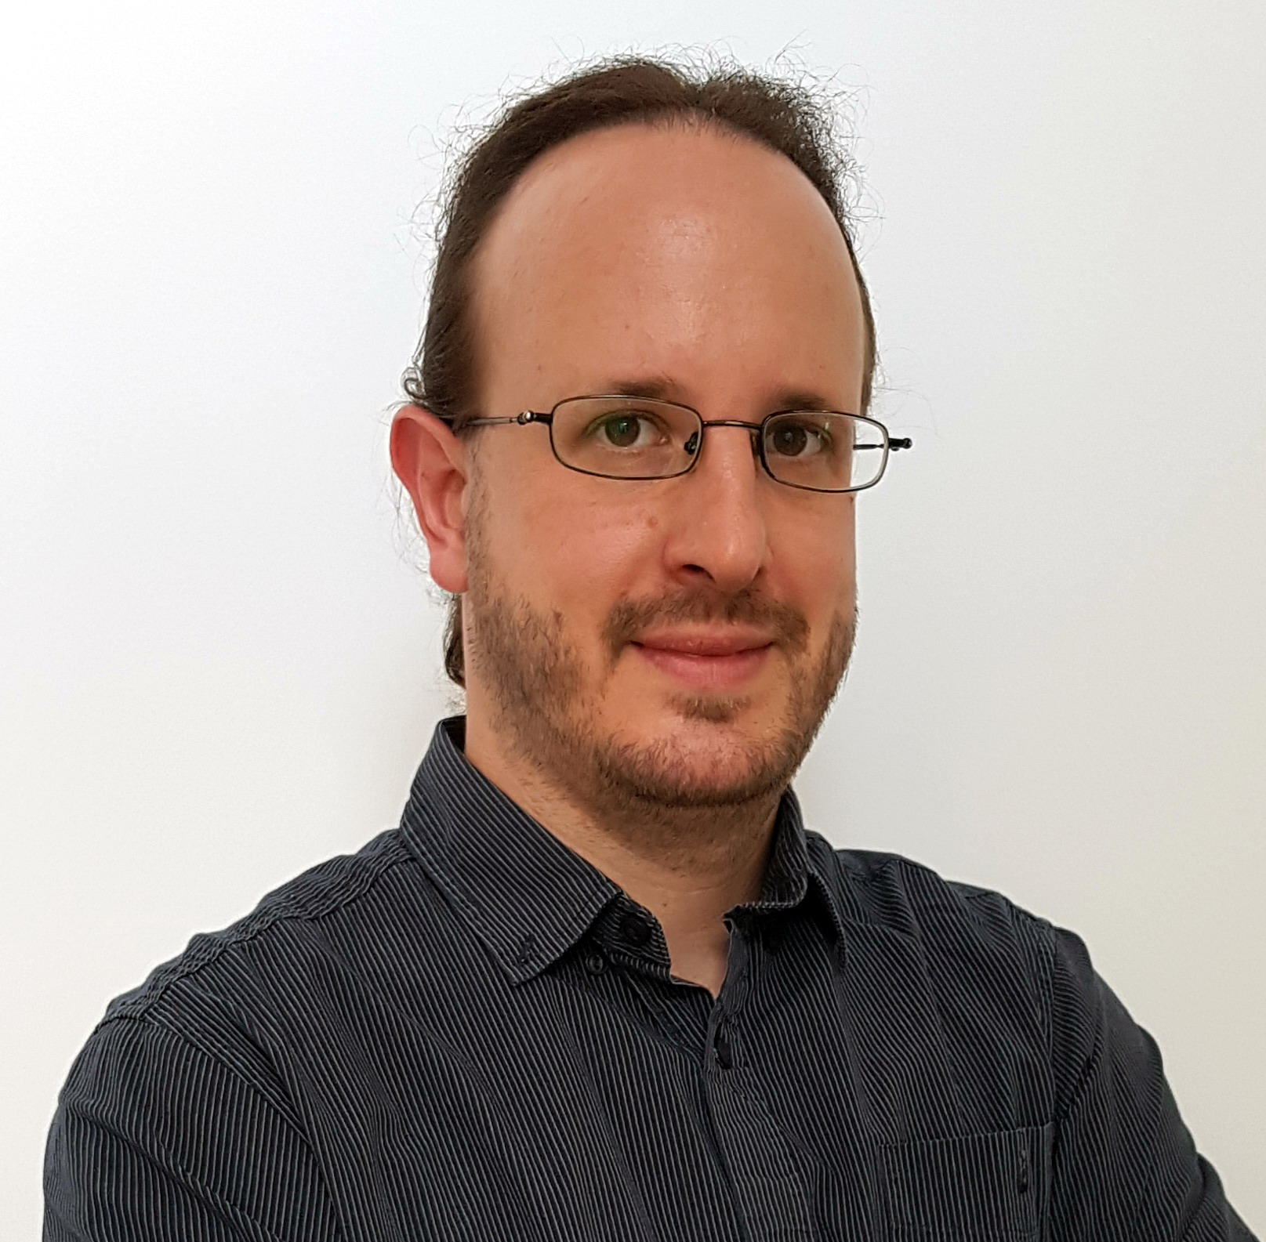
Any questions or problems?
If there's something strange,
In your neighbourhood
Who you gonna call?
Contact the LOC:
LOC: Réka Nagy, Dániel Dunai, Tamás Szepesi

