Slide 1
Disruption Mitigation/Avoidance trigger
J. Vega on behalf of the Disruption Mitigation/Avoidance trigger team

Slide 2
Contributions
Adaptive method to produce real-time mitigation triggers and transfer learning
J. Vega, G. A. Rattá, D. Gadariya
Detection of Changes in the Dynamics of Thermonuclear Plasmas to Improve the Prediction of Disruptions
T. Craciunescu, A. Murari
Current status of disruption indicators for JT-60SA: Slowing down of macroscopic MHD modes & MARFE detection by VIS camera
M. Gelfusa, R. Rossi, T. Craciunescu, A. Murari
Status of NTUA proposal
NTUA EUROfusion ML team

Slide 3
Adaptive method to produce real-time mitigation triggers and transfer learning
J. Vega, G. A. Rattá, D. Gadariya
Laboratorio Nacional de Fusión – CIEMAT, Madrid, Spain

Slide 4
Data availability
The mode lock signal seems not to be available in real-time
All previous work related to disruption prediction for JT-60SA was based on the ML signal
J. Vega et al. Fus. Eng. Des. 146 (2019) 1291-1294
Signals to recognise the current quench are not appropriated to predict disruptions
What about the use of the line integrated density to recognise incoming disruptions?

Slide 5
Line integrated density for disruption prediction
Is it possible to develop a disruption predictor by using a LID signal only?
The simple amplitude is not enough
Signal transformation is a possibility
J. Vega et al. Nature Physics 18, (2022) 741 - 750
Signals can be mapped to specific parameter spaces
J. Vega et al. Nuclear Fusion 60 (2020) 026001 (13 pp)
An adaptive predictor from scratch has been created with a LID signal in a two-dimensional parameter space made up of the amplitudes of consecutive amplitudes
Anomaly detection is combined with supervised classification

Slide 6
Rationale of the predictor
Previous adaptive predictors from scratch need one disruption to create the first model: to be avoided
S. Dormido-Canto et al. Nuclear Fusion 53 (2013) 113001 (8pp)
J. Vega et al. Nuclear Fusion 54 (2014) 123001 (17 pp)
Predictors based on pure anomaly detection show high false alarm rates
S. Esquembri et al. IEEE Transactions on Nuclear Science 65, 2 (2018) 836 - 842
The parameter space based on consecutive samples is optimal to detect outliers in the signal temporal evolution
Outliers are outside a band around the diagonal of such space
The centroid method for disruption prediction shows that this band is not necessarily symmetric around the diagonal
J. Vega et al. Nuclear Fusion 60 (2020) 026001 (13 pp)

Slide 7
Predictor
Dataset of chronological discharges
Loop while non-disruptive discharges are processed: the objective is to learn how a non-disruptive behaviour is
Anomaly detection to create the first classifier
(the first disruption is not missed)
First model
First model ready
Active model
Discharge prediction
False alarm, missed alarm or tardy alarm?
NO
YES
Retraining
The real production of discharges is simulated
Retraining can be carried out between discharges

Slide 8
Predictor details
Pure data-driven predictor
The band limits are linear
Physics meaning
Smooth evolution of signals mean a non-disruptive behaviour
Sudden signal variations mean a disruptive behaviour
Disruptive zone
X(t)
Non disruptive zone
Disruptive zone
X(t – τ)
As a discharge is in execution, points appear in the parameter space and depending on the zone they allow the identification of the plasma behaviour

Slide 9
Results
JET datasets of LID
Discharges with Ip > 2 MA
Disruptions at Ip > 1.5 MA
C wall
Range 65988 – 73126
1439 (1354 + 85) shots
ITER-like wall
Range 94152 – 97123
874 (643 + 231) shots
Tests
C wall data (1)
No retraining after anomaly detection
C wall data (2)
Retraining after missed alarms, tardy alarms or false alarms
ILW data (3)
Transfer learning: last model with C wall data is used for ILW shots
Retraining after missed alarms, tardy alarms or false alarms
 | Detected disruptions | Detected with warning time > 0 | Tardy detections | False alarms | Retrainings
CW no retraining (1) | 70.59% (60/85) | 38.82% (33/85) | 31.76% (27/85) | 0.15% (2/1354) | 0
CW retraining (2) | 98.82% (84/85) | 94.12% (80/85) | 4.71% (4/85) | 0% (0/1354) | 3
ILW adaptive transfer (3) | 93.94% (217/231) | 86.58% (200/231) | 7.36% (17/231) | 1.87% (12/643) | 3
A paper is in preparation

Slide 10
Conclusions
Line integrated density can be used to predict disruptions
Available in real-time
Predictions can take only tens of us
No problems for real-time implementations
The linear models that define the band limits are trained with 10 – 15 samples
Extremely fast training that allows performing the training between discharges
The combination of anomaly detection and supervised learning allows achieving very low false alarm rate
The combination of anomaly detection and adaptive supervised learning with a LID signal could be used for transfer learning
Test OK from CW shots to ILW shots
It seems to be valid thinking of the transition CW – metallic wall in JT-60SA
What happens from one machine to another?

Slide 11
Detection of Changes in the Dynamics of Thermonuclear Plasmas to Improve the Prediction of Disruptions
Teddy CRACIUNESCU, Andrea MURARI

Slide 12
Anomaly detection
A typical issue for training machine learning tools for disruption prediction is the choice of the most adequate examples.
For example, when deciding if an alarm is early, in the literature thresholds ranging from 1 to 3 seconds have been used.
The objective of developed the techniques consists of optimising the choice of examples to train predictors for mitigation using basic signals.
Signals tested
Plasma current
Locked mode amplitude
Techniques deployed
Embedding dimensions
Chaos detection
Recurrences statistics
Recurrences and Complex networks

Slide 13
Database, signals
Pulse number | Experiment | Disruption time (s)
80512 | restart | 46.0909996032715
80652 | RF commissioning | 53.1450004577637
80847 | Experiment-2.2.1 Determination of intrinsic impurities composition in the full W divertor | 59.2939987182617
81159 | RF + NBI sync tests + Experiment -2.2.1 Determination of intrinsic impurities composition in the full W divertor | 59.26200104
81985 | Experiment 3.3.1 Characterisation of W divertor in H-mode | 52.2779998779297
90699 | Mixed pulsed for experiments M15-17-Optimisation of disruption mitigation for high current operation and M15-14 Main chamber recycling and radial SOL fluxes ELM/inter‐ELM | 56.6609992980957
91570 | Experiment H16-01: Isotope effect on edge and core transport | 49.4469985961914
92045 | Experiment M15-02 Hybrid scenario development for DT | 50.43899918
92132 | Experiment M15-29 - Impurity migration and ammonia formation in seeded H-modes | 54.01800156
92226 | Experiment M15-26 - Isotope effect on edge & core transport | 52.7449989318848
plasma current I
locked mode amplitude LM

Slide 14
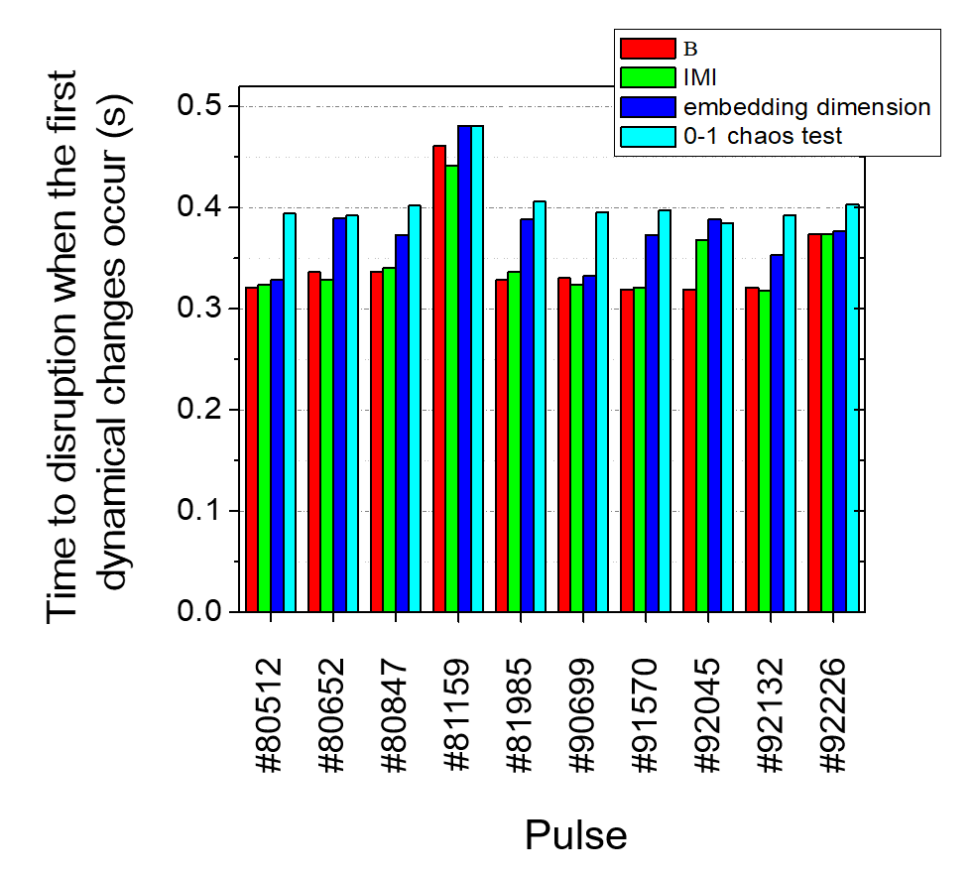
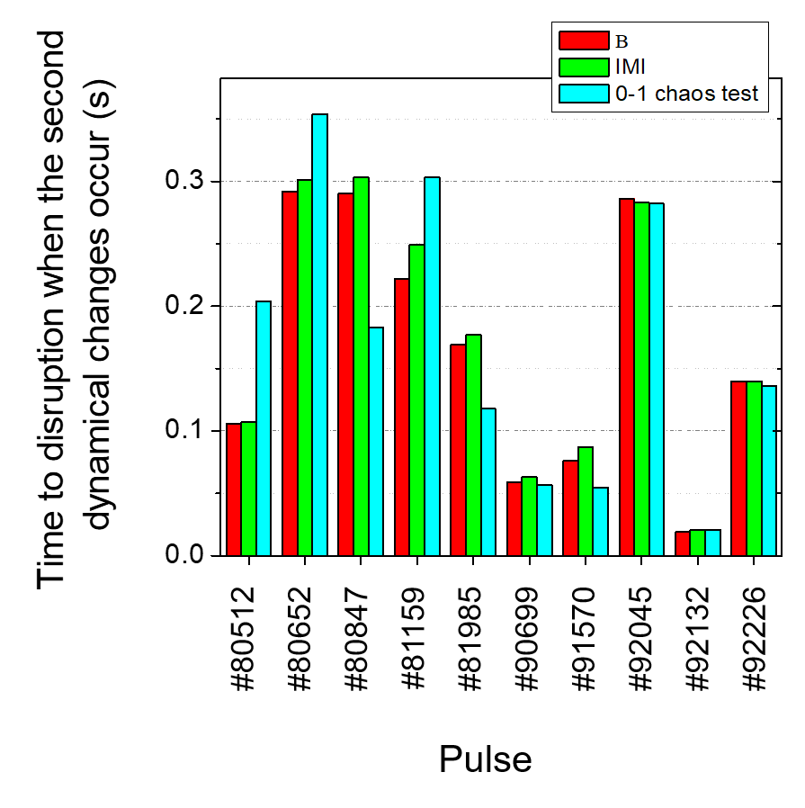
Results – overview
Time instance - calculated as time intervals to disruptions
Time instance when the indicators (embedding dimension, 0-1 chaos test, $ω$, IMI) show the occurrence of the firs (left) and second (right) dynamical changes

Slide 15
Conclusions
The deployed methods are mathematically completely independent and therefore the fact that they provide very coherent results is quite reassuring and gives confidence in the conclusions.
First signs of an approaching disruption are present in the I and LM signals about 300 ms before the beginning of the collapse, a comfortable time interval to undertake mitigation actions.
The techniques presented should therefore allow building a significantly more reliable training sets for the predictors already providing quite satisfactory performance.
Unfortunately, most of the analysis techniques are quite demanding in terms of computational resources. However 0-1 chaos test runs in about 1.2 ms on a laptop computer, compatible with real time applications (on JET the cycle time of the real time network is 2 ms).
(More details in the pin board, journals, entry 369)

Slide 16
Current status of disruption indicators for JT-60SA:
Slowing down of macroscopic MHD modes
MARFE detection by VIS camera
M. Gelfusa¹, R. Rossi¹, T. Craciunescu² and A. Murari³
¹ University of Roma Tor Vergata, Italy
² INFLPR, Romania
³ Consorzio RFX, Italy

Slide 17
Slowing down and locking detection of maroscopic MHD modes
Task objectives:
Scaling of the mode slowing down detection algorithm from AUG to JET. Evaluate possible alternatives to the LM saddle coils solutions (probably not available from Day 0 at JT60-SA)
E. Peluso et al. 2020 Appl. Sci. 10 (21), 7891
Development of a tool for MARFE detection from VIS camera.

Slide 18
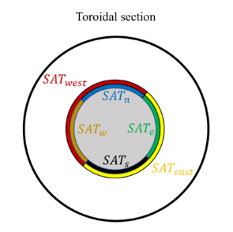
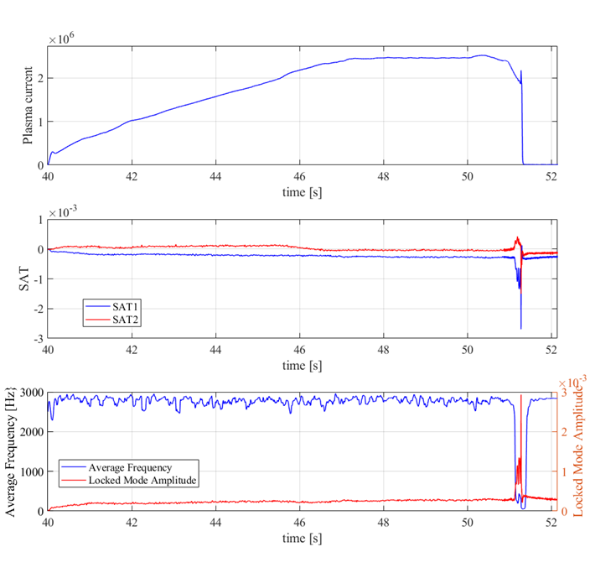
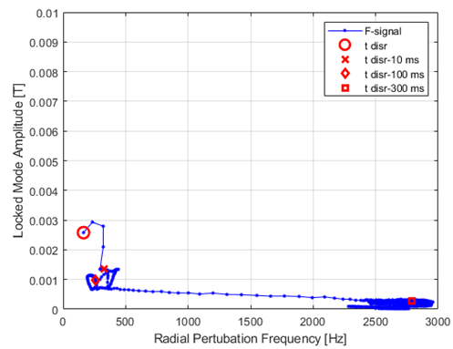
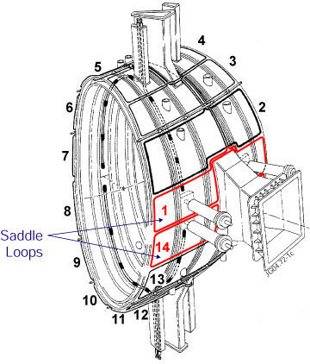
Slowing down and locking detection of macroscopic MHD modes
Transfer of the slowing down algorithm from AUG to JET:
Transfer using large saddle coils (AUG-like)
The transfer has been achieved with no difficulties.
Day-0 requirements: noise level of signals (no plasma)
AUG
JET

Slide 19
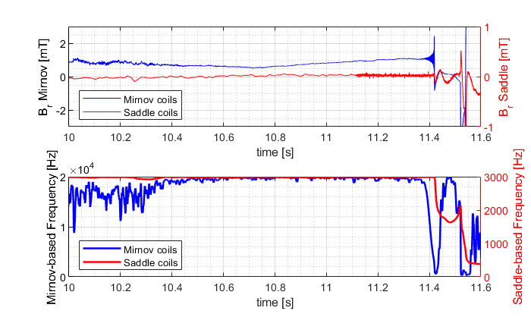
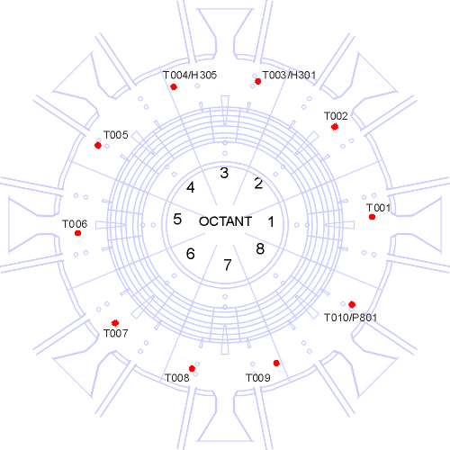
Slowing down and locking detection of maroscopic MHD modes
Transfer using small Mirnov coils (chosen because saddle coil diagnostic may be not present from day-0).
Transfer achieved.
Small coils are not n=1 mode specific and some tuning of the hyperparameters may be needed.
(More details in the JET pin board, SOFT, entry 41)

Slide 20
MARFE detection by VIS camera
High visible radiation on the high field side of the poloidal plane is often observed by the visible cameras (and it precedes the mode locking and electron temperature anomalies)
T. Craciunescu et al. IEEE Transactions on Plasma Science 2014 42 (8)
Status:
An algorithm has been developed to detect the presence of anomalous visible radiation
(by measuring the radiation barycentre position)
(More details in the JET pin board, SOFT, entry 42)

Slide 21
Status of NTUA proposal
NN architecture: done
Initial training on JET C – Wall data : done, initial results need improvements (hyperparameter tuning needed etc)

Slide 22
Roadmap till December 2022
Modify hyperparameters to produce improved results and present them
Possible use of synthetic datasets using python SDV module
Technical report to be delivered

