Slide 1
WPSA CM Topical Session: edge/divertor modelling
WPSA Project Planning Meeting, 6-9 September 2022
Gloria FALCHETTO
WPSA Code Management Area Coordinator

Slide 2
WPSA.CM Edge/Divertor Modelling Tasks
Thu 8th 14h30-16h Parallel session: Edge/divertor modelling
title | speaker
Status and plans on the benchmark of SOLPS_ITER to SONIC. | G Rubino
Initial research phase scenario edge/SOL modelling | L Balbinot K Galazka P Chmielewski
Discussion on equilibria / strike point positions
Modelling support to Langmuir probe design assessment for Integrated Research Phase (WPDIV need)* | G Falchetto - intro L Balbinot
* SA-EN.FE.08-T001 Definition of Langmuir probes specifications compatible with actively cooled divertor.
Del owner J Gunn (CEA)

Slide 3
SLIDES for DISCUSSION SESSIONS
ACTIONS FROM MAY GENERAL MEETING

Slide 4
WPSA GPM Edge/SOL Modelling session Q&A discussions & actions
Edge/SOL modelling
  SOLEDGE activate drifts ?
  SOLPS-ITER Ar puffing modelled
    Peter Lang : what about modelling Ar from the inboard? Eg by pellet (different then puffing from core) which is found to radiate more efficiently
      Balbinot: Ar puffing location studied with SOLEDGE : puffing from dome lead to detachment at lower density
      Rubino: tested in SOLPS-ITER on Ni – would need to recover old data
  SOLPS-ITER benchmarck
  contact with Yamoto re-established ongoing analysis of discrepancies on D case and get SONIC results from case with C

Slide 5
Support to AC divertor Langmuir probe design
Request from WPDIV/F4E for modelling support to the assessment of the AC divertor Lagmuir probes design
WPSA.CM : Estimate heat loads on the divertor by exisiting simulations of the nominal scenario with the edge/SOL transport codes SOLEDGE2D and SOLPS_ITER

Slide 6
Number of probes is reviewed based on that on the 1st cassette.
Courtesy
V Tomarchio (F4E)
Number of probes will be limited by the 48-pin connector.
  < 48 probes per one cassette
Probes are installed on the 4 cassettes.
  P-3, P-4, P-9, P-15 sections
The same cables or the same routes on the VV are reused.
Notes:
This is the 1st divertor cassette which the probes are installed.
Signals detected by the probes are transported to horizontal port and extracted to outside of the vessel via this 48-pin connector.
So, number of probes are limited by this connector, and up to 48 probes can be installed on one cassette.
On the 1st cassette, probes are installed on the 4 cassettes; section 3, 4, 9 & 15.
When we install probes on the same toroidal section on the 2nd cassette, we can reuse the cables or the cable routes on the VV.
So, we assume probes are installed on the same toroidal section of the 1st cassette.

Slide 7
Probes of different regions are installed on the different cassettes.
Courtesy
V Tomarchio (F4E)
The following is one example.
P-3: Outer target
<16 sets of triple probes
Inner target
<16 sets of triple probes
P-3
P-4: Outer target
>16 sets of triple probes
P-15: Inner target
<16 sets of triple probes
P-4
P-15
P-9
P-9: Baffles, dome, outer cover
< 48 single probes
Notes:
This is one example of probe position.
As shown on the last meeting, the inner target & outer target are triple probe, but the baffles, dome, and outer cover are single probe.
On the P3 & P4 toroidal sections, up to 16 sets of triple probes are installed. And up to 16 sets of triple probes are on the P15 inner target.
Up to 48 single probes are on baffles, dome, and outer cover of P9 section.

Slide 8
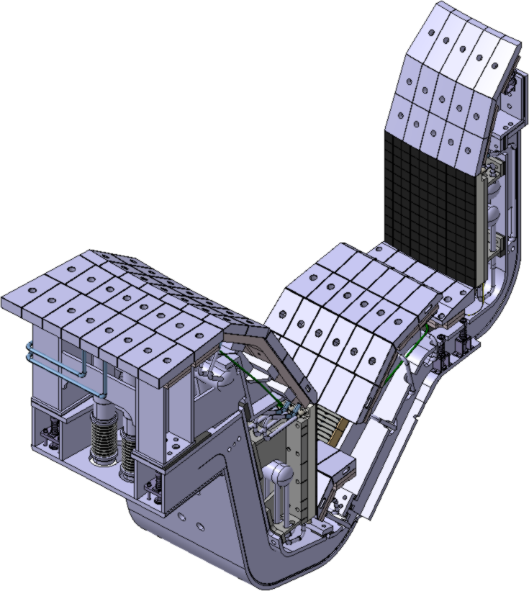
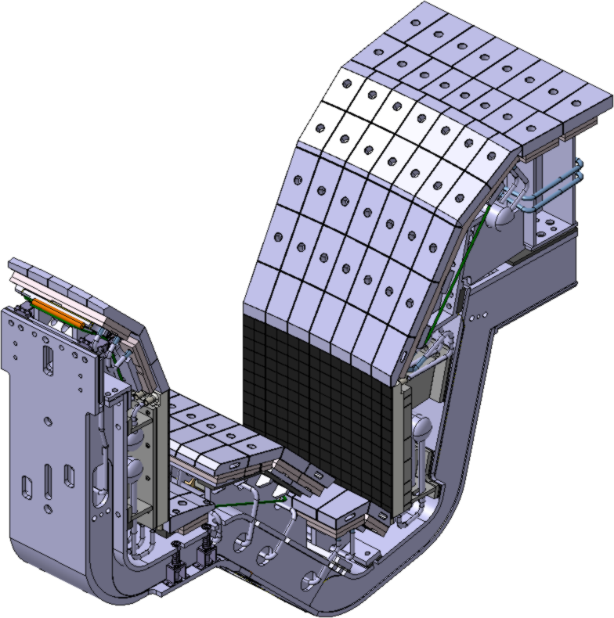
Installation position on the inner & outer targets
3 targets
3 targets
Installation position
(6 targets per 1 cassette) x (4 cassettes)
Number of probe heads along the poloidal direction will be <36 on 1 target.

Slide 9
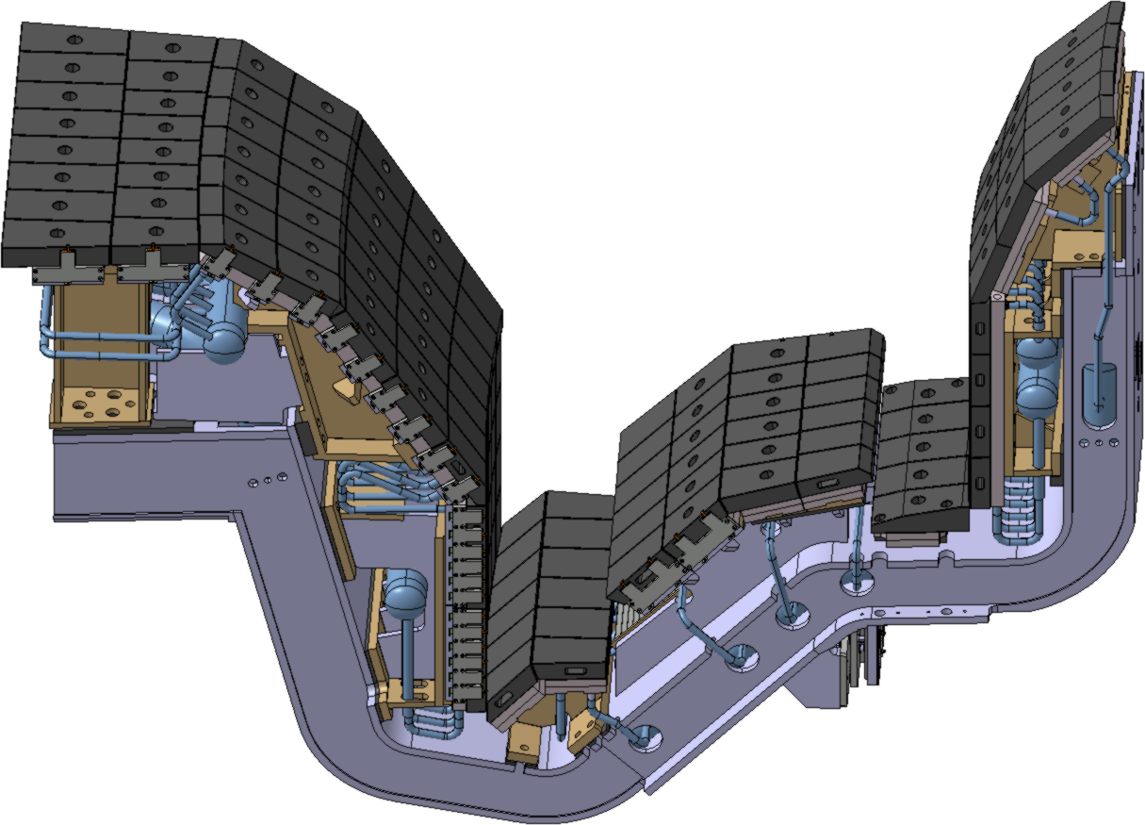
Outer baffle
Similar design to the 1st cassette is planned.
Space of the probe and machining area of the heat sink & graphite tile are similar to those in the 1st cassette
Installation position
(3 toroidal positions per 1 cassette) x (4 cassettes)
Number of probe heads along the poloidal direction will be changed from the 1st cassette.

Slide 10
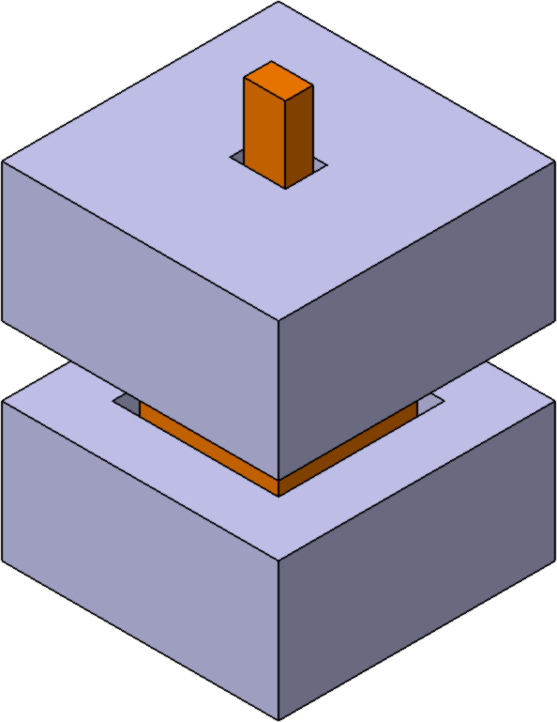
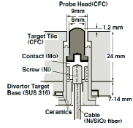
Inner baffle & dome & outer cover
The probe heads are embedded underneath the graphite tile such as JT-60U.
Machining of the graphite tile is necessary to install the probe head.
Machining (mainly tapping) of the heat sink will be needed to bolt the probe head to the heat sink.
Probe head
Ceramic
5
3
2
20
20
25
Radial
Toroidal
Poloidal
Conceptual design for JT-60SA
(e.g.) Installation of the probe head underneath the JT-60U target tile
Installation position
(3 toroidal positions per 1 cassette) x (4 cassettes)
Number of probe heads along the poloidal direction will be changed from the 1st cassette.

