Slide 1

Feedback from Ticket Meeting #66 and update on network(s) status
Operation Committee meeting OC-72 – July 19, 2022
F. Boillod-Cerneux (Chair), R.Hatzky (ACH-MPG) and J.David

Slide 2
Last Ticket Meeting was #66 (17th June 2022)
Summary from slides presented & Alessandro’s minutes
Next TM events: Save the date!
13 September 2022 10h00 – 12h00 | TM meeting #67 | By video
10 October 2022 10h00 – 12h00 | TM meeting #68 | By video
7 November 2022 10h00 – 12h00 | TM meeting #69 | By video

Slide 3
Sanity checks
Status of systems: June 9th – June 30th
Messages
Jun 9: scheduled maintenance operations on Marconi on June 14th
Jun 16: Marconi100: power capping and performance loss on Sunday June 19
Jun 23: connectivity issues
Jun 29: scheduled maintenance operations on Marconi100 on July 5th
Jun 30: Marconi100: power capping and performance loss on Sunday July 3

Slide 4
Summary of ticket activity
No issue and Marconi and Marconi100 are stable
Thank you CINECA
Escalated tickets:
Nvidia ticket 19978 : escalated to Nvidia’s compiler engineers

Slide 5
Sanity checks
 | Marconi
 | maintenance 14.06.2022 | production 24.6.2022
Linpack |  | 3 slow nodes
Stream
Switches

Slide 6
Sanity checks
Power capping discussion
Power capping on Marconi: sysadmins are working on improving the power capping monitoring system. Waiting for a node to study (it may take some time)

Slide 7
Sanity checks
 | MARCONI100
 | production 30.06.2022
Dgemm
Stream
Nvlink
p2p

Slide 8
ACH-MPG Applications performance curve status
From : ACH-MPG own measurements (Serhiy)
time in minutes
Code name | Marconi partition | input main parameters | 04/07/2022
 |  |  | test1 | test2 | test3 | avg
STARWALL | SKL 16 nodes | ntri_w=72200 nharm=5 ntri_p=76800 | 24,69 | 18,51 | 18,11 | 20,44
 | SKL 64 nodes | ntri_w=80000 nharm=5 ntri_p=76800 | 25,48 | 18,33 | 20,48 | 21,43
GENE | SKL 16 nodes | nx0=1024 nky0=32 nz0=24 nv0=96 nw0=16 lx=140 ntimestep=900 | 19,86 | 20,03 | P15 | 19,95
 | SKL 16 nodes (iter, in sec) |  | 1,23 | 1,24 | P15 | 1,235
 | SKL 128 nodes | nx0=1024 nky0=32 nz0=48 nv0=96 nw0=32 lx=560 ntimestep=300 | 19,15 | 21,3 | 21,09 | 20,51
 | SKL 128 nodes (iter, in sec) |  | 3,93 | 4,51 | 4,18 | 4,208
EUTERPE | SKL 16 nodes | clones=12 nptot=10000000 | 16,61 | 18,14 | 16,27 | 17,01
 | SKL 128 nodes | clones=96 nptot=100000000 | 30,82 | 30,4 | 25,63 | 28,95
ORB5 | 16 nodes, 4 MPI tasks per node, 4 GPUs per node | job_time = 7200.0 nrun = 700 | 32,28 | 32,27 | 32,2 | 32,25
LAMMPS | 16 nodes, 4 MPI tasks per node, 4 GPUs per node | run =2000000 units =lj | 27,35 | 27,67 | 27,28 | 27,43
GENE | 16 nodes, 4 MPI tasks per node, 4 GPUs per node | ntimesteps = 3000 | 20,15 | 20,15 | 20,4 | 20,23
P15 - error in reading input file (0: forrtl: No such file or directory)

Slide 9
ACH-MPG Applications performance curve status

Slide 10
ACH-MPG Applications performance curve status

Slide 11
ACH-MPG Applications performance curve status

Slide 12
ACH-MPG Applications performance curve status

Slide 13
ACH-MPG Applications performance curve status

Slide 14
ACH-MPG Applications performance curve status
More fluctuations than usual

Slide 15
ACH-MPG Applications performance curve status
Very fast
Waiting time in queue
time in hours
Code name | Marconi partition | input main parameters | 04/07/2022
 |  |  | test1 | test2 | test3 | avg
STARWALL | SKL 16 nodes | ntri_w=72200 nharm=5 ntri_p=76800 | 0,36 | 0,463 | 0,669 | 0,497
 | SKL 64 nodes | ntri_w=80000 nharm=5 ntri_p=76800 | 3,894 | 4,237 | 4,341 | 4,157
GENE | SKL 16 nodes | nx0=1024 nky0=32 nz0=24 nv0=96 nw0=16 lx=140 ntimestep=900 | 0,014 | 0,014 | 0,014 | 0,014
 | SKL 128 nodes | nx0=1024 nky0=32 nz0=48 nv0=96 nw0=32 lx=560 ntimestep=300 | 1,971 | 2,314 | 2,451 | 2,245
EUTERPE | SKL 16 nodes | clones=12 nptot=10000000 | 0,049 | 0,36 | 0,36 | 0,256
 | SKL 128 nodes | clones=96 nptot=100000000 | 1,321 | 1,423 | 1,971 | 1,572
ORB5 | 16 nodes, 4 MPI tasks per node, 4 GPUs per node | job_time = 7200.0 nrun = 700 | 0,479 | 0,855 | 0,926 | 0,754
LAMMPS | 16 nodes, 4 MPI tasks per node, 4 GPUs per node | run =2000000 units =lj | 0,001 | 0,002 | 0,461 | 0,155
GENE | 16 nodes, 4 MPI tasks per node, 4 GPUs per node | ntimesteps = 3000 | 1,044 | 1,446 | 1,485 | 1,325

Slide 16
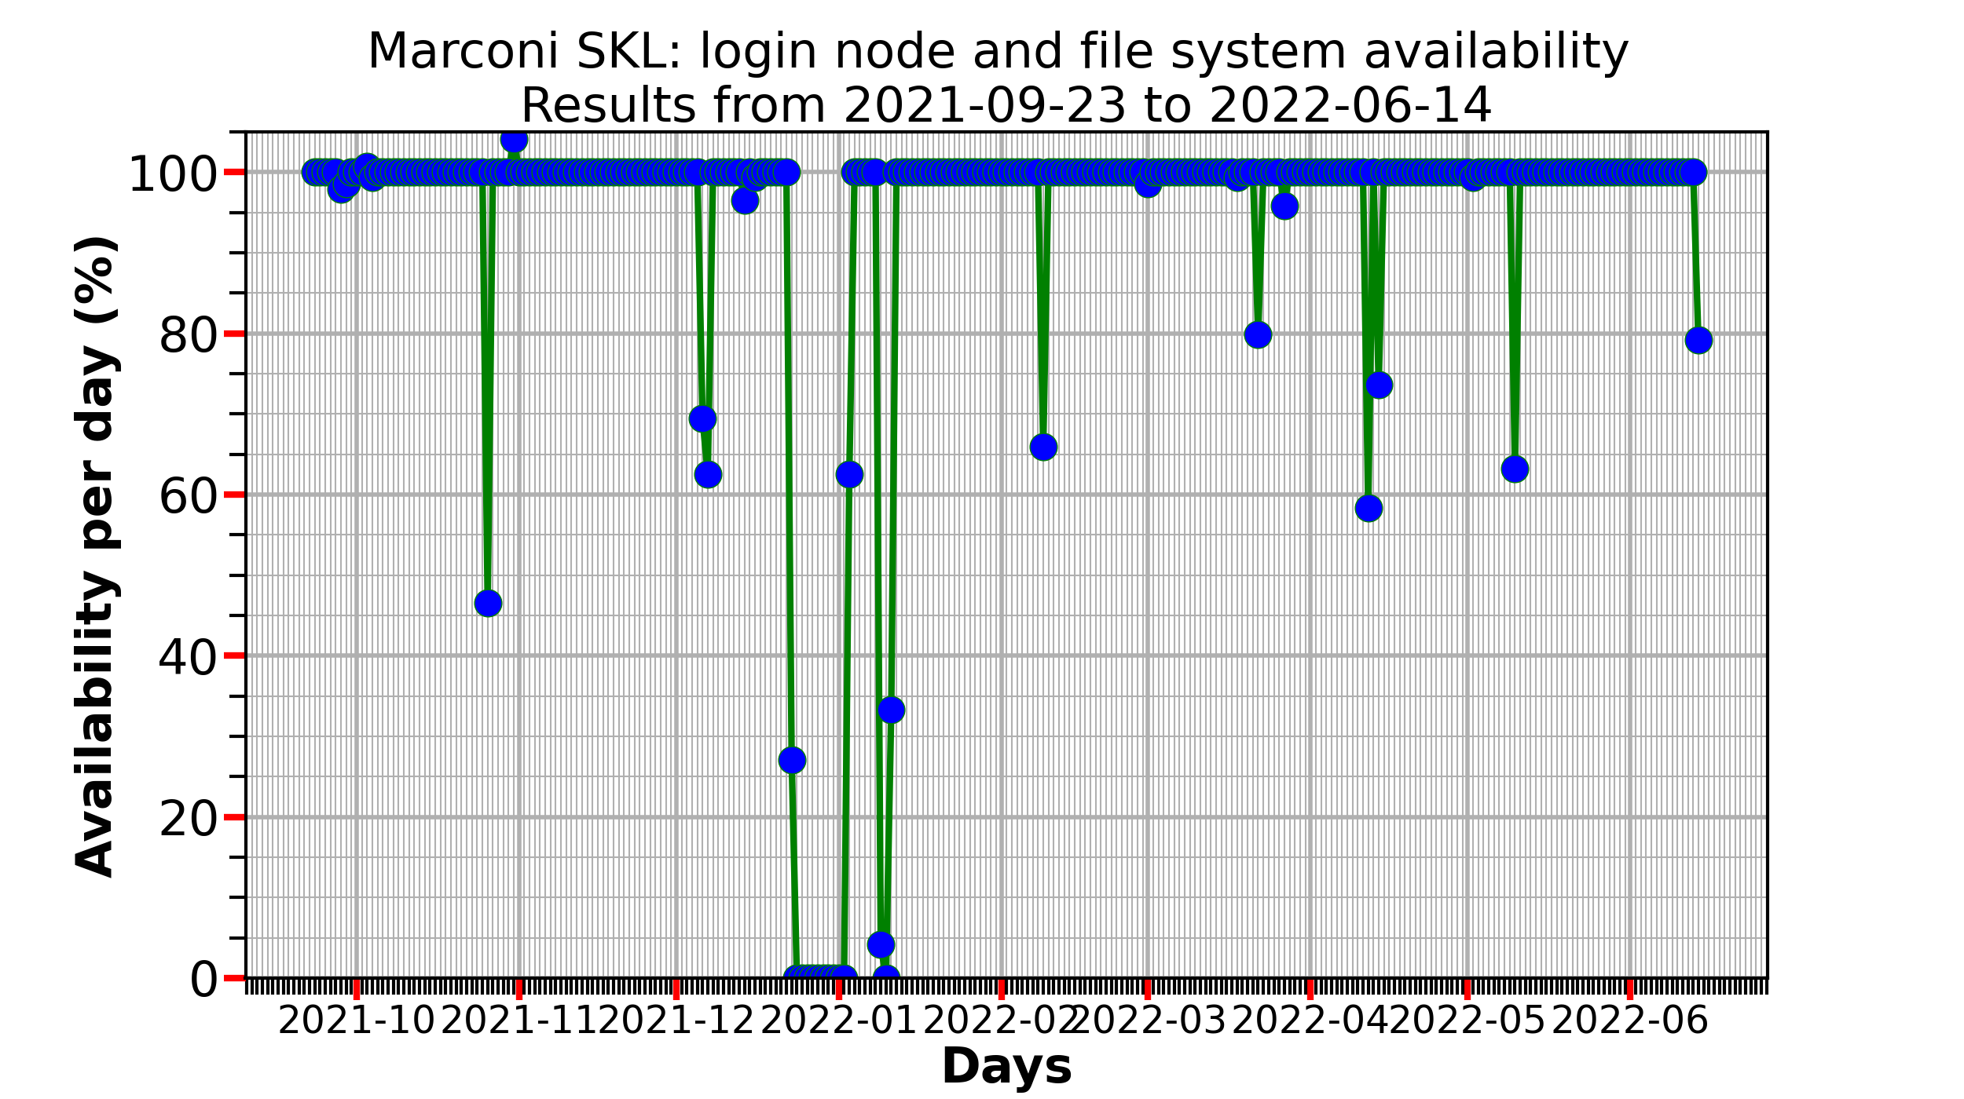
ACH-MPG: system availability status

Slide 17

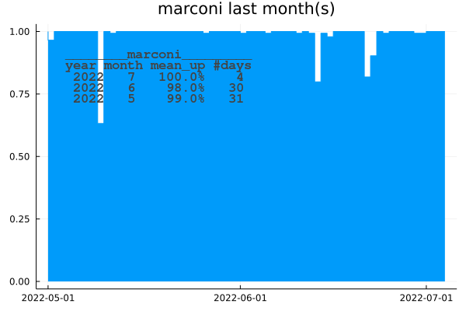
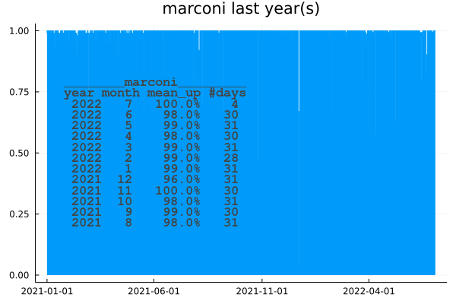
External network (ssh to marconi login nodes) :
marconi : jdad / previous (may,june 2022) & current month (july, till 2022-07-04)
marconi : jdad / since year 2021
From jdad’s home workstation ssh measurements.

Slide 18
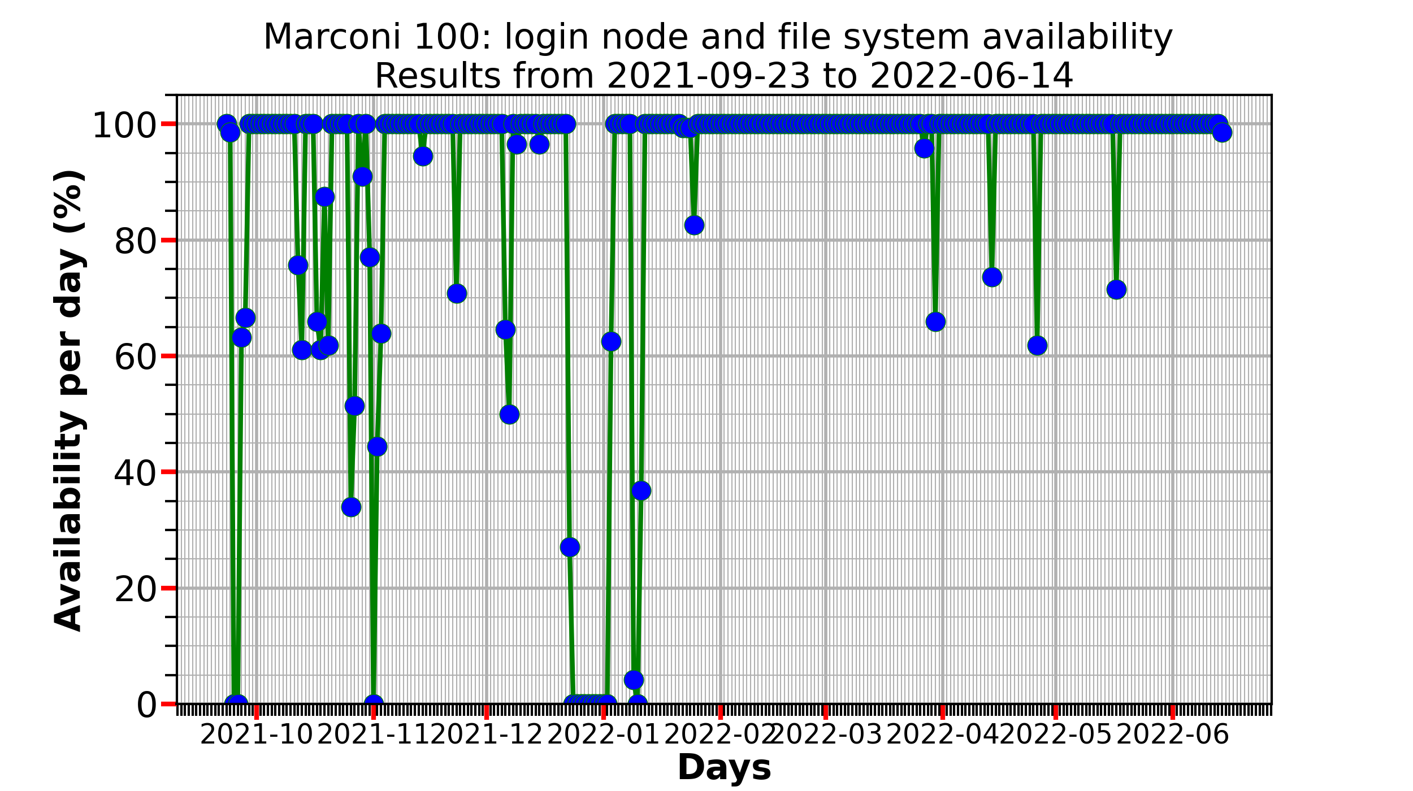
ACH-MPG: system availability status

Slide 19

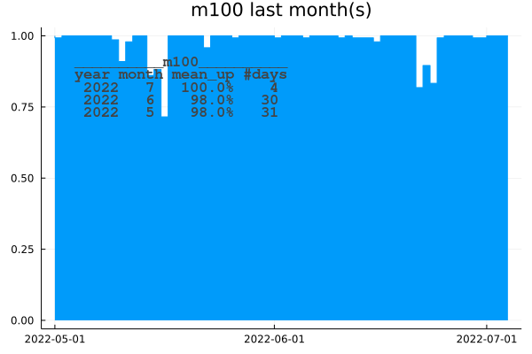
External network (ssh to m100 login nodes) :
m100 : jdad / previous (may,june 2022) & current month (july, till 2022-07-04)
For comparison : marconi : same period
From jdad’s home workstation ssh measurements.

Slide 20
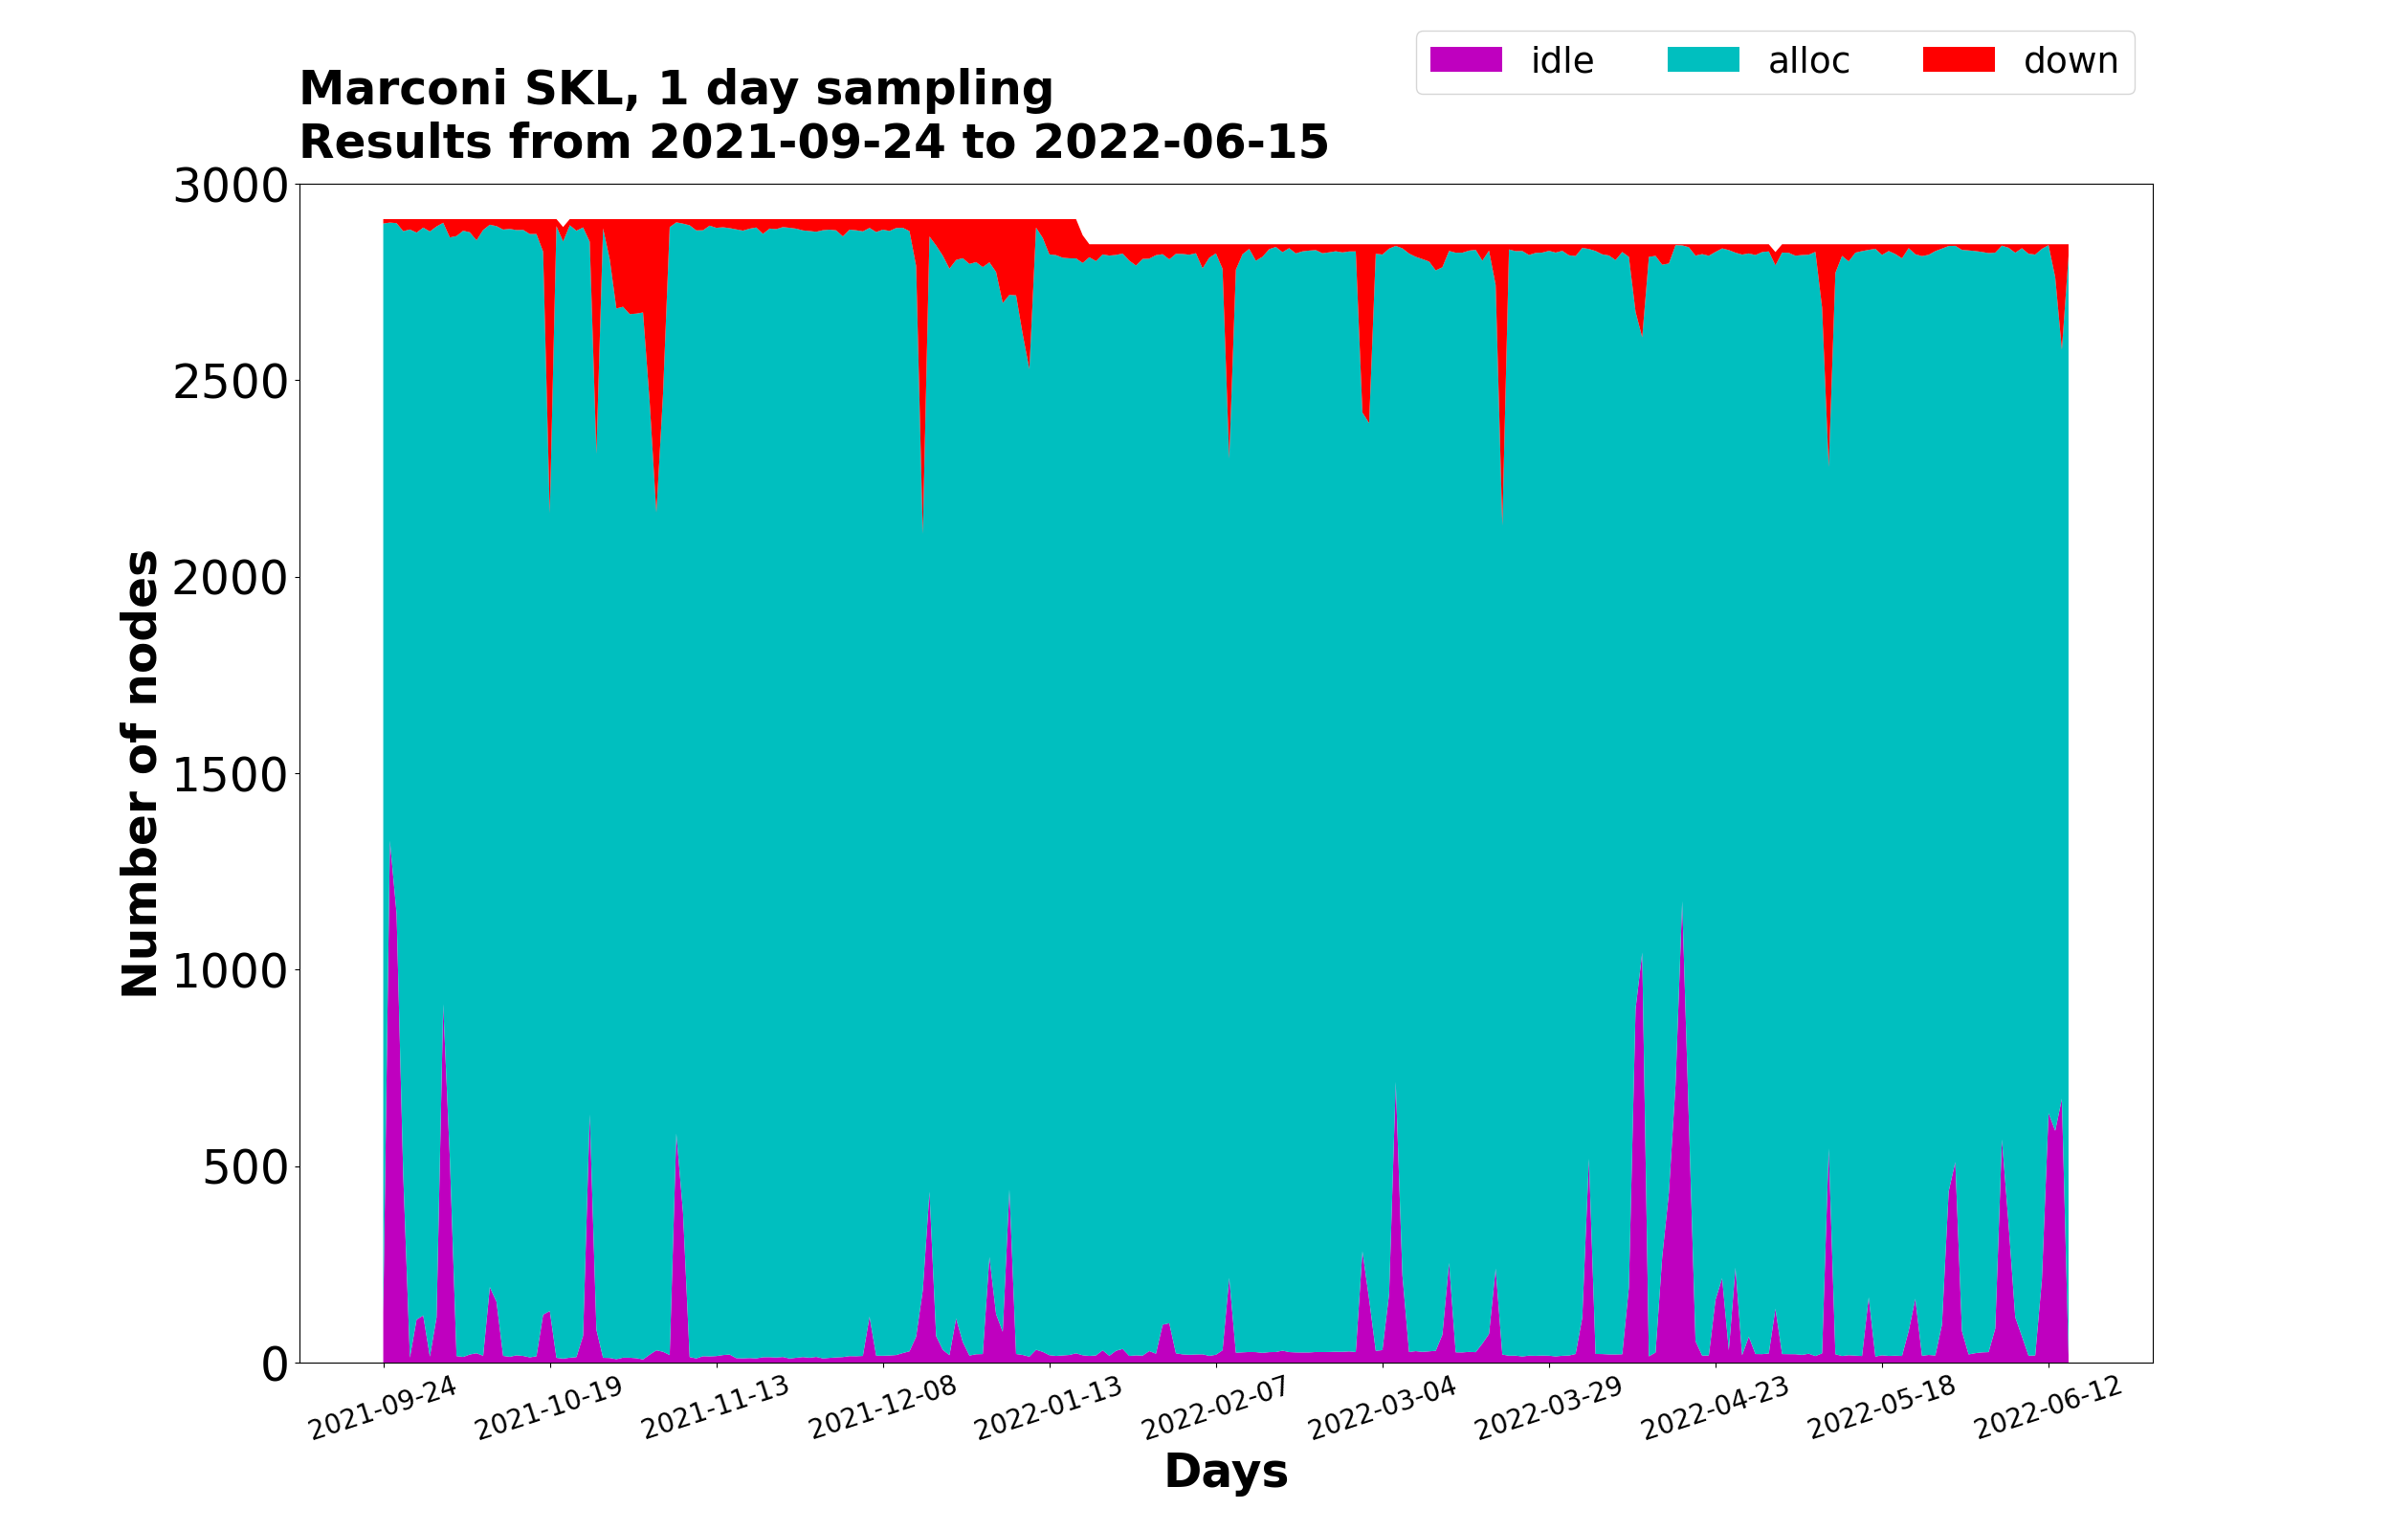
ACH-MPG Applications performance curve status
Heavily used ☺

Slide 21
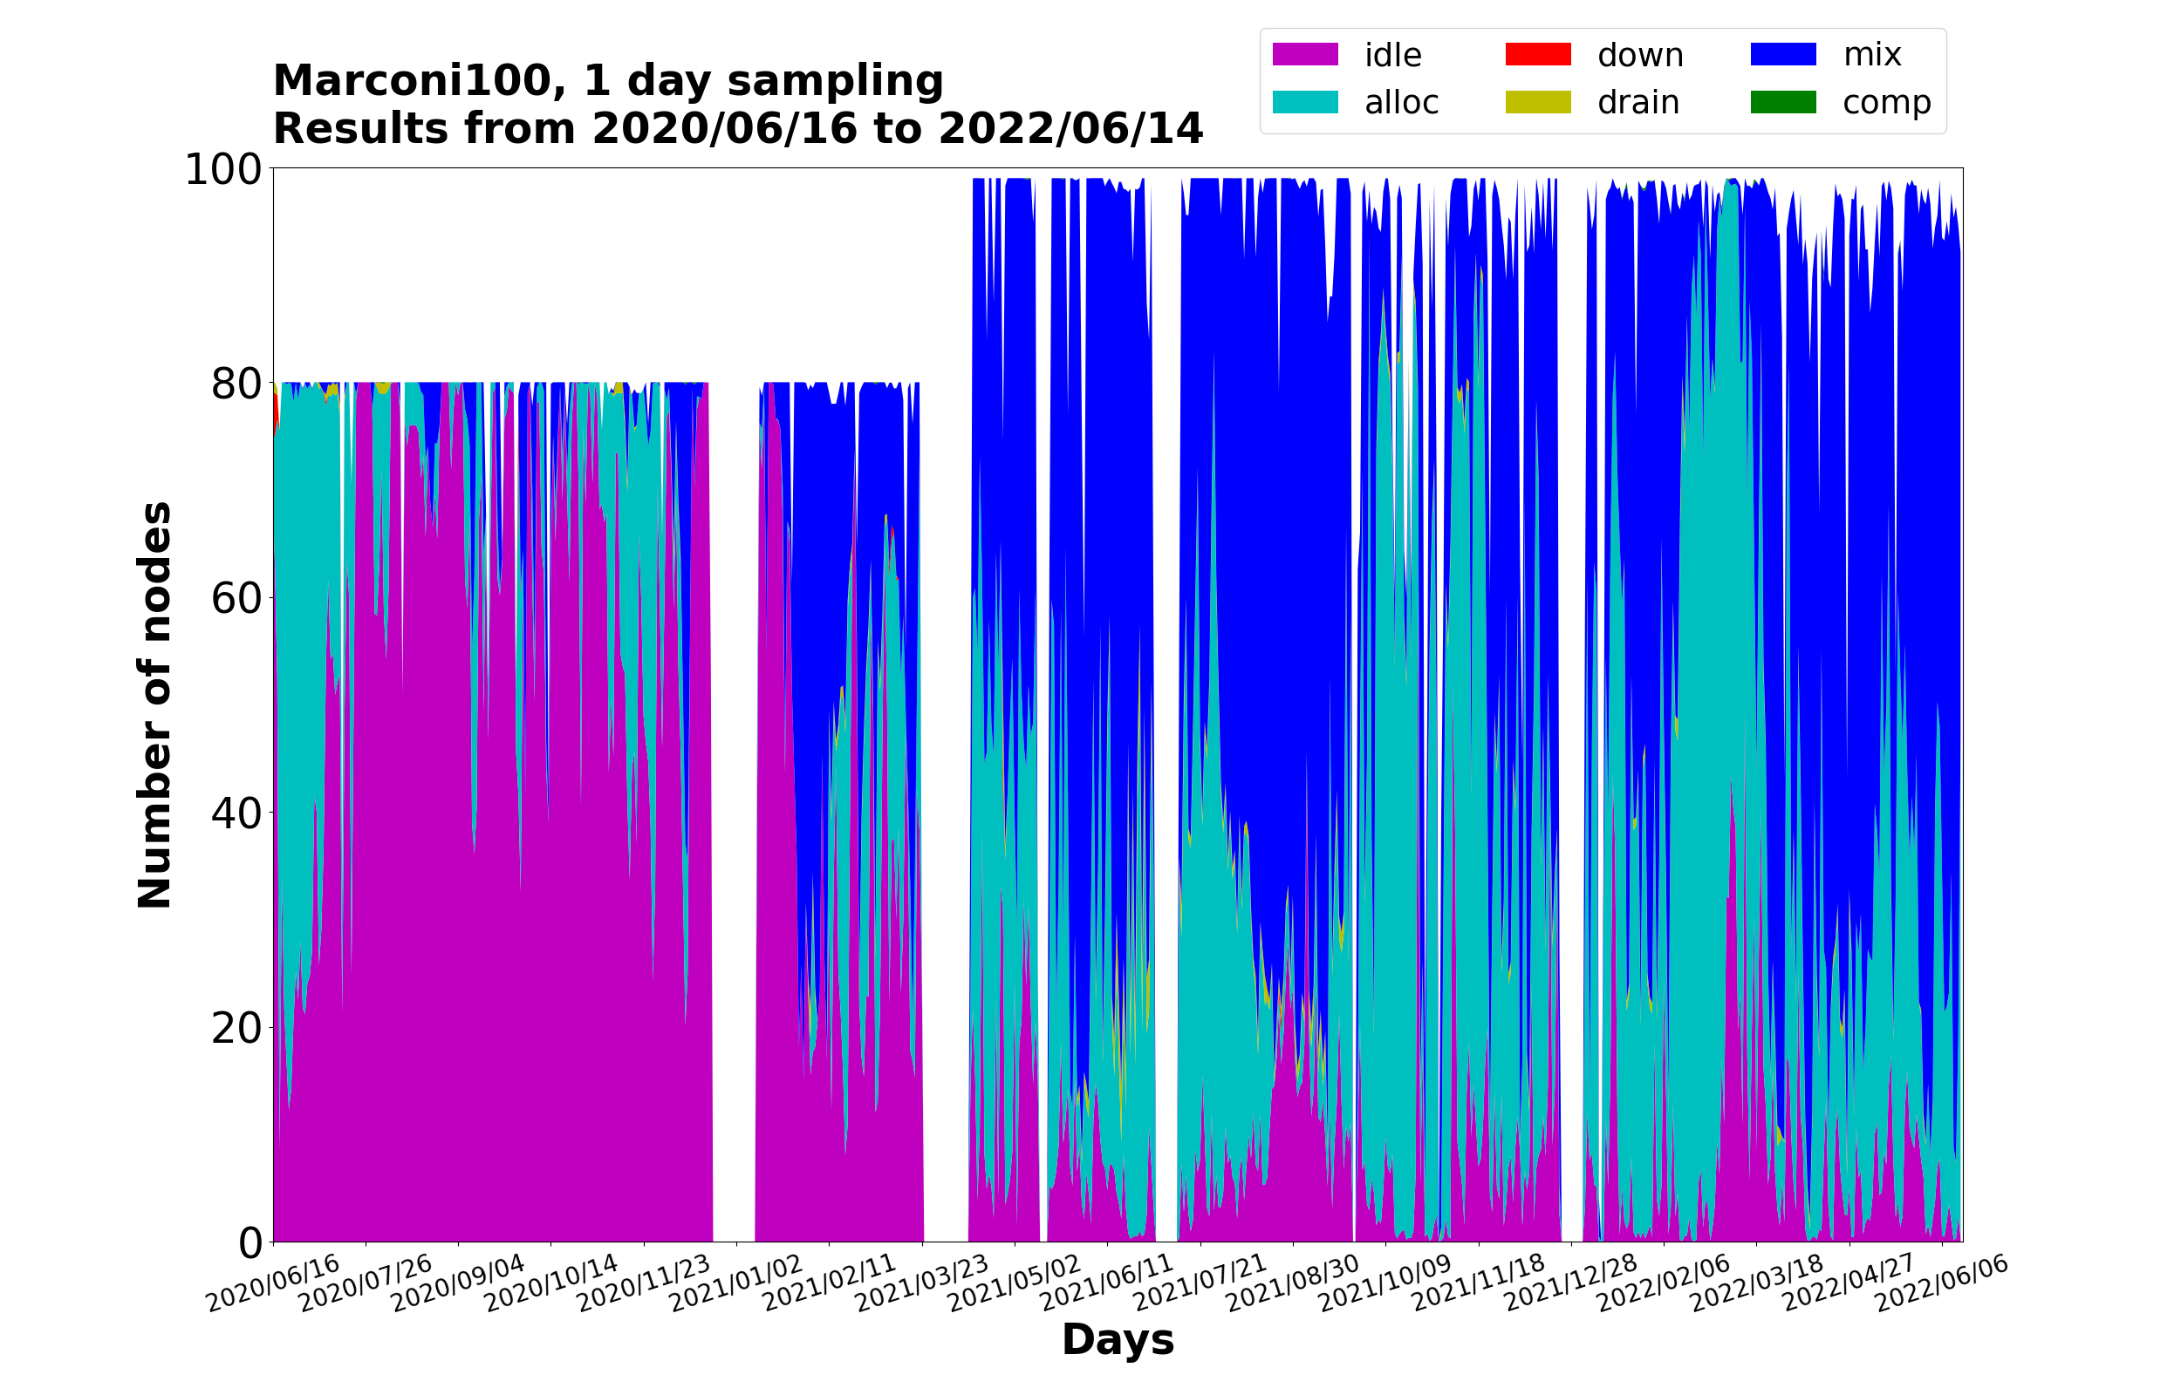
ACH-MPG Applications performance curve status

Slide 22
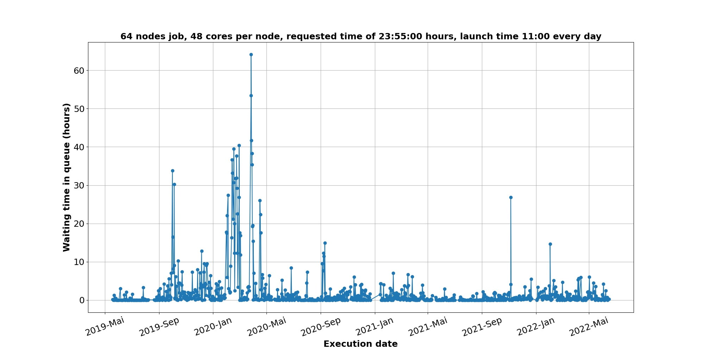
Applications performance curve status : Waiting times

Slide 23
AOB
HPCMD:
Start working on 16 nodes
susana is working on the database settings. susana can propagate the config on 16 nodes, then admin can change the limit of debug queue.
when we agree all together on tests, we can extend to 128 nodes. Extension to 128 nodes for a short period of time of about 2 days so to allow extensive tests
Starwall benchmarks
Nitin executes the code on the same 16 nodes (just one switch).
Serhiy and David do the same tests on the gateways.
Nitin pushes the case to Giacomo.
Action opened at TM committee
Deliverable of GPU WK
RP14 deliverable ongoing

Slide 24
Close of TM report
Operation Committee meeting OC-72 – July 19, 2022
F. Boillod-Cerneux (Chair), R.Hatzky (ACH-MPG) and J.David

