Slide 1
CRM for EIRENE simulations of EU-DEMO detachment
D. Borodin, F. Cianfrani

Slide 2
INTRODUCTION
Detached plasma divertor: plasma temperature below 10eV→ atomic and molecular (A&M) reactions
CRM: list of particles/reactions: balance equations → equilibrium btw plasma A&M species
YACORA: solver+ established database [1] → CRM in tokamaks
EIRENE: Monte-Carlo transport solver + CRM
AIM:
Interchange btw YACORA and EIRENE to provide CRM for detachment control modelling
This work:
JET
EU-DEMO
CRM with molecular source → main reactions in
molecular source from simulations → transport

Slide 3
COLLISIONAL-RADIATIVE MODEL
Particle species
H⁺, H, H₂⁺,H₂
Reaction | Type | Source
H₂ + e → H₂⁺ + e + e | molecular ionization | H2vibr
H₂ + e → H₂(b_{triplet}) → H + H + e | neutral dissociation | H2vibr
H₂ + e → H + H⁺ + e + e | dissociative ionization | Amjuel
H₂ + H⁺ → H₂⁺ + H | charge exchange (CX) | H2vibr
H + e → H⁺ + e + e | ionization | Amjuel
H₂⁺ + e → H + H⁺ + e | neutral dissociation (MAD) | Amjuel
H₂⁺ + e → H⁺ + H⁺ + e + e | dissociative ionization (MAI) | Amjuel
H₂⁺ + e → H + H | dissociative recomb (MAR) | Amjuel
H⁺, e sinks (reservoirs)
Molecular source:
Reference value
Plasma parameters:
Fixed electron and ion densities:
n_{e} = n_{i} = 10¹⁹m⁻³ for [1]
n_{e} = n_{i} = 10²¹m⁻³ for [2]
Temperature: T_{e} = T_{i} = 0.2÷30eV.
JET
EU-DEMO
[1] M Groth et al. 2013 Nucl. Fusion 53 093016 [2] F Subba et al. 2020 Nucl. Fusion 61 106013

Slide 4
COLLISIONAL-RADIATIVE MODEL: results
JET
YACORA solver
H₂⁺ density peak
large H₂ density
EU-DEMO

Slide 5
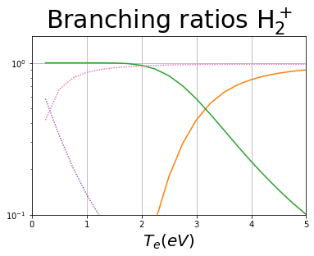
COLLISIONAL-RADIATIVE MODEL: results
EU-DEMO
low temperature (T < 2eV) leading reaction chains:
MAD
MAR/MAD competition at very low temperature
H₂+H⁺→ H₂⁺+H H₂⁺+e → H+H⁺+e
H₂+H⁺→ H₂⁺+H H₂⁺+e → H+H
MAR

Slide 6
VIBRATIONALLY RESOLVED CRM
vibrationally resolved molecular states H₂(v) (v=0 ..14) with electron-induced ladder-like trans H₂(v) + e → H₂(v±1) + e rates H2vibr
EU-DEMO
vibrational transitions are the main reaction channels at low temperatures

Slide 7
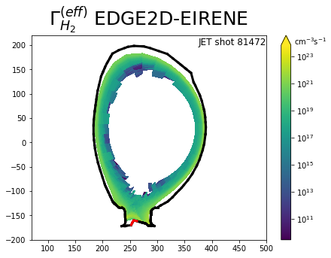
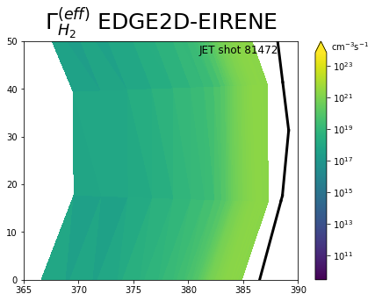
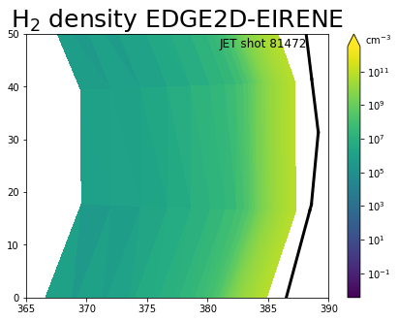
MOLECULAR TRANSPORT
molecule density scales linearly with the source → effective source term
JET
up-stream region: substantial overlap effective source and density
Gas puffing

Slide 8
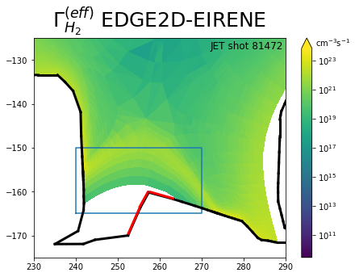
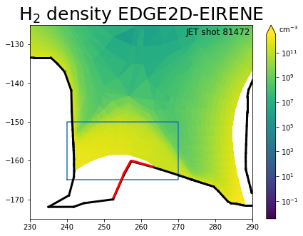
MOLECULAR TRANSPORT
molecule density scales linearly with the source → effective source term
JET
divertor region: discrepancy → novel physical conditions (dominance of CX reactions at low temperature)
Gas puffing

Slide 9
CONCLUSIONS
CRM for A&M reactions in
1) it captures game-changing branching difference in dependence of plasma temperature for various reaction contributions (MAD vs MAR, vibrational trans vs dissociation/ionization)
2) the molecular source (D₂ influx) is introduced and a way to related it with EDGE2D-EIRENE runs including transport in divertor is demonstrated
3) it is staged for both standalone use (as presented) and for intergration into EIRENE for detachment control analysis
4) an extension to include isotope effect and electronic excitations for computing spectroscopic emission (opacity) is foreseen.

Slide 10
Thanks for the attention!

