Slide 1
UEDGE-CRUMPET predicted isotopologue effect on atomic and molecular lines in DIII-D high-recycling divertor plasmas
Andreas Holmª, Mathias Grothª, Adam McLean^{b}, Filippo Scotti^{b}, Thomas D. Rognlien^{b}, William H. Meyer^{b}, Morgan W. Shafer^{c}, Robert S. Wilcox^{c}, Eric M. Hollmann^{d}
ª Aalto University, Espoo, Finland
^{b} Lawrence Livermore National Laboratory, Livermore, CA, USA
^{c} Oak Ridge National Laboratory, Oak Ridge, TN, USA
^{d} University of California San Diego, San Diego, CA, USA

Slide 2
Molecular processes affect the atomic and molecular radiative power sinks
Well-diagnosed, unseeded ohmic D plasmas in DIII-D under high-recycling LFS conditions are simulated by UEDGE coupled to the collisional-radiative (CR) code CRUMPET
The role of the molecular isotope (isotopologue) on the radiative plasma power losses are assessed using UEDGE-CRUMPET
UEDGE-CRUMPET run and post-processed with effective rates for hydrogen and deuterium to capture the isotopologue effect

Slide 3
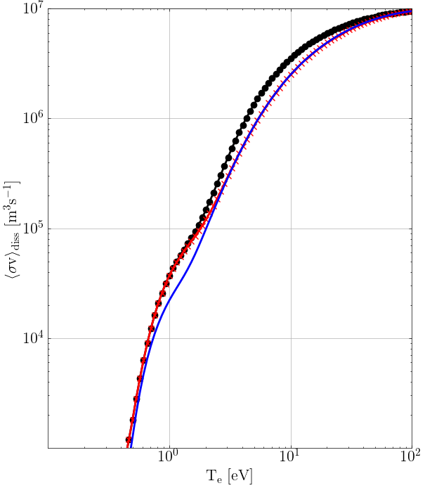
MCCC data [1] predicts an isotope effect on dissociation for T_{e}=0.7-3 eV
n_{e}=n_{i}=10²⁰ m⁻³
EIRENE rates
Predicted isotope effect strongest for temperatures associated with detachment onset and detached conditions
MCCC data indicates weaker dissociation of both H₂ and D₂ for T_{e}>3 eV compared to EIRENE data (AMJUEL, HYDHEL, H2VIBR)
Deuterium - MCCC
Hydrogen
MCCC
[1] mccc-db.org, accessed July 6th 2022

Slide 4
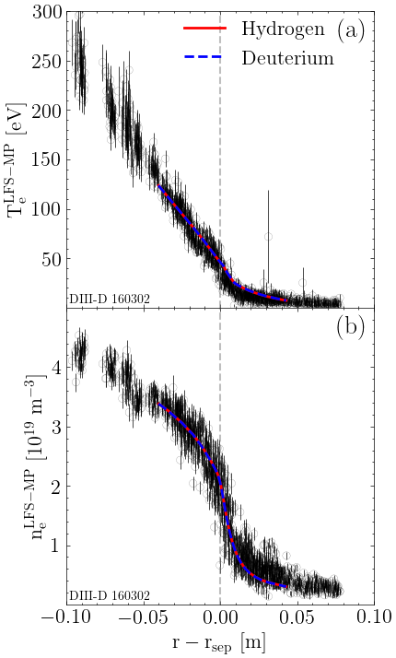
No isotopologue effect observed for target or upstream plasma conditions: n_{e} under-estimated by a factor of x3
LFS-mp T_{e}
Corresponding under-prediction of n_{e} and J_{sat} observed in Groth et al., NME2019
LFS-t T_{e}
LFS-t n_{e}
LFS-t J_{sat}
Hydrogen
Deuterium
Under-estimation of n_{e}
yields a corresponding
under-estimation of J_{sat}
LFS-mp n_{e}
Strong gradients
at separatrix not
supported by
anomalous radial
diffusion model?
Hydrogen
Deuterium
Weaker radial T_{e}-gradient
results in x2 higher T_{e} in
UEDGE-CRUMPET
compared to measurements

Slide 5
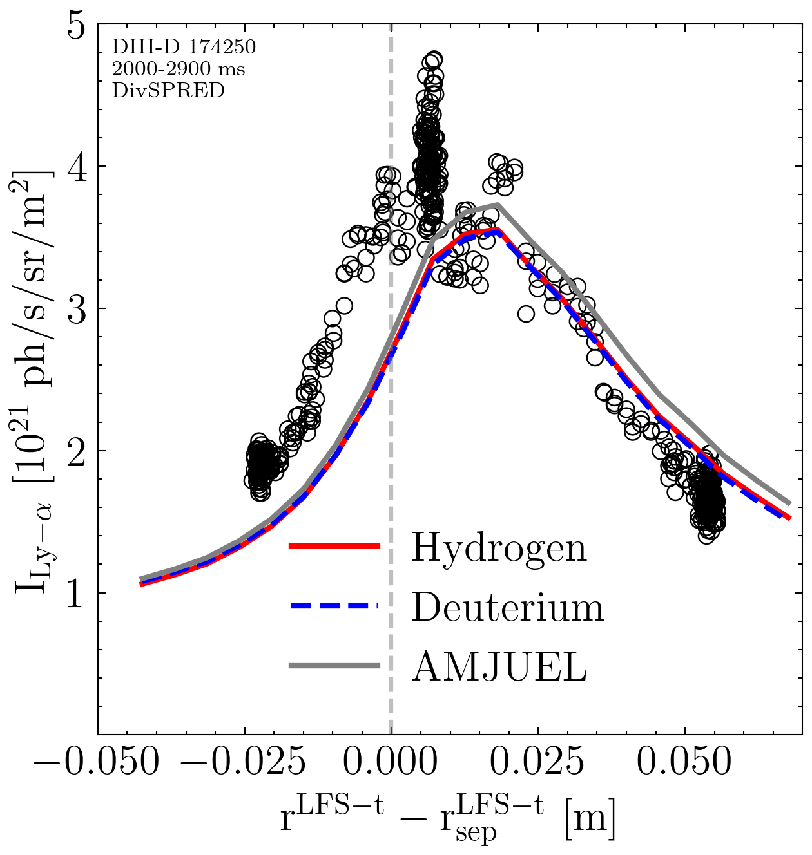
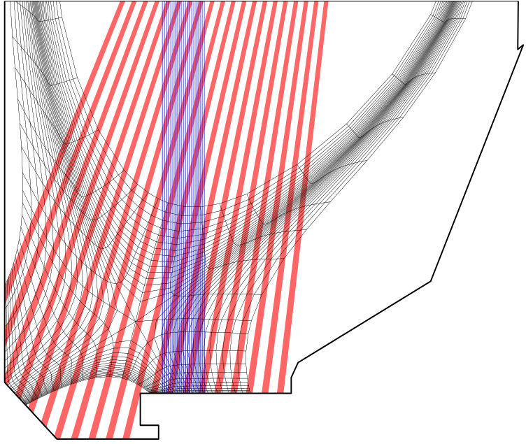
Lyman-α line intensity agreement with high-recycling LFS target: negligible isotopologue effect
Results post-processed with CRUMPET and synthetic spectroscopy module for atomic, molecular, and molecularly-induced radiation
Lyman-α (DivSPRED)
DivSPRED
MDS
Ly-α radiation is found to be the dominant radiative power loss channel
Hydrogen
Deuterium
AMJUEL
Synthetic
spectrometer systems

Slide 6
UEDGE-CRUMPET predicts high-recycling LFS Balmer-α emission: detached HFS agreement is poor
Balmer-α (MDS)
Similar observations as in EDGE2D-EIRENE
Groth et al., NME 2019
Isotopologue and molecular effects strongest in the detached HFS divertor
HFS Ba-α emission driven by molecular processes
Role of preferential recycling as excited molecules and molecule-surface interaction?
Underestimation of EIR into the n=3 state by UEDGE-CRUMPET could explain underestimation
$−$ Molecularly-induced
$⋯$ Direct excitation
Hydrogen
Deuterium
AMJUEL
Under-estimation of
Ba-α at HFS detached
conditions
Predictions incicate strong
molecularly-induced
atomic radiation
Observable isotopologue effect
0

Slide 7
UEDGE-CRUMPET predicts high-recycling LFS Balmer-α emission: detached HFS agreement is poor
Balmer-α (MDS)
Similar observations as in EDGE2D-EIRENE
Groth et al., NME 2019
Isotopologue and molecular effects strongest in the detached HFS divertor
HFS Ba-α emission driven by molecular processes
Role of preferential recycling as excited molecules and molecule-surface interaction?
Underestimation of EIR into the n=3 state by UEDGE-CRUMPET could explain underestimation
$−$ Molecularly-induced
$⋯$ Direct excitation
Hydrogen
Deuterium
AMJUEL
Under-estimation of
Ba-α at HFS detached
conditions
Predictions incicate strong
molecularly-induced
atomic radiation
Observable isotopologue effect
0

Slide 8
Fulcher band intensity overestimated by x10 due to over-population of the d³Π_{u} state: Lyman-Werner dominant
Population of the d³Π_{u} state: preferential recycling as vibrationally excited molecules and molecule-surface interaction
Depopulation of the d³Π_{u} state: availability of MCCC rates
Fulcher intensity
Lyman-Werner intensity
Lyman-Werner bands over-estimated by a x3 by UEDGE-CRUMPET vs AMJUEL
Bands could not be resolved at highest HR-VUV gain
In agreement with EDGE2D-EIRENE
Groth et al., NME 2019
Hydrogen
Deuterium
AMJUEL
Fulcher band intensity
overstimated by x10
UEDGE-CRUMPET ovepredicts
Lyman-Werner band intensity by
x3 compared to AMJUEL
Observable isotopologue effect
Observable isotopologue effect
0.0
0.0

Slide 9
Isotopologue effect and molecular processes strongest at the detached HFS (<1% for H₂ → ~7% for D₂)
Implications for ITER detached operation?
Negligible isotope effect at the high-recycling LFS
Molecular emission up to 10% of atomic emission at the high-recycling LFS
Up to x10 overestimation of molecular emission based on extrapolation of Fulcher predictions
In agreement with EDGE2D-EIRENE
Groth et al., NME 2019
Isotopologue effect

Slide 10
Negligible isotopologue effect and molecular radiation predicted by UEDGE-CRUMPET for high-recycling conditions
Ohmic, deuterium-only DIII-D discharges with high-recycling LFS divertor conditions and detached HFS conditions were simulated by UEDGE-CRUMPET
Predictions in agreement with the EDGE2D-EIRENE predictions in Groth et al., NME 2019
Isotopologue effect and molecularly-induced atomic radiation stronger in the detached HFS target
UEDGE-CRUMPET overpredicts the integrated Fulcher band intensity by a factor of 10 due to an overestimation of the d³Π_{u} state
Molecule-surface interaction, preferential recycling as vibrationally excited molecules
d³Π_{u} populations dependent on available depopulation rates

Slide 11
Acknowledgements and disclaimer
This work was supported by US DOE under contract nos. DE-FC02-04ER54698, DE-AC52-07NA27344, and DE-AC05-00OR22725.
This report was prepared as an account of work sponsored by an agency of the United States Government. Neither the United States Government nor any agency thereof, nor any of their employees, makes any warranty, express or implied, or assumes any legal liability or responsibility for the accuracy, completeness, or usefulness of any information, apparatus, product, or process disclosed, or represents that its use would not infringe privately owned rights. Reference herein to any specific commercial product, process, or service by trade name, trademark, manufacturer, or otherwise, does not necessarily constitute or imply its endorsement, recommendation, or favoring by the United States Government or any agency thereof. The views and opinions of authors expressed herein do not necessarily state or reflect those of the United States Government or any agency thereof.
This work was supported by the Academy of Finland under grant no. 13330050.

