Slide 1
The impact of vibrationally and electronically excited H₂ on the molecular assisted recombination rate in detached plasma regimes
R. Chandraª, A. Holmª, M. Grothª
ªAalto University, Espoo, Finland
PSI 2022 13-17 June 2022 (Updated for TSVV-5)
Notes:
Hello, I am Ray Chandra and welcome to my poster presentation. I will present to you the result of my investigation on the impact of vibrationally and electronically excited hydrogen molecules on the molecular assisted recombination rate in detached plasma regimes.

Slide 2
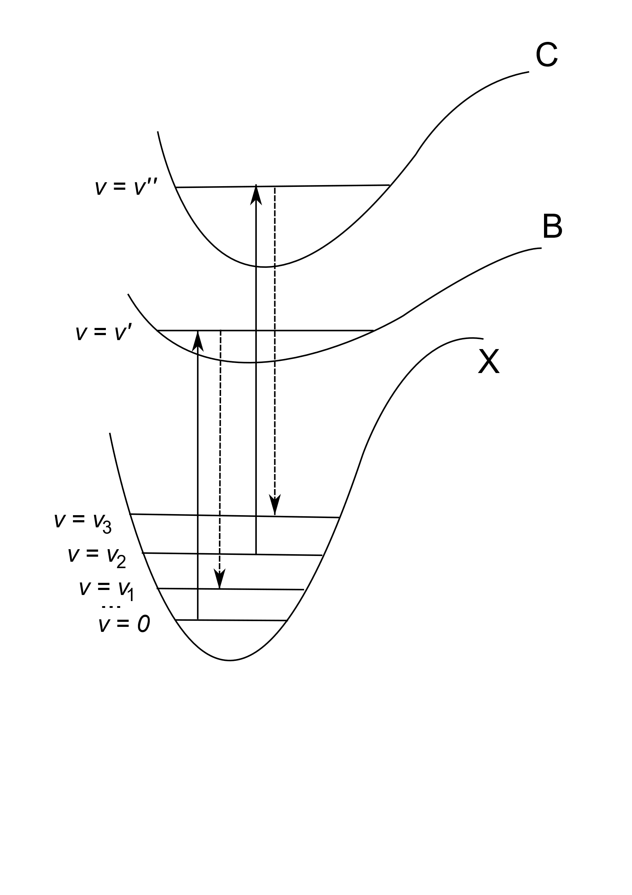
In divertor plasmas, molecular activated recombination (MAR) occurs with the presence of vibrationally excited H₂ molecules
In edge codes only the ladder-like transition from direct electron impact is considered $H_{2}\left(v\right)+e→H_{2}^{−}→H_{2}\left(v±1\right)+e$
Here we investigate the role of H₂ electronic transitions to the population of vibrationally excited H₂ using CR model CRUMPET
Notes:
It is known that molecular activated recombination, in divertor plasma conditions, occurs with the presence of vibrationally excited hydrogen molecules. They can be populated by direct electron-impact excitation through a formation of a negative molecular ion. This resonant process is often included in scrape-off layer codes such as SOLPS or EDGE2D-EIRENE, where the excitation and de-excitation only occur in single steps. Another way to populate the vibrational states is to excite the molecule electronically to a higher state and de-excite into a higher vibrational level of the electronic ground state. Here we investigate the role of hydrogen molecule electronic transitions to the excited singlet B and C states, using the collisional radiative model CRUMPET.

Slide 3
H
CR Model CRUMPET¹
Table 1
$$\dot{n}=Mn+Γ$$
Collisional Processes Included in CRUMPET
1. $H_{2}\left(v\right)+e→H_{2}^{−}→H_{2}\left(v±1\right)+e$
2. $H_{2}\left(v\right)+e→H_{2}^{}\left(B^{1}Σ_{u}^{+},v^{′}\right)+e$
3. $H_{2}\left(v\right)+e→H_{2}^{}\left(C^{1}Π_{u}, v^{′′}\right)+e$
4. $H_{2}^{}\left(B^{1}Σ_{u}^{+},v^{′}\right)→H_{2}\left(w\right)+hv$
5. $H_{2}^{}\left(C^{1}Π_{u}, v^{′}′\right)→H_{2}\left(w\right)+hv$
6. $H_{2}\left(v\right)+e→e+H+H$
7. $H_{2}\left(v\right)+H^{+}→H_{2}^{+}+H$
8. $H_{2}\left(v\right)+e→H^{−}+H$
(1)
Included species:
H₂($X^{1}Σ_{g}^{+},v$)(v=0-14)
H₂($B^{1}Σ_{u}^{+},v^{′}$)(v’=0-36)
H₂($C^{1}Π_{u}, v^{′′}$)(v’’=0-13)
H₂⁺
H⁻
H(n=1)
CR Model with M of size 18x18 and 69x69
¹Holm, A., et al. (2021) Nuclear Materials and Energy 27, 100982
Notes:
The collisional radiative model CRUMPET solves the linearized rate equations shown in equation 1. The size of the rate matrix M depends on the number of species in which the dynamics need to be determined. Our calculation for the purpose of this study considers also the vibrational levels of the excited B and C states. When the electronic transitions are considered, M will have size 69. As a comparison, without electronic transitions, M will have size 18. The rate matrix M is filled with reaction rates depending on the included reactions. The reactions are listed in table 1. Without electronic transitions, the blue shaded reactions are omitted. When solved to steady state, the linearized equations resulted in the population number of the included species.

Slide 4
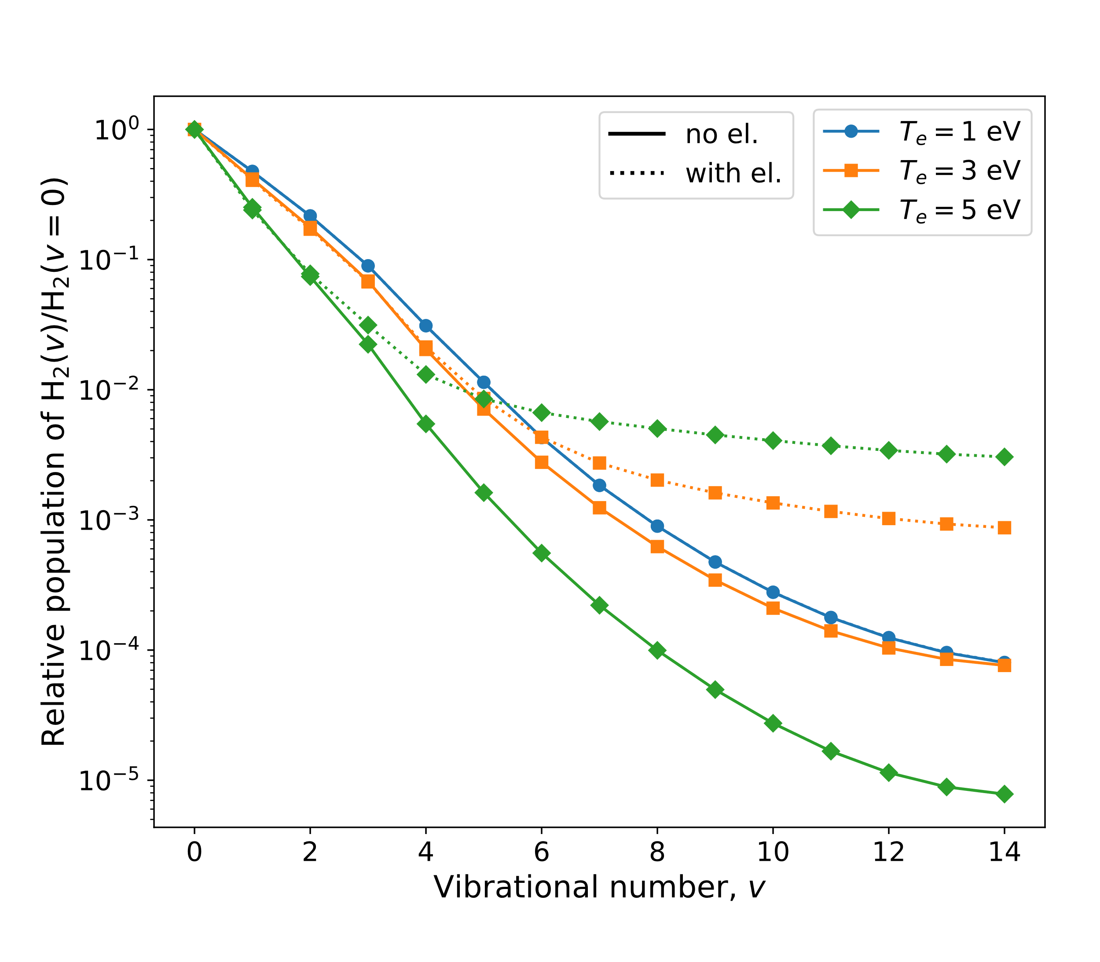
With increasing T_{e}, the higher vibrational states of H₂ are less populated when the electronic transitions of H₂ is not included in the model. This trend is reversed when electronic transitions are included.
Notes:
Here are the population distribution of the vibrationally excited molecules in the electronic ground state. The solid lines are when electronic transitions are not included, the dotted lines are when electronic transitions are included. With increasing electron temperature, the higher vibrational states of H2 are less populated when the electronic transitions are not included. The opposite trend occurs when electronic transitions are included. This means the electronic transitions play a role in populating the higher vibrational states, which may enhance molecular activated recombination rates.

Slide 5
Table 1
Collisional Processes Included in CRUMPET
1. $H_{2}\left(v\right)+e→H_{2}^{−}→H_{2}\left(v±1\right)+e$
2. $H_{2}\left(v\right)+e→H_{2}^{}\left(B^{1}Σ_{u}^{+},v^{′}\right)+e$
3. $H_{2}\left(v\right)+e→H_{2}^{}\left(C^{1}Π_{u}, v^{′′}\right)+e$
4. $H_{2}^{}\left(B^{1}Σ_{u}^{+},v^{′}\right)→H_{2}\left(w\right)+hv$
5. $H_{2}^{}\left(C^{1}Π_{u}, v^{′}′\right)→H_{2}\left(w\right)+hv$
6. $H_{2}\left(v\right)+e→e+H+H$
7. $H_{2}\left(v\right)+H^{+}→H_{2}^{+}+H$
8. $H_{2}\left(v\right)+e→H^{−}+H$
Reaction 7 and 8 lead to plasma recombination only through the ionic products following the T_{e},N_{e}-dependent reactions:
9. $e+H_{2}^{+}→H+H$
10. $H^{−}+H^{+}→H+H^{∗}→H+H+hv$
Notes:
Molecular activated recombination is initiated from precursor reactions, shown here in Table 1 number 7 and 8. The ion conversion pathway, number 7, produces a positive molecular ion through charge exchange. The dissociatve attachment pathway, number 8, produces a negative ion from dissociation of the molecule via electron impact and attachment of the electron. Both of these pathways can only result in plasma recombination, if the ionic product undergoes a follow up reaction listed here as reaction 9 or 10. These reactions compete with other processes that depletes the ionic product that returns an ion or more.

Slide 6
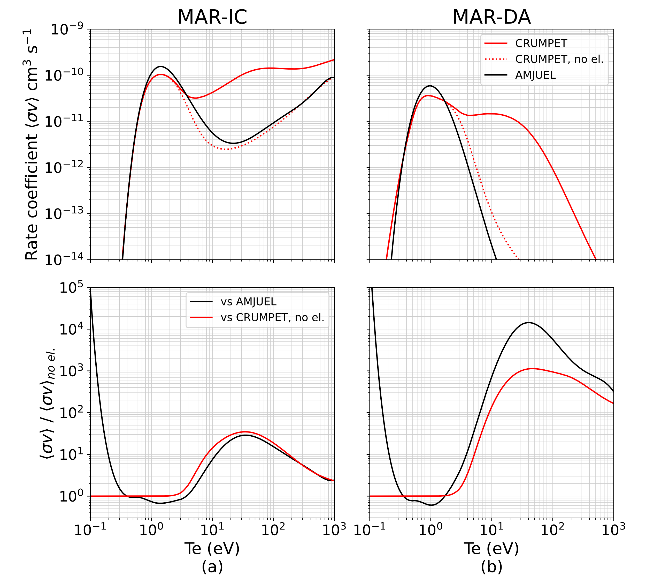
The effective recombination rate coefficients for the ion conversion (Reaction 7, MAR-IC) and dissociative attachment (Reaction 8, MAR-DA) are enhanced at T_{e} larger than 3 eV
Notes:
So, we can establish an effective recombination rate from the two MAR pathways when the follow up reaction rate is included in the calculation. Here we show the different effective recombination rate coefficients from the two MAR pathways, when electronic transitions is considered, shown by the solid red line, and when electronic transitions are neglected, shown by the dotted red line. The effective rate coefficients obtained from the widely used database for EIRENE code AMJUEL is shown for comparison. It is clear here that when electronic transitions are included in the rate matrix, the rate coefficient is enhanced quite significantly at Te larger than 3 eV.

Slide 7
At T_{e} where MAR is enhanced, MAR competes with direct dissociation and ionization. Evaluation on the impact of electronic transitions of H₂ requires information on T_{e}, N_{e}, and N_{H2}.
Recent detachment study in Magnum-PSI using B2.5-Eunomia code¹ provides coupled T_{e},N_{e}, and N_{H2} to CRUMPET
T_{e},N_{e}, and N_{H2} are taken from simulations of varying states of detachment i.e. different gas pressures in the target chamber of Magnum-PSI -> 0.27 – 2.0 Pa
¹Chandra, R. et al. (2021) Plasma Physics and Controlled Fusion, 63(9), 095006
Notes:
However, at such temperatures, the precursor reactions, reaction number 7 and 8 from before, competes with direct dissociation and ionization of the molecules. Thus, an evaluation of the impact of electronic transitions require information on the molecular hydrogen density in addition to the electron temperature and density. A recent detachment study in the linear plasma device Magnum-PSI using B2.5-Eunomia code can provide coupled quantities of electron temperature, density and molecular density to be used in CRUMPET. These quantities are taken from B2.5-Eunomia simulations in varying states of detachment, which is controlled by the amount of gas pressure in the target chamber of Magnum-PSI. We take the pressures from 0.27 to 2.0 Pa in that study and calculate the effective recombination rate using also information on the volumes of the grid cells containing the electron temperature density and molecular density.

Slide 8
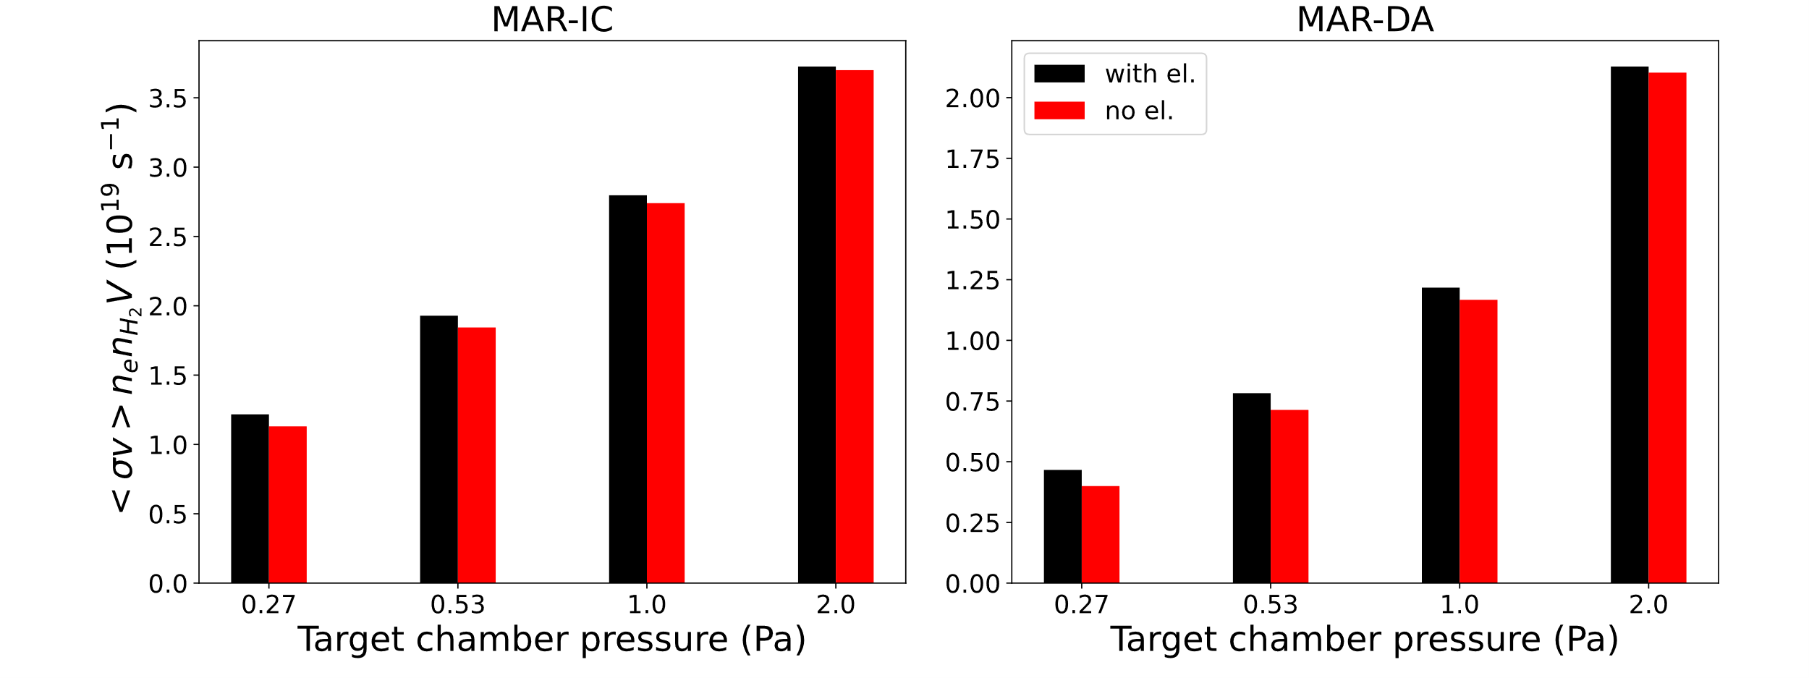
The impact of electronic transitions of H₂ to MAR is marginal for attached plasma and becomes negligible towards detached plasma conditions.
This conclusion can be expected to occur in tokamak divertors with similar T_{e,} N_{e,} and N_{H2}, however, similar application of the analysis presented here to tokamak simulations should provide further insight
Notes:
Using the effective rate coefficients shown earlier, the total effective recombination rate is shown here for each of the pathways, ion conversion and dissociative attachment. The rates are calculated with electronic transitions included, shown in black, and without electronic transitions, shown in read. At the lowest gas pressure of 0.27 Pa, when the plasma is still attached, the impact of electronic transition is the highest, although marginal. For dissociative attachment, the enhancement of MAR is about 16% at this plasma condition, and for ion conversion is about 7%. The impact becomes negligible as the plasma is driven towards further detached state. Hence, we conclude that for detached plasma conditions, the impact of electronic transition of molecular hydrogen to the MAR rate is small and should not greatly affect the global particle balance. While this calculation is based on plasma conditions in a linear device, the same impact should be expected in tokamak divertors with similar electron temperature, density and molecular density. However, similar application of the analysis presented here to tokamak simulations will be an interesting comparison and should provide further clarification and insight. For further details of this study , we direct you to a paper that will be submitted under the same title in this conference proceeding. Thank you for your attention.

