Slide 1
EIRENE IMASification: status and remaining issues
Yu. Yakovenko, P. Chmielewski, D. Yadykin
EIRENE-NGM Development, Code Camp 2022, KU Leuven, Belgium

Slide 2
Outline
General Grid Description (GGD) structure
Status
Things to be done
Summary
Questions

Slide 3
GGD and how quantities are stored

Slide 4
Triangular grid in grid_ggd
The EIRENE files holding the grid contain:
List of nodes with their coordinates (R and Z);
List of triangles, with reference to the nodes being their vertices;
List of neighbors of each triangle, including the “material properties” (MP) of the triangle sides.
In grid_ggd, this information is put into a 2D grid space (poloidal space).
The following subspaces are organized:
All grid nodes
All grid cells
All grid edges
Subsets of edges having a certain MP value
A special subset with 1 element for storing average values.
We have written Fortran routines for transforming the grid description in EIRENE format to GGD format and back.
A data structure is created that contains what is needed for both representations.
A description can be found on an ACH confluence page (the grid part is more or less ready, the rest is under costruction): https://docs.psnc.pl/display/WFMS/EIRENE

Slide 5
EIRENE input
The files storing physical quantities contain:
Text headers
Values for all cells
Average value
Possibly values for additional grid cells (for ducts etc.)
The initial list of quantities includes electron temperature, ion temperature(s), ion density(es), ion velocity field (vx, vy, vz), components of the B unit vector (bx, by, bz), and field strength (BF).
Problem: storing velocity projections to R and Z is now impossible in the edge_profiles IDS
F. Imbeaux has sent a request for IDS extension.
Temporary solution: storage in the ‘temporary’ IDS (implemented).
Storage of temperatures and densities is implemented in edge_profiles IDS.
Storage of B components is implemented in ‘equilibrium’ (with some issues to be discussed later).
Additional grid cells are not implemented yet.
Text headers of the input files are not implemented, either.
The repository is in ~g2yyakov/public/eirene/version0.9

Slide 6
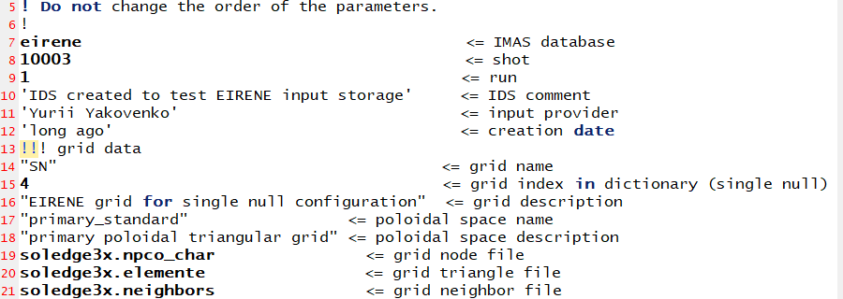
Input saving in IMAS
To store the input, one needs:
To prepare files with the grid and the physical quantities (tallies)
To run the program save_input.exe
The command file controlling the program looks like that (see also next slide):

Slide 7
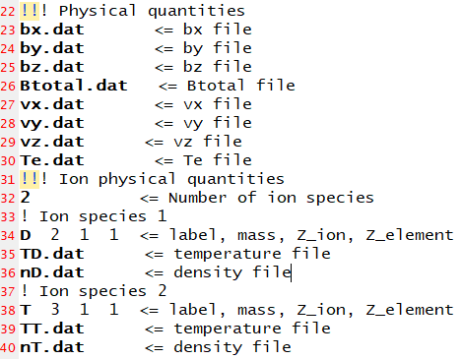
Command file for input saving, cont.
The part of the command file controlling the tallies is as follows:

Slide 8
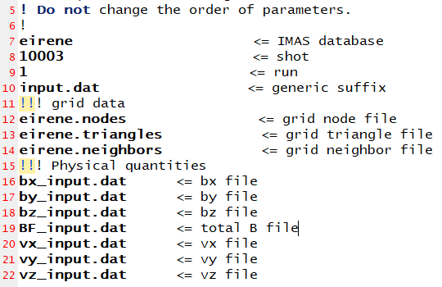
Input recovering
To recover the input from IMAS, one needs to run the program proivide_input.exe.
The temperate and density files have the names: e_T<suffix>, D_T<suffix>, D_n<suffix>, etc.
The command file determines the desirable names of the files to be produced:

Slide 9
EIRENE output
The volume-averaged output tallies are given for the same grid subsets (although the file format is slightly different).
Not implemented yet.
Surface-averaged tallies may need organization of grid subsets.
The list of volume-averaged tallies was investigated; they can be placed into the edge_profiles and edge_sources IDS’s.
It seems that there are no places to store photon sources in the edge_sources IDS (only sources caused by photons).

Slide 10
Things to be done
Add possibilities to write some things that the IMAS standard provides for (code, code version, etc.);
For grid:
Add a description of the “additional” cells;
3D (toroidal coordinate)?
Add other grids, if required.
For input:
Implement velocities;
Test with EIRENE;
Investigate the list of quantities and implement more quantities;
Add code keys in XML format.
For output:
Extend the edge_sources IDS to store photon quantities;
Surface-averaged tallies (organizing grid subsets?);
Implementation

Slide 11
Summary
Routines for storing the triangular grid have been tested.
Routines for storing the input quantities have been tested.
Many things are yet to be improved (e.g., some extensions of the edge_profiles IDS are expected).
Routines for storing the output quantities are to be written yet.
Is extension of edge_sources is required?

Slide 12
Questions about EIRENE input
Is it correct that the x, y, z coordinates are the same as R, Z, phi (the cylindrical coordinates – in this order exactly)? Yes
Do we have several sorts of ions in the input data (this is, in fact, already implemented)? Yes
Do we have different velocities for several sorts of ions? Yes

Slide 13
Questions about EIRENE input, cont.
The input contains b_{x}, b_{y}, b_{z}, and B. IMAS gives us slots for storing B_{R}, B_{Z}, and B_{tor}. It is easy to transform local values but not averages. Now we store them in the ‘temporary’ IDS, which is not a nice permanent solution. What else can we do? Should we recalculate the averages? Then which averages are they (the volume ones, the cross-section ones, …)? Not really needed; it is enough to put B_average=1, bx=0, by=1, bz=0

Slide 14
Questions about EIRENE output
Is it right that the EIRENE output contains sources for all molecules taken together? For all atoms taken together? Will it be reasonable then to introduce neutral(1)=atom, neutral(2)=molecule, without describing their properties (like charge, mass etc.)? No
Similarly, it correct to set ion(1)=bulk ion, ion(2)=test ion? Not exactly, but we need no save separately bulk ions and test ions
The IDS ‘edge_sources’ has no places for any photon sources (only places for ion and neutral sources due to photons)? Are they important? Should we put them to the ‘temporary’ IDS? The ‘radiation’ IDS

Slide 15
General questions
Code-specific parameters: How easy is it to generate a list of the code parameters in XML format (and get it back from XML)? To postpone until the code input format is established
How important are the text comments placed at the beginning of data files? ---

Slide 16
General questions, cont.
Now everything is being done for a poloidal 2D triangular mesh. Should integration with other meshes be postponed to some later times? ---
What, in general, will be the roadmap of the EIRENE IMASification (things to be implemented and the desirable order of their implementation)? X-points and other generic subsets Code that produced the input ???

Slide 17
Thank you!
Bedankt!

Slide 18
GGD basics
GGD is a data structure for storing grids of arbitrary structure, together with physical quantities given on these grids.
GGD is found in the Data Dictionary of most IMAS IDS.
Each IDS contains the structures grid_ggd and ggd.
grid_ggd holds description of grid elements (nodes, cells, etc.) and relations between them;
ggd, quantities on this grid.
Each physical quantity is “attached” to one or more grid subsets (for example, the subset of all grid points, of all grid cells, of SOL grid points, of separatrix edges etc.).
If you want to store, say, ion flux at separatrix edges, you put a list of the flux values to ggd and refer to the separatrix-edges subset (defined in grid_gdd).

