Slide 1
CRMs and A&M data session D2 - EIRENE code camp
convener: F. Cianfrani

Slide 2
D2 session summary
A&M Databases
HYDKIN
EIRENE routines:
Food for thoughts
CRM and photon tracing module in EIRENE (Ray Chandra)
………….

Slide 3
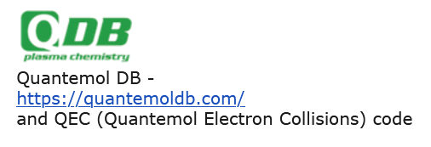
A&M DATABASES

Slide 4
A&M DATABASES
ALADDIN, COLLISIONSDB
A&M and Particle-Surface interaction data for fusion
Heavy-particle, electron and photon collisions
output: XML, tabular
Molecular Convergent Close-Coupling
Electron and positron collisions
Target: H₂ (isot.), H₂⁺ (isot), HeH⁺
diss, excitation + vibrational resolution
output: tabular
A&M and Particle-Surface interaction data, Boltzmann solver
CX, diss, elastic, excitation, ionization, recombination, ..
free account: download limit (20)
output: xsec, csv

Slide 5
A&M DATABASES
collection several databases
cross sections, interaction pot., osc. strength, transport data
CX, diss, elastic, excitation, ionization, recombination, ..
output: XML
Federated database, node structure
FAIR
Input: SQL output: XML, tabular

Slide 6
new HYDKIN
Availables now from main page at
Still work in progress

Slide 7
new HYDKIN: grouping of reactions
OLD: reactions grouped by database
NEW: reactions grouped by formula → identified by number
plotter: reactions from different databases → comparison
solver: radio button: avoid multiple reactions with same formula

Slide 8
new HYDKIN: grouping of reactions
Grouped reactions differing for vibrational resolution (one row)
next stage: bundle vibrational state

Slide 9
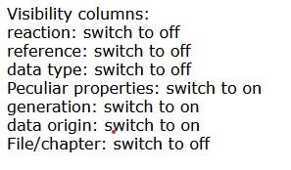
new HYDKIN: columns
List of (retractable) columns:
number: identify the reaction (AMJUEL number w/o letters)
reaction: formula
reference
data type: experimental, calculated, mixed…
Peculiar properties: additional info
generation: 0 for now
data origin: type of fit (original data, improved fit, …)
File/chapter: database/section

Slide 10
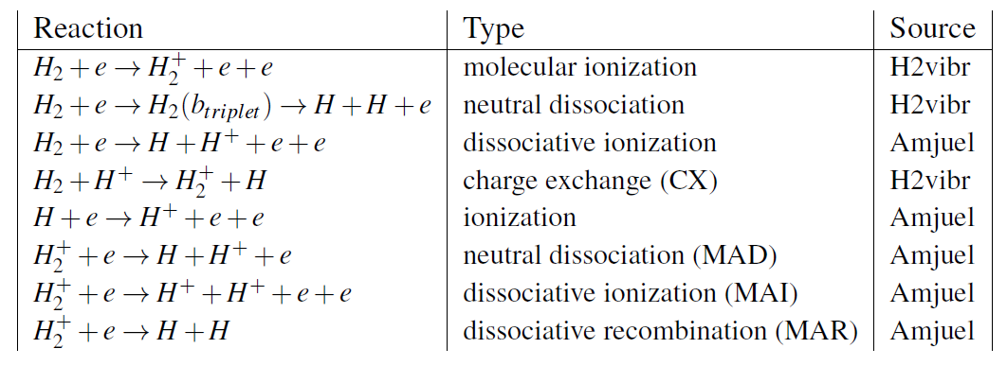
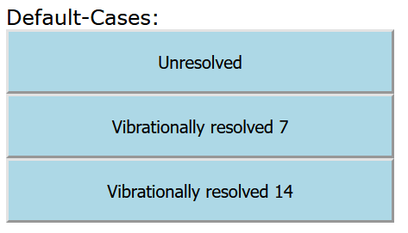
new HYDKIN: default cases
Deduced from JET (EDEGE2D-EIRENE) and DEMO simulations
with and w/o vibrational resolution
Groth et al. Nucl.Fusion 2013
Subba et al. Nucl.Fusion 2021
+ molecular volumetric source

Slide 11
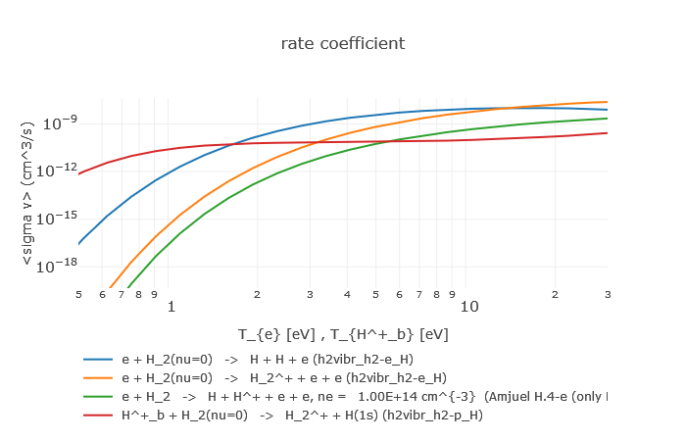
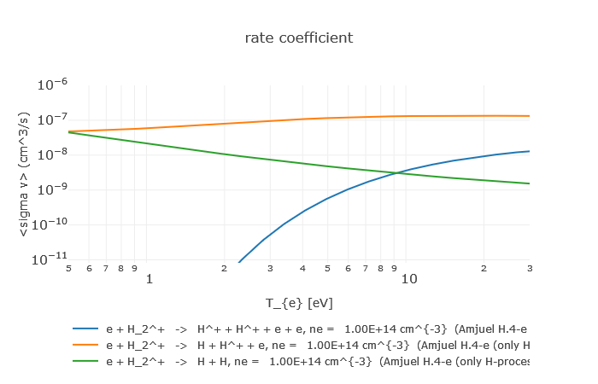
new HYDKIN: default cases- unresolved
H₂ dissociation
Heavy particles collisions dominating at low temperature
H₂⁺ dissociation
MAR/MAD competition at low temperature

Slide 12
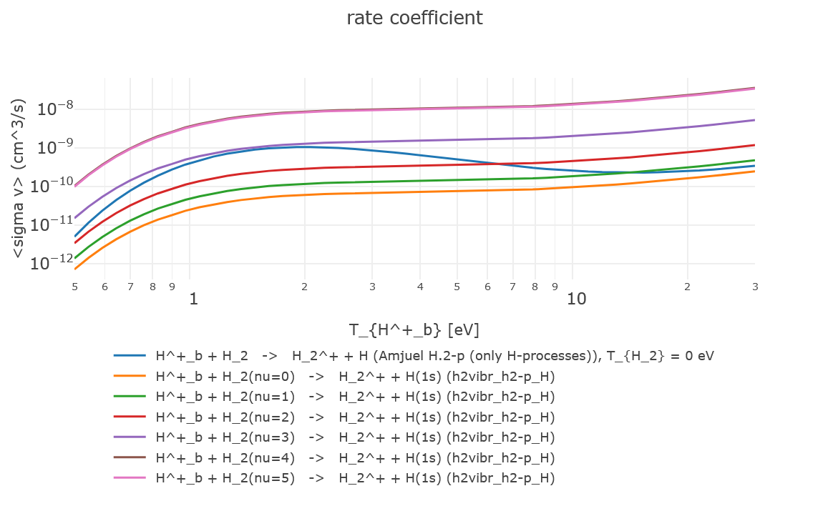
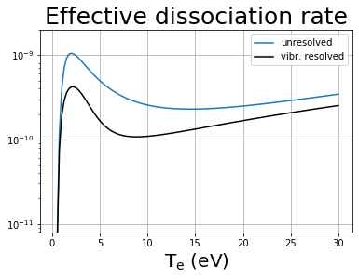
new HYDKIN: default cases- unresolved vs resolved
H⁺ + H₂ → H₂⁺ + H
H2VIBR: resolved
AMJUEL: unresolved
cm³/s
Vibrationally resolved data from H2VIBR provides a reduced dissociation rate.

Slide 13
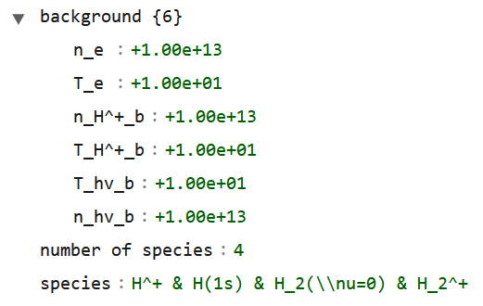
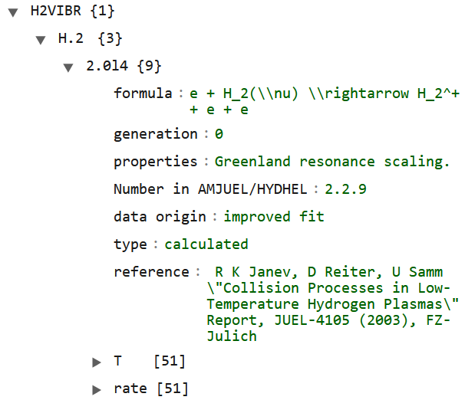
new HYDKIN: output
new json-output containing:
background parameters
selected particles
selected reactions
column values
rates
preliminary for interplay with other programs….

Slide 14
new HYDKIN: output
new json-output containing:
background parameters
selected particles
selected reactions
column values
rates
save and reload it

Slide 15
new HYDKIN: outlook
New HYDKIN:
grouping of reactions
new column/features
default cases
json output reusable for new runs
… some issues still to be solved:
electronic states
inclusion more CRMs
inclusion further databases (ADAS, IAEA, ..)
increase readability and usability
direct link with EIRENE input files → standalone HYDKIN dedicated module

Slide 16
EIRENE routines: src/file-handling
slreac: open data stream and read A&M dataset
if FILNAM= AMJUEL, HYDHEL, METHAN, H2VIBR → read_coeff., set_react._data
if FILNAM= TAB2D, ADAS → tab2d
if FILNAM= CR → colrad
tab2d: read a 2d table of A&M data and put into REACDAT structure
type(adas_data), pointer :: ap → defined in modules/eirmod_comxs
colrad: prepare usage of A&M data for internal CR code
not yet fully developed: it now just reads AMJUEL population coefficients

Slide 17
food for thought:
load data from other external databases:
tabular form: new types in eirmod_comxs → MCCC case
xml: ???
via HYDKIN…
HYDKIN:
preprocessing and EIRENE input file generation → json output
HYDKIN-dedicated module inside EIRENE → status HYDKIN_DATA type
update colrad:
internal CRM: we need data for internal state resolution!!!
HYDKIN-dedicated module is an alternative
bundle states

