Slide 1
Hybrid kinetic-diffusive methods and Monte Carlo estimators
Bert Mortier, Emil Løvbak, Giovanni Samaey
NUMA (Numerical Analysis and Applied Mathematics)
Dept. of Computer Science, KU Leuven
Tine Baelmans
Mechanical Engineering, KU Leuven

Slide 4
Diffusive scaling and fluid limit
Microscopic scale
  Particles in position-velocity phase space
  Kinetic equation for evolution of distribution
Macroscopic scale
  Moments over velocity space
  Limiting macroscopic equation, e.g., for density

Slide 5

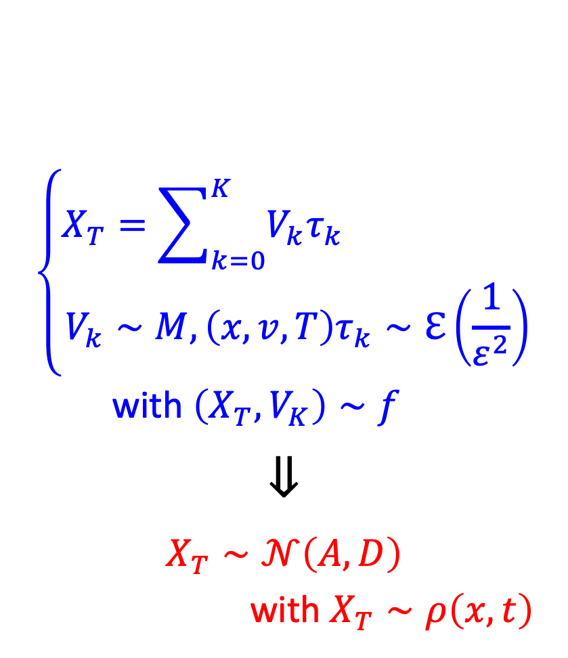


Dual description of the limiting equation
$$∂_{t}f+\frac{v}{ε}∂_{x}f=\frac{1}{ε^{2}}\left(ρM−f\right)$$
$$⇓$$
$$∂_{t}ρ−u∂_{x}ρ=∂_{xx}ρ$$
$$\left\{\begin{aligned}X_{T}=\sum_{k=0}^{K}{V_{k}τ_{k}} \\ V_{k}∼M,\left(x,v,T\right)τ_{k}∼ℇ\left(\frac{1}{ε^{2}}\right)\end{aligned}\right.$$
with $\left(X_{T},V_{K}\right)∼f$
$$⇓$$
$$X_{T}∼𝒩\left(A,D\right)$$
with $X_{T}∼ρ\left(x,t\right)$
$$ε↘0$$
$$ε↘0$$

Slide 6
Fluid limits and fluid approximation in fusion
Time-scale separation in “detached regimes” (high collision rate)
→ Fluid approximation (like the plasma) would be much more efficient!
  No fast degrees of freedom (velocities equilibrate quickly)
  No numerical noise
→ Hybrid methods
  Combine fluid approximation with a kinetic correction
  Monte Carlo only for the kinetic correction
→ Asymptotic-preserving particle methods

Slide 7
Fluid limits and fluid approximation in fusion
Time-scale separation in “detached regimes” (high collision rate)
→ Fluid approximation (like the plasma) would be much more efficient!
  No fast degrees of freedom (velocities equilibrate quickly)
  No numerical noise
→ Hybrid methods
  Combine fluid approximation with a kinetic correction
  Monte Carlo only for the kinetic correction
→ Asymptotic-preserving particle methods

Slide 8
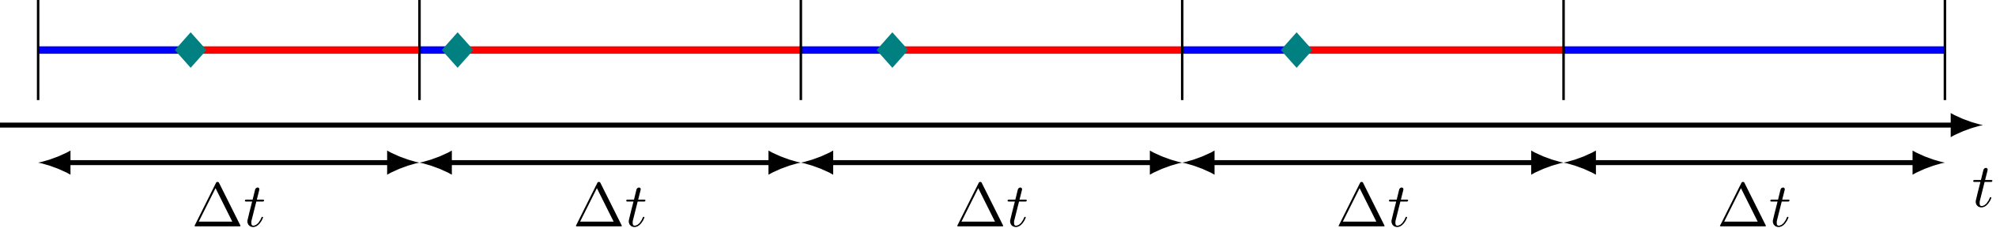
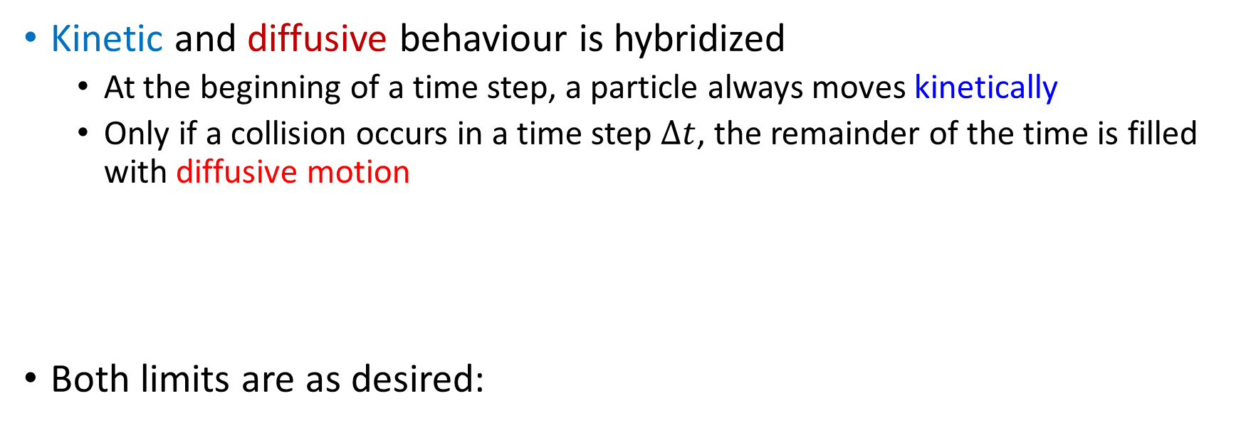
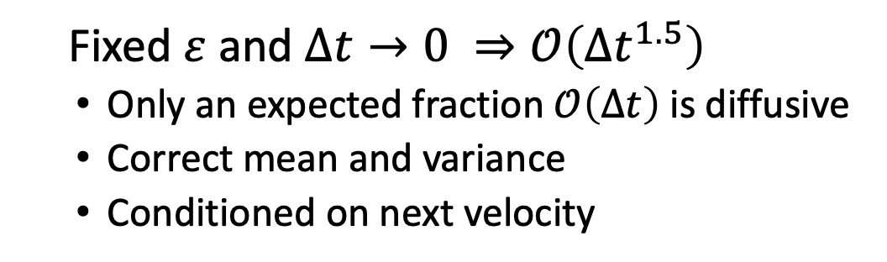
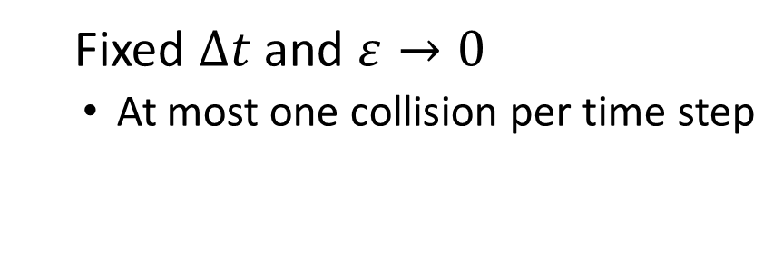
KDMC: an APMC method
Kinetic and diffusive behaviour is hybridized
  At the beginning of a time step, a particle always moves kinetically
  Only if a collision occurs in a time step $Δt$, the remainder of the time is filled with diffusive motion
Both limits are as desired:
Standard MC
KDMC
Fixed $ε$ and $Δt→0 ⇒𝒪\left(Δt^{1.5}\right)$
  Only an expected fraction $𝒪\left(Δt\right)$ is diffusive
  Correct mean and variance
  Conditioned on next velocity
Fixed $Δt$ and $ε→0$
  At most one collision per time step
Mortier, Baelmans, Samaey, A Kinetic-Diffusion Asymptotic-Preserving Monte Carlo Algorithm for the Boltzmann-BGK Model in the Diffusive Scaling, SIAM Journal on Scientific Computing 44 (2) pp. A720-A744, 2022

Slide 9
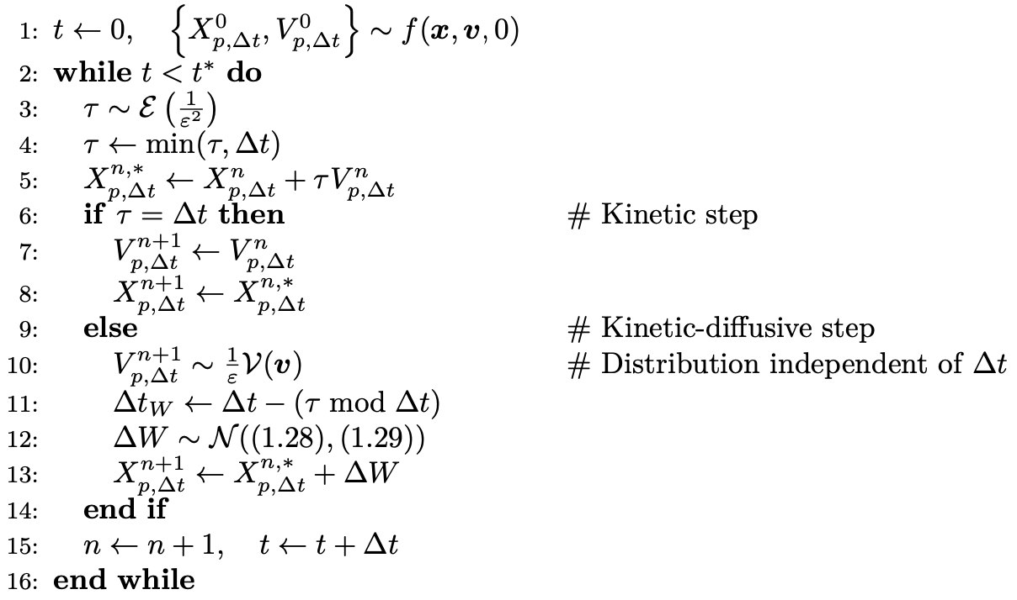
KDMC algorithm

Slide 10
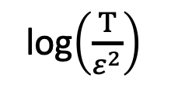
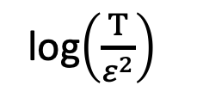
KDMC: behaviour
log(bias)
log(cost)
Standard MC
Random walk MC
KDMC
Multi-level
log$\left(\frac{T}{ε^{2}}\right)$
log$\left(\frac{T}{ε^{2}}\right)$

Slide 11
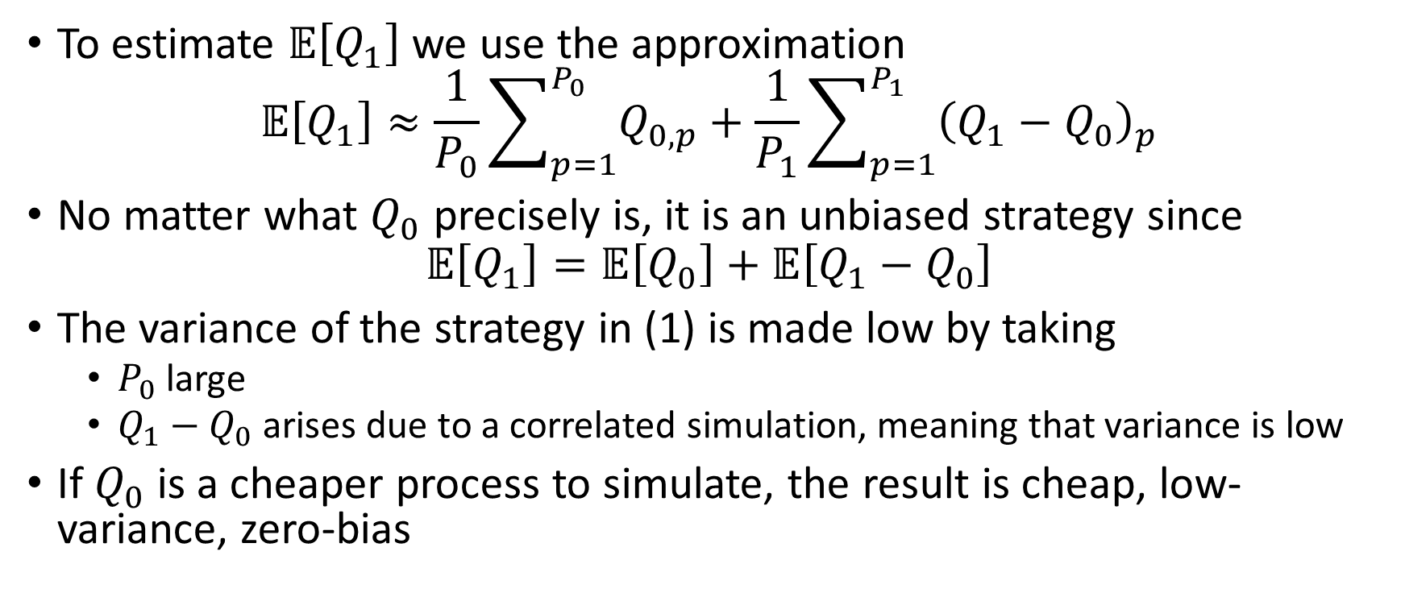
MLKDMC: control variate
To estimate $𝔼\left[Q_{1}\right]$ we use the approximation
$$𝔼\left[Q_{1}\right]≈\frac{1}{P_{0}}\sum_{p=1}^{P_{0}}{Q_{0, p}}+\frac{1}{P_{1}}\sum_{p=1}^{P_{1}}{{\left(Q_{1}−Q_{0}\right)}_{p}}$$
No matter what $Q_{0}$ precisely is, it is an unbiased strategy since
$$𝔼\left[Q_{1}\right]=𝔼\left[Q_{0}\right]+𝔼\left[Q_{1}−Q_{0}\right]$$
The variance of the strategy in (1) is made low by taking
  $P_{0}$ large
  $Q_{1}−Q_{0}$ arises due to a correlated simulation, meaning that variance is low
If $Q_{0}$ is a cheaper process to simulate, the result is cheap, low-variance, zero-bias
(1)
Mortier, Robbe, Baelmans, Samaey, Multilevel asymptotic-preserving Monte Carlo for kinetic-diffusive particle simulations of the Boltzmann-BGK equation, Journal of Computational Physics 450 pp. 110736, 2022

Slide 12
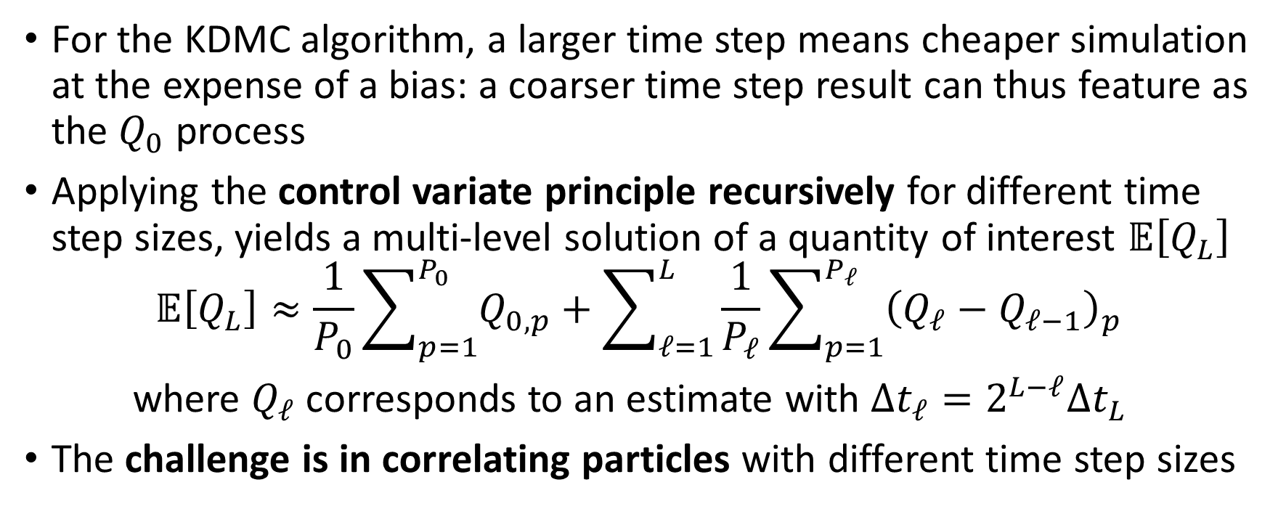
MLKDMC
For the KDMC algorithm, a larger time step means cheaper simulation at the expense of a bias: a coarser time step result can thus feature as the $Q_{0}$ process
Applying the control variate principle recursively for different time step sizes, yields a multi-level solution of a quantity of interest $𝔼\left[Q_{L}\right]$
$$𝔼\left[Q_{L}\right]≈\frac{1}{P_{0}}\sum_{p=1}^{P_{0}}{Q_{0, p}}+\sum_{ℓ=1}^{L}{\frac{1}{P_{ℓ}}\sum_{p=1}^{P_{ℓ}}{{\left(Q_{ℓ}−Q_{ℓ−1}\right)}_{p}}}$$
where $Q_{ℓ}$ corresponds to an estimate with $Δt_{ℓ}=2^{L−ℓ}Δt_{L}$
The challenge is in correlating particles with different time step sizes

Slide 13
Code structure
KDMC
sample_sum = simulate_particle_ensemble(num_particles, delta_t)
  kinetic_time, begin_position, end_position, velocity = particle.kinetic_step()
  begin_position, end_position = particle.diffusive_step(delta_t)
MLKDMC
sample_sum, square_sum = simulate_particle_ensemble(num_particles, delta_t)
  kinetic_time, begin_position, end_position, velocity = particle.kinetic_step()
  begin_position, end_position = particle.diffusive_step(delta_t)
sample_sum, square_sum = simulate_particle_pairs(num_particles, delta_t, ML_factor)
  kinetic_time, begin_position, end_position, fine_velocity = particle.kinetic_step()
  begin_position, end_position, fine_xi = particle.diffusive_step(delta_t)
  kinetic_time, begin_position, end_position, velocity = particle.dependent_kinetic_step(fine_velocity)
  begin_position, end_position, xi = particle.dependent_diffusive_step(delta_t, fine_xi)

Slide 14
Monte Carlo method for neutral particles
Neutral particles follow velocity-jump process
  Charge exchange: particle gets new velocity
    → momentum and energy source
  Ionization: particle disappears
    → mass, momentum and energy source
Stochastic process: What is being simulated?
Post-processing: What is being counted?

Slide 15
Simulation types
  Analog simulation: particles disappear during ionizations
  Collision-type simulation: weight updates on collision
  Track-length-type simulation: continuous weight update along path
Mortier, Baelmans, Samaey, A study of source term estimators in coupled finite-volume/Monte-Carlo methods with applications to plasma edge simulations in nuclear fusion, arXiv:2012.08981, 2020

Slide 16
Source term estimation: analog simulation
Analog estimation
Collision estimation
16

Slide 17
Source term estimation: non-analog simulation
Collision estimation
Track-length estimation
Next-event estimation
17

Slide 18
Set-up for analytical study: 1D0D setting
Particles have velocity ±v, with v a fixed value
The spatial domain has length L
Particles disappear due to absorption or boundary crossing
Only three parameters remain then:
  p: probability of positive velocity after a collision
  R_{t}: total collision rate
  R_{s} /R_{t} : probability of scattering collision / survival probability

