Slide 1
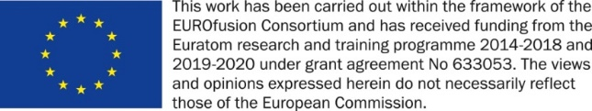



Powder metallurgy produced tungsten fiber reinforced Tungsten (W_{f}/W)
2022.08.11 I Yiran Mao, Jan Coenen, Alexis Terra, Rui Shu, Xiaoyue Tan, Chao Liu, Johann Riesch, Yucheng Wu, Christoph Broeckmann and Christian Linsmeier

Slide 2
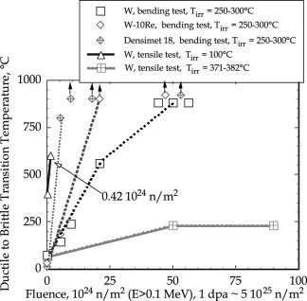
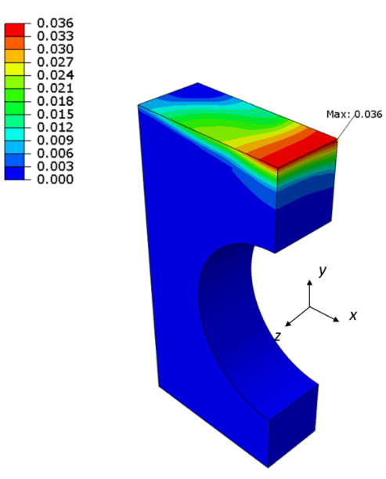
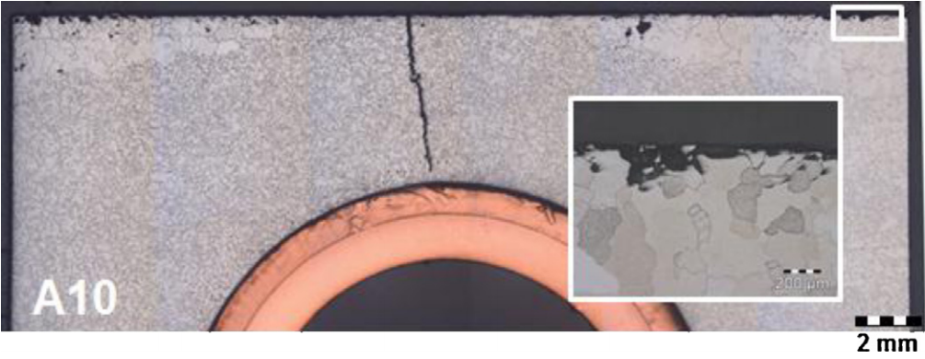
Crack formation for tungsten armor
Intrinsic brittleness of tungsten material
Thermal heat load at the divertor: thermal stress and thermal fatigue
H Bolt, et al; Journal of Nuclear Materials, Volumes 307–311, Part 1, 2002, Pages 43-52
Neutron embrittlement
G. Pintsuk et al. / Fusion Engineering and Design 88 (2013) 1858– 1861 1861
A damage resilient material is required
Accumulated equivalent plastic strain field in the tungsten armor block after the 5th HHF load cycle at 20 MW/m².
-M.Li 2015.

Slide 3
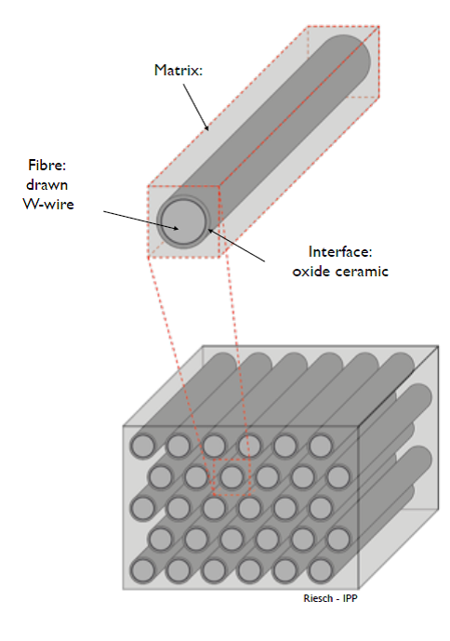
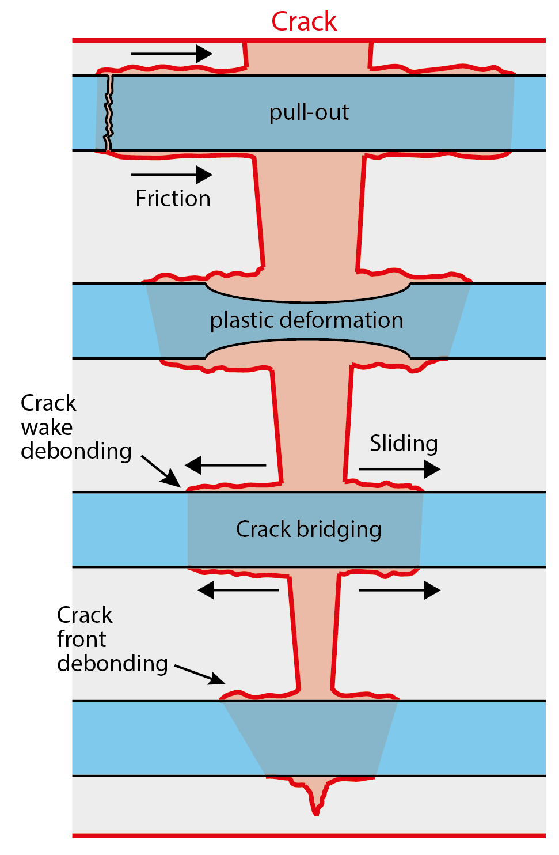
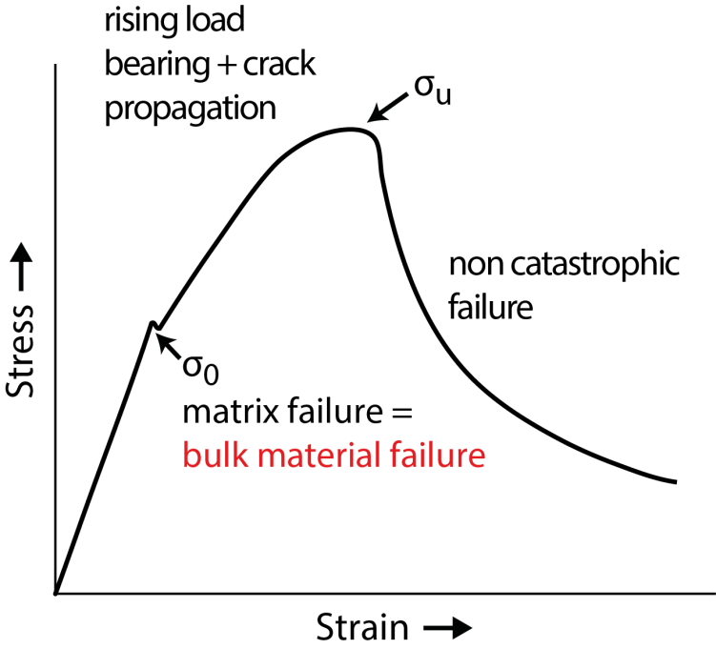
Solution: Tungsten fiber reinforced tungsten composites
Pseudo ductile behavior
Tungsten fiber-reinforced tungsten (W_{f}/W)

Slide 4
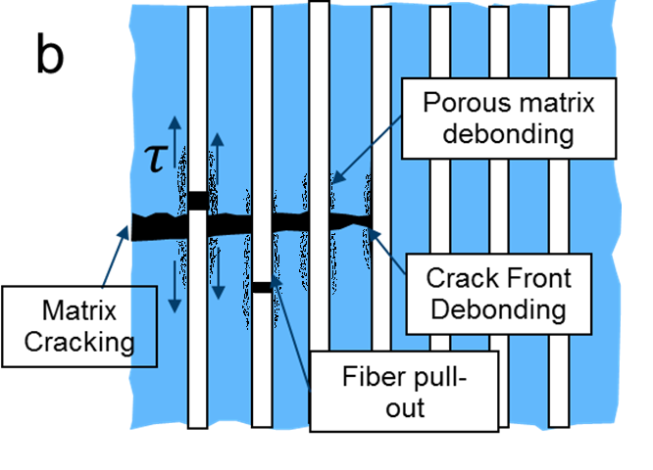

Porous matrix composites
It is the same principle like weak interface composite
a
Interface debonding
$$τ$$
Crack Front Debonding
Matrix Cracking
Fiber pull-out
“a controlled amount of fine scale matrix porosity, obviating the need for a fiber coating.
This approach can be viewed as an extension of the porous coating concept wherein crack deflection occurs because of the low fracture toughness of the porous interphase.”
Examples:
SiC/SiC
CFC

Slide 5
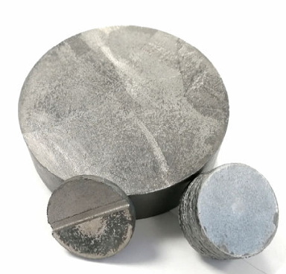
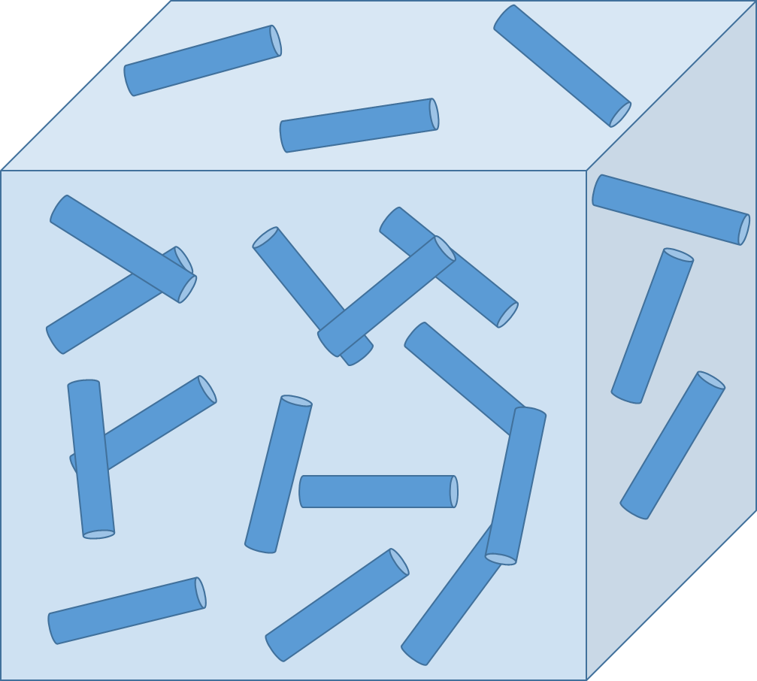
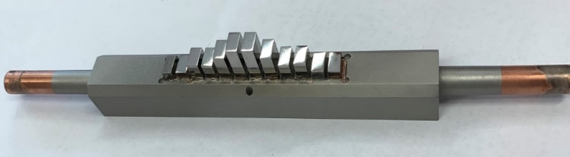
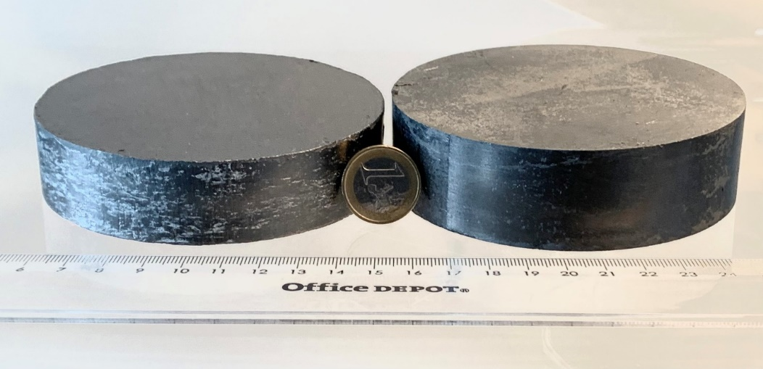
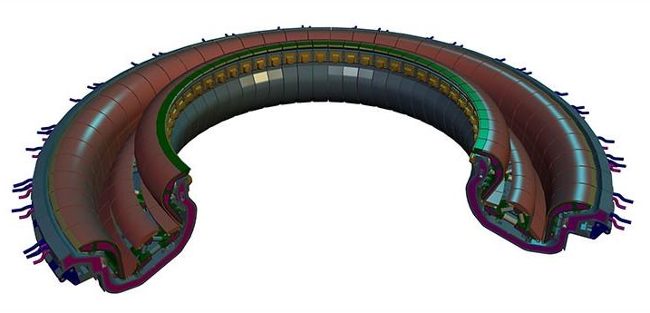
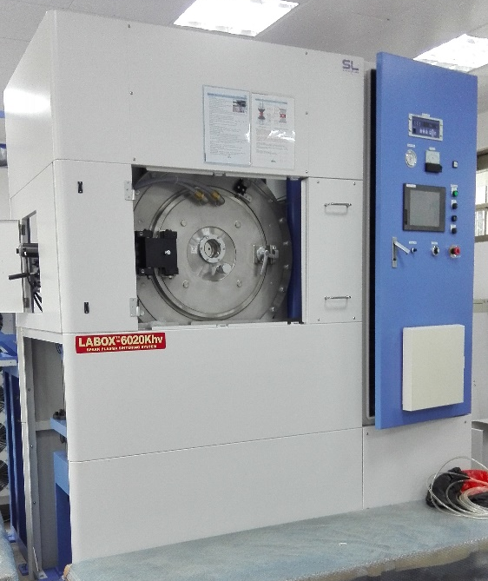
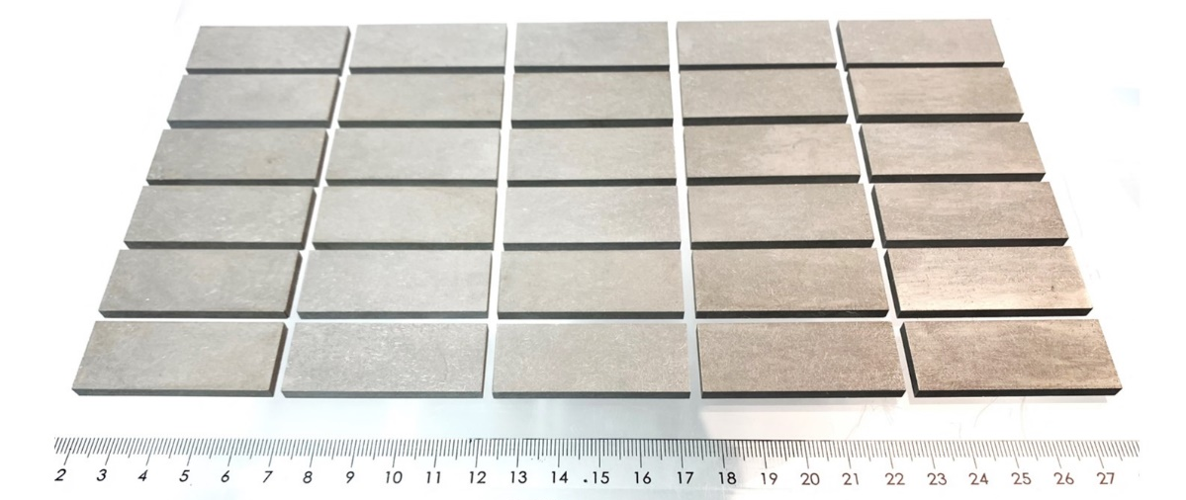


Production upscaling
Large scale FAST/SPS facility in HFUT, sample geometry up to 300 mm in diameter
Sample with a dimension of 105 mm x 30(25) mm has been produced
Large Scale PM W_{f}/W

Slide 6

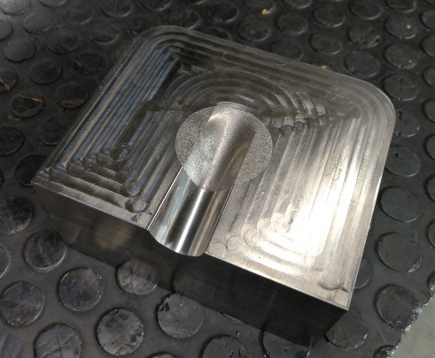
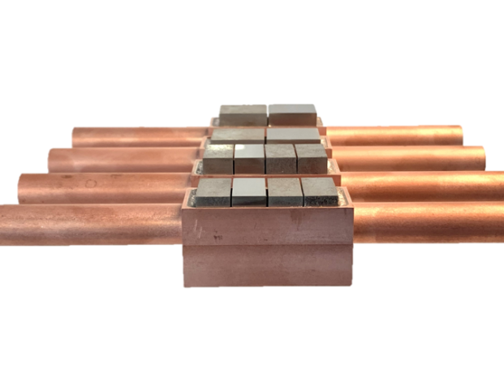

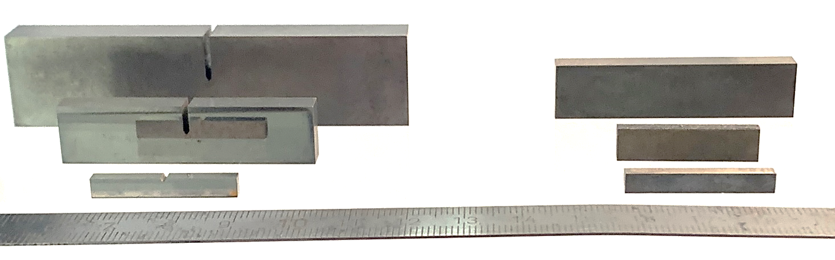

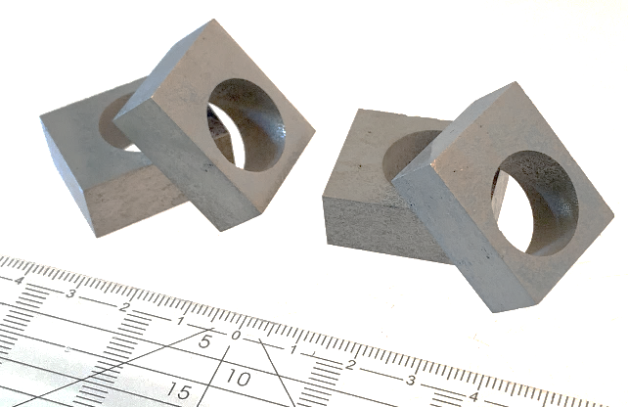
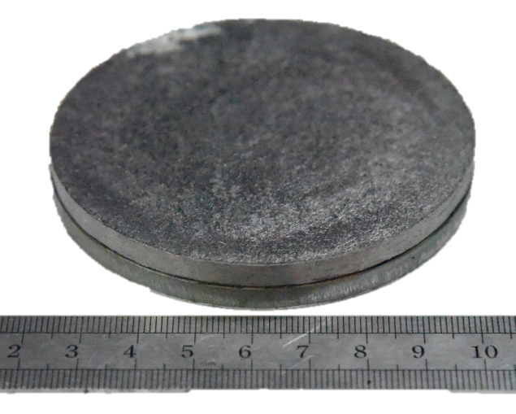
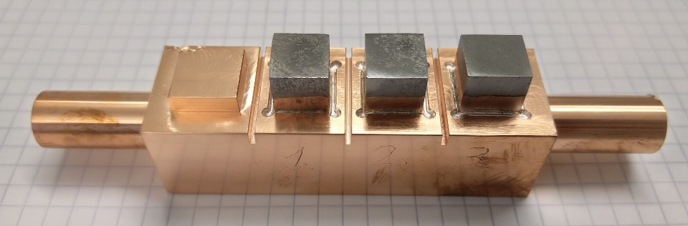

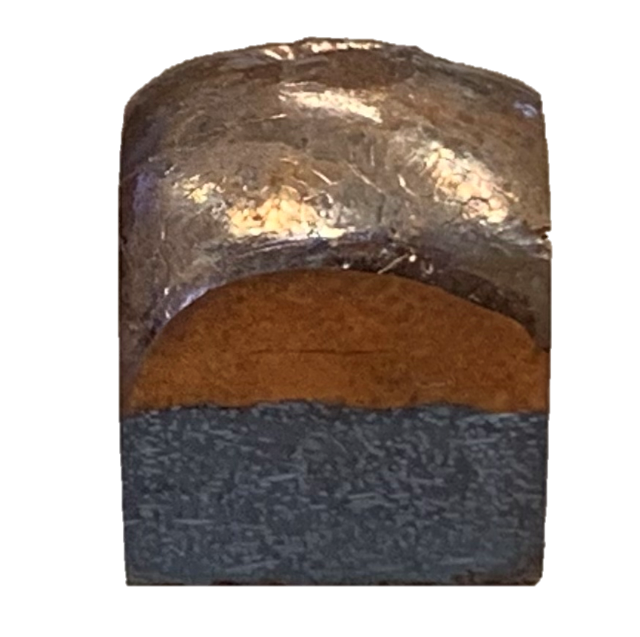
Application projects
Flat tiles design with W_{f}/W
Up to 23x28x8 mm
Mechanical tests with different size up to 84 mm x 20mm x 10 mm
W_{f}/W Application in foundry industry
Melt guiding part
W_{f}/W joint with Copper
Component design, W_{f}/W joint with steel via V
20 mm to 105 mm in diameter
Cu infiltration into the porous matrix
W_{f}/W monoblocks, 28x12x23 mm

Slide 7
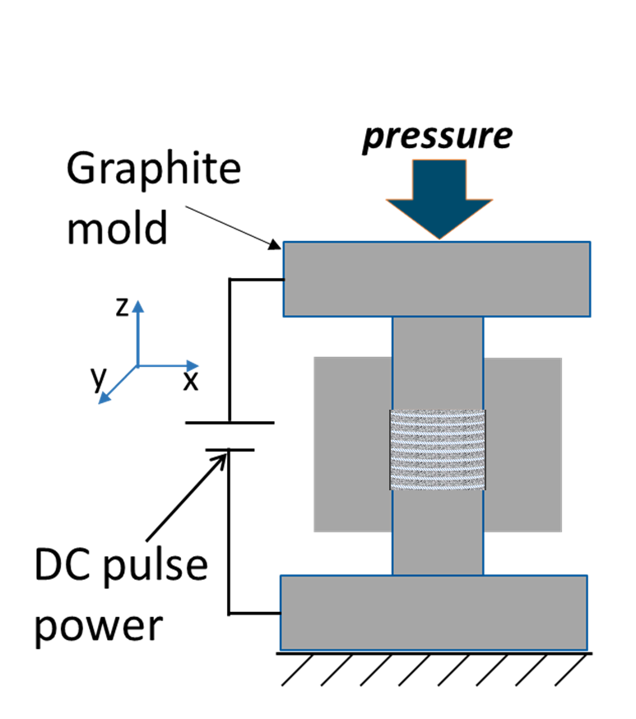
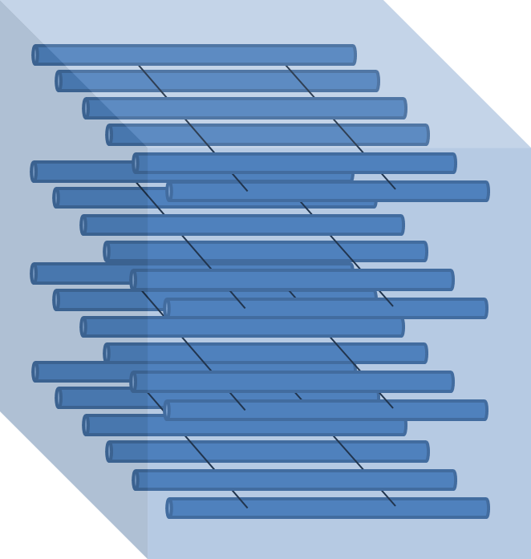
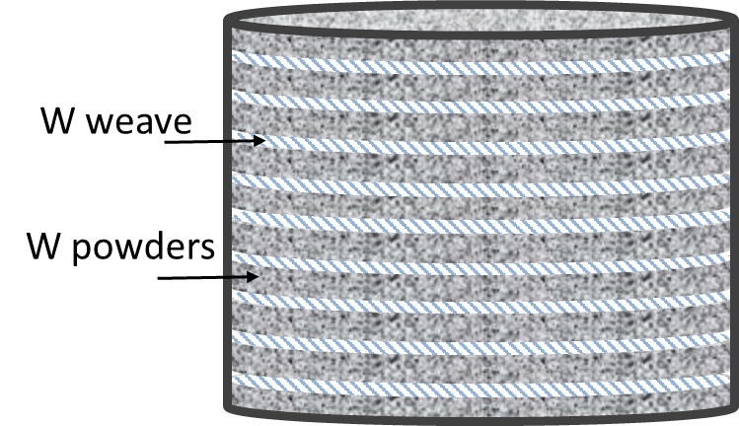
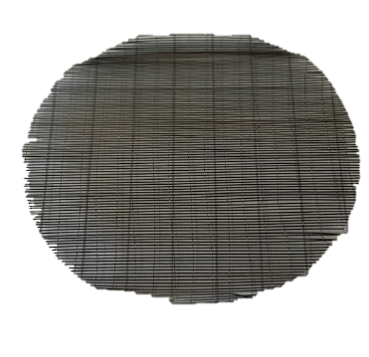
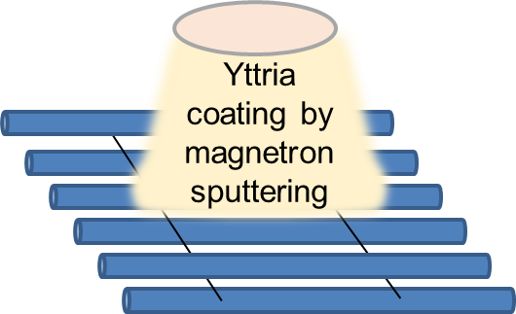
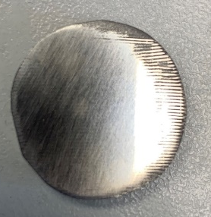
Long fiber W_{f}/W
Tungsten Weaves laser cutting and coating
Alternate placement of W weaves and W powders in the graphite tool of SPS
Spark Plasma Sintering (SPS)
Wf/W with long aligned fibers
Production

Slide 8
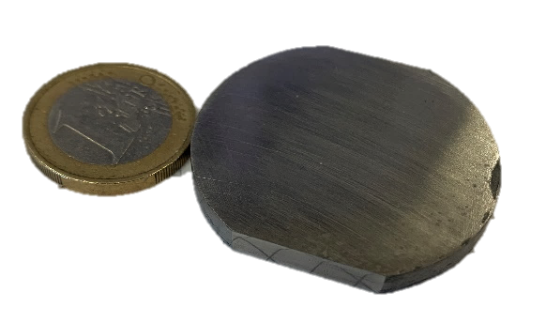
Long fiber W_{f}/W
Microstructure
50 µm
200 µm
Interface impacted by SPS process but remain intact
Fiber arrangement may need to be improved

Slide 9
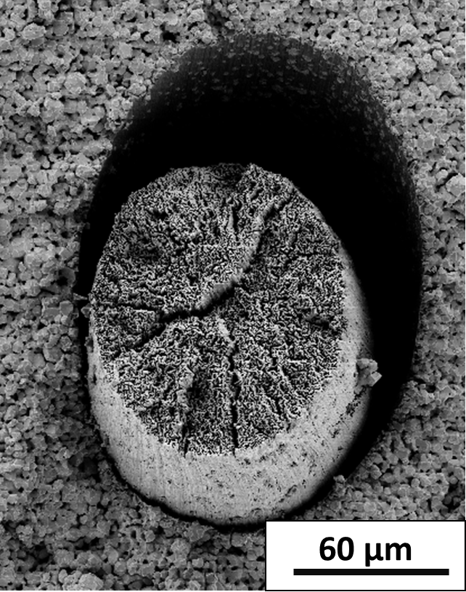
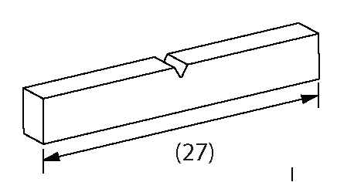
Long fiber W_{f}/W
Mechanical properties
Samples | Fracture energy density (kJ/m²) | Fracture toughness, K_{q}(MPa m^{0.5}₎ | Flexural strength (MPa)
Pure tungsten | 0.1±0.0 | 5.5±0.0 | 381±46
W_{f}/W | 1.9±0,7 | 25.5±7.8 | 221±17
Porous matrix W_{f}/W | 3.3±1.0 | 21±7.1 | 235±10
Long fiber W_{f}/W | 11.6±3.1 | 67.6±15.0 | 495±78
Long fiber W_{f}/W show more promising mechanical properties compared to short fiber W_{f}/W

Slide 10
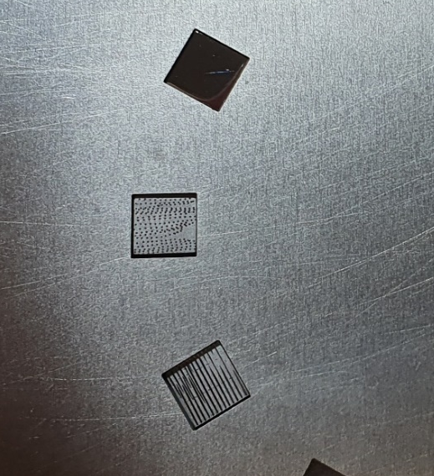
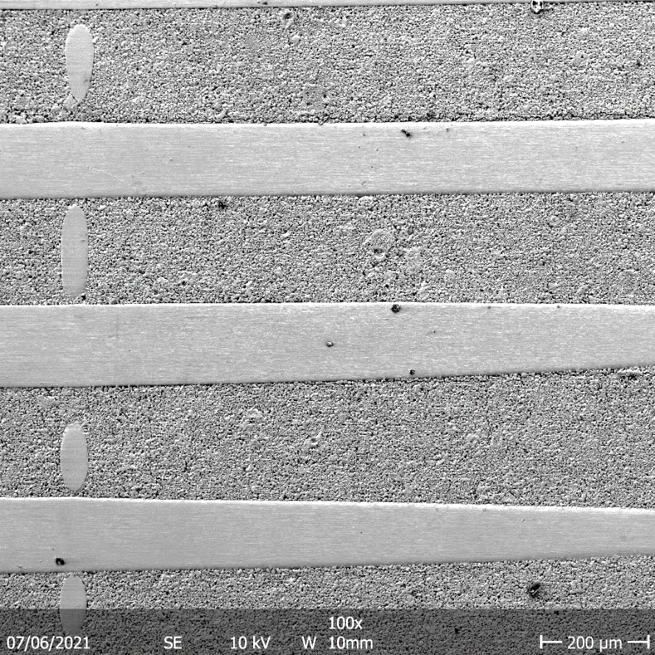
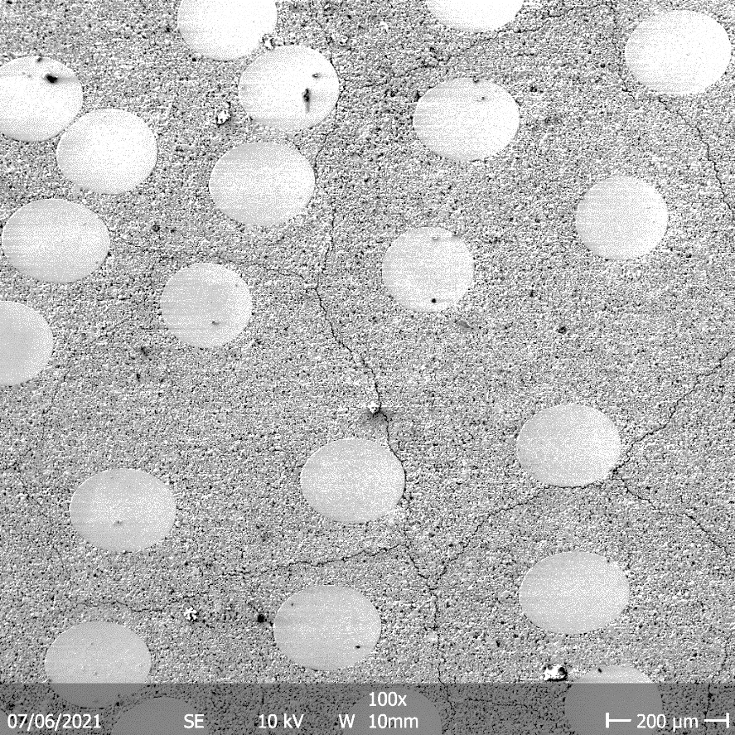
Long fiber W_{f}/W
Thermal shock
Fiber vertical to the loading surface
Fiber parallel to the loading surface
Loading condition
Labs = 0.38 GW/m², Tbase = RT, n = 100 pulses
After the loading: crack bridging by the fibers

Slide 11

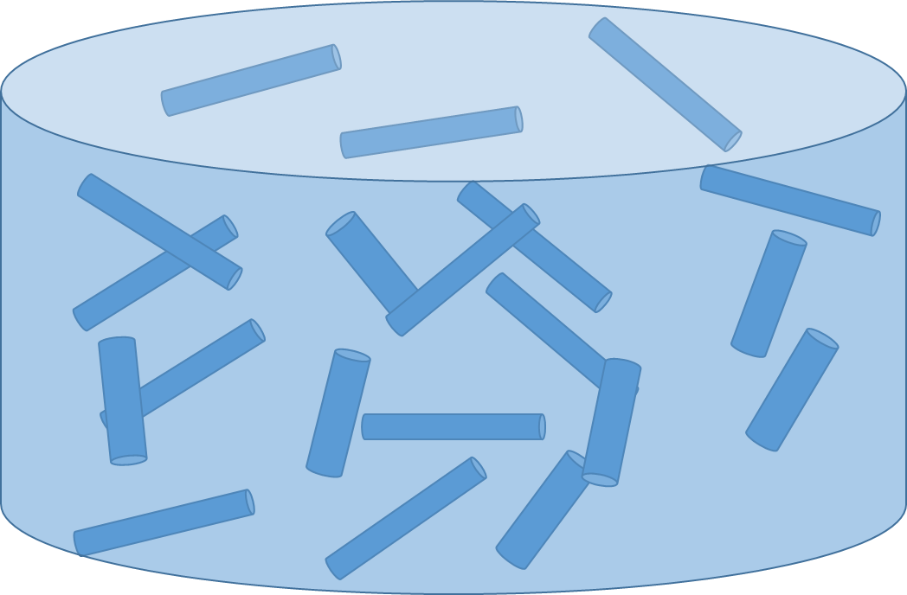
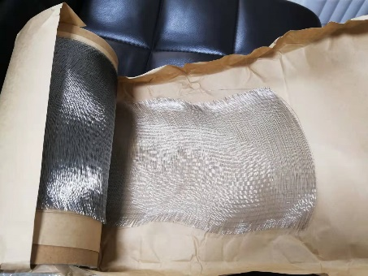
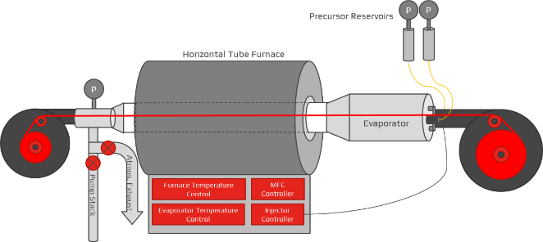
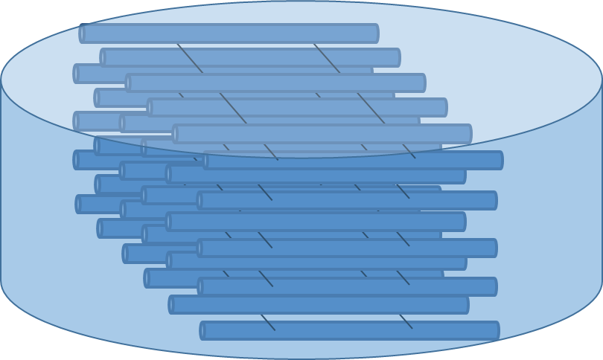

Development outlook
-From several kilograms to hundred kilograms
Typical samples
3mm
105 mm x 30 mm, 4.5 kg
105 mm
Typical samples
1-3mm
105 mm x 10-30 mm, 1.5-4.5 kg
105 mm

Slide 12
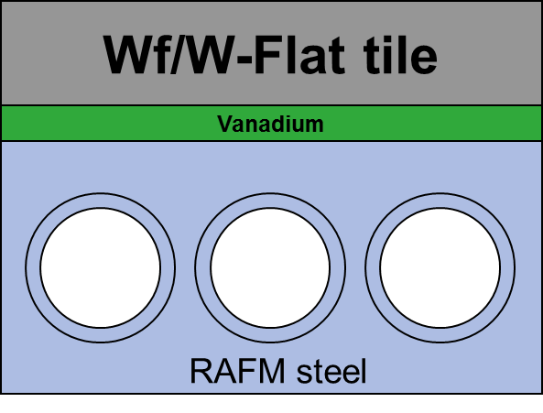
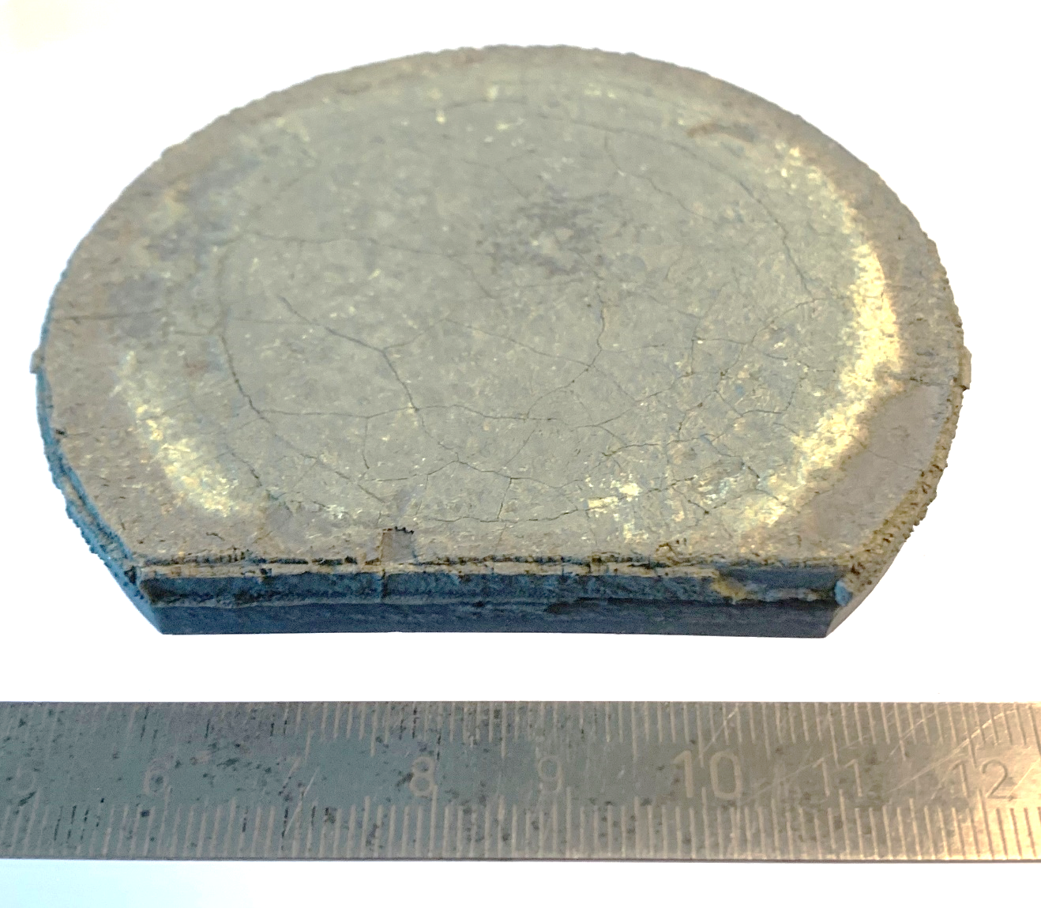
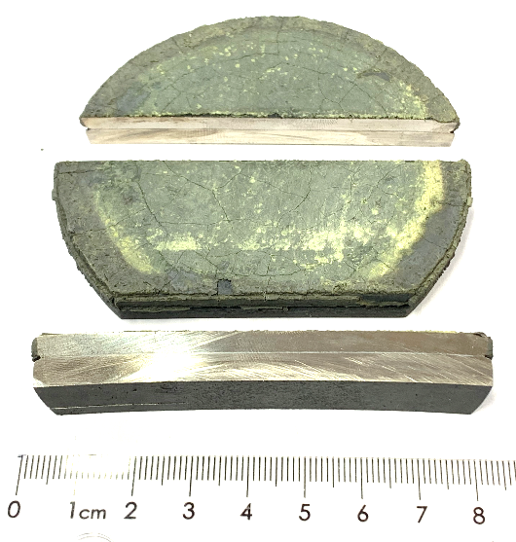
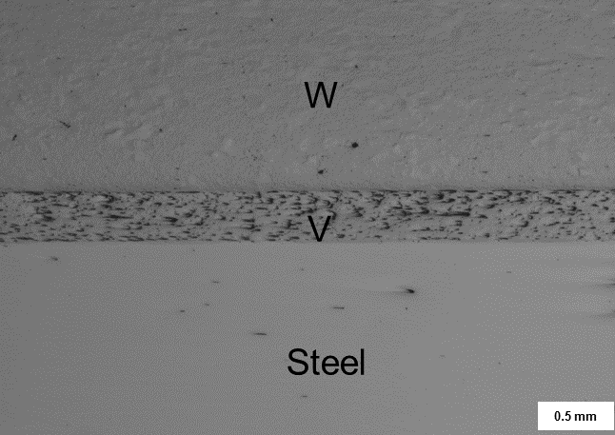
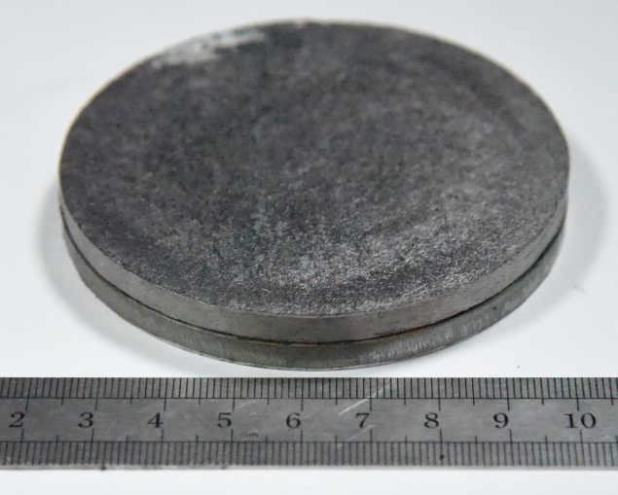

W_{f}/W
For Flat Tile Applications incl. Joining
parameters
Temperature | 850°C
Pressure | 30MPa
Holding time | 15min
Heating rate | 25 K/min
Cooling rate | 5 K/min
Test of Residual stresses and stress during quenching – utilize steel to maximze stresse
W_{f}/W- 5 mm
V - 0.3 mm
316L - 5 mm
Vanadium as stress relieving interlayer
Heated to 1000°C
Quenched at 4°C

Slide 13
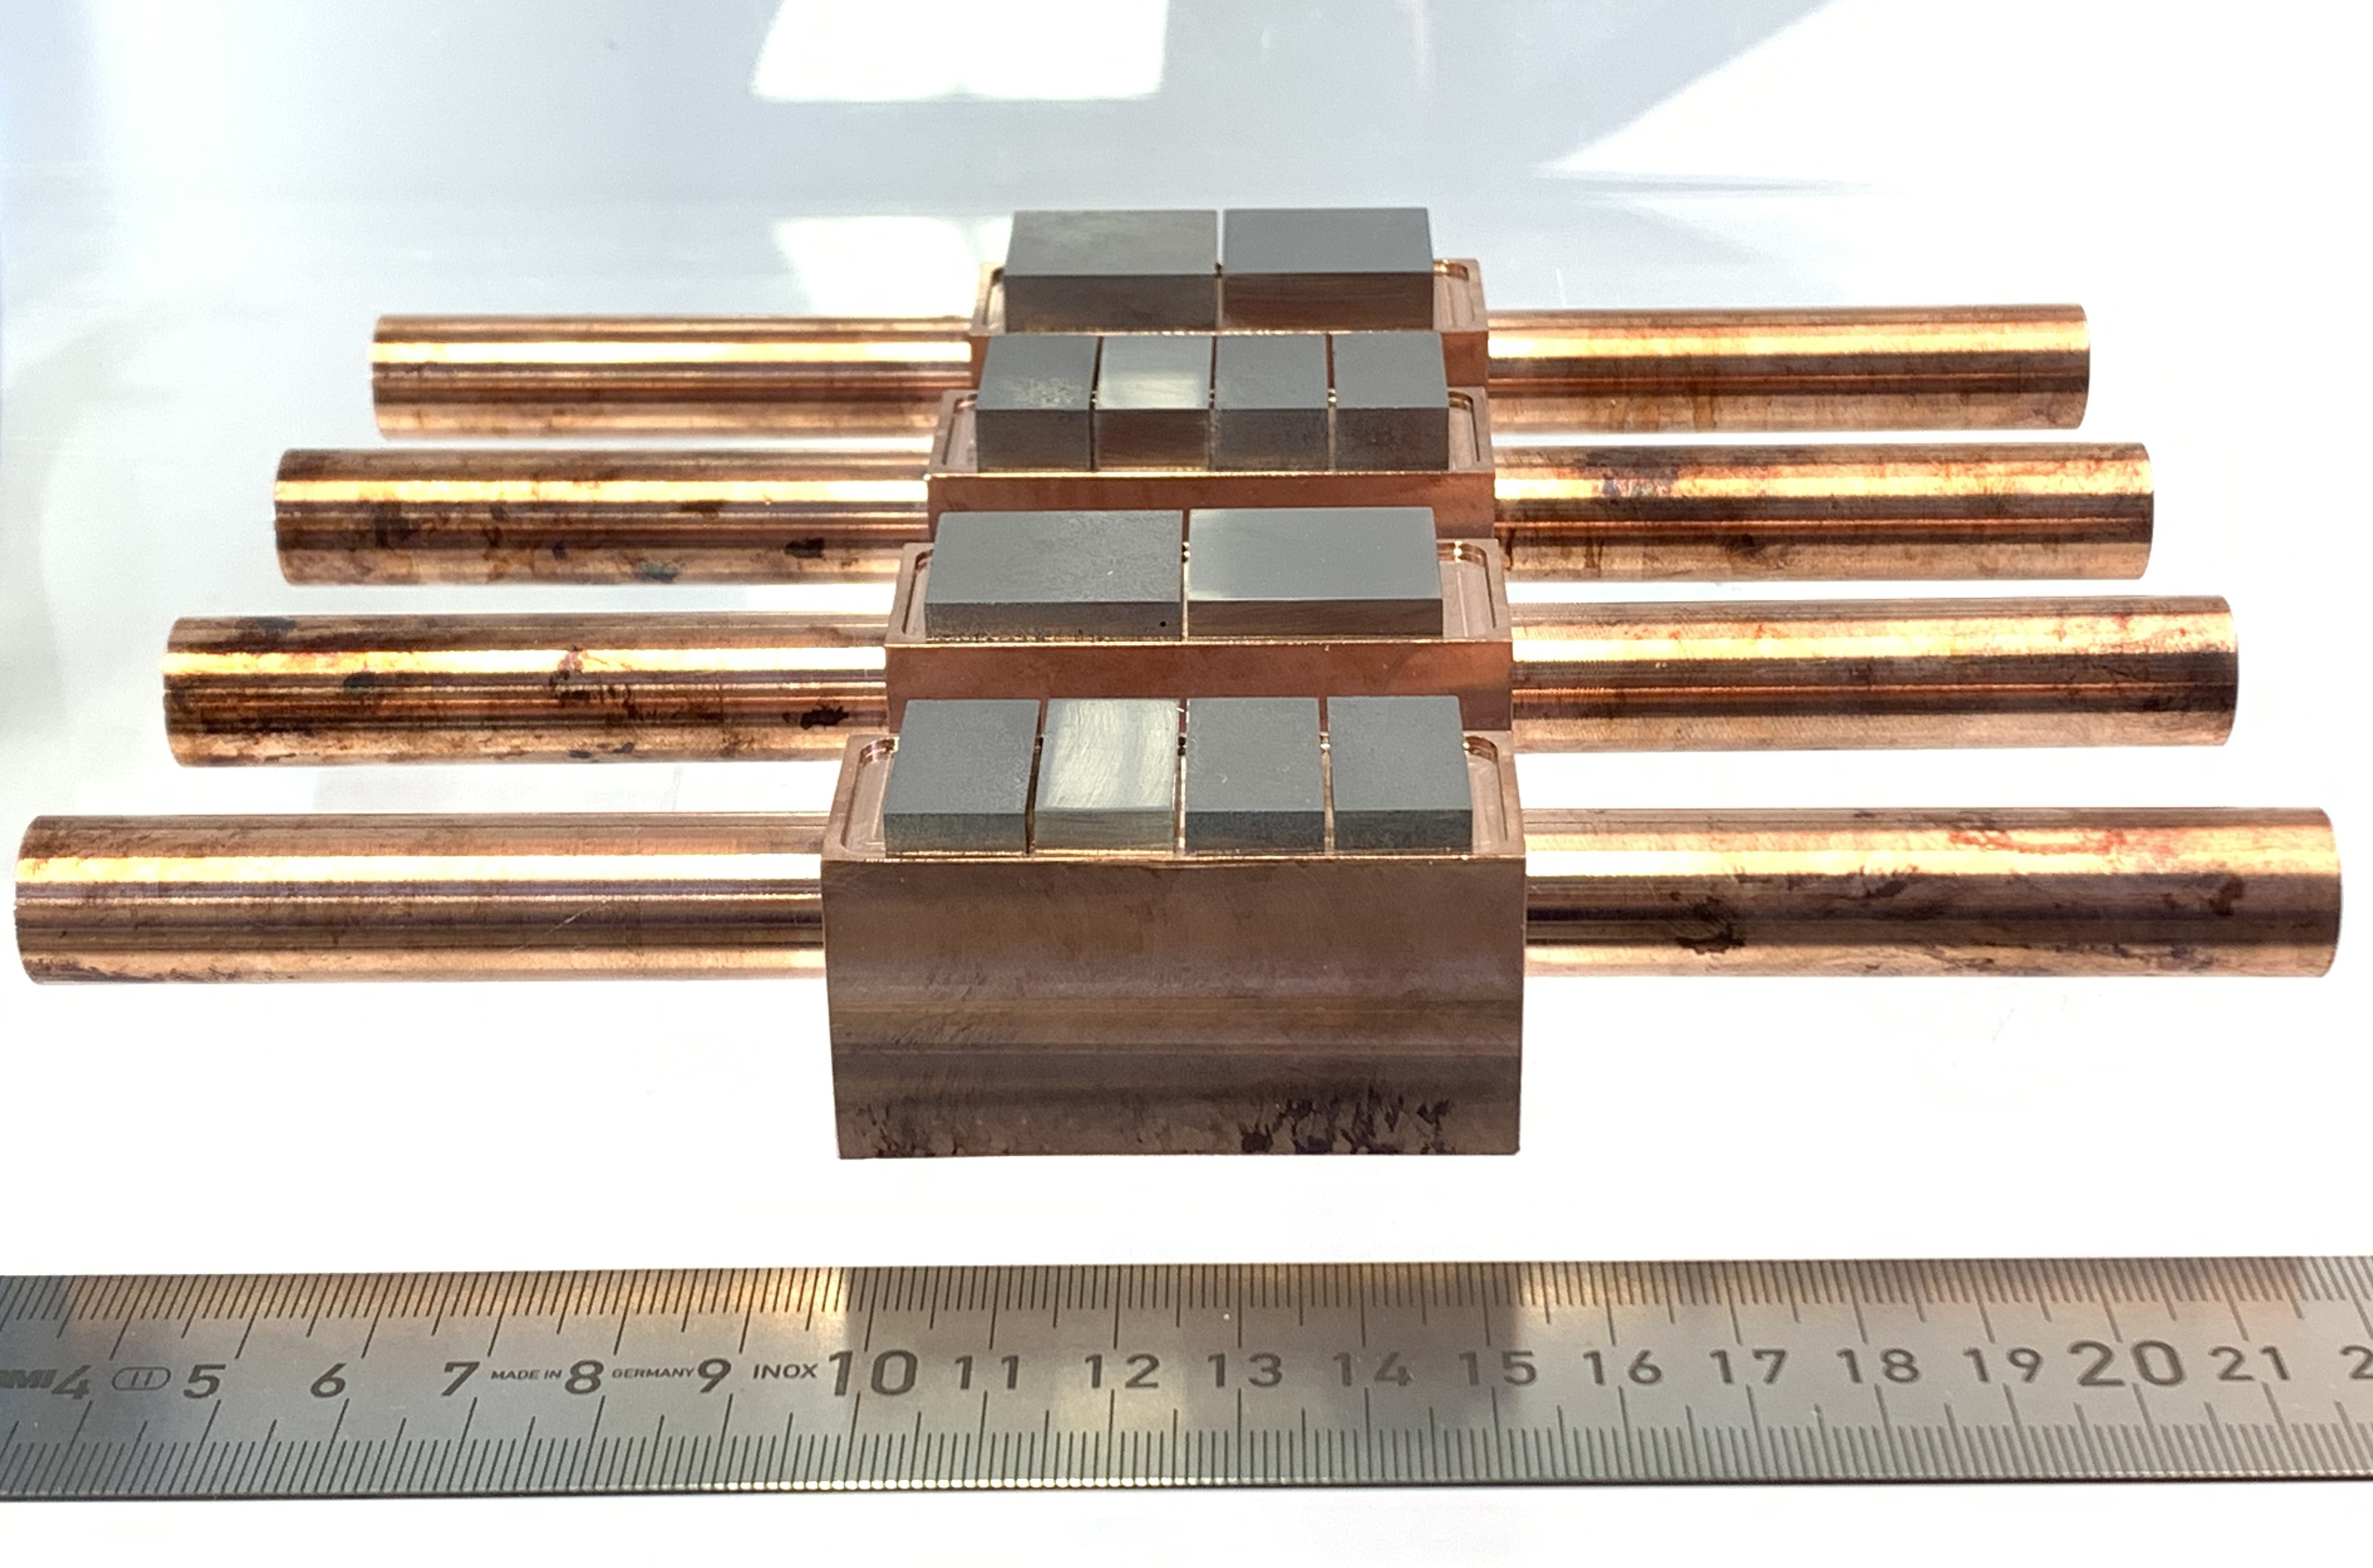
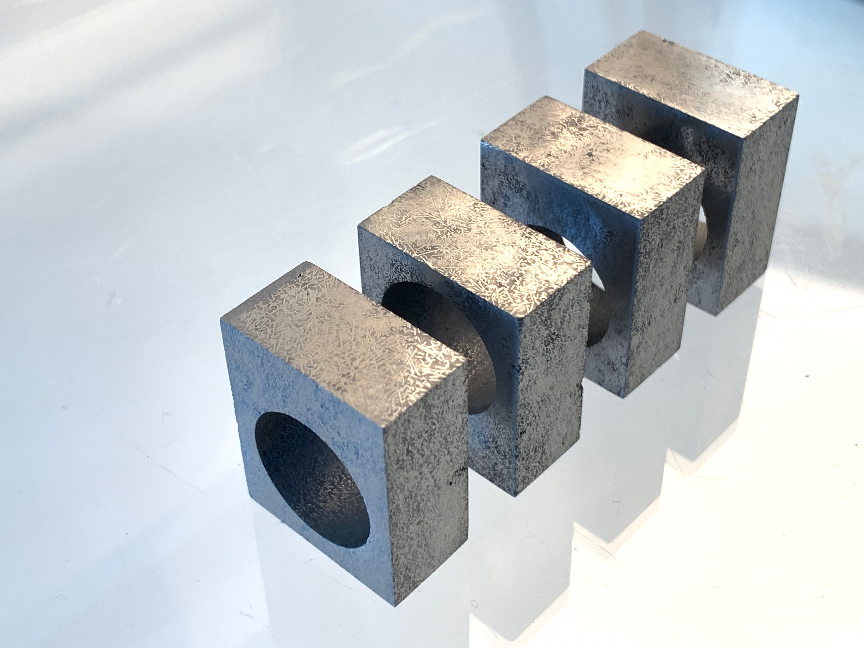

Mock Ups for Gladis Testing
Material produced and Cut – joining underway
Joining at FZJ
Joining at ENEA

Slide 14
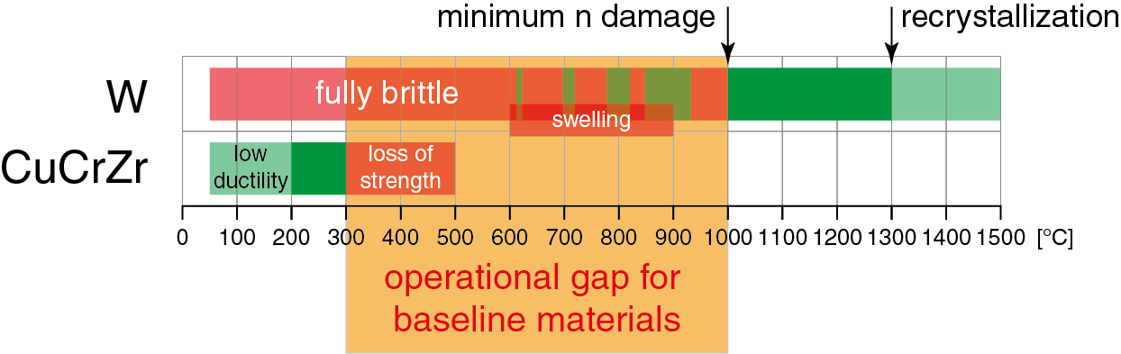
Operational Window
Of W_{f}/W
Crack resistance at low temperatures
High strength at elevated temperatures and high heatfluxes
Based on: Zinkle, S. J. & Busby, J. T.
Structural materials for fission amp; fusion energy Materials Today , 2009, 12, 12-19
Tokamak Energie Ltd: Cyclic testing at minimum 10 MWm⁻² up to 1000 cycles, 60s on/off.

Slide 15

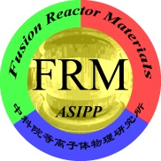
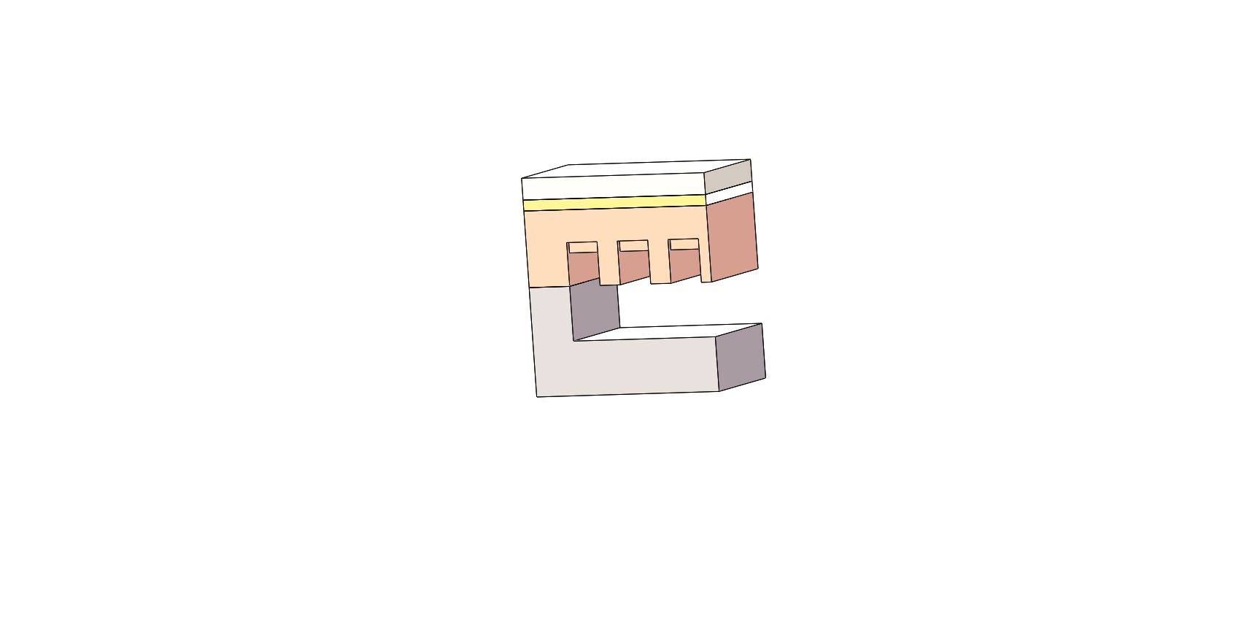
Finding an Application of the Material
Tungsten Flat-Tile
20 MW/m² Tmax：1060℃
W
W/Cu FGM or WfCu
For a Composite Material a dedicated wayof solving problems or adding operational space can be found
E.g allow operating W_{f}/W above 1500 ºC
Stable properties during irradiation
No need for monoblock – joining W_{f}/W & Wf/Cu
CuCrZr or
novel Cu alloy
RAFM
Cooling water: 150 ℃, 16m/s, 5 MPa
G.N.Luo ( ICFRM 2019)

Slide 16
Advanced Concepts
What goes beyond what exists
W_{f}/W
W_{f}/W
CVI produced W_{f}/W with infiltrated copper Coolant (missing proof of principle)
Complet Wf/W based component CVI / PM
With 3D weaves – needs development
W_{f}/W
W_{f}/W pure W
Utilizing µ-structure tungsten as armour

Slide 17
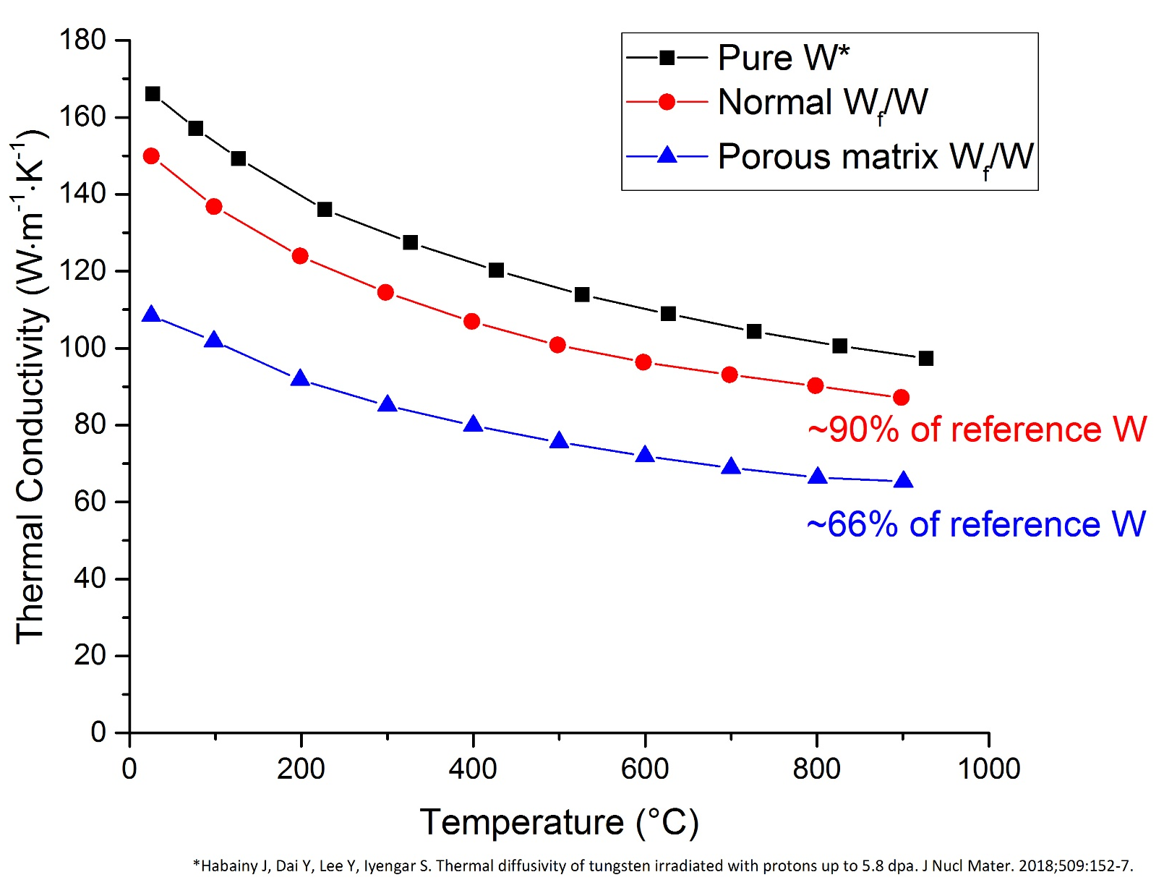
Thermal conductivity

