Slide 1
PWIE-SP A.3.T – plans for 2022 Performance of advanced materials under high heat loads and their microstructural characterization & Effect of hydrogen on the strength of W wire
J. Riesch^{*,a}, Y. Mao^{b,c}, A. Lau^{b}, A. Feichmayer^{a,e} B. Böswirthª, S. Elgetiª, H. Greunerª, T. Höschenª, J.W. Coenen^{b,d}, and R. Neu^{a,e}
ªMax-Planck-Institut für Plasmaphysik, 85748 Garching, Germany
^{b}Forschungszentrum Jülich GmbH, Institut für Energie- und Klimaforschung – Plasmaphysik, 52425 Jülich, Germany
^{c}School of Mechanical Engineering, Hefei University of Technology, Hefei 230009, China
^{d}Department of Engineering Physics, University of Wisconsin - Madison, Madison, WI53706, USA
^{e}Technische Universität München, 85748 Garching, Germany
Notes:
20 min + 3 min Diskussion

Slide 2
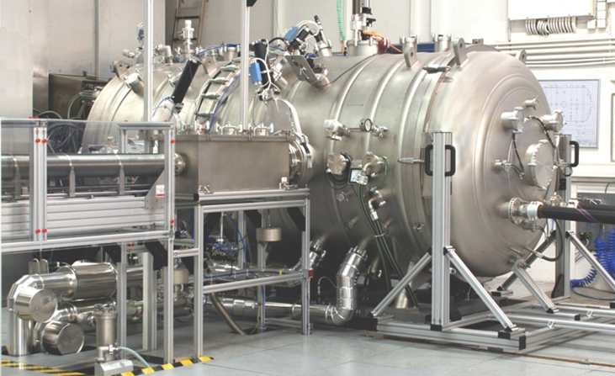
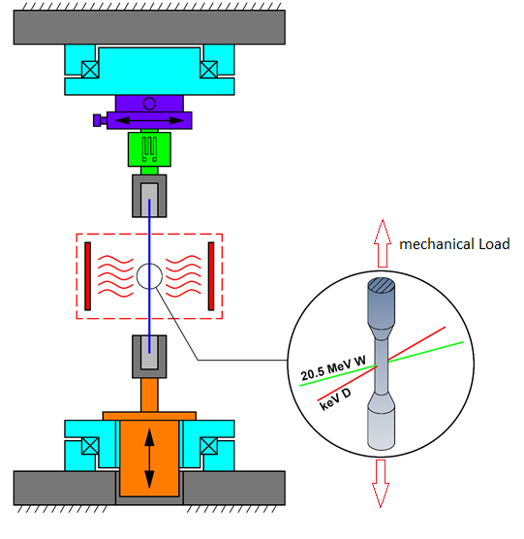
PWIE-SP A.3.T – plans for 2022
Performance of advanced materials under high heat loads and their microstructural characterization
Use high heat flux facility GLADIS at IPP, Garching
Test advanced W composite based mock-ups until its limits
Microstructural evaluation by light and electron microscopy
Effect of hydrogen on the strength of W wire
Use in-situ testing device GIRAFFE at IPP, Garching
Use keV H/D beam to load very thin W wire
Evaluate change of stress state due to uptake of H/D
Garching LArge DIvertor Sample test facility [Greuner et al. J NUCL MATER 367-370,(2007) 1444-1448]
General-purpose irradiated fiber and foil experiment
Rotary stage
Load cell
Sample
Heating / Cooling
Linear actuator
Rotary stage

Slide 3
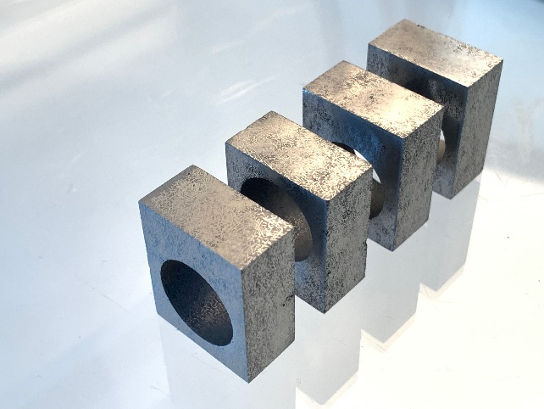
High heat flux tests – new mock-ups
Mono-Block concept according to WPDIV
Manufacturing within WPMAT in collaboration with ENEA
Aim: direct comparison to conventionsl W materials
Status: blocks cut, manufacturing of mock-up on- going
Large scale flat-tile mock-ups
Aim: investigate the effect of size on the performance of W_{f}/W composite mock-ups → does the composite concept allow for larger flat tile sizes?
Status: tiles cut and soldered, final machining of mock-ups on-going, pre-characterization planned in September, first tests planned in October

Slide 4
Effect of hydrogen on strength
Plasma source installed at GIRAFFE and tested
ECR ion gun (Tectra Gen II)
energy range of 25 eV – 5 KeV, total beam current of 1mA (at 5 kV)
e.g. 1x10¹⁸ D ions / m²s at 300 eV
Hardware adoptions in progress
guiding pipe, beam sensors, …
First tests planned for October
Stress relaxation by D
load sample to dedicated load and hold it there
load sample with D beam and monitor load
Midterm: investigate synergies between D effect and irradiation damage
Giraffe (General-purpose irradiated fiber and foil experiment)
Rotary stage
Load cell
Sample
Heating / Cooling
Linear actuator
Rotary stage

