Slide 1
SP1.3 Contribution of SCK•CEN
Dmitry Terentyev - AUG/2022

Slide 2
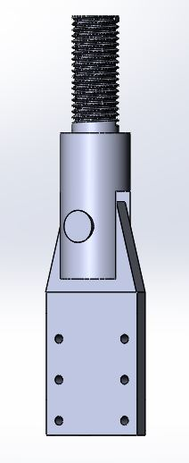
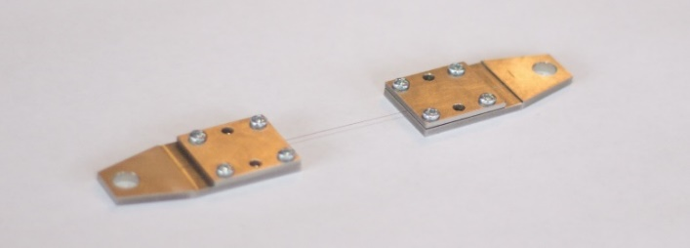
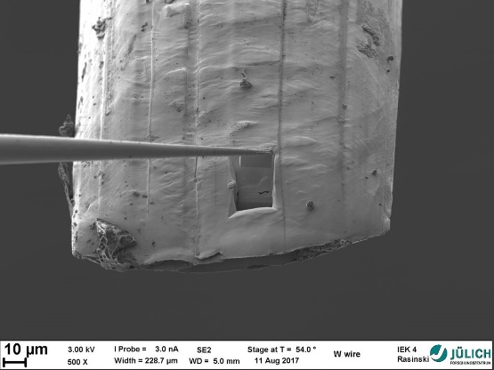
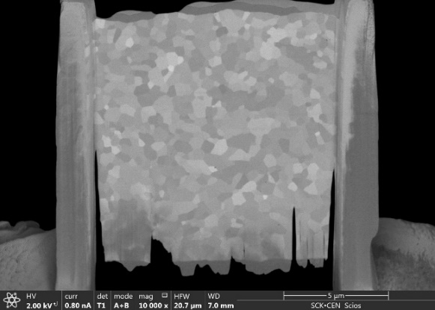
Work plan for 2021-2025
Investigate effect of high- and low- temperature neutron irradiation in W fibers and W yarns/braids. K-doped fibers should be considered.
  Tensile strength
  Microstructure
Strategy:
  Develop tensile testing procedure in hot cells
    For 145 µm wire
    For relevant braids/yarns
  Irradiation
    Temperature= low (50-70), 300-400, 600, 800, 1200°C
    Damage level = 0.15-0.2; 0.5, 1 dpa
  Post Irradiation examination
    Tests in the temperature range RT-600°C
    SEM
    FIB + TEM/APT (up to interest of other collaborators)

Slide 3
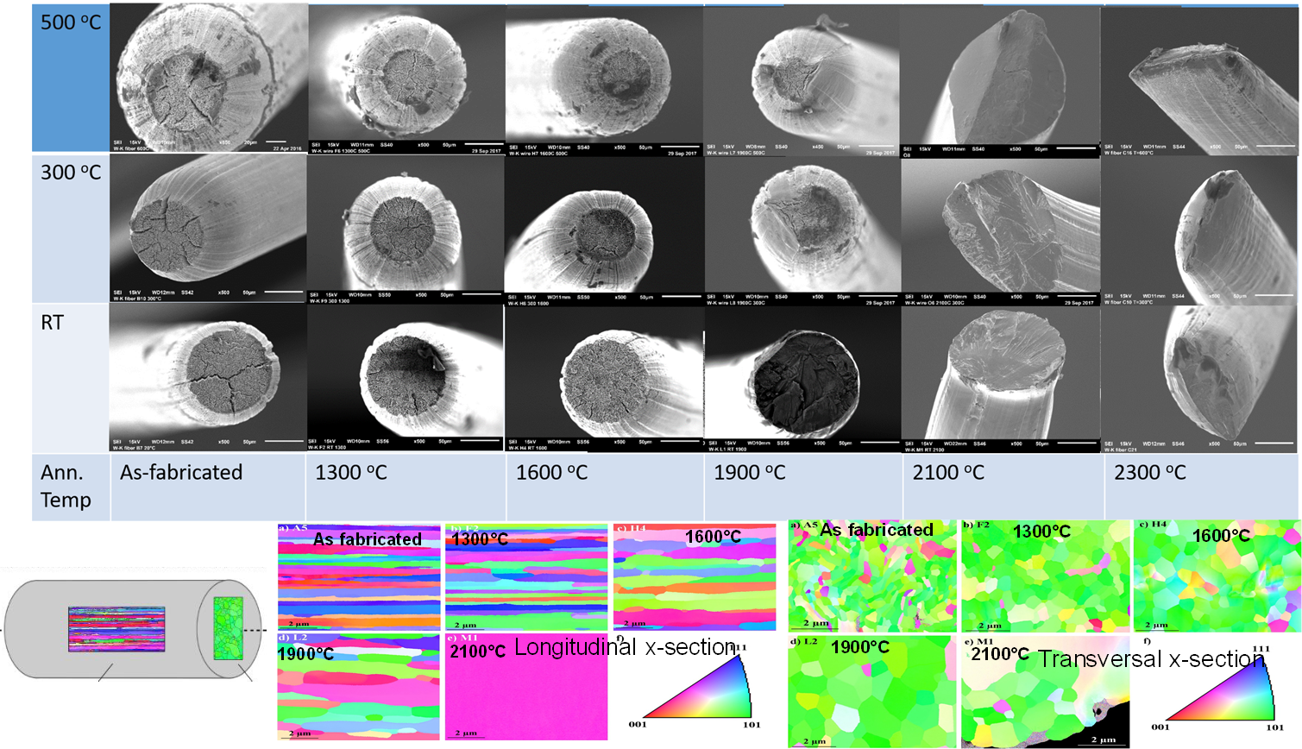
Summary of activities over FP8 period
Tensile testing of individual wires
Effect of high-T annealing on wire strength & ductility
Morphology of wire microstructure vs. annealing temperature
Fracture modes of wires vs. T_{anneal}
Testing of Wf-W composites
Effect of neutron irradiation on Wf-W
composites
Microstructure of as-irradiated Wf-W
composites

Slide 4
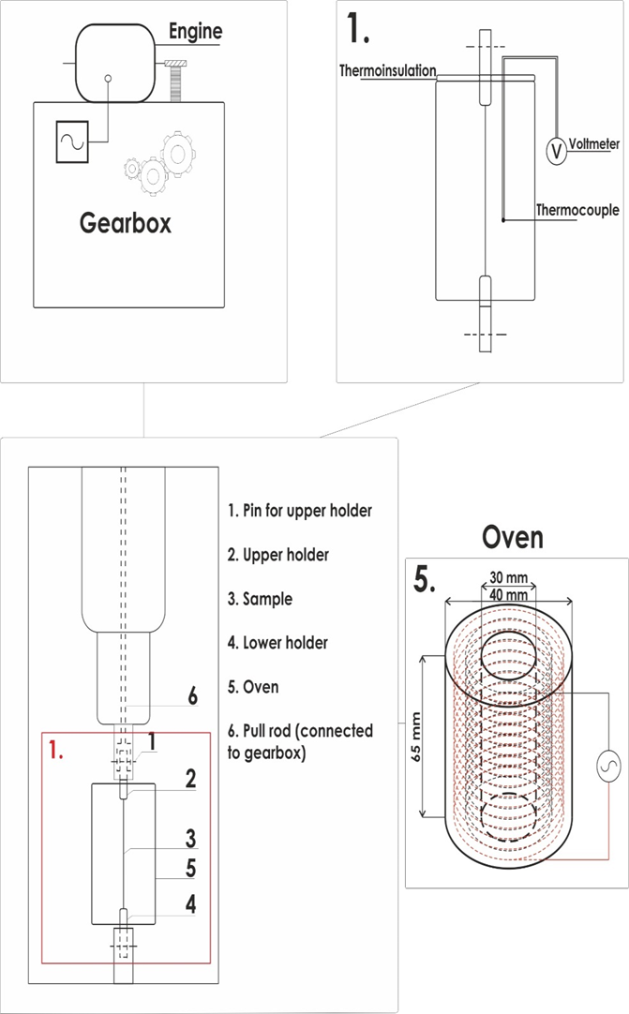

Proposal to use bending tests with small-punch stage, explain the available standard and what can be extracted
In FP8, strength and ductility of W fibers was assessed by tensile testing
Fixing the wire needs carful manual operation
Performing such fixation in Hot Cell is challenging
We suggest to perform “bend-like” test because
  Sample mounting is much easier (robust)
  Test mode should allow to reveal UTS and DBTT
  For macro-samples, EN standard is issued

Slide 5
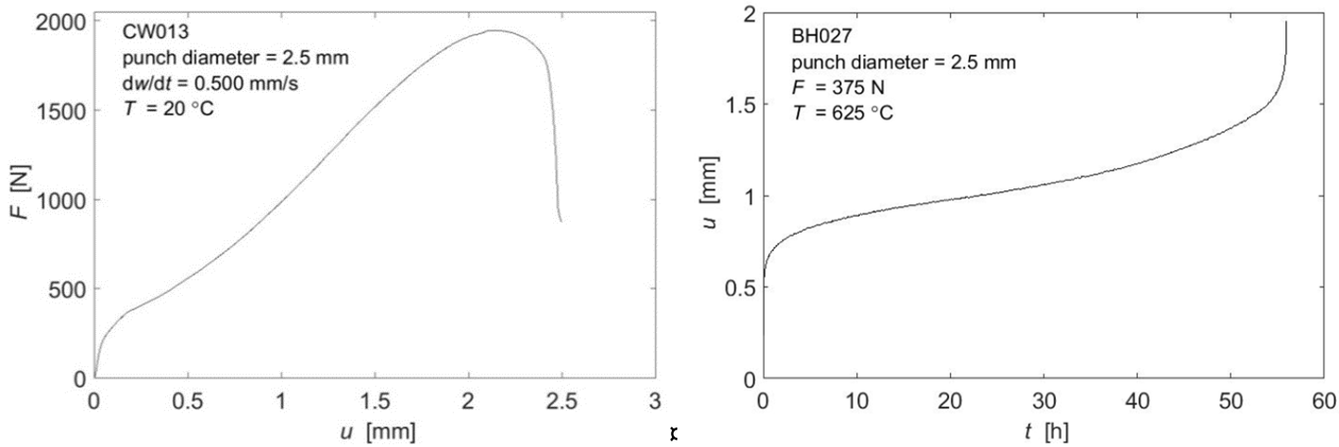
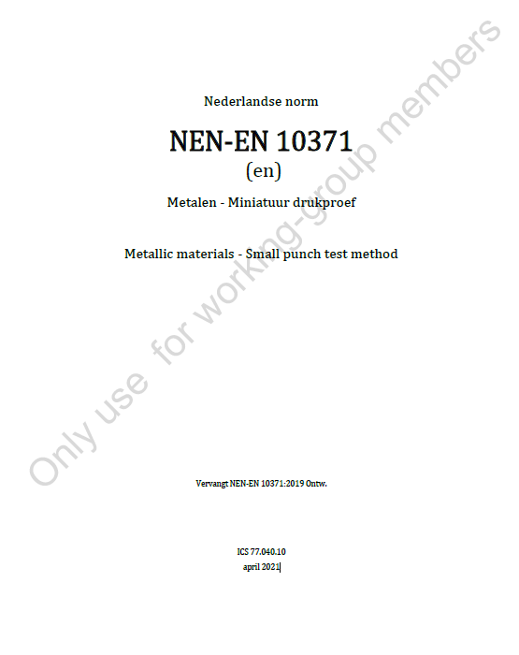
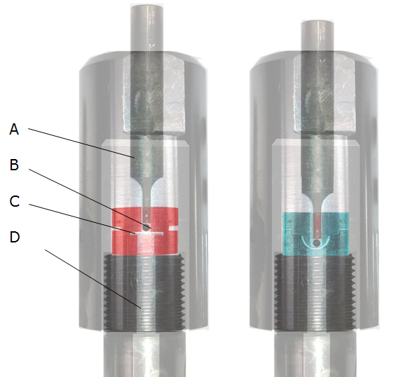
New EN standard on Small Punch Test
The EN-10371:2019 specifies the small punch method of testing metallic materials and the estimation of tensile, creep and fracture mechanical material properties from cryogenic up to high temperatures
Both the EN-10371 standard and the ASTM E3205-20 are based on the pre-normative CEN Workshop Agreement, CWA 15627:2006 E, i.e. the Code of Practice: “Small Punch Test Method for Metallic Materials”

Slide 6
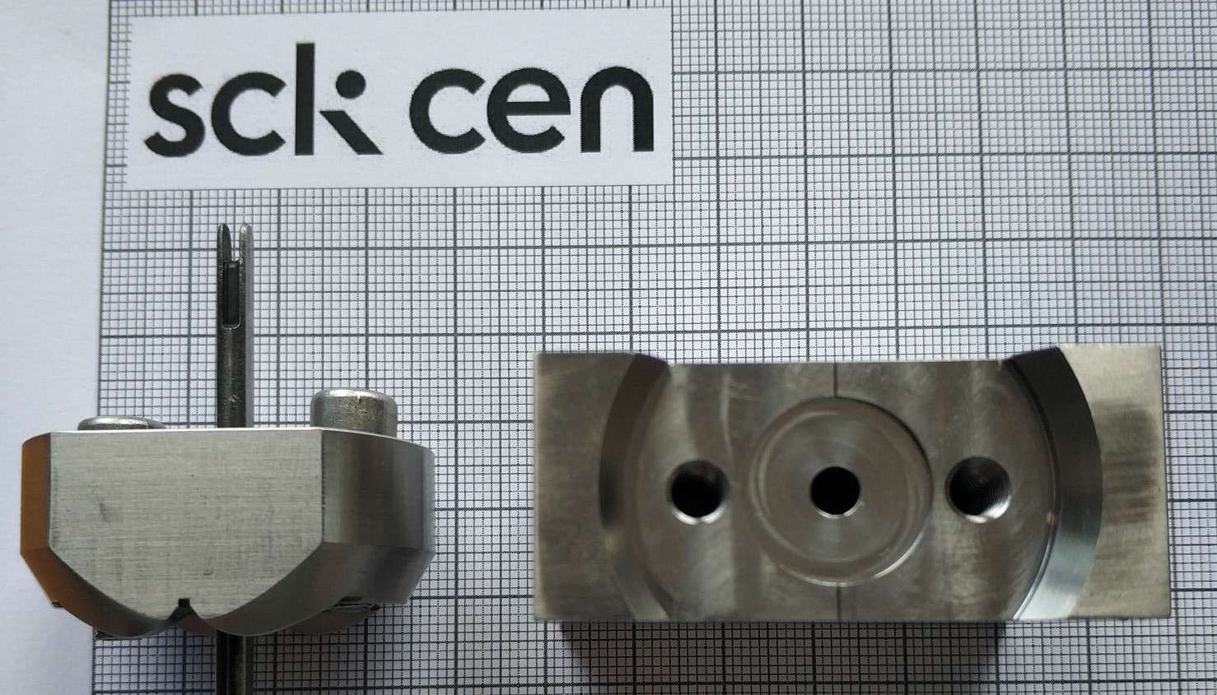
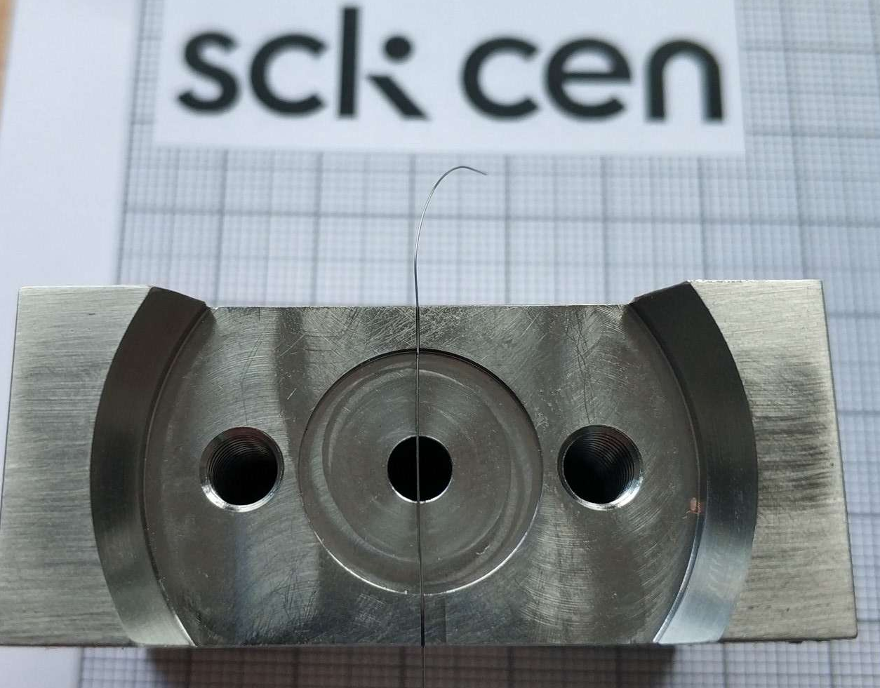
Drawings and Pictures of bending stage
Setup is made out of NiMoNic90, tests can be done up to 600 °C in air
Assembly can be made in fume hood (if dose rate allows)

Slide 7
Preliminary plan for irradiation programme : combined with W_design_rule_validation
Irradiation of W fibers (145 µm) and yarns (to be defined) will merged together with irradiation of W (for validation of DIV design rules)
Irradiation conditions:
  Dose: 0.2 and 1 dpa (in W)
  Temperatures: 400 and 1000 °C
Schedule:
  Assembly of the irradiation device in Q3-Q4 2022
  Irradiation:
    0.2 dpa completion: Q1 2023
    1 dpa completion: Q4 2023

Slide 8
Further actions
2022
  Qualification tests using SPT setup at RT and Elevated temperature to establish
    DBTT of W wires/yarns in non-irradiated state
    Establish relationship between tensile strength and SPT strength in non-irradiated state
    Perform SEM analysis of the SPT-tested samples and compare with Tensile-tested samples
2023
  Start irradiation
  Extract first samples irradiated at 0.2 dpa and perform SPT test & SEM

Slide 9
Copyright © SCK CEN
PLEASE NOTE!
This presentation contains data, information and formats for dedicated use only and may not be communicated, copied, reproduced, distributed or cited without the explicit written permission of SCK CEN.
If this explicit written permission has been obtained, please reference the author, followed by ‘by courtesy of SCK CEN’.
Any infringement to this rule is illegal and entitles to claim damages from the infringer, without prejudice to any other right in case of granting a patent or registration in the field of intellectual property.
SCK CEN
Studiecentrum voor Kernenergie
Centre d'Etude de l'Energie Nucléaire
Belgian Nuclear Research Centre
Stichting van Openbaar Nut
Fondation d'Utilité Publique
Foundation of Public Utility
Registered Office: Avenue Herrmann-Debrouxlaan 40 – BE-1160 BRUSSELS
Operational Office: Boeretang 200 – BE-2400 MOL

