Slide 1
PWIE-SP A.A4.T-T002 – D001 Assessment of hydrogen impact on material properties linked to ITER relevant PFUs
M. Richou
29th of August 2022 – WPPWIE SPA meeting

Slide 2
Assessment of hydrogen impact on material properties linked to ITER relevant PFUs
M. Richou¹, M. Lemetais², Q. Tichit¹, Y. Corre¹, G. Kermouche² and the WEST team
1
2
SPA - Midterm -29th August 2022

Slide 3
Global strategy
Use of WEST to assess and model tokamak plasma impact on recrystallization and softening
Assess: what are the properties we plan to investigate ?
Loss of mechanical properties -> Hardness measurements
Modification of the microstructure -> EBSD measurements
For what modelization ?
Impact on recrystallization and softening kinetics.
In this presentation :
1. Studied tungsten – implementation in WEST
2. WEST campaigns (Heat flux and cumulative pulse duration, misalignment)
First measurements on one WEST PFU
3. Samples with well-known plasma (D, He) loading (used for the input needed for the modeling)

Slide 4
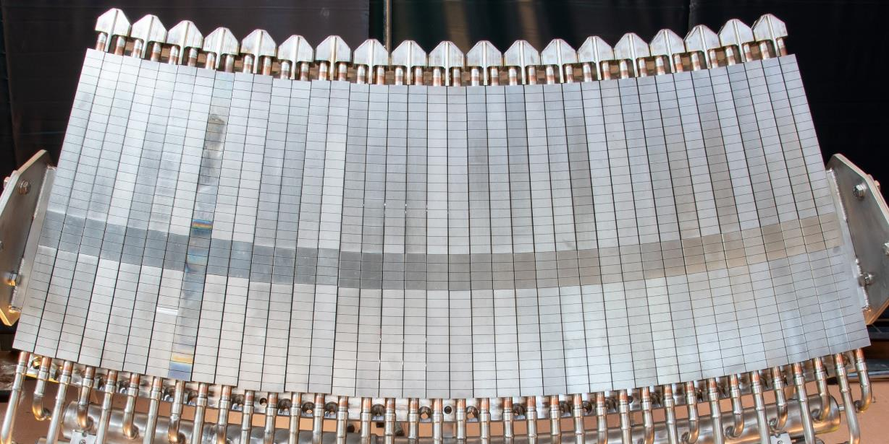
1. Studied tungsten – implementation in WEST
Incident flux
Tungsten and component manufactured by AT&M/ASIPP
ITER-like Geometry:
6mm W thickness
Block width from 26.3 mm to 31.8 mm
AT&M rolled W (ITER W grade material)
A-A
CuOFHC
CuCrZr
500 mm

Slide 5
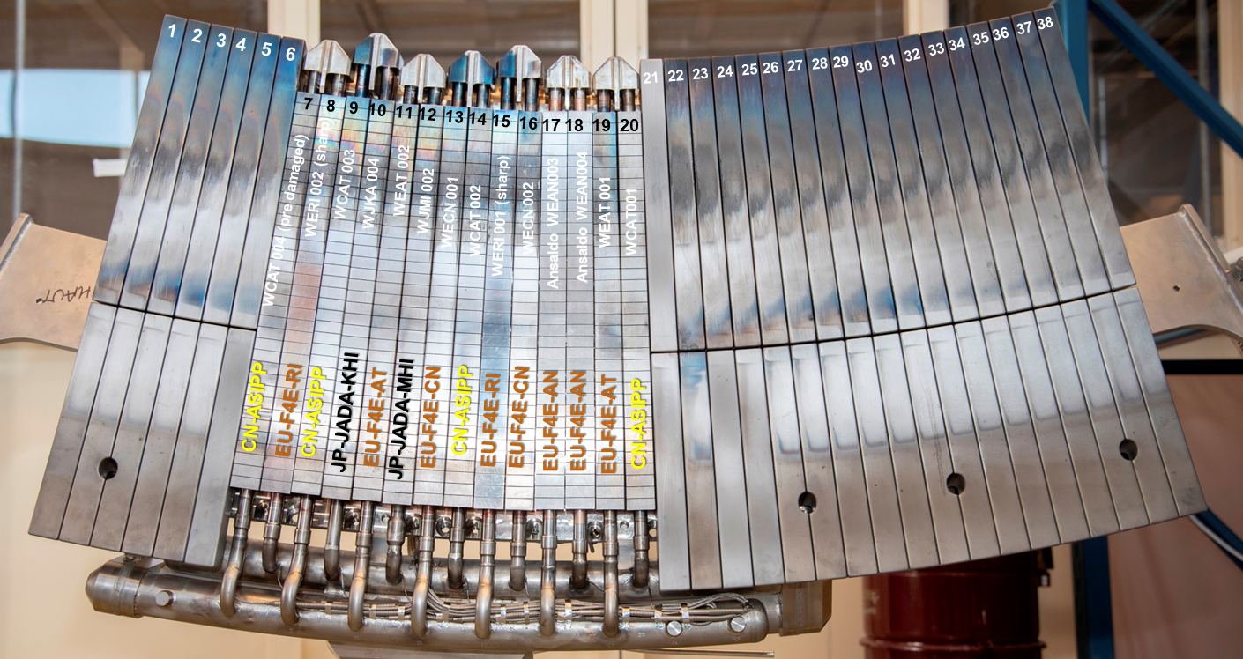
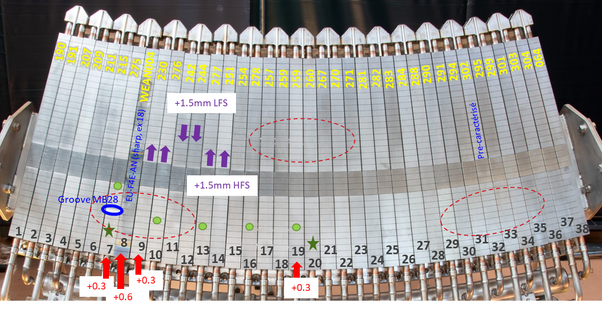
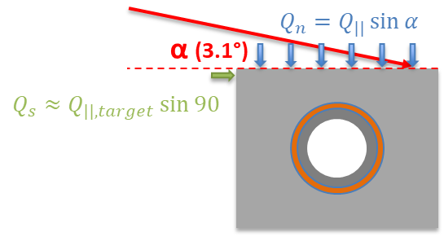
2. WEST campaigns
 | Duration max (s) | Cumul (s) | LH max (MW) | W LH total (MJ) | Max heat flux - Qn (MW/m²)
C4 – D2 | 55 (USN) | 9678 | 5.4 | 7823 | <6 [J.Gaspar, Nuclear Fusion, 2021]
July-Nov19
C4 - He | 30 | 2991 | 4.5 | 4300
Oct-Nov19
C5 | 23 | 4630 | 5.4 | 2625 | 6 [J. Bucalossi, Nuclear Fusion, 2022]
Nov20-Jan21
C4 : 14 ITER like PFU
C5 : 2 full sectors
5

Slide 6
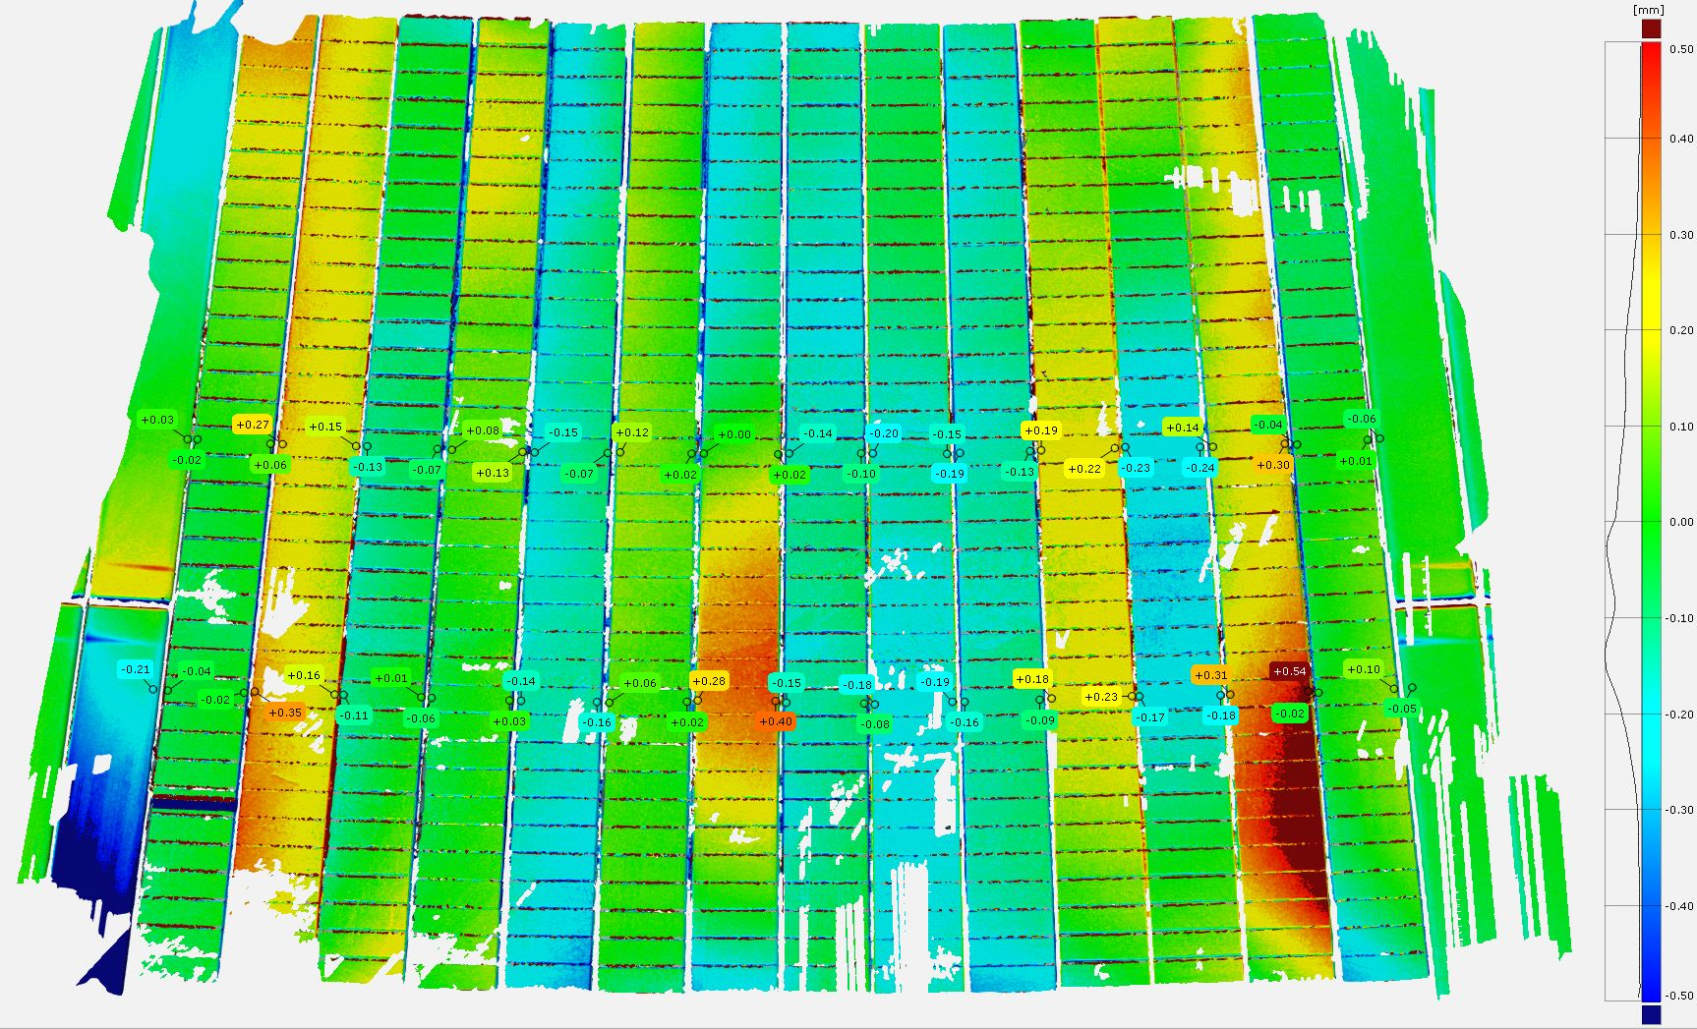
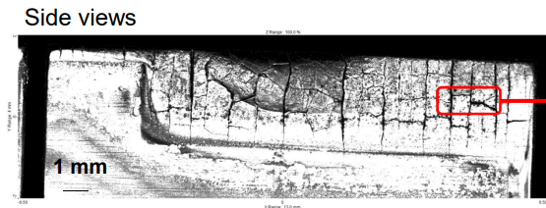
2.1 Misalignement in WEST
14 PFUs
$$Q_{n}=Q_{||}\sin{α}$$
α (3.1°)
δ
$$Q_{s}≈Q_{||,target}\sin{90}$$
C4
C5
δ
WEAN004, post C5
δ = 0.4 mm
δ = 0.5 mm
➔A misalignement (or exposed edges) leads to expose the leading edge with huge heat flux
(If Qn = 5.2 MW/m² - > Qs ~ 100 MW/m² !!!)
➔ In WEST, some PFUs are misaligned on purpose (during C4: up to 0.5 mm)

Slide 7
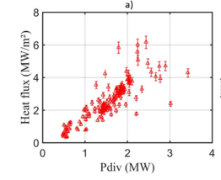
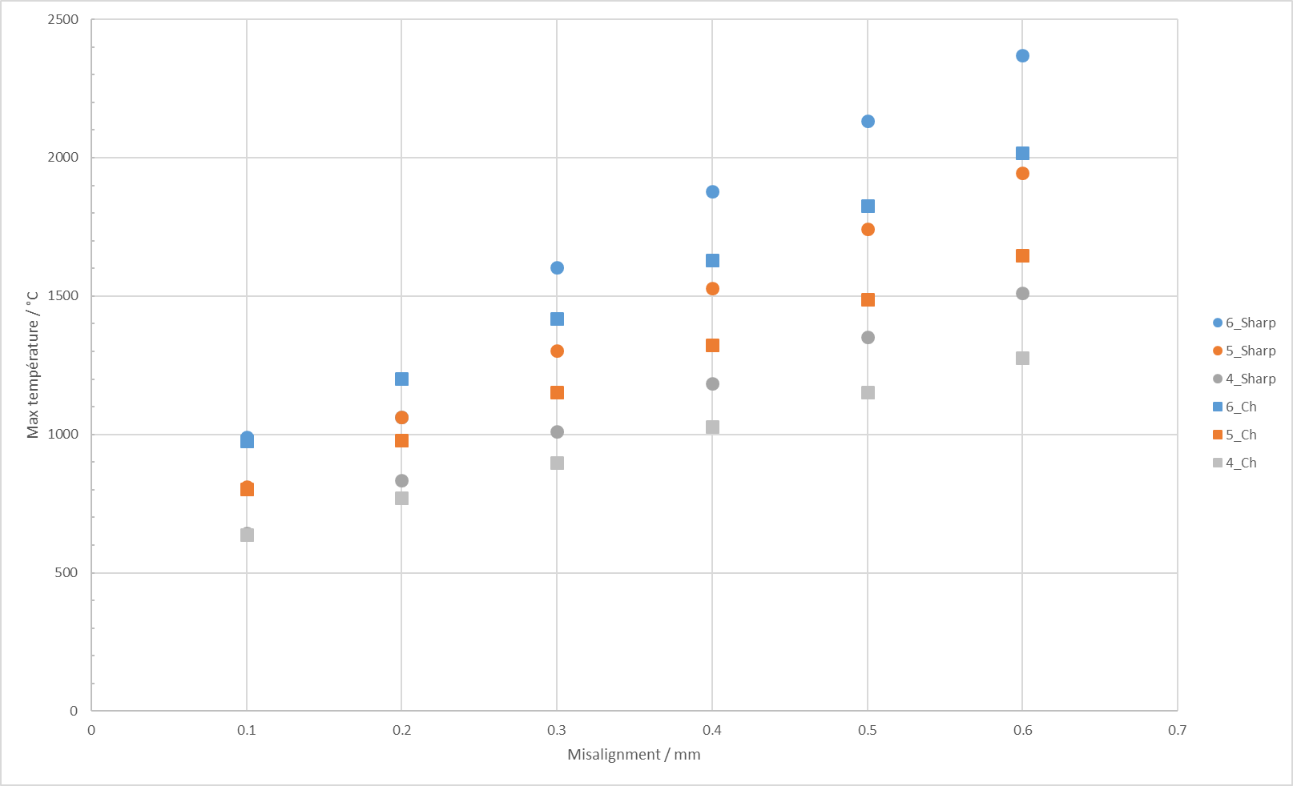
2.2 High surface loading in WEST (2/2)
From embedded measurments
J.Bucalossi et al., nuclear fusion, 2022
T=1500°C (Sharp, δ =0.3 mm)
Qn
T=1500°C (Sharp, δ =0.6 mm)
Qn = 6 MW/m²
Sharp
ANSYS simulations
Temperature Max. / °C
δ

Slide 8
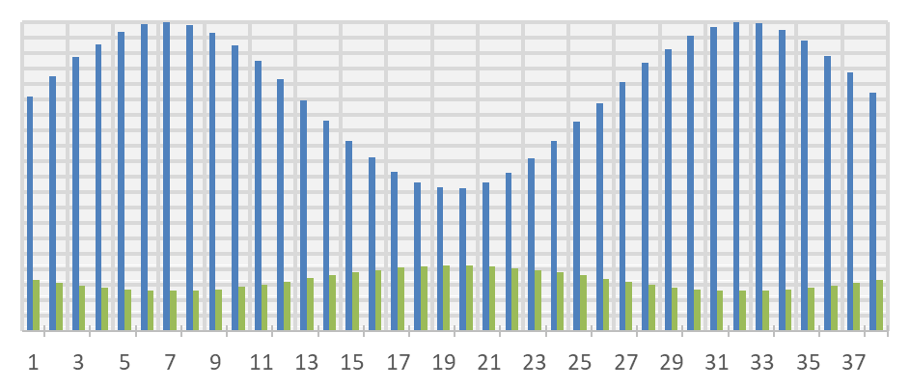
2.3 Combinaison of heat flux and misalignement
Highest heat flux zone
8
Normalised heat flux
100 %
OSP
50 %
ISP
PFUs
-> Focus on the OSP LE region
OSP
The PFU 8 is of interest (δ ~ 0.4 mm ) (may have reached 1500°C during the C4 campaign)
But…is it recristallised (it is a question of time…) ?
Notes:
NB PFU 13^peut être un candidat (WECN001)

Slide 9
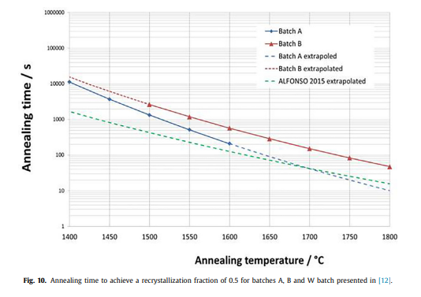
2.4 Loading time
For a leading edge surface temperature of 1500°C, annealed during 300s, hardness is decreased by a half (Alfonso etal.).
Monoblock 24
26
Y. Corre, submitted
M. Richou, Nuclear Materials, 2020
Future steps : Check the annealed time and Qn on PFU 8, monoblocks 23-27

Slide 10
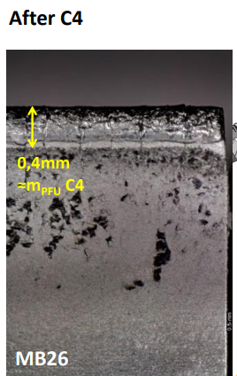
2.5 Visual observation of the relevant PFU
Plasma loaded surface
Presence of cracks, deposits on the zone dedicated to the hardness measurment
Hardness measurments are not relevant on the full not polished PFU
Future step : polish, use of sample rather than a complete PFU
δ = 0.4 mm
M. Diez, 2021, Nuclear Fusion
Notes:
Discrimner transient et SS WERI002 Mono 20 TE

Slide 11
3. Reference samples to check the potential mean field model on well known loaded samples (Collab Rasinsky)
Sample 0: Reference sample without any RXX or plasma loading
Sample 1 : Only D plasma (7-8 10²¹ D/m².s)
Sample 2.1 to 2.3 : D plasma annealing (7-8 10²¹ D/m².s) inducing recrystallisation
Exposed at 1350 °C for 1h, 2h and 5h respectivelly
Sample 3 : Only He plasma (8-9 1021 He.m².s) Exposed at 1100°C for 1h (recrystallisation not reached).

Slide 12
Conclusions and prospects
From January meeting (Jan presentation)
Experimental (mainly hardness measurements):
Perform the hardness measurements on the WEST PFUs
Perform the nanoindentation/EBSD measurements on WEST PFU samples (samples provided by SP.B3)
Model:
Define the influence of microstructure (due to manufacturing processes) on recrystallization/restoration using mean field model
According to hardness measurements, propose parameters to be implemented in mean field model to take into account plasma loading
Link with the WEST plasma operation (needed for correlation of experimental and modelisation):
Assess the temperature and fluence reached during plasma operation (C4 and C5 WEST campaigns) for the analyzed PFUs
✓
Not relevant
Identification of the most relevant PFU first
✓ (poster at SOFT)
Some characterizations are planned first (2023)
Under progress

