Slide 1
High fluence exposure for plasma erosion and D retention on W_{f}/W composites
29.08.2022 Yiran Mao, Thomas Morgan, Jan Coenen

Slide 2
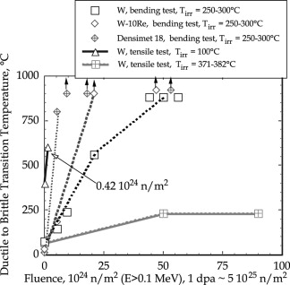
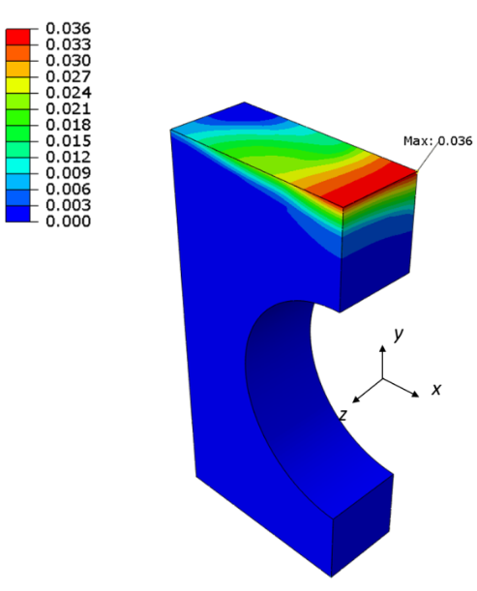
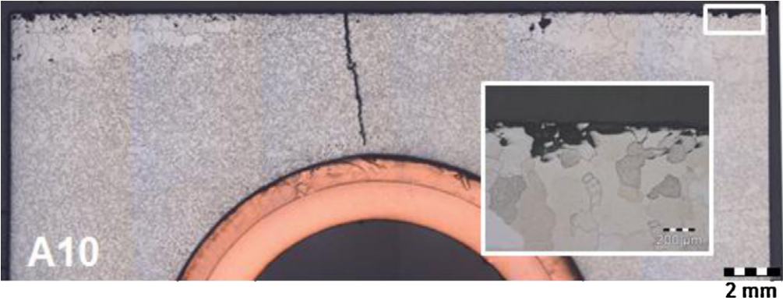
Background
Intrinsic brittleness of tungsten material limits its application in future fusion devices
Thermal heat load at the divertor: thermal stress and thermal fatigue
Accumulated equivalent plastic strain field in the tungsten armor block after the 5th HHF load cycle at 20 MW/m².
-H. Bolt, V. Barabash, G. Federici, J. Linke, A. Loarte, J. Roth, K. Sato, Plasma facing and high heat flux materials - Needs for ITER and beyond, J. Nucl. Mater. 307-311(1 SUPPL.) (2002) 43-52.
-G. Pintsuk, I. Bobin-Vastra, S. Constans, P. Gavila, M. Rödig, B. Riccardi, Qualification and post-mortem characterization of tungsten mock-ups exposed to cyclic high heat flux loading, Fusion Eng. Des. 88(9-10) (2013) 1858-1861.
Neutron embrittlement reduces the toughness of W during fusion operation
-M. Li, J.-H. You, Interpretation of the deep cracking phenomenon of tungsten monoblock targets observed in high-heat-flux fatigue tests at 20 MW/m 2, Fusion Eng. Des. 101 (2015) 1-8.
A damage resilient material is required

Slide 3
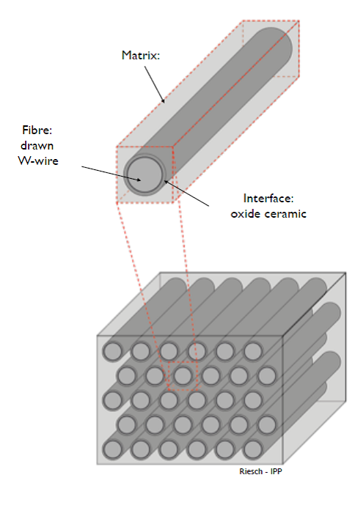
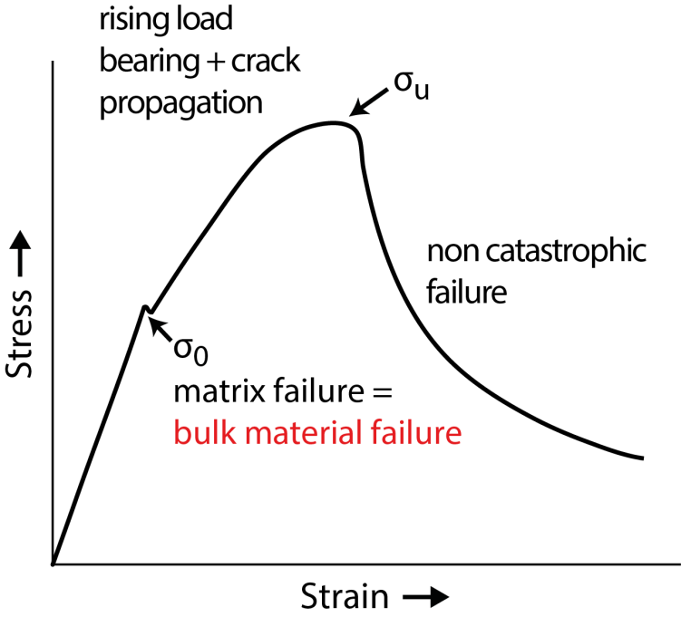
Tungsten fiber reinforced tungsten composites
Pseudo ductile behavior
Energy dissipation mechanisms:
a – pull-out of fibers
b – pull-out of matrix elements
c – crack deflection at interface
d – crack bridging by fiber
e – crack meandering at interf.
Tungsten fiber-reinforced tungsten (W_{f}/W)
-J. Riesch, Y. Han, J. Almanstotter, J.W. Coenen, T. Hoschen, B. Jasper, P. Zhao, C. Linsmeier, R. Neu, Development of tungsten fibre-reinforced tungsten composites towards their use in DEMO-potassium doped tungsten wire, Phys. Scr. T167(T167) (2016) 014006.
-K.K. Chawla, Ceramic matrix composites, Composite Materials, Springer2019, pp. 251-296.

Slide 4
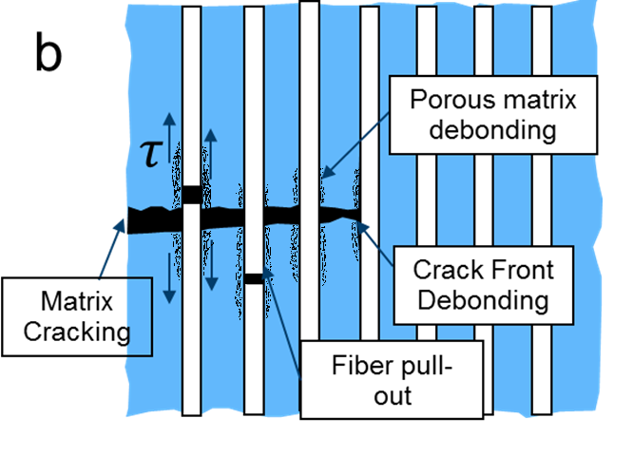
Porous matrix W_{f}/W
It is the same principle like weak interface composite
“a controlled amount of fine scale matrix porosity, obviating the need for a fiber coating.
This approach can be viewed as an extension of the porous coating concept wherein crack deflection occurs because of the low fracture toughness of the porous interphase.”
Examples:
SiC/SiC
CFC

Slide 5
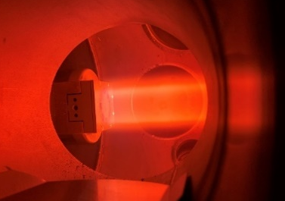
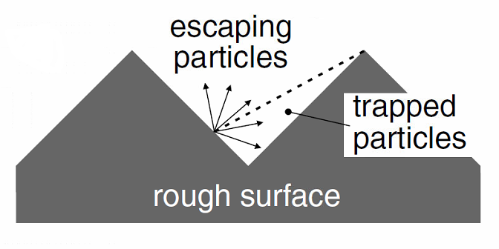
Plasma erosion on porous matrix W_{f}/W
Neon plasma, 98-117 eV, total fluence of 3,65×10²⁴ Ne⁺ m⁻², 100 min, ~200⁰C
Theoretical weight loss due to sputtering is 4.0 mg
With the increasing porosity, the weight loss decreases
The sputtered W were re-caught by the pores/surface roughness

Slide 6
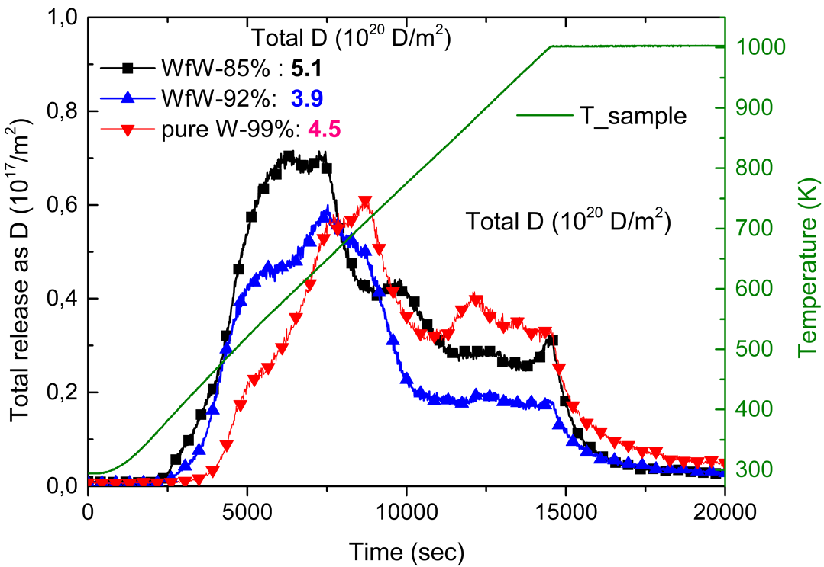
D retention
For deuterium retention evaluation, the D plasma exposure was applied. The average bias voltage between the D plasma and the samples was 78 eV; the total fluence was 4.99x10²⁵D⁺ m⁻². During the exposure, the temperature was ~202 °C. Then the D retention was measured by TDS
Porous matrix W_{f}/W shows similar retention compared to pure W

Slide 7
Goal
As we can see, the reduced erosion mass loss relies on the surface morphology. It need to be investigated that whether there is a limit of this effect, how does the surface morphology change after long time exposure. Also, how is the high plasma flux influences this effect.
Due to the open pores, Wf/W give similar D retention compared to pure W. How is the high plasma flux influences this effect (defects?)

Slide 8
Methods
Ne plasma is planned to be used to test the erosion resistance of porous matrix Wf/W and compared to ITER-grade W. Relatively long time exposure is planned together with microstructure characterization in between, to characterize the evolution of the erosion procedure. Up to 8x10²⁶Ne⁺m⁻² (54V bias).
D plasma is planned to be used to test the D retention with high plasma density and flux. Up to 2,3x10²⁷D⁺m⁻² (54V bias)
Ne plasma
2.5x10²⁵Ne⁺m⁻²
Inspection
Ne plasma
3,2x10²⁶Ne⁺m⁻²
Inspection
Ne plasma
8x10²⁶Ne⁺m⁻²
Erosion
Characterization
D plasma
2.3x10²⁷D⁺m⁻²
Retention
TDS

Slide 9
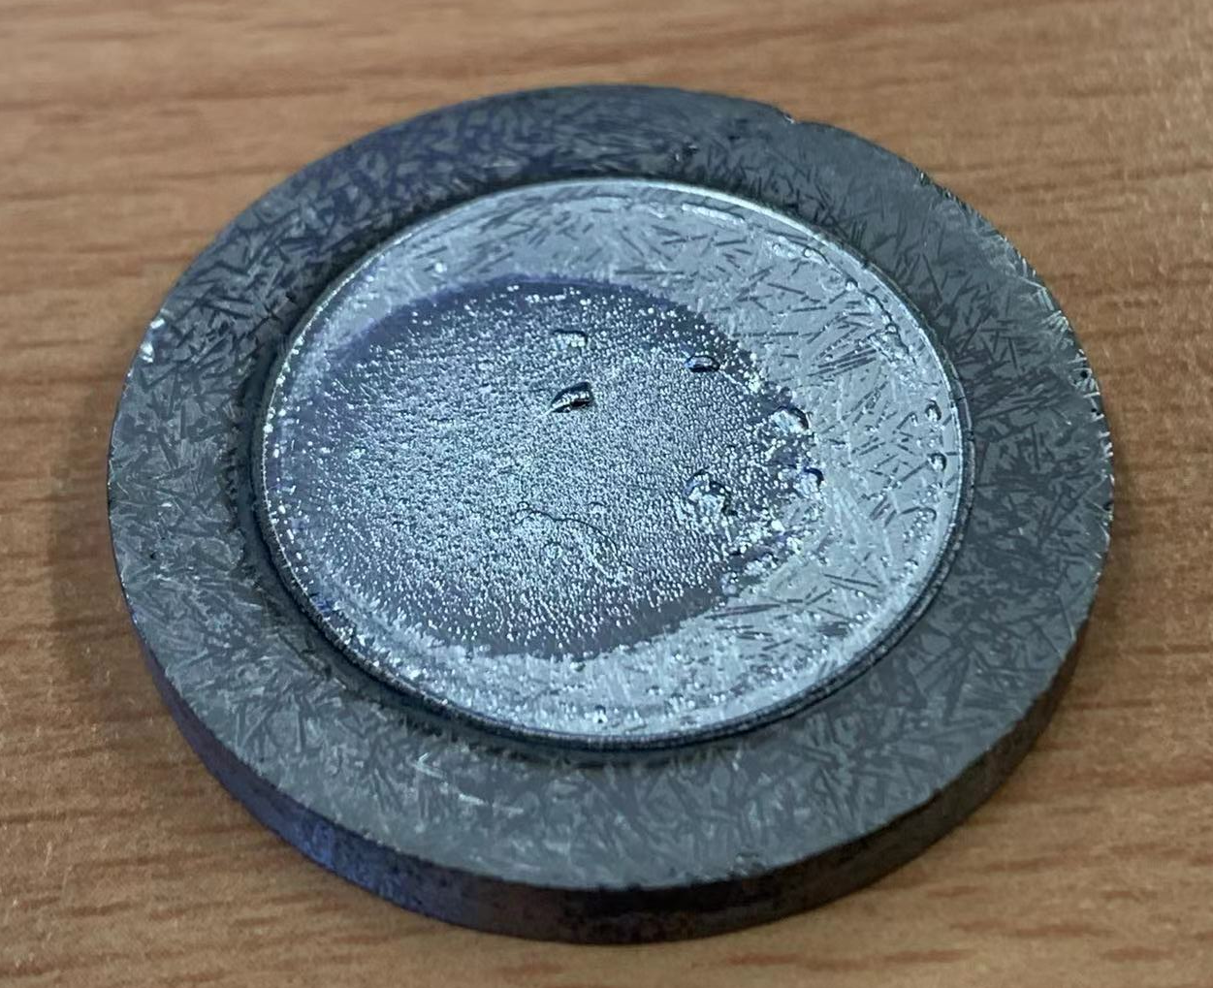
Preliminary results erosion
The mass change is dominated by the re-deposition of the Mo mask

Slide 10
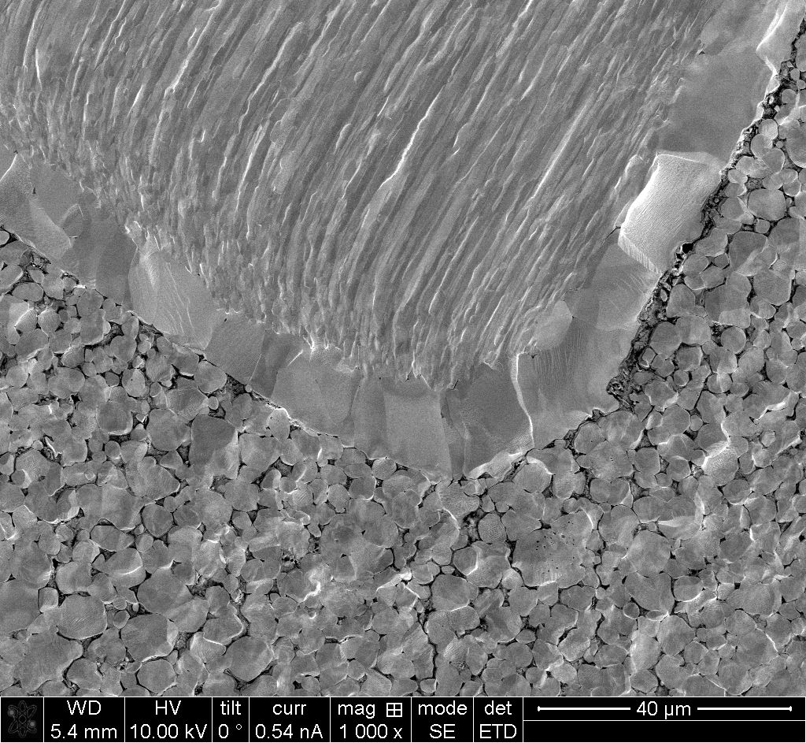
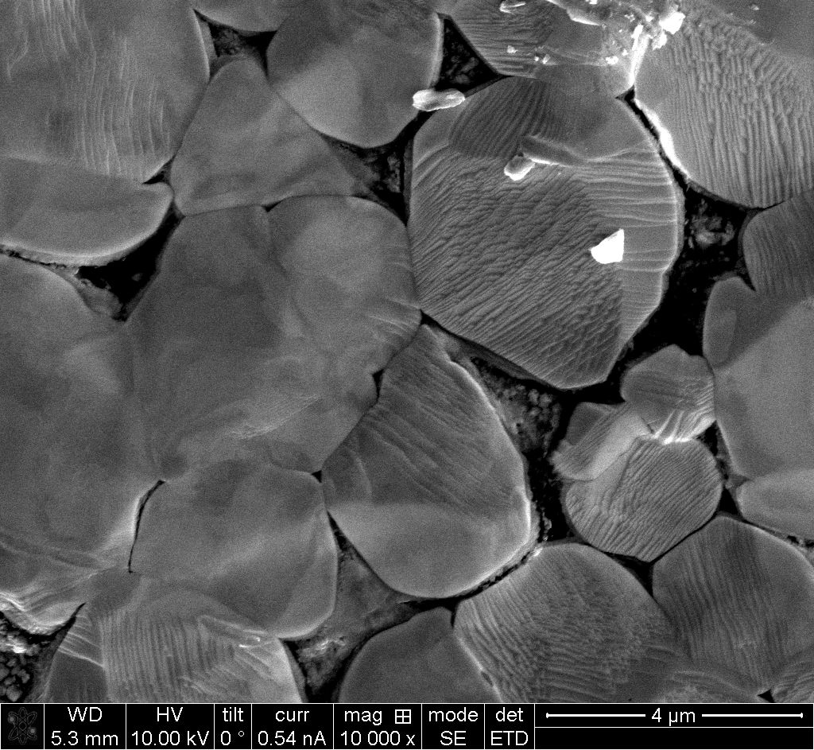
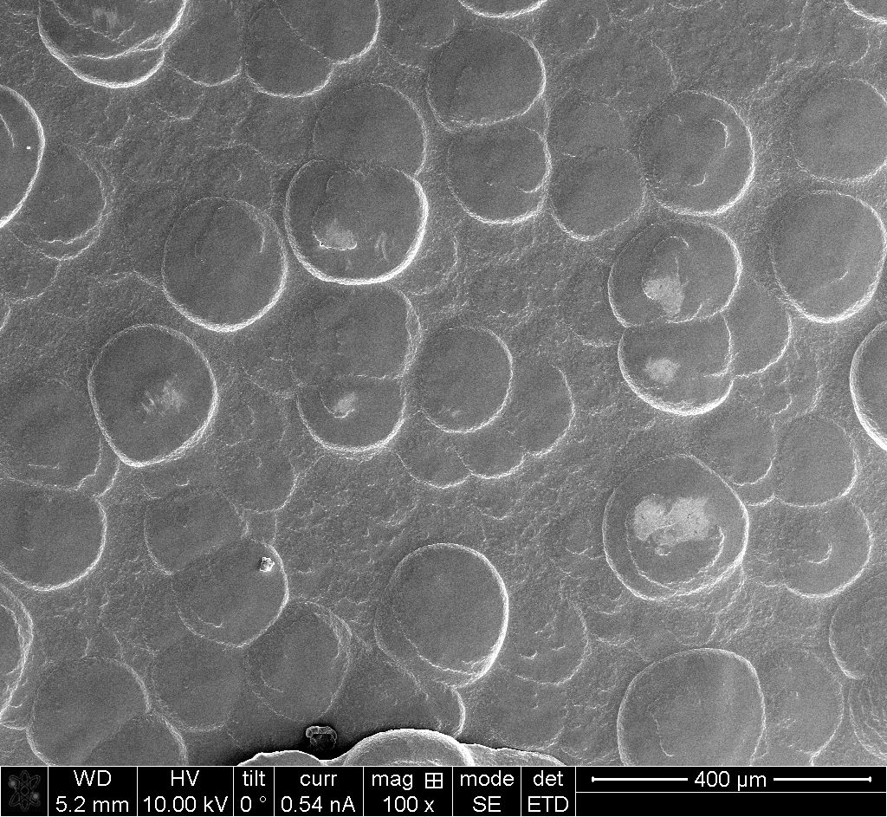
Preliminary results erosion
Erosion area
deposition area

Slide 11
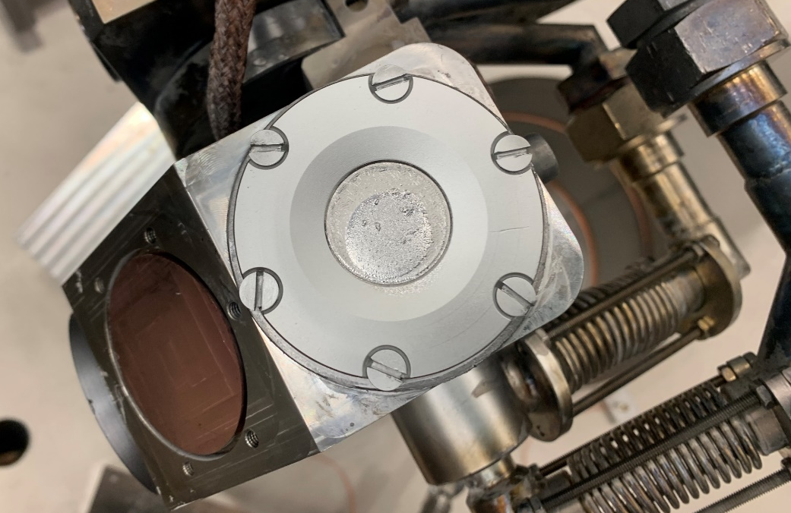
Summary
Ne plasma exposure has been performed up to in order to test the erosion properties of Wf/W
D plasma exposure hase been performed up to in order to test the retention of Wf/W
Re-deposition due to the mask need to be optimized.

