Slide 1
TSVV3 – Regular advancement meeting 24/08/2022 – Task 6: multi-species plasmas Project news
P. Tamain

Slide 2
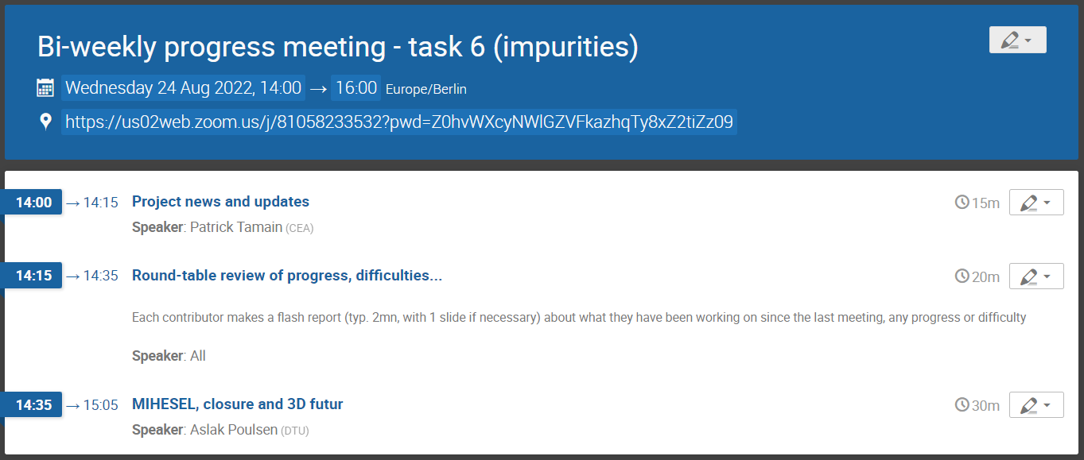
Today’s meeting agenda

Slide 3
2023 workplan update
Scientific board request update of 2023 work-plan for the end of september
I will provide each team leader before the end of the week with a reminder of the initial workplan for 2022 and 2023 regarding the objectives they are concerned with
Please provide feedback by mid-September on:
Status of each objective (still valid, delayed, abandoned) with a brief reason explaining any change
Possible new objectives not announced in initial workplan

Slide 4
Preparation of end of year report
Report of 2022 activities expected mid-December
Together with 2023 workplan review, can you please send me brief update on current status of 2022 activities with respect to deliverables
Do we plan a general review meeting of the project?
Would have to be on-line given budget restrictions

Slide 5
In-person numerical workshop
Doodle sent to converge on date this morning: https://doodle.com/meeting/participate/id/epQgYWVa
Please fill before next Wednesday (31/09)

Slide 6
Today’s meeting agenda
Upload presentations on https://indico.euro-fusion.org/event/2226/ or send to me please.

