Slide 1
New facilities for HYDKIN toolbox
D.Borodin, F.Cianfrani, B. Küppers

Slide 2
HYDKIN:
toolbox for plotting and manipulation of A&M data with a user-friendly graphical interface: HYDKIN
EIRENE databases: AMJUEL, HYDHEL, H2VIBR, METHANE, ..
available at http://www.eirene.de/hydkin/
Password-protected (for access contact the authors)
Reiter Phys.Scripta 2009

Slide 3
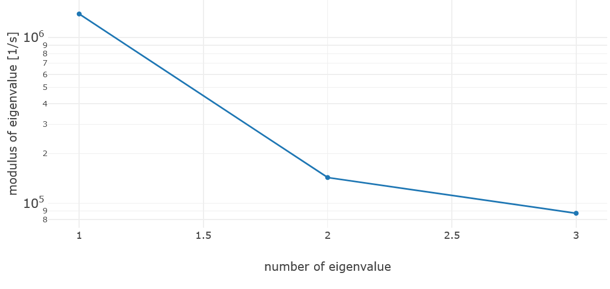
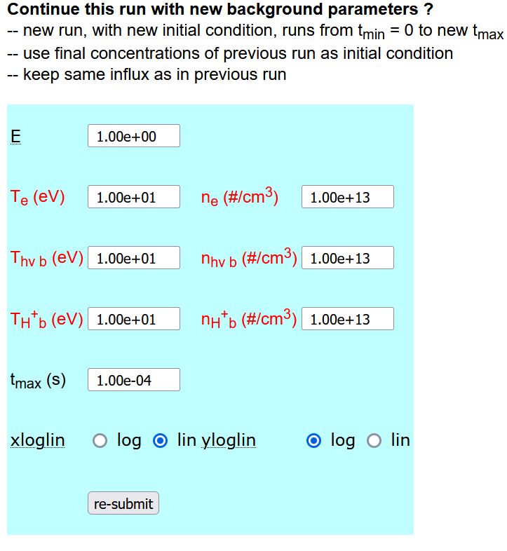
HYDKIN: particle solver
1-dimensional
reservoirs, P/Q species
spectral analysis
sensitivity analysis

Slide 4
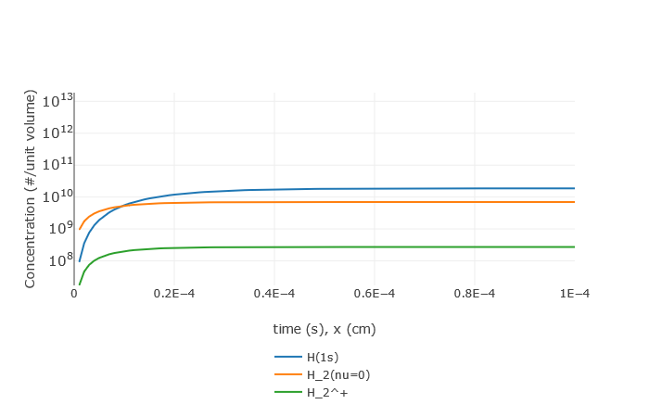
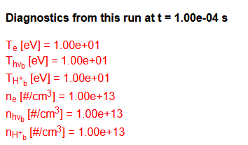
HYDKIN: particle solver output
Default case (see next slides)
“infinite reserve” of particles at fixed temperature and density
reservoir
Development of stationary equilibrium

Slide 5
HYDKIN:
HYDKIN can be used to
to import/export data (db, fhg, json formats),
to produce input data for EIRENE and for other codes,
to check and improve the results of the simulation,
to check data for consistency, abnormal features, ..
to understand the physics and identify the most significant processes (among the selected ones).

Slide 6
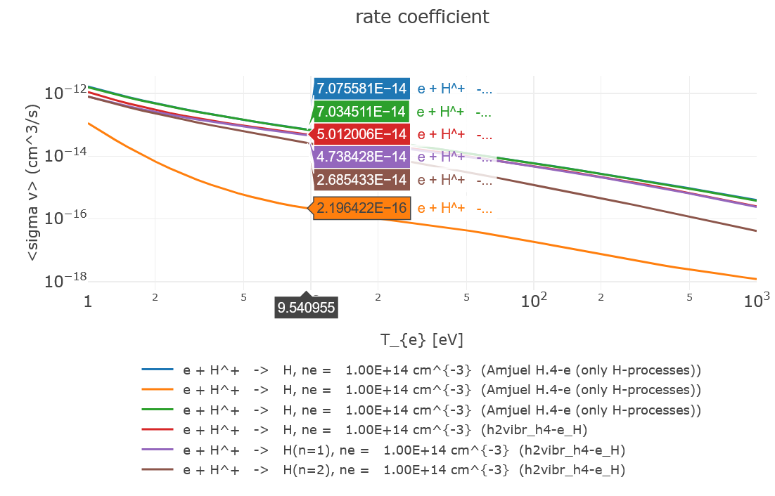
HYDKIN: comparison recomb. rates
e + H⁺ → H
SF rad + 3b recomb
JH rad + 3b recomb
SF Ly-α removed
SF n=1
SF n=2
JH Ly-α opaque
JH: Johnson-Hinnov J. Quant. Spectr. Rad. Transf. 1973
SF: Sawada Fujimoto J. Appl. Phys. 1995

Slide 7
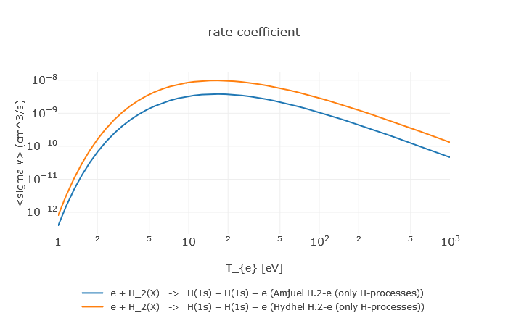
HYDKIN: comparison dissociat. rates
e + H₂ → H + H + e
HYDHEL
AMJUEL
Factor 3 wrong

Slide 8
new HYDKIN:
Availables now from main page at
Still work in progress (temporary stop)

Slide 9
new HYDKIN: grouping of reactions
OLD: reactions grouped by database
NEW: reactions grouped by formula → identified by number
plotter: reactions from different databases → comparison
solver: radio button: avoid multiple reactions with same formula

Slide 10
new HYDKIN: grouping of reactions
Grouped reactions differing for vibrational resolution (one row)
next stage: bundle vibrational state

Slide 11
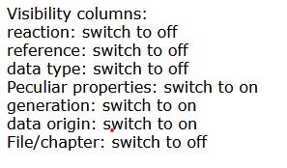
new HYDKIN: columns
List of (retractable) columns:
number: identify the reaction (AMJUEL number w/o letters)
reaction: formula
reference
data type: experimental, calculated, mixed…
Peculiar properties: additional info
generation: 0 for now
data origin: type of fit (original data, improved fit, …)
File/chapter: database/section

Slide 12
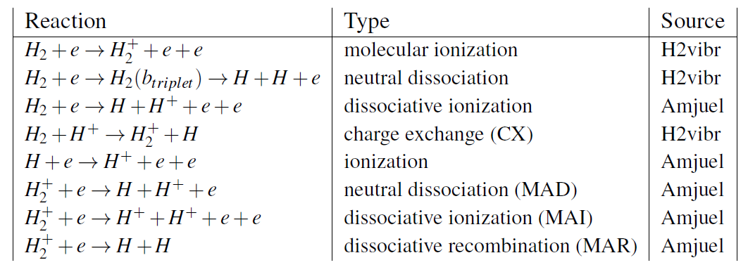
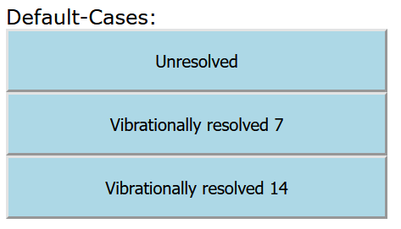
new HYDKIN: default cases
Deduced from JET (EDEGE2D-EIRENE) and DEMO simulations
with and w/o vibrational resolution
Groth et al. Nucl.Fusion 2013
Subba et al. Nucl.Fusion 2021
+ molecular volumetric source

Slide 13
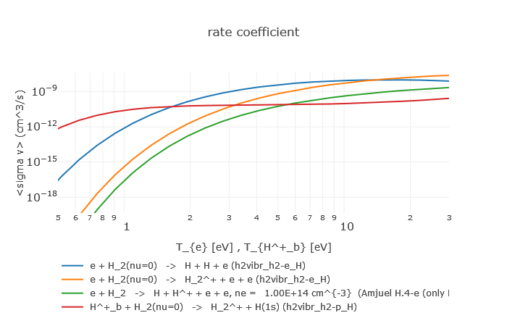
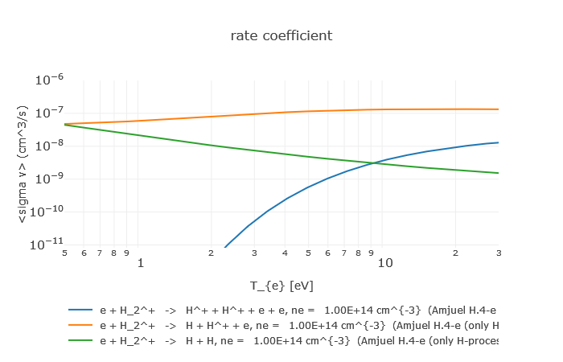
new HYDKIN: default cases- unresolved
H₂ dissociation
Heavy particles collisions dominating at low temperature
H₂⁺ dissociation
MAR/MAD competition at low temperature

Slide 14
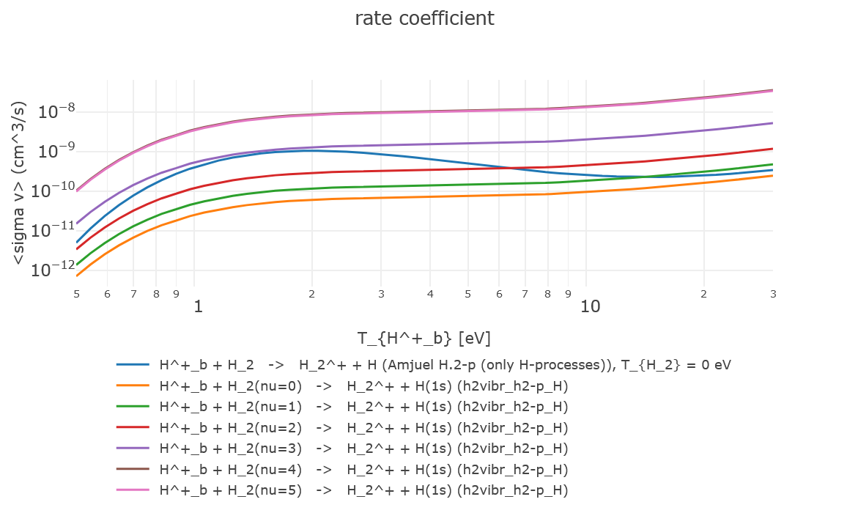
new HYDKIN: default cases- resolved
H⁺ + H₂ → H₂⁺ + H
H2VIBR: resolved
Higher vibr states
AMJUEL: unresolved
Vibrationally resolved data from H2VIBR provides a reduced dissociation rate.
A Holm et al. CPP 2022

Slide 15
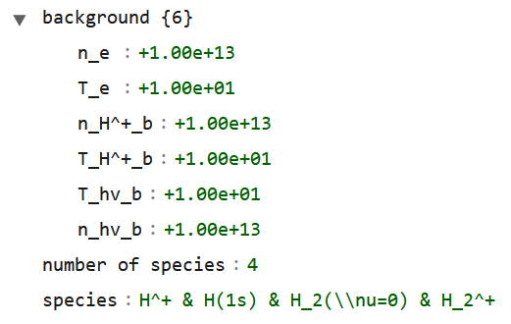
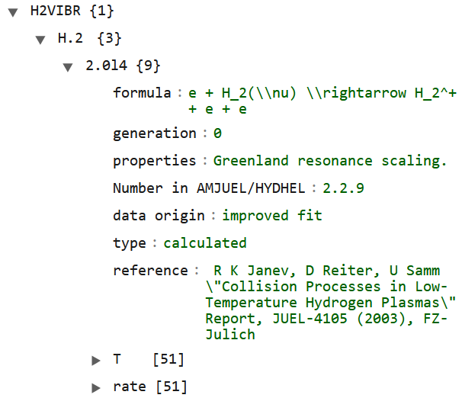
new HYDKIN: output
new json-output containing:
background parameters
selected particles
selected reactions
column values
rates
preliminary for interplay with other programs….

Slide 16
Outlook
New HYDKIN:
grouping of reactions
new column/features
default cases
json output
… some issues still to be solved:
electronic states
inclusion more CRMs
inclusion further databases (ADAS, IAEA, ..)
increase readability and usability
direct link with EIRENE input files → standalone HYDKIN dedicated module

Slide 17
Thanks for the attention!

