Slide 1
FSD Planning Meeting : WPPWIE for AWP 2023
Sebastijan Brezinsek
J.W. Coenen, A. Hakola, K. Schmid, A. Kirschner,
H. v. d. Meiden, J. Likonen, G. Calabro, M. Reinhart

Slide 2
Contributions to ITER
WPPWIE strongly supports ITER with experimental studies and modelling related to Roadmap Mission 2
Regular inclusion of high priority topic according to ITER Research Plan, ITPA DivSOL, and IO interaction
WP PWIE supports ITER with experimental studies and modelling related to EUROfusion Mission 2
Identification of topics according to ITER Research Plan, ITPA DivSOL, and direct interaction with IO
Support ITER in lifetime estimations for the W divertor and Be first wall components [budget approach]
Plasma (He, D) and high heat flux exposure of reference / pre-damaged / re-crystallised materials
High fluence experiments (MAGNUM-PSI, WEST) / repetitive loads / fatigue of W PFCs
Support ITER in fuel retention estimations and fuel recovery schemes [housekeeping approach]
Tritium monitor diagnostic: retention location identification and quantification (LID-QMS and LIBS)
ITER tool box: baking, ICWC and ECWC, GDC including laboratory experiments (e.g. TOMAS) and modelling
Support ITER in material migration, fuel retention and dust production estimations
Modelling of global material migration and transport to remote areas and ducts (e.g. JET mirror stations)
He-Be and He-W interaction and its impact on erosion and deposition pattern including W fuzz formation

Slide 3
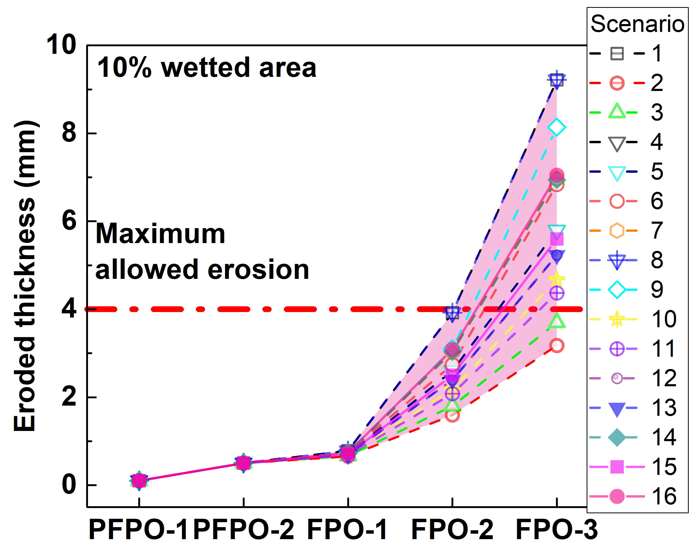
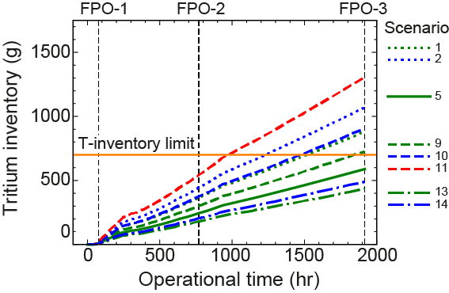
Example of joint activity with IO
Different plasma backgrounds
Different plasma backgrounds
R.A. Pitts et al. PSI 2022
G. De Temmerman, et al., in preparation for Nuclear Fusion
Joint IO + Labs + EUROfusion activity: => ITER predictions based on WallDYN and ERO2.0 with SOLPS-ITER
including WPPFC/PWIE laboratory results + JET results + WallDYN and ERO modelling benchmark
Open issue => uncertainties in plasma background => FW particle fluxes + energies (CXN)! => SP B/D/E
Open issue => fuel removal technique at lowish ITER FW baking temperature => SP C/E/X

Slide 4
Contributions to DEMO
WPPWIE works hand in hand with the DCT in the general area of PWI and Exhaust
WPMAT (+PRD) provides plasma-facing materials and WPDIV provides plasma-facing components
Joint exploration and assessment of PEX solutions for DEMO with WPDES and WPTE
Supports DEMO baseline scenario via WPDES: vital input to the conceptual design
Testing of DEMO PFCs solution (FW and Divertor) on plasma and combined plasma and transient heat load
PSI modelling regarding first wall erosion under steady-state conditions and transients
Re-deposited W layer stability and corresponding dust conversion factors
Fuel inventory predictions based on implantation and neutron damage in W-based PFCs
Recommends alternative DEMO-compatible plasma exhaust solutions:
Physics basis for alternative power exhaust solutions (highly radiative LSN divertor as reference / WPDES)
Predictive plasma edge modelling for alternative divertor solutions and their exploitation (PEX)
Technical realisation within the DEMO boundary conditions (together with WPDES)

Slide 5
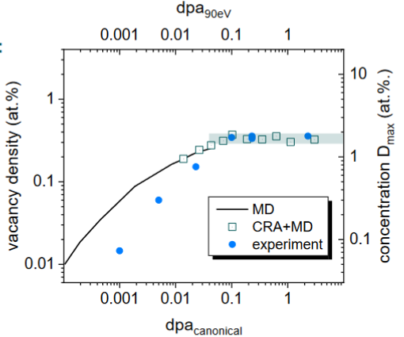
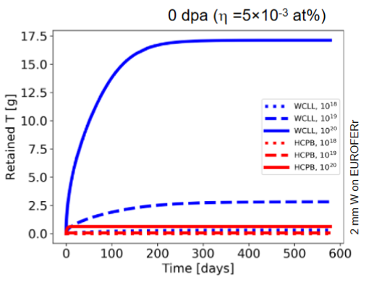
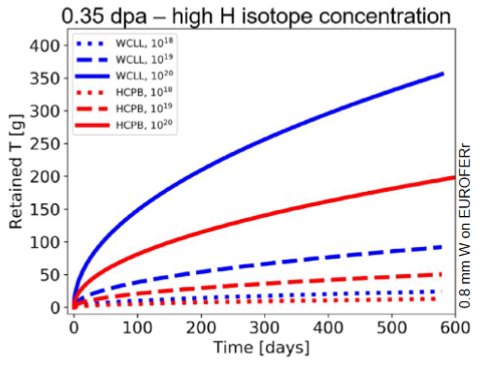
Example DEMO with FTD+EEG
T. Schwarz-Selinger et al. PSI 2022
Joint FSD and FTD work incl. EEG => DEMO predictions based on ad-hoc WallDYN FW fluxes
and dedicated experiments/modelling regarding (self-)damage in W and synergistic effects with plasma
Open issue => uncertainties in plasma background => FW particle fluxes
=> uncertainties in neutron damaged Eurofer behavior (permeation / H content) => TSVV7 + SP C/B/D + FTD
Open issue => uncertainties in erosion of vs. retention in FW materials => TSVV5 + SAE +BB + DCT + JULE-PSI

Slide 6
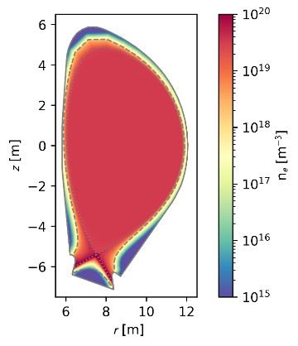
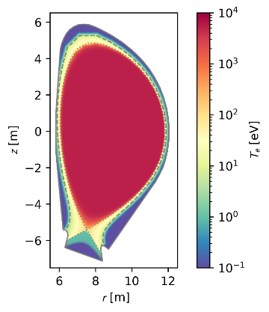
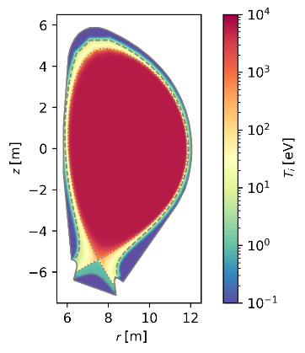
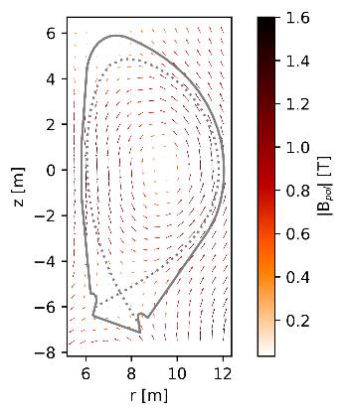
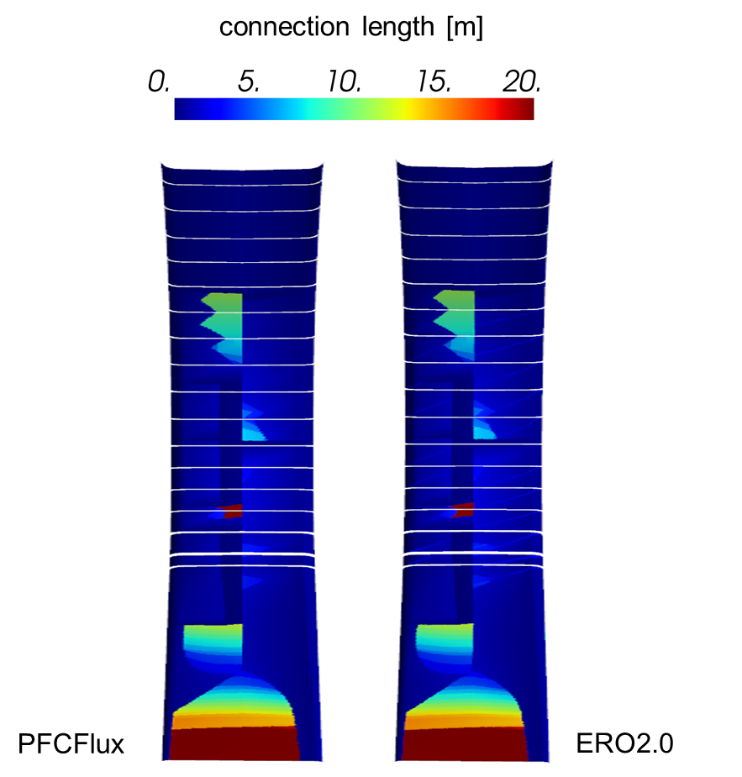
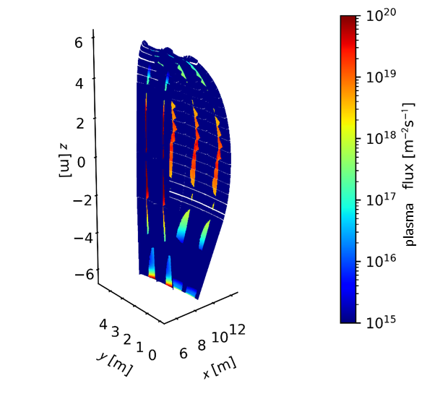
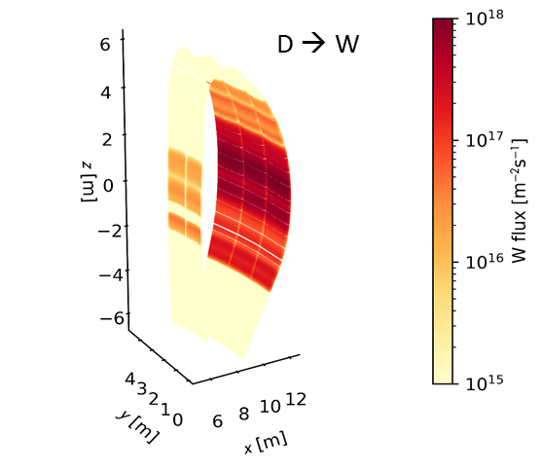
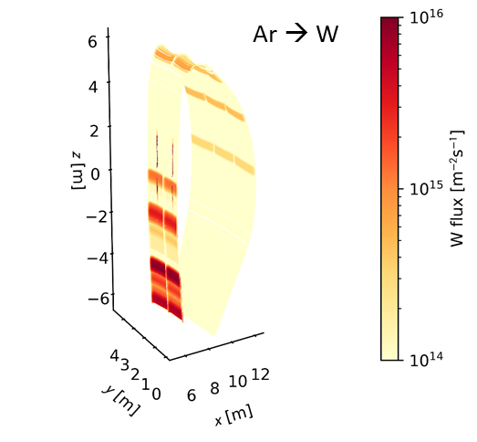
First ERO2.0 for DEMO (TSVV7+SPD+DCT)
n_{e}
T_{e}
T_{i}
DEMO main chamber erosion determined by CXN and residual Ar neutrals
Extended grid to wall and full
EIRENE neutral distribution missing (energy and angle resolved)
Experience from W7-X 3D modelling very useful!
Experiments in TE required!
SOLPS 2D
EFIT + 3D field lines
Γ_{D+}
3D ERO2.0 of one segment
Ch. Baumann

Slide 7
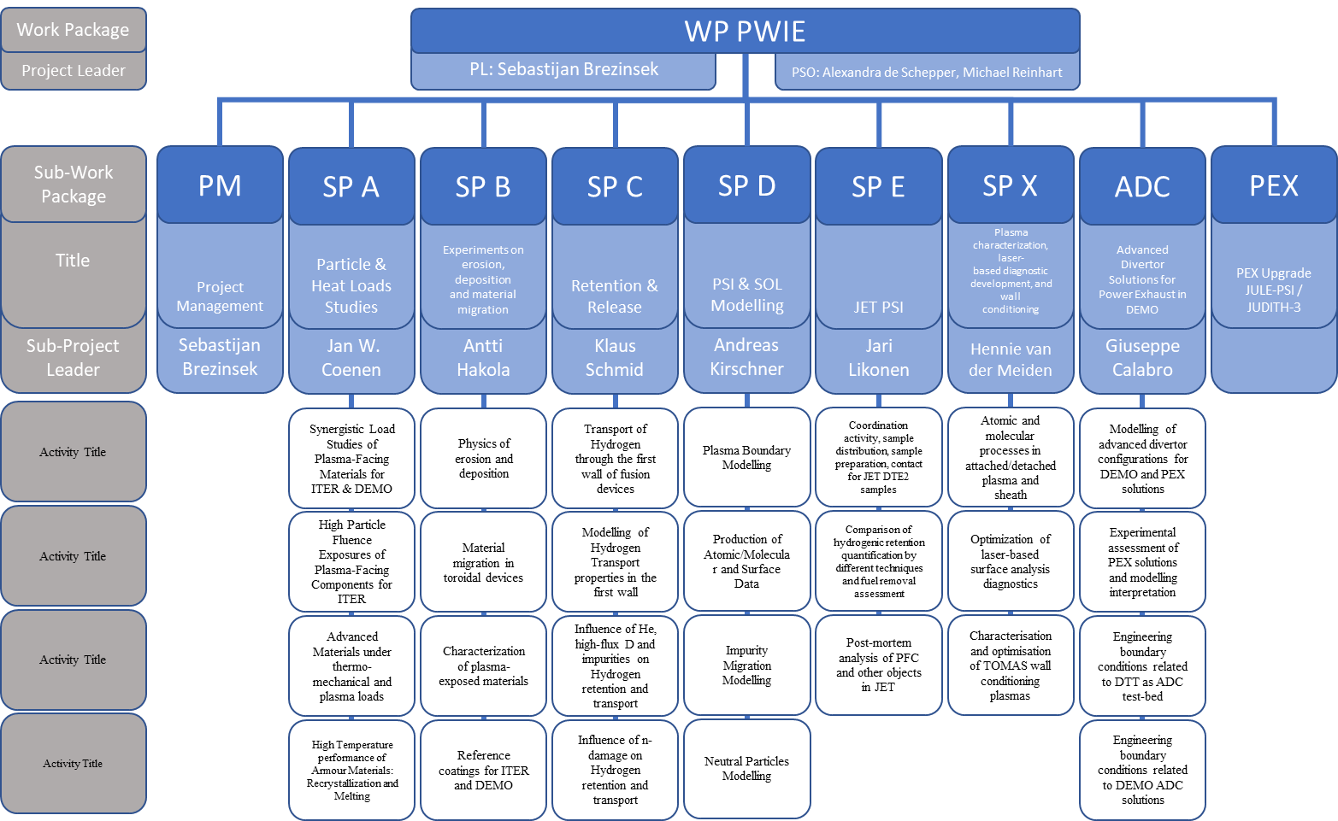
WPPWIE Structure 2022/2023
DPL for ADC: Giuseppe Calabro
In general for 2023:
SP A. SP B, SP C, SP D, SPX structure and activities remain largely as in 2022
New tasks and deliverables largely along the indicative plan for PWIE
Moderate modifications: high priorities (IO, FSD), delays, other reasons (KIPT)
SPE planed for 2022+2023 => Request for resources to prolong for 2024-2025
ADC should be closed in 2023 => Request for resources to complete in 2023
Note the presentation covers new budget (some HW and HR of 2022 into 2023)

Slide 8
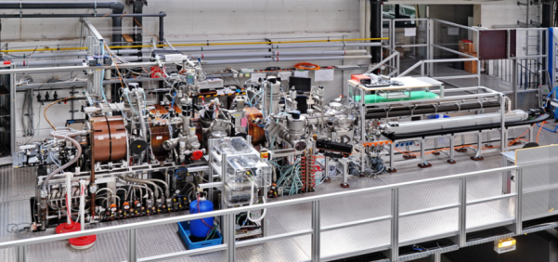
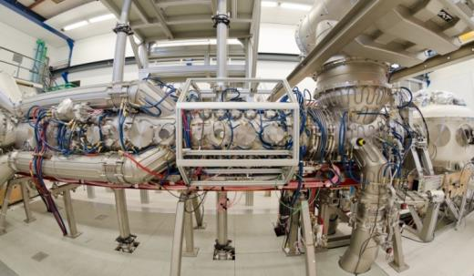
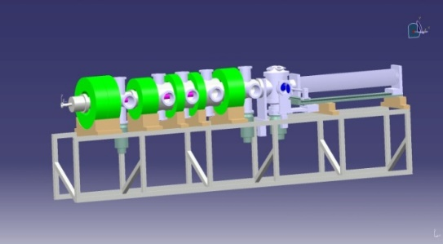
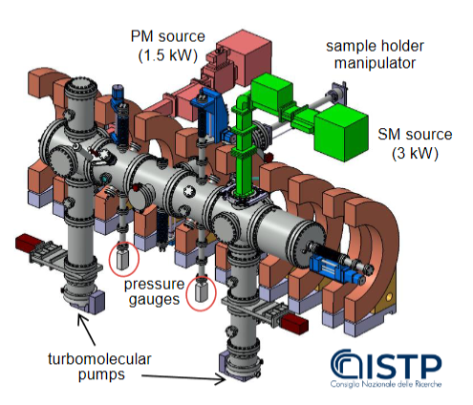
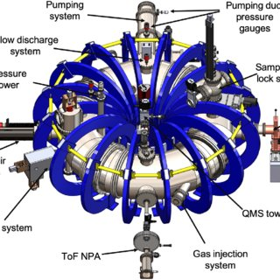
Plasma facilities: 2022/2023 resource allocation
PSI-2:
Medium flux and fluence
(70 days)
(~50 days + X )
MAGNUM-PSI
and UPP:
High flux and
fluence
(40 and 15 days)
(40 and 15 days)
JULE-PSI:
Medium flux and fluence
[Be and T
In HML / PEX 2024]
(~20 days - X => D start-up
experiments)
GyM:
Low flux and fluence
(20 days)
(20 days)
Increase in operational costs indicated by labs, but no clear statements about rise (electricity, working gas, Helium, heating etc.
Machine cost revision will come!
TOMAS:
Wall conditioning and fuel removal
(20 days) (20days)

Slide 9
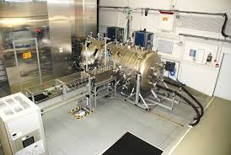
High heat flux facilities: 2022/2023 resource allocation
JUDTIH 2 / 3 (PEX: Be & n)
E-beam:
Steady-state and transient loads
(20 days)
(~25 days)
GLADIS
(Neutral Beam):
Steady-state load
(8 days)
(~10 days)
Increase in operational costs indicated by labs, but no clear statements about rise (electricity, working gas, Helium, heating etc.
Machine cost revision will come!
OLMAT may replace some QSPA activities for
DEMO disruption studies (tbc)
QSPA / QSPA-m
Plasma Gun:
Transient loads
(20 days in 22) 20 days in 23)
To be clarified!
MAGNUM and PSI-2:
pulsed or laser for transients
OLMAT (at TJ-II)
(Neutral Beam):
Transient loads
(4 days)
(~10 days)

Slide 10
Analysis facilities: 2022/2023 resource allocation
Internal facility review (SP B) regarding capabilities, techniques, materials, sample sizes, availability done
Distribution of work with inclusion of interest of labs in topic as much as possible done
Focus on ion beam facilities in financial support (accelerators and associated analysis stations)
Not enough funding to support other techniques TDS, PALS, Microscopy, FIB, Microscopy etc.
Assume it comes in-kind from the research units
T-lab in Saclay in 2023 shall get re-directed resources from WEST sample analysis foreseen (high fluence)
=> from SPB to SPC transferred
RUs | Facility | Days | Days
DIFFER | Accelerator | 15 | ~15
FZJ | Accelerator | 12 | ~12
IST | Accelerator | 12 | ~12
JSI | Accelerator | 20 | ~20
MPG | Accelerator | 57 | ~57
NCSRD | Accelerator | 8 | ~8
RBI | Accelerator | 12 | ~12
VR | Accelerator | 18 | ~18
VTT | Accelerator | 5 | ~5
Final allocation depends on availability of facility and samples
Limited financial resources for ³He gas for analysis available
Request for increase in “hardware budget” due to inflation

Slide 11
SP A - Update
Particle and heat load studies in preparation of the exploitation of ITER and DEMO
SPL: J.W. Coenen
Total: ~128 PM (with 60 KIPT)
Focus on damage evolution of ITER-like MBs
(including WEST MBs)
Recrystallisation evolution in W (incl. modelling)
Focus on ITER-like MBs testing under multiple seeding, species, ELMs, and He
Plasma qualification of new materials for DEMO and other toroidal facilities (e.g. W7-X)
Disruption-like loading for DEMO
Melting of MBs => MEMOS-U modelling
(tbd with WPTE)
KIPT treatment? Keep PM – remove machine time?
SP A.1 Synergistic Load Studies of Plasma-Facing Materials for ITER & DEMO
SP A.2 High Particle Fluence Exposures of Plasma-Facing Components for ITER
SP A.3 Advanced Materials under thermo-mechanical and plasma loads
SP A.4 High Temperature performance of Armour Materials: Recrystallization and Melting
Participants: CEA, CIEMAT, DIFFER, DTU, FZJ, JSI, KIPT, LPP-ERM-KMS, MPG, VR
EEG: W properties after WEST exposure
EEG: W-coatings (VPS) technique

Slide 12
SP B - Update
Experiments on erosion, deposition and material migration
SPL: A. Hakola
Total: ~90 PM
SP B.1 Physics of erosion and deposition
New: Focus on He experiment analysis
W erosion/redeposition and roughness studies
Post-mortem analysis (service) for toroidal devices
LIBS is now in portfolio of analysis techniques
Limited number of reference samples with “deposits” simulating JET and expected ITER and DEMO coatings
Start of metallic dust survey and compilation for DEMO => requires additional funding of ~12 PM!
Grant Deliverable
SP B.2 Material migration in toroidal devices
SP B.3 Characterization of plasma-exposed materials
SP B.4 Reference coatings for ITER and DEMO
Participants: CEA, CIEMAT, DIFFER, ENEA, FZJ, IAP, IPPLM, IST, JSI, MPG, OEAW, RBI, VR, VTT
Note: Collaboration experiments
with WPTE and WPW7X

Slide 13
SP C - Update
Retention and Release
SPL: K. Schmid
Total: ~95 PM
Focus on first principle understanding of H,D, T in W and co-deposits (increase of complexity)
Permeation in ITER and DEMO-like materials and full components (FTD not yet adapting)
New: Neutron damage of EUROfer and impact on retention (experiment + modelling)
T-retention of dedicated W samples (incl. titriated water) in CEA Saclay with increase resources
Damaged (n, p, W ion) W material, fuel retention, fuel recovery and diagnosis by LIBS and LID-QMS
SP C.1 Transport of Hydrogen through the first wall of fusion devices
SP C.2 Modelling of Hydrogen Transport properties in the first wall
SP C.3 Influence of He, high-flux D and impurities on Hydrogen retention and transport
SP C.4 Influence of n-damage on Hydrogen retention and transport
Participants: CEA, DIFFER, ENEA, FZJ, IPPLM, JSI, MPG, OEAW, VR, UKAEA
ERG J. Denis linked to JET simulations
EEG T retention in DEMO FW

Slide 14
SP D - Update
Plasma-edge and Plasma-wall Interaction Modelling
SPL: A. Kirschner
Total: ~90 PM
Plasma-boundary modelling for PWI experiments
with focus on He plasmas and campaigns (based on TE
work with focus on PWIE needs)
Atomic/molecular and surface data (expansion e.g. to T and heavy seeding gases Kr)
PWI and transport studies in linear plasmas and toroidal devices (incl. TE faciitlies and W7-X)
Local erosion/deposition/surface roughness modelling
Divertor performance studies for DEMO ADC solutions
DTT-relevant PWI modelling not yet covered (funding from WPDIV?) At least for SN and XD solution should be done => ~12 PM required
JT-60SA divertor optimisation with KU Leuven to be included (with WPDIV)
SP D.1 Plasma Boundary Modelling
SP D.2 Production of Atomic/Molecular and Surface Data
SP D.3 Impurity Migration Modelling
SP D.4 Neutral Particles Modelling
Participants: CEA, DIFFER, ENEA, FZJ, IPP.CR, KIT, MPG, OEAW, VR, VTT

Slide 15
SP E - Update
PWI with Be, T and neutrons: focus on JET post-mortem analysis and its interpretation
SPL: J. Likonen
Total: ~100 PM incl. UKAEA
Only existing (stored) samples from pre-DT operation to be analysed and interpreted
Focus on first wall and recessed samples (assess CX fluxes, mirrors and erosion)
Uncertainty assessment of retention analysis
Modelling in connection with SPD of transport to recessed areas and fuel retention
Request to prolong project into 2024+2025
Preparation of post-DT analysis (strategy + test)
JET LIBS experiment responsibility (tbd)
Complementary LIBS studies of existing JET samples within the stock
Post-DT sample analysis in 2025-2030 (depends on activation and access)
SP E.1 Coordination activity, sample distribution, sample preparation, contact for JET DTE2 samples
SP E.2 Comparison of hydrogenic retention quantification by different techniques and fuel removal assessment
SP E.3 Post-mortem analysis of PFC and other objects in JET
Participants: VTT, CU, FZJ, IAP, IPPLM, ISSP-UL, IST, MPG, NCSRD, VR, UKAEA

Slide 16
LIBS in JET – plan
Physics plan proposal made and send to operator to assess time required and technique capability
Issue to reach lower part of divertor (4,6) not possible (size limit) and top of machine (upper dump plate) due to weight
Idea is to USE later a few of EQUIVALENT or SAME tiles for ex-situ comparison
Main chamber
- poloidal scan at one toroidal location in the vessel (1 sector) with inner and outer limiters (Be). We would like to measure at each limiter stone of the limiter at least one point in the centre, left wing, right wing. LIBS will do about 100 laser pulses per position to get a depth analysis => poloidal distribution of material migration
- poloidal scan at a second toroidal location in the vessel with limiters (second sector). This can be a much reduced scan in order to see if there are asymmetries in toroidal location. This could cover three stones top, centre, bottom on inner and outer limiters => confirm poloidal symmetry
- high resolution toroidal scans on one limiter stone of the inner and outer limiters (1 LIBS per castellation => matrix) => demonstrate the capability to measure individual castellations
- poloidal scan at the locations where KS8 lines-of-sight (9 spots) hit the Be cladding and a recessed W-coated limiter. => cross-comparison with diagnostics/ determination of Be deposit on W -coated limiters / deposition in recessed areas
- single measurement points on spots of KS3 lines-of-sight (horizontal channels) => could be covered above
- poloidal scan at the top of the machine covering the upper dump plate (including molten areas) at one toroidal location => determination of material mixture, fuel content and technical challenge to apply LIBS on molten structures
- toroidal scan at centre stone of limiters (3 spots per stone) for all individual limiters
- toroidal scan at upper dump plate (if analysis on molten tile is useful)
Divertor:
- Poloidal scans at one toroidal positions in the vessel. Inner carriers (tile 1, 3) and tile (closer gap tile), outer carriers (tile 7,8) and LBSRP. In principle, we need ~5 spots per tile in poloidal direction and 3 spots in toroidal direction. Preferred is the sector where the KS3 line-of sights are present. .=> poloidal distribution of material migration and comparison with diagnostics
- Poloidal scan at second toroidal position (second sector). A limited number of spots to confirm symmetry. Preferred is the sector and position of KT3 diagnostic observing LBSRP tile 6,7,8.
- Poloidal/toroidal high resolution scans (matrix) at tile 0 and tile 1 where maximum deposition is found. Location next to LID-QMS carrier
- Full toroidal scan on tile 0 and 1 with 3 spots per tile => toroidal symmetry
S. Brezinsek (August 2022)

Slide 17
SP X - Update
Plasma characterization, laser-based diagnostic development, and wall conditioning
SPL: H. van der Meiden
Total: ~70 PM
SP X.1 Atomic and molecular processes in attached/detached plasma and sheath
Atomic and molecular data benchmark in linear plasmas (for TSVV 5) with novel diagnostics
LIBS optimisation and interpretation for ITER and beyond
Wall conditioning optimisation with focus of fuel removal and in-operando diagnosis
Waiting for JULE-PSI in 2024/2025: in-situ LIBS with Be and plasma complementary to JET LIBS for ITER
SP X.2 Optimization of laser-based surface analysis diagnostics
SP X.3 Characterisation and optimisation of TOMAS wall conditioning plasmas
Participants: CEA, CIEMAT, CU, DCU, DIFFER, ENEA, FZJ, IPPLM, ISSP-UL, KIPT, LPP-ERM-KMS, UT, VR

Slide 18
ADC - Update
ADC or Power Exhaust in DEMO
Request: 18-24 PM
SP-ADC.F / Modelling of advanced divertor configurations for DEMO and PEX solutions
Complete DEMO ADC plasma modelling in particular for hybrid configurations in SP-ADC-F
Assessment of all PEX modelling and experimental preparation => Physics report and outcome
DEMO technology part closed => FTD and DCT
DTT technology part closed => WP DIV
SP-ADC.G / Experimental assessment of PEX solutions and modelling interpretation
SP-ADC.H / Engineering boundary conditions related to DTT as ADC test-bed
closed
SP-ADC.I / Engineering boundary conditions related to DEMO ADC solutions
SP-ADC.J / Modelling of standard and advanced divertor configurations for DTT

Slide 19
Other Topics
Budget for Missions is 36k€
too low for multiple campaigns (post-Corona)
Annual Meeting in person not possible
US-EU collaboration on new PISCES from 2024 on
In-situ self-damage of W and plasma loading

Slide 20
Additional funding request: summary (OLD)
Metallic dust compilation from tokamaks towards DEMO: 12 PM
DEMO ADC modelling completion for hybrid configurations: 12 PM
DEMO ADC modelling and experiment conclusions: 6 PM
PWI modelling for DTT SN and XD (ERO): 12 PM
Extension of SP E for 2024+2025 to cover LIBS at JET analysis and interpretation: (88 PM +12 PM)/y incl. UKAEA with 12 PM.
RH-Operational costs not included. Missions to JET unclear.
Travel budget should be at increased to 75k€ in order to cope with FP9 rules and permit campaign participation
Handling of KIPT and QSPA time?
Post-mortem analysis after DT in 2025+ to be clarified

Slide 21
Additional funding request: summary (RQUEST TO PB)
Metallic dust compilation from tokamaks towards DEMO: 6 PM in 23 / 6 PM in 24
DEMO ADC modelling completion for hybrid configurations: 9 PM in 23 and closure 23
DEMO ADC modelling and experiment conclusions: 6 PM in 23 and closure 23
PWI modelling for DTT SN and XD (ERO): 6 PM in 23 / 6 PM in 24
Extension of SP E for 2024+2025 to cover LIBS at JET analysis and interpretation: (88 PM +12 PM)/y incl. UKAEA with 12 PM.
RH-Operational costs not included. Missions to JET unclear.
Travel budget should be at increased to 75k€ in order to cope with FP9 rules and permit campaign participation
Handling of KIPT and QSPA time?
Post-mortem analysis after DT in 2025+ to be clarified

Slide 22
International Collaborations / Travel
ID | International Collaboration in WP Activities | Planned year(s) of engagement | Status
IC01 | SP D.3: EU-Japan (LHD, NAGDIS) | 2021-2025 | Running
IC02 | SP D.3: EU-US (UCSD, PISCES) | 2021-2025 | Renewed?
IC03 | SP D.3: EU-China (EAST) | 2021-2025 | Running
IC04 | SP X.1: EU-Japan (NAGDIS, LHD) | 2021-2025 | Running
IC05 | SP ADC.F: EU-CHINA (EAST) | 2021-2022
IC06 | SP ADC.G: EU-CHINA (EAST) | 2021-2022
IC07 | SP ADC.H: EU-CHINA (EAST) | 2021-2022
IC08 | SP ADC.I: EU-CHINA (EAST) | 2021-2022
IC09 | SP E.2: EU-Japan (Rokasho/Broader Approach F4E) | 2022-2023 | F4E visit needed
IC10 | SP B.1: EU-US (UCSD, PISCES) | 2022-2025 | Renewed
IC11 | SP X.2: EU-RUS (MePHI) | 2022-2025 | Not possible
IC12 | ITER collaboration (e.g. SP D and SP E) | 2021-2025 | -
IC13 | ITPA collaboration (e.g. SP A and SP X) | 2021-2025 | -
IC14 | IAEA collaboration (e.g. SP C and SP X) | 2021-2025 | -
Limited number of visits in 2022 due to COVID restrictions (China). ITPA and IO visits likely.
Overall travel funding in 2022 is 38k€. Insufficient to perform joint experiments at MAGNUM, TOMAS, PSI-2, Culham as well as at VTT (LIBS with Be)! No General PWIE Meeting in Person possible.

