Slide 1

WP PWIE: SPA reporting 2022 /
SPA plans for 2023
SPL A: Jan W. Coenen
Talk 14.10.2022
Notes:
Please Indicate your subproject

Slide 2
Introduction
Midterm meeting was held at 29.8
  Today will contain a summary and update wrt to status and plan for 2023
  https://indico.euro-fusion.org/event/2219/

Slide 3
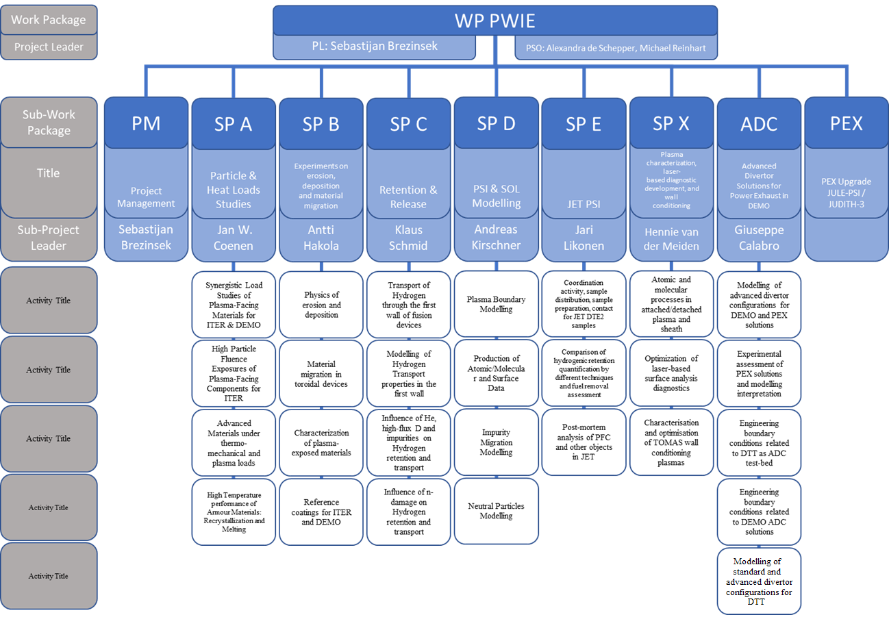
PWIE 2021/2022: SPA
Notes:
Please mark your Subproject in

Slide 4
Milestones 2022
Relevant Work Package Milestones for SPA extracted from WPPWIE PMP 2022
WM28 | SP A | Comparison of W-heavy alloy PFCs with other advanced W materials developed in EUROfusion with focus on combined /sequential high heat flux and high fluence plasma exposure carried out (DEMO+ITER) | 31.12.2022
WM29 | SP A | Exposure of DEMO baseline PFC mono-blocks (from WPDIV) in MAGNUM-PSI in D+Ar and optional with He addition to high fluence plasmas (DEMO) | 31.12.2022
WM30 | SP A | Modelling of W melt experiments in ASDEX Upgrade and WEST with MEMOS-U completed (ITER+DEMO) | 31.12.2022
Notes:
Repalce by your SPX

Slide 5
SP A Deliverables 2022
Activity | Deliverable | Title
PWIE-SP A.1. | D001 | Damage threshold for different W materials at varying loading conditions in matrix form / Understanding the damage mechanisms and changes in material properties and changes in the retention behavior (FZJ)
PWIE-SP A.1. | D002 | Pre-crack damage evolution and erosion under transient loading (DIFFER)
PWIE-SP A.1. | D003 | Qualification of OLMAT as HHF facility in comparison with QSPA and GLADIS (CIEMAT)
PWIE-SP A.1. | D004 | Qualification of W-Heavy Alloys for use in W7-X in conjunction with test on new tungsten mock-ups (WPMAT) and PFUs for WEST (WPTE) (MPG)
PWIE-SP A.1. | D005 | Qualification of current baseline materials under transient (HHF plasma load with QSPA) and steady state loading (PSI-2, JUDITH) (KIPT)
PWIE-SP A.2. | D001 | Influence of plasma on Rx under slow transient loading (DIFFER)
PWIE-SP A.2. | D002 | Pre- and post-characterization of samples (MPG)
PWIE-SP A.3. | D001 | Analysis of Material behavior e.g. (W_{f}/W) under Plasma and heat loading regarding mechanical properties e.g. cracking, embrittlement, and microstructure. Link to SP A4 (FZJ)
PWIE-SP A.3. | D002 | Performance of advanced materials under high heat loads and their microstructural characterization (MPG)
PWIE-SP A.3. | D003 | Results from tests of small-scale samples of W and other advanced materials and components (LPP-ERM/KMS)
PWIE-SP A.3. | D004 | Investigation of advanced materials under ELM-like/disruption transient loading and subsequent analysis (KIPT)
PWIE-SP A.3. | D005 | Exposure of advanced materials in Magnum-PSI and subsequent analysis including thermal shock response of CVD-W to pulsed plasma (DIFFER)
PWIE-SP A.3. | D006 | Effect of energetic ion irradiation on the strength of W wire (MPG)
PWIE-SP A.4. | D001 | Assessment of hydrogen impact on material properties linked to ITER relevant PFUs (CEA)
PWIE-SP A.4. | D002 | Annealing of chosen tungsten-based materials and quantification of recrystallization kinetics (DTU)
PWIE-SP A.4. | D003 | Development and validation of the MEMOS-U code (link with WPTE – WEST/AUG) (VR)
PWIE-SP A.4. | D005 | Influence of plasma pre irradiation with heat loads near surface recrystallization on surface damaging with heat loads above the melting threshold (KIPT)
PWIE-SP A.4. | D006 | Analysis for PSI-2 exposed materials, focusing on recrystallization (FZJ)
Notes:
Replace by your deliverables

Slide 6
For 2022
Deliverables
D-SPA1 Provide the data, and experimental validation needed for utilisation of current baseline materials in ITER,W7-X and JT60-SA by means of Synergistic exposures in HHF and Linear Plasma Devices. Power load capabilities and damage thresholds.
D-SPA2 Provide the necessary experiments to allow extrapolation of data from existing materials studies towards the effect of high flux and fluence on materials and components.
D-SPA3 Develop qualification methods for advanced materials for ITER & beyond by different thermomechanical test procedures, heat load treatment techniques, and laboratory experiments as well as linear plasma devices.
D-SPA3 Develop tools to assess damage of components under conditions close or above melting temperature as provide understanding of recrystallisation processes of components at high temperature

Slide 7
SP A Tasks 2022
SP A1
Synergistic Load Studies of Plasma-Facing Materials for ITER & DEMO
SP A2
High Particle Fluence Exposures of Plasma-Facing Components for ITER
SP A3
Advanced Materials under thermo-mechanical and plasma loads
SP A4
High Temperature performance of Armour Materials: Recrystallization and Melting
SP A1
Continuation of activities
Evaluation of OLMAT / CIEMAT and adaption for 2022
SP A2
Continuation of activities
Choose new Materials / Mockups
  PRD/MAT/DIV
    SP A3
Continuation of activities
New Material Types / Samples
Synergistic Loads on SMART-W
SP A4
Continuation of Activities
removal to TOKES activities due to EEG
Further extension of Rcrystallisation activities DTU.CEA.FZJ
Notes:
This is just a summary table – Michael will provide it.

Slide 8
General Comments
Main delays in 2022 due to
  Ukrainian War
  Late signing of EUROfusion Agreement in 2021
  Magnum out of operation in large part of 2022

Slide 9
WP PWIE: SPA 1
Overview
Notes:
Please Indicate your subproject

Slide 10
SPA.1:Synergistic Loads ITER & DEMO
Establish a test matrix for Materials utilized in WEST & ITER with respect to updated load specifications. in the available devices (DIFFER, FZJ, MPG)
Study the impact of synergistic loads on ITER and DEMO relevant baseline Materials (tungsten) and new materials developments with Laser (Laser at PSI-2) and e-beam (JUDITH) as well as steady-state plasma exposure (He, H). A special focus will be the qualification of these materials under high cycle numbers and seed-impurities exposure. (FZJ)
Post-mortem analysis will characterize the induced surface modifications and damages as well as investigate changes of the materials properties due to e.g. recrystallization behavior and/or surface morphology changes (FZJ, MPG, DIFFER, KIPT)
Determine underlying mechanisms of evolution of crack propagation in materials for ITER and current day devices (FZJ, DIFFER, KIPT, MPG)
Qualify W materials for use in W7-X (MPG, FZJ)
Synergy effects from sequential stationary (PSI-2 / MAGNUM-PSI) and transient (QSPA) plasma loads. (DIFFER, MPG, FZJ, KIPT)
Studies of fatigue cracks formation in deformed/re-crystalized W, fatigue damage of W_{f}/W wires, latticing W etc.
Combination of pulsed and steady state loading (e.g. behaviour of QSPA pre-damaged targets in PSI-2, JUIDTH compared with reference samples) (FZJ, KIPT)
Study the Behavior of pre-cracked samples under edge loading conditions - links to HHF facilities such as JUDITH and WEST (DIFFER, FZJ)
Isssues: Magnum Delays – thus 2021 work done but 2022 shifted / Ukrain War
Deliverable SPA 1: T001-D001, T001-D002 , T001-D003, T001-D004, T001-D005
Status: 2022 on track, further work in 2023, MAGNUM shifted, QSPA shifted
Facilities: PSI-2 14d JUDITH 10d, Gladis 4d, Magnum 5 days, QSPA 10d, OLMAT 4d
Human Resources: total # 48.5PM
Involved RU: FZJ,DIFFER,CIEMAT,MPG,KIPT
Linked WP or TSVV: WPTE, WPMAT, WPDIV
Notes:
PD: Plasma Devices as in PEP listed
HHF: High Heat flux as in PEP listed
IBF: Ion beam Facility as in PEP listed
Other facilties as in PEP listed

Slide 11
WP PWIE: SPA 1
Results
Notes:
Please Indicate your subproject

Slide 12
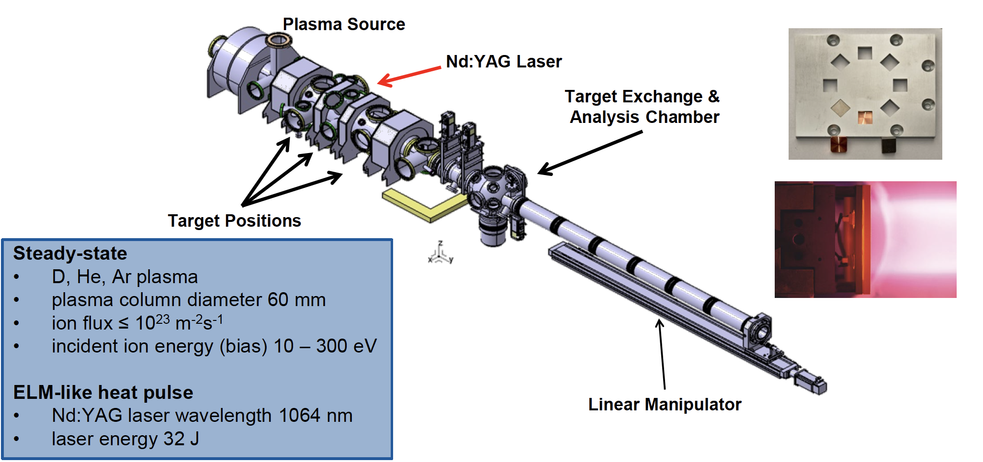
Work at PSI-2 FZJ
Damage threshold for different W materials at varying loading conditions in matrix form
& Understanding the damage mechanisms and changes in material properties, influence of / changes in the retention behavior (FZJ)

Slide 13
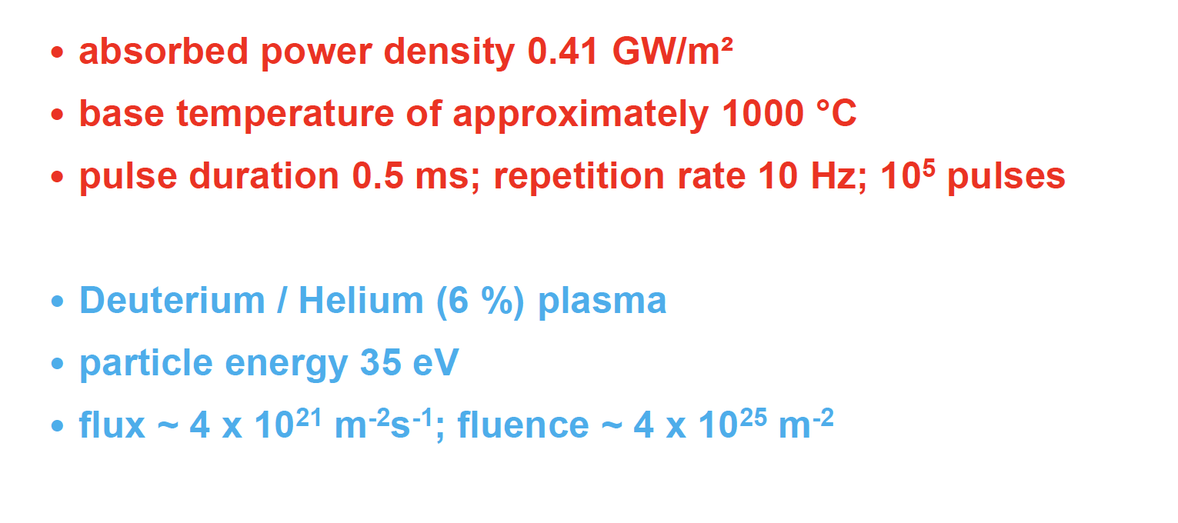
Conditions

Slide 14
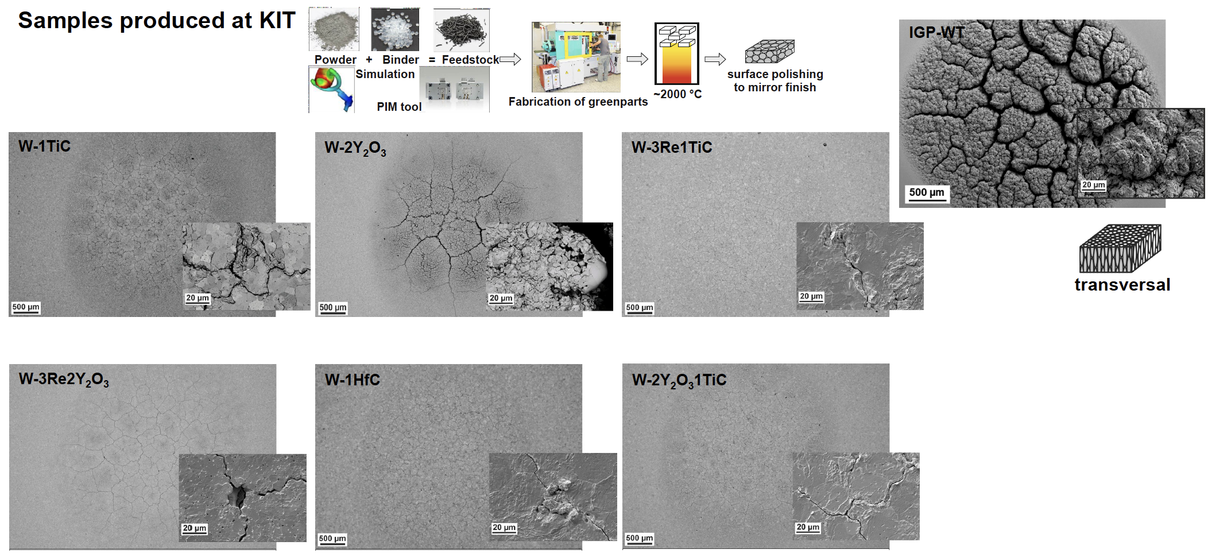
PIM with high pulse number exposures

Slide 15
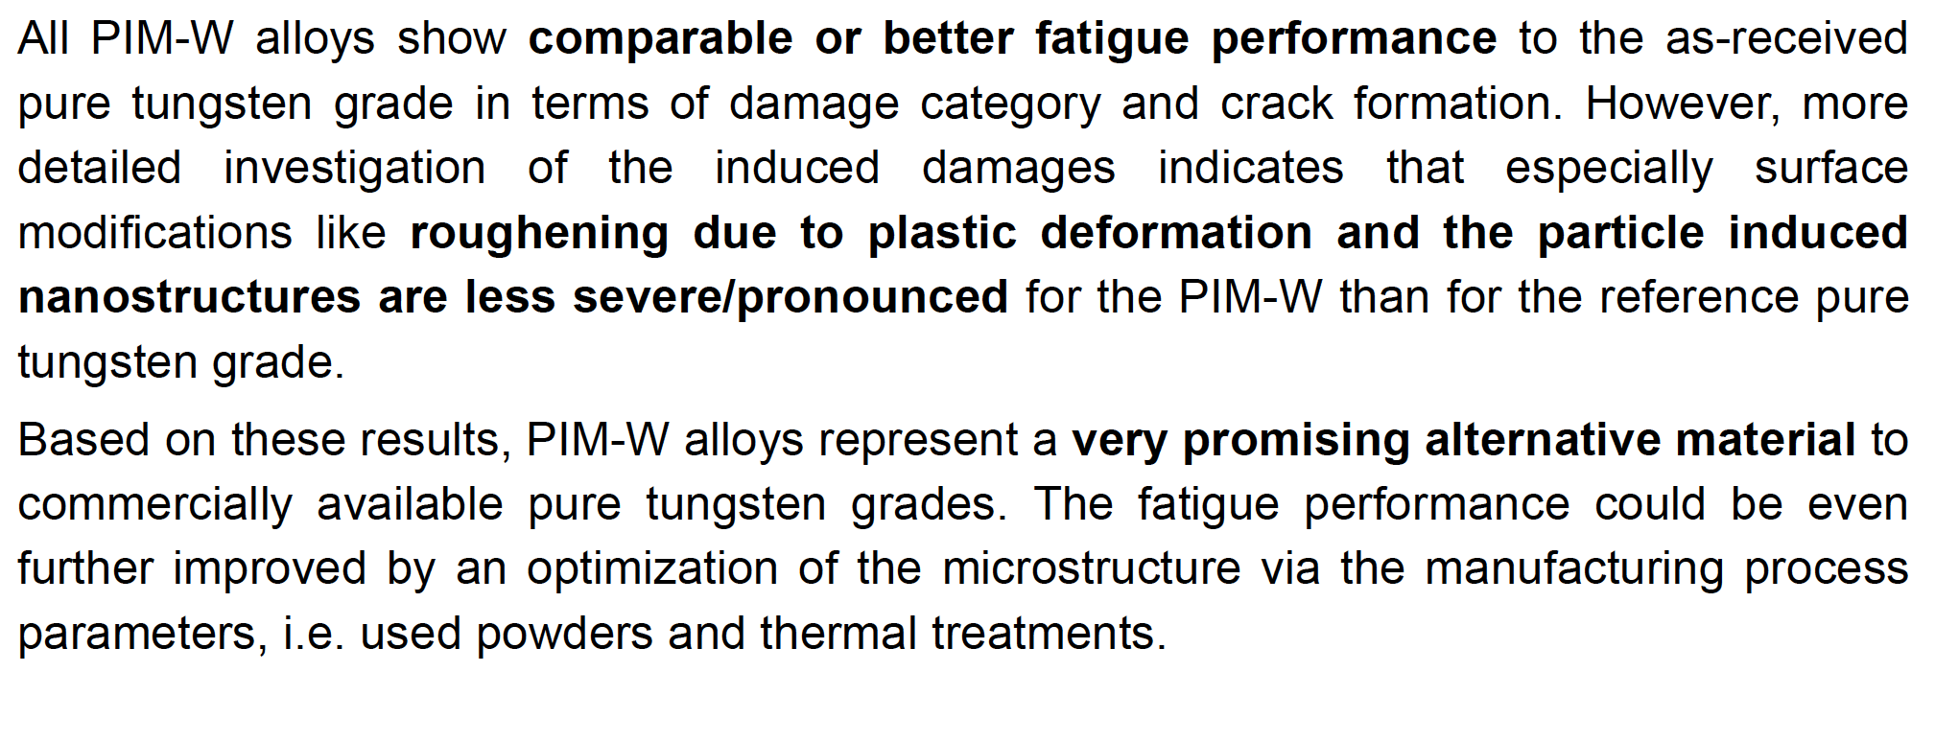
PIM Summary

Slide 16
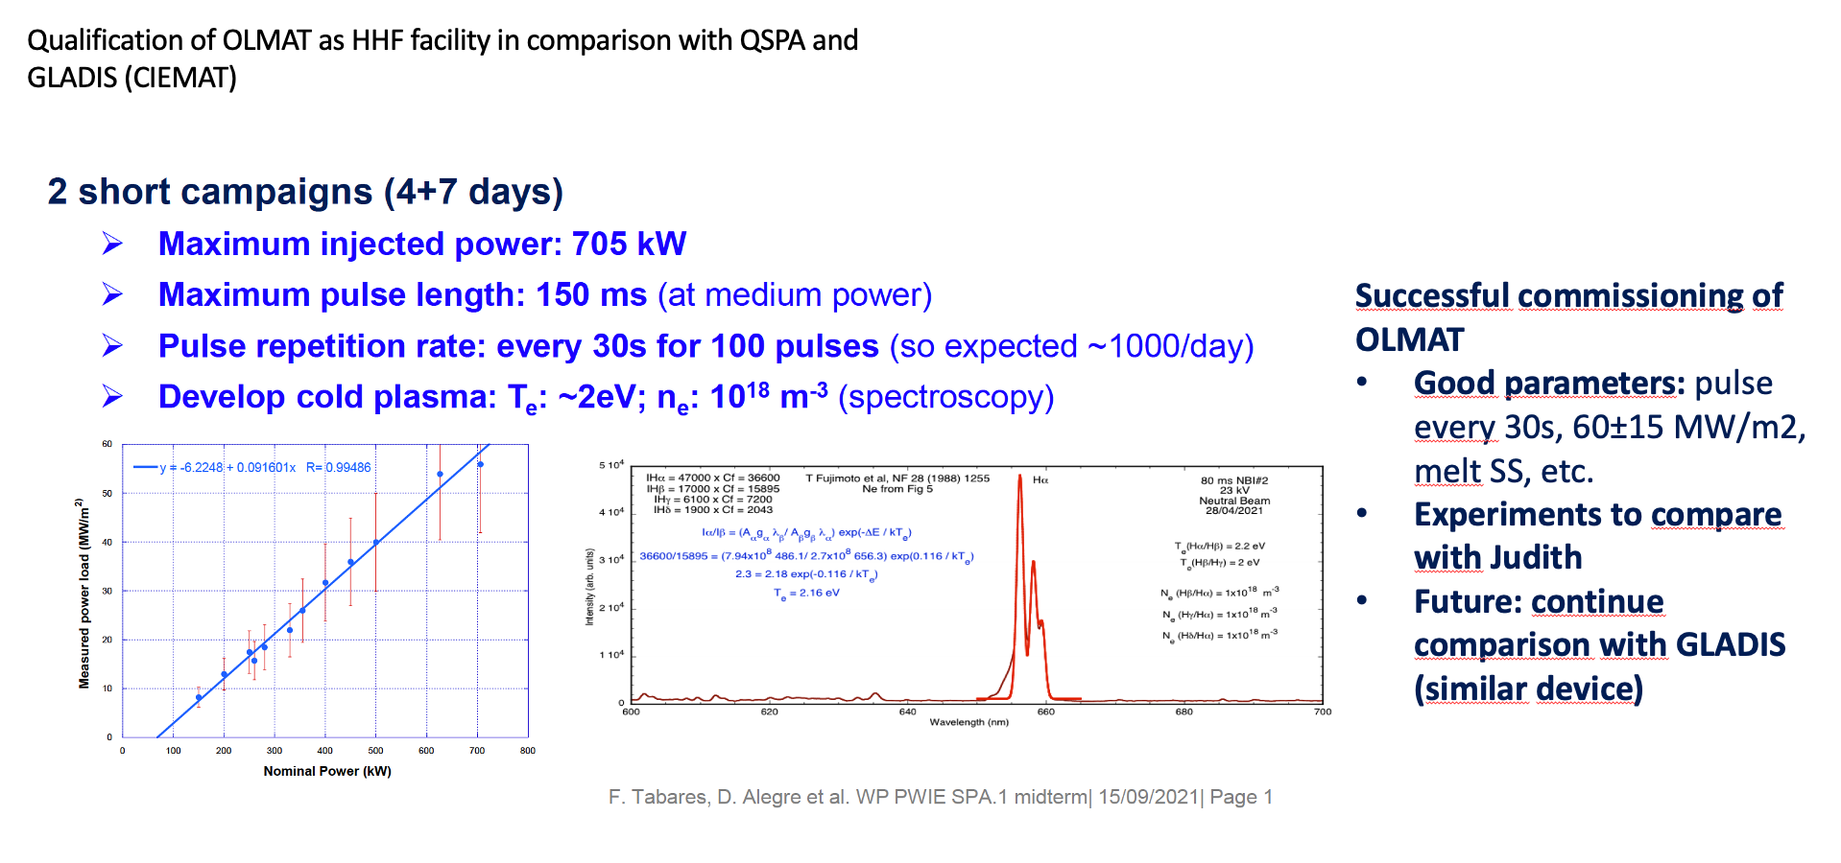
Work at OLMAT - CIEMAT
Comissioning in 2021
OLMAT as a HHF Facility for Testing ITER & DEMO DivertorArmor Materials

Slide 17
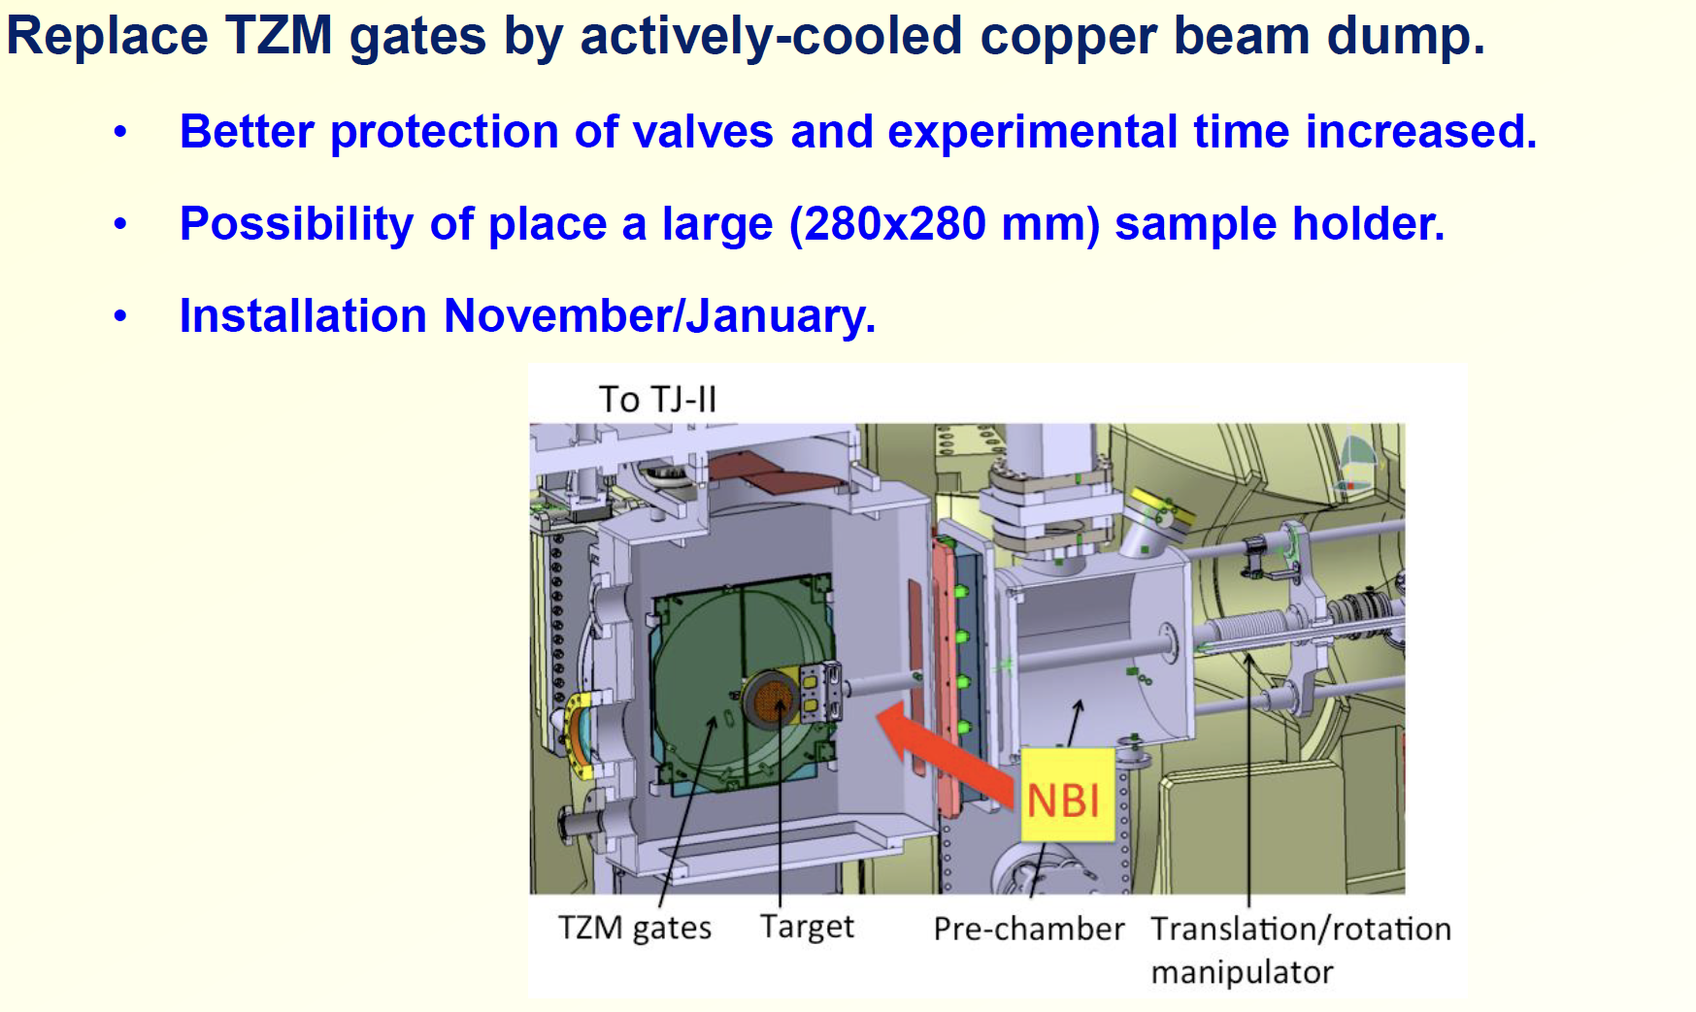
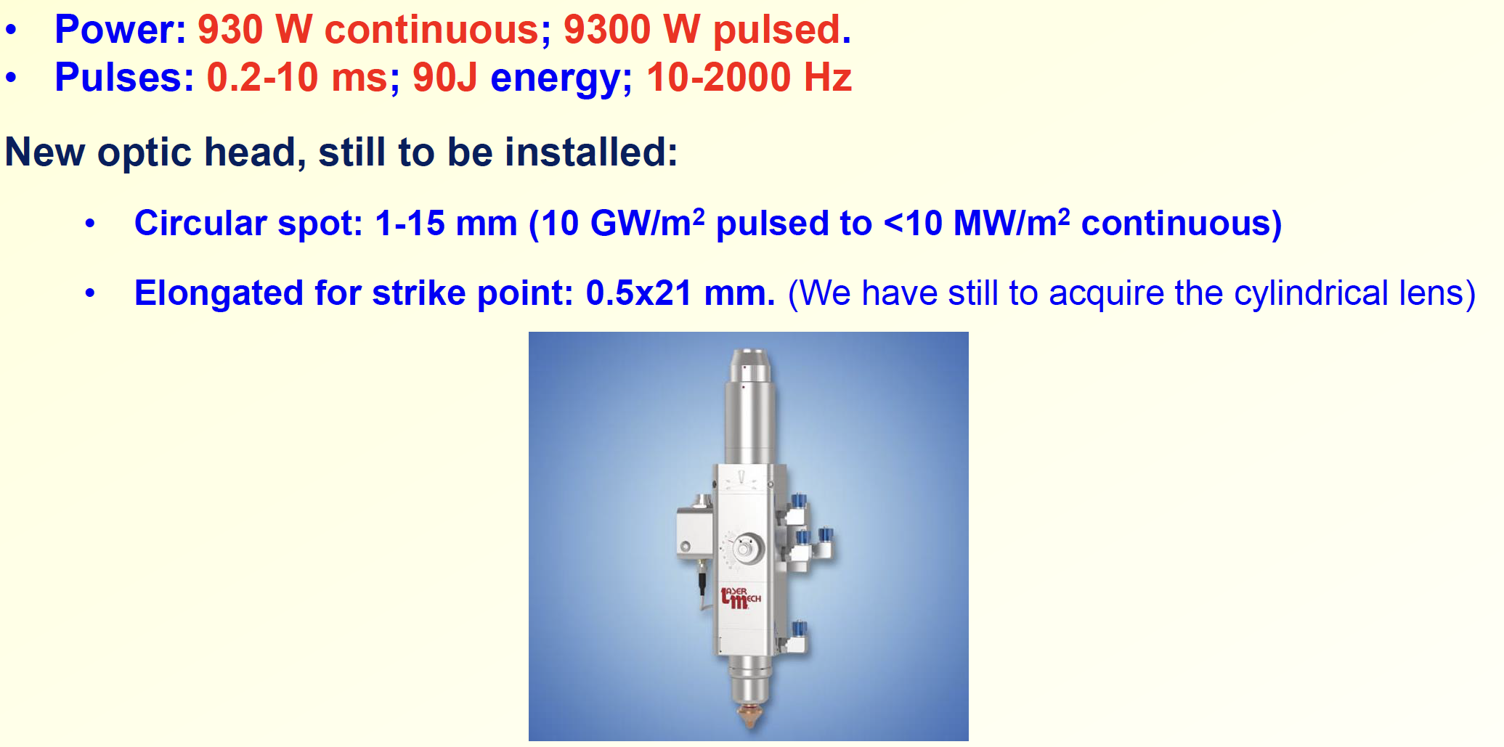
Upgrades in 2021

Slide 18
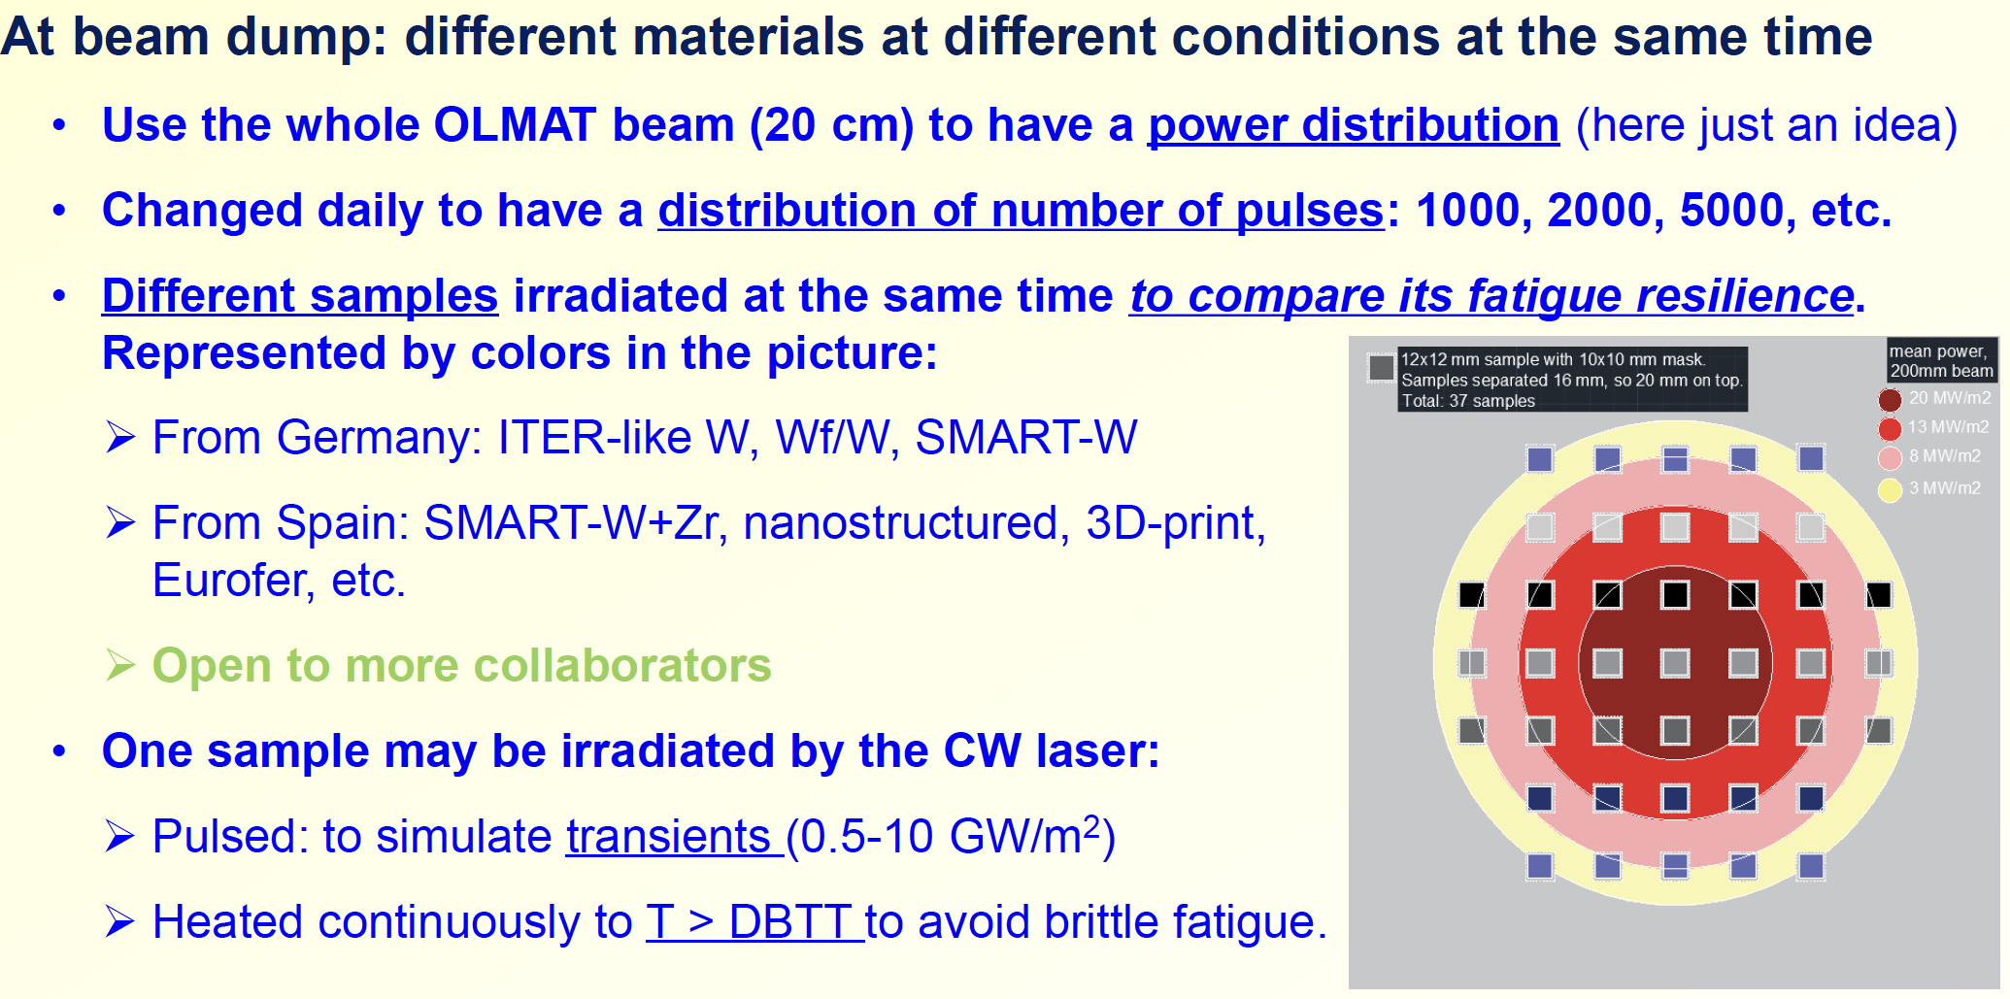
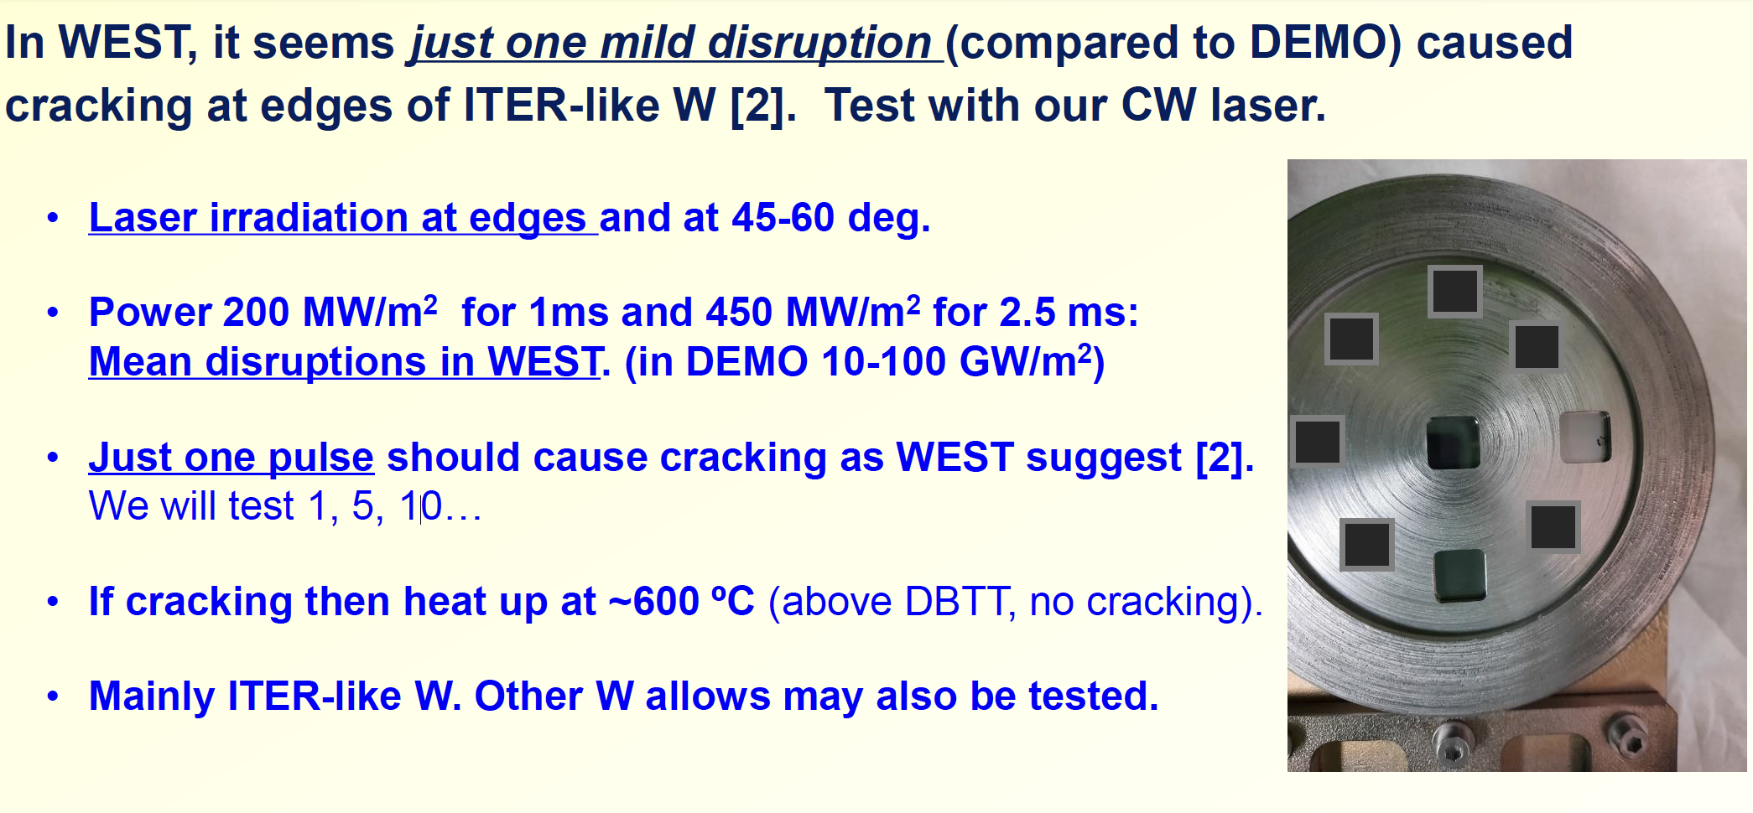
Experiments in late 2022

Slide 19
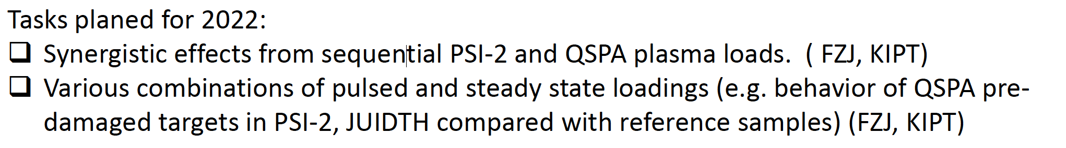
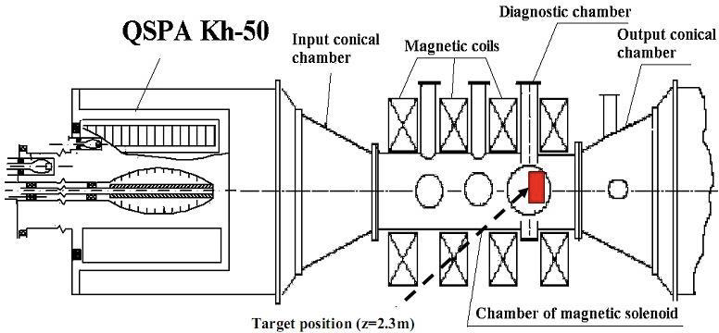
Work at QSPA(s) KIPT / Ukraine
https://indico.euro-fusion.org/event/2219/attachments/3643/6494/KIPT.pdf
Qualification of current baseline materials under transient (HHF plasma load with QSPA) and steady state loading (PSI-2, JUDITH) (KIPT)

Slide 20
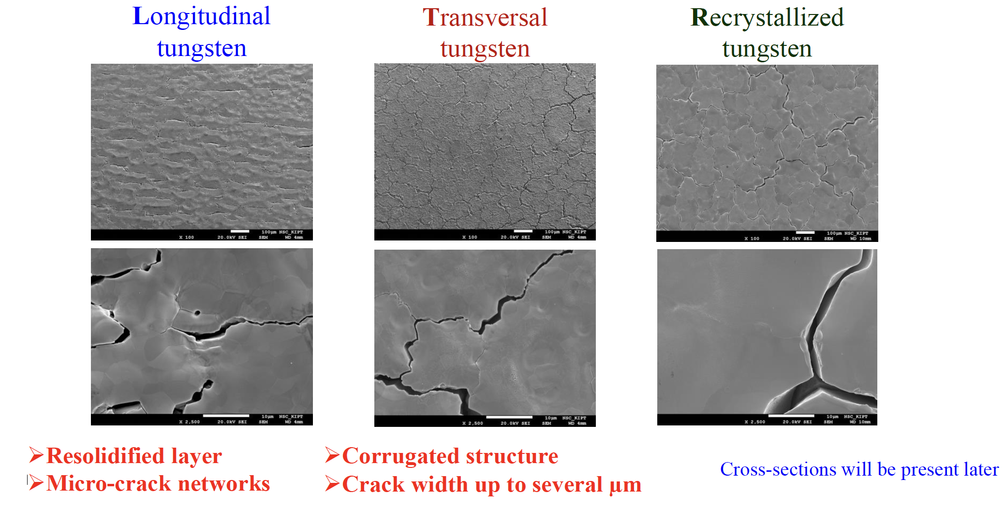
SEM for 200 pulses, q=0.75 MJ/m²,T_{base}=400 C

Slide 21
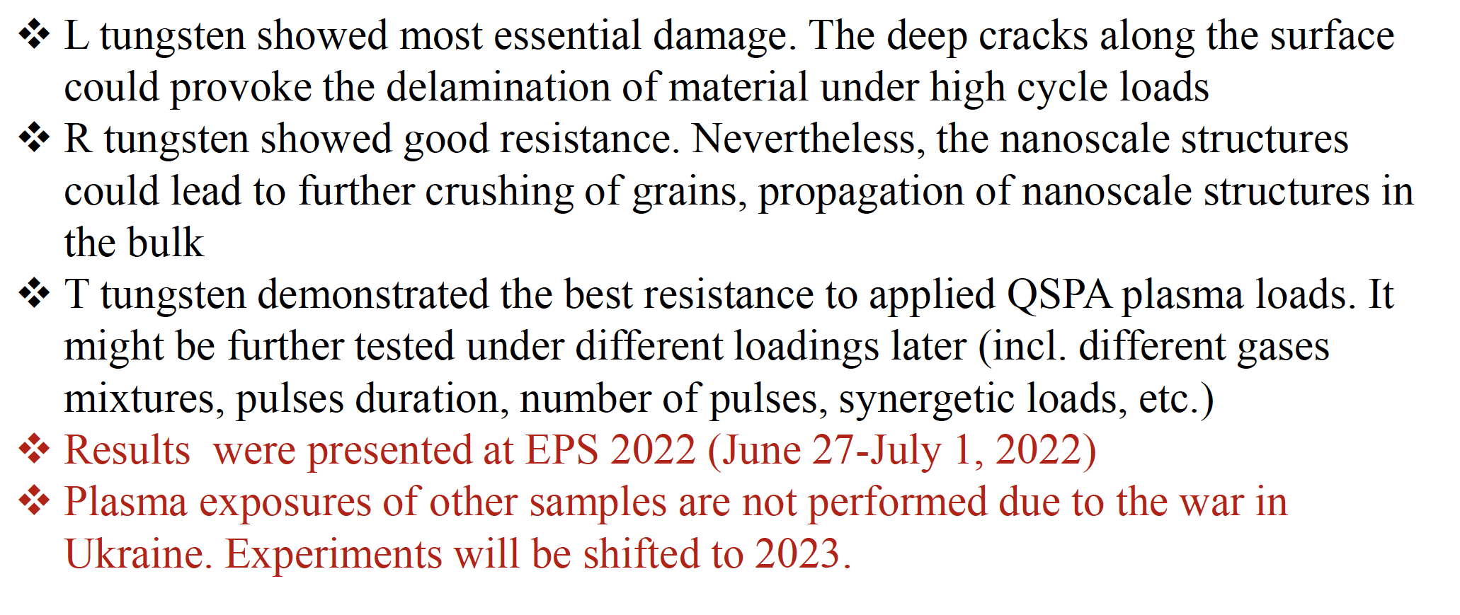
Summary KIPT

Slide 22
WP PWIE: SPA 2
Overview
Notes:
Please Indicate your subproject

Slide 23
SPA.2:High Particle Fluence Exposures
Inputs required:
W components produced e.g. by ENEA via WP DIV
PFUs and similar
Tasks to be performed:
Recrystallization behavior of DEMO tungsten grades under high flux/fluence plasma loading (DIFFER)
Pre- and post analysis of materials and components (MPG)
Further analysis linked to facilities and staffing in SP B
Isssues: Magnum Delays
Deliverable SPA 2: T001-D001 T001-D002
Status: 2021 on track , further work in 2023,
Facilities: MAGNUM #7d
Human Resources: total # 9PM
Involved RU: DIFFER,MPG
Linked WP or TSVV: WPTE, WPMAT, WPDIV
Notes:
PD: Plasma Devices as in PEP listed
HHF: High Heat flux as in PEP listed
IBF: Ion beam Facility as in PEP listed
Other facilties as in PEP listed

Slide 24
WP PWIE: SPA 2
Results
Notes:
Please Indicate your subproject

Slide 25

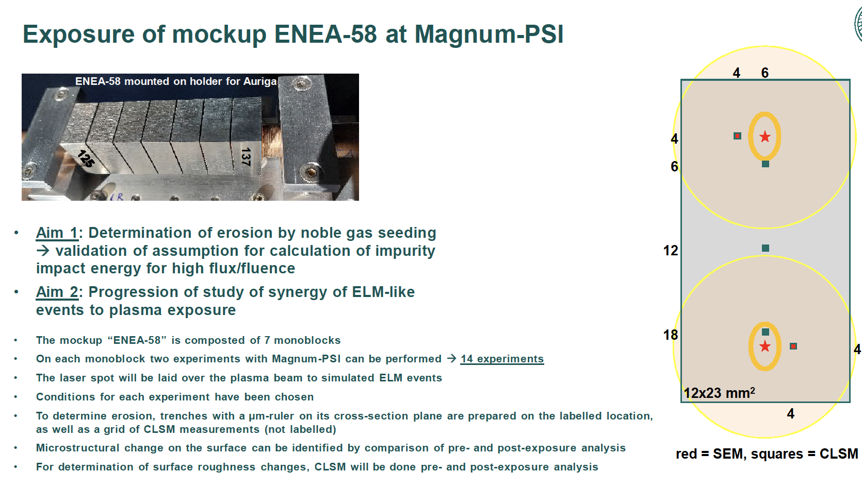
Work at IPP/MPG
related to targets exposed at Magnum
Pre- and post-characterisation of ENEA-58 mock-up for exposure in Magnum-PSI

Slide 26
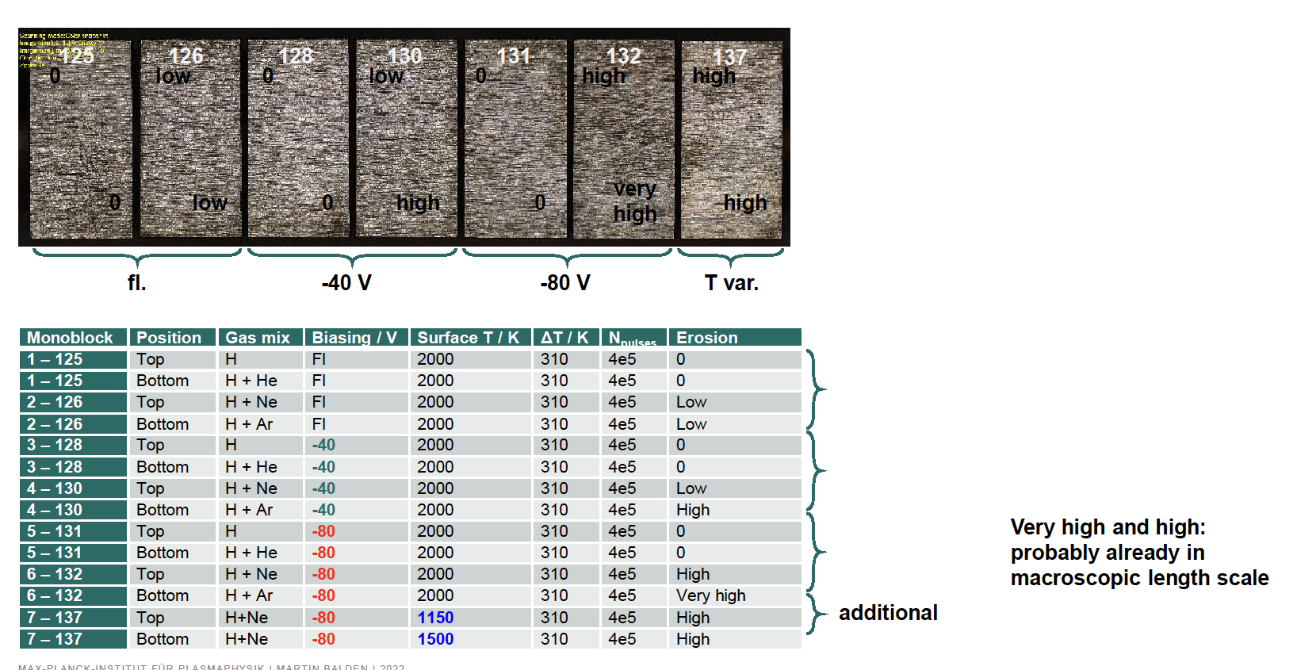
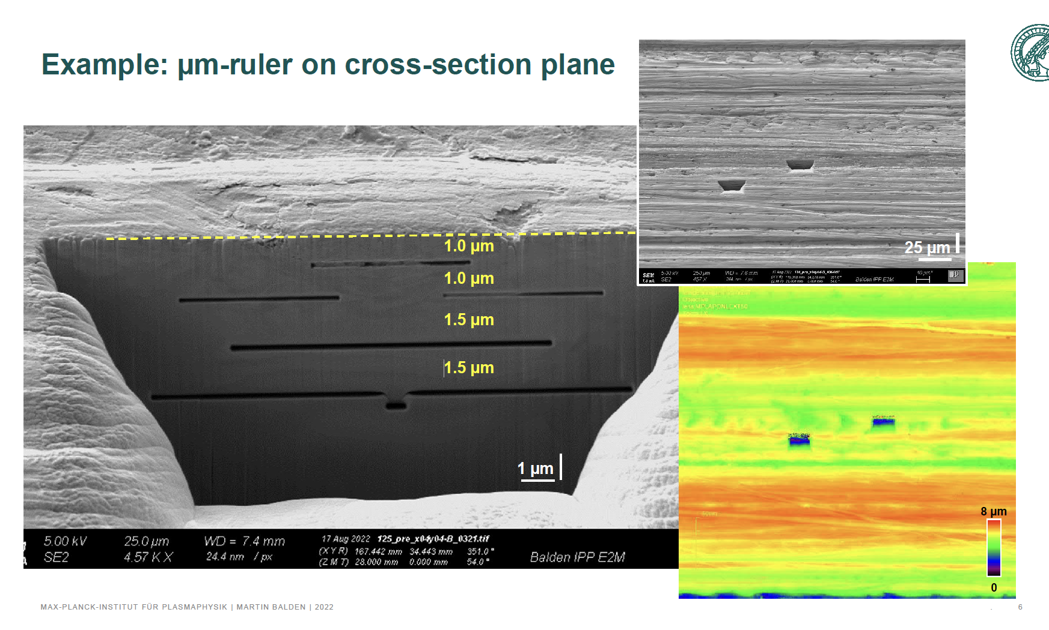
Exposure of mockup ENEA-58

Slide 27
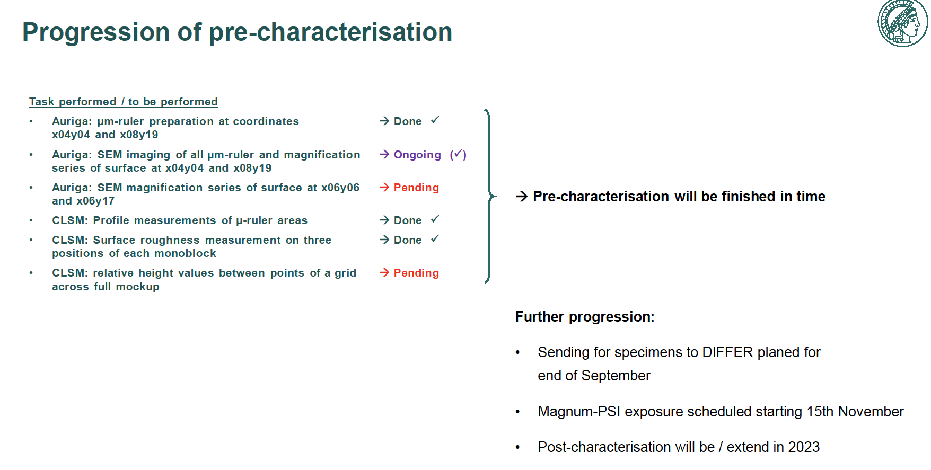

Slide 28
WP PWIE: SPA 3
Overview
Notes:
Please Indicate your subproject

Slide 29
SPA.3:Advanced Materials …
Tasks to be performed:
Plasma qualification of new materials (WPMAT) and components (WP DIV) for DEMO: Thermal shock and plasma synergistic loading of advanced material including exposures in Magnum-PSI (KIPT, DIFFER, FZJ)
Exposure of advanced materials e.g. W_{f}/W (WP PRD), SMART alloys (WP MAT), additively manufactured components (WP DIV) and others to heat loads and/or plasma loads for assessment of their PWI properties and exploration of limits of their application (FZJ, MPG)
Study of basic thermo-mechanical properties for advanced materials for divertor applications including reference material properties for comparison with neutron-irradiated sample in future (LPP-ERM/KMS, MPG)
  Establish experimental techniques
  Mechanical testing of W-yarns up to very high temperatures, subsequent microstructural characterization (link to neutron irradiation of W yearns & subsequent mechanical testing) (SCK-CEN as part of RU LPP-ERM/KMS)
  Establish experimental basis by e.g. self or proton damage (MPG, FZJ)
  Effect of fusion environment on the mechanical properties of W wire (MPG)
Exposure in plasma devices to study the interplay of recovery, recrystallization, plasma and ELM-like loading on surface cracking and fatigue lifetime (FZJ, KIPT, DIFFER)
Post-mortem analysis to characterize the induced surface and microstructure modifications as well as changes of the materials properties due to e.g. recrystallization behavior and/or surface morphology changes (FZJ, MPG)
Issues: NONE
Deliverable: SPA A3 : T001-D001, T001-D002 , T001-D003, T001-D004, T001-D005, T001-D006
Status: 202 om track, further work in 2023
Facilities: PSI-2 #11d JUDITH # 10d, Gladis #4d, Accelartor #10 days, QSPA #5d, Magnum #4d
Human Resources: total # 32.5PM
Involved RU: FZJ,DIFFER,LPP-ERM/KMS,MPG,KIPT
Linked WP or TSVV: WPTE, WPMAT, WPDIV
Notes:
PD: Plasma Devices as in PEP listed
HHF: High Heat flux as in PEP listed
IBF: Ion beam Facility as in PEP listed
Other facilties as in PEP listed

Slide 30
WP PWIE: SPA 3
Results
Notes:
Please Indicate your subproject

Slide 31
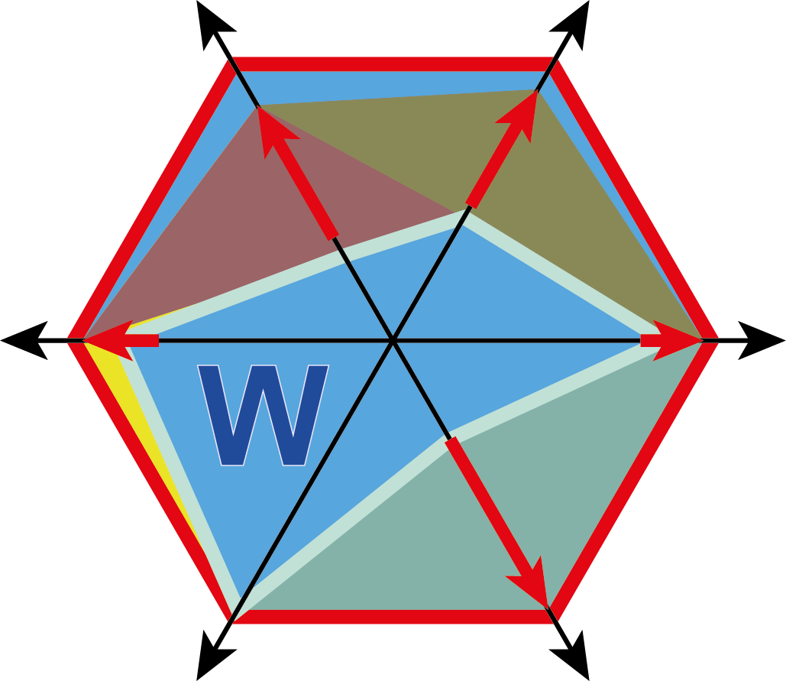
Work on Advanced Tungsten Materials
Mechanical properties
Metal-matrix composites
Oxidation
Thermal properties
H isotope interaction
D001 Analysis of Material behavior e.g. (Wf/W) under Plasma and heat loading regarding mechanical properties e.g. cracking, embrittlement, and microstructure.
Sputtering
Activation
Transmutation

Slide 32
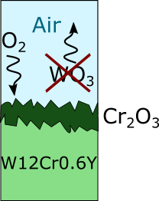
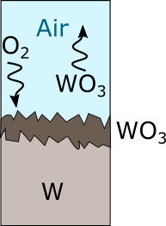
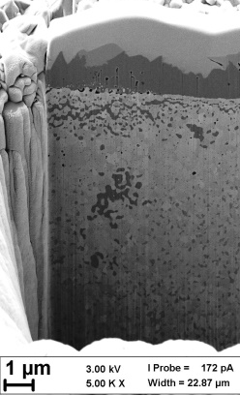
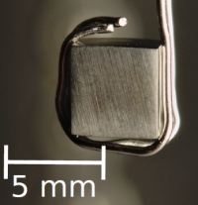
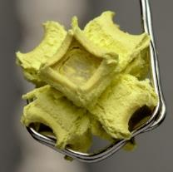


Tungsten based Smart ALLOYs
Utilize chromium and yttrium to achieve stable oxidation suppression
Fusion accidents & Oxidizing environments
Challenge:
Suppress oxidation when utilizing refractories during ‘Loss of coolant’ and air ingress
W-Cr-Y alloys form protective chromium oxide layer
Formation of tungsten-oxides is suppressed
Addition of yttrium (~ 0.6 wt%) is crucial
Nucleation sites, grain-boundary segregation, oxide pegs, impurity binding…
1000°C, 1 bar,
80 vol.% Ar+20 vol.% O₂, 10 hours
Litnovsky, A.; Klein, F.; Schmitz, J.; Wegener, T.; Linsmeier, C.; Gilbert, M.; Rasinski, M.; Kreter, A.; Tan, X.; Mao, Y.; Coenen, J.W; Bram, M. & Gonzalez-Julian, J. Smart first wall materials for intrinsic safety of a fusion power plant
Fusion Engineering and Design, Elsevier BV, 2018

Slide 33
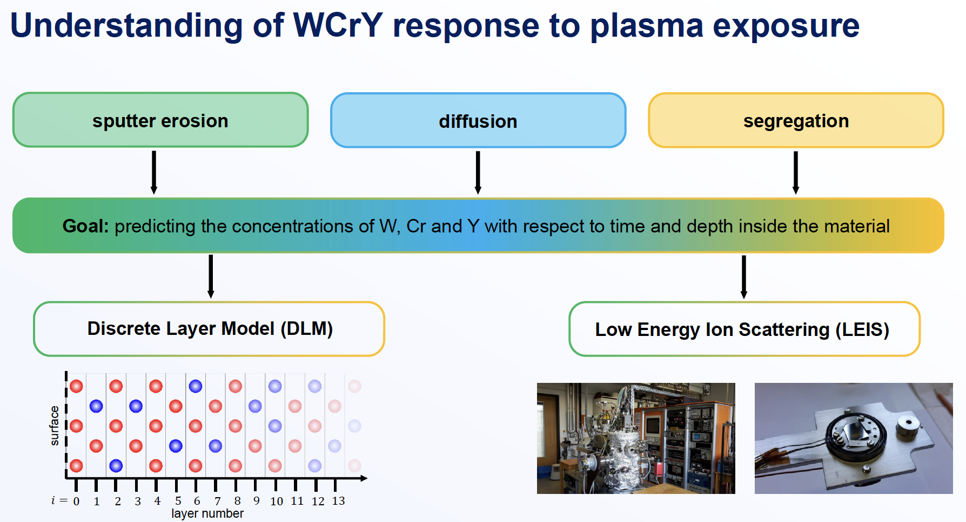
An update on SMART material studies

Slide 34
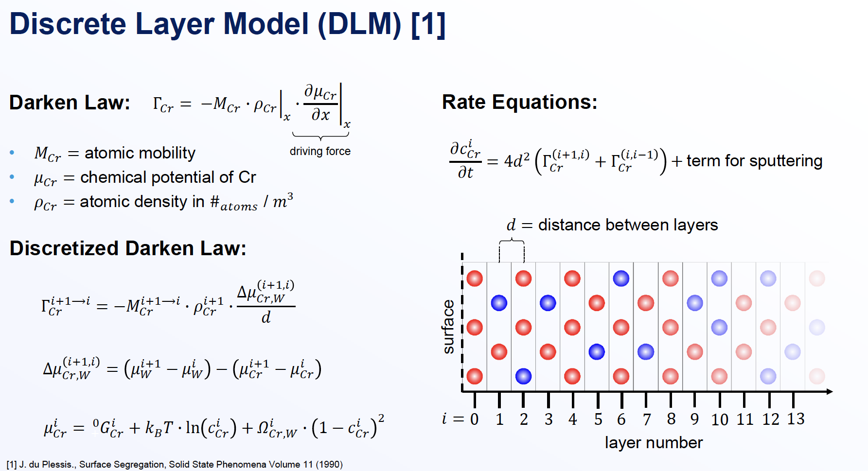

Slide 35
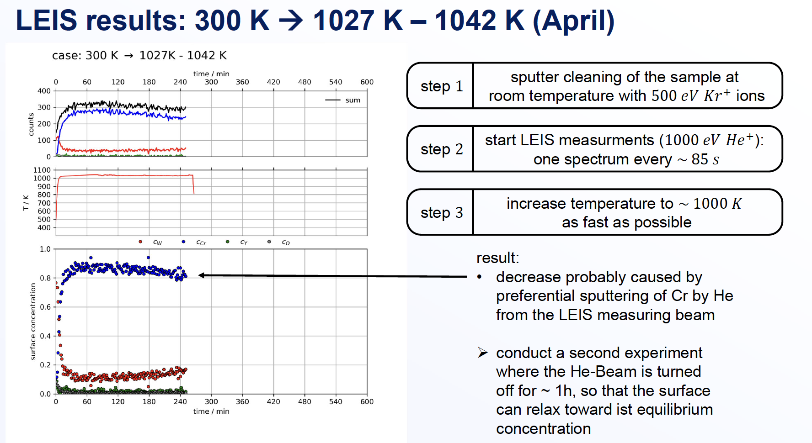
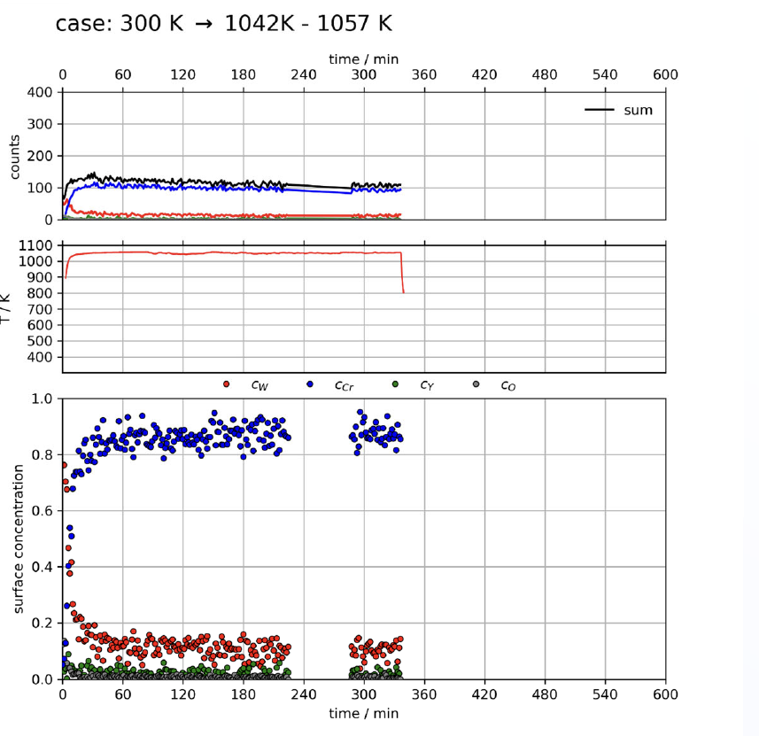
LEIS results

Slide 36
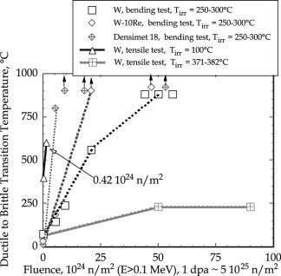
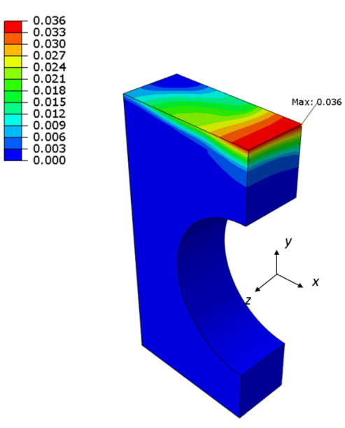
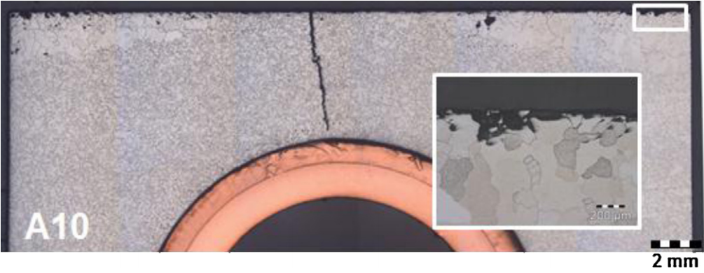
D005 Y. Mao Exposure of advanced materials in Magnum-PSI and subsequent analysis
Intrinsic brittleness of tungsten material limits its application in future fusion devices
Thermal heat load at the divertor: thermal stress and thermal fatigue
Accumulated equivalent plastic strain field in the tungsten armor block after the 5th HHF load cycle at 20 MW/m².
-H. Bolt, V. Barabash, G. Federici, J. Linke, A. Loarte, J. Roth, K. Sato, Plasma facing and high heat flux materials - Needs for ITER and beyond, J. Nucl. Mater. 307-311(1 SUPPL.) (2002) 43-52.
-G. Pintsuk, I. Bobin-Vastra, S. Constans, P. Gavila, M. Rödig, B. Riccardi, Qualification and post-mortem characterization of tungsten mock-ups exposed to cyclic high heat flux loading, Fusion Eng. Des. 88(9-10) (2013) 1858-1861.
Neutron embrittlement reduces the toughness of W during fusion operation
-M. Li, J.-H. You, Interpretation of the deep cracking phenomenon of tungsten monoblock targets observed in high-heat-flux fatigue tests at 20 MW/m 2, Fusion Eng. Des. 101 (2015) 1-8.
A damage resilient material is required

Slide 37
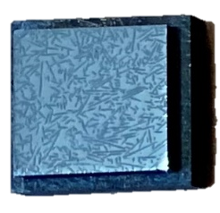
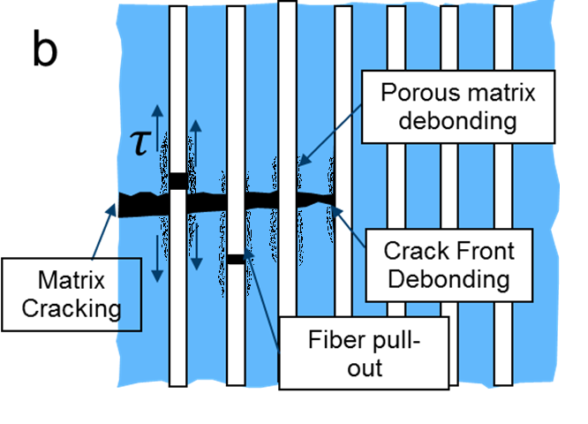
Porous matrix W_{f}/W
It is the same principle like weak interface composite
“a controlled amount of fine scale matrix porosity, obviating the need for a fiber coating.
This approach can be viewed as an extension of the porous coating concept wherein crack deflection occurs because of the low fracture toughness of the porous interphase.”
Examples:
SiC/SiC
CFC

Slide 38
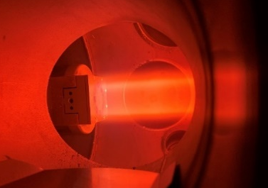
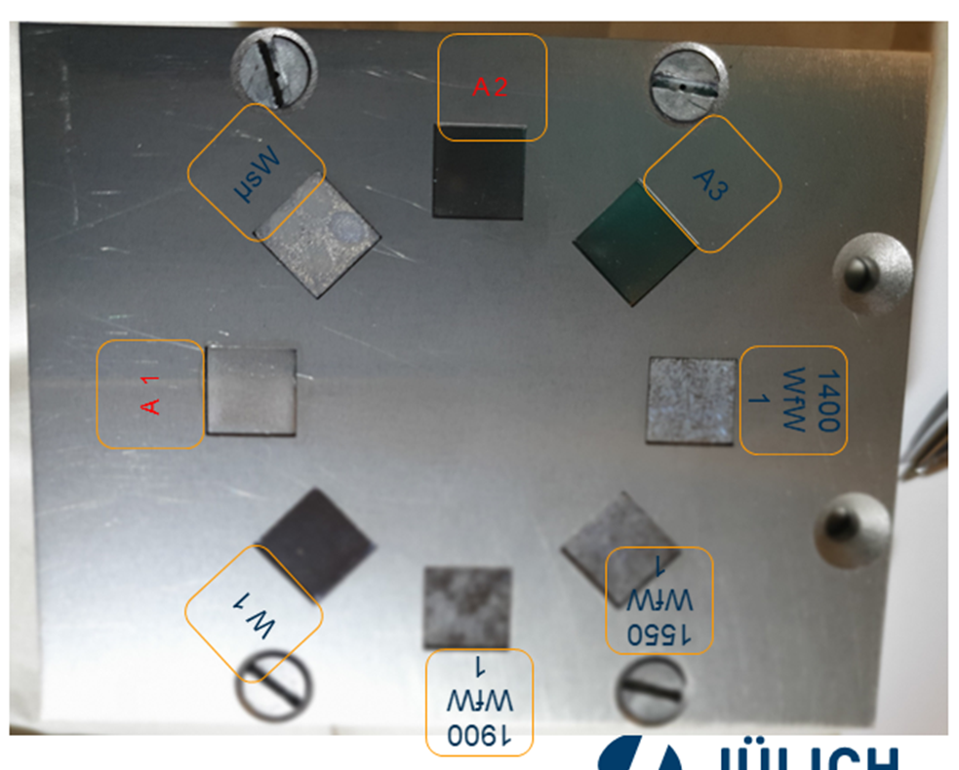
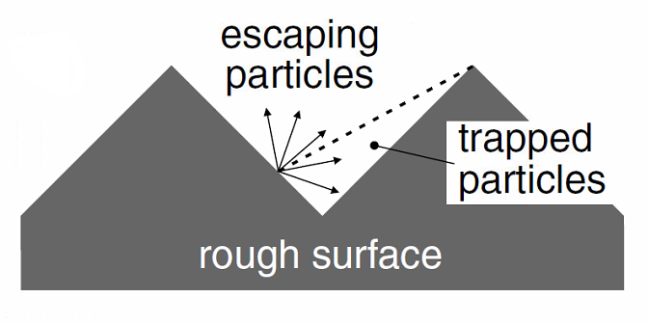
Plasma erosion on porous matrix W_{f}/W
Neon plasma, 98-117 eV, total fluence of 3,65×10²⁴ Ne⁺ m⁻², 100 min, ~200⁰C
Theoretical weight loss due to sputtering is 4.0 mg
With the increasing porosity, the weight loss decreases
The sputtered W were re-caught by the pores/surface roughness

Slide 39
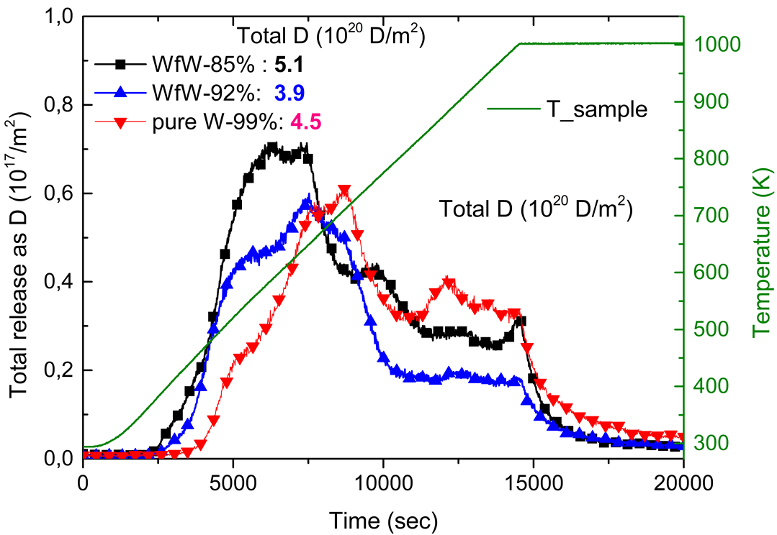
D retention
For deuterium retention evaluation, the D plasma exposure was applied. The average bias voltage between the D plasma and the samples was 78 eV; the total fluence was 4.99x10²⁵D⁺ m⁻². During the exposure, the temperature was ~202 °C. Then the D retention was measured by TDS
Porous matrix W_{f}/W shows similar retention compared to pure W

Slide 40
Goal
As we can see, the reduced erosion mass loss relies on the surface morphology. It need to be investigated that whether there is a limit of this effect, how does the surface morphology change after long time exposure. Also, how is the high plasma flux influences this effect.
Due to the open pores, Wf/W give similar D retention compared to pure W. How is the high plasma flux influences this effect (defects?)

Slide 41
Methods
Ne plasma is planned to be used to test the erosion resistance of porous matrix Wf/W and compared to ITER-grade W. Relatively long time exposure is planned together with microstructure characterization in between, to characterize the evolution of the erosion procedure. Up to 8x10²⁶Ne⁺m⁻² (54V bias).
D plasma is planned to be used to test the D retention with high plasma density and flux. Up to 2,3x10²⁷D⁺m⁻² (54V bias)
Ne plasma
2.5x10²⁵Ne⁺m⁻²
Inspection
Ne plasma
3,2x10²⁶Ne⁺m⁻²
Inspection
Ne plasma
8x10²⁶Ne⁺m⁻²
Erosion
Characterization
D plasma
2.3x10²⁷D⁺m⁻²
Retention
TDS

Slide 42
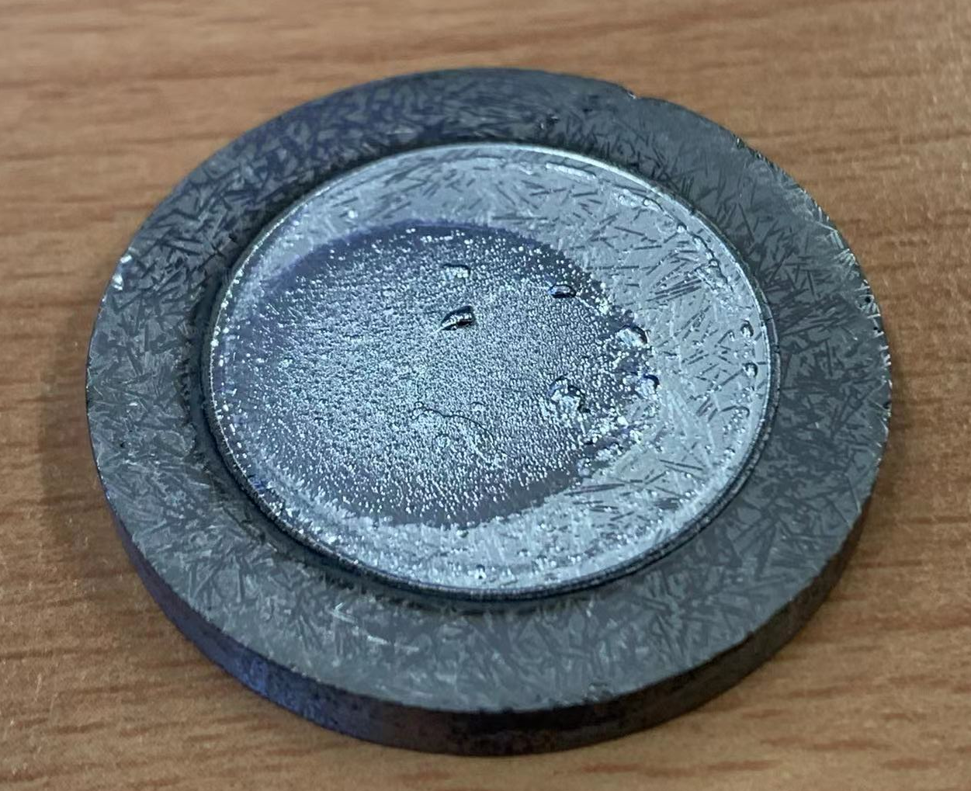
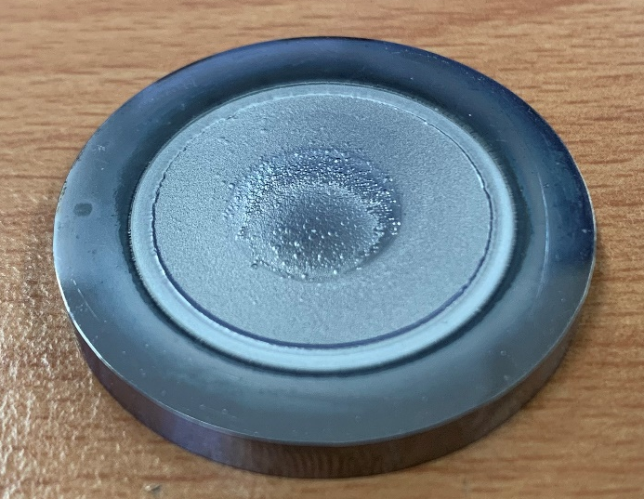
Preliminary results erosion
The mass change is dominated by the re-deposition of the Mo mask

Slide 43

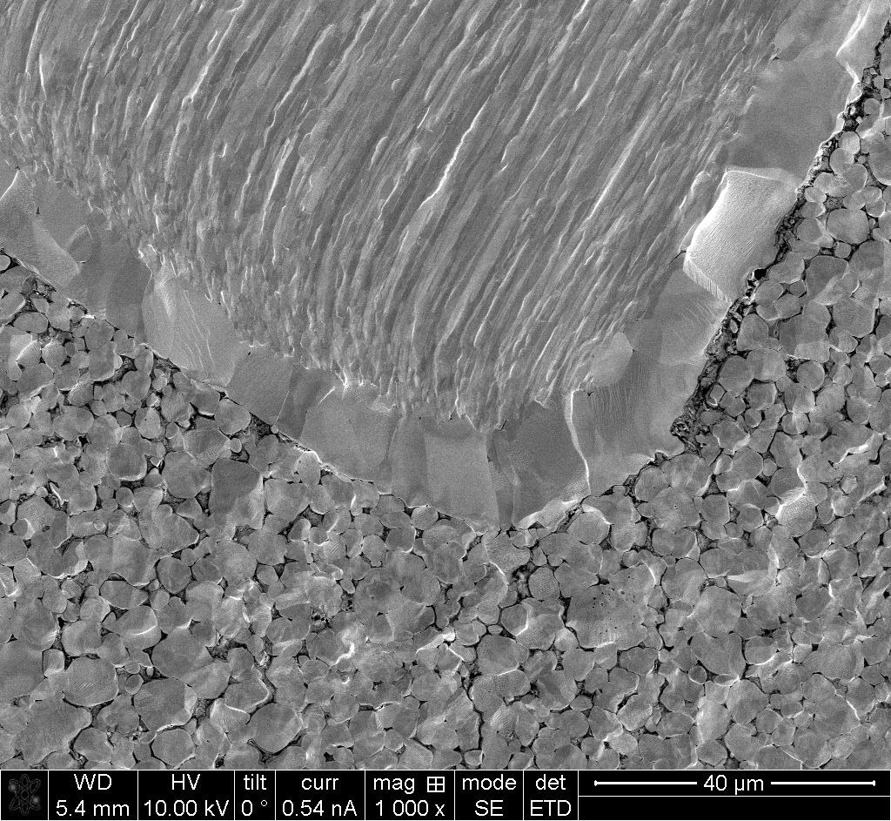
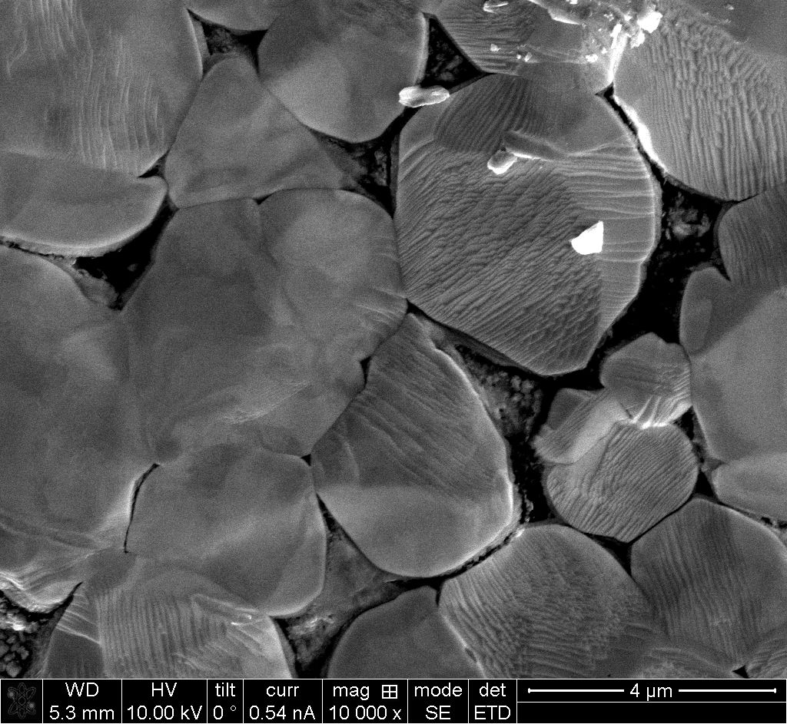
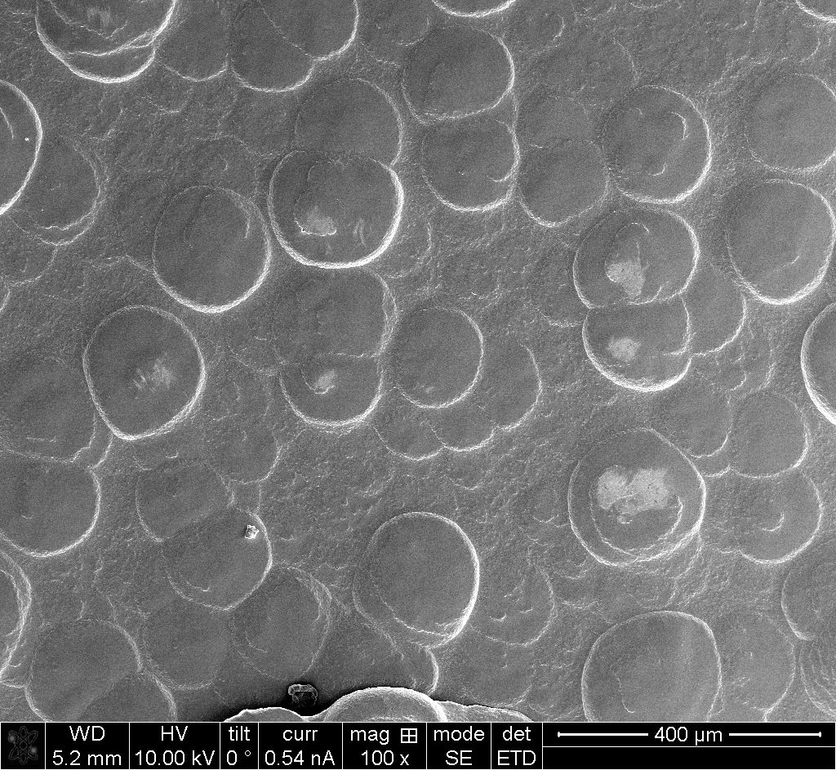
Preliminary results erosion
Erosion area
deposition area

Slide 44
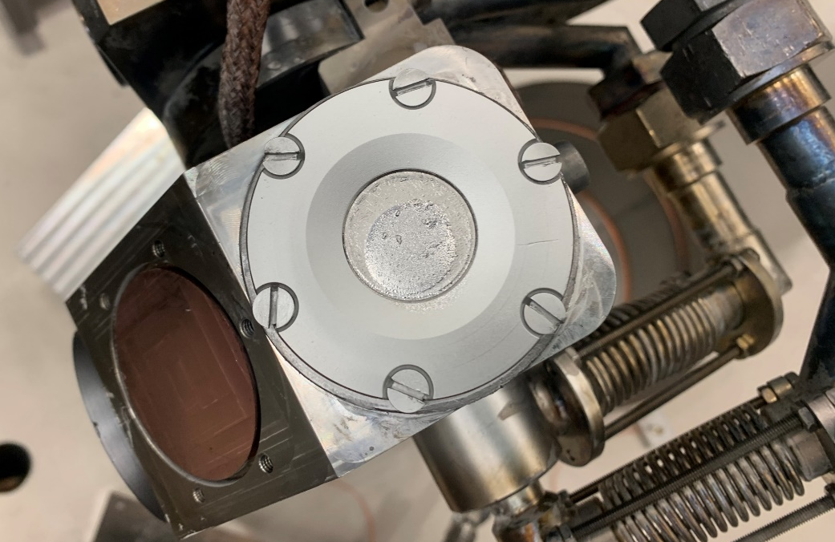
Summary
Ne plasma exposure has been performed up to in order to test the erosion properties of Wf/W
D plasma exposure hase been performed up to in order to test the retention of Wf/W
Re-deposition due to the mask need to be optimized.

Slide 45
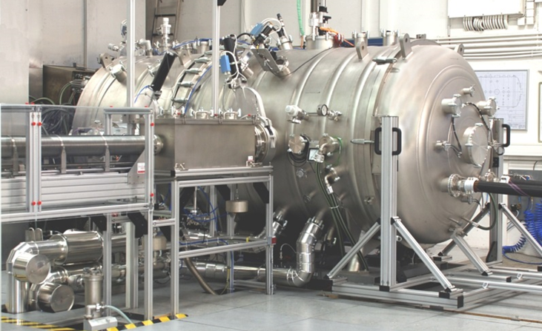
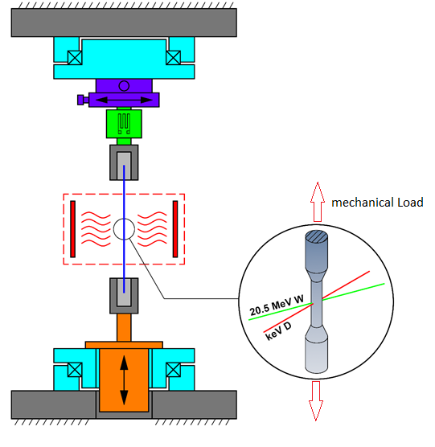
D002 J.Riesch, H.Greuner Performance of advanced materials under high heat loads and their microstructural characterization (MPG)
Performance of advanced materials under high heat loads and their microstructural characterization
  Use high heat flux facility GLADIS at IPP, Garching
  Test advanced W composite based mock-ups until its limits
  Microstructural evaluation by light and
  electron microscopy
Effect of hydrogen on the strength of W wire
  Use in-situ testing device GIRAFFE at IPP, Garching
  Use keV H/D beam to load very thin W wire
  Evaluate change of stress state due to uptake of H/D
Garching LArge DIvertor Sample test facility
[Greuner et al. J NUCL MATER 367-370,(2007) 1444-1448]
General-purpose irradiated fiber and foil experiment
Rotary stage
Load cell
Sample
Heating / Cooling
Linear actuator
Rotary stage

Slide 46
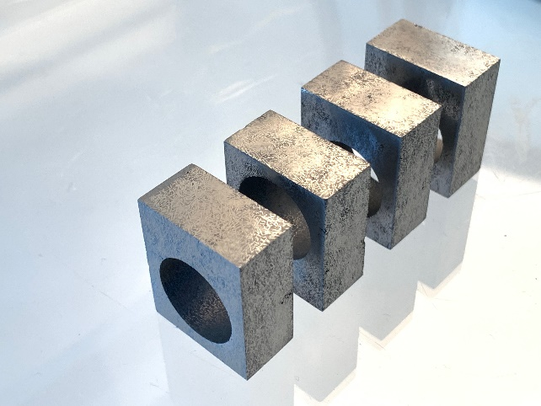
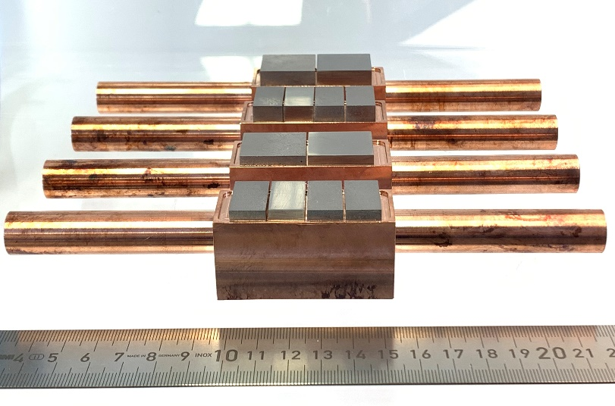
High heat flux tests – new mock-ups
Mono-Block concept according to WPDIV
  Manufacturing within WPMAT in collaboration with ENEA
  Aim: direct comparison to conventionsl W materials
  Status: blocks cut, manufacturing of mock-up on- going
Large scale flat-tile mock-ups
  Aim: investigate the effect of size on the performance of W_{f}/W composite mock-ups
  → does the composite concept allow for larger flat tile sizes?
  Status: tiles cut and soldered, final machining of mock-ups on-going, pre-characterization planned in September, first tests planned in October

Slide 47
Effect of hydrogen on strength
Plasma source installed at GIRAFFE and tested
  ECR ion gun (Tectra Gen II)
    energy range of 25 eV – 5 KeV, total beam current of 1mA (at 5 kV)
    e.g. 1x10¹⁸ D ions / m²s at 300 eV
  Hardware adoptions in progress
    guiding pipe, beam sensors, …
First tests planned for October
  Stress relaxation by D
    load sample to dedicated load and hold it there
    load sample with D beam and monitor load
  Midterm: investigate synergies between D effect and irradiation damage
Giraffe
(General-purpose irradiated fiber and foil experiment)
Rotary stage
Load cell
Sample
Heating / Cooling
Linear actuator
Rotary stage

Slide 48
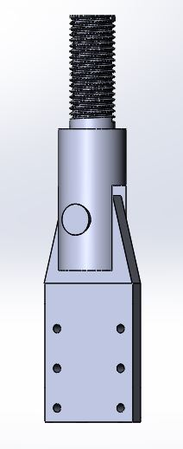
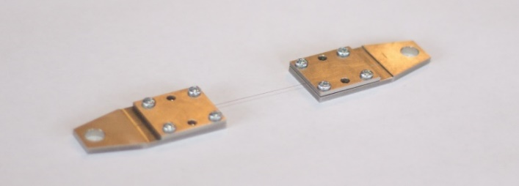
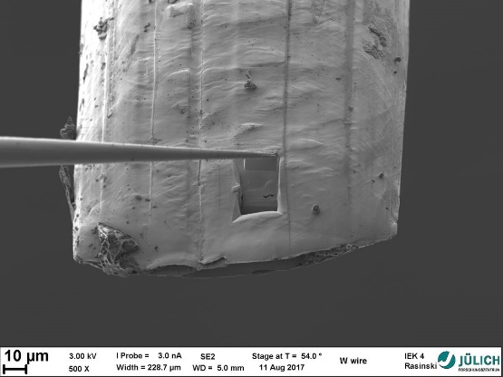

Work plan for 2021-2025
D003 Results from tests of small-scale samples of W and other advanced materials and components (LPP-ERM/KMS)
Investigate effect of high- and low- temperature neutron irradiation in W fibers and W yarns/braids. K-doped fibers should be considered.
  Tensile strength
  Microstructure
Strategy:
  Develop tensile testing procedure in hot cells
    For 145 µm wire
    For relevant braids/yarns
  Irradiation
    Temperature= low (50-70), 300-400, 600, 800, 1200°C
    Damage level = 0.15-0.2; 0.5, 1 dpa
  Post Irradiation examination
    Tests in the temperature range RT-600°C
    SEM
    FIB + TEM/APT (up to interest of other collaborators)

Slide 49

Summary of activities over FP8 period
Tensile testing of individual wires
Effect of high-T annealing on wire strength & ductility
Morphology of wire microstructure vs. annealing temperature
Fracture modes of wires vs. T_{anneal}
Testing of Wf-W composites
Effect of neutron irradiation on Wf-W
composites
Microstructure of as-irradiated Wf-W
composites

Slide 50


Proposal to use bending tests with small-punch stage, explain the available standard and what can be extracted
In FP8, strength and ductility of W fibers was assessed by tensile testing
Fixing the wire needs carful manual operation
Performing such fixation in Hot Cell is challenging
We suggest to perform “bend-like” test because
  Sample mounting is much easier (robust)
  Test mode should allow to reveal UTS and DBTT
  For macro-samples, EN standard is issued

Slide 51
Further actions
2022
  Qualification tests using SPT setup at RT and Elevated temperature to establish
    DBTT of W wires/yarns in non-irradiated state
    Establish relationship between tensile strength and SPT strength in non-irradiated state
    Perform SEM analysis of the SPT-tested samples and compare with Tensile-tested samples
2023
  Start irradiation
  Extract first samples irradiated at 0.2 dpa and perform SPT test & SEM

Slide 52

KIPT work on advanced Materials in SPA3
D004, V.Makhlai Investigation of advanced materials under ELM-like/disruption transient loading and subsequent analysis (KIPT)

Slide 53
WP PWIE: SPA 4
Overview
Notes:
Please Indicate your subproject

Slide 54
SPA.4:High Temperature / Recryst. & Melting
Tasks to be performed:
Characterization of microstructural changes caused by plasma exposure. Tungsten-based material exposed to different plasma conditions will be investigated in terms of mechanical and microstructural depth profiles. Heterogeneities will be traced in hardness and orientation maps and the locally dominating restauration mechanism identified. (DTU)
Tungsten material exposures in the QSPA under giant ELMs or disruptions with pronounced surface melting (KIPT). Characterization of dust in QSPA experiments: size analysis, influence of B field on trajectories. Stick effects at the surface.
Plasma heat loads which causes surface recrystallization and changes in Microstructure and melt threshold (QSPA/PSI-2/GLADIS) (KIPT, CEA, VR)
Assessment of effect of H and He on W recrystallization with links to WP TE (FZJ, DTU, CEA)
Joint activities with WP TE on damaged components (e.g. melting) (VR)
Experiments on Recrystallization in PSI-2 linked with SP A1 (FZJ, DTU)
Development of the MEMOS-U code Comprehensive validation activities. (link with WP TE (WEST, AUG) and SP B) (VR)
  Sensitivity of MEMOS-U to thermionic property uncertainties. Parametric simulation studies with MEMOS-U. Implementation of active cooling.
  Link to SP D (Plasma Background)
Issues: Generally not enough PM / Ukraine War
Deliverable: SPA A3 : T001-D001, T001-D002 , T001-D003, T001-D004, T001-D005, T001-D006
Status: 2022 on track , further work in 2023
Facilities: Exposures under SPA1, SPA2,SPA3 , QSPA #5d,
Human Resources: total # 34 PM
Involved RU: CEA,DTU,VR,FZJ
Linked WP or TSVV: WPTE, WPMAT, WPDIV
Notes:
PD: Plasma Devices as in PEP listed
HHF: High Heat flux as in PEP listed
IBF: Ion beam Facility as in PEP listed
Other facilties as in PEP listed

Slide 55
WP PWIE: SPA 4
Results
Notes:
Please Indicate your subproject

Slide 56

Work on WEST & Tungsten PFU
D001 M.Richou Assessment of hydrogen impact on material properties linked to ITER relevant PFUs (CEA)
See highlight Talk
Global strategy
Use of WEST to assess and model tokamak plasma impact on recrystallization and softening
Assess: what are the properties we plan to investigate ?
  Loss of mechanical properties -> Hardness measurements
  Modification of the microstructure -> EBSD measurements
For what modelization ?
  Impact on recrystallization and softening kinetics.

Slide 57


Work at DTU
See highlight Talk
D002 Annealing of chosen tungsten-based materials and quantification of recrystallization kinetics

Slide 58

CT at DTU 3D imaging center

Slide 59

PM tungsten fibre reinforced tungsten

Slide 60

Work at KTH also linked to WPTE / ITER
D003 S.Ratynskaia Development and validation of the MEMOS-U code (link with WP TE – WEST/AUG) (VR)

Slide 61

ITER-like actively cooled W leading edge melting experiment in WEST

Slide 62

Modelling Results

Slide 63

Code Additions
Updating physics model for reactor regimes: vxB in the current solver, multi-emissive magnetized sheaths, volumetric heat source for modelling of RE-induced melting

Slide 64



KIPT work / Ukraine
D005: Influence of plasma pre irradiation with heat loads near surface recrystallization on surface damaging with heat loads above the melting threshold
Further Experiments will be shifted to 2023.

Slide 65
WP PWIE: Dicussion 2023
Continuations & More
Notes:
Please Indicate your subproject

Slide 66
Milestones 2023
Relevant Work Package Milestones for SPA extracted from WPPWIE PMP 2022
WMXX | SP A | Asses the Viability of Materials for DEMO Including prototype materials such as KIT VPS on Steel as well as lifetime assessment linked to WEST / Magnum / JUDITH | 31.12.2023
WMXX | SP A | Exposure of DEMO baseline PFC mono-blocks (from WPDIV) in MAGNUM-PSI | 31.12.2023
WMXX | SP A | Work on WEST Materials regarding recrystallisation. Further studies on Material recrystallisation incl. µ-CT work. | 31.12.2023
Notes:
Repalce by your SPX

Slide 67
SP A Tasks 2023
SP A1
Synergistic Load Studies of Plasma-Facing Materials for ITER & DEMO
SP A2
High Particle Fluence Exposures of Plasma-Facing Components for ITER
SP A3
Advanced Materials under thermo-mechanical and plasma loads
SP A4
High Temperature performance of Armour Materials: Recrystallization and Melting
SP A1
Continuation of activities
Include KIT FGMs
Include Pre-damage of W
Lifetime assesment
SP A2
Continuation of activities
Choose new Materials / Mockups
  PRD/MAT/DIV
  Slow transients + analysis
    SP A3
Continuation of activities
New Material Types / Samples
Synergistic Loads on SMART-W
SP A4
Continuation of Activities
µm- CT Analyse von Compositen
Further extension of Rcrystallisation activities DTU.CEA.FZJ
Notes:
This is just a summary table – Michael will provide it.

Slide 68
General Comments
Most work will continue through to 2023
New Materials will be added to the studies in SPA 1 / 3
Additional analysis techniques added to SPA 4
Focus shifts to ITER Lifetime and DEMO
See if materials can be obtained used by start ups to elaborate potential in DEMo programme (externally funded ?)

Slide 69
WP PWIE: SPA 1
Outlook & Comments
Notes:
Please Indicate your subproject

Slide 70
FZJ
Continuation of Work
Finalize Analysis of PIM Material
Add Lifetime Assessment and Pre-damage Studies related to ITER / WEST
FGM Studies in PSI-2 based on Materials supplied by KIT

Slide 71
IPP
Continuation of work
Further Studies on Materials related to W7-X / JT60 SA
Work on W Heavy Alloys
Work on ITER Materials
TBC

Slide 72
KIPT
Likely PM will be retained and Machine time to be shifted into 2024

Slide 73
Differ
Continuation of work plus
  Lifetime Assessment and Pre-damage Studies related to ITER / WEST

Slide 74
Ciemat
Contiuation of work
Especially new materials
Use of Laser for Crack studies on Edges

Slide 75
WP PWIE: SPA 2
Outlook & Comments
Notes:
Please Indicate your subproject

Slide 76


Expected lifetime limits for ELM-like loading in ITER
Multi-machine scaling now gives a good regression to estimate unmitigated type-I ELM-loads in ITER
Taking this scaling and translating it into operational limits for the divertor implies that very strong ELM mitigation is required to avoid edge melting
T. Eich et al. Nucl. Mater. Energy (2017)
J.P. Gunn et al. Nucl. Fusion (2017)
R.A. Pitts Nucl. Mater. Energy (2019)

Slide 77

Avoiding surface damage fatigue implies even lower limits
PFCs are also vulnerable to surface crack-network development due to fatigue failure (~10⁶ ELMs in ~100 DT shots ITER*)
Threshold for this is significantly lower than toroidal gap edge melting
How significant is this damage for PFC performance?
  Risk to increase likelihood of macro-cracking through stress concentration?
  Can the strong roughening created increase erosion?
  Can the isolated grains caused by cracking be lost or melt?
Pintsuk et al. Fusion Eng. Des. (2013)
Wirtz et al. Nucl. Mater. Energy (2017)
*R.A. Pitts Nucl. Mater. Energy (2019)

Slide 78
Differ
Continuation of work plus
  Lifetime Assessment and Pre-damage Studies related to ITER / WEST

Slide 79
WP PWIE: SPA 3
Outlook & Comments
Notes:
Please Indicate your subproject

Slide 80
FZJ
Continuation of work
Focus on SMART – W / Wf/W

Slide 81
SCK-CEN
Finalization of 2021 / 2022 task
Then iterate for new tasks
2023
  Start irradiation
  Extract first samples irradiated at 0.2 dpa and perform SPT test & SEM

Slide 82
Differ
Continuation of work
Lifetime assessment of new materials
  Slow transients + analysis on previously used ENA mockups
  Melting and predamage on existing mnoblock chains

Slide 83
IPP MPG
Continuation of work
  Analysis – prost and precharacterisation of chains used in Magnum
Further Use of Giraffe etc.

Slide 84
WP PWIE: SPA 4
Outlook & Comments
Notes:
Please Indicate your subproject

Slide 85
CEA
Pre-damage studies ?
Recrystallisation and effets for WEST PFUs

Slide 86
KIPT
Likely PM will be retained and Machine time to be shifted into 2024

Slide 87
DTU
Extension of use of µ-CT on new materials
Recystrallisation studies on ITER and DEMO Materials

Slide 88

KTH

Slide 89
Add Ons
Outlook & Comments
Notes:
Please Indicate your subproject

Slide 90
Crack formation for tungsten armor
Intrinsic brittleness of tungsten material
Thermal heat load at the divertor: thermal stress and thermal fatigue
H Bolt, et al; Journal of Nuclear Materials, Volumes 307–311, Part 1, 2002, Pages 43-52
Neutron embrittlement
G. Pintsuk et al. / Fusion Engineering and Design 88 (2013) 1858– 1861 1861
A damage resilient material is required
Accumulated equivalent plastic strain field in the tungsten armor block after the 5th HHF load cycle at 20 MW/m².
-M.Li 2015.

Slide 91



Solution: Tungsten fiber reinforced tungsten composites
Pseudo ductile behavior
Tungsten fiber-reinforced tungsten (W_{f}/W)

Slide 92

Porous matrix composites
It is the same principle like weak interface composite
a
Interface debonding
$$τ$$
Crack Front Debonding
Matrix Cracking
Fiber pull-out
“a controlled amount of fine scale matrix porosity, obviating the need for a fiber coating.
This approach can be viewed as an extension of the porous coating concept wherein crack deflection occurs because of the low fracture toughness of the porous interphase.”
Examples:
SiC/SiC
CFC

Slide 93









Production upscaling
Large scale FAST/SPS facility in HFUT, sample geometry up to 300 mm in diameter
Sample with a dimension of 105 mm x 30(25) mm has been produced
Large Scale PM W_{f}/W

Slide 94











Application projects
Flat tiles design with W_{f}/W
Up to 23x28x8 mm
Mechanical tests with different size up to 84 mm x 20mm x 10 mm
W_{f}/W Application in foundry industry
Melt guiding part
W_{f}/W joint with Copper
Component design, W_{f}/W joint with steel via V
20 mm to 105 mm in diameter
Cu infiltration into the porous matrix
W_{f}/W monoblocks, 28x12x23 mm

Slide 95






Long fiber W_{f}/W
Tungsten Weaves laser cutting and coating
Alternate placement of W weaves and W powders in the graphite tool of SPS
Spark Plasma Sintering (SPS)
Wf/W with long aligned fibers
Production

Slide 96

Long fiber W_{f}/W
Microstructure
50 µm
200 µm
Interface impacted by SPS process but remain intact
Fiber arrangement may need to be improved

Slide 97


Long fiber W_{f}/W
Mechanical properties
Samples | Fracture energy density (kJ/m²) | Fracture toughness, K_{q}(MPa m^{0.5}₎ | Flexural strength (MPa)
Pure tungsten | 0.1±0.0 | 5.5±0.0 | 381±46
W_{f}/W | 1.9±0,7 | 25.5±7.8 | 221±17
Porous matrix W_{f}/W | 3.3±1.0 | 21±7.1 | 235±10
Long fiber W_{f}/W | 11.6±3.1 | 67.6±15.0 | 495±78
Long fiber W_{f}/W show more promising mechanical properties compared to short fiber W_{f}/W

Slide 98



Long fiber W_{f}/W
Thermal shock
Fiber vertical to the loading surface
Fiber parallel to the loading surface
Loading condition
Labs = 0.38 GW/m², Tbase = RT, n = 100 pulses
After the loading: crack bridging by the fibers

Slide 99






Development outlook
-From several kilograms to hundred kilograms
Typical samples
3mm
105 mm x 30 mm, 4.5 kg
105 mm
Typical samples
1-3mm
105 mm x 10-30 mm, 1.5-4.5 kg
105 mm

Slide 100






W_{f}/W
For Flat Tile Applications incl. Joining
parameters
Temperature | 850°C
Pressure | 30MPa
Holding time | 15min
Heating rate | 25 K/min
Cooling rate | 5 K/min
Test of Residual stresses and stress during quenching – utilize steel to maximze stresse
W_{f}/W- 5 mm
V - 0.3 mm
316L - 5 mm
Vanadium as stress relieving interlayer
Heated to 1000°C
Quenched at 4°C

Slide 101


Mock Ups for Gladis Testing
Material produced and Cut – joining underway
Joining at FZJ
Joining at ENEA

Slide 102

Operational Window
Of W_{f}/W
Crack resistance at low temperatures
High strength at elevated temperatures and high heatfluxes
Based on: Zinkle, S. J. & Busby, J. T.
Structural materials for fission amp; fusion energy Materials Today , 2009, 12, 12-19
Tokamak Energie Ltd: Cyclic testing at minimum 10 MWm⁻² up to 1000 cycles, 60s on/off.

Slide 103



Finding an Application of the Material
Tungsten Flat-Tile
20 MW/m² Tmax：1060℃
W
W/Cu FGM or WfCu
For a Composite Material a dedicated wayof solving problems or adding operational space can be found
E.g allow operating W_{f}/W above 1500 ºC
Stable properties during irradiation
No need for monoblock – joining W_{f}/W & Wf/Cu
CuCrZr or
novel Cu alloy
RAFM
Cooling water: 150 ℃, 16m/s, 5 MPa
G.N.Luo ( ICFRM 2019)

Slide 104
Advanced Concepts
What goes beyond what exists
W_{f}/W
W_{f}/W
CVI produced W_{f}/W with infiltrated copper Coolant (missing proof of principle)
Complet Wf/W based component CVI / PM
With 3D weaves – needs development
W_{f}/W
W_{f}/W pure W
Utilizing µ-structure tungsten as armour

