Slide 1
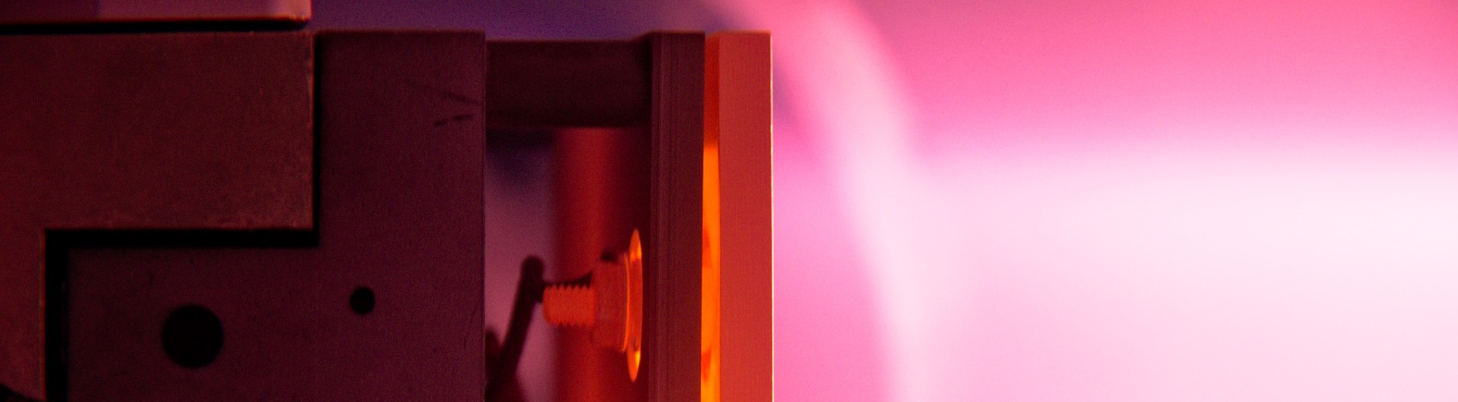
Update on PIM studies
14th October 2022 I M. Wirtz et al.
Forschungszentrum Jülich GmbH, Institut für Energie- und Klimaforschung, 52425 Jülich, Germany

Slide 2
Environmental conditions
Steady state heat loads:
Transient thermal loads:
up to 20 MWm⁻² in ITER
(lower loads in DEMO)
up to 60 MJm⁻²
very high thermal
loads
(disrupt., ELMs, VDEs)
crackings
melting
dust formation
recrystallization
failure of joints
plasma
exposure
neutrons
Plasma loads:
Neutrons:
sputtering
hydrogen
helium
up to 14 MeV
defects
transmutation

Slide 3
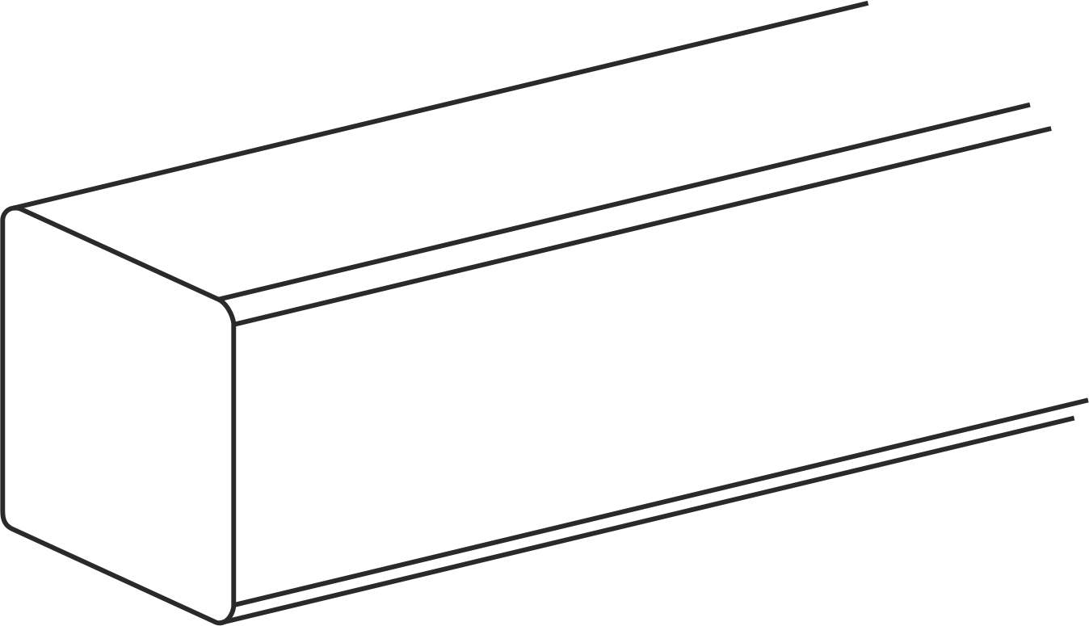
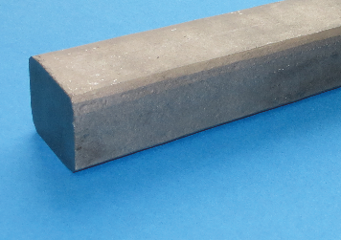
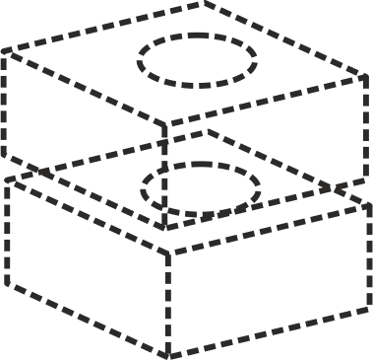
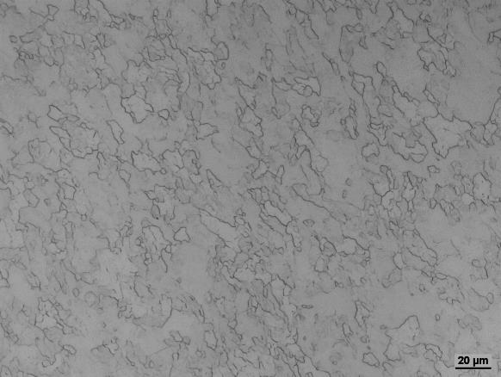
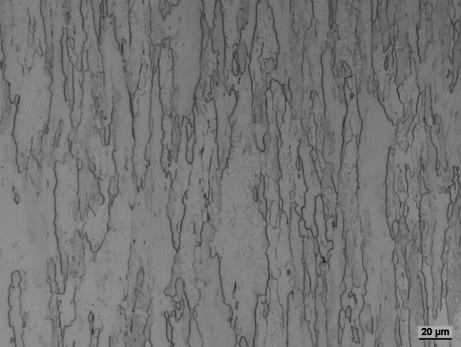
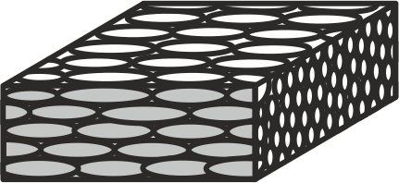
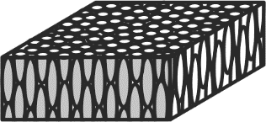
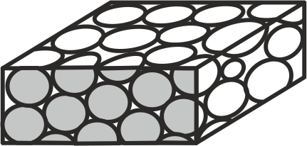

Reference material
Plansee pure tungsten according to ITER specifications (‟IGP-W”)
Top view, $∅$ ~10 µm
Side view, 5 × 25 µm²
longitudinal
transversal
recrystallized
12 × 12 × 5 mm³
1600 °C, 1 hour
50 µm

Slide 4

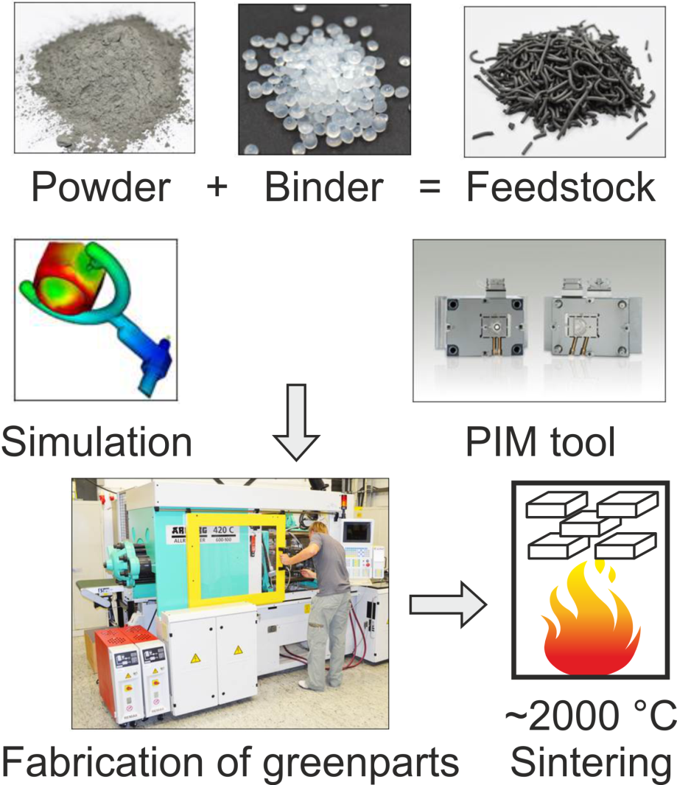
Sample material
Powder injection molding
Time & cost effective near-net-shape forming process with shape complexity and high final density
Mass production of near-net-shape parts
Create new materials/investigation of properties
Brittle to ductile transition for pure PIM W at 200 °C (low strain rates)
No porosities or cracks, high density (better than 99 % t.d.)
No recrystallization – possible grain growth at very high temperatures only
Fully isotropic material properties
Courtesy of S. Antusch, KIT

Slide 5
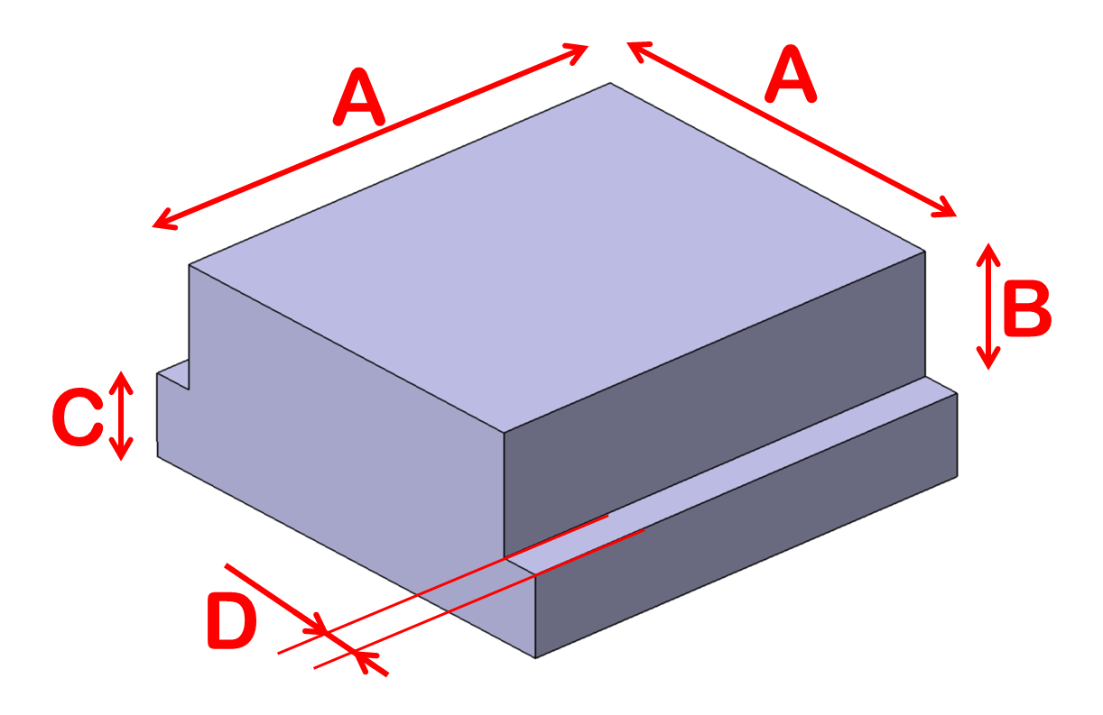
Sample material
Powder injection molding
Time & cost effective near-net-shape forming process with shape complexity and high final density
  Based on low and high pulse number pure heat load tests performed in WPMAT-HHFM the following PIM alloys were chosen for synergistic tests:
          W-1TiC
          W-2Y₂O₃
          W-3Re1TiC
          W-3Re2Y₂O₃
          W-1HfC
          W-2Y₂O₃1TiC
A: 10 mm; B: 2 mm; C: 3 mm; D: 1 mm

Slide 6
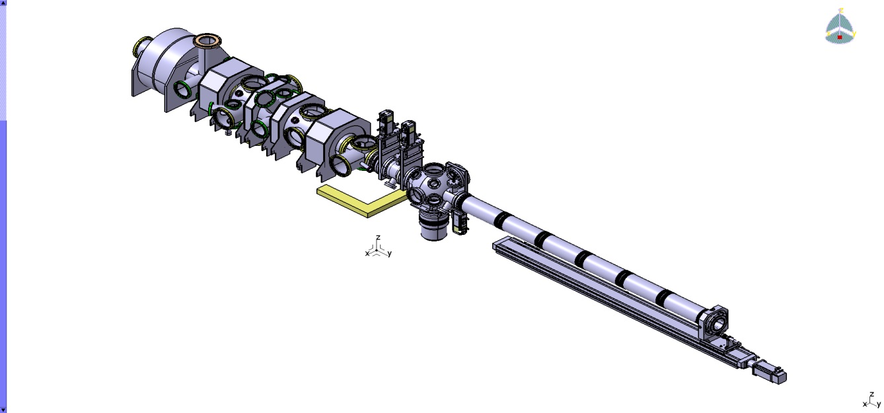
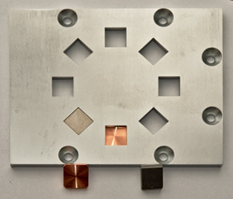
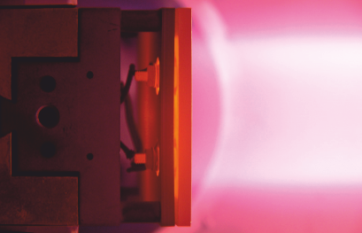
Linear plasma device PSI-2
Plasma Source
Nd:YAG Laser
Target Exchange &
Analysis Chamber
Target Positions
Steady-state
D, He, Ar plasma
plasma column diameter 60 mm
ion flux ≤ 10²³ m⁻²s⁻¹
incident ion energy (bias) 10 – 300 eV
ELM-like heat pulse
Nd:YAG laser wavelength 1064 nm
laser energy 32 J
Linear Manipulator

Slide 7
PSI-2 conditions for all experiments
absorbed power density 0.41 GW/m²
base temperature of approximately 1000 °C
pulse duration 0.5 ms; repetition rate 10 Hz; 10⁵ pulses
Deuterium / Helium (6 %) plasma
particle energy 35 eV
flux ~ 4 x 10²¹ m⁻²s⁻¹; fluence ~ 4 x 10²⁵ m⁻²

Slide 8
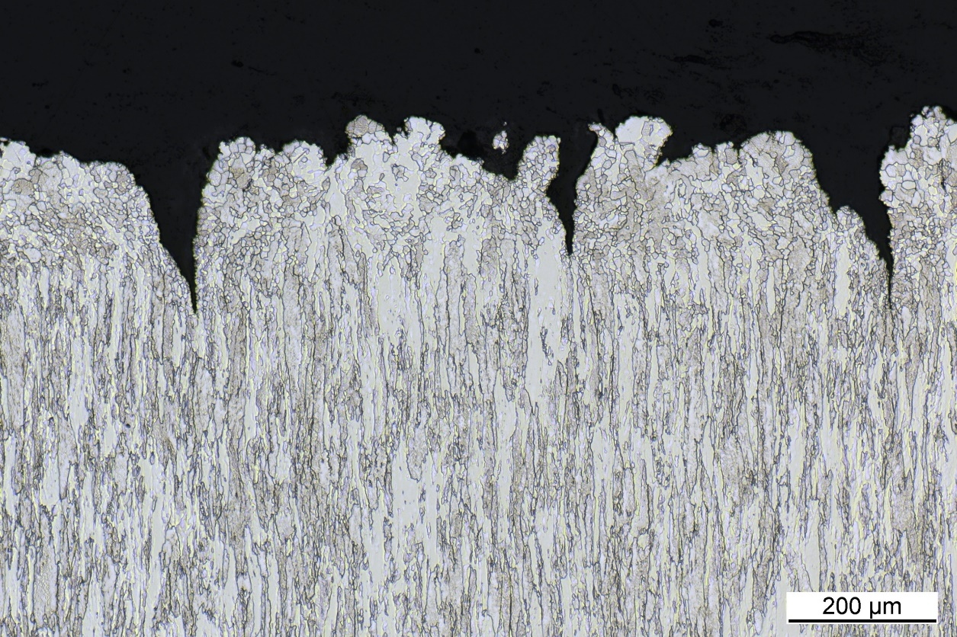
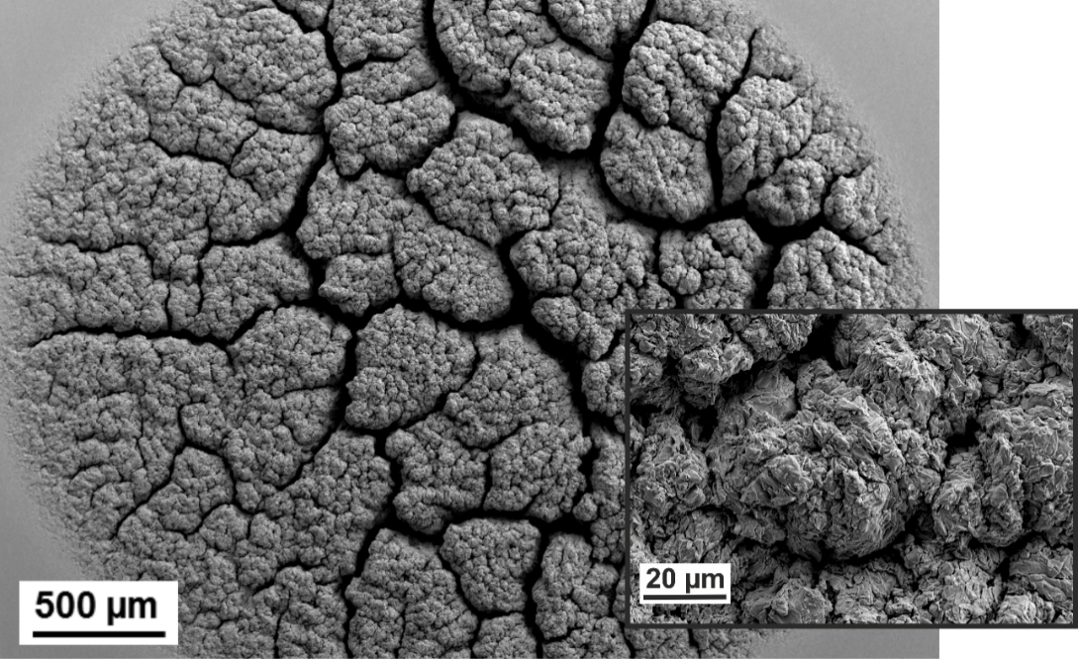
IGP-WT, High pulse number tests
Metalographic cross section
SEM images
transversal
FIB cut

Slide 9

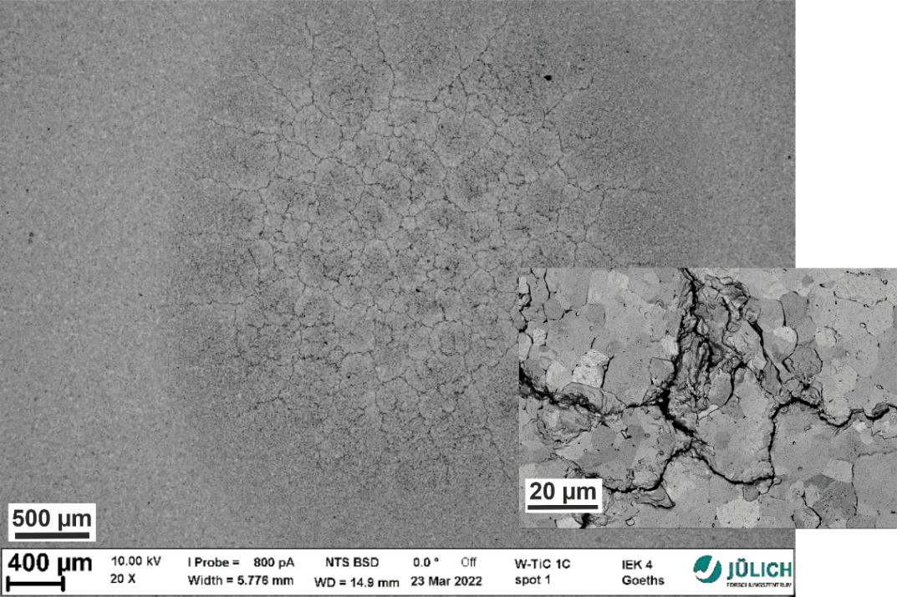
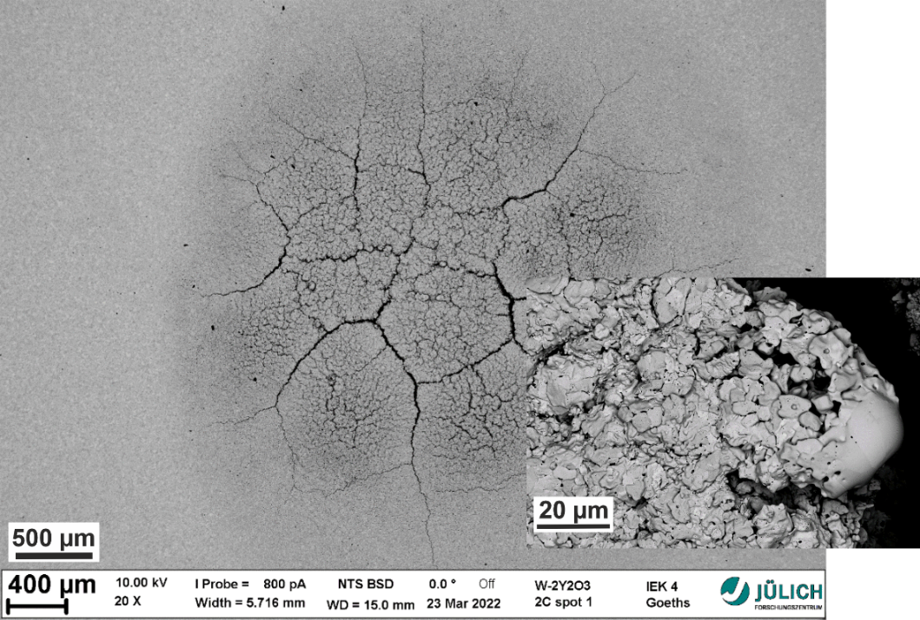
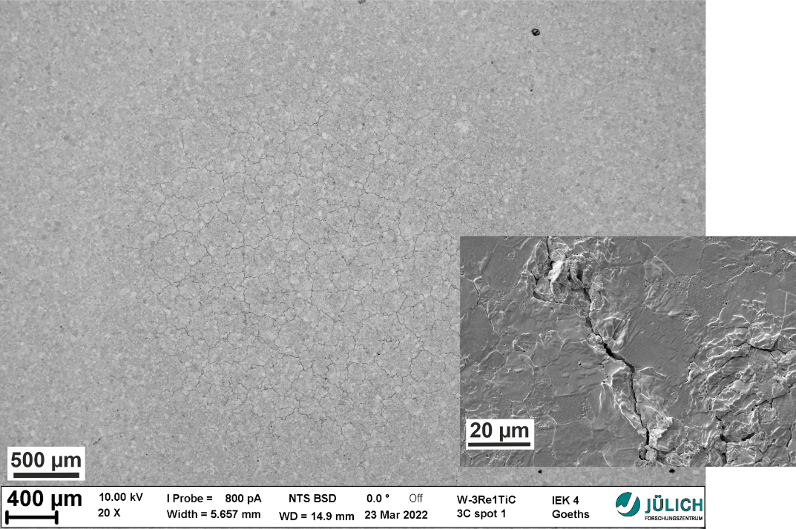
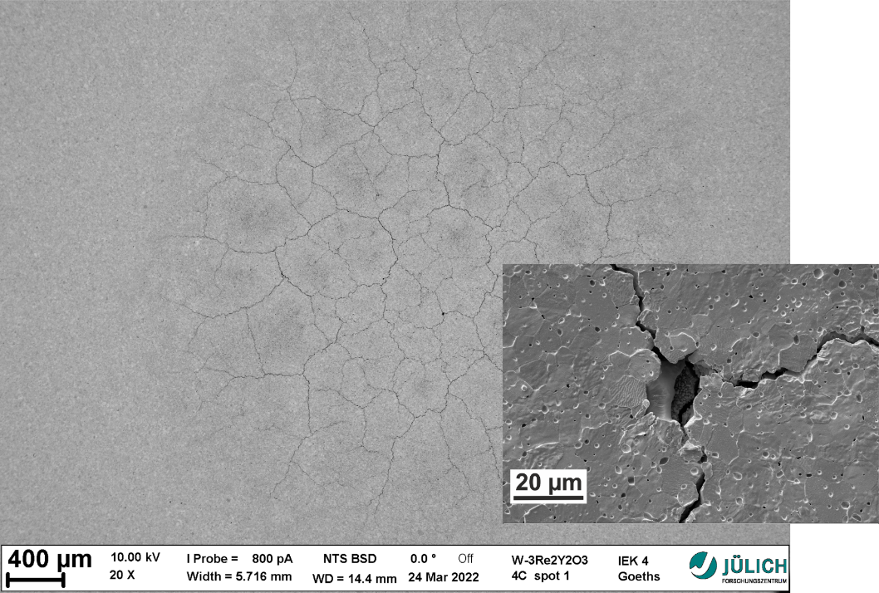
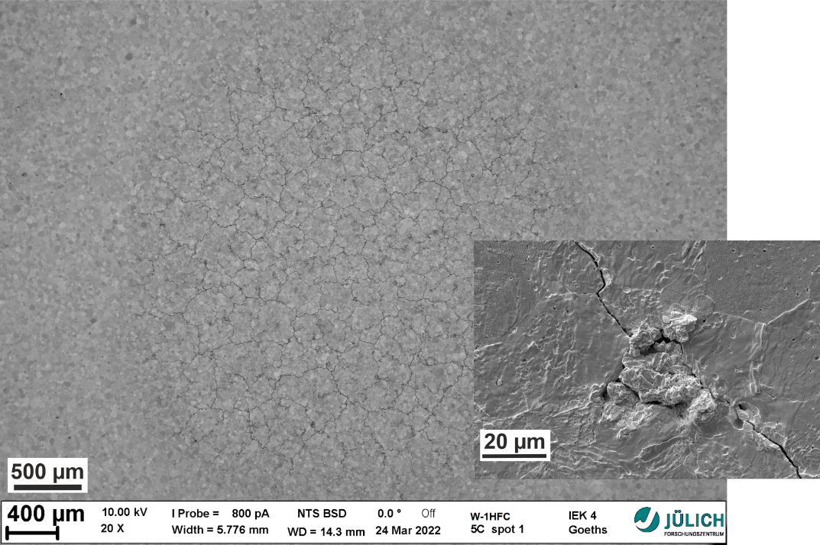
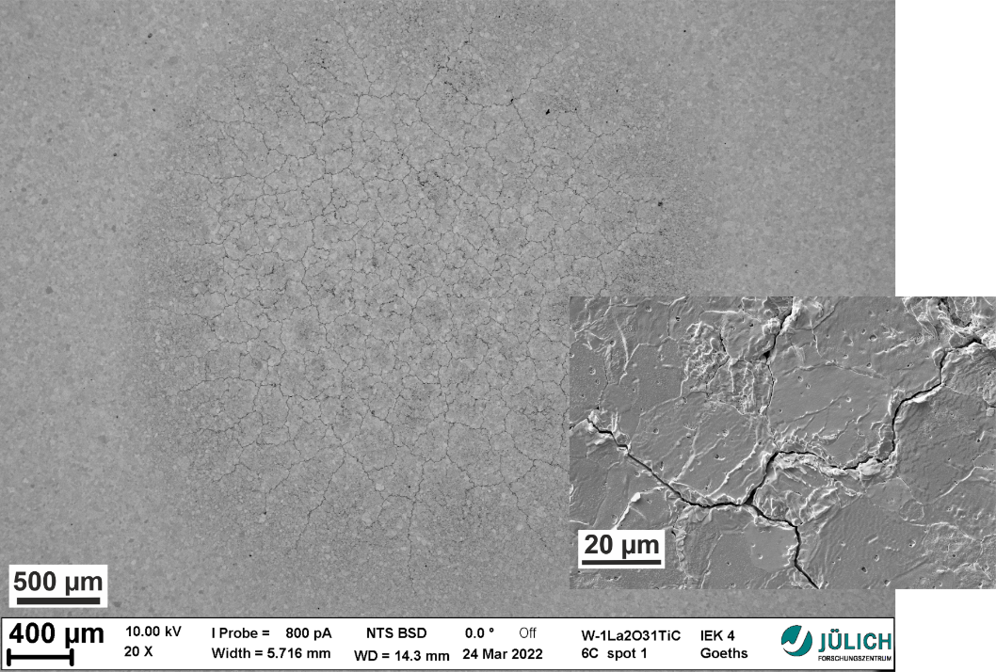
PIM samples, High pulse number tests
SEM images
IGP-WT
W-1TiC
W-2Y₂O₃
W-3Re1TiC
W-3Re2Y₂O₃
W-1HfC
W-2Y₂O₃1TiC

Slide 10
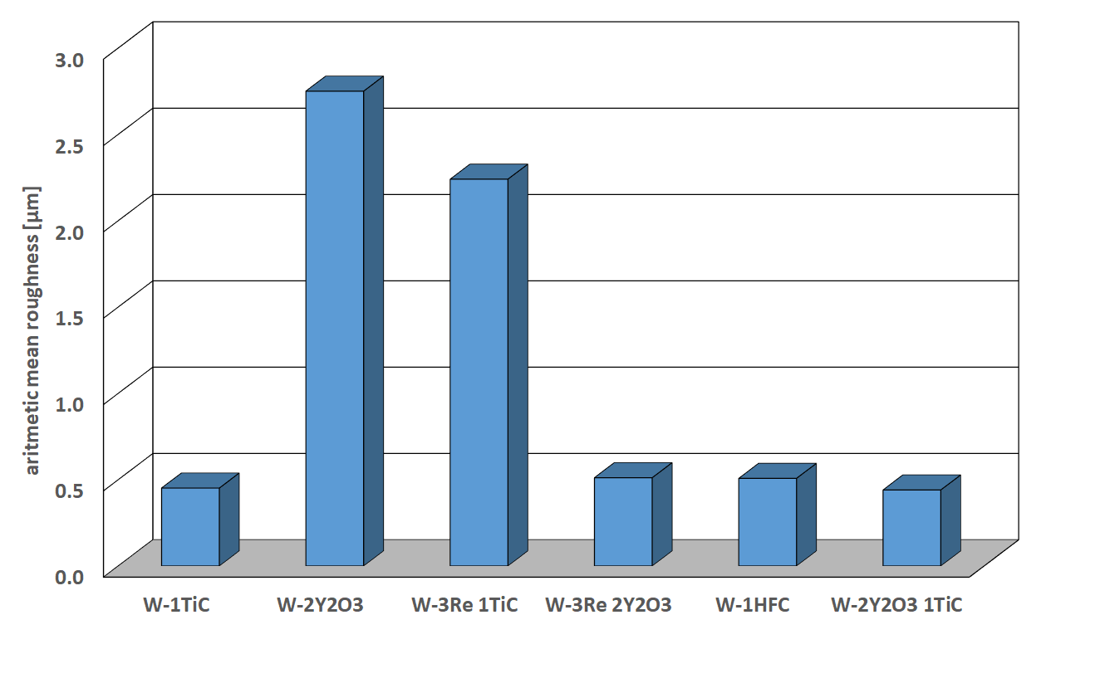
PIM samples, post mortem analysis
FIB cuts and bubble formation
W-1TiC
IGP-WT
Bubble size and density is comparable/very similar for all tested materials. Exemplarily shown for W-1TiC and IGP-WT.
Roughening
reference for IGP-W ~ 19 µm
W-2Y2O3 and W-3Re1TiC show a factor of 4 to 5 higher surface roughness than the other three PIM alloys. However, all samples have a much lower surface roughness than the IGP-W reference material.

Slide 11
Next steps, summary and conclusions
Preparation of metallographic cross sections in order to investigate the crack propagation into the material
PIM-W alloys show comparable or better fatigue performance to the as-received pure tungsten grade in terms of damage category and crack formation
more detailed investigations of the induced damages indicate that especially surface modifications like roughening due to plastic deformation and the particle induced nanostructures are less severe/pronounced
PIM-W alloys represent a very promising alternative material to commercially available pure tungsten grades. The fatigue performance could be even further improved by an optimization of the microstructure via the manufacturing process parameters, i.e. used powders and thermal treatments.

