Slide 1
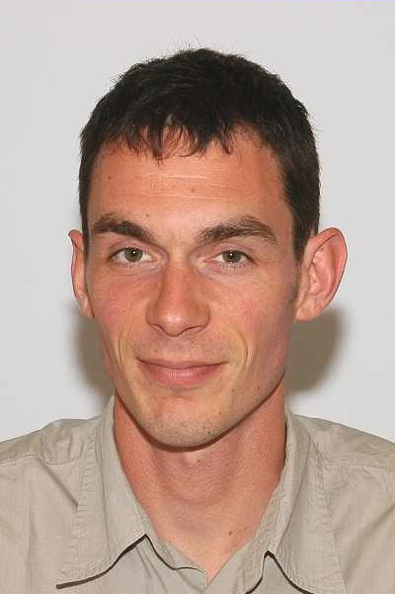
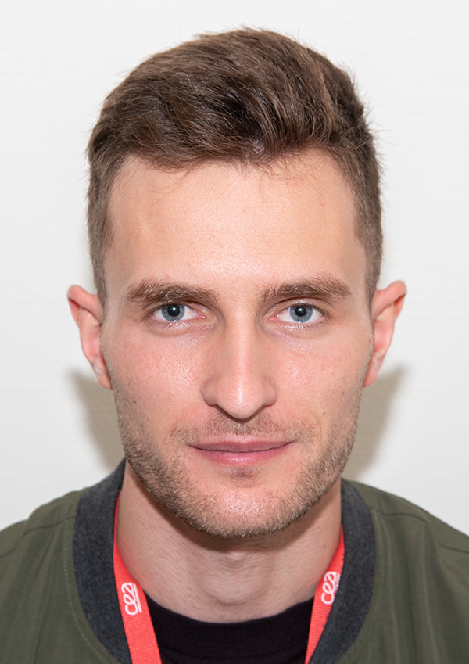
Assessment of hydrogen impact on material properties linked to ITER relevant PFUs
M. Richou¹, M. Lemetais², Q. Tichit¹, Y. Corre¹, L. Gallais³, G. Kermouche² and the WEST team
WPPWIE - SPA – Review meeting – 14th of October 2022

Slide 2
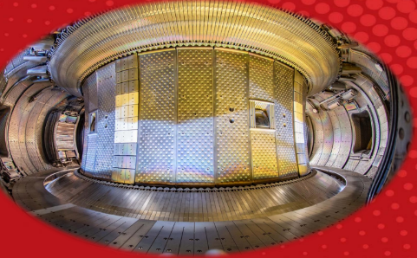
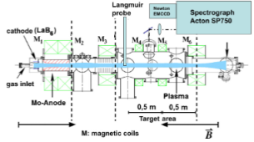
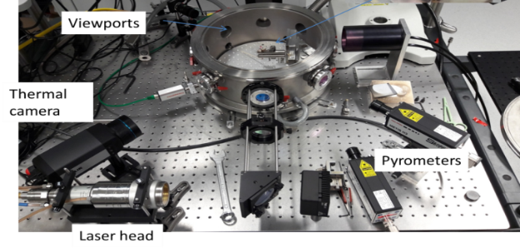
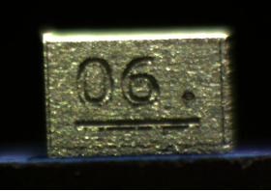
The strategy
WEST: Thermal field+D+He (Combined effect)
Thermal field (WPMAT)
Isothermal, anisothermal
West plasma conditions
For T < 1350°C : conventional set-ups
For T > 1350°C : conventional set-ups are limited (ampoules operational temperature, low heating speed 5°C/min [1]
H
He
PSI2 [2]…
WPPWIE
Testing
Characterization
(EBSD,indentation, nano-indentation)
5 mm
[1] M. Minissale et al., 2020
[2] A. Pospieszczyk et al. 2013
Modelisation

Slide 3
Recovery and recrystallization
X=0
ta: Annealing time
X=1 (fully recrystallized)
Dislocation
Tungsten maintained at Ta (annealing temperature)
Hardness  (X_{h}= 1 fully softened)
Grain boundary
Sub grain boundary
New grain
Temperature and time dependent process
Notes:
During primary recrystallization, the new grains grow at the expanse of the strain hardened microstructure (removal of dislocations), the driving force being the stored energy associated to dislocations and sub-grain boundaries.
Recovery summarizes all thermally activated mechanisms by which dislocations annihilate and rearrange themselves into more stable configurations. Dislocation density
Recrystallization is a thermally activated process by which strain-free regions (nuclei) are generated and grow into it.

Slide 4
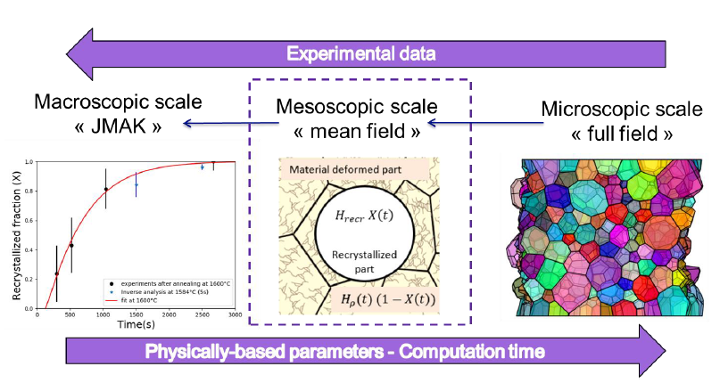
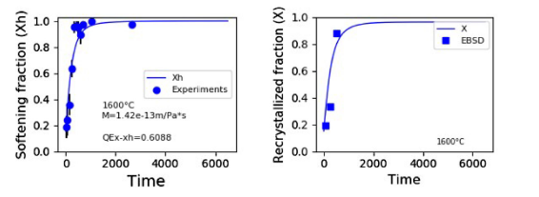
MODELIZATION
What modelization ? Assess the Impact of recrystallization and softening
[3] A. Durif et al., 20202
[4] M. Lemetais et al., 2022 (to be submitted)

Slide 5
Studied tungsten in WEST
WEST campaigns
Visual observation of relevant PFUs

Slide 6
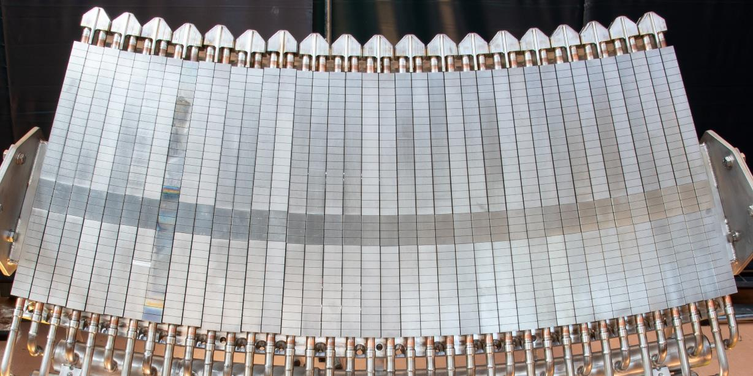
1. Studied tungsten – implementation in WEST
Tungsten and component manufactured by AT&M/ASIPP
ITER-like Geometry:
6mm W thickness
Block width from 26.3 mm to 31.8 mm
AT&M rolled W (ITER W grade material)
Chamfer
A-A
CuOFHC
CuCrZr
500 mm

Slide 7
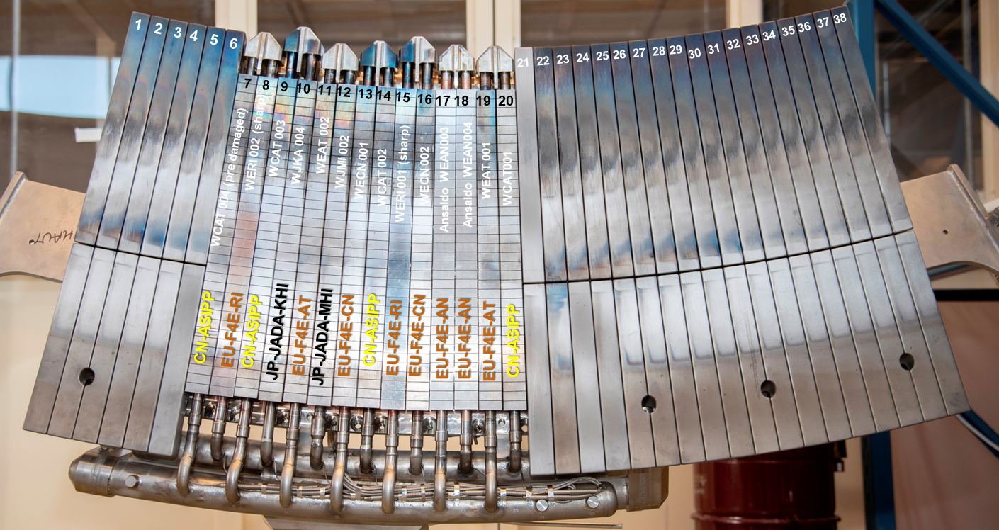
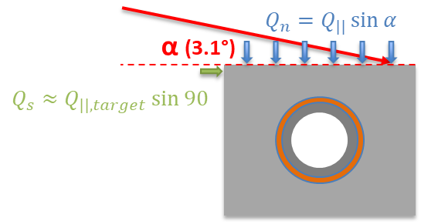
2. WEST campaigns
 | Duration max (s) | Cumul (s) | LH max (MW) | W LH total (MJ) | Max heat flux - Qn (MW/m²)
C4 – D2 | 55 (USN) | 9678 | 5.4 | 7823 | <6*
July-Nov19
C4 - He | 30 | 2991 | 4.5 | 4300
Oct-Nov19
C5 | 23 | 4630 | 5.4 | 2625 | 6*
Nov20-Jan21
C4 : 14 ITER like PFU
C5 : 2 full sectors
*[J. Bucalossi, Nuclear Fusion, 2022]

Slide 8
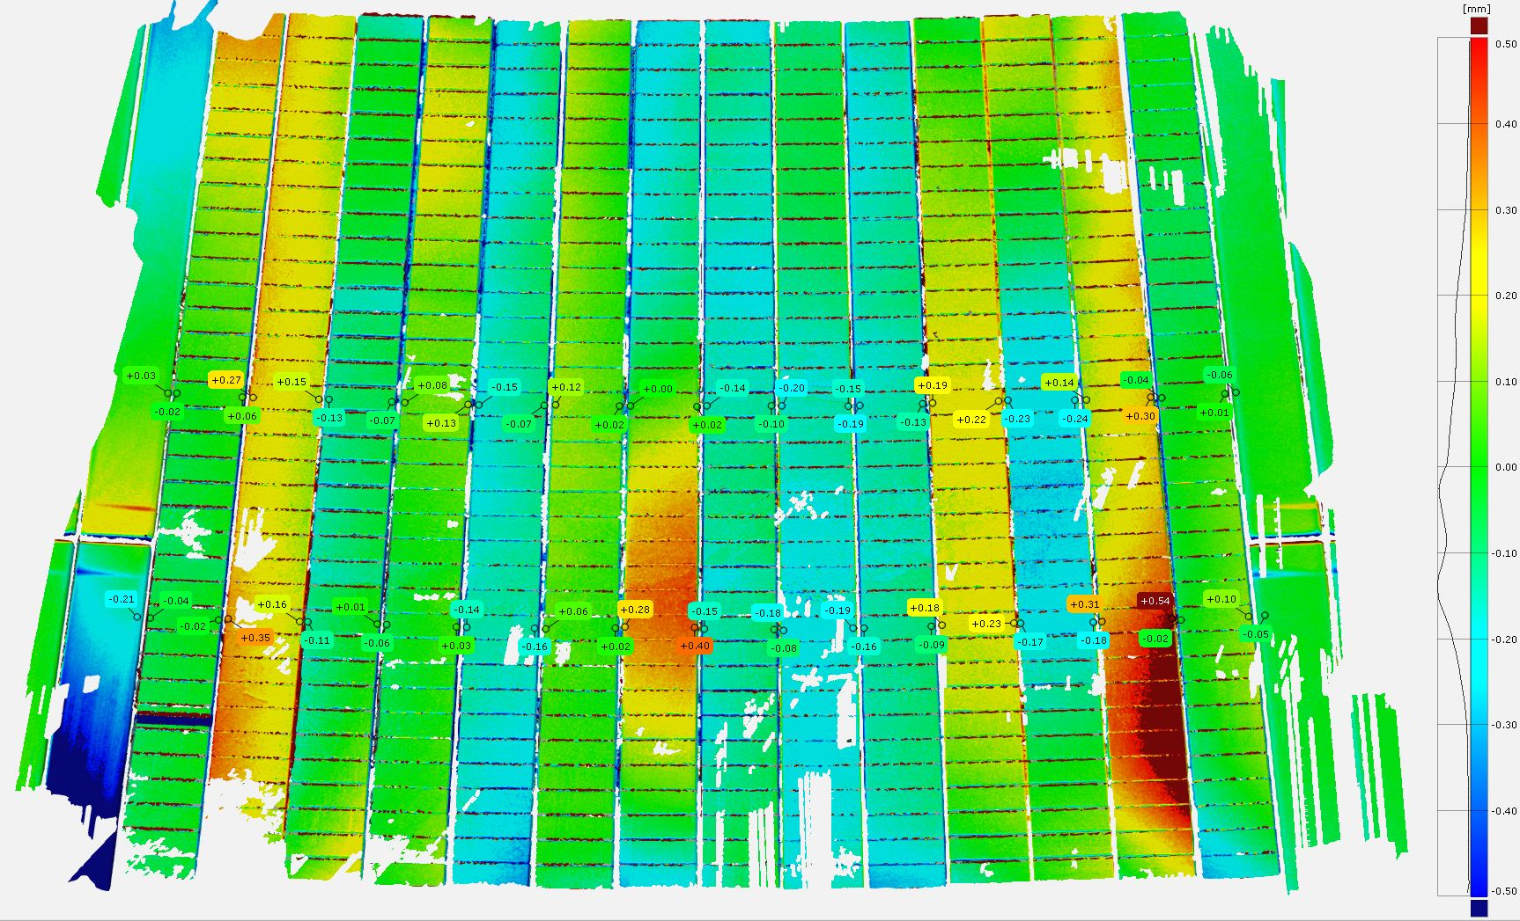
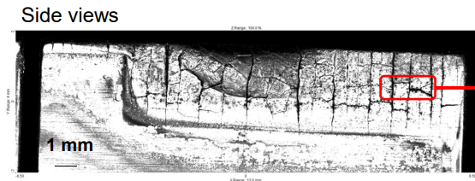
2.1 Misalignment in WEST
14 PFUs
$$Q_{n}=Q_{||}\sin{α}$$
α (3.1°)
δ
$$Q_{s}≈Q_{||,target}\sin{90}$$
C4
C5
δ
WEAN004, post C5
2.3 mm
(δ+groove on purpose)
δ = 0.4 mm
δ = 0.5 mm
➔A misalignement (or exposed edges) leads to expose the leading edge with huge heat flux
(If Qn = 5.2 MW/m² - > Qs ~ 100 MW/m² *!!!)
➔ In WEST, some PFUs are misaligned on purpose (during C4: up to 0.5 mm)
* [Y Corre et al 2021 Phys. Scr. 96 124057]
Notes:
Y Corre et al 2021 Phys. Scr. 96 124057.
Dans un deuxième temps nous avons amélioré les analyses et les simulations, tu peux indiquer que si on prend les processus d’émission thermoionique et un flux plus piqué (lq=3mm), on trouve 150.MW.m2, S. Ratynskaia et al. PSI2022, submitted. A savoir que pour cette expérience nous avons un écart entre mesures standard et mesure avec caméra IR VHR, on trouve des flux plus piqué avec la caméra VHR donc plus d’intensité, c’est juste pour info

Slide 9
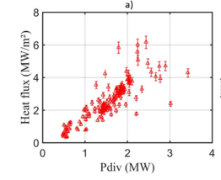
2.2 High surface loading in WEST (2/2)
From embedded measurments
J.Bucalossi et al., nuclear fusion, 2022
T=1500°C (Sharp, δ =0.3 mm)
Qn
T=1500°C (Sharp, δ =0.6 mm)

Slide 10
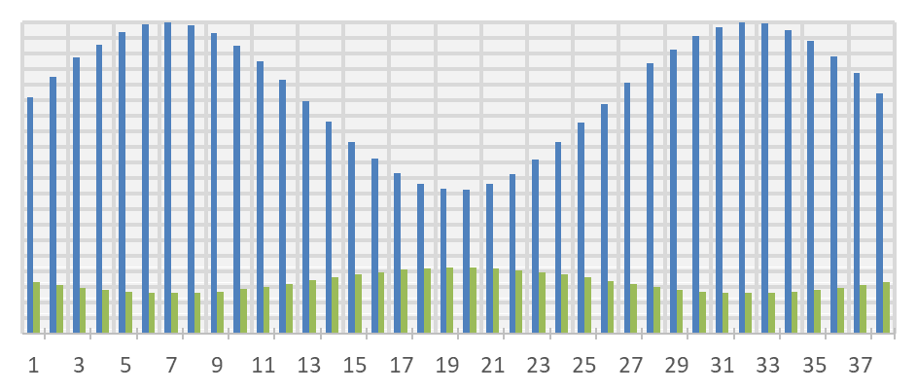
2.3 Combinaison of heat flux and misalignement
Highest heat flux zone
δ
8
19
Normalised heat flux
100 %
OSP
50 %
ISP
PFUs
OSP
1
38
The PFU 8 is of interest (δ ~ 0.4 mm ) (may have reached 1500°C during the C4 campaign)
But…is it recristallised (it is a question of time…) ?
➔ Focus on the OSP LE region
Notes:
NB PFU 13^peut être un candidat (WECN001)

Slide 11
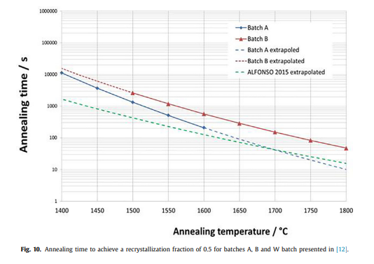
2.4 Loading time
M. Richou, Nuclear Materials, 2020
➔ At 1500°C, > 300 s are needed to reach a decrease by a half of hardness
Future steps : Check the annealed time and Qn on PFU 8 and 19, monoblocks 23-27

Slide 12
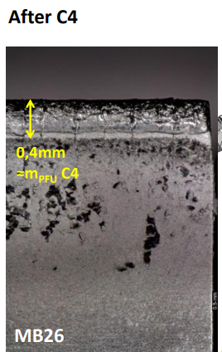
3. Visual observations of the relevant PFU
Plasma loaded surface
➔ Presence of cracks, deposits on the zone dedicated to the hardness measurment
➔ Hardness measurments are not relevant on the full not polished PFU
➔ Future step : polish, use of sample rather than a complete PFU
δ = 0.4 mm
[M. Diez, 2021, Nuclear Fusion]
Notes:
Discrimner transient et SS WERI002 Mono 20 TE

Slide 13
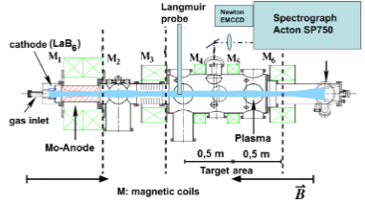
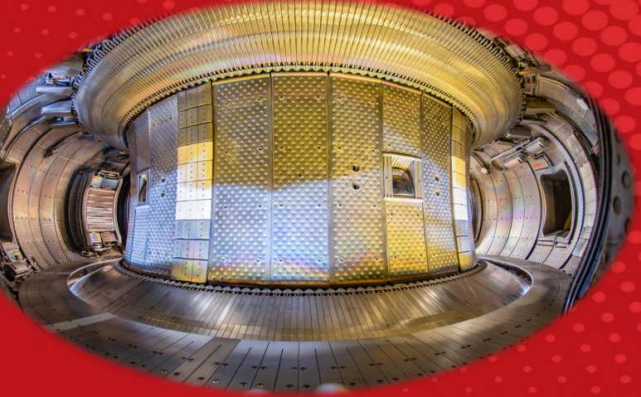
Conclusions and prospects
 | WEST | Thermal field (isothermal) | Thermal field (anisothermal) WPMAT | H | He
Testing | ✓ | ✓ | ✓ | ✓
Testing condition assessment | 2023
Characterization | 2023 | ✓ | ✓ Analysis 2023 | ✓ Dislocation density beg. 2023
Modelisation |  | ✓ Upgrade may be needed

