Slide 1





Update TOMAS facility 2022
Andrei Goriaev¹
Kristel Crombé^{1,2}
1
2

Slide 2
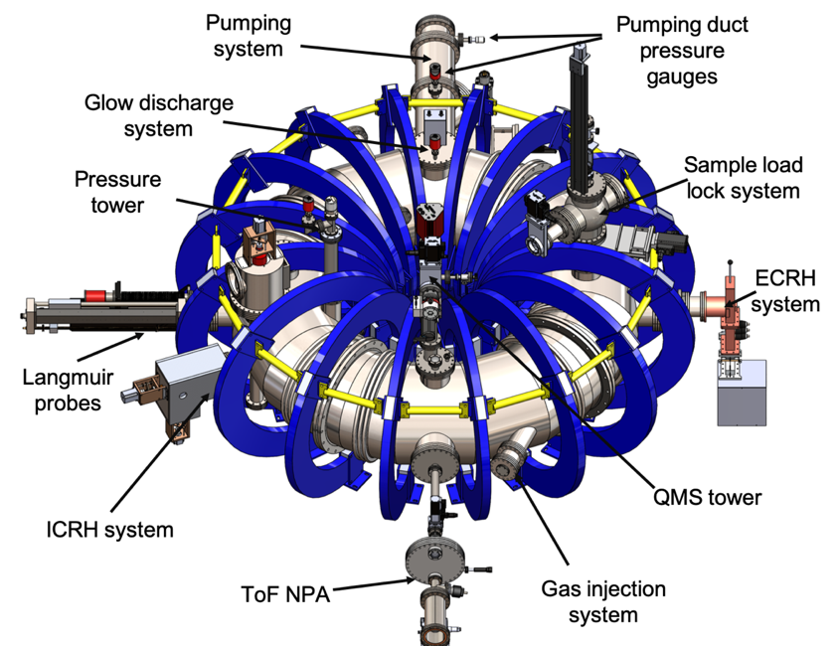
The TOMAS device
The TOroidal MAgnetized System (TOMAS) plasma facility aims at complementary research on wall conditioning methods, plasma production and plasma–surface interaction studies.
Technical parameters of TOMAS
Parameter | Value
Volume | 1.1 m³
Major Radius | 0.78 m
Field on axis | 125 mT
Minor Radius | 0.26 m
RF frequency | 10–50 MHz
RF power | up to 6.0 kW
EC frequency | 2.45 GHz
EC power | 0.6–6.0 kW
GD power | 9 kW

Slide 3
Technical upgrades
Mechanical engineering
Development of the new horizontal and vertical Langmuir probe system allowing for floating potential measurements (4-pin probes)
Development of the safety fence 3D model
CAD model of the new horizontal and vertical movable Langmuir probes
CAD model of the safety fence combined with the TOMAS site picture

Slide 4
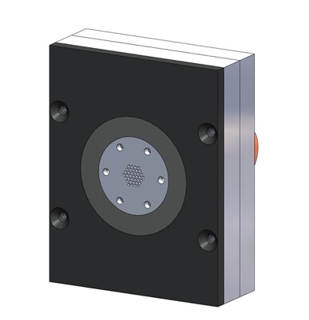
Technical upgrades
Diagnostic installation and system improvement
Installation, commissioning and test of the Retarding Field Analyzer
Installation, commissioning and test of the NIR/VIS/UV spectrometer
Development of GUI for controlling different diagnostics and ICRH matching
Load-lock system port
NIR/VIS/UV spectrometer
Sample holder
Button probe
Sample holder
ECRH port
Holder plate
Position of the sample holder during first RFA tests and 3D model of the RFA detector (Button probe) integrated into the sample holder

Slide 5
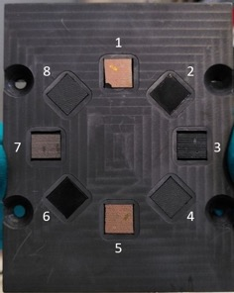
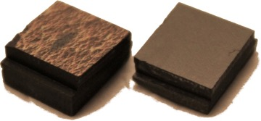
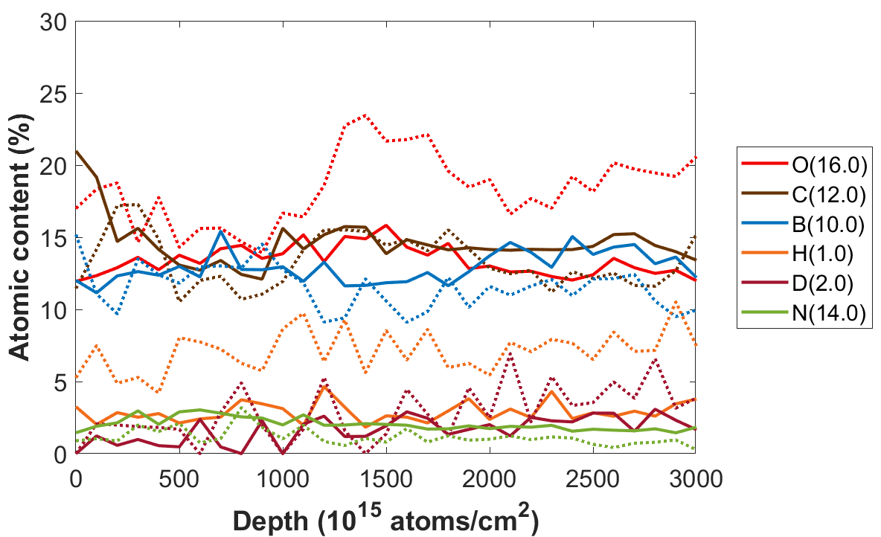
Scientific results: material exposure
Modification of tokamak (TEXTOR) co-deposits by GDC and ICWC plasmas at DC sample biasing
1 and 5
3 and 7
D removal can be observed at high power IC plasmas
Hydrogen plasmas erode carbon, while boron is not removed
H is removed more effectively than D in He plasma
higher fuel removal efficiency with the increasing IC power
removal of C and O from the B containing C-co-deposit layers dominate in H2 plasma
isotope H-D exchange in the surface layer of around 250 nm is not observed
Samples mounted on mask for exposure. 1 and 5 are TEXTOR samples with thick co-deposits, 3 and 7 TEXTOR samples with thin co-deposits
Presented by L. Dittrich on 25th International Conference on Plasma Surface Interaction in Controlled Fusion Devices
HI-ERDA depth profile of thick co-deposits (ICWC exposure). The dotted line - the atomic content before exposure, the full line - after exposure

Slide 6
Scientific results: plasma characterization
Characterization of hydrogen RF plasma parameters by means of triple Langmuir probes and ToF NPA
P = 1.5 kW
Higher pressure increases the total flux of neutrals but reduces the particles’ energy
Increasing the magnetic field improves the confinement of ions -> higher fluxes of neutral particles with higher average energies
An average tendency of higher densities and lower temperatures when the magnetic field and the pressure is increased
A radial oscillation of the temperature is independent of the magnetic field
The TOMATOR 1-D code reproduces the oscillation pattern, however, the temperature estimations are much lower
Radial profiles of electron temperature and electron density with 𝑩_{𝟏} = 𝟎.𝟎𝟕 𝐓 and 𝑩 _{𝟐} = 𝟎.𝟏𝟏 𝐓
Presented by D. López on 24th Topical Conference on Radio-frequency Power in Plasmas
Flux spectra of neutral particles showing a bimodal fit using Maxwellian distributions

Slide 7
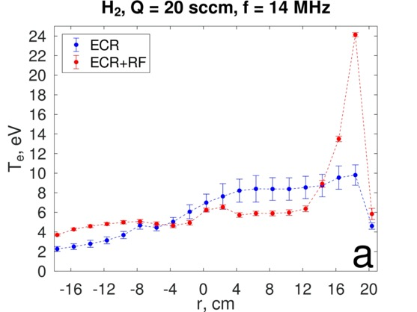
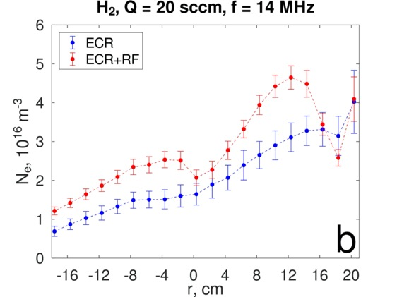
Scientific results: plasma characterization
Measurement of hydrogen plasma parameters (Langmuir probes) of combined EC+RF discharges
2 kW
2 KW + 1.5 kW
The low-temperature (< 10 eV) and weakly ionized plasma (< 4 × 10¹⁶ m⁻³) is created in the ECR discharge
Additional RF power input leads to changes in plasma parameters independently from the ECR discharge
  an increase in the electron temperature in some regions along the radius up to 24 eV
  an increase in the electron density in some regions along the radius;
  an increase in the plasma pressure
Depending on the plasma density and k║ at B=const: slow wave (SW) propagation only, SW and Fast Wave (FW) simultaneous propagation, and FW propagation only
2 kW
2 KW + 1.5 kW
Presented by Yu. Kovtun on 24th Topical Conference on Radio-frequency Power in Plasmas
Radial distribution of electron temperature (a) and density (b) in ECR and combined ECR + RF discharges

Slide 8
Scientific results: diagnostic commissioning
First RF plasma production studies by means of spectroscopy and Langmuir probes
Successful commissioning of the NIR/VIS/UV spectrometer in TOMAS
Test of spectrometer for IC breakdown studies
  IC breakdown possible in He and He (H) with H concentration up to ~ 20%
  No breakdown below 6.5*10⁻⁴ mbar (limited IC power available 2.5 kW)
  No breakdown in pure H plasmas
  Delay in He I line appearance with decreasing pressure at constant IC power (1.5 kW)
  Delay in He I line appearance with increasing H concentration
Triple probe and spectrometer data compared, triple probe faster response
An example of recorded helium spectra
Presented by K. Crombé on 24th Topical Conference on Radio-frequency Power in Plasmas
An example of recorded H_{alpha} (656.46 nm)

Slide 9
Scientific results: diagnostic commissioning
First measurements of local ion fluxes in hydrogen RF plasma
Successful commissioning of the Retarding Field Energy Analyzer (RFA) in TOMAS
Tests of the RFA in hydrogen RF plasmas with different discharge parameters
  The average ion energy decreases and ion flux density increases at the pressure increase
  The average ion energy is directly dependent on the IC input power
  The ion distribution function has non-linear magnetic field dependence
  The average ion energy decreases moving away from the plasma center
An example of ion energy distribution functions at different gas injection rates
Presented by A. Goriaev on 24th Topical Conference on Radio-frequency Power in Plasmas
Average ion energy and ion flux density at different neutral gas pressure

Slide 10
Scientific results: models validation
Studies of X-mode ECRH scenarios beyond the Cut-off Density
As breakdown occurs and density rises above R-cutoff, an evanescent region appears for the X-wave.
  The Fast X-wave (FX) can only exist below this R-cutoff. Beyond the UHR layer,
  the Slow X-wave (SX) can exist
Power is absorbed at the ECR by cyclotron damping since temperature and density rise at R-cutoff location
When R-cutoff is reached, only the tunneling wave can couple its energy at the ECR
When the density for the UHR is reached a sudden rise in temperature indicates coupling of the Electron Bernstein Wave (EBW)
Identification of the three power absorption regimes
Presented by J. Buermans on 24th Topical Conference on Radio-frequency Power in Plasmas
Reflected power with respect to injected power

Slide 11
Ongoing work: technical
Overview of TOMAS upgrade diagnostics (Yu. Kovtun, to be presented in ICFDT6 conf.) -> tomorrow
Calibration of RF probes for the ICRH system -> done
Development of the automatic ICRH matching routine
  Collecting necessary data
Installation of the Chronos fast camera
  Shifted to 2023
Repair of the hydrogen mass flow controller
  Done! To be reconnected to the control system
Analysis of the RF amplifier malfunctioning at high power -> done
Purchasing of the new NI data acquisition system
  Waiting for delivery

Slide 12
Ongoing work: scientific
Modification of tokamak (TEXTOR) co-deposits by GDC and ICWC plasmas at variable sample biasing
  Post-mortem sample surface analysis
Studies of the boron layer erosion by GDC and ICWC plasmas from coated W7-X graphite samples
  Data interpretation
Modeling of radial RF plasma profiles with TOMATOR-1D code
  Comparison with experimental results
Studies of GD+RF mixed discharges (break down and plasma parameters)
  Data analysis

