Slide 1
TALIF for Atomic Density Measurments in Magnum-PSI
Kaden Loring^{1,2}, Kay Schutjes^{1,3}, Hennie van der Meiden¹, and Ivo Classen¹
1. DIFFER, Eindhoven, Netherlands
2. Stanford University, Palo Alto, California
3. Technical University of Eindhoven, Eindhoven, Netherlands

Slide 2
Outline
1. Background and Motivation
2. Current Status
3. Planned Experiments
4. Future Experiments
5. Summary

Slide 3
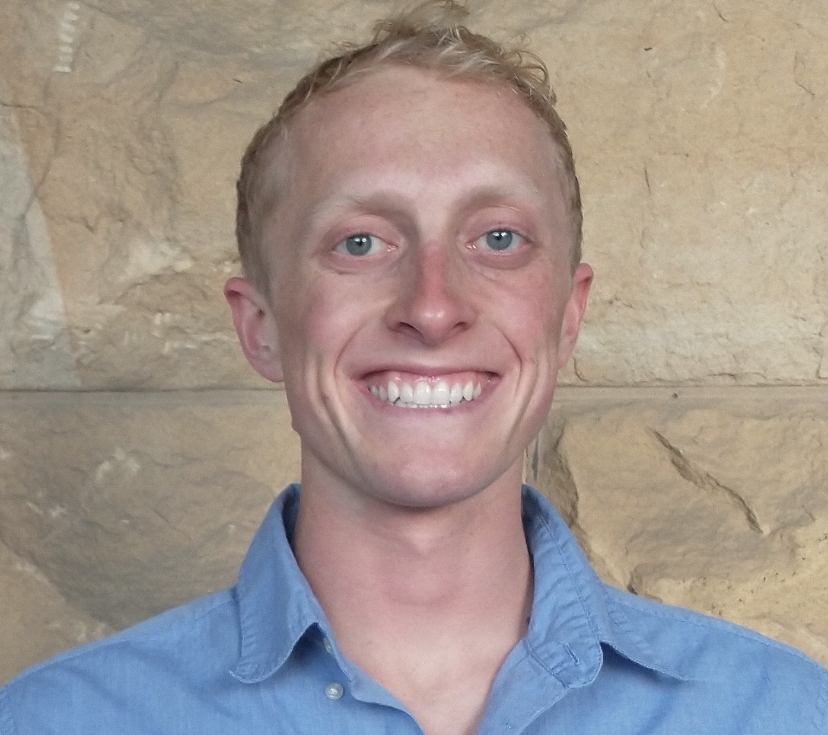
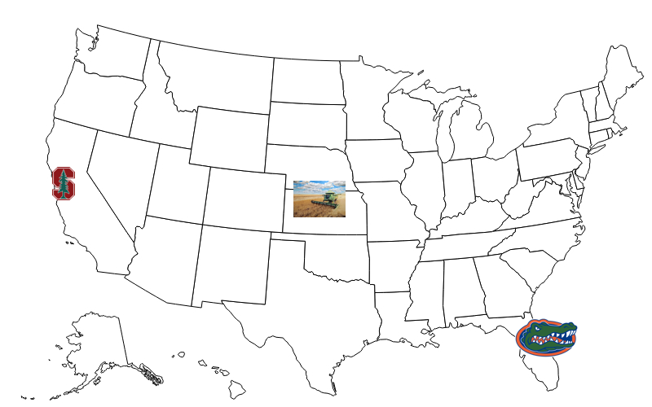
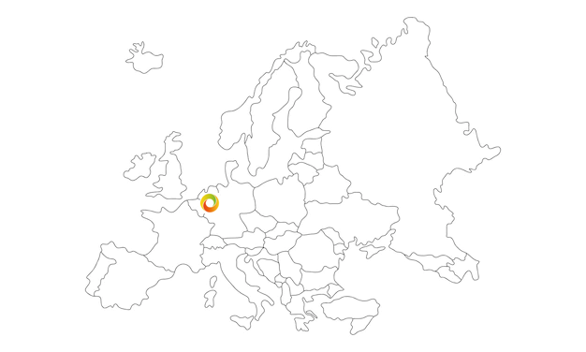
About the Presenter
Kaden Loring
(he/him)
Notes:
Before I talk about the technical information, I wanted to introduce myself briefly as I am both new to the field and new to the EUROfusion community. I grew up in a farming community largely made up of the descendants of Scandinavian immigrants in the agricultural state of Kansas. I earned my bachelors degree in Physics from the University of Florida where I had the opportunity to do research for the LIGO gravitational wave observatory in an optics lab. In September 2021, I began my combined MS/PhD degree at Stanford University in California. In March of 2022, I was awarded a Fulbright research grant to join the plasma edge diagnostics group at DIFFER in Eindhoven, The Netherlands for a year. Following this Fulbright year, I hope to select a thesis project for my Stanford PhD and carry out that research at either DIFFER or another EUROfusion-affiliated research center.

Slide 4
Section 1
Background and Motivation

Slide 5
Preview of Major Points
Background and Motivation
Edge simulation codes need atomic hydrogen (H) densities in ITER-like divertor conditions
TALIF @ Magnum-PSI for H density
Plans for CARS and VUV-LIF for rovib. H₂ populations
Notes:
Today, I’m aiming to do three things. 1) Tell you what I’m going to explain, 2) explain it, and 3) Tell you again what was explained. I hope to do this in a story-like manner.

Slide 6
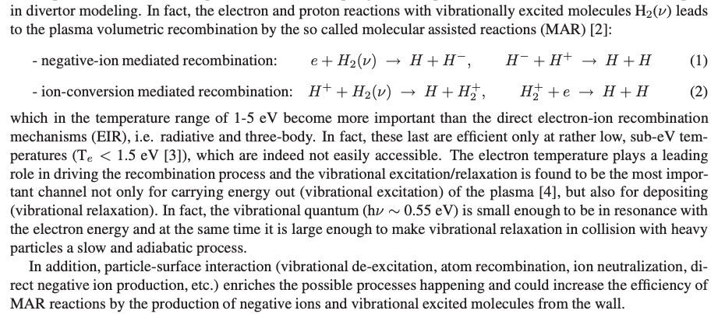
Interesting Divertor Processes:
Background and Motivation
Electron-Ion Recombination (EIR):
Relevant at T_{e} < 1.5 eV
Ex. three-body and radiative
Molecular Assisted Recombination (MAR):
Dominant for T_{e} = 1-5 eV
Involves both vibrational (de)excitation and catalyzed recombination
Particle-Surface Interaction:
Ex. Ion neutralization, molecular formation
All are affected/noted by H population!

Slide 7
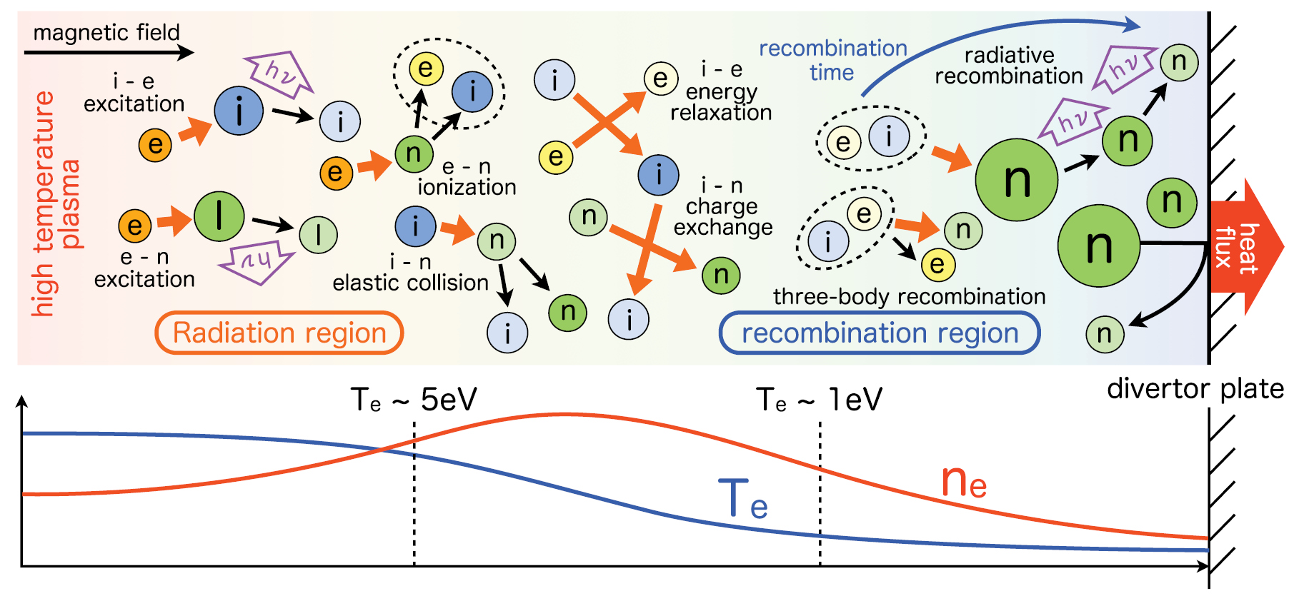
Atomic Hydrogen Density: Why?
Background and Motivation
Cartoon of processes occurring near divertor plate, many of which involve atomic hydrogen. The green ‘n” circles are neutrals. Credit: Y. Hayashi et al (2016).

Slide 8
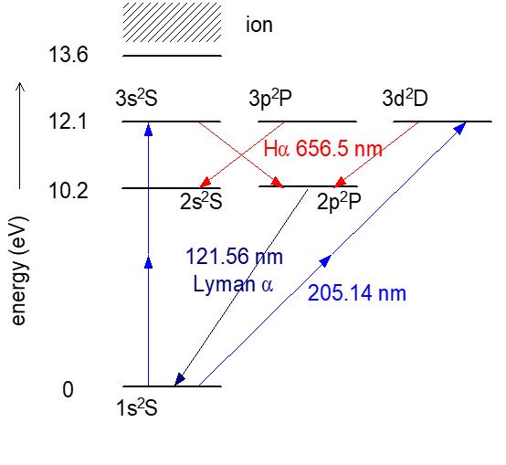
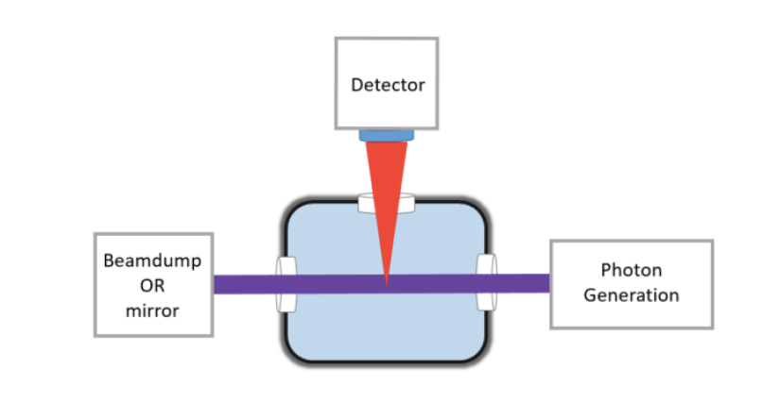
H TALIF
Background and Motivation
LIF:
n=1 to n=2,3 requires λ=122, 102 nm
(VUV, high-self absorption, lg vacuum system ☹)
TALIF:
n=1 to n=3 requires two λ=205 nm
(accessible with combo of laser dyes ☺)
Detected Signal:
n=3 -> n=2 Balmer-alpha @ λ=656.5 nm
(top) TALIF energy transition for H. (bottom) Simplified TALIF setup.

Slide 9
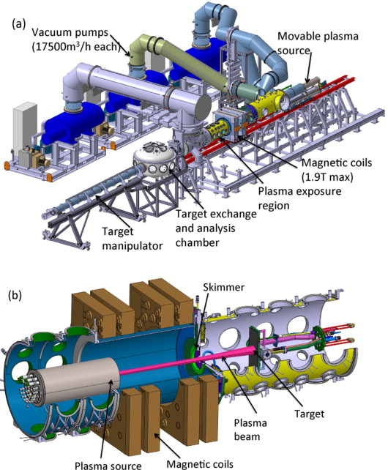
TALIF @ Magnum-PSI
Background and Motivation
ITER-like Divertor Conditions:
(near target)
n_{e} = 10²¹ m⁻³
T_{e} = 1 eV
B = 1 T
All within Magnum-PSI Operational Limits!
(a) Global view of Magnum-PSI. (b) cut-away of vacuum chamber. Credit: G. De Temmerman et al (2013)

Slide 10
Section 2
Current Status

Slide 11
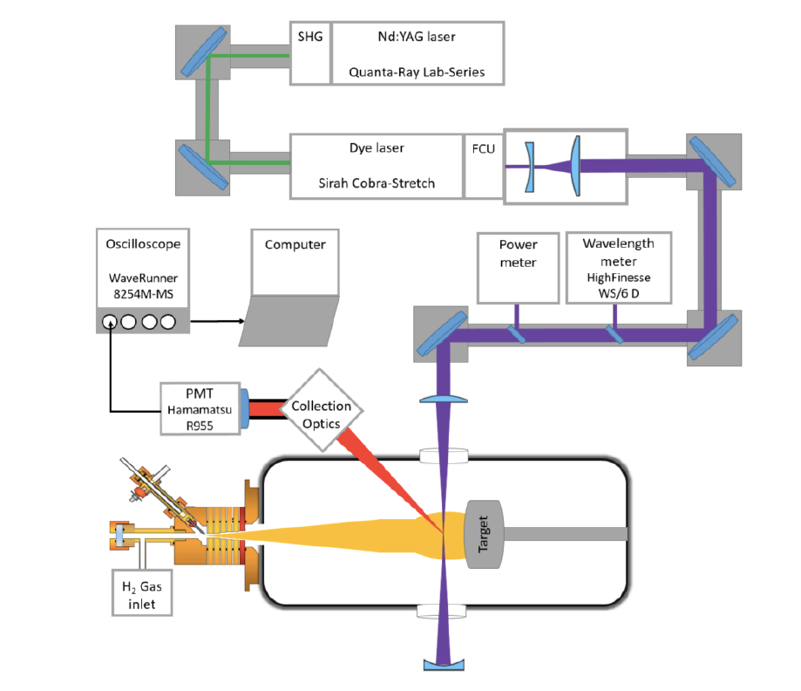
Experimental Setup
Current Status
Pump:
10 ns, 10 Hz, 0.5 J, λ=532 nm, vertical-pol
Dye:
grating-selected λ, 532->615->205 nm with SHG and then BBO mixing
Injection:
Beam expander and convex lens for small radius at plasma (0.7 mm)
Detector:
Fiber-array to gated PMT to anode current
Depiction of setup for TALIF.

Slide 12
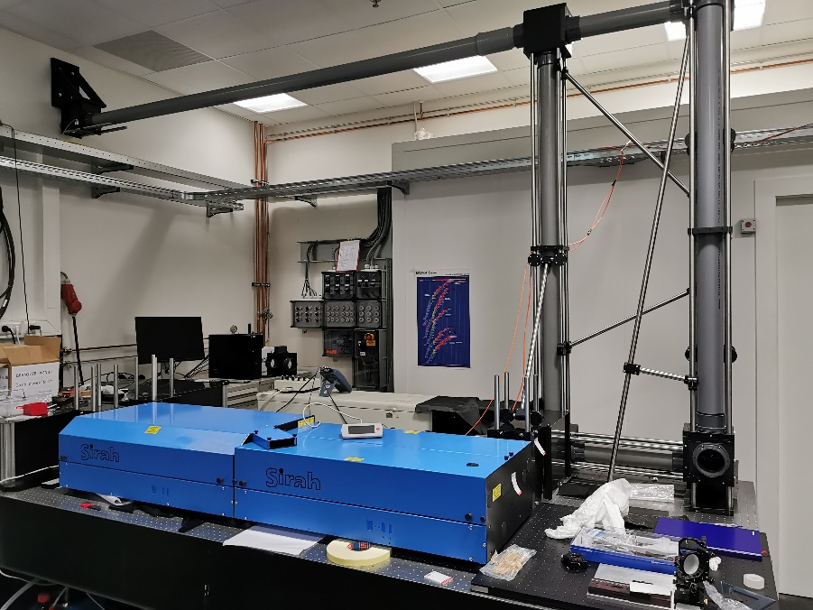
Experimental Setup
Current Status
Pump:
10 ns, 10 Hz, 0.5 J, λ=532 nm, vertical-pol
Dye:
grating-selected λ, 532->615->205 nm with SHG and then BBO mixing
Injection:
Beam expander and convex lens for small radius at plasma (0.7 mm)
Detector:
Fiber-array -> gated PMT -> anode current
Nd:YAG (background), dye laser (foreground), transmission pipe to UPP/Magnum (vertical)

Slide 13
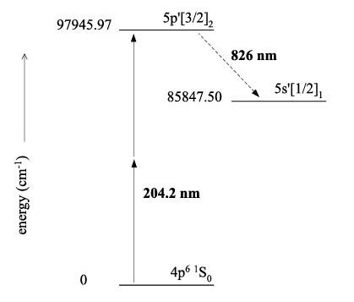
Krypton Calibration
Current Status
Absolute density calibration needs known amount of atoms
Krypton has TALIF signal at similar wavelength as H
Lifetime (τ) of Kr and H needed, other parameters deduced from optical set-up, literature, and simple measurements
Two-photon transition in Kr. Credit: Mazouffre (2001)
n: ground state density of species
S: signal in arbitrary units
σ: two-photon cross-section
ν: photon frequency
I: laser beam energy (areas equal)
A: Einstein transition probability for spontaneous emission
T: transmission of optical detection branch
η: detector quantum efficiency
Notes:
two-photon excitation of the ground state to the 5p’[3/2]2
state requires two 204.2 nm photons

Slide 14
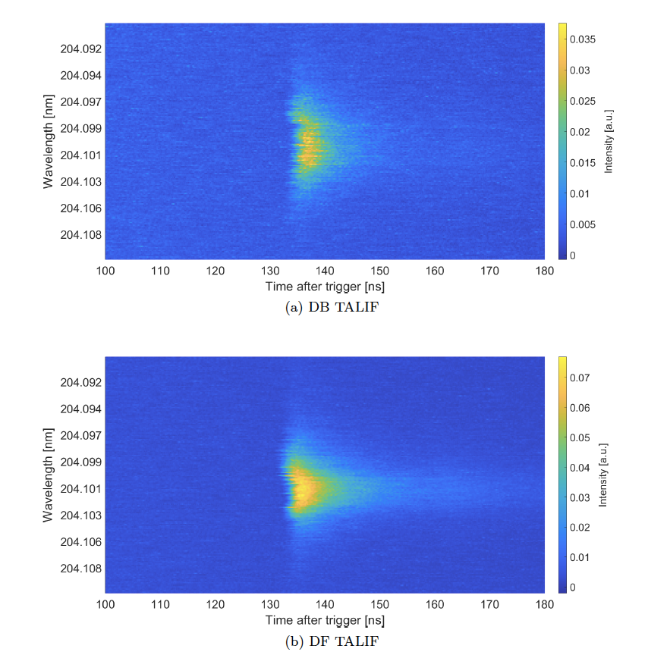
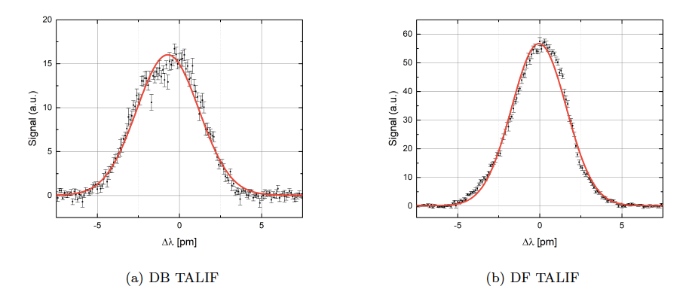
Krypton Calibration
Current Status
DF gives 3.1x more signal, 3.6x higher peak
Comparison of broadening (DF vs DB) gave anomalous temperature (Krypton isotope broadening?)
(top) Time traces of DB and DF signals in Kr while scanning over λ. (left) Time-integrated signal for wavelength deviation from observed resonance.
Notes:
Krypton excitation energy ~ H
plasma source not needed

Slide 15
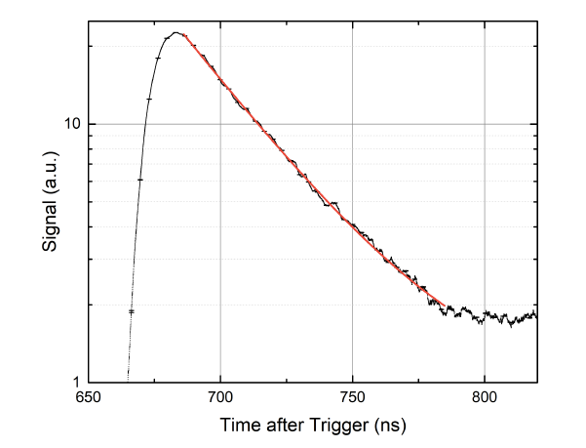
Krypton Calibration
Current Status
Avg of 100 measurements
τ_{Kr}(meas) = 33.00 ± 0.04 ns
In close agreement with values measured in literature
τ_{H} will still be needed for n_{H}
Lifetime defined as time from laser shut-off to signal being 1/e of max value. Shown here for measurements with Kr.
Notes:
uncertainty is calculated by determining the largest outlier of the average, divided by the
square root of the number of measurements

Slide 16
Section 3
Planned Experiments

Slide 17
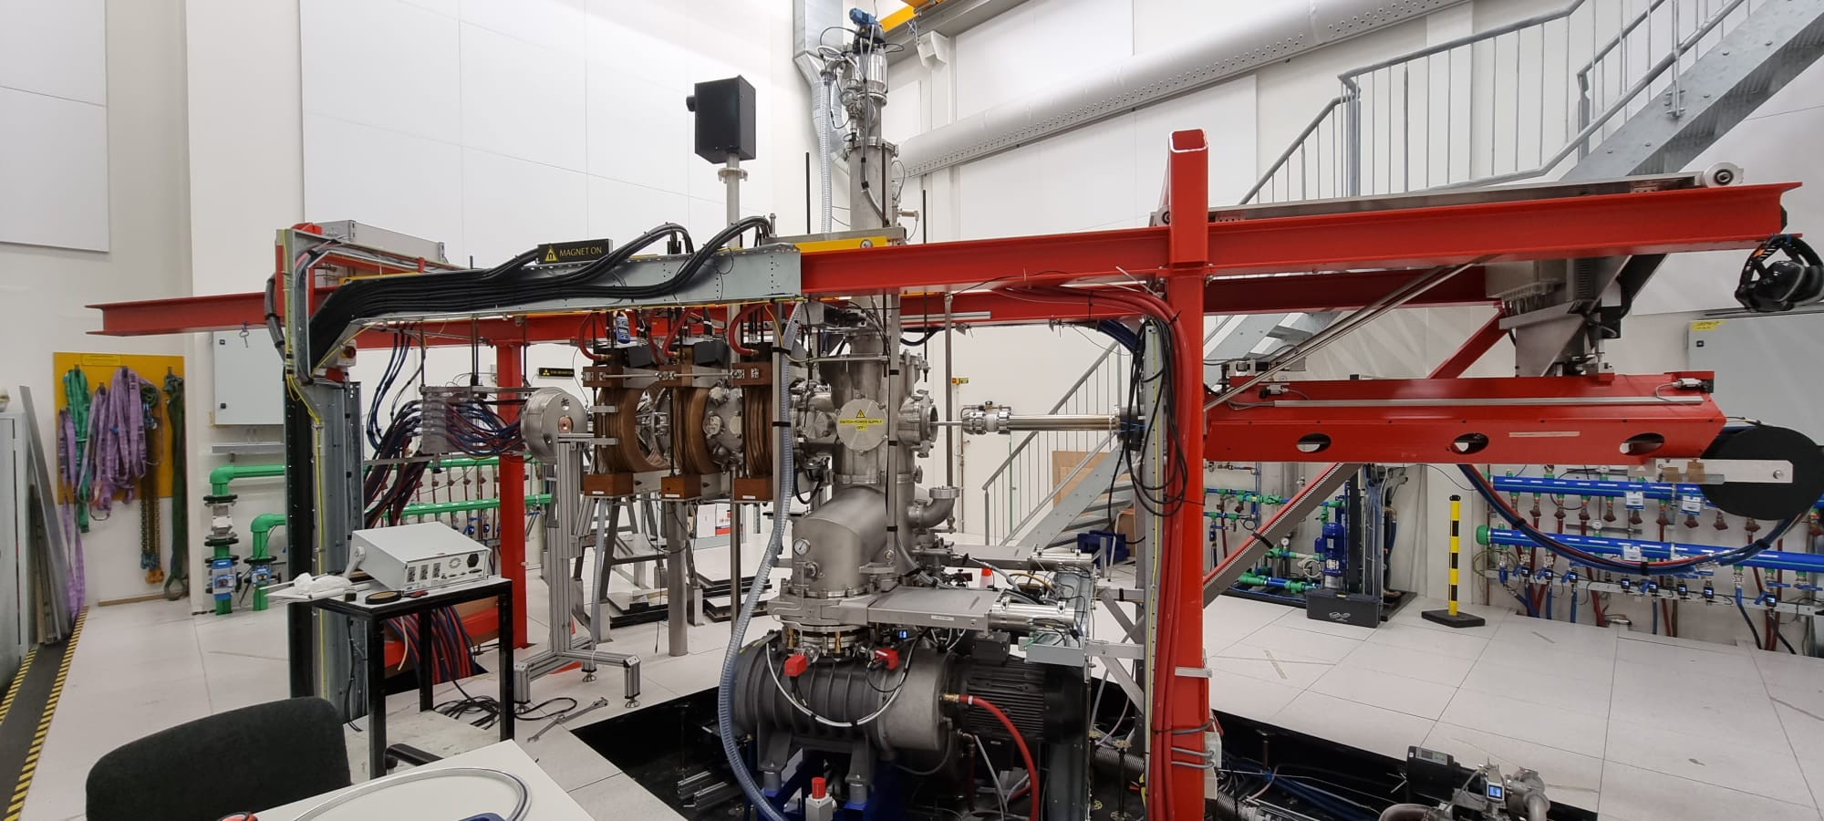
TALIF @ UPP: Proof of Concept/Calibration
Planned Experiments
November 2022
Krypton in UPP for alignment and second calibration
Laser linewidth needs measured
H plasma
Laser linewidth needs measured
H at UPP for τ_{H}, n_{H}, and temperature
Upgraded Pilot-PSI (UPP) at DIFFER.

Slide 18
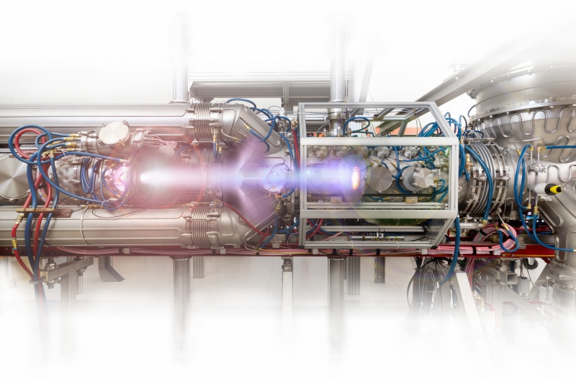
H TALIF @ Magnum-PSI
Planned Experiments
February 2023
First n_{H} ground state measurement in ITER-like divertor conditions
Provides useful parameter to edge and divertor simulation codes
Operational Limits (Magnum, UPP):
n_{e}: 4E21, ~1E19 [m⁻³]
T_{e}: 15 (pulsed), <5 [eV]
B: 2.5, 0.2 [T]

Slide 19
Section 4
Future Experiments

Slide 20
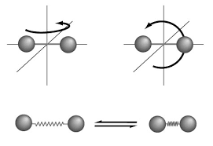
CARS and VUV-LIF H₂ Spectroscopy
Future Experiments
Rovibrational H₂ provide MAR mechanism to divertor plasma
CARS for ν=0-2
VUV-LIF for higher excited states
VUV-LIF challenging as optical system must be in vacuum
Rovib H₂ populations also important parameter for edge codes
Cartoon of rovibrational H₂.

Slide 21
Section 5
Summary

Slide 22
Major Points
Summary
Edge simulation codes needs H density in ITER-like divertor conditions
TALIF @ Magnum-PSI for H density
Plans for CARS and VUV-LIF for rovib H₂ populations

Slide 23
Experiment Timeline
Summary
TALIF @ UPP – November 2022
TALIF @ Magnum-PSI - February 2023
CARS @ UPP - Spring 2023
CARS @ Magnum-PSI – Summer 2023
VUV-LIF @ UPP/Magnum-PSI – Fall 2023?

Slide 24
Kaden Loring
PhD candidate
kloring@stanford.edu
Team: Kaden Loring^{1,2}, Kay Schutjes^{1,3}, Hennie van der Meiden¹, and Ivo Classen¹
1. DIFFER, Eindhoven, Netherlands, 2. Stanford University, Palo Alto, California, 3. Technical University of Eindhoven, Eindhoven, Netherlands

Slide 25
Questions?

Slide 26
Bonus Slides
Notes:
Mostly just drafts of slides.

Slide 27
General View of Problem at Hand

Slide 28
Common Acronyms
ITER: International Thermonuclear Experimental Reactor
DEMO: DEMOnstration Reactor
TALIF: Two-photon Absorption Laser Induced Florescence
MAR: Molecular Assisted Recombination or Molecular Activated Recombination (equiv.)
SOL: Scrape-Off Layer
CARS: Coherent Anti-Raman Scattering
VUV-LIF: Vacuum Ultra-Violet Laser Induced Florescence
H: atomic hydrogen (and its atomic isotopes, unless noted otherwise)
H₂: molecular hydrogen (and its isotopes, unless noted otherwise)
Rovib: rovibrational
Notes:
I will do my best to introduce acronyms as I speak, but in case I forget, here is a quick preview.

Slide 29
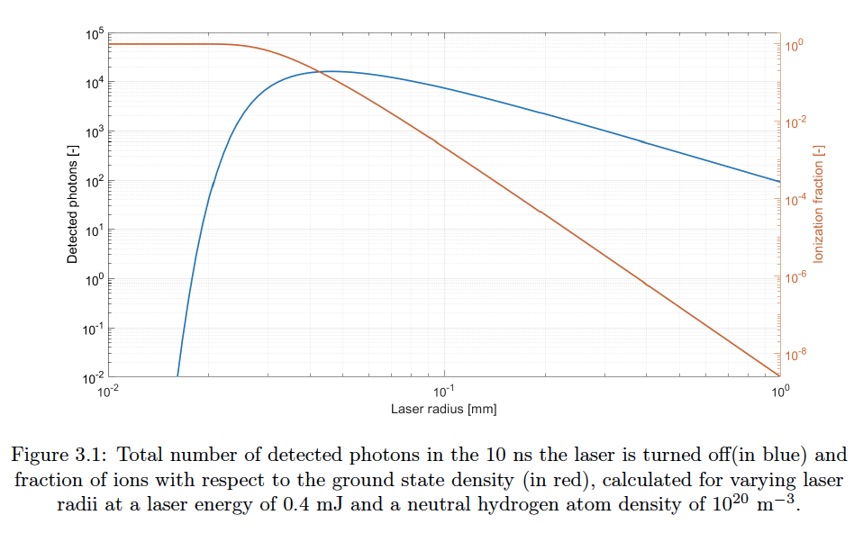
Simulation Result: optimal laser radius

Slide 30
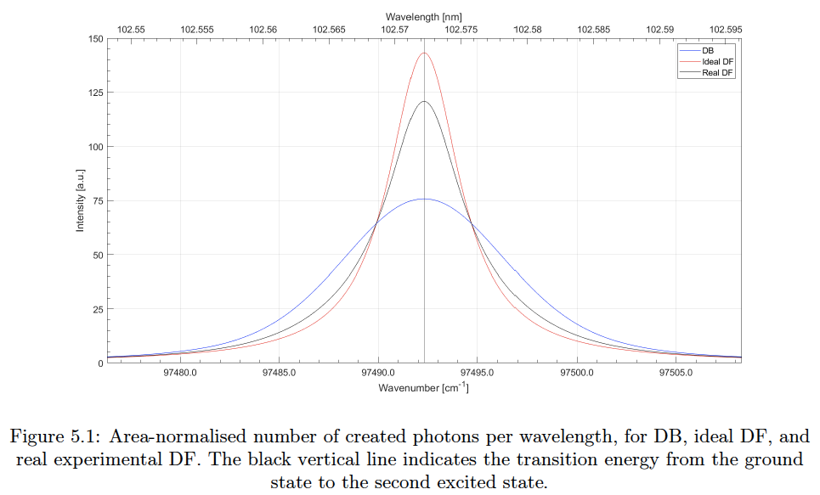
Simulation Result: Expected Signal

Slide 31
Experimental Setup
Current Status
Pump:
Nd:YAG with second harmonic generation crystal (λ = 532 nm)
q-switch for 10 ns pulse @ 10 Hz, E ~ 0.5 J
Delivered to Sirah dye laser with vertical polarization (efficiency)

Slide 32
Experimental Setup
Current Status
Dye Laser:
Molecular dyes w/ wavelength selection by two 2400 grooves/mm gratings
Expected linewidth of 1.6 pm at λ=615 nm (Rhodamine 610 + 640 combo)
615 as intermediary as no 532->205 nm dye exists

Slide 33
Experimental Setup
Current Status
Frequency Conversion Unit (FCU):
Frequency doubled by SHG KDP crystal
Third harmonic generation by mixing fundamental and 2nd harmonic in BBO, λ = 205 nm
Expect linewidth of 0.6 pm

Slide 34
Experimental Setup
Current Status
Laser Injection:
TALIF signal increase for smaller laser radii
Beam expander - > convex lens - > 0.7 mm radius in plasma
Doppler-free: mirror on opposite side of chamber (higher signal)
Doppler-broadened: dump on opp. side (gives temperature info)
Notes:
Beam expander to decrease divergence as laser light travels to magnum/UPP and then convex lens to bring it back to size.

Slide 35
Experimental Setup
Current Status
Detector:
Fiber-array for spatial resolution
Gated PMT collection from fibers
Current from PMT anode gives some spectral details
Notes:
PMT: used extensively in TALIF setups, but rationale not given
Grating spectrometer + CCD: spectral resolution must be smaller than the broadening of incoming light, too large in this experiment
ICCD: none could be attained for this experiment
CCD and EMCCD: high quantum-efficiency at Balmer-alpha but not fast enough for this purpose

