Slide 1
VUV spectrometer for PSI-2 Status report PWIE-SP X.1.T-T002-D002
Michael Reinhart

Slide 2
Overview
Work is part of deliverable PWIE-SP X.X1.T-T002-D002
Tasks:
Setup a passive spectroscopy system for VUV at PSI 2
Use VUV OES for measurements of H/H2 (and isotopologues) emission lines
Aims:
Diagnostic method for recombining plasmas in PSI-2
Input for modelling activities

Slide 3
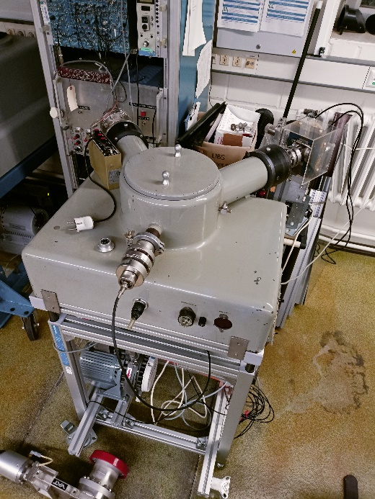
Status
Seya-Namioka Vacuum Monochromator
500 mm focal length
Typical resolution 0.05 nm with 1200 g/mm grating
Status: Commissioning is delayed
Under vacuum
UV light source added
Electron multiplier detector added
To be done:
Setup of controls for the scanning motor
Setup for data aquisition

Slide 4
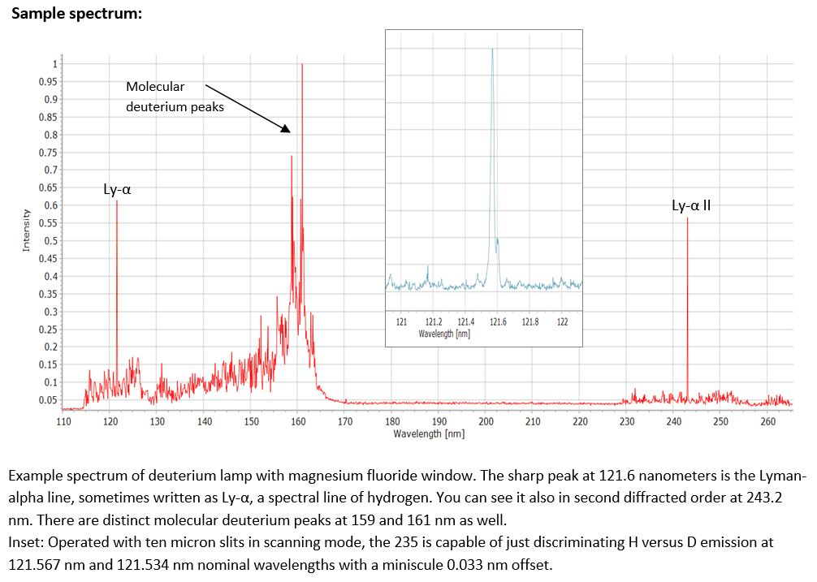
Example spectrum
Sample spectrum by manufacturer:
Discrimination of H-D emission of Lα possible?

Slide 5
Setup at PSI-2
Manipulator ports
Langmuir probe
Plasma dump
Magnets
Magnets
Plasma source
Linear
Target
manipulator
VUV
Spectrometer
Mirror path
Pros: Focus by mirror, spatial resolution possible, less restrictions on location
Cons: Potential loss of intensity, additional components (mirror+controls, pumping)
Observation ports
VUV
Spectrometer
direct view

Slide 6
Timeline
Commissioning of spectrometer: Coming months
Installation + measurements at PSI-2: next year

