Slide 1

WPPrIO Preparation of ITER Operation: IMAS activities for AWP23
Meeting #12 of the SC on the EUROfusion-IO development of IMAS (09/11/2022)
X. LITAUDON (PL) , G. FALCHETTO (PSO) on behalf of PrIO team

Slide 2
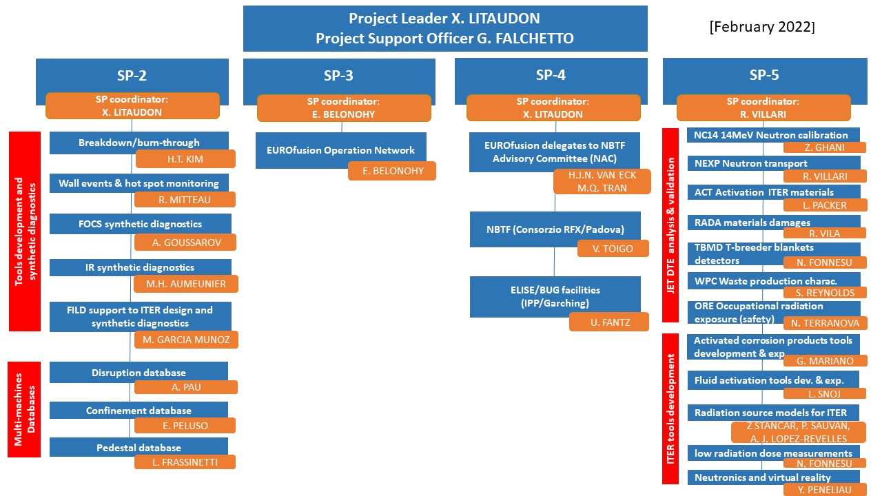
Implementation of some of the 2020 GA recommendations
[EUROfusion role in ITER operation & scientific exploitation EUROFUSION GA (20) 32 - 4.7 ]
SP-1
SP-1. Project management
SP-2. Preparation of ITER first experimental campaigns
SP-3. Plant systems and plasma operation
SP-4. ITER Neutral Beam Test Facility and R&D
SP-5. Neutronics, Nuclear waste and Safety
Presentation of key achievements, 2023 objectives & project milestones per Sub-Project

Slide 3
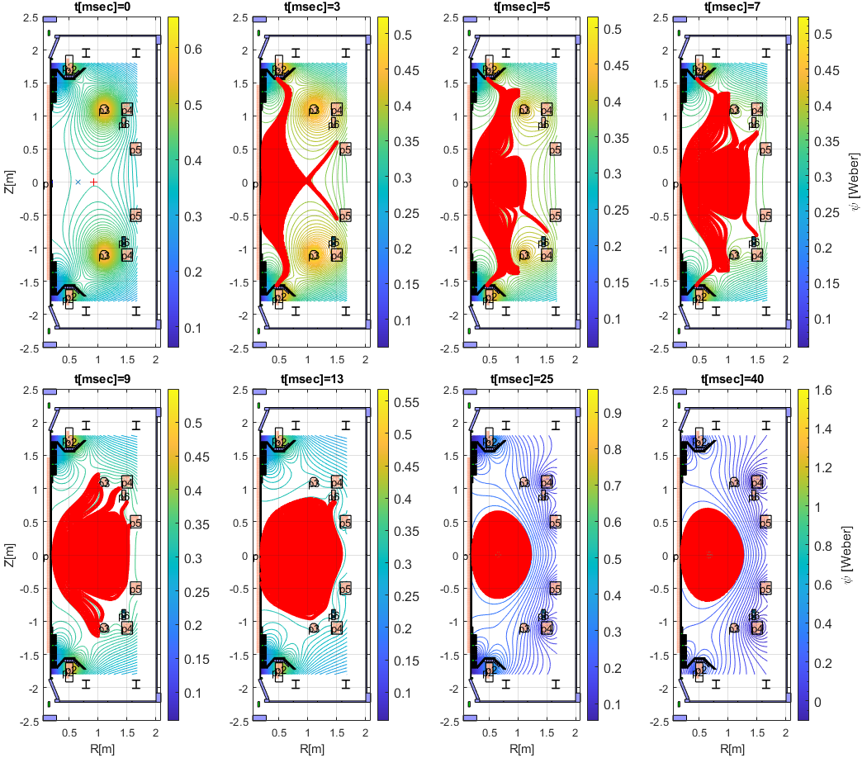
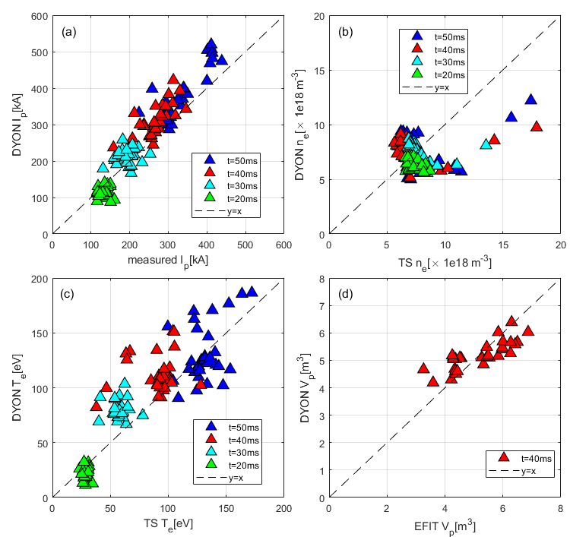
SP-2-2022: Validated Breakdown/Burn-through tools for ITER first operation
Full electromagnetic burn-through model developed and validated on MAST using input as in the control room (with WTE)
  Further validation, IMAS interface development and ITER application
Absorption of EC waves in ITER first plasma start-up conditions in the GRAY-BKD0-CREATEBD framework adapted to IMAS
[Kim et al. 2022 Nucl. Fusion 62 (2022) 126012]
#27512 in MAST
[Kim et al 2022 Nucl. Fusion]
International agreement with Korea
[Ricci et al. 2022]
Tools to be ready for ITER first operation

Slide 4
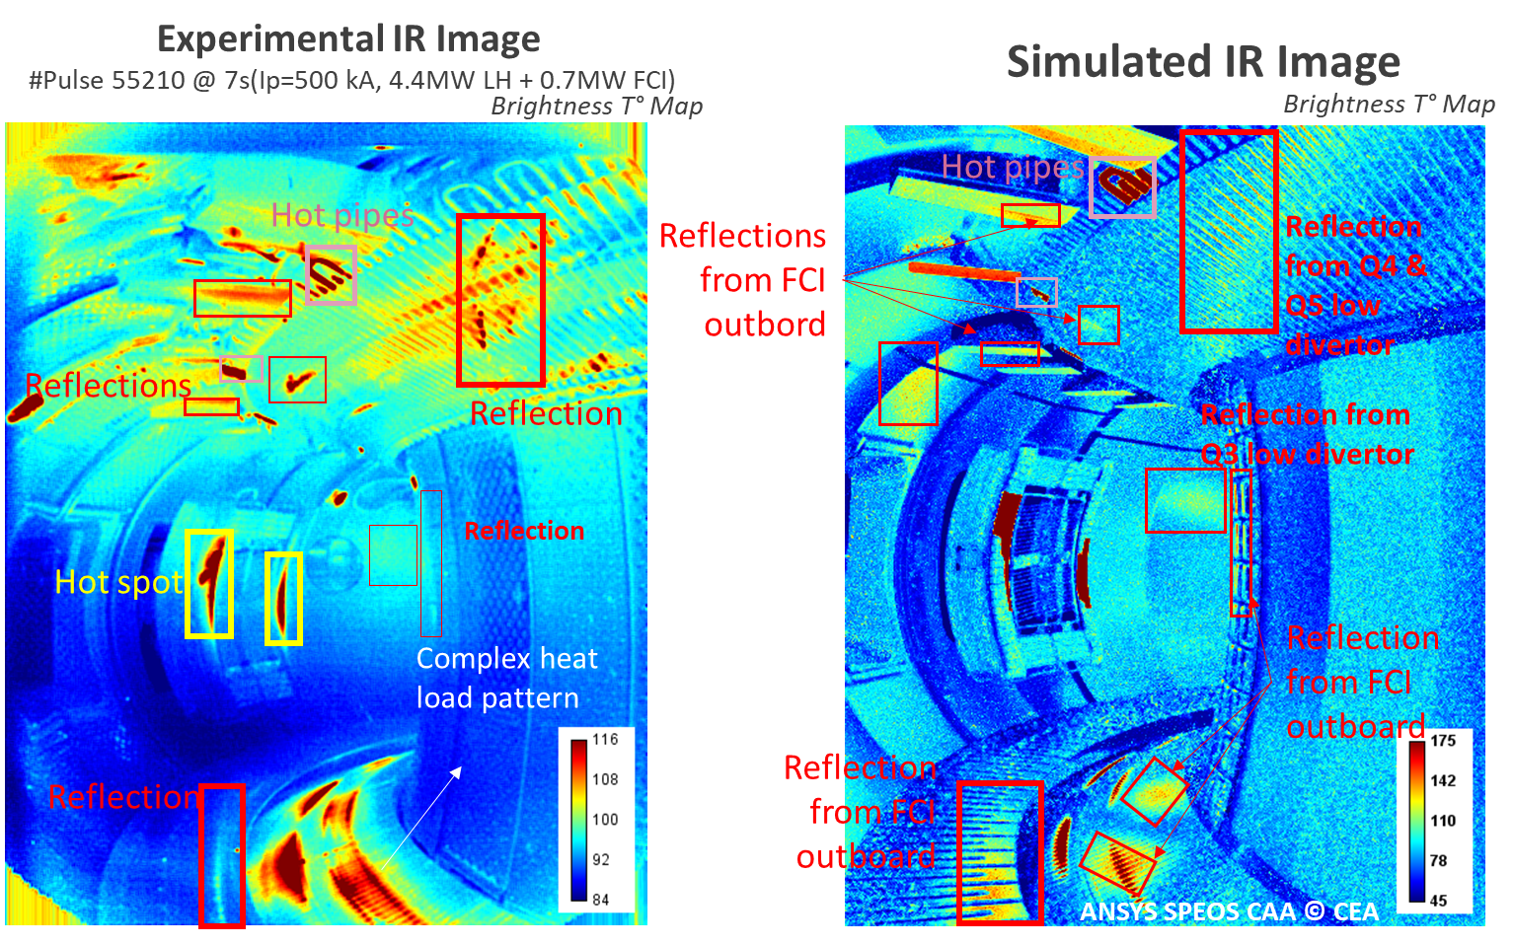
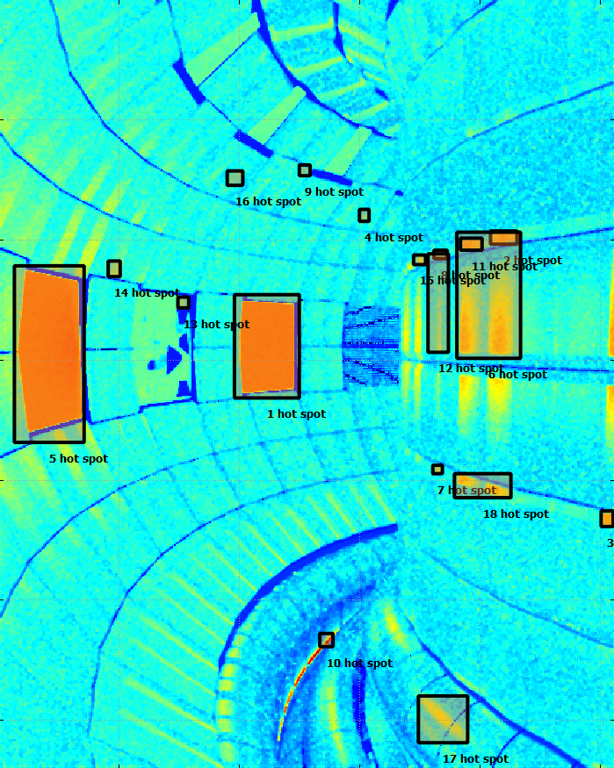

SP-2-2022: IR synthetic diagnostic & wall monitoring for real time protection
Automatic hot-spot detection in ITER simulated IR images
Qualitative comparison on WEST, AUG, W-7X (with TE, W7X)
WEST wide angle TG view
[Aumeunier Nuclear Materials and Energy 2021]
Tools to be ready for ITER first operation
[Mitteau sub. To PPCF]

Slide 5
SP-2-2023 objectives: Preparation of ITER first experimental campaigns - IMAS work
+ 1ppy ACH support
Develop plasma breakdown/burn-through simulation tools and apply to ITER operation
(with TSVV11)
  Parameter scan of ITER Ohmic plasma initiation with full electromagnetic DYON , ECH pre-ionization model
  Parameter scan (neutral pressure, EC power, impurities) for ITER first plasma operation start-up using tight coupling scheme between kinetic models (BKD0), ECRH absorption (GRAY), and CREATE-BD magnetic models (adapted to IMAS)
Develop IR temperature synthetic diagnostic for off-line analysis and ITER real-time application & ITER wall monitoring system (with TE, W7X)
  accelerated photon Ray Tracing code for generating sequences of images
  assessment of ITER applicability of AI-based wall monitoring system from IR imaging diagnostic
  initiate IMAS transition: workplan for implementation into IMAS and input data adaptation)
Finalise synthetic diagnostic for the Fibre Optics Current Sensor in IMAS
Develop FILD synthetic diagnostics and simulation in support to FILD design (in synergy with similar task for JT-60SA)
  Synthetic diagnostic (FILDSIM) simulation to produce realistic synthetic signals
  + IMAS interface
M7 | Models for plasma burn-through and breakdown adapted to ITER conditions | Dec 2023 | PRIO.D.04

Slide 6
SP-5-2023 objectives: Neutronics, Nuclear waste and Safety
"Radiation source development and simulation of the radiation field in ITER"
  Perform sensitivity scans with the ITER H&CD plasma modelling framework on selected ITER PFPO scenarios (He plasma with energetic proton population), and create MCNP neutron/gamma source descriptions.
  Propagate the realistic PFPO sources throughout the ITER MCNP model and study radiation fields, sensitivity of ITER neutron/gamma detectors' response, and assess the possibility of developing synthetic diagnostics models.
  Work toward the standardization of the plasma->kinematics->neutron transport code workflow, focusing on making it embedded within the IMAS framework.

Slide 7
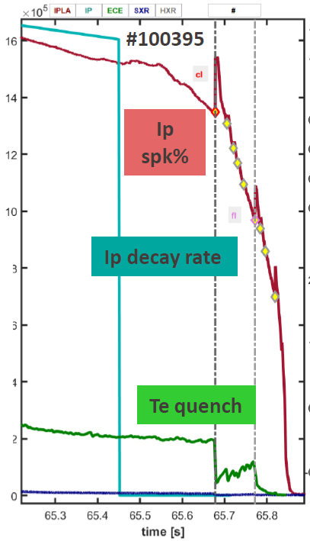
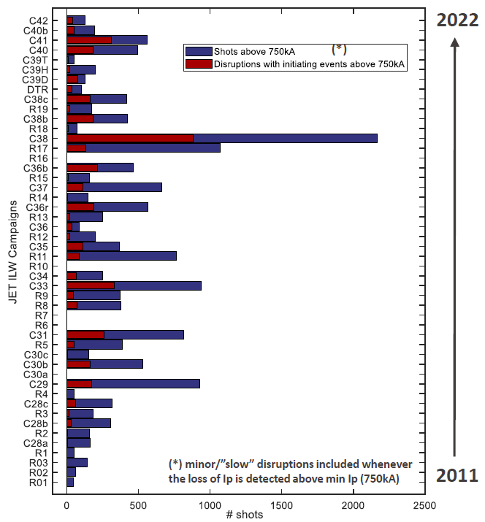
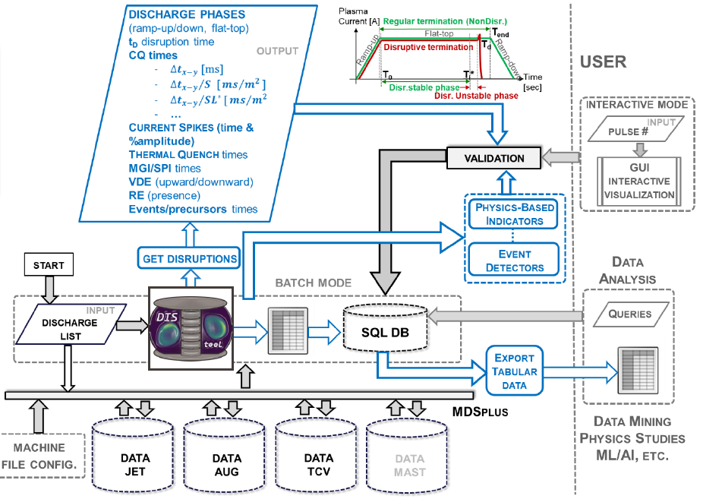
SP-2: Multi-machines workflow for multi-machines disruption analysis
First release of the EUROfusion JET ILW Disruption Database (4000 pulses) on the Gateway early 2023 and expand to other facilities (2023)
DIS_{tool} code framework
Machine generic Events definition
JET ILW database
[Pau 2022]

Slide 8
Multi-machines EUROfusion databases
With WPTE
Pedestal
  Process and include in the database the validated data of the JET pedestal for the new campaigns, including profile data
  Extend the database by including further TCV, AUG, MAST-U data, assuming local (contact person) will be available.
Disruption
  Reference publication describing the multi-machine overall framework - Application to JET
  full automatization of IMAS/IDS mapping from database on the Gateway,
  extension to AUG and TCV, potential extension to MAST-U, JT-60SA (resources ?)
Confinement
  Scientific exploitation of the 0-D database (isotope effect in JET and AUG) (with WPTE support), and submission of a paper
M8 | At least one multi-machine database(s) on the EUROfusion Gateway for exploitation | July 2023 | PrIO.D.03
PRIO.D.03 | Report on the exploitation of the EUROfusion multi-machines database | Dec. 2023

Slide 9
Back-up slides

Slide 10
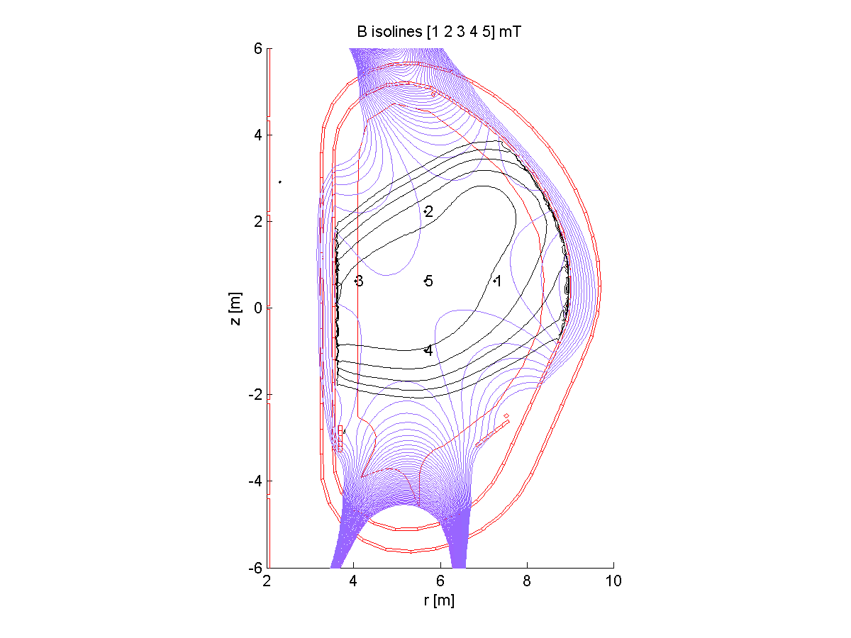
Coupling scheme between kinetic models (BKD0), ECRH absorption (GRAY), and CREATE-BD magnetic models, IMAS adaptation and application to ITER
A reference ITER scenario was identified for the first implementation on IMAS of the magnetic simulation tools and a first test of the BKD0-CREATE BD coupled simulator on ITER.
The GRAY code implemented in IMAS has been upgraded to include multi-pass EC absorption via a simple reflection model at the first wall. The dependence of EC absorption on electron density and temperature during the ITER First Plasma start-up has been assessed using the launching geometry corresponding to the FPPC mirrors designed to support EC operation at First Plasma.
In 2023: scan of ITER parameters using tight coupling
Field map at BD and control points
EC absorption for XM and OM polarization in the FP of ITER. Results shown for the UL Lower Steering Mirror virtual beam.

Slide 11
EUROfusion Pedestal database
Database Work up to June 2022
  Extend the pedestal database to JET TT and DT. To be ready by Dec. 2022
  Planned to transfer the JET and TCV database to the gateway by autumn 2022.
  Initiate inclusion of 1D profiles for the confinement and pedestal databases to analyze the 2-D peeling-stability limits at the pedestal: work to start in September 2022. No major problems foreseen for the local versions. Preparation of scripts to IMAS might be more challenging, but planned to be ready by Dec 2022.
Difficulties encountered
  Include new data from EUROfusion facilities: the work on the AUG and MAST-U version is lagging behind. Tools are ready, but the local contact persons are overloaded with other duties. Discussions with WPTE TFLs is ongoing to find a solution.
2023 high level objectives
  Continue the extension of the databases to include new experimental campaigns
  Include MAST-U and AUG data to the IMAS version of the database on the Gateway
  Finalize the inclusion of the 1D profiles in IMAS and update the databases

Slide 12
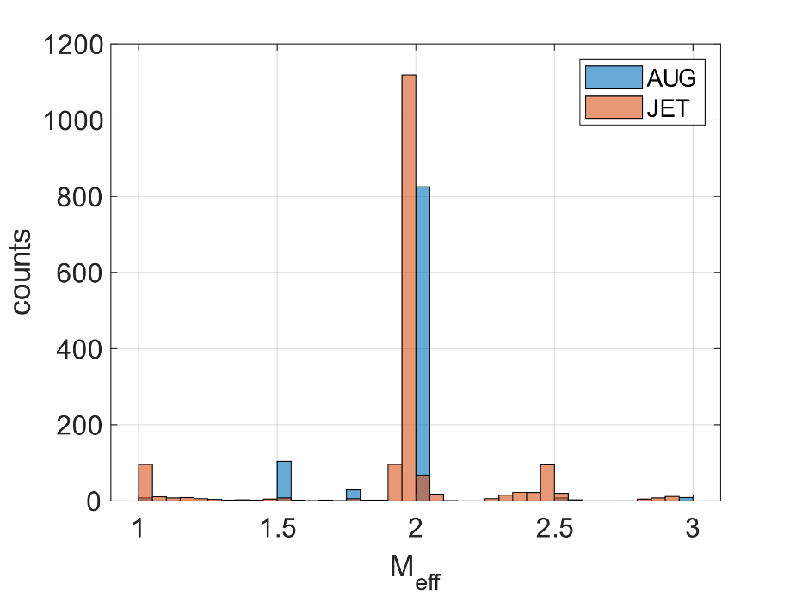
EUROfusion Confinement database
The construction of the confinement database is meant to improve both the modelling and the empirical scaling efforts across the EUROfusion facilities.
The main relevant scientific objects are the revision of the ITER-98 confinement scaling law using ILW data from WPTE devices and the contribution of WPTE plasma profiles for transport studies.
The 0-D database is composed of 2664 entries:
  1681 from JET, C29 to the C41 campaign (isotopic mixtures) and 983 from AUG, from 2014 to 2020 (different isotopic mixture).
Profile database has started, in collaboration with experts, and an initial bulk list of 735 JET pulses has been selected.

