Slide 2
TSVV-03: Synthetic diagnostic probes in FELTOR Raúl Gerrú and DTU Team, Technical University of Denmark (DTU)

Slide 3
OUTLOOK
Goals and implementation.
Routine to set them up.
Example results.
Probe set-up routine.
Limitations and discussions.

Slide 4
Goals
Obtain 1D arrays of data as pins measurements.
Pins can be positioned freely in whole domain.
Defining the sampling rate from the numerical probe (faster rate) independently of the 2D/3D time outputs (slow rate).

Slide 5
Implementation
1st: Interpolation of data to pin position.
2nd: Saving locally the data in the small time steps (thin lines).
3rd: When we reach a 2D/3D saving time (thick lines every $Δ$t), we dump the probe data of that time window into the output.
Simulation time
Probe times saving locally
2D data dump into output
t
t+$Δ$t
t+2$Δ$t
t+3$Δ$t

Slide 6
Inputs parameters for the probe
Probe parameters:
Num_pins: Total number of pins.
R_probe: R position of each pins (in computational coordinates).
Z_probe: Z position of each pins (in computational coordinates).
Phi_probe: Toroidal plane in which the pins should be positioned.
Timing parameters:
“timestepper”:
“deltaT”: time between 2D outputs (in computational units).
“output”:
“itstp”: Amount of time saved between 2D saving times.

Slide 7
For simplicity: FELTOR probe/input set-up routine
In FELTOR utilities (https://github.com/mwiesenberger/feltorutilities, private for the moment), “FELTOR Inputs creator.ipynb”:

Slide 8
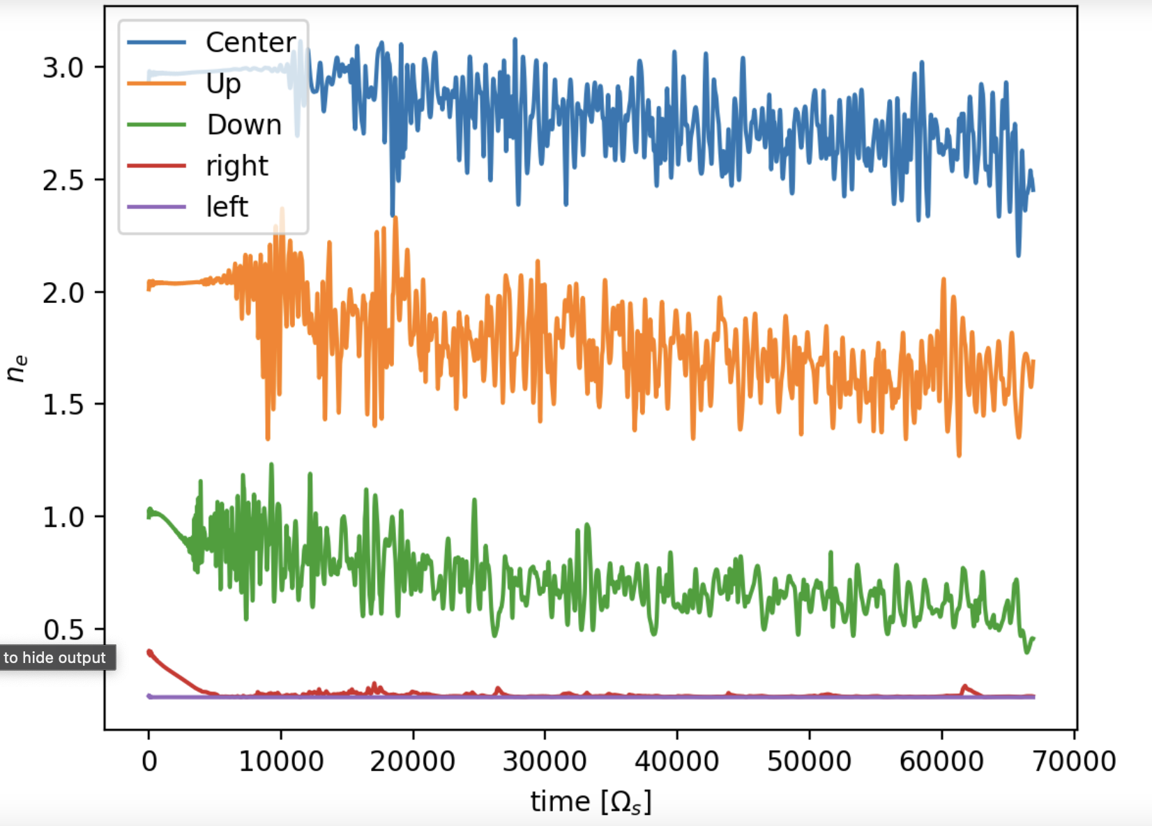
First results
Inner edge
edge
OMP density signals:
LCFS
SOL
Far SOL

Slide 9
Limitations and discussions
Limited to FELTOR computed fields (N_{i}, n_{e}, U_{i,||}, u_{e,||}, $φ$, A_{1,||}) and no complex fields.
Not possible to give pins’ positions in magnetic coordinates (with routine we can tune it).
No interpolation in toroidal direction. Constrained to toroidal planes.
If we want good 2D blob studies… is it really interesting to have higher frequencies for the pin data?

Slide 10
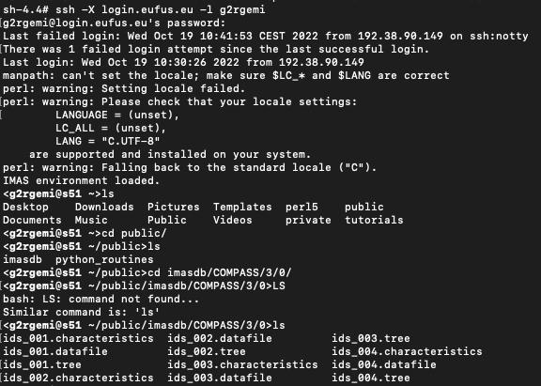
IMAS implementation
We have a Python routine run locally transfering probe data from .nc output files to IMAS files.
Then transfered to Gateway (first test data available at g2rgemi/public/imasdb/COMPASS/3/0)
Further work on transfering complete data.

Slide 12
END

