Slide 1
CNPS – DTT MHD&TH Seminar - September 3rd, 2021
When the chorus sings …
… and laboratory plasmas join in (*)
Fulvio Zonca1,2, Xin Tao3 and Liu Chen2,1
1Center for Nonlinear Plasma Science and ENEA C.R. Frascati, 00044 Frascati, Italy
2IFTS and Dept. Physics, Zhejiang University, Hangzhou, 310027 P.R. China
3Department of Geophysics and Planetary Sciences, USTC, Hefei, P.R. China
(*) Contributions from: S. Briguglio, M.V. Falessi, G. Fogaccia, V. Fusco,
Z. Qiu, G. Vlad, X. Wang
Frascati, September 3rd 2021

Slide 2
Self-consistent NL electron response
Asymptotic expansion:
Formally solving NL Vlasov using small amplitude expansion

Slide 3
Nonlinear electron response
Renormalization via same-k interactions:
Consider the NL contribution without fast spatiotemporal scales
Effect of self-interactions of the wave number of interest with itself

Slide 4
Nonlinear electron response
Renormalization via same-k interactions:
By iterative solution one obtains the dominant renormalized response ➔ Dyson – like equation (DSE)
resonance broadening

Slide 5
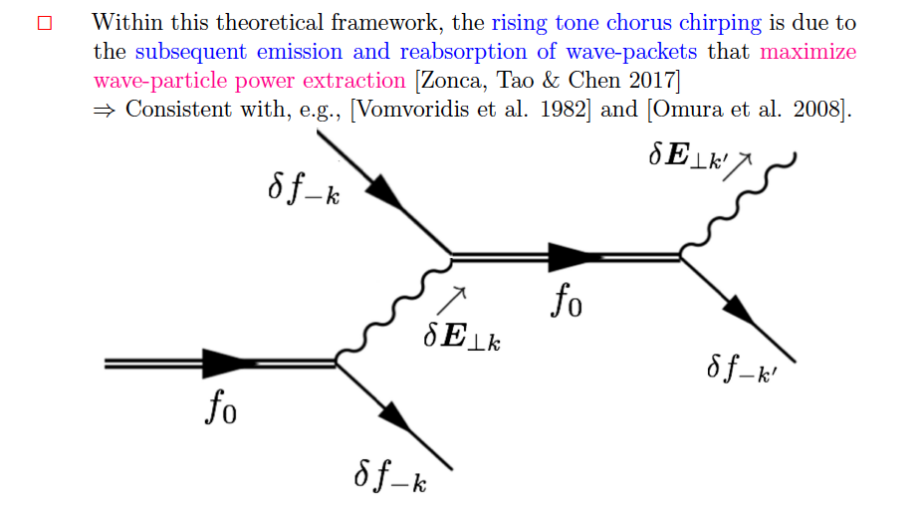
Dyson description of chorus chirping

Slide 6
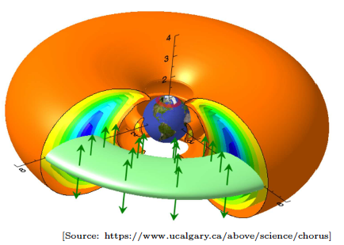
Reduced Dyson description
Reduced Dyson description:
Derive evolution equation for nonlinear growth and frequency shift
Based on the existence of a narrow (quasi-coherent) spectrum and its resonant excitation
Use localized source to ignore magnetic field non-uniformity
propagator
resonance broadening

Slide 7
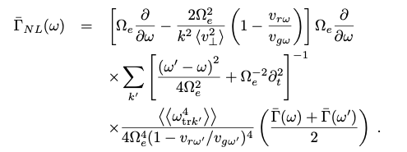
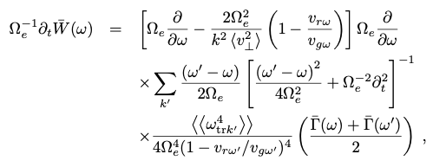
Reduced Dyson description
Reduced Dyson description:
Narrow spectrum: recovers Vomvoridis 1982
Analytic result derived for the first time
Self similar solution that ballistically propagates

Slide 8
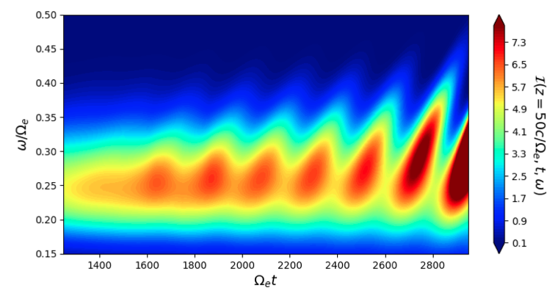
Numerical results
Reduced Dyson description:

Slide 9
Discussions
The theoretical framework for chorus emission is fully
developed based on the DSE+WKE solution. Supported by
extensive numerical verification.
It describes universal chirping phenomena in space/lab plasmas
More generally: A "Trap-Release-Amplify" Model of Chorus Waves. Xin Tao, Fulvio Zonca and Liu Chen, Journal of Geophysical Research: Space Physics, 126, e2021JA029585 (2021)
Incorporates Vomvoridis and Helliwell models within
one single self-consistent description
➔ Vomvoridis: chirping a |A| (demonstrated
num. by X. Wang and exp. by L.M. Yu)
➔ Helliwell: chirping connected with nonuniform B
Predictive capability: can correctly predict recent chirping
whistler (chorus) observed at MARS (crustal B)
➔ Submitted

Slide 10
Nonlinear electron response
Asymptotic expansion:
Formally solving NL Vlasov using small amplitude expansion
(52)

Slide 11
Resonance Broadening
Coupling of $δ\overline{f}k+k′$ with (k’)* and $δ\overline{f}k−k′$with k’ (Dupree 66):
resonance broadening

