Slide 1
SOLEDGE analysis of the NT edge
Paola Muscente, Paolo Innocente
paola.muscente@igi.cnr.it

Slide 2
Final aim of the study
Investigate the effects of NT configuration on plasma performance from the power exhaust point of view
What we expect
Possible improvement due to L-mode with respect to the H-mode PT, i.e. no limits on P_{SOL} (not need to be above the L-H power threshold), and an easier power exhaust dissipation due to a possible bigger λ_{q} ^{[1,2]}
Targets of the studies
NT edge transport study
Compare with the PT one in both L-mode and H-mode configurations
Edge turbulences study in NT
Compare with the PT one in both L-mode and H-mode configurations
Tools
Using interpretive and predictive tools for
Study of the transport: SOLEDGE2D-EIRENE*: a fluid-Monte Carlo code, which requires empirical input parameters found by modelling experiments
Including turbulences: SOLEDGE3X*, 3D first-principles code including turbulences
→ Both codes are suited to treat complex geometries and configurations and allows to extend the simulation domain to the whole PFC
[1] R. Maurizio et al., 2021, Nuclear Fusion 61.2 024003
[2] M.E. Austin et al., 2016, 59th APS-DPP Bulletin Bo4 2
*Developed by CEA

Slide 3
Transport studies with
SOLEDGE2D-EIRENE
Comparison with the PT in L-mode
Additional studie: Investigate triangularity effect on particles and heat diffusion in the whole near-SOL
Comparison with the PT in H-mode

Slide 4
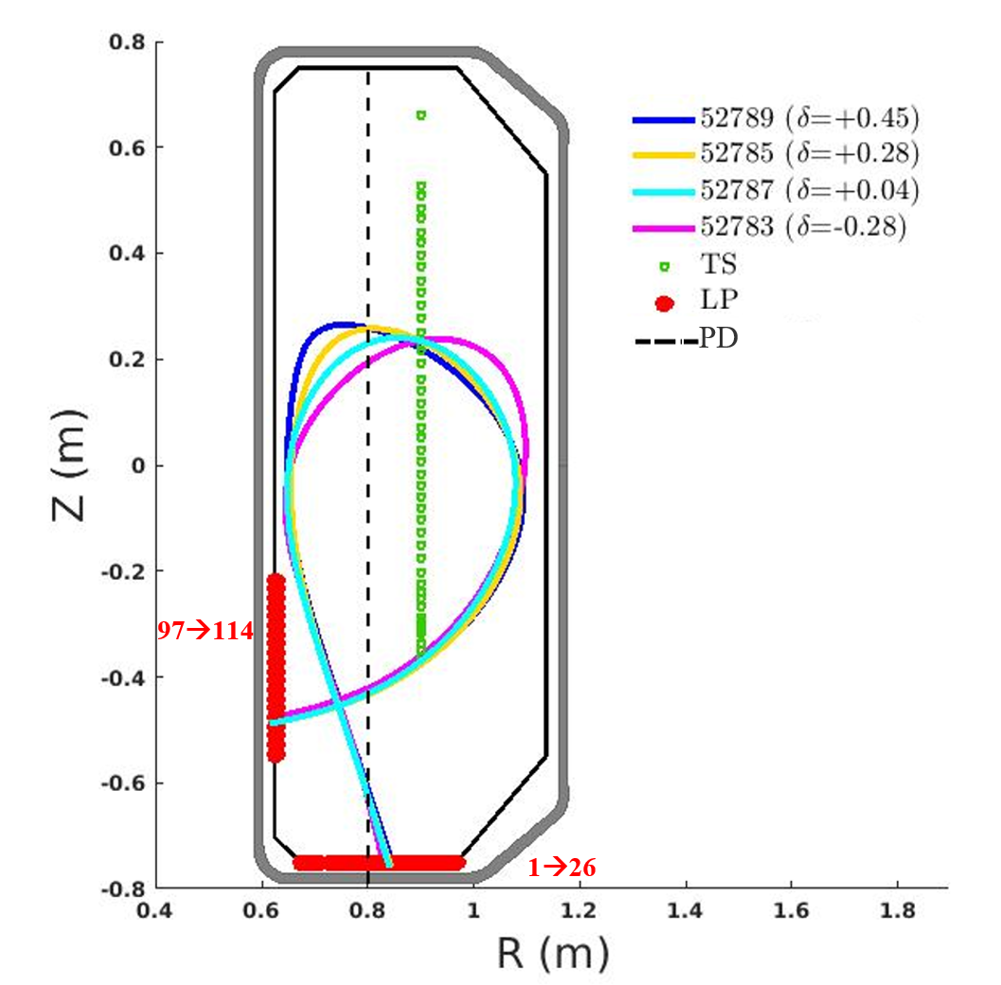
Transport studies: Comparison with the PT in L-mode
Equilibria of the TCV pulses
Aim:
Compare the power exhaust in NT with respect to the PT L-mode investigating particle and heat diffusion and heat flux decay length (λ_{q}) behaviour
Study:
Transport with SOLEDGE2D-EIRENE
Experimental dataset:
upper triangularity scan performed in TCV^{[3]}
ohmically heated
L-mode deuterium plasmas
high recycling regime
[3] M Faitsch et al., 2018 Plasma Phys. Control. Fusion 60 045010

Slide 5
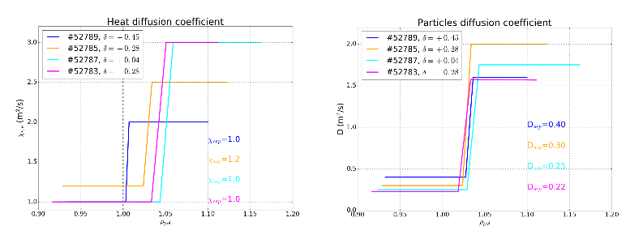
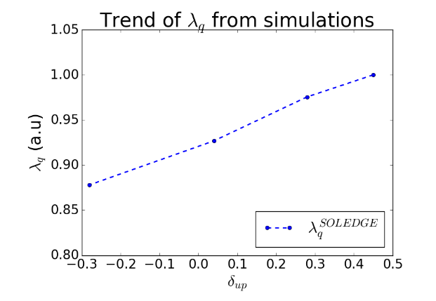
Transport studies: Comparison with the PT in L-mode - RESULTS
The study allowed to characterize the edge transport in NT discharges, showing that the triangularity affects not only the core but also the edge transport
In particular:
- Focusing inside and at the separatrix :
Particle transport has a monotonic behaviour, decreasing towards NT
Heat transport does show any particular trend
- λ_{q} on the outer mid plane increases monotonically with δ_{up} (consistent with the previuos IRT analysis ^{[3]})

Slide 6
NT edge transport study: enlarging the study
The analysis does not allow to have precise information about transport in the whole SOL
Necessary additional studies
Investigate if triangularity affects more the particles or the heat diffusion not only at the separatrix but also in the whole near-SOL
→ χ_{i,e} profile fixed + D profiles in ad hoc shapes (n_{sep} fixed)
D profile fixed + χ_{i,e} profiles in ad hoc shapes (n_{sep} fixed)
Focus on experiments (RT07/RT02 pulses), which have data from diagnostics that cover much better regions of interest
→ TS extended up to the divertor region
→ Helium beam at the omp
→ RPTCV

Slide 7
Additional transport study:
triangularity effects on heat and particles diffusion

Slide 8
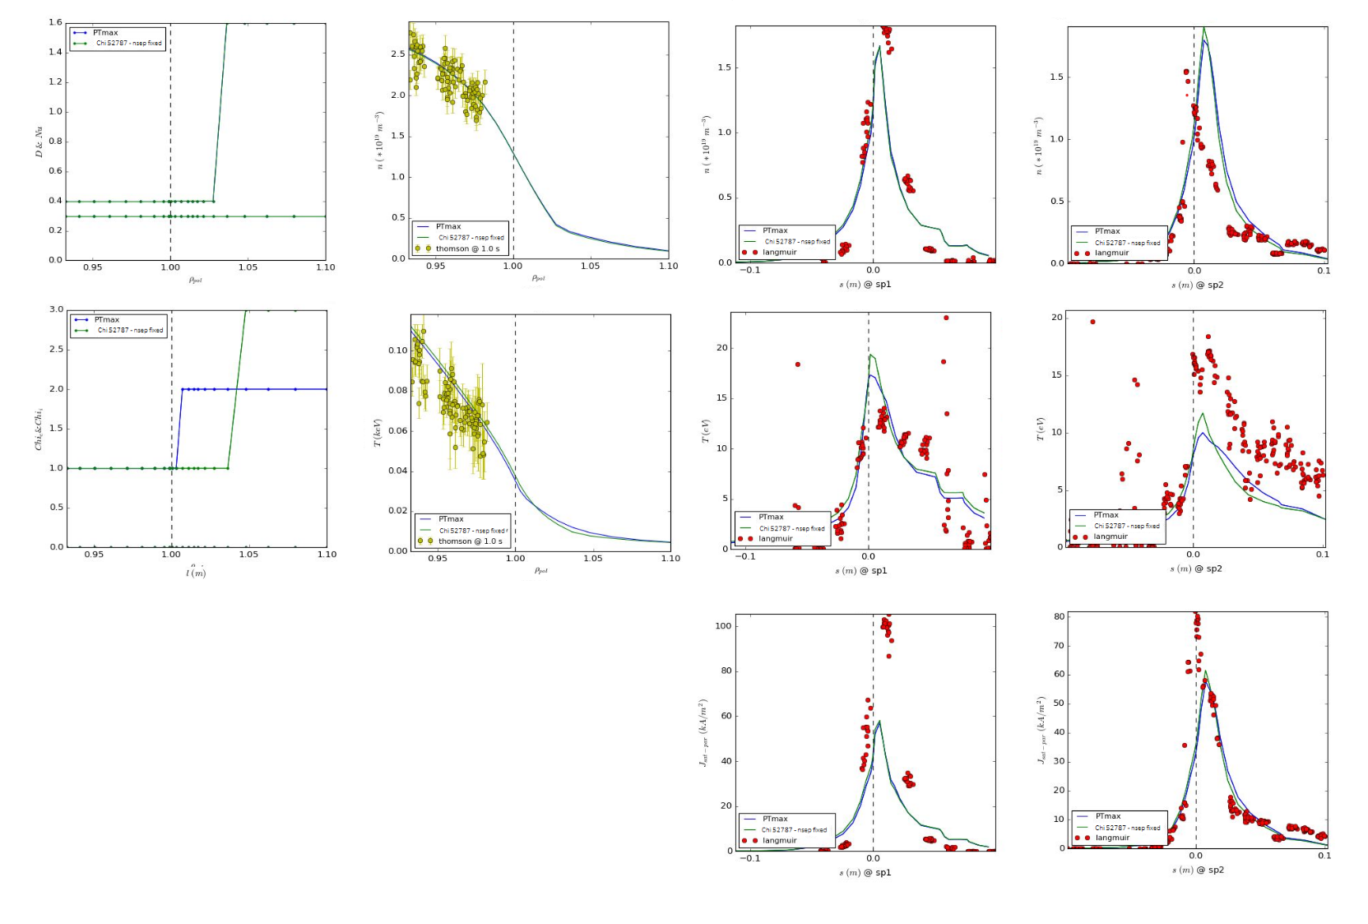
Additional transport study: triangularity effects on heat diffusion
In χ-fixed cases, the χ_{i,e} profile chosen was the one which change out of the separatrix after ~ λ_{T} for all the cases
PT (+0.45)
Targets
Inner outer
Outer mid plane
n_{e}
n_{e}
-- Fixed
-- Ad hoc
D & Nu
n_{e} (x 10¹⁹ m⁻³)
T_{e}
T_{e}
χ_{i,e}
T_{e} (keV)
GOOD MATCH
J_{sat,i}
J_{sat,i}

Slide 9
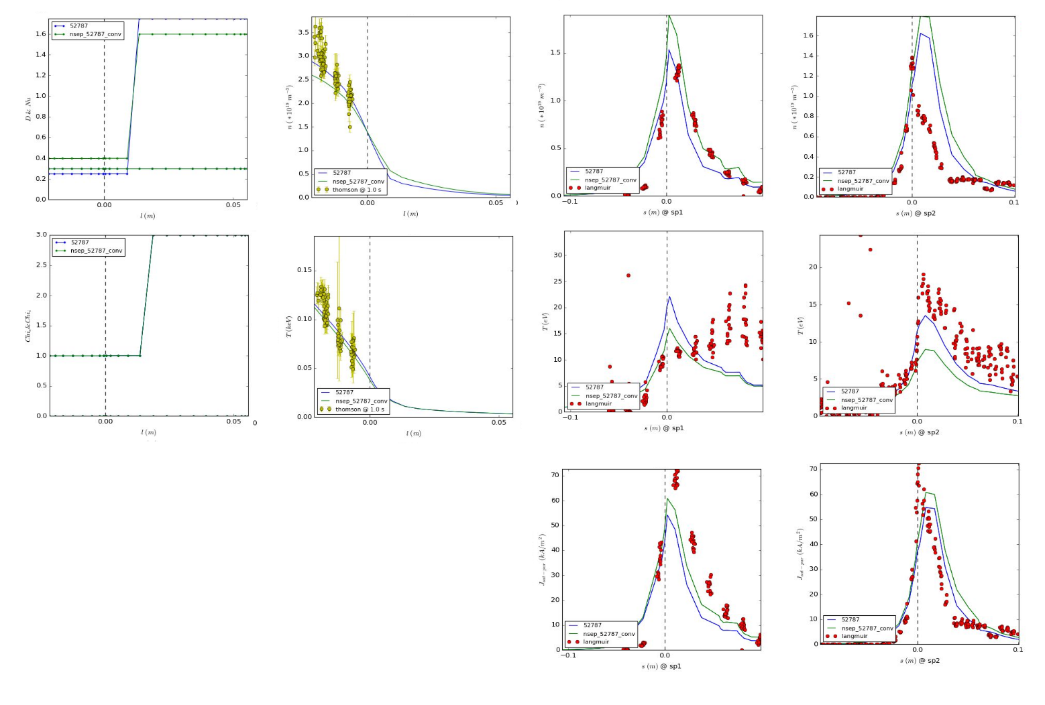
Additional transport study: triangularity effects on particles diffusion
D-fixed cases follow the same logic: the profile chosen was the one which change out of the separatrix after ~ λ_{n} for all the cases
PT (+0.04)
Targets
Inner outer
Outer mid plane
n_{e}
n_{e}
-- Fixed
-- Ad hoc
D & Nu
n_{e} (x 10¹⁹ m⁻³)
T_{e}
T_{e}
χ_{i,e}
T_{e} (keV)
Observations
n profile is understimated
J_{sat,par} is ok but:
n_{sp} is overestimated
T_{sp2} is underestimated
J_{sat,i}
J_{sat,i}

Slide 10
Additional transport study: triangularity effects on heat and particles diffusion
Conclusions
Fixing χ_{i,e}
The match between data and simulated profiles is good as before;
Little change in shape is visible: arbitrariety on the coefficient profile shapes
→ necessary a study of the code sensibility
Fixing D
Simulated profiles do not match data as good as before;
Density profile at the outer mid-plane is overestimated;
Density and temperature at the outer target are over/underestimated respectively
Triangularity takes effect more on the particle diffusion in the SOL

Slide 11
Additional transport study:
Comparison with the PT in L/H-mode with high covering diagnostics

Slide 12
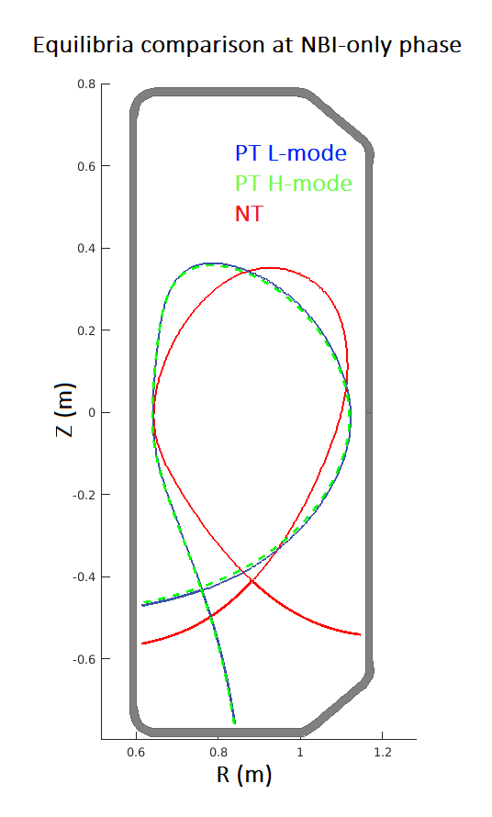
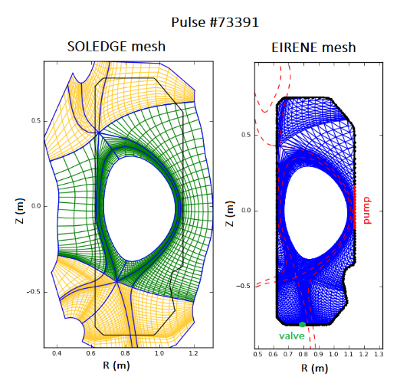
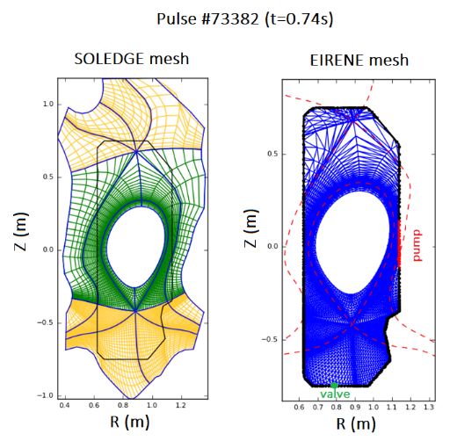
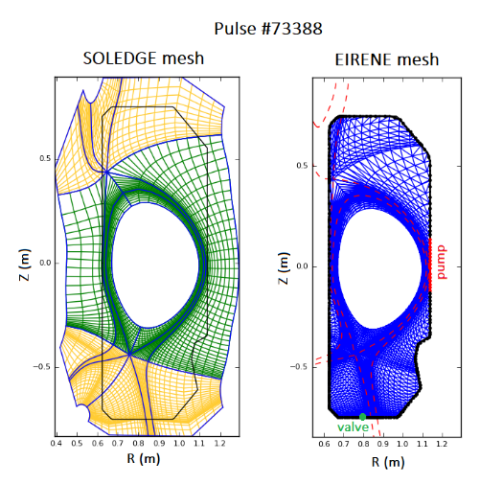
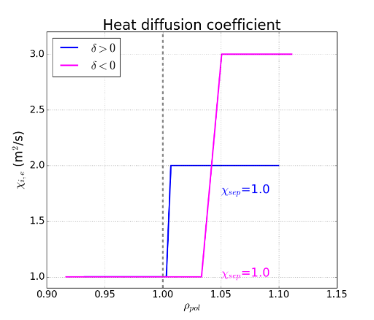
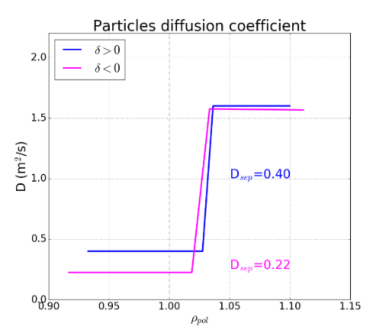
IDTT-like shape TCV pulses: meshes and starting transport coefficient profiles
Comparison with the PT in L/H-mode with high covering diagnostics (RT07)
PT L-mode
PT H-mode
NT
(t = 0.7s)
(t = 0.74s)
meshes
Starting transport coefficient profiles from a previous study in which we compared NT and PT L-mode TCV pulses

Slide 13
Turbolence studies with
SOLEDGE3X

Slide 14
Aim:
Improve power exhaust studies with a global approach to edge plasma modelling, including a 3D self-consistent description of the turbulence
SOLEDGE3X
can manage turbulence
self-consistent
able to simulate either in 2D (transport mode) or 3D
assumes symmetry for the toroidal direction
able to work with the realistic wall geometry
neutrals (EIRENE)
implemented in neutral model: Charge Exchange and Elastic Collision
impurities (the code is fully multi-species)
[4]D.Galassi, Nuclear Fusion 57(3):036029
DOI:10.1088/1641-4326/aa5332

Slide 15
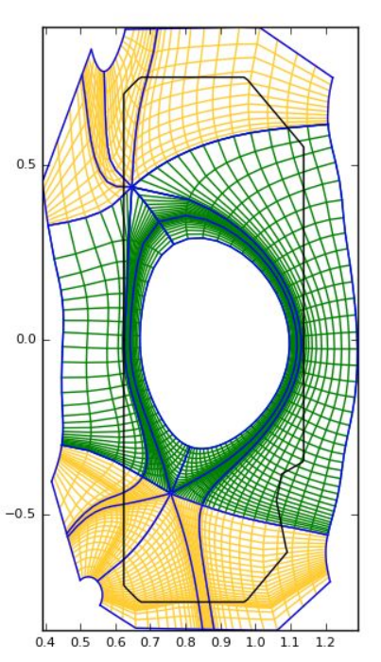
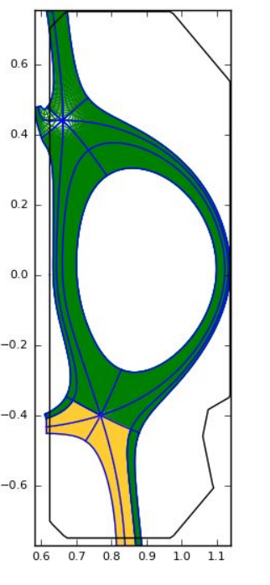
Starting point: TCV pulse – PT
‘‘trasport’’ mesh
‘‘turbulence’’ mesh
Definition of the mesh ~ mm
Start with
reduced mesh to reduce the
computational time
The transport mode but with
the high defined mesh
(until particle balance is reached)

Slide 16
Thanks for your attention!

