Slide 1
Global ORB5 simulations of NT
G. Di Giannatale^{a)}, P. Donnel^{b)}, E. Lanti ^{a)}, M. Murugappan^{a)}, L. Villard^{a)}, A. Bottino^{c)}, S. Brunner^{a)}, B. McMillan^{d)}, A. Mishchenko^{e)}, T. Schneider^{c)}
^{a)} EPFL, SPC, CH-1015 Lausanne, Switzerland
^{b)} CEA, IRFM, F-13108 Saint-Paul-lez-Durance, France
^{c)} Max-Planck-Institut fur Plasmaphysik, D-85748 Garching, Germany
^{d)} CFSA, Department of Physics, University of Warwick, Coventry CV4 7AL, United Kingdom
^{e)} Max-Planck-Institut fur Plasmaphysik, D-17491 Greifswald, Germany

Slide 2
ORB5 - Code, equations and approximations
ORB5 is a full $f,$EM, flux-driven, global, PIC GK code, recently refactored and ported on GPU (x4 acceleration)
$δf$ splitting used as control variate. The total distribution function is represented as $f=f_{0}(ψ, t)+δf$and only $δf$is discretized using markers.
Leads noise reduction (under PIC-Monte Carlo considerations)
Fields solved with B-splines
The solver works in Fourier space. Assuming that the perturbations are almost field aligned it solves the fields for few modes per radial location.

Slide 3
Linear simulations
Initial profiles are the same for PT and NT in $ρ_{vol}$
Kinetic electrons included in the hybrid form:
trapped electrons treated kinetically
passing electrons treated adiabatically. They are still pushed and then they can become trapped (and viceversa)
No substantial difference can be argued for linear simulations in this regime

Slide 4
Non linear analysis
Model includes: electrostatic turbulence, kinetic trapped electrons, ECRH source ^{A)}, non linear collisional operator ^{B)}, long wavelength approximation for the polarization term, limiter
Triangularity ± 0.5 at LCFS
Ion-ion collisional time about 100’000 $Ω_{i}$
Simulations are extremely challenging: ECRH source and collisions are treated with random kicks → huge source of noise for a PIC code → almost impossible to reach a quasi steady state condition
Simulation initialized with analytical profiles
When the noise has grown too much we collect the T, n and we start a new simulation with the new profiles (this procedure kills all the phase space structure.. )
The last simulation has been adapted without destroying the phase space structure (no marker resampling)
^{A)} P Donnel et al 2021 Plasma Phys. Control. Fusion 63 064001
^{B)} P Donnel et al 2021 Plasma Phys. Control. Fusion 63 025006

Slide 5
Global assessment: the confinement time
Inverse of confinement time
Same range as TCV
Not clear how far we are from an equilibrium
Simulation time reached almost 1 confinement time for NT triangularity (not for PT, simulations have not reached the same final time)
ECRH input power is transferred to ions in very long time.. No effects of the heating source
Next step replace the ECRH with another ad-hoc heating operator ?

Slide 6
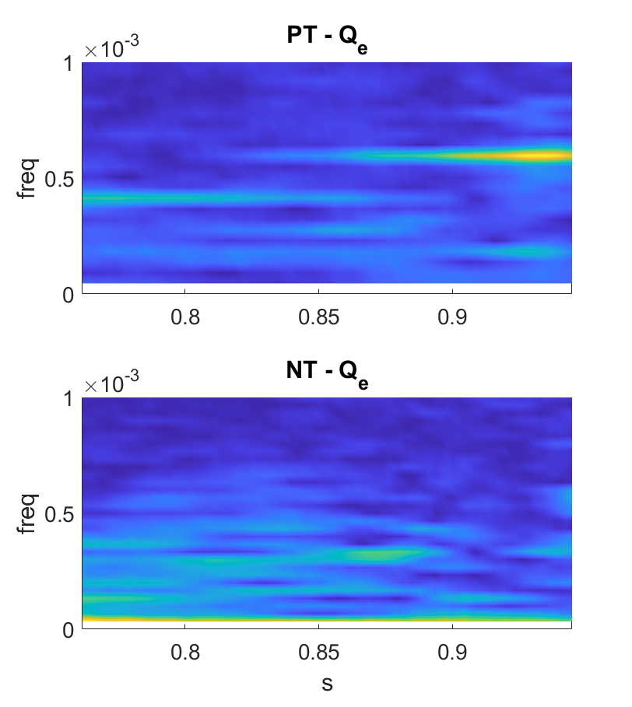
Avalanche mediated transport(1)
$$t$$
$$t$$
s
s
$$t$$
$$t$$
s
s

Slide 7
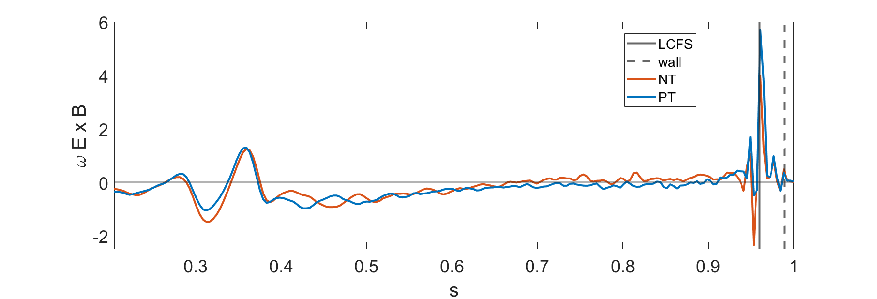
Avalanche mediated transport(2) – ZF sensibility
This difference can be due to a wrong modeling ($∂_{t}(δf_{lim})=−γδf_{lim}$)
First run)
flat $T and n$ profiles in the SOL:
$f_{lim}→f_{0 lim}=f_{0 wall}$
other runs)
not flat $T and n$ profiles in the SOL!
$f_{lim}→f_{0′ lim}≠f_{0 wall}$
$f_{0′ lim}$ built with $T$ flux surface averaged of the
first simulation in the SOL
ZF shearing rate first run
ZF shearing rate last run
Fixed: now $f_{lim} →f_{0 wall}$
$$∂_{t}\left(f_{lim}⁡\right)=−γ(f_{lim} −f_{0 wall})$$

Slide 8
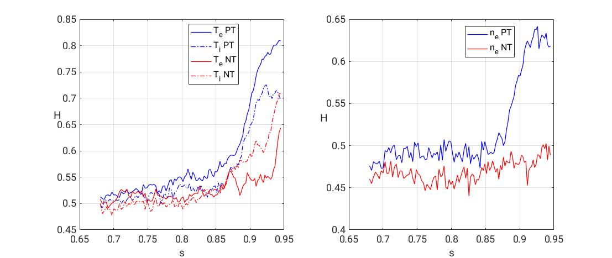
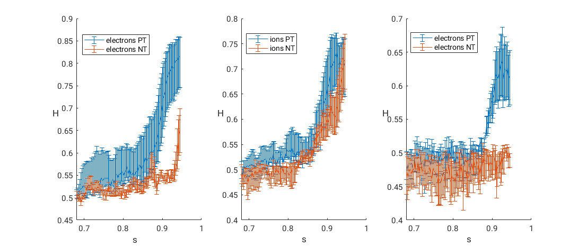
Transport indication – Hurst exponent
Hurst exponent is a coefficient that can be associated to the kind of transport: diffusive (H = 0.5), subdiffusive (H < 0.5), superdiffusive (H > 0.5)
What does make the PT to be more superdiffusive?

Slide 9
Attempt to describe the transport with a fractional dynamics
Attempt to describe the limiter-induced non-diffusive dynamics
Non-locality in space and time
Using fractional operators to correlate T and Q
First attempt: splitting the time and the spatial dependence of the pdfs
Rietz derivative $D_{x}^{μ}\left(T\right) vs Q. D_{x}^{1}\left(T\right)=\frac{d}{dx}H\left(T\right)=\frac{d}{dx}∫\frac{T\left(x^{′}\right)}{x−x^{′}} dx′$
$$t [Ω_{i}^{−1}]$$
$$t [Ω_{i}^{−1}]$$
$$t [Ω_{i}^{−1}]$$

Slide 10
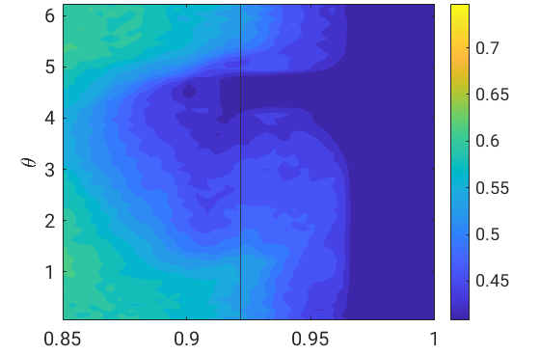
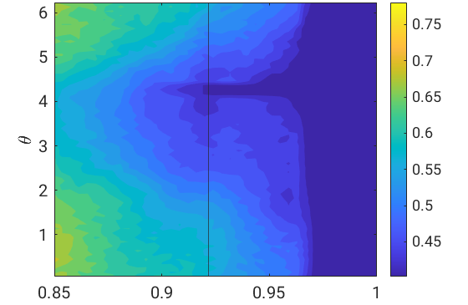
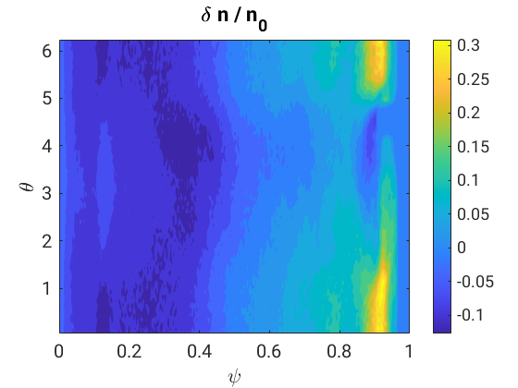
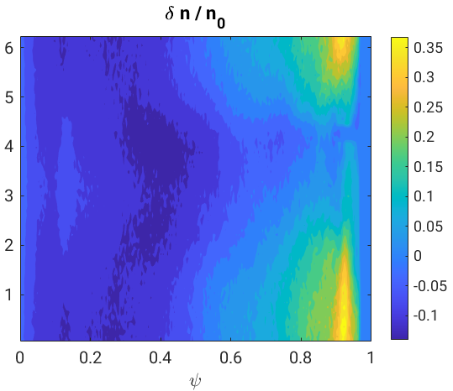
Limiter effects on density
$$n\left(ψ,θ\right)$$
(PT)
$$n(ψ,θ)$$
(NT)
With a more refined look (2D data), an other limiter effects show up: strong symmetry breaking !
Importance of a polarization term in the QNE dealing with 2D density?
(PT)
(NT)
Planned to try a 2D $f_{0}$= $f(ψ, θ)$
Density fluctuations are up to 30% of $n_{0}‼$

Slide 11
Conclusions
Adapting $f_{0}$ may be crucial to keep the $δf ordering$ (M. Murugappan TSVV4)
Inserting 2D dependence of density in polarization term may be important (inserted as milestone for TSVV1- myself)
Super-diffusive transport may be a consequence of the limiter
Why NT and PT react differently ?
Now gradient driven simulations are under evaluation to evaluate the limiter effect
Fractional operators seem a promising way to underline the transport process
Bad news, the full run ECRH + collisions was too optimistic. We have to change our flux-driven plan..
In ORB5 we do not freeze the Temperature: it is possible to compare how much power NT require to sustain T wrt PT

