Slide 1
E-TASC B2SAFE pilot deployment status
Nov 11th 2022

Slide 2
Contents
Overall plan review & status
Use case workshop procedure plan
Eduuni wiki access checklist

Slide 3
Overall plan
Limited test phase
Use case design workshops with initial testers
Automation implementation based on use case designs
Review and discussion about next phase
Details in following slides…

Slide 4
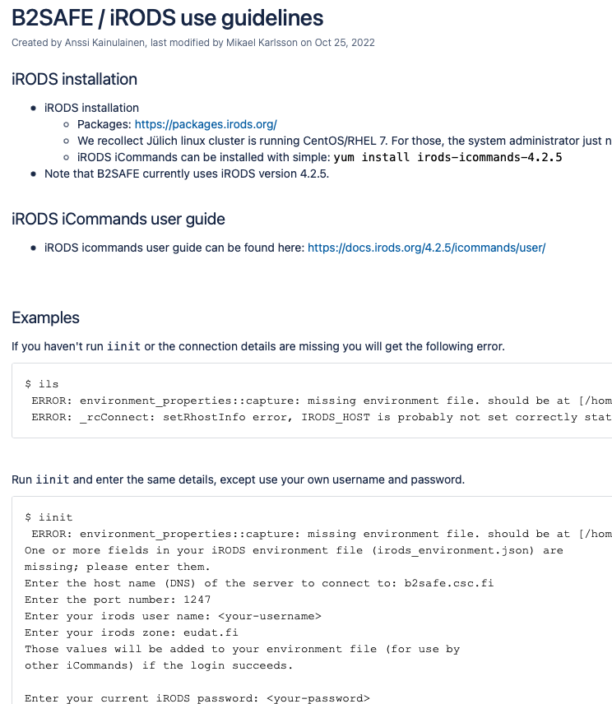
1. Limited test phase
✓ User group created: etasc
✓ Access opened between CSC B2SAFE and Jülich linux cluster
✓ 2 TiB pilot capacity allocated
Installation of iRODS tools on Jülich linux cluster by Jülich admin
✓ Documentation links, instructions and basic examples given:
https://wiki.eduuni.fi/pages/viewpage.action?pageId=309273596
CSC will create accounts for 1-2 test users, who have experience with iRODS
Selected users: Emil Loevbak, Niels Horsten (and Giovanni Samaey)
Took longer to find test users, schedule adjusted later accordingly
CSC will create personal folders, and possibly a shared folder
More elaborate structures after use case definition
Self testing begins
Basic iRODS commands, B2SAFE features
Manual test of data transfers for selected datasets/collections
Collect needs and ideas for use case clarification
Schedule: Early November (now)

Slide 5
2. Use case design workshops
CSC will adjust initial technical use case definition
Handful of workshops with test user(s) & an additional person
Review of test experiences and initial use case
Clarification and ”freeze” of basic use case
Definition of technical automation features (existing or new ones) based on use case
Small team preferable, commitment to workshop work (e.g. 2-3 meetings)
TODO: Need to book meeting times!
Schedule: Late November

Slide 6
3. Automation implementation
First implementation of automation features
Short testing period of automation features
Iteration of automation features with test users
Feedback and feature adjustment
Possibly implementing an additional use case
Requires collaboration
Schedule: Early December

Slide 7
4. Review and discussion on next phase
Review of implementation results in wider project group
Adjusted use cases
Automation features
Test experiences
Discuss future plans
Further needs and required resources and schedule
Possible production deployment and access for more users
Alternatively: post-pilot data migration and shutdown of service
Schedule: January 2023

Slide 8
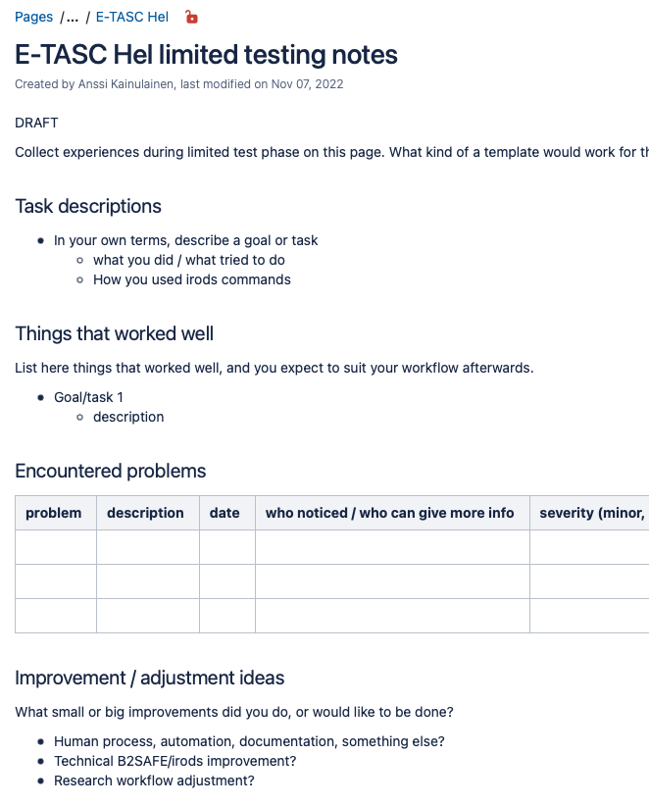
Use case workshop procedure: preparation
Preparation: Collect experiences during test phase (independent work)
what you did, what you tried to do
how you used irods commands
things that worked well
problems you encountered
adjustments you made or wanted
-> To be collected and shared in wiki
Question: Would it help to create some template for collecting notes?
Challenge in communication/translation between different fields of expertise.
What details we wish to see might be different from what you wish to see.
https://wiki.eduuni.fi/display/csceudat/E-TASC+Hel+limited+testing+notes

Slide 9
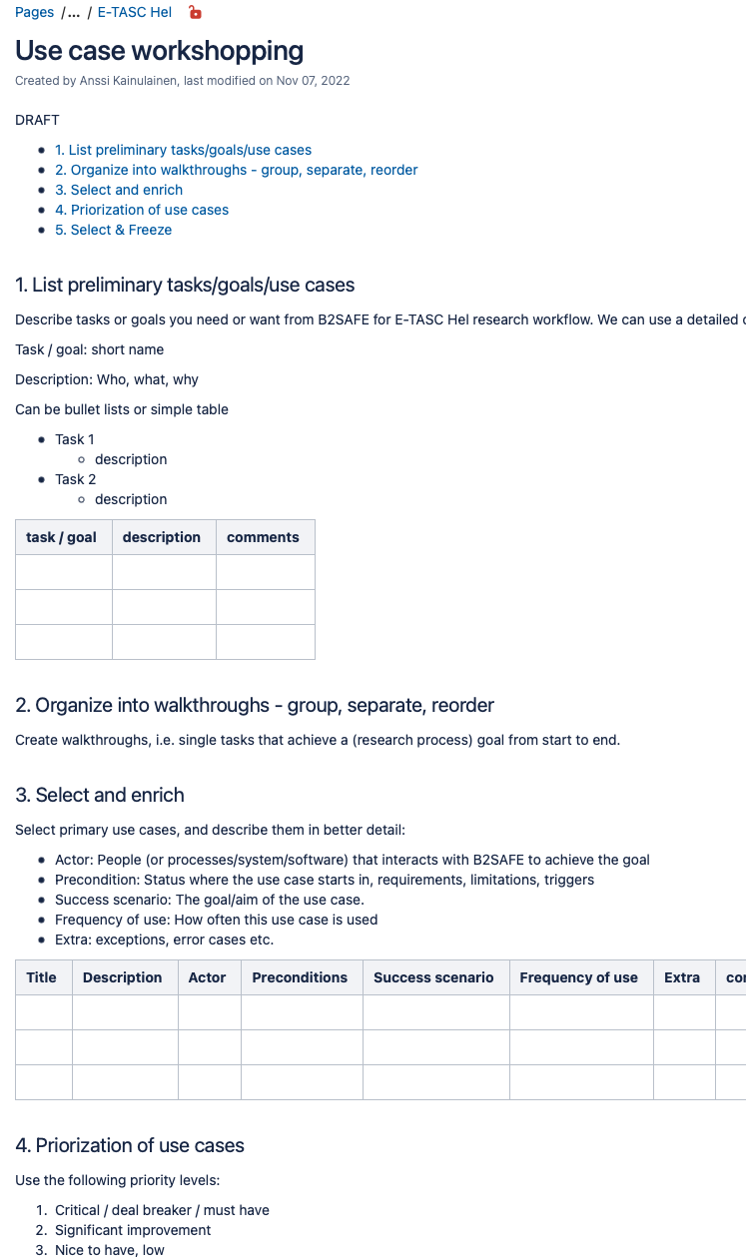
Use case workshop procedure: During workshops
During workshop meetings
List individual goal oriented tasks
-> collect, reorganize into walkthroughs
-> select primary use case(s), and describe in more details
Prioritize & select/freeze basic use case
-> Translate into technical automation feature(s) = implementation specification
https://wiki.eduuni.fi/display/csceudat/Use+case+workshopping

Slide 10
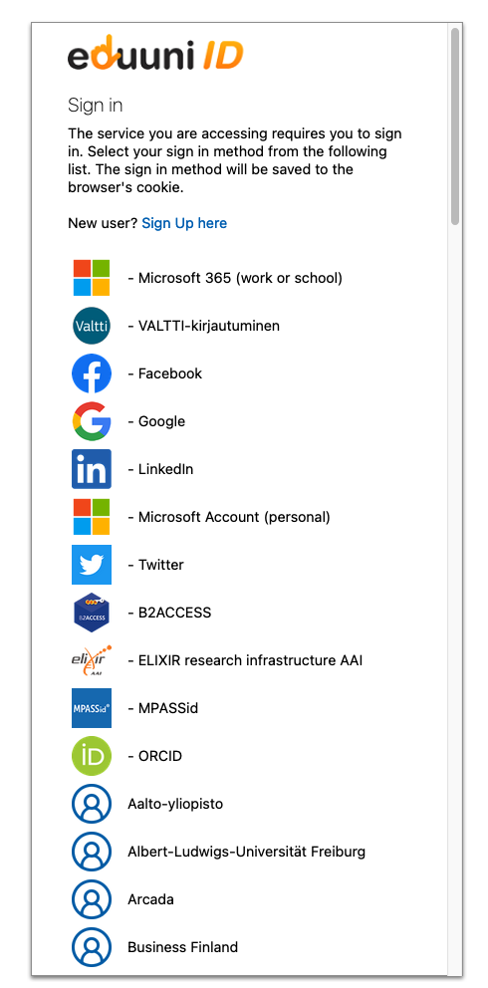
Access to Eduuni wiki
Access to ETASC-page only to project members, who have logged in to Eduuni
Known project members’ emails have been pre-added to access list
If new people need access, contact CSC
First time login might have some delay before identity & access is active
Select “Log in” from wiki.eduuni.fi upper-right corner
Select your home organization from list (see image)
Access through trust federations, e.g. Geant internationally, Haka/Virtu in Finland
If your organization is not on the list
Let CSC know, we’ll ask our support to check whether your organization has exposed proper trust federation identity provider metadata
Alternatively, try B2ACCESS
Might have similar account activation steps, if you’re using it for the first time, and your home organization trust federation metadata needs fixing
Social media identities also possible, but not preferred

