Slide 1
WP PWIE: SP ADC.J Final report
SPL ADC.J: P. Innocente, C. Meineri, G. Rubino, A. Uccello, L. Balbinot

Slide 2
SP ADC.J Tasks 2021/2022
Deliverable ID(s) | Task Title
D001 | SOLEDGE2D-EIRENE modelling of DTT XD configuration (P1), DN XD: (P3)) (RFX)
D002 | SOLEDGE2D-EIRENE modelling of DTT XD configuration (P1), DN XD: (P3))(UNITUS)
D003 | SOLEDGE2D-EIRENE modelling of DTT in SN and DN with the longest outer leg configurations (hybrid configuration between SN and SXD “SNhybSXD” (P1) and between DN and SXD “DNhybSXD” (P3)) (POLITO)
D004 | SOLEDGE2D-EIRENE modelling of DTT with inner divertor adaption (hybrid configuration between SN and XD “SNhybXD” (P2) and between DN and XD “DNhybXD” (P3)) (ENEA)
D005 | SOLEDGE2D-EIRENE modelling of open divertor geometry in a subset of promising shapes (shape tbd from list of modelled SOLEDGE2D-EIRENE runs) (P2) (POLITO)
D006 | SOLEDGE2D-EIRENE modelling of open divertor geometry in a subset of promising shapes (shape tbd from list of modelled SOLEDGE2D-EIRENE runs) (P2) (ENEA)
D007 | SOLPS-ITER modelling of DTT SN (closed) divertor with and without dome with drifts activated (using EIRENE) (P1) (CNR)
D008 | SOLPS-ITER modelling of DTT DN (closed) divertor with and without dome with drifts activated (using EIRENE) (P3) (UNITUS)
Due date 30.04.2022
* Activities iniatially postponed to 2022 and then started in late 2022 (after summer) due to lack of equlibrium files until the middle o July
Finally available DN, DN XD and DN with long legs.

Slide 3
SP ADC Tasks 2021/2022
Tasks have been summarized in three different topics and presentations:
P. Innocente: selection of the best divertor shape for SN, XD (and their long legs variants) between narrow (closed) and wide (open) divertor – 15‘
C. Meineri: analysis of DN configurations with the divertor shapes resulting from previous activity symmetrized up/down - 5‘
G. Rubino: analysis single null configuration without and with dome using SOLPS-ITER with kinetic neutrals activating drifts - 10‘

Slide 4
selection of the best divertor shape for SN, XD (and their long legs variants) between narrow (closed) and wide (open) divertor

Slide 5
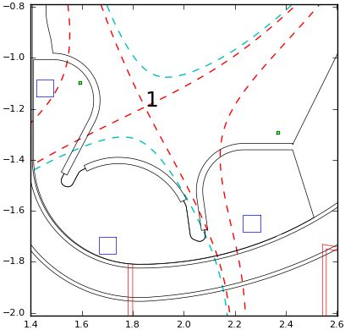
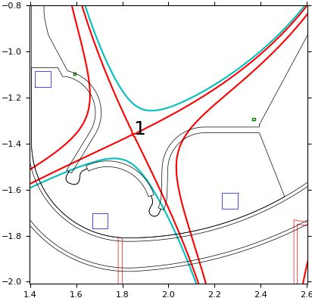
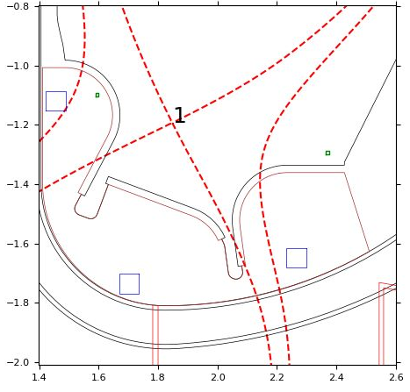
From divertor shape definition to optimization
Definition of different divertor shapes compatible with constraints and fundamental choices
Definition of reference (and additional) magnetic configurations
Selection by comparison between shapes and a reference standard shape
Divertor shape optimization
Wide divertor (WD)
Standard/narrow divertor (ND)
Wide flat-dome divertor (WFD)

Slide 6
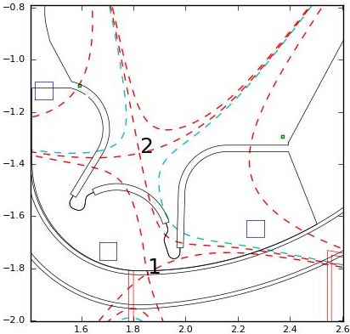
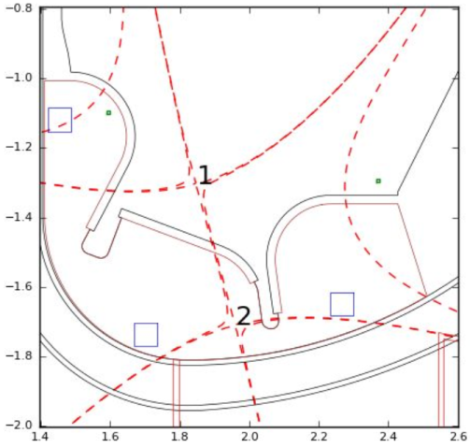
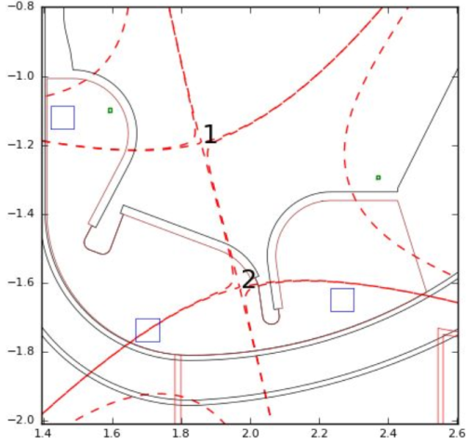
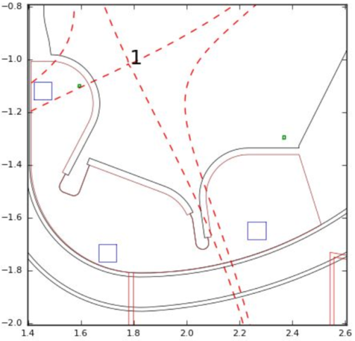
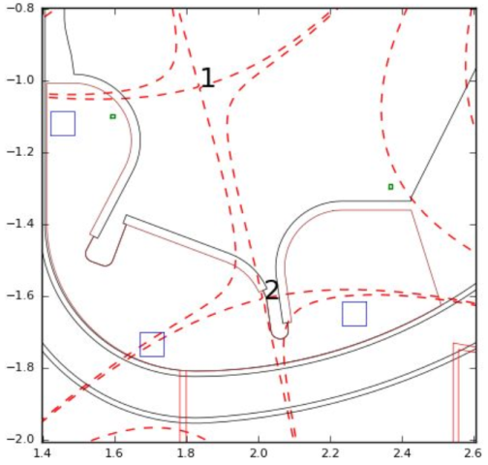
Magnetic equilibria for different divertor shapes
ND
A set of magnetic configurations have been produced for all divertor shapes using coils external to the vessel
The ND has parameters similar to present DEMO divertor design
The WFD allows configurations with long external legs (LSN & SXD)
The WFD with an appropriate wall allows negative triangularity configurations
SN – 5.5 MA
XD – 4.5 MA
WFD
LXD – 4.5 MA
SN – 5.5 MA
XD – 4.5 MA
XD – 4.5 MA
LSN – 5.5 MA
SXD – 4.5 MA

Slide 7
Divertor parameters
Device | L_{IT}/Rx | L_{OT}/Rx | α_{IT} | α_{OT}
DTT (ND) | 0.09-0.15 | 0.15-0.17 | 2.0° | 1.9°
DTT (WFD) | 0.07-0.14 | 0.24-0.34 | 1.6°-2.0° | 2.0°-2.3°
DEMO | 0.15 | 0.21 | 1.5° | 1.6°
ITER | 0.19 | 0.20 | 3.2° | 2.7°
JT-60SA | 0.21 | 0.29 | 5.6° | 3.5°
SN configuration
Narrow divertor is similar to (present) DEMO divertor in terms of legs length and grazing angle
Wide divertor can test a wide range of leg lengths
In general grazing angle is in between ITER and DEMO
Divertor | L_{IT}/Rx | L_{OT}/Rx | α_{IT} | α_{OT}
DTT (ND) | 0.09-0.11 | 0.11-0.14 | 0.6° | 0.0-0.2°
DTT (WFD) | 0.10-0.11 | 0.10-0.25 | 1.1°-1.2° | 0.3°-0.6°
XD configuration

Slide 8
Assessment of divertor performance
Edge modeling of a representative set of magnetic configuration:
SN in pure D power scan with P_{SOL}=3.5÷25 MW with five different divertors and different transport parameters and with sub-divertor modeling
XD in pure D power scan with P_{SOL}=3.5÷8 MW with five different divertors
SN scan in neon and argon seeding at full power P_{IN}=30 MW with four different divertors and different transport parameters (a few cases), with sub-divertor and variation in transport parameters
XD scan in neon seeding at full power P_{IN}=30 MW with four different divertors
Comparison of performance with the narrow divertor
Gas puffing and top pedestal density estimation – core/edge integration

Slide 9
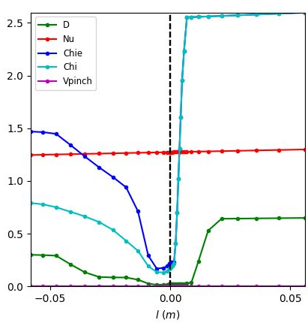
Modelling methods and edge code
Transport parameters [*]:
based on heat flux decay length λ_{q,u}≈1.5 mm for the SN in attached condition in agreement with Eich scaling;
Profiles from JET/C-Mod experiments modelling;
Two options for divertor region
Equal for SN, XD and all divertor shapes
Seeding with neon and argon
Fixed pumping speed S=100 m³/s ➔ gas-puffing adjusted to achieve target separatrix density
Not considered drifts and neutrals-neutral collisions
SOLEDGE2D-EIRENE 2D edge fluid/kinetic code
Targets:
same separatrix density
about same radiation (with seeding)
H-mode condition ➔ P_{SOL}≥18 MW
Transport profiles
[*] L. Balbinot et al., NME 34 (2023)

Slide 10
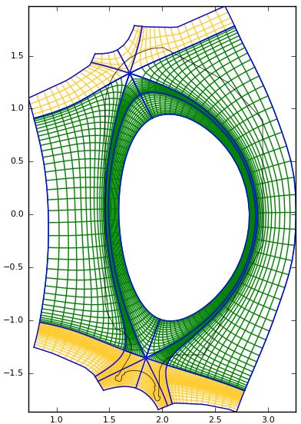
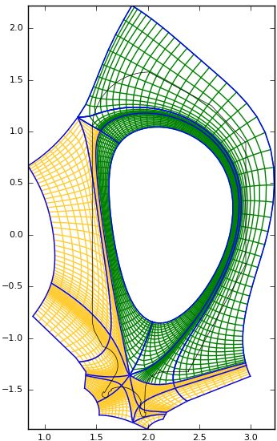
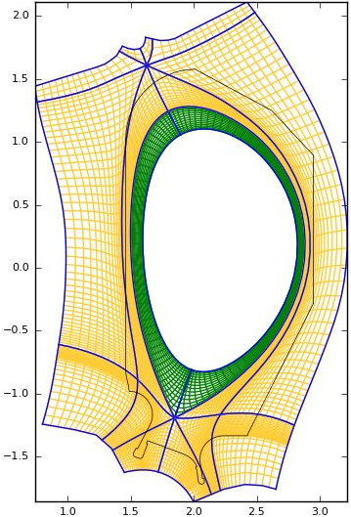
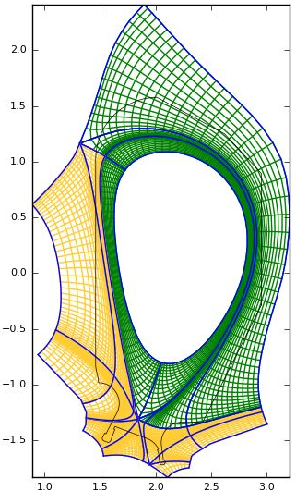
Fluid meshes for the base configurations
SN
XD
SN
XD
D gas puffing
Seeding gas puffing
Pumps entrances

Slide 11
P_{SOL} scan in pure deuterium
To provide an indication on allowed maximum heat flux for detachment
To provide a starting point for seeded modeling
To provide an indication on pumping efficiency

Slide 12
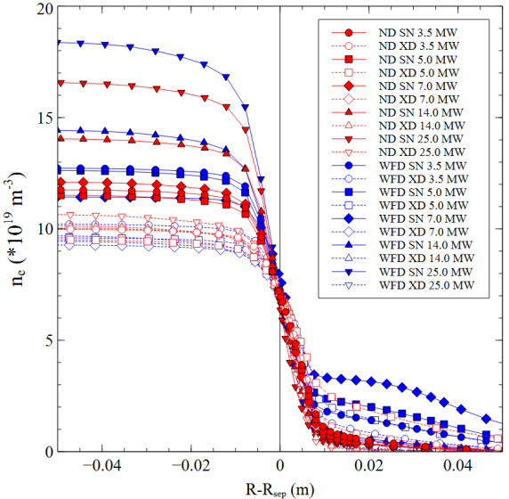
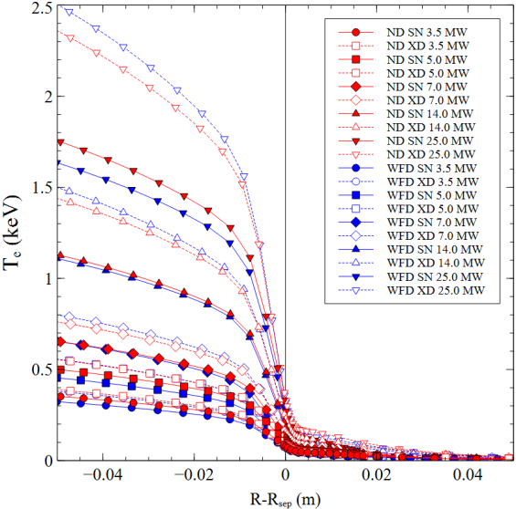
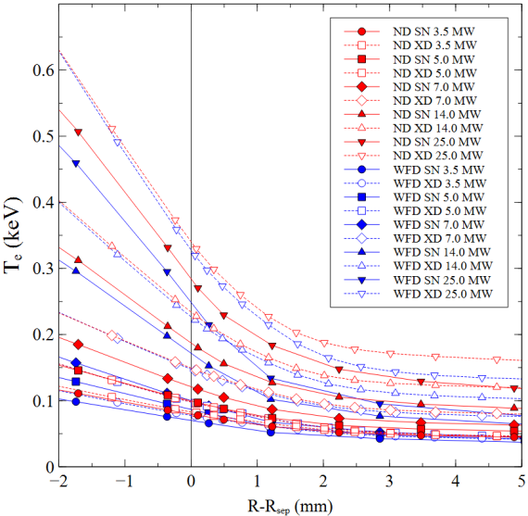
Profiles at outer mid-plane PSOL=3.5-25 MW
Same separatrix density
Different top pedestal density (higher/lower pumping efficiency ➔ higher/lower gas-puffing)
Highest top density in SN
Lowest density in XD (open markers) ➔ low pumping efficiency due to strike points far from pumps slots
Higher top density in XD due to lower density
Higher separatrix temperature in XD due to longer connection length

Slide 13
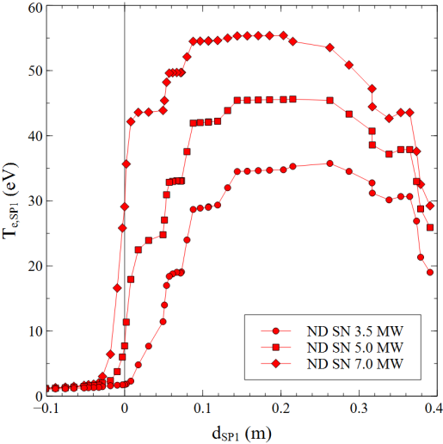
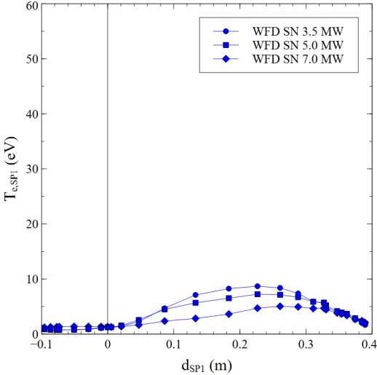
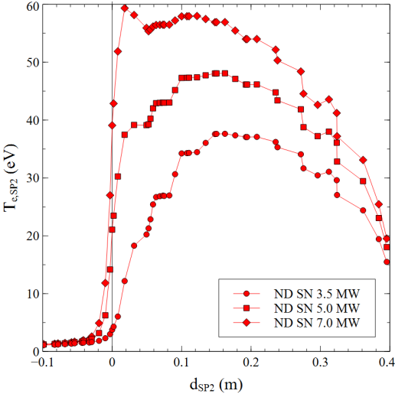
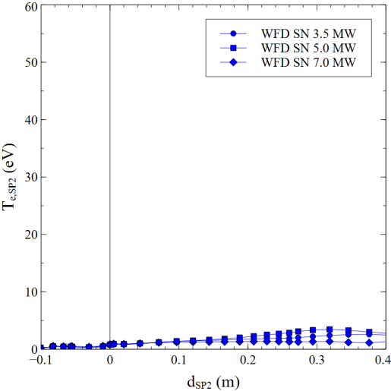
SN: profiles at targets / temperature
In pure D with the wide divertor detachment is obtained below P_{SOL}≈7 MW at n_{sep}=7·10⁹ m⁻³
Inner target
Inner target
Outer target
Outer target
Detachment threshold

Slide 14
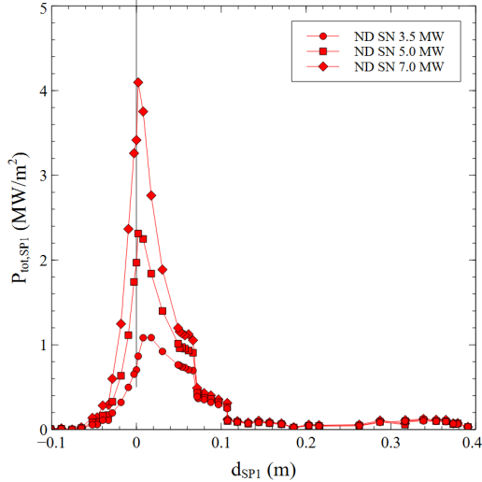
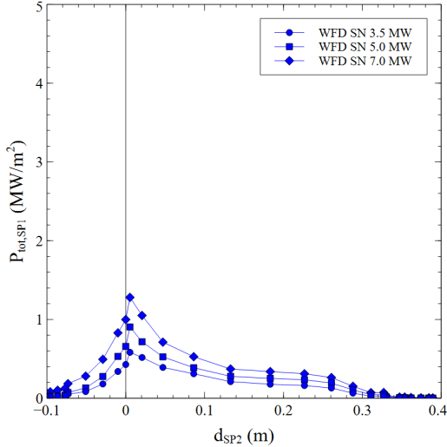
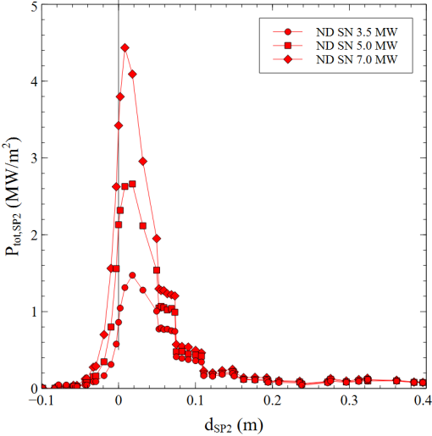
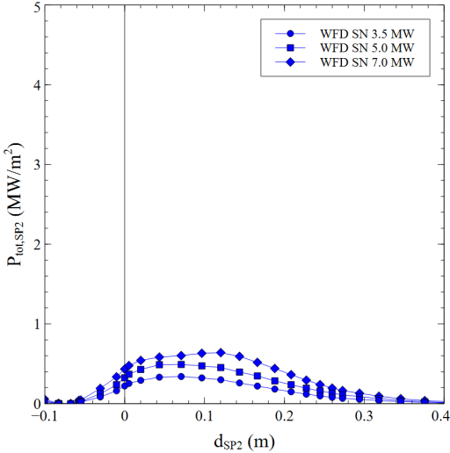
SN: profiles at targets / heat flux
In pure D with the wide divertor detachment is obtained below P_{SOL}≈7 MW at n_{sep}=7·10⁹ m⁻³
Peak heat flux is well below 10 MW/m²
Similar conditions at both targets (but drifts not included)
The standard divertor provides worst performance ➔ higher temperatures and peak heat fluxes
Inner target
Inner target
Outer target
Outer target

Slide 15
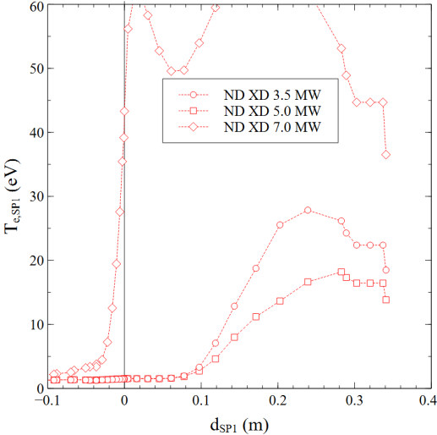
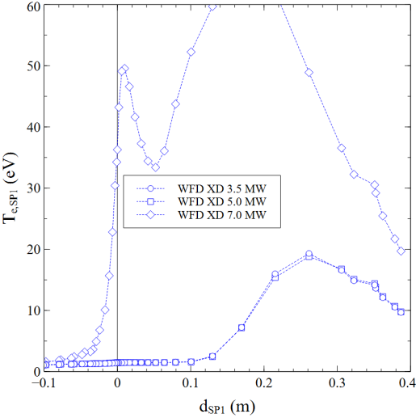
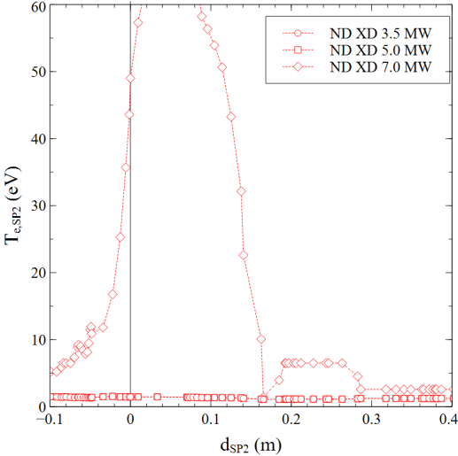
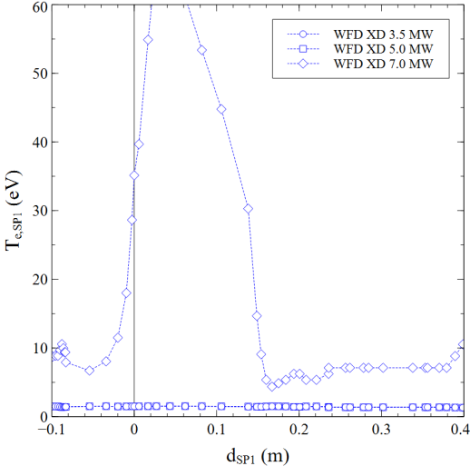
XD: profiles at targets / temperature
For the XD configuration the two divertors provide similar results
Due to the near zero grazing angle (high flux expansion) deep detachment is achieved at the outer target
Inner target
Inner target
Outer target
Outer target
Detachment threshold

Slide 16
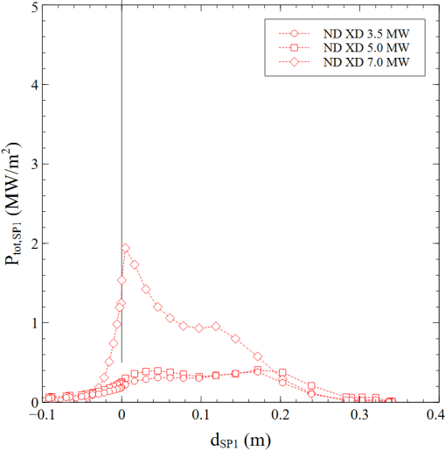
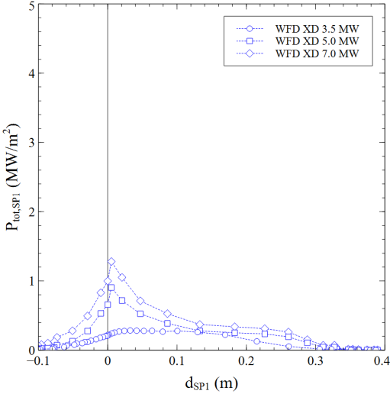
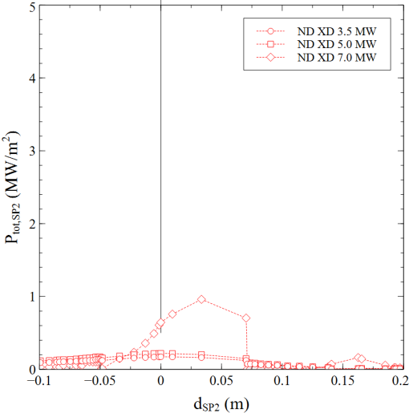
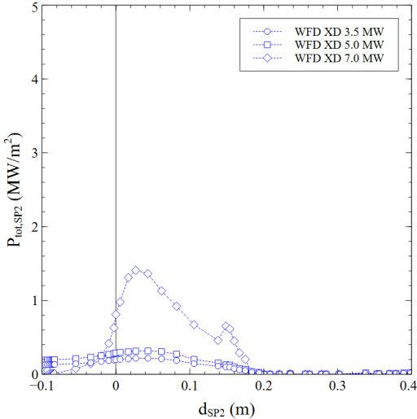
XD: profiles at targets / heat flux
For the XD configuration the two divertors provide similar results
Due to the near zero grazing angle (high flux expansion) deep detachment is achieved at the outer target
Also peak heat flux is low due to the low grazing angle (also at inner target)
Inner target
Inner target
Outer target
Outer target

Slide 17
Operation at full power with seeding
Evaluate minimum requested contamination to achieve detachment
Evaluate operative window in impurity content
Configuration stability against operating condition

Slide 18
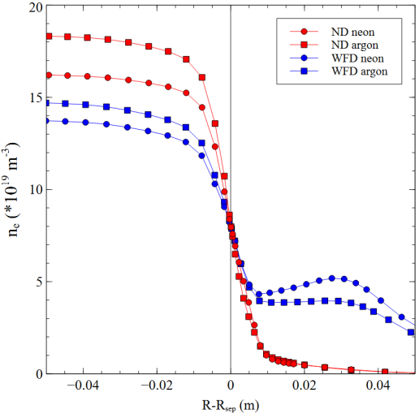
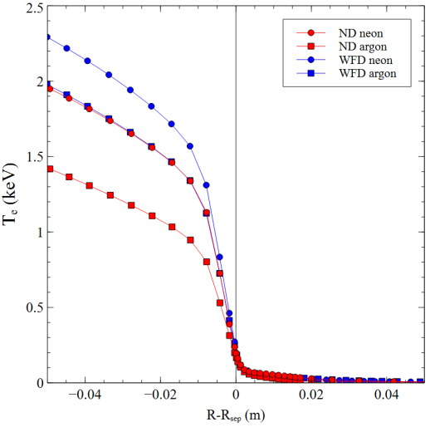
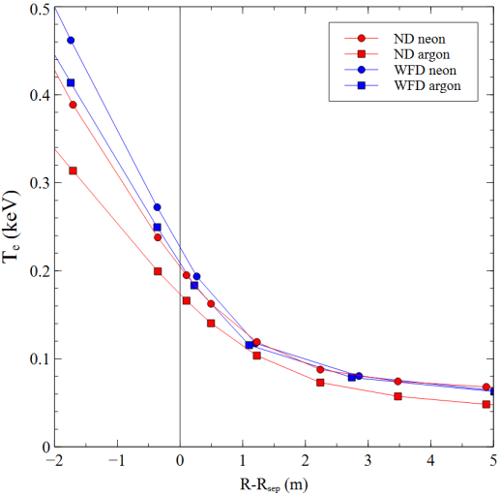
Profiles at outer mid-plane
P_{IB} = 30 MW (10 MW rad. in the inner core, 5 MW ELMs)
P_{IB} splitted between e and D to achieve similar temperatures
n_{sep}=8∙10¹⁹ m⁻³
P_{SOL}=P_{IB}-P_{rad,in} (must be > 18-20 MW to access H-mode)
SN
Higher core density with argon
Higher core temperature with neon
Higher temperature at separatrix with neon (related to Ne/Ar cooling properties)
SN

Slide 19
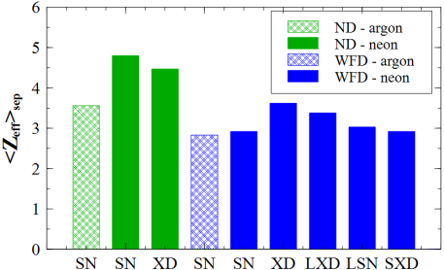
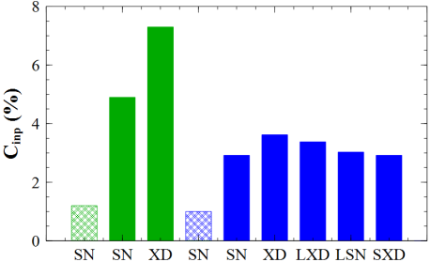
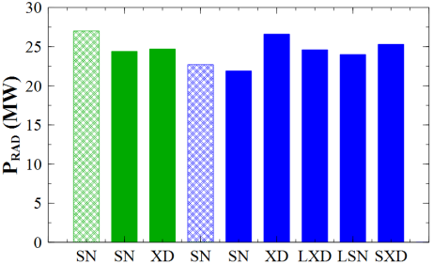
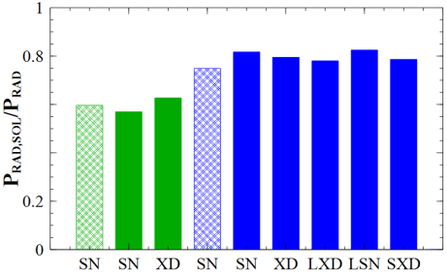
Summary of seeding results
Full power modeling with P_{IB}=30 MW at fixed separatrix density n_{sep}=8·10⁹ m⁻³ with neon (and argon) seeding to achieve detachement
The wide flat divertor performs better than the standard narrow divertor in SN and XD
Argon performs better than neon in terms of <Z_{eff}>_{sep} and impurity concentration (C_{imp}) for both divertors
In the wide flat divertor SXD provides similar result than SN
The wide flat divertor performs relatively well for all configurations

Slide 20
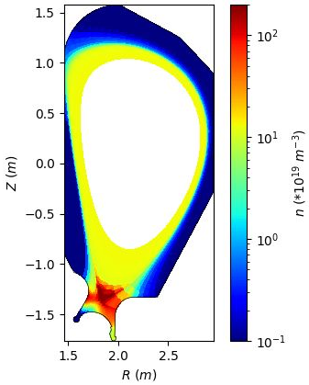
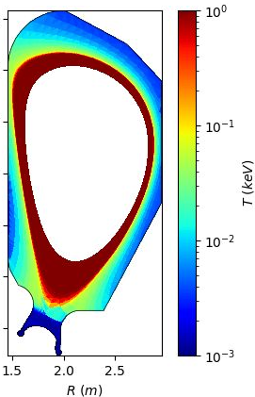
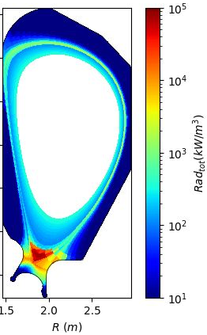
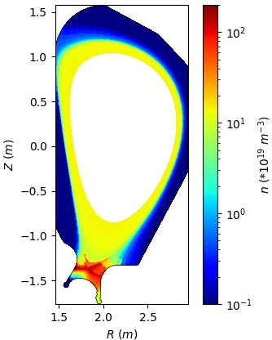
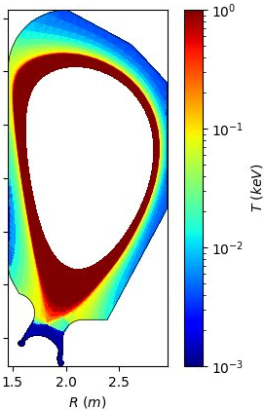
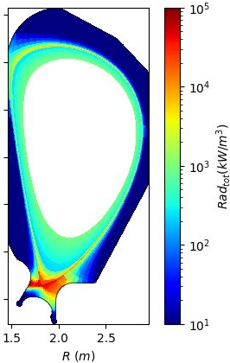
Standard/narrow divertor – XD with neon
<Z_{eff}>_{sep}=2.4
P_{rad,tot}=28 MW
P_{SOL}=8 MW
C_{Ne}=3.6%
Fast cooling of legs
Radiation localize at the x-point
Most radiation inside separatrix
Seems unable to sustain H-mode
XD configuration easily falls down to X-point radiator
<Z_{eff}>_{sep}=4.5
P_{rad,tot}=25 MW
P_{SOL}=21 MW
C_{Ne}=7.3%
H-mode condition can be recovered but at high impurity concentration
Can sustain H-mode

Slide 21
Conclusions
A divertor shape able to accept many magnetic divertor configuration has been studied and optimized by the edge code SOLEDGE2D
The wide divertor can provide reliable operation for SN and XD configurations in pure deuterium at reduced power and with seeding at full power
The wide divertor provides better exhaust performance than a standard narrow divertor
With the designed pumping aperture it provides a high pumping capability for the SN configuration, less for the XD one
Results depend on transport parameters, different values for impurities or at different density can affect final conclusion
Fine tuning on magnetic configurations (strike point position, separatrix distances) can also affect results

Slide 22
Thanks

Slide 23
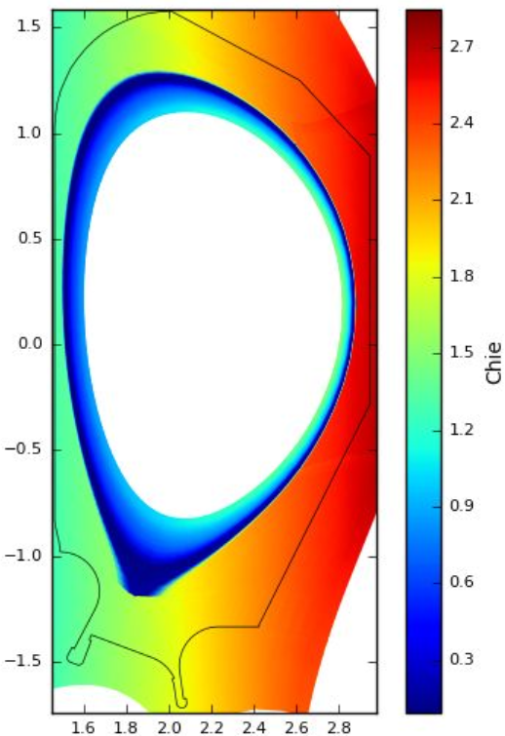
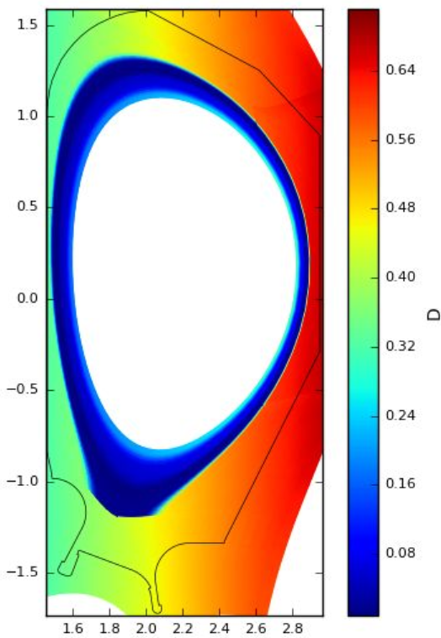
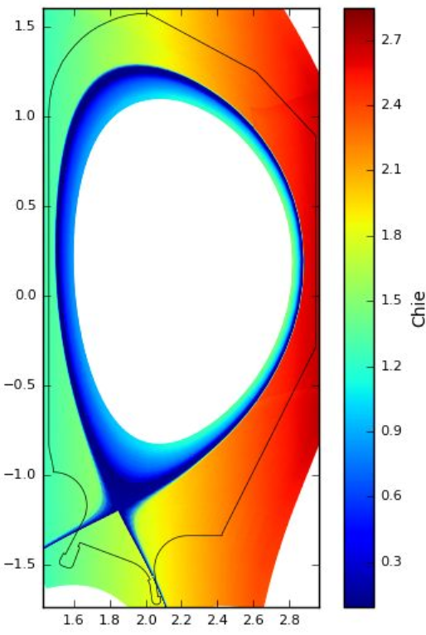
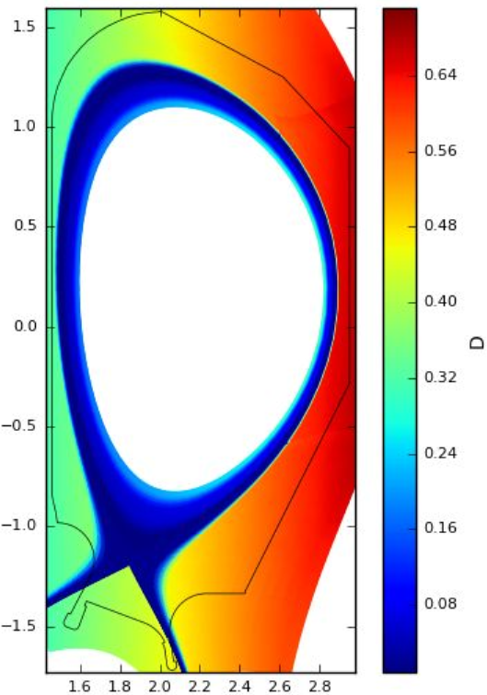
2D transport parameters map
Transport parameters have been normalized to B_{t} - Two options for the divertor region:
Value as in the OMP far SOL (as in the JET/C-Mod modeling)
Values like at OMP
Transport in divertor region as at the OMP far SOL
Transport in divertor region like at OMP

Slide 24
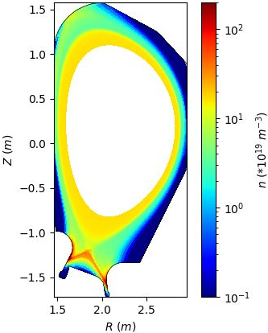
Wide flat divertor - SN
Neon seeding
<Z_{eff}>_{sep}=2.9
P_{rad,tot}=22 MW
P_{SOL}=26 MW
C_{Ne}=2.8%
Radiation is concentrated on divertor legs
Longer legs provide larger radiative volume, better performance
Argon seeding
<Z_{eff}>_{sep}=2.8
P_{rad,tot}=23 MW
P_{SOL}=24 MW
C_{Ar}=1.0%
Argon provide better results than neon with similar radiation in the core

Slide 25
Wide flat divertor - XD (short and long leg)
Short leg XD
<Z_{eff}>_{sep}=3.6
P_{rad,tot}=27 MW
P_{SOL}=24 MW
C_{Ne}=4.6%
H-mode operation is possible with a reasonable impurity content
Longer leg LXD
<Z_{eff}>_{sep}=3.4
P_{rad,tot}=25 MW
P_{SOL}=24 MW
C_{Ne}=3.4%
A Longer leg provide better results

Slide 26
Long leg configurations with neon
Long leg SN
< Z_{eff}>_{sep}=3.0
P_{rad,tot}=24 MW
P_{SOL}=26 MW
C_{Ne}=2.3%
Long external legs provides a bigger radiative volume reducing request on impurity
But top wall must be moved upward (or equilibrium must be improved)
Long leg XD (SXD)
<Z_{eff}>_{sep}=2.9
P_{rad,tot}=25 MW
P_{SOL}=25 MW
C_{Ne}=1.9%
SXD provides less impurity content in the core thanks to a higher top pedestal density

