Slide 1
WPPIE Final Meeting, ADC.F
Fabio Subba (G. Rubino, O. Pan, T. Lunt, A. Järvinen, P. Chmilewski, W. Dekeyser, L. Aho-Mantila, S. Carli, H. Reimerder, ...)
WPPWIE Final Meeting| 2023-01-17

Slide 2
Tasks Summary
Activity | Task title
SP F.1 | XD Modelling (F. Subba)
SP F.2 | SX Modelling (G. Rubino)
SP F.3 | SF- Modelling (O. Pan, T. Lunt)
SP F.4 | Simplified models (A. Järvinen)
SP F.5 | Sensitivity studies (P. Chmielewski)
SP F.6 | Numerical enhancements (W. Dekeyser)
SP F.7 | DN Modelling (L. Aho-Mantila) - FROZEN

Slide 3
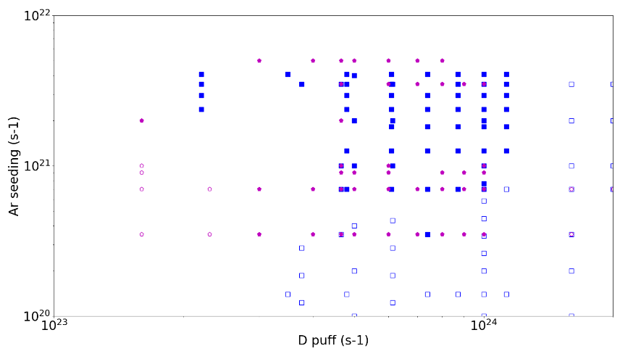
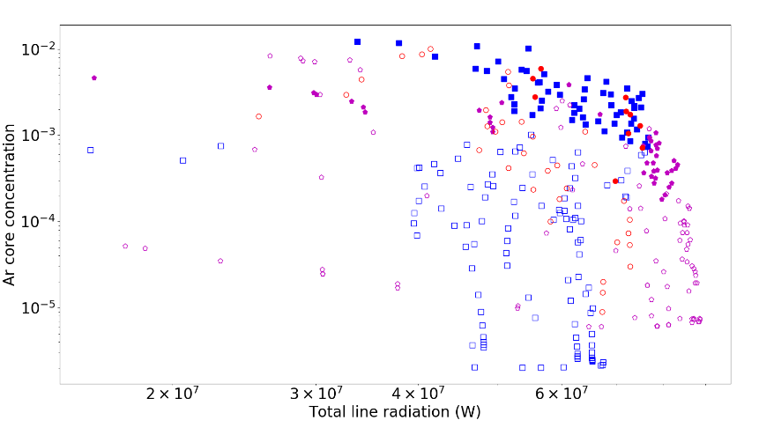
SN vs. XD Parameter Space, Fluid Modelling
X-Divertor
The available SN and XD scan over D and Ar puff was extended
Produce “global parameter space” plots to select “acceptable divertor” conditions
n_{e,omp} < 4.2e19 m⁻³ (fraction of Greenwald density)
T_{e, target} < 5 eV (proxy for detachment)
Take-home message, XD can operate at lower Ar puff (concentration) level, roughly 50%
Reason identified with the larger connection length / radiative volume.
Single Null

Slide 4
Starting-Up XD Kinetic Simulations
Scan to calibrate fluid vs kinetic models.
Criterion adopted: reproduce similar divertor neutral pressure
Albedo (Pa) | D₀ pressure (Pa) | D₂ pressure (Pa) | D_{total} pressure (Pa)
0.85 | 2.60 | 4.64 | 7.04
0.75 | 1.48 | 2.35 | 3.83
0.65 | 0.93 | 2.11 | 3.04
0.55 | 0.72 | 1.66 | 2.38
0.45 | 0.59 | 1.38 | 1.96
0.35 | 0.56 | 1.24 | 1.80
Puff
Pump

Slide 5
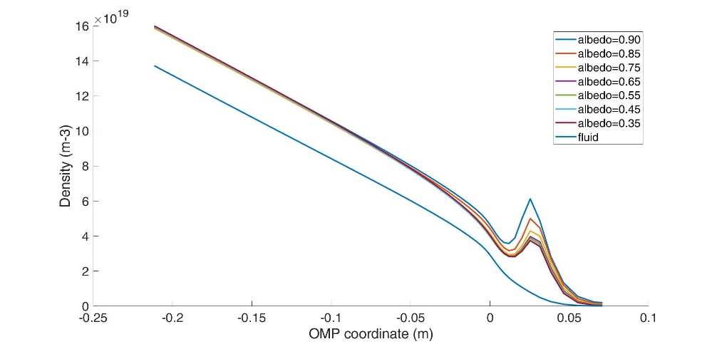
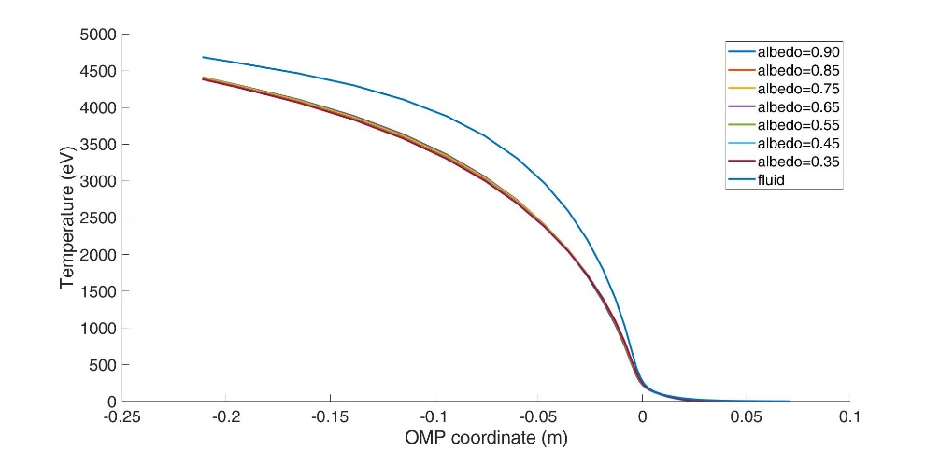
Kinetic vs. Fluid Comparison at OMP
Similar divertor conditions do not result in similar OMP detailed profiles.
Not surprising since the fueling location has moved ➔ larger penetration in the core expected
Matching core parameters as opposed to divertor might be a second possibility. Not completed.

Slide 6
XD Modelling Summary
The database of XD fluid simulations was extended/completed (also SN)
It was shown that XD allows accessing detached regimes for lower impurity concentration than SN
The reason is likely related to larger connection length and increased divertor volume
Kinetic cases for XD were started. Some first converged cases were used for parameter tuning purposes.

Slide 7
SX Modelling
Previous fluid simulations show the possibility to define a wider operational window with SX wrt SN (L. Xiang)
WPPWIE modeling of DEMO SX configuration can be divided into two main sub-activities:
Assessment of the effect of kinetic neutral models, i.e. coupling with EIRENE
2. Assessment of the outer leg divertor geometry, that is evaluate the effect of the baffling
Is the fluid model applicable? Compare fluid and kinetic cases, K_{n} > 1 in the divertor?
Lack of molecules in the fluid cases
Same temperature for ions and neutrals

Slide 8
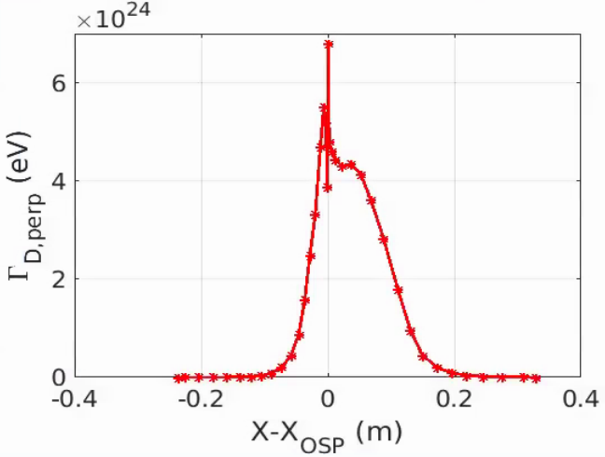
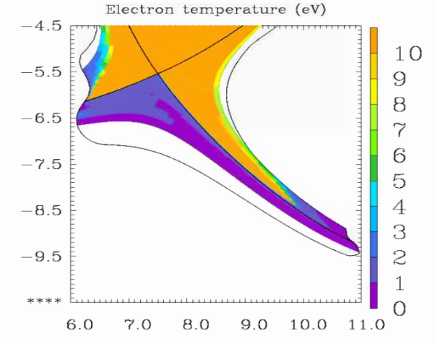
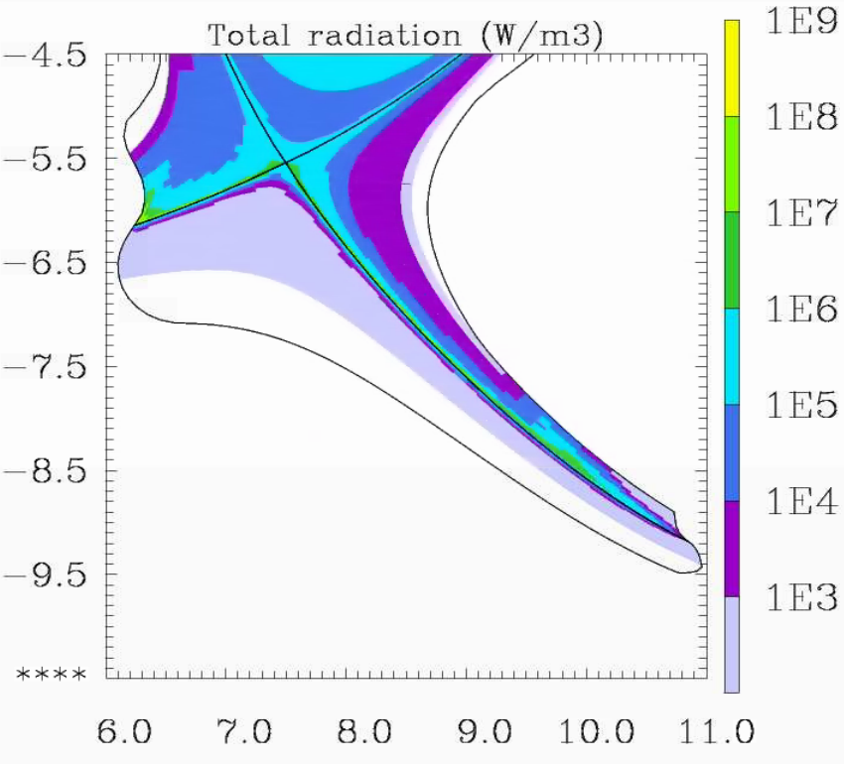
SX – Kinetic Neutrals
First optimization of the mesh is performed to get rid of spikes in the proximity of the outer strike point
One did converge with both inner and outer detached targets (problem with maximum dt < 2e-6 s)
n_{e,omp} = 3e19 m⁻³
λ_{q} = 4.3 mm (with D,χ agreed in WPADC, Militello’s report)
P_{rad} ⁼ 122 MW (30 MW from core)
Increase in the main plasma pollution: Z_{eff,core} > 3

Slide 9
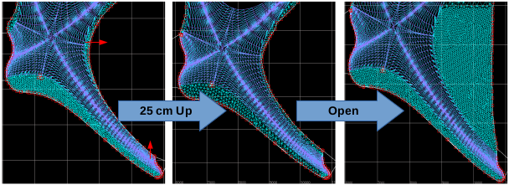
SX – Outer Target Geometry
3 different geometries taken into account to assess the outer target baffling effect
Wide and Open outer divertor are still running
No converged cases are produced yet
Same dt restriction are present: dt < 2e-6

Slide 10
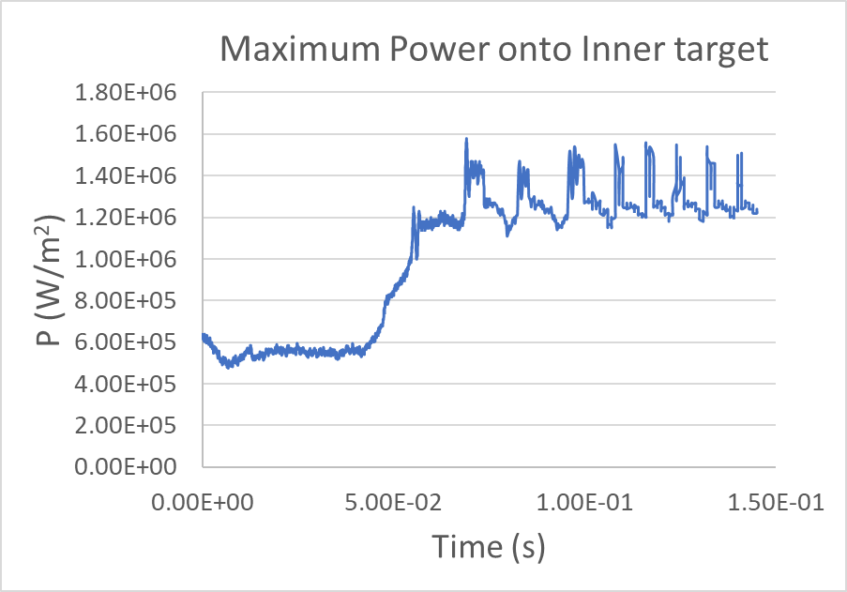
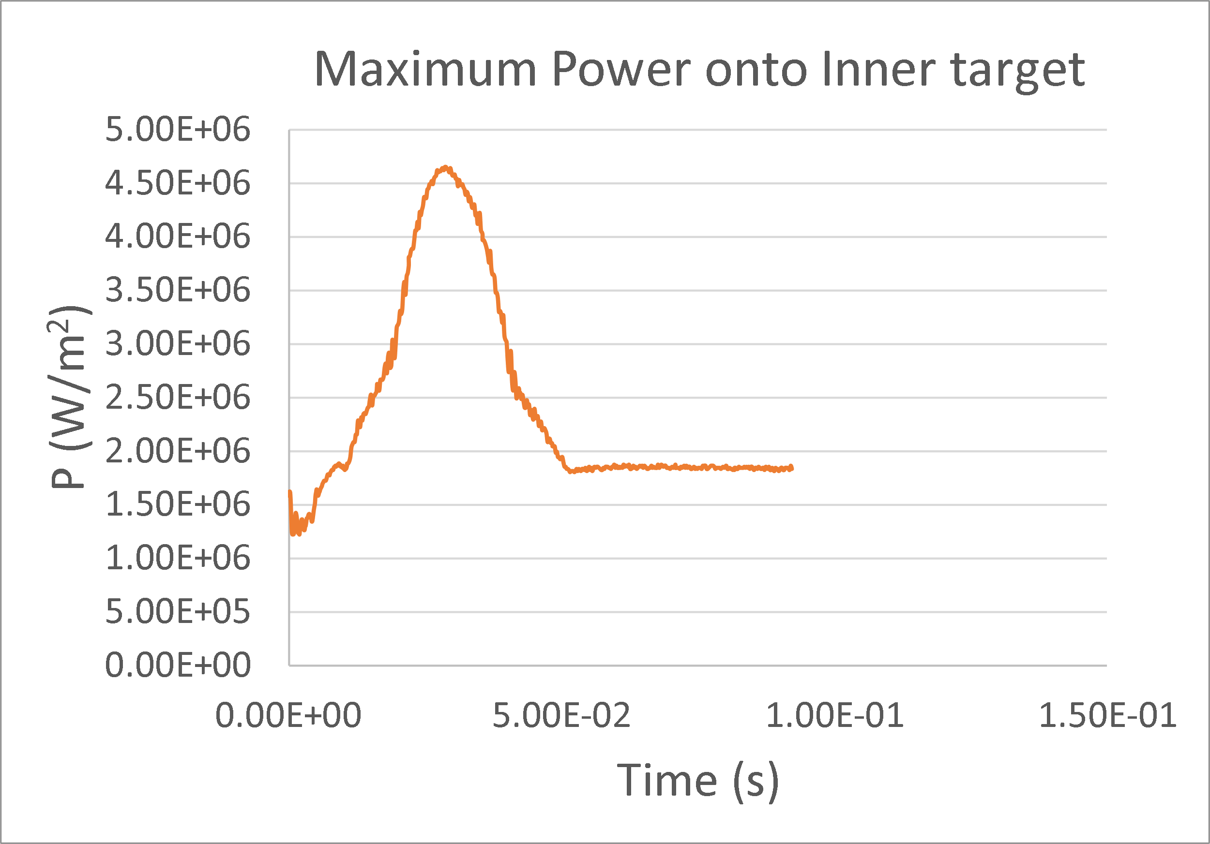
Challenges of SX Kinetic Simulations
Γ = 6.4e23 D/s, n_{eomp} ≈ 3.1e19 m⁻³
Varying puffing (to vary Te,max,IT)
Oscillation in the peak power onto inner target (do not dependent on dt)
Oscillation in the Te on inner target 2eV<T_{e}< 3eV (physical?)
Change in the puffing to change T_{e,IT}
→ Oscillation in T_{e,max,IT} if 2eV<T_{e}< 3eV while power oscillations disappear

Slide 11
SX - Summary
Reference geometry: the possibility to do SOLPS-ITER with kinetic neutrals was demonstrated.
It was possible to access a region with both target detached
Very low target power flux:
Outer target < 0.1 MW/m² (T_{max} ~ 0.2 eV)
Inner target < 1.2 MW/m² (T_{max} ~ 1.5 eV)
Radiated fraction: ~ 90%
Not yet available on MDSPlus
Alternative geometry:
No converged case obtained so far
Time step extremely small ~ 10⁻⁷ – 10⁻⁶ s
Stability is very sensitive to mesh details/quality, but no definite conclusion obtained so far.
Oscillatory behavior detected for some T range. Analyzing to determine if physics or numeric

Slide 12
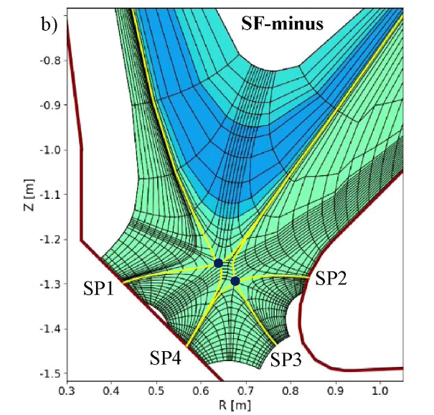
SF- Simulations
Snow-Flake is topologically similar to a disconnected double-null.
However, the very unusual location of the secondary X-point makes it impossible for standard SOLPS-ITER meshing tools.
The mesh was built semi-manually (same tool as EMC3), then adapted to SOLPS-ITER
Also, challenging convergence was detected: a scan over transport parameters was performed
Both fluid and kinetic simulations performed
https://doi.org/10.1016/j.nme.2020.100896

Slide 13
SF- Fluid Neutrals
Input power: 150 MW (electron 75 MW, ion 75 MW)
Core boundary D flux 3.5e22/s, He flux 7.0e20/s
Gas puffing along the outer boundary (D, bundled Ar)
Transport coefficients:
$D=0.1{m^{2}}/s;$
$χ_{i}=χ_{e}=0.1\left(core\right), 0.3(SOL) {m^{2}}/s$
Distance between separatrices: 4 mm at OMP
$(λ_{T_{e},omp}≈6 mm$)

Slide 14
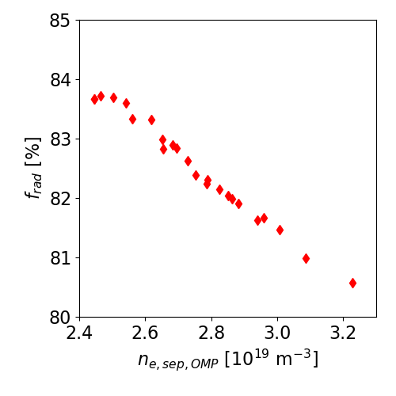
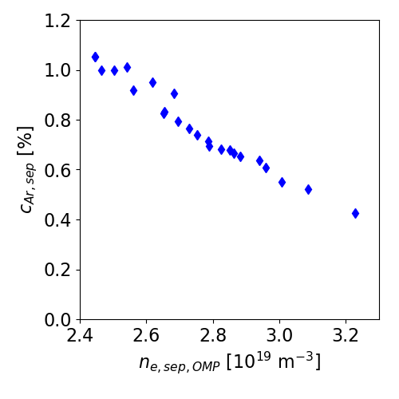
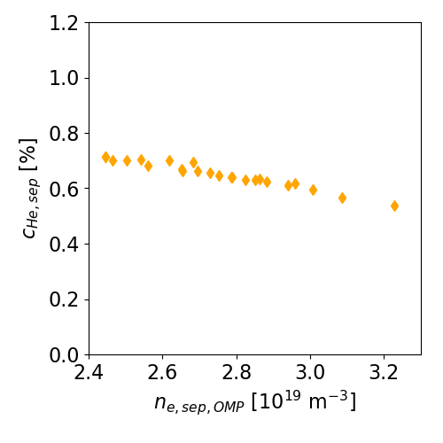
SF- Parametric Scan
Parameter scan (uploaded on MDSplus 184889-184919):
D puffing at the outer boundary: 1.6e23-6.0e23 atom/s
Ar puffing at the outer boundary: 7.0e20-1.1e21 atom/s
Select cases with the maximum target temperature $≈5$ eV
Line radiation fraction
Impurity concentration at the separatrix

Slide 15
SF- Simulation with Kinetic Neutrals
Input power: 150 MW (electron 75 MW, ion 75 MW)
Gas puffing at the outer mid-plane (D, Ar)
Pumping in the private flux region
Transport coefficients:
$D=0.3{m^{2}}/s; χ_{i}=χ_{e}=0.6 {m^{2}}/s$
Distance between separatrices: 4 mm at OMP
$(λ_{T_{e},omp}≈6 mm$)
Pump

Slide 16
SF - Simulation with Kinetic Neutrals
SP1
SP4
SP2
SP3
Fully detached targets
X-point radiator with a total radiative fraction > 90 %
Radiation | SP1 | SP2 | SP4
139 MW | 1.2 MW | 0.1 MW | 1.8 MW

Slide 17
SF- Simulations Summary
Mesh building was not obvious, and quite time-consuming
Models were performed with both fluid and kinetic neutrals
Run stability proved to be sensitive to numerical parameters, possibly due to the special mesh characteristics.
Deep detachment was shown at all targets, with X-PT radiator development

Slide 18
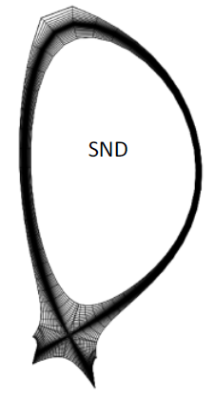
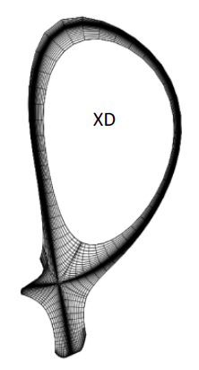
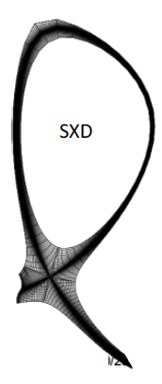
Simplified Models
SOLPS-ITER database, generated through EUROfusion ADC studies, is investigated here focusing on single-null (SN), X-divertor (XD), and Super-X (SX) [1 – 6].
The investigated database:
No drifts
Fluid neutrals
150 MW input power divided equally between electrons and ions
D₂- and Ar-injection scans (He also in the simulations)
Ar bundled to 3 species:
Neutral argon
Ar ions not fully ionized
Fully ionized Ar
SN
XD
SX
SOLPS-ITER grids of the investigated configurations [1]
[1] F. Militello WP-DTT1/ADC (2014-2020) report, 2021
[2] H. Reimerdes NF 2020
[3] L. Xiang NF 2021
[4] L. Aho-Mantila NME 2021
[5] F. Subba NME 2017
[6] F. Subba PPCF 2018

Slide 19
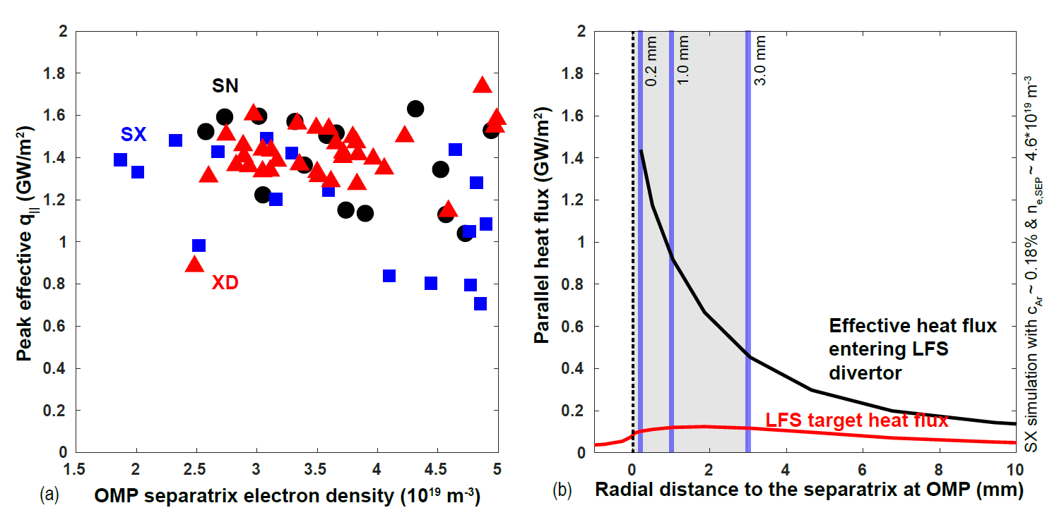
LFS divertor q// ranges between about 1.0 – 1.6 GW/m²
Focus on the LFS near-SOL: 0 – 3 mm from separatrix
Only including simulations with:
q_{targets,max} < 5 MW/m²
T_{e, targets, max} < 5 eV
n_{e, OMP, sep} < 5*10¹⁹ m⁻³
c_{Ar} < 2%
For comparison with the Lengyel model:
q||: The effective heat flux entering the LFS divertor (includes dissipated power between OMP and X-point)
c_{Ar}: Average between OMP and X-point within 0 - 1 mm flux tubes from the separatrix
n_{e,SEP}: OMP separatrix electron density

Slide 20
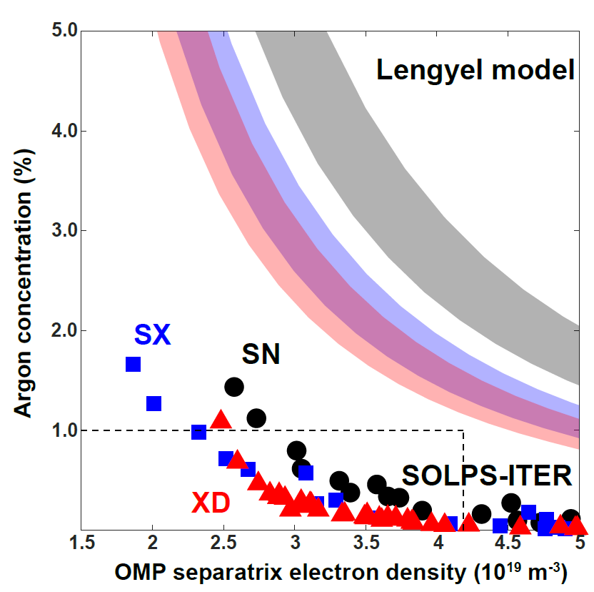
The Lengyel Model Overestimates Cz
Lengyel model would predict no solution within acceptable range of c_{Ar} (< 1%)
Consistent with R. Goldston et al. PPCF 2017 projecting very high impurity concentration for EU-DEMO
However, SOLPS-ITER predicts detached solutions in the range of n_{e,SEP} < 0.6*n_{GW} and c_{Ar} < 1%
Due to increase of L_{CONN} from SN to SX and XD, Lengyel model predicts lower c_{Ar} for these ADCs, which is qualitatively consistent with SOLPS-ITER
However, the Lengyel model is likely to predict this result based on different reasons than SOLPS-ITER!

Slide 21
Line Radiation is not Sufficient
The standard Lengyel model assumes that the dissipation is strongly dominated by the primary radiating impurity
SOLPS-ITER simulations show Ar radiation contributing only 40 – 60% of dissipation in the SN and XD configurations and 20 – 40% in the SX configuration in the LFS near SOL

Slide 22
Importance of Radial Transport
SX is predicted to have x2 larger cross-field transport heat loss than the XD and SN
Proportional to the total surface area of SOL - PFR boundary in LFS: SN ~ 80 m², XD ~ 130 m², and SX ~ 280 m².
SX maintains most of the near-SOL divertor leg plasma T_{e} > 20 eV (long leg)
Large surface area and temperature gradient lead to significant heat transport to PFR in SX
Obviously, this conclusion is subject to the uncertainty of the cross-field transport coefficients that user must specify in SOLPS-ITER
Recycling processes provide the remaining heat loss of about 20%

Slide 23
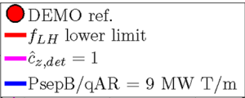
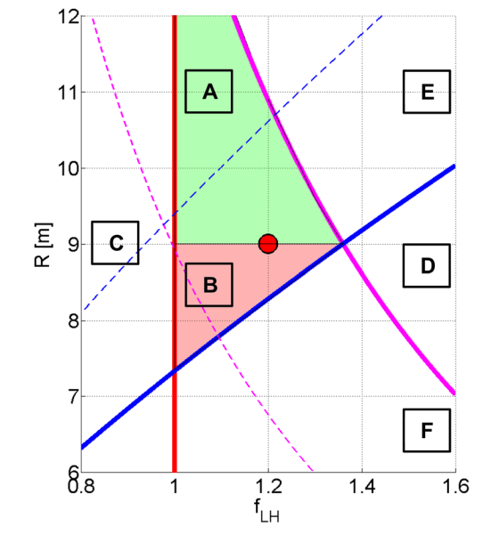
Possible Influences on Reactor Design
This type of approach has been used for scaling of c_{z} for configuration and scenario parameters in EU-DEMO
This is an OK approach, if Lengyel integral does give a reasonable approximation for scaling of Ar radiation with c_{z}
Possibly, a more refined approach could be designed
M. Siccinio et al. Nucl. Fusion 59 (2019) 106026
https://doi.org/10.1088/1741-4326/ab3153

Slide 24
Simplified Models Summary
Databases from SN, XD and SX were analyzed and compared to the standard Lengyel model
The good information is that the Lengyel model seems to overpredict the impurity concentration needed for a given detachment level, consistently for all configurations
In SOLPS-ITER simulations, impurities account for only 40-60% of the power loss from a selected flux tube
The competing mechanism was identified to be radial transport
The possibility to revise our reactor design strategy after proper model parameter tuning was suggested.

Slide 25
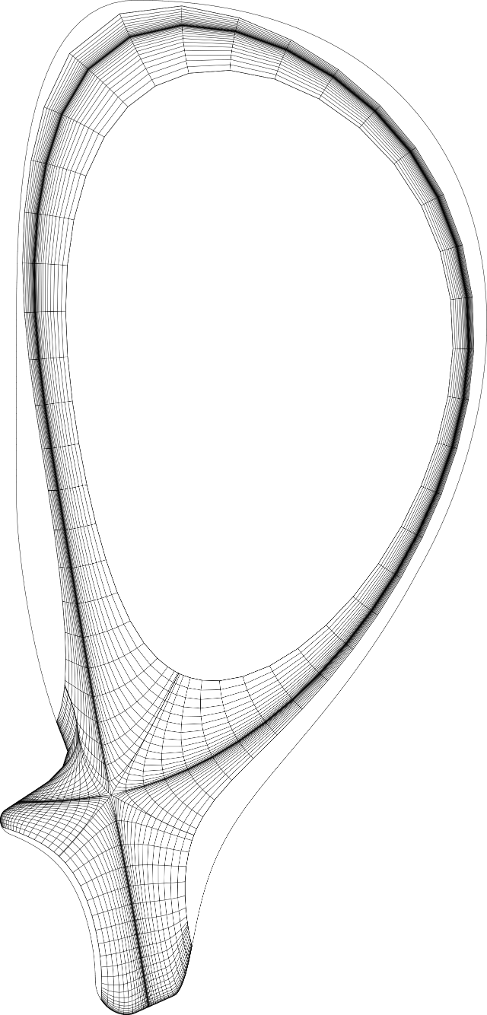
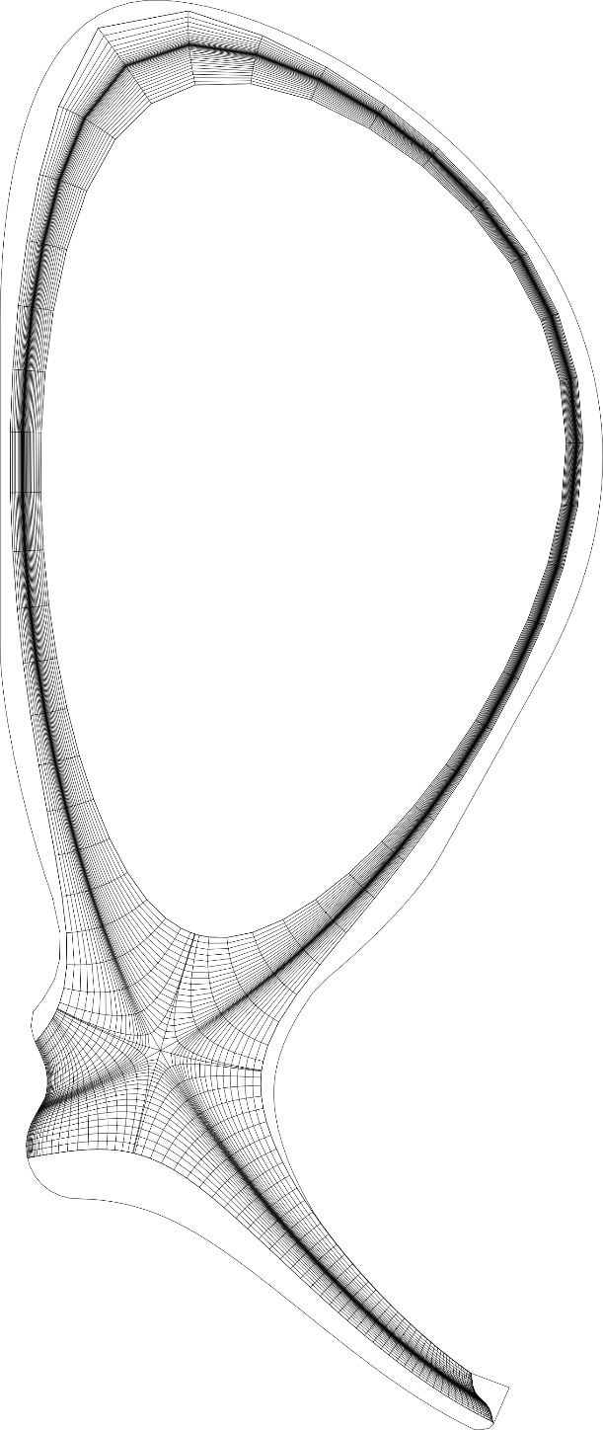
Sensitivities: DEMO XD configuration
Simulations with SOLPS-ITER (multifluid B2 code)
Neutrals are described by the fluid model
D plasma with tungsten targets and wall
Boundary conditions: deuterium flux to the SOL at the inner-core boundary
Sensitivity studies with use of the SOLPS-ITER with fluid neutrals
transport coefficients
input power

Slide 26
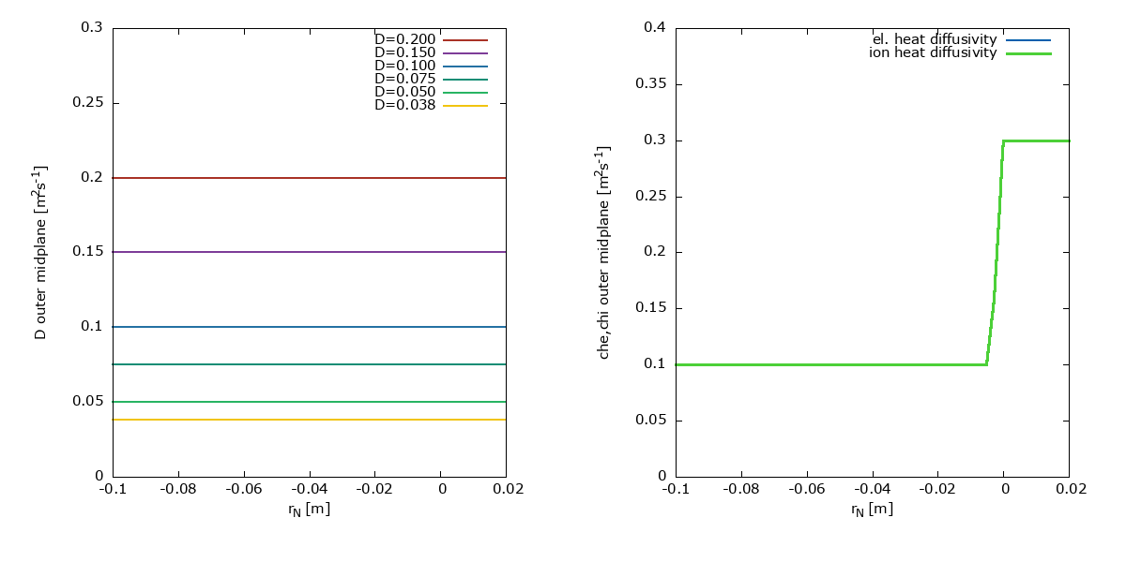
Main Modeling Assumptions
Pin = 150 MW
Constant particle flux core-SOL boundary condition
No gas puffing
Particle density diffusivity and electron heat diffusivity
Scan o different transport levels

Slide 27
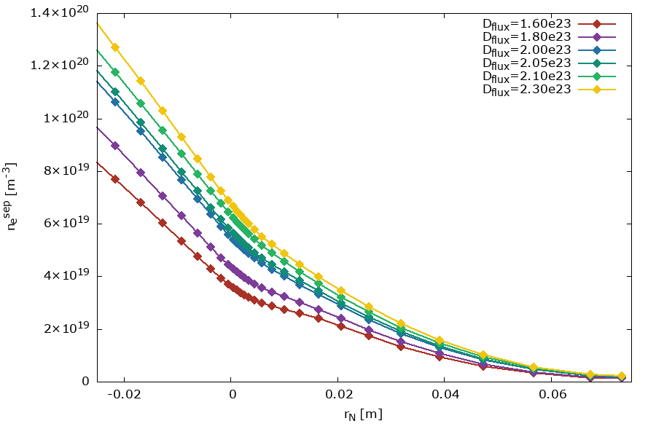
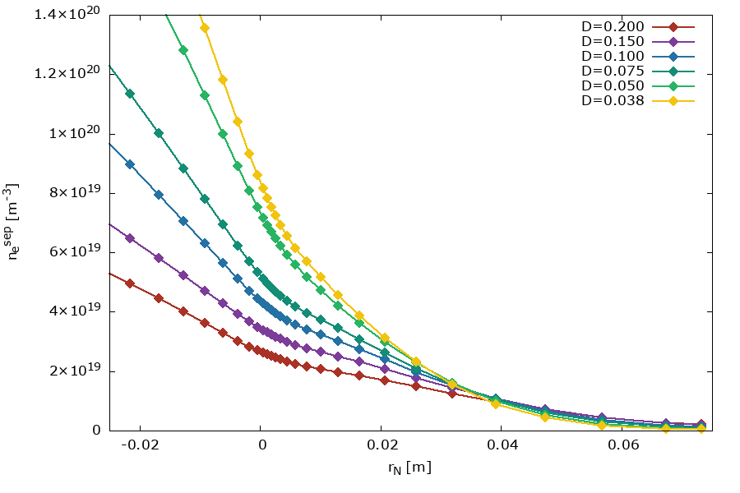
Sensitivities: XD Modelling
Reduction of perpendicular transport leads to the n_{e}^{sep} increase
Comparison of SXD and XD configurations shows an analogous impact on the plasma at targets for different perpendicular pransport and input power

Slide 28
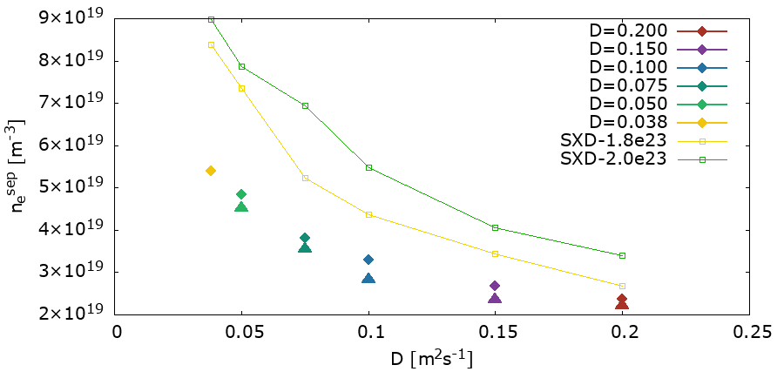
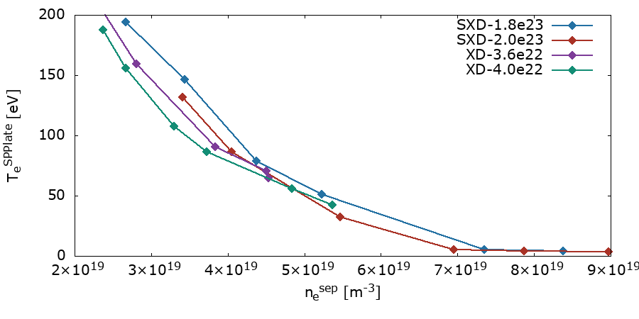
Sensitivity: XD Modelling
Changes of the electron density at separatrix with increase of the particle density diffusivity for different values of deuterium flux to the SOL for XD and SXD configurations
D flux to SOL equal to 3.6×10²²s⁻¹ (triangles) and 4.0×10²²s⁻¹ (diamonds) for XD and solid lines for SXD
To keep the n_{e}^{sep} constant with changes of D, the particle flux at the ICB should be modified

Slide 29
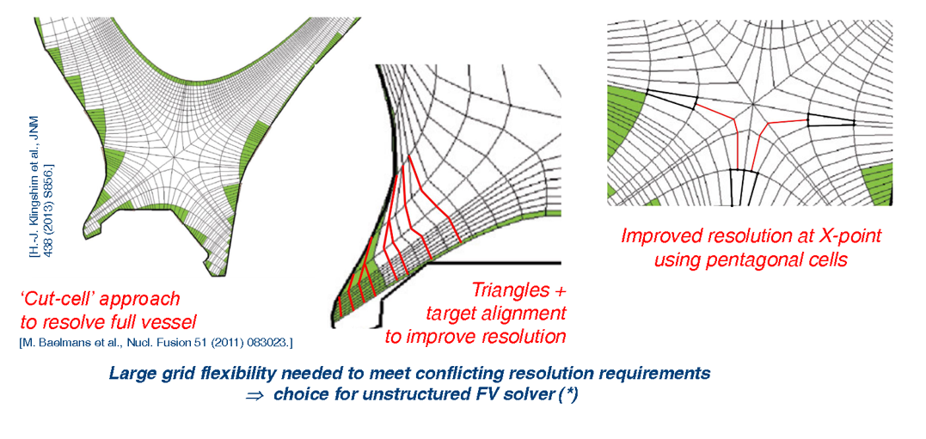
New Unstructured FV Solver for SOLPS-ITER

Slide 30
New Solver First Tests

Slide 31
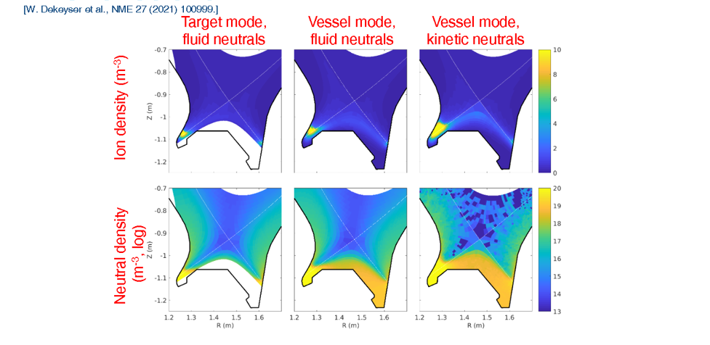
Relevance for Divertor Solution
For relatively orthogonal meshes, fluid neutrals can be effective provided extended meshes are adopted

Slide 32
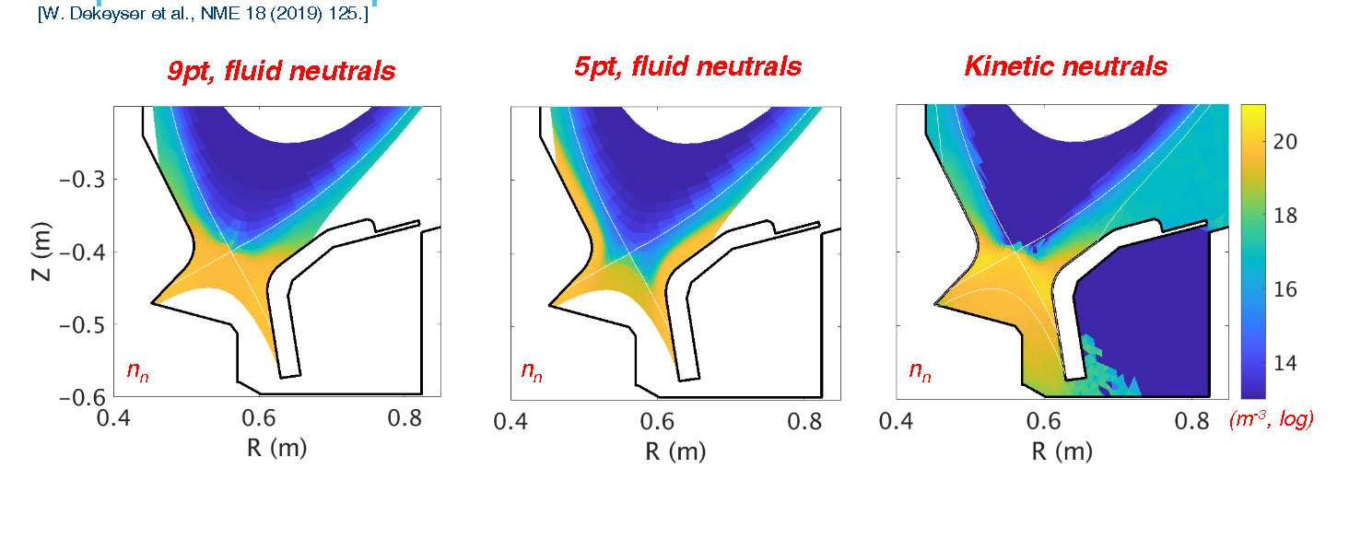
Importance for 9-pt Stencil
For neutrals, in regions of highly distorted mesh the 9-pt stencil can bring the solution fairly close to the full-kinetic treatment

Slide 33
Numerical Enhancements Summary
Several numerical enhancements for SOLPS-ITER were recently released.
First tests, prove the possibility to obtain considerable advantages
Accuracy (wide-grid option, 9-pt stencil)
Speed (advanced fluid neutrals)
No direct ADC simulations studied, but enabling results with far reaching medium-long term perspectives
Currently deep testing ongoing from the user community

Slide 34
THANK-YOU FOR ATTENTION

Slide 35
Baffled - Motivation
Theory predicts high neutral divertor pressure to be beneficial for PEX.
SOLPS-ITER modeling predicts high neutral pressure can be obtained with baffled long-legged divertor
Experiments on TCV confirm simulations
How does this scale to Eu-DEMO?
Need to modify the geometry (done)
Simulations not completed

Slide 36
Numerical Enhancements
Some work was devoted to develop new numerical features of the SOLPS-ITER code.
This contributed to the launch in November 2022 of the SOLPS-ITER wide grid version. Three major improvements relevant for advanced divertor configuration studies
A wide-grid code version, allowing to:
Extend the fluid mesh up to the solid wall (far-SOL accurate studies)
Switch to fully un-structured mesh (solve problems for complex topologies, e.g. SF)
A so-called Advanced Fluid Neutral model (Can reproduce accurately the physics and results from the kinetic neutral case for high-density scenarios)
Full implementation of the 9-Pt stencil, taking out un-accuracies introduced in regions of strongly distorted mesh
Systematic application to ADC configurations not yet available, but strong enabling capacity for future activities

Slide 37
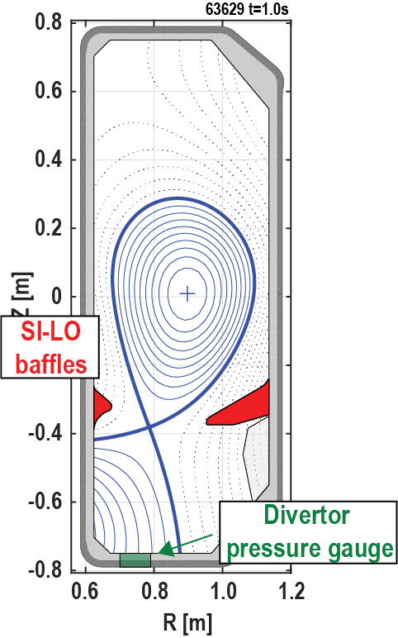
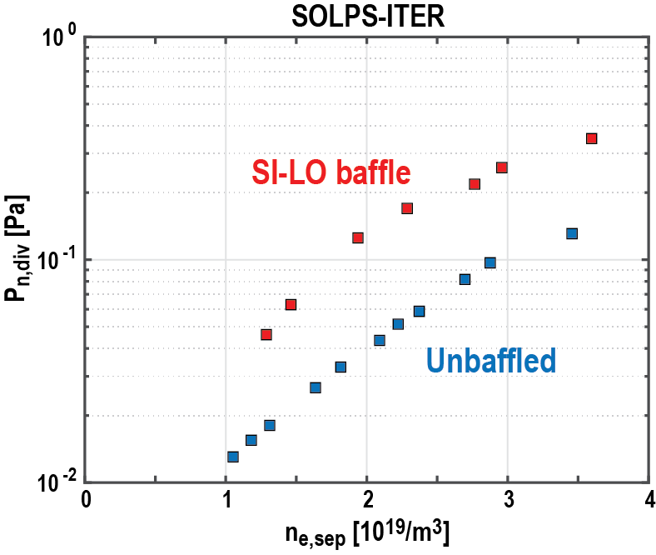
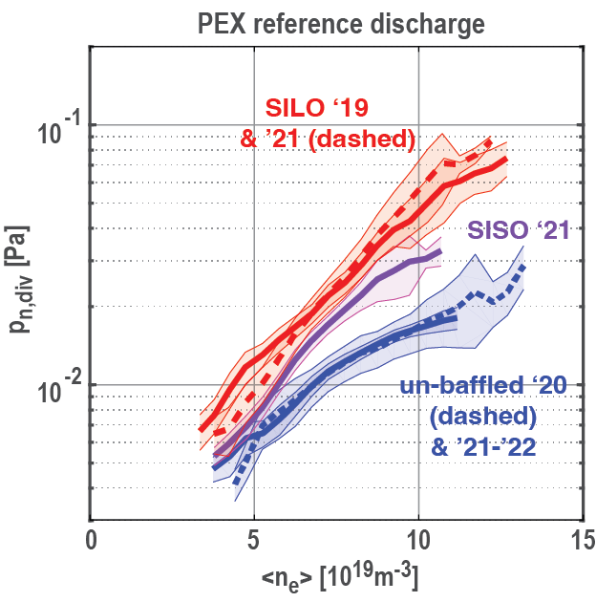
Baffles increase divertor neutral pressure
[1]
[2]
x 2-3
x 2-3
Density ramp
Experiment confirms magnitude of $p_{n,div}^{}$ increase
Absolute magnitude 3-4 x lower than predictions
[1] M. Wensing, et al., PoP 28 (2021) 082508
[2] H. Reimerdes, et al., 25th PSI conference, June 2022

Slide 38
Higher divertor neutral pressure linked to improved exhaust performance
Empiric scaling of tolerable exhaust power in AUG^{[1]}
Predicted ITER divertor target response^{[2]}
SOLPS-4.3
$$\frac{P_{sep}}{R}\left[\frac{MW}{m}\right]≤0.77\left(p_{0}+18p_{0,N}\right)\left[Pa\right]$$
Fig. 5(a) of [2]
Note that in a fixed geometry it is difficult to disentangle the roles of $p_{0}$and $n_{e,sep}$for power exhaust
[1] A. Kallenbach, et al., NF 55 (2015) 053026
[2] R. Pitts, et al., NME 20 (2019) 100696

Slide 39
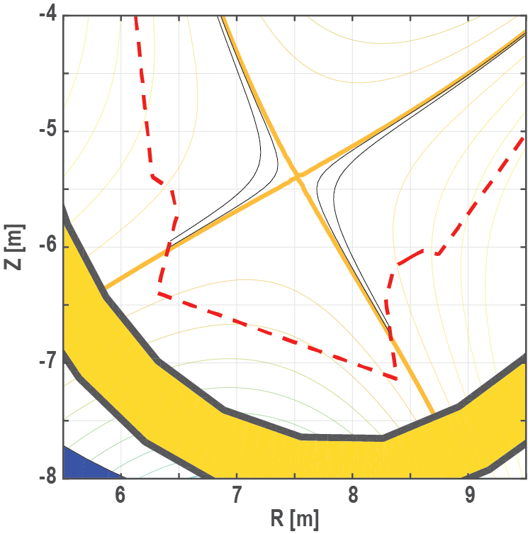
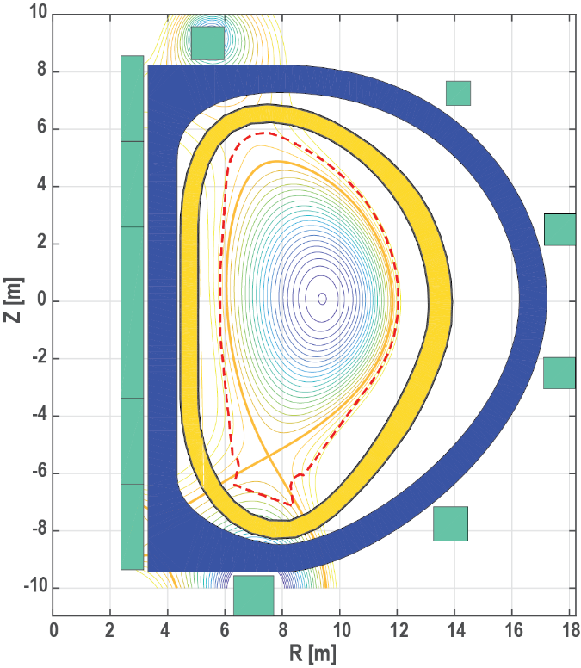
EU-DEMO SN coil configuration & equilibrium with increased leg-length and stonger baffling
Coils and magnetic equilibrium of ‘2018’ EU-DEMO configuration^{[1,2]}
$R_{0}$=8.9m
$B_{T}$=4.9T
$I_{P}$=19MA
[1] H. Reimerdes, et al., NF 60 (2020) 066030
[2] F. Militello, et al, NME 26 (2021) 100908

Slide 40
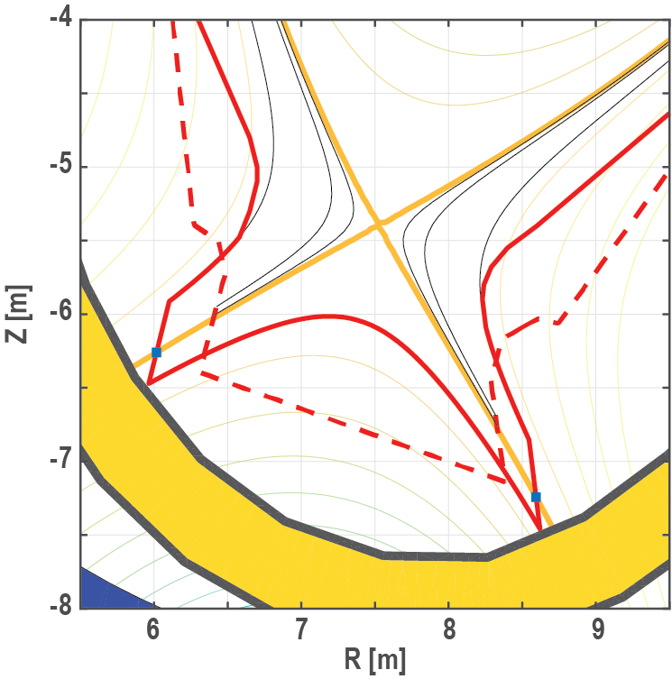
EU-DEMO SN coil configuration & equilibrium with increased leg-length and stonger baffling
Coils and magnetic equilibrium of ‘2018’ EU-DEMO configuration^{[1,2]}
$R_{0}$=8.9m
$B_{T}$=4.9T
$I_{P}$=19MA
TBLLD
[1] H. Reimerdes, et al., NF 60 (2020) 066030
[2] F. Militello, et al, NME 26 (2021) 100908
Notes:
TBLLD characterised by the absence of large Rt and additional X-points!

Slide 41
EU-DEMO SN coil configuration & equilibrium with increased leg-length and stonger baffling
Coils and magnetic equilibrium of ‘2018’ EU-DEMO configuration^{[1,2]}
Modifications
Extend divertor legs by placing targets closer to the reference vessel
Vessel may have to be modified to allow for larger divertor cassette!
Extend baffles towards X-point
TBLLD
[1] H. Reimerdes, et al., NF 60 (2020) 066030
[2] F. Militello, et al, NME 26 (2021) 100908

Slide 42
Tightly-baffled, long-legged divertor (TBLLD) in DEMO requires optimisation
Need to investigate parametric dependencies, e.g. with SOLPS-ITER
Compare performance to reference (Ar seeded SN)^{[1]}
Parameters
Distance of CFR baffle
Distance of PFR baffle
Orientation of targets → grazing angle
Baffle extension towards X-point
Poloidal length
Features
Neutral passage between inner and outer target
Physics aspects
Pumping!
3mm
1mm
50mm
TBLLD
[1] F. Subba, et al., this meeting
Notes:
Slide optional
$dR_{u}=50mm$ ($ρ_{pol}=1.017)$
$$ρ_{pol}=0.987$$

