Slide 1






TSVV Task 5: “Neutral Gas Dynamics in the Edge”
12.09.2023
Mid-term review for E-TASC SB
D. Borodin et al.

Slide 2

TSVV-5: Neutral Gas Dynamics in the Edge
Main simulation tool:
EIRENE code (and EIRENE-CFD packages) http://www.eirene.de/
We aim to transform it to IM- and HPC-ready neutral gas module (EIRENE-NGM) suitable for simulations on ITER and DEMO scale with large focus on (semi)detached divertor plasmas
FP-9 deliverables:
Neutral gas code that allows for an efficient use of HPC resources (towards exascale systems and/or HPC booster techniques) through suitable parallelization methods.
Revised and extended physics basis for the neutral gas model. Further development of the underlying collision-radiative model towards the full vibrational resolution for all hydrogen isotopes and specific impurities for seeding.
Improved (in contents and structure) Atomic and Molecular database for volumetric and surface processes. Database access through generalized interfaces to, e.g., atomic, molecular, nuclear and surface (AMNS) physics data.
Interfaces and boundary conditions necessary for future applications; modularization of the neutral gas code to facilitate coupling to computation fluid dynamics (CFD) codes (2D or 3D codes, turbulence codes, time-dependent) and possibly also to gyro-kinetic/gyrofluid plasma codes.
Strategy towards a validated predictive capability for integrated fusion reactor modelling for (semi-)detached divertor plasmas. Liaison with TSVV Tasks 3 and 4.
Neutral gas code that allows for an efficient use of HPC resources (towards exascale systems and/or HPC booster techniques) through suitable parallelization methods.
Revised and extended physics basis for the neutral gas model. Further development of the underlying collision-radiative model towards the full vibrational resolution for all hydrogen isotopes and specific impurities for seeding.
Improved (in contents and structure) Atomic and Molecular database for volumetric and surface processes. Database access through generalized interfaces to, e.g., atomic, molecular, nuclear and surface (AMNS) physics data.
Interfaces and boundary conditions necessary for future applications; modularization of the neutral gas code to facilitate coupling to computation fluid dynamics (CFD) codes (2D or 3D codes, turbulence codes, time-dependent) and possibly also to gyro-kinetic/gyrofluid plasma codes.
Strategy towards a validated predictive capability for integrated fusion reactor modelling for (semi-)detached divertor plasmas. Liaison with TSVV Tasks 3 and 4.
Code performance, parallelization, refactoring, domain decomposition, I/O for HPC, …
Fluid-kinetic hybridisation (FKH) and improved CRMs
physics
Improved AMNS data, both in structure/physics and content
EIRENE as NGM – restructuring, interfaces to other codes, time-dependent runs, kinetic ions
Validation with experiments and test of predictive capabilities for ITER and DEMO

Slide 3
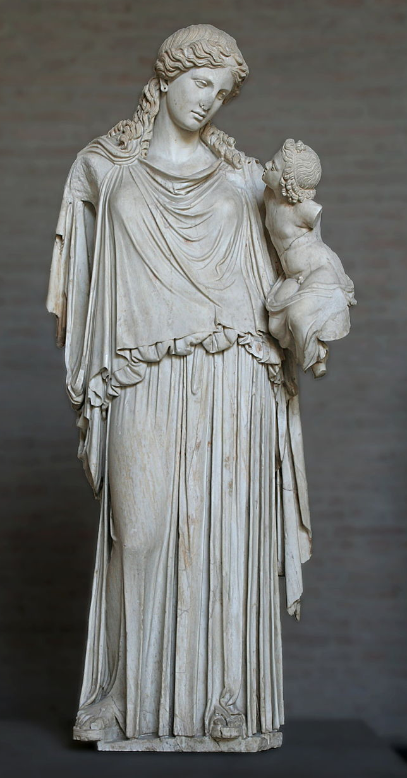
EIRENE-NGM-DEVELOPERS (TSVV-5)
D.V. BORODIN, F. Cianfrani, S. Wiesen, D. Harting, P.Börner, B.Küppers
Forschungszentrum Jülich, Institut für Energie- und Klimaforschung – Plasmaphysik, Germany
W. DEKEYSER, S. CARLI, M. BLOMMAERT, N. HORSTEN, W. VAN UYTVEN, M. BAELMANS
KU Leuven, Department of Mechanical Engineering, Belgium
B. MORTIER, G. SAMAEY, E. LOEVBACK (with ACH-MPG)
KU Leuven, Department of Computer Science, Belgium
Y. Marandet, P. Genesio
Aix-Marseille Univ., France
H. Bufferand
CEA, IRFM, France
E. WESTERHOF, J.G. MUNOZ, P.W. GROEN
DIFFER - Dutch Institute for Fundamental Energy Research,
Eindhoven, the Netherlands
M. GROTH, A. HOLM , A.CHanDRA
Department of Applied Physics, Aalto University,
Espoo, Finland
ACH-VTT:
O.LaPPI
F. Granberg J. Åström
ACH-IPPLM:
D.Yadykin
Yu.Yakovenko
ACH-MPG:
H.LEGGate
Eirene with the infant Ploutos
ITER Organisation:
X.Bonnin

Slide 4
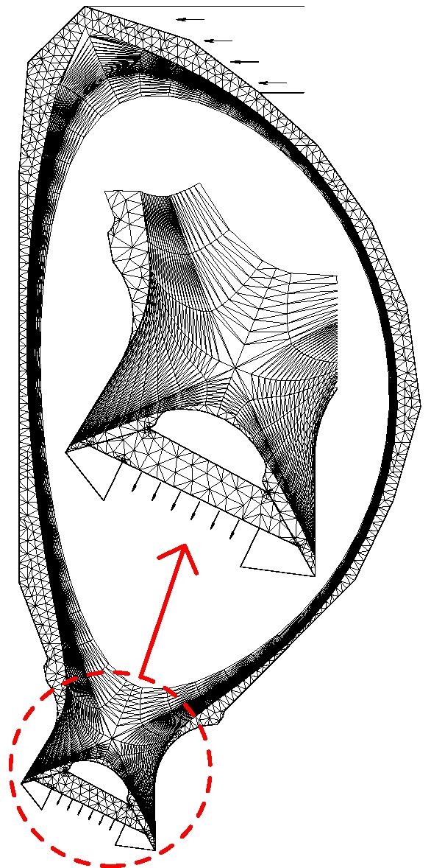
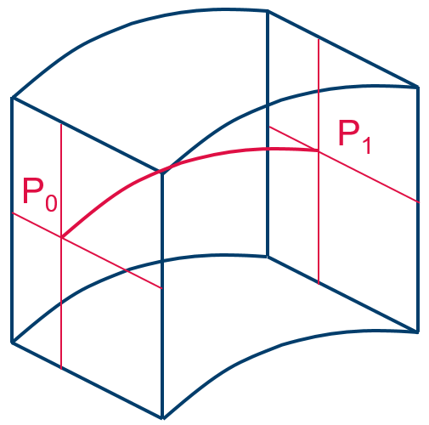
What is EIRENE in a nutshell (e.g. in SOLPS)?..
Macroscopic:
Microscopic:
Plasma flow parameters
EIRENE-NGM: a 3D3v MC multi-species transport code incl. radiation transfer, kinetic
or F-K hybrid.
CFD codes (computational fluid dynamic):
B2, Edge2D, EMC3, SOLEdge3X, etc…
3D EIRENE volume cell
2D or 3D Volume grid (e.g. tetraeder) adopted for current magnetic configuration
Source terms (Particle, Momentum, Energy)
CRMs
(HYDKIN, AMJUEL, ADAS, …)
for atomic and molecular neutrals H,H*,H₂,H₂(v),H₂*,H⁻,H₂⁺,…, impurities
Ionisation, CX, recombination etc.

Slide 5
Fluid-kinetic hybridization (FKH)
Accuracy
Code performance
A hierarchy of neutral models:
D.V. Borodin et al., FEC-2020, NF (2022)
Seamless in volume
Fluid,
AFN
Hybrid Fluid-Kinetic approach (FKH)
kinetic,
MC
Asymptotic-Preserving MC (APMC)
Spatial FKH
Micro-macro FKH (mMH)
Cancellation error (can be suppressed by enforcing positivity)
Firm domain allocation
Spatial by source
Micro-macro kinetic diffusion (KDMC)
Bias error (can be suppressed via multi-level)
No coupling with CFD needed
Evapor./condens.
Notes:
BM:
- Added cancellation error and bias inside the boxes
- changed colorscheme of the triangles
- the fact that FKH asymptotically becomes AFN or K and KDMC asymptotically becomes K, are indicated by connecting the blocks
- Added dashed lines to stress that the bottom is a further categorization of the top
- Repeated FKH as a term in the bottom part to show it is the same
- Group the spatial FKH’

Slide 6
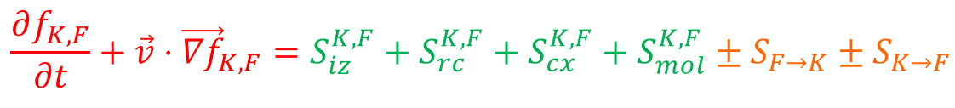
F-K Hybridisation approaches utilized in EIRENE-NGM
A) Full kinetic
B) Spatial, “micro-Macro” hybr.
C) APMC: KDMC
Plasma flow parameters
Plasma flow parameters
Plasma flow parameters
3D
cell
NGM
1) Kinetic
Mean, covariance
2) Diffusive
x(t_{n+1}), v(t_{n+1})
3D
cell
3D
cell
CFD
CFD
NGM
CFD
NGM
FKH
Source terms
Source terms
Source terms
f= f_{F} + f_{K}, optionally with
evaporation/condensation:
Kinetic step with constant velocity followed by random walk with appropriate parameters

Slide 7
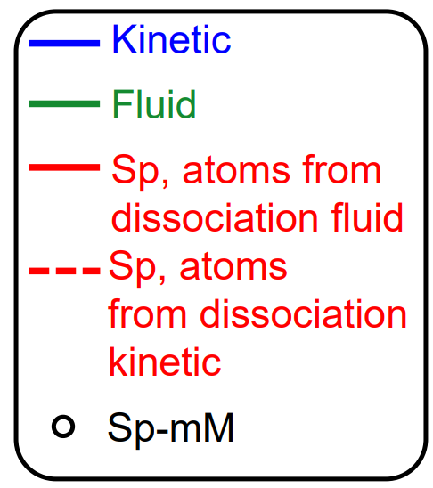
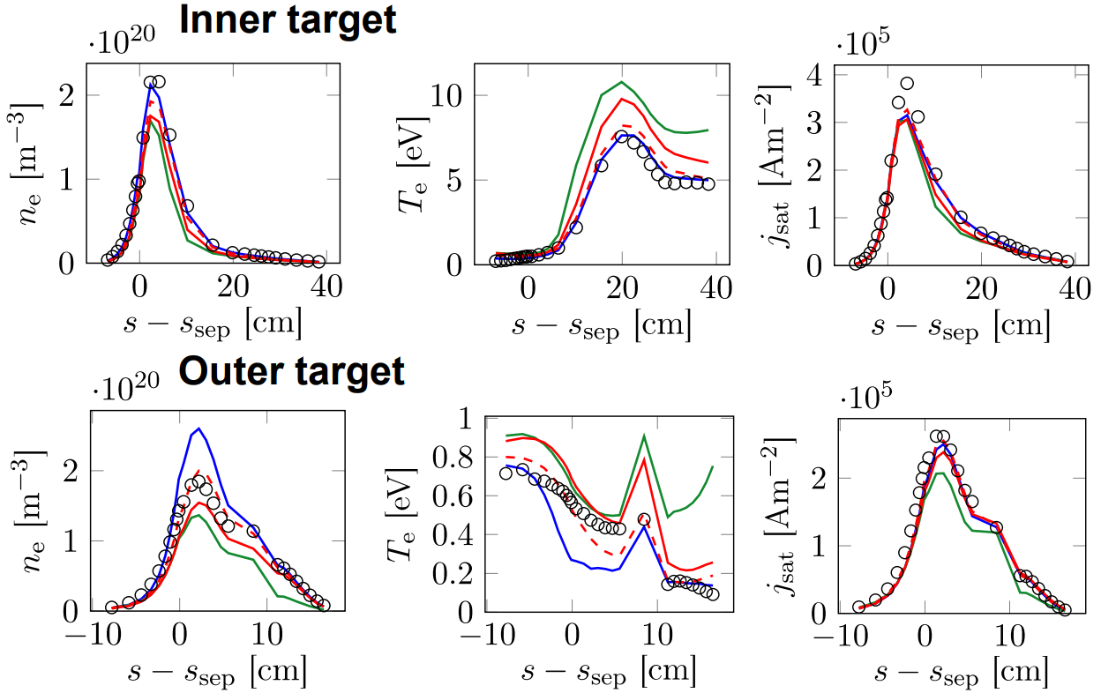
Recent progress with micro-Macro (JET L-mode case)
N.Horsten et al., PET-2021
Purely micro-macro (mM) approach for rectangular slab geometry with fixed background plasma
2021
Micro-macro combined with spatially hybrid approach (Sp-mM)
→ factor 5-10 faster than full kinetic!
• Realistic geometry, void regions
• Coupling to kinetic molecules
• Coupled plasma-neutral simulations

Slide 8
Recent FKH Progress 2022/23 (KU Leuven)
The fluid, (SpH) hybrid and kinetic neutral models were validated with a realistic JET ILW L-mode plasmas cases [2]
  This not a slab, but a realistic tokamak configuration, incl. voids, molecules, …
  Large fluid-kinetic discrepancies at low density (factor 2), but smaller discrepancies at higher density (50%)
  Fluid-kinetic discrepancies in both density regimes successfully corrected by hybrid approach
Drift and n-n effects are successfully introduced
ITER W/Be case with/without drifts – AFN/kinetic
More work on algorithmic differentiation - AD (TAPENADE) is actively ongoing in 2023
Alternative hybrid approach that avoids cancellation errors by construction under development. Hilbert expansion based fluid model derived; both diffusive & hydrodynamic scaling investigated
Release of fluid and hybrid approaches in extended grids version of SOLPS-ITER to the community during dedicated workshop hosted in KU Leuven, November 2022
➔ FKH is also contributed from CEA/AMU with parallelisation for CRMs, “condensation/evaporation”, links to SOLEDGE and TSVV-3 etc.

Slide 9
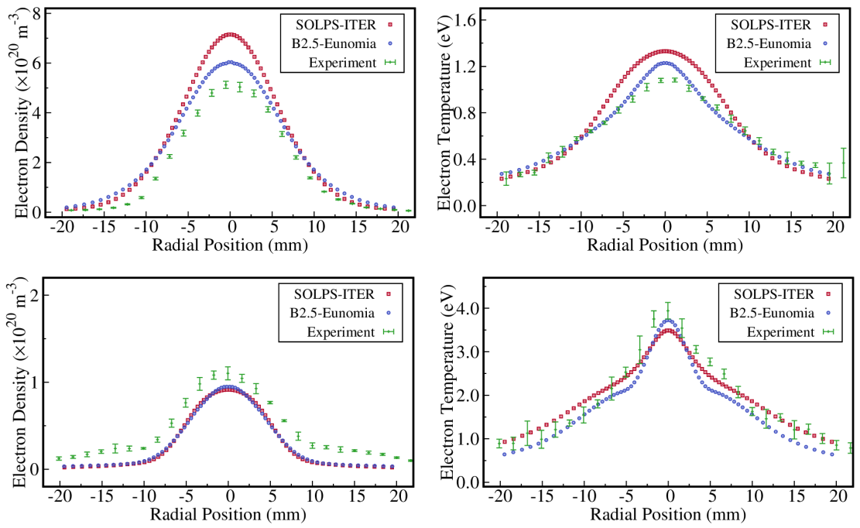
EIRENE application to Magnum-PSI
Comparison of SOLPS-ITER (B2.5-EIRENE) with B2.5-ENOMIA
Aim: transfer all the useful development into EIRENE
Main differences are identified to be in CRMs (MAR, EI, EC) – direct comparison is often not possible.
New FEM model for PWI in EIRENE (based on FreeFem++)
  Aim: treat self-consistently temperature and sputtering, absorption and outgassing, recycling, transients (time-dependent simulations)
Comparison with TS profiles near the target
High Density Case
Low Density Case
J. Gonzalez, E. Westerhof, et al.,
PET 2021, CPP (2022)

Slide 10
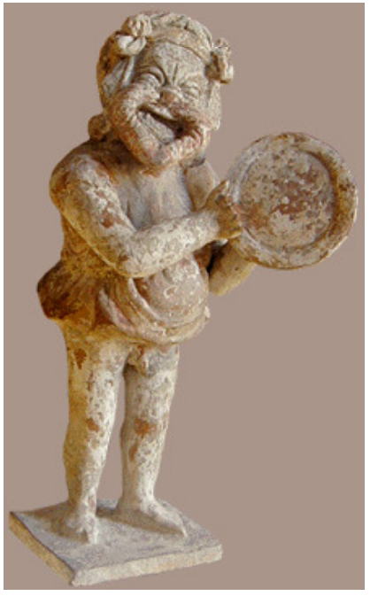

General code development of EIRENE
Main goals and decisions:
  Segregating EIRENE into “starter” and a compact, free of most branching “numeric core” ➔ Optimisation for HPC, transparency and ease of use.
  Unloading the main loop from branching agreed
    Abstractisation of the cell type (removing “geometry” branching)
    Abstractisation of A&M reactions + tracking of internal states
  Version merging scope agreed including synchronisation with SOLPS-ITER
  Uniform coding style (e.g. variable name conventions, use of OOP, etc.)
With support from the ACHs (Advanced Computing Hubs)
  EIRENE “toy model” – EIRON and profiling of EIRENE
  ➔ Test of parallelisation schemes incl. domain decomposition options
  ➔ Can be used for other purposes e.g. optimisation of ML-KDMC
  EUDAT-based simulation catalogue
    Portfolio of simulation cases
  IMASification of the simulation grid (GGD objects) in close contact with
  ITER (X.Bonnin) and utilizing the positive SOLPS-ITER experience
Eiron
Eirene

Slide 11
Code development – version merging
The main focus with regard to development of the EIRENE code in 2022 was on reuniting the various diverging versions of the code used in FZJ and at ITER.
Roughly 20 different code versions have been analysed and merged together. Thereby taking advantage of developments provided by FZJ external developers.
These developments include
  Charge state bundling
  Parallelization of the code using shared memory techniques (OpenMP)
  Extensions of the existing parallelization of the code with message passing techniques (MPI) by implementation of different parallelization schemes.
  Introduction of radiation tallies
  Implementation of species resolved volume averaged tallies and their use with species specific rescaling of calculation results in order to improve the particle balances.

Slide 12
Code development - priorities
Initially version-specific code has been generalized in a way it can be used by all the interested parties (RU or specific architecture related code removed).
All changes to the code are carefully tested (still ongoing!..).
Code modifications affecting simulation results were tracked down to their origin and the reasonability investigated.
Updated reference outputs are provided for the testcases in the continuous integration chain (CI).
We are approaching the 1st milestone version (MsV) release of the code, which should be a basis for further joint development also with ITER

Slide 13
EIRENE licencing - User Agreement (UA)
Old UA
acknowledgement of FZJ origin of EIRENE, non-military use, non-commercial use, no cost/liability for FZJ, etc.
www.eirene.de/EPL
New UA “EPL (EIRENE public license)”
Based on copyleft licence (however GPL3.0 occurs to be not suitable).
Similar declarative statements as in the old UA.
More clear statement about the EIRENE-based publications.
Developers and users are divided into “basic” and “associated” ones (AD).
NEW: commercial use of executable for any AD group.
➔ ADs get more rights on decision-making, direct access to the repository, etc.
ADs must keep to the “Developer Code of Conduct” (see at INDICO).
Current status: License is ready and being in a process of exception

Slide 14
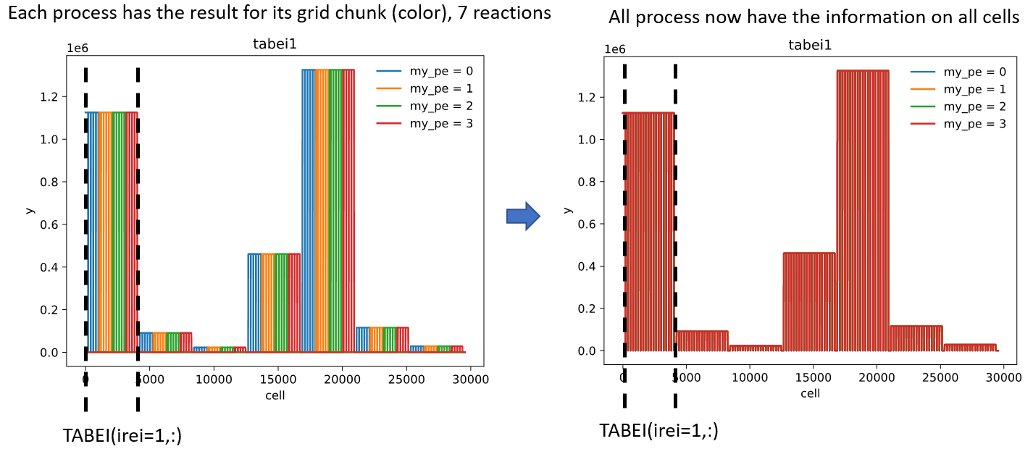
AMU/CEA contribution (Y.Marandet, P.Genesio, N.Rivals, …)
MPI parallelisation of rate coefficient calculation
with support from ACH- MPG and ACH-VTT
(also utilising EIRON)
2) Code restructuring: CRMs in the main loop, MPI parallelization of calls to the CR model, data structures, IMASification, technical interfaces, …, merging into the “MsV”
3) Interface to TSVV-3:
→ SOLEDGE3X interface planned for 2023 (styx2.0; N. Rivals)
→ Demontration of coupled MPI/OpenMP runs of SOLEDGE3X-EIRENE
→ neutral and hybrid models in SOLEDGE3X

Slide 15
EIRENE: collisional-radiative model (CRM) challenges
treating non-stationary effects
improving performance for simulations on ITER and DEMO scales
metastables (MS) in atoms (e.g. He)
vibrational (and rotational) states in molecules
isotopes: D₂, T₂, H₂, DT, HD, …, Be-H/D/T, N-xxx, …
control the exploding amounts of data

Slide 16

CRM solvers available
CRM (technically) = reaction data + SOLVER
$$\frac{dN_{i}}{dt}=0$$
Most solvers solve algebraic stationary system of equations
in such cases the solver is much less valuable than the A&M data collection
this statement is underlined even by the developers of the very well established and mostly up-to-date YACORA model
CRM containing molecular species is even more complex, e.g. one needs to track more processes and more states (vibrational, rotational).
Tracking all the states as separate species demands enormous CPU and memory resources.
EIRENE pre-calculates rates for each volume cell. It also allows to pre-calculate values for various T_{i}/T_{e} ratios.
D.Wünderlich and U.Fantz,
Atoms 2016, 4(4), 26

Slide 17
CRM FOR MOLECULES
H₂⁺
H₂ + H⁺ → H₂⁺+H
H₂⁺ + e → 2H⁺ + 2e
H₂
H₂ + e → H₂⁺+ 2e
H₂⁺ + e → 2H
SOURCE
background
H₂ + e → 2H + e
H₂⁺ + e → H + H⁺ + e
H₂ + e → H + H⁺ + 2e
H + e → H⁺ + 2e
Plasma parameters:
H
T_{e}=T_{i}=0.2÷30eV.
n_{e}=n_{i}=10¹⁹m⁻³
n_{e}=n_{i}=10²¹m⁻³
JET
Databases:
AMJUEL, HYDHEL
EU-DEMO

Slide 18
CRM FOR MOLECULES : vibral resolution
H₂⁺
H₂(X)
H₂ + H⁺ → H₂⁺+H
H₂⁺ + e → 2H⁺ + 2e
ν = 5
H₂ + e → H₂⁺+ 2e
H₂⁺ + e → 2H
ν = 4
ν = 3
background
ν = 2
SOURCE
ν = 1
ν = 0
H₂ + e → 2H + e
H₂⁺ + e → H + H⁺ + e
H₂ + e → H + H⁺ + 2e
H + e → H⁺ + 2e
Plasma parameters:
H
T_{e}=T_{i}=0.2÷30eV.
n_{e}=n_{i}=10¹⁹m⁻³
n_{e}=n_{i}=10²¹m⁻³
JET
H₂(ν) + e → H₂(ν±1) + e
Databases:
AMJUEL, H2VIBR
EU-DEMO

Slide 19
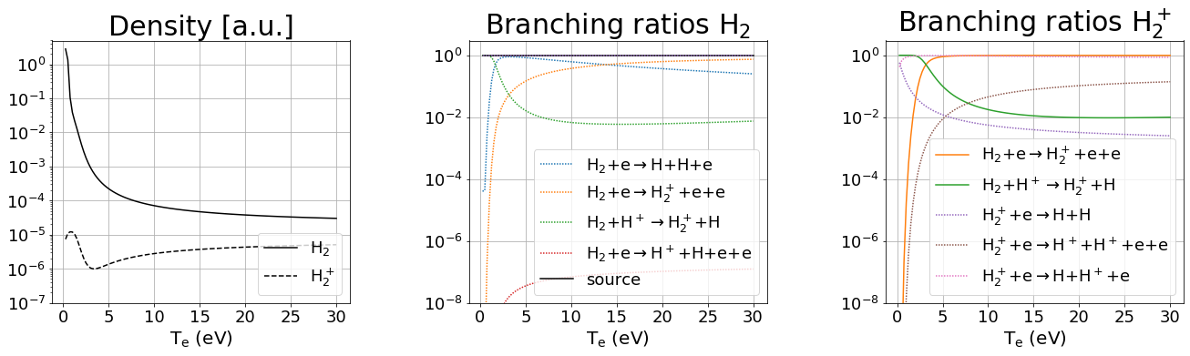
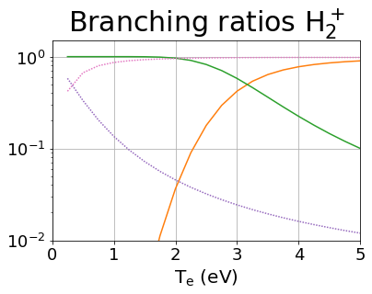
CRM FOR MOLECULES: leading reactions
EU-DEMO
low temperature (T < 2eV) leading reaction chains:
MAD
MAR/MAD competition at very low temperature
H₂+H⁺→ H₂⁺+H H₂⁺+e → H+H⁺+e
H₂+H⁺→ H₂⁺+H H₂⁺+e → H+H
MAR

Slide 20
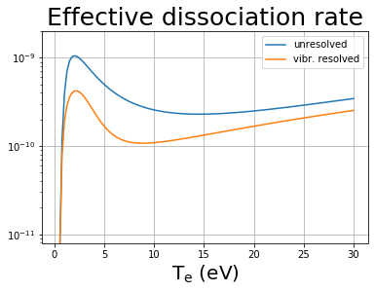
EU-DEMO – effect of resolution by vibrostates
F.Cianfrani et al.,
EPS-2022
Fully in line with the EIRENE and other CRMs:
JET modelling:
“Up to 40% reduction in effective dissociation rate due to transport of vibrational states”
A.Holm, M.Groth, et al.,
PET, CPP 2021

Slide 21
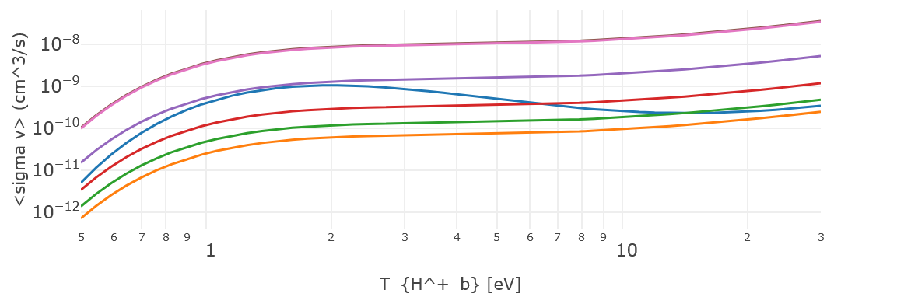
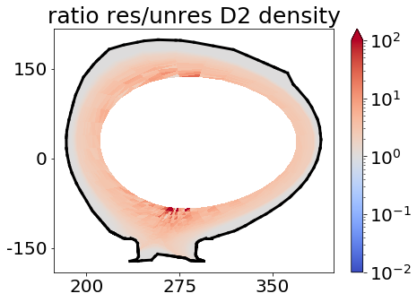
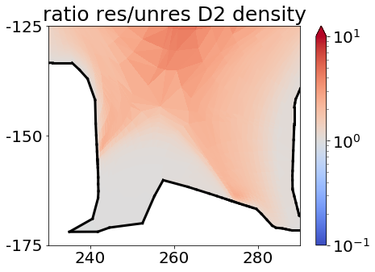
Resolved vs. unresolved on vibrostates CRM in EIRENE
H2VIBR: resolved
AMJUEL: unresolved
Larger molecular density (factor≃2∸3) along the separatrix with vibr. resolution.

Slide 22
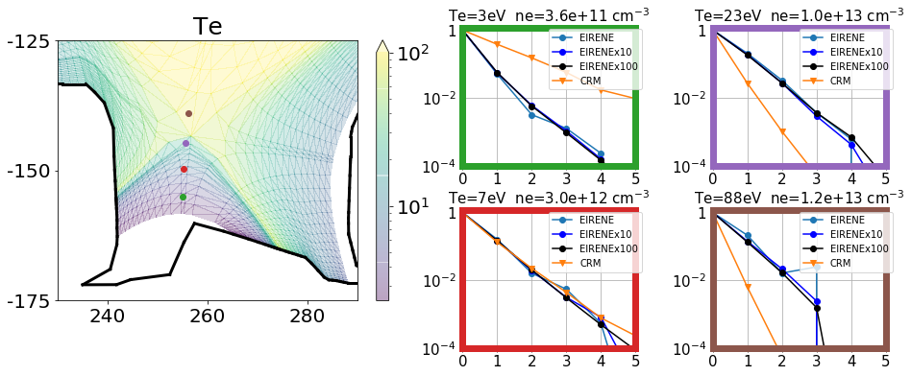



Standalone CRM vs EIRENE – 1 (statistic issues)
EIRENE: 793’300 histories
EIRENEx10: 7’933’000 histories
EIRENEx100: 79’330’000 histories
Simulations: SOURCE v=0
CRM overestimates excited state population at low temperature
$$\text{n}\text{ν}\text{/}\text{n}\text{0}$$
$$\text{n}\text{ν}\text{/}\text{n}\text{0}$$
CRM underestimates excited state population at large temperature
$$\text{n}\text{ν}\text{/}\text{n}\text{0}$$
$$\text{n}\text{ν}\text{/}\text{n}\text{0}$$

Slide 23
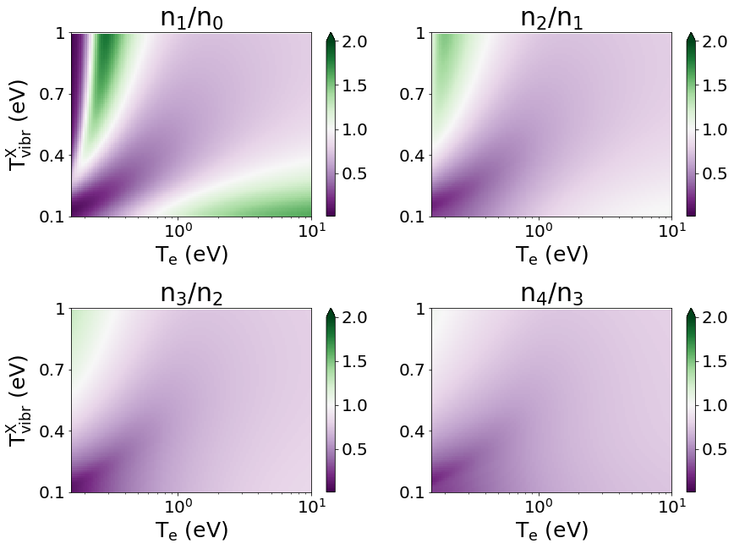
EXCITED MOLECULAR STATES
Model for excited states on top of ground state distribution:
d ³Π_{u}
population coeff. excited state d ³Π_{u}:
n_{i} = n(d,ν=i)
ν = 5
ν = 4
ν = 3
ν = 2
ν = 1
ν = 0
a ³Σ_{g}
spont.
decay
e-impact exc.
Fantz
Wünderlich ADT 2006
MCCC database:
Scarlett ADT 2021
X
ν = 5
Boltzmann distr. T_{vibr}
ν = 4
ν = 3
ν = 2
ν = 1
dissociat./ ionization
ratio of Fulcher band intensities as a proxy for ground state vibr. distribution
SOURCE
ν = 0

Slide 24
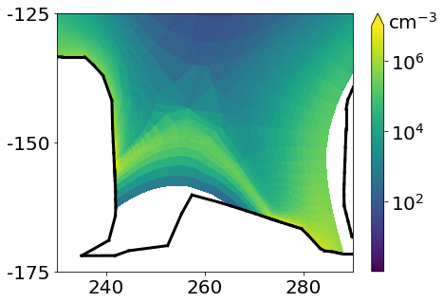

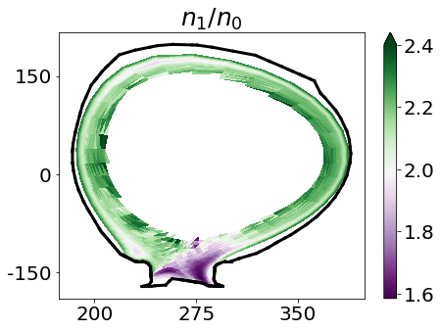
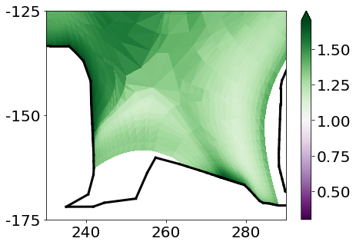
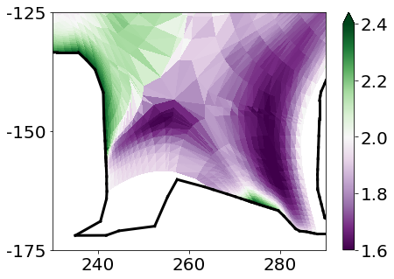
EIRENE: excited molecular states in divertor
Hydrogen (H)
Deuterium (D)
Vibrostate population ratio - 2D distribution
excited
state
d ³Π_{u}:
Vibro-
state
popu-lation
ratio
n₁/n₀:
divertor population coefficients≃1.2
divertor population coefficients≃1.6

Slide 25
Standalone CRM Ploutos: what is inside?..
Earlier known as “HydKin”
CRM solver (transport excluded, pure A&M side of the problem) with extensive features
  Stationary and non-stationary solution (assuming velocity and plasma pars)
  Any specie can be treated as “Reservoir”
  “Spectral analysis” based on eigenvalue approach (which reactions are most important?)
  Sensitivity analysis – vary the plasma parameters, solver settings, reactions, etc.
Plotting, solver results visualisation
  Useful for fast consistency checks and trivial analysis while constructing the CRMs
  Good for physics analysis in case one follows established routines
Flexible reaction tables interconnected with the solver and plotting
  Optimised for consistency checks and trivial analysis while constructing the CRMs
  Input/output in various formats (new: JSON) including directly for EIRENE
  Critical things are highlighted, level of information detail controlled by the user.
  Data is grouped by the reactions (even if from various sources).
  Standard or custom initial configurations
Power of web-based
Interface!

Slide 26
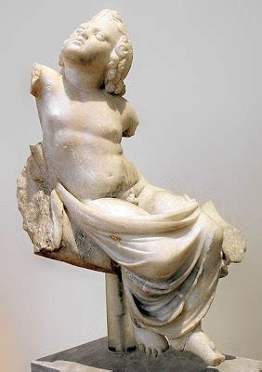
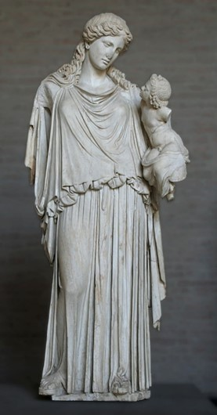
PLOUTOS can be used to
www.eirene.de
to import/export data (JSON, tabular, etc.)
to produce input data for EIRENE and for other codes with CRMs
  ➔ load/improve/save the developed configuration (selected reactions and parameters) including starting from the standard pre-sets
to check data for consistency and abnormal features
do sensitivity studies:
  ➔ understand A&M side of the problem and identify the most significant processes (among the selected ones)
Both statues are at
Glyptothek, Munich.
EIRENE

Slide 27
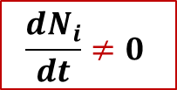
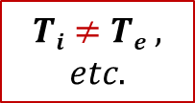

New CRM Solver for EIRENE concepted
This CRM is aimed to precompute rate coefficients accounting for all parametric dependences (n_{e}, T_{e}, but also T_{i}, …) in contrast with currently used polynomial fits (AMJUEL, …) + add a number of levels/processes not accounted for at this time
The internal states (e.g. rovibrational states in molecular species) are to be tracked with a flexible a flexible control over this resolution (as separate specie or variable).
The nonstationary solution for balance equations should be the default one
(with the stationary only as a useful option).
The solver should be modular, thus usable standalone or even in various codes.
The improved A&M data input should be readable and structured (for starters JSON, potentially also HDF5). It should be pre-processed mostly automatic and easily exchanged with other codes and tools. We need tools for visualisation and testing.
  The only way to meet the exploding amounts of data from RMPS and CCC for molecules (with resolution by rovibrational states)
  IAEA GNAMPP assists, but also reveals the challenges
$$Ti≠Te ,$$
$$etc.$$
$$\frac{dN_{i}}{dt}≠0$$
$$Why not$$
$$also ERO?..$$
Not only performance and reliability to be improved, but additional physics can be provided!

Slide 28
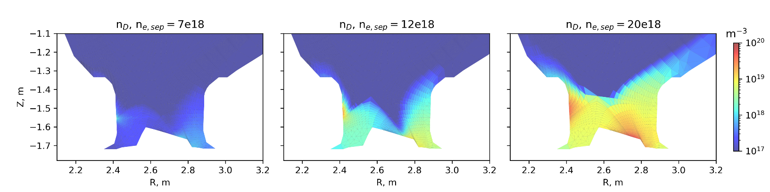
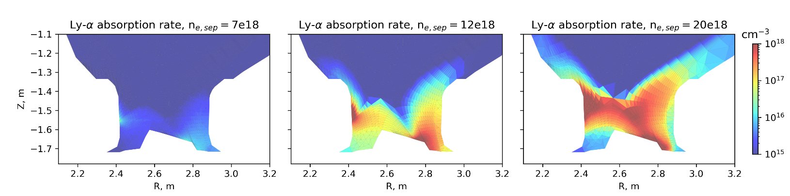
Ly-α and Ly-β opacity -1 (R.Chandra, M.Groth - Aalto)
low-recycling high-recycling detached
Ly-α and Ly- β absorption
➔ extra ionisation
➔ increases population of excited D neutrals
$$S_{eff}=S_{(1)}+\sum_{p}{\left(C_{(1,p)}−R_{1\left(p\right)}(F_{\left(p,1\right)}+\frac{A_{1}}{n_{e}})\right)+\sum_{p}{\left(Γ_{(1,p)}−R_{ext\left(p\right)}(F_{\left(p,1\right)}+\frac{A_{1}}{n_{e}})\right) }}$$
JET81472 D+Be
EDGE2D-Eirene
Eff. Ionization rate from collisional-radiative process
Eff. Ionization rate from photon absorption

Slide 29
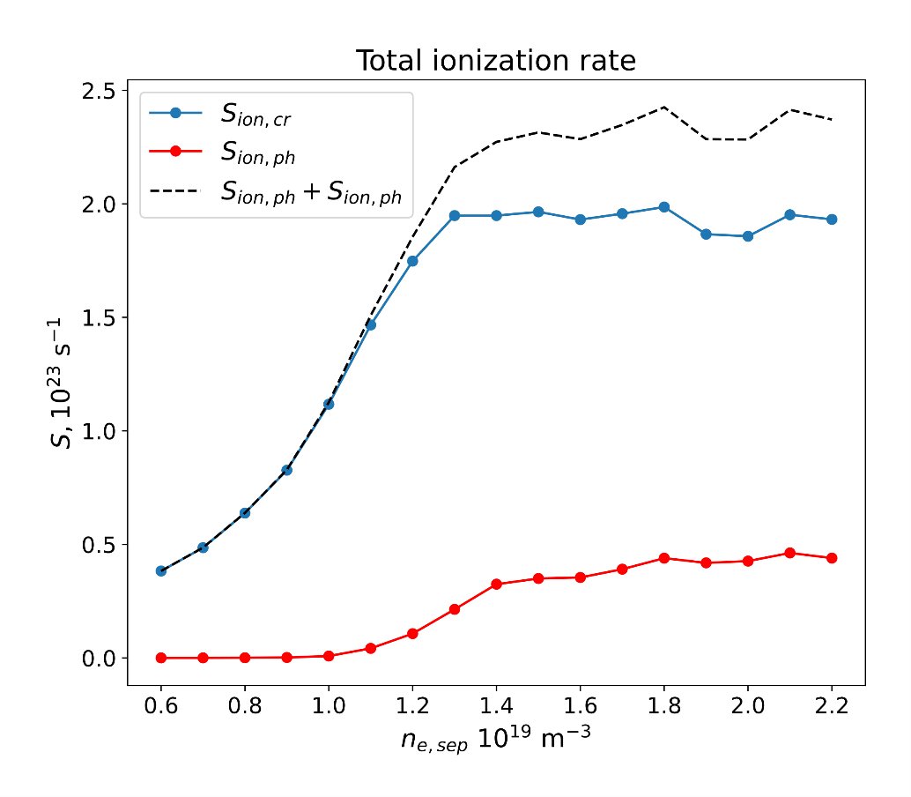

Ly-α and Ly-β opacity -2 (R.Chandra, M.Groth - Aalto)
Photon absorption adds up to ~20% of total CR ionization rate in detached conditions
Ionization rate integrated over the whole plasma volume
No effect in low recycling regimes
New plasma solution required with modified S_{ion} → future coupling to plasma codes

Slide 30
Summary: TSVV-5 progress and plans
Physics
  Fluid-kinetic hybridisation (FKH) development successfully continues
  A&M CRM extension and refinement (large focus on standalone so far…)
  Establishing simulation cases (validation, ITER, DEMO) – in progress
Code development
  Parallelisation: OpenMP-MPI hybrid (related code refactoring done; EIRON “toy”-model allows testing CPU loading and domain decomposition approaches)
  Code streamlining (Segregation of the numeric core, etc.) – concepted
  Merging all existing versions into first milestone one (MsV) – 99% complete
  Improved I/O (JSON/HDF5), visualisation, IMASification, etc. – in progress
Organisational items
  Repository for simulations (EUDAT?..) – TSVV side is clear, waiting for ACH support.
  New EIRENE license, “infectious open source”, flexible for later updates - available at www.Eirene.de/EPL, accepting ongoing
  Regular VCs and annual Code Camps – next agreed NOV 2023
Requires communication with other TSVVs
Requires ACH support

Slide 31
TSVV-5: IMS WP for 2021
A dedicated event similar to a code camp for a short circle of the involved developers is necessary to start over with the code leaning. The concerting including selection of particular coding techniques, code reorganization schemes etc will begin already by the preparation of this event and will continue after it with application to a single case to be selected.
The structured list of the "portfolio" cases is already developed as a draft to be reviewed and finalized by the task members during the year. We expect the ACH D to provide assistance in organising the commonly accessible and linkable to HPC resources catalogue of the simulations (e.g. EUDAT-based).
The FEM FW model should be coded and tested by first application to a selected MAGNUM-PSI experiment.
Also establishing the work on the CRM improvement and FKH is expected: definition of the related simulation cases, incorporating new data formats and parameters for CRMs, agreeing on “test bed” cases for FKH approaches etc. This needs status review at regular task meetings.
Assessment of fundamental data (cross-sections and rates) in AMJUEL (AMJUEL, HYDHEL, H2VIBR) against fundamental data used by and derived from other CRMs (e.g., YACORA) using slab models will take place. Development/exploitation of CRM post-processing tools for comparison to JET and MAGNUM-PSI experimental data (e.g., Fulcher band measurements). Assessment of availability of fundamental data for hydrogen isotopes and compare cross-sections and rates.
Code Camp 2021
TSVV-5 requirements and focus group are clear . . .
Ploutos web-based tool

Slide 32
TSVV-5: IMS WP for 2022
Theory/algorithmic development work on FKH combined with application to verification (mostly slab) cases: generalization AFN model for drifts and n-n collisions; Overview and assessment of techniques to reduce bias, cancellation and modelling errors; etc.
Coding and data management effort on CRMs: new molecular data formats (e.g. ADAS “mdf”) and recent RMPS or CCC data including for various H/D/T isotopes; move on using the IMAS; compile ITER/DEMO-relevant data. A contact with data providing groups for instance through the framework provided by the IAEA A&M data unit (GNAMPP).
Code reorganisation: test correctness of the “starter-core” modular EIRENE-NGM version for various geometries. Continue applying the modulated version to further CI and “portfolio” cases, provide necessary bug fixes and code generalisations.
Start over with HPC-related optimisation for the core (load balancing schemes, domain decomposition etc). Some ACH support is expected in particular for HPC code-performance optimisation.
Execute SOLPS-ITER with vibrationally excited hydrogen molecules for and assess their impact on the state of the divertor plasma (JET L-mode). Assess impact of hydrogen isotopes on state of divertor plasma. Utilise CRM post-processors to predict spectroscopic signature of molecules (Fulcher band), for hydrogen, deuterium and tritium.
Assess state of photon tracing model in current EIRENE version, reactivate photon tracing model in standalone EIRENE simulations, execute simple test runs (slab) and actual tokamak geometries (JET).
Goals redefined
EIRON
toy-model

Slide 33
TSVV-5: IMS WP for 2023 (still ongoing!..)
Begin with development of the universal framework for the CFD-EIRENE and other interfaces (e.g. with codes inside TSVV-3, 4, 7). Demonstrate workable schemes on particular examples.
Provide adjoint (AD) approach in Eirene through interfacing with Tapenade in for-/back- ward AD mode. Assess bottlenecks for use of AD with EIRENE, focusing on the context of SOLPS-ITER.
Demonstrate time-dependent simulations for the new modular code including the new features (FKH, CRMs). Consider algorithmic improvements (including theory work if needed) to optimise the performance for the time-dependent runs.
Apply modular EIRENE-NGM with the new version FEM for the FW to MAGNUM-PSI: simulate MAGMUM-PSI plasmas with various degree of detachment as independent snap shots. Validate those with spectroscopy and other diagnostics. Assess performance and other requirements for related time-dependent runs.
Setbacks due to COVID, colleagues missing or changing field etc. Some items were reached later than initially planned.
EIRON, PLOUTOS, Code Camps, MsV, established work with ACHs and ITER, EPL, new www.Eirene.de, joining with IAEA GNAMPP,….

Slide 34
Thanks for the attention!

Slide 35
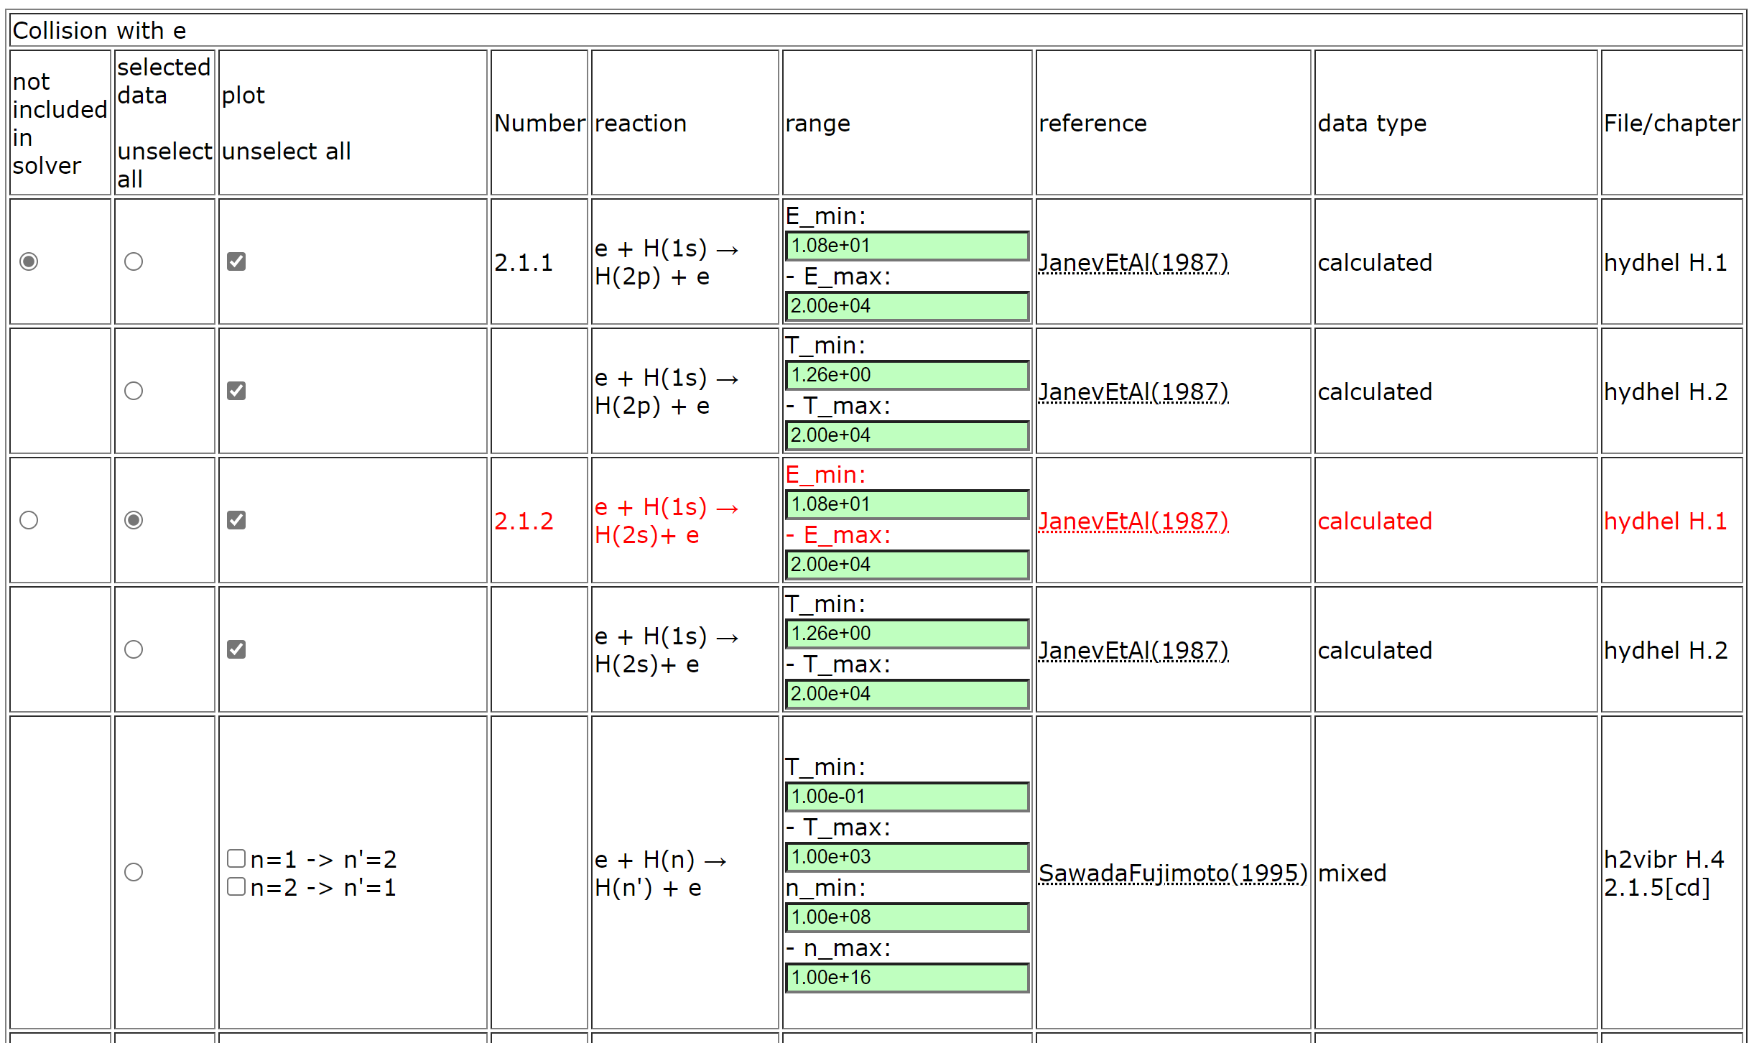
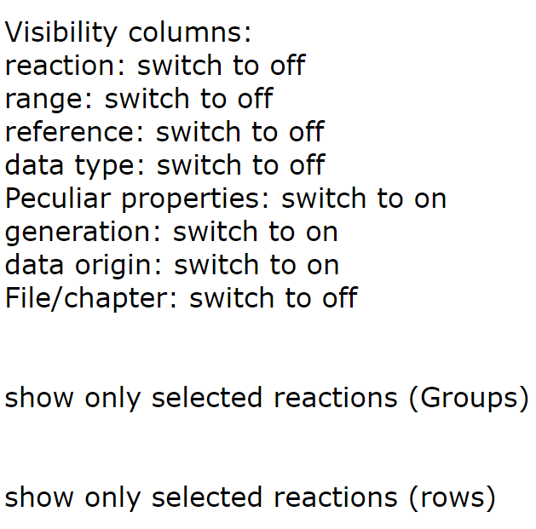
PLOUTOS – (H₂ 2022/23 case)
Buttons to adjust table content

Slide 36
DIFFER contribution (mostly J.Gonzalez, left the field)
Surface temperature from SOLPS-FEM (solid line) and pyrometer measurements at the target centre (dashed line) for different neutral pressures in the target chamber.
FEM model for PSI
(based on FreeFem++)
2) Simulations for Magmum-PSI
➔ Testing CRM data, reproducing density etc
➔ EIRENE vs EUNOMIA
3) General code development
➔ regrouping of main variables (data stuctures)

Slide 37
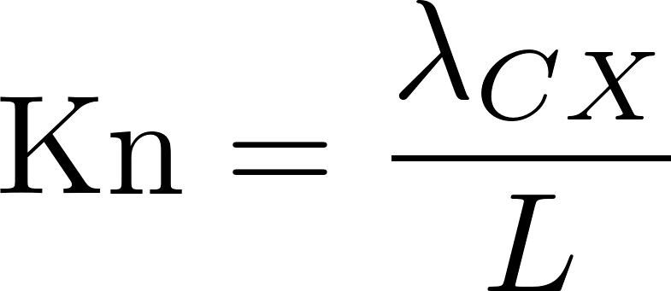
Rules of thumb – Knudsen number
average CX mean-free path of neutral atoms
macroscopic length scale of the problem
Rules of thumb:
Kn < 0.01 strict validity fluid approach
0.01 < Kn < 0.1 good validity fluid approach
0.1 < Kn < 1 transition to kinetic
Kn > 1 strong kinetic effects
Kn > 10 fully kinetic

