Slide 1
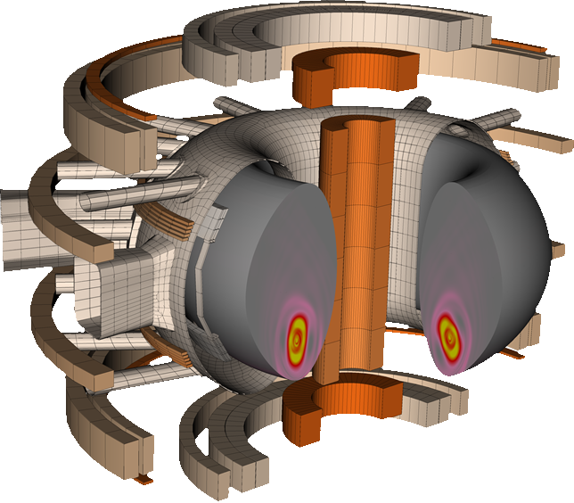
Midterm report for TSVV 8: MHD transients
Matthias Hoelzl for the project team

Slide 2
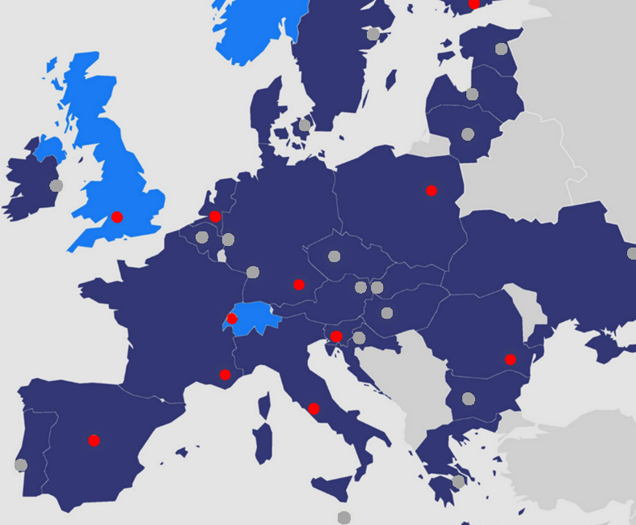
The TSVV 8 Team (at present)
Contributors (with and without funding):
Calin Atanasiu (IFA-NILPRP)
Marina Becoulet (CEA)
Daniele Bonfiglio (ENEA-RFX)
Andres Cathey (MPG)
Shimpei Futatani (CIEMAT-UPC)
Herve Guillard (CEA-INRIA)
Matthias Hölzl (MPG)
Guido Huijsmans (CEA)
Mengdi Kong (UKAEA→EPFL)
Sven Korving (DIFFER-TU/e)
Leon Kos (JSI-UNILJ)
Zhixin Lu (MPG)
Verena Mitterauer (MPG)
John Morris (UKAEA)
Boniface Nkonga (CEA-COTE D'AZUR)
Stanislas Pamela (UKAEA)
Guglielmo Rubinacci (ENEA-CREATE)
Nina Schwarz (MPG)
Weikang Tang (MPG)
Francesco Vannini (MPG)
Fabio Villone (ENEA)
Javier Artola (MPG) → now collaborating from IO
Oliver Bardsley (UKAEA)
Ashish Bhole (CEA-INRIA) → still collaborating
Alexandre Fil (UKAEA) → soon CEA/IRFM
Marta Gruca (IPPLM)
Isabel Krebs (DIFFER) → still collaborating
Sarah Sadouni (CEA)
Fabian Wieschollek (MPG)
ACH contributors:
Federico Cipolletta
Ludovic Fleury
Ihor Holod
Huw Leggate
JOREK community
TSVV 9
WP TE
ITER
AUG
JET
WP SA
TSVVs 10, 1, 4
DEMO
DTT
WEST
…
+
+

Slide 3
Main codes developed and used
JOREK
non-linear reduced & full MHD
hybrid and kinetic models
Disruptions, pedestal, core, SOL/divertor, turbulence
Neutrals, impurities, runaway electrons, energetic particles, …
STARWALL 3D thin resistive walls
CARIDDI 3D volumetric resistive walls
TRIMEG
GK full-device simulations
Advanced PiC methods

Slide 4
Work package structure
Models and verification
Work package Usability
Work package Numerics
Work package Kinetics
Methods

Slide 5
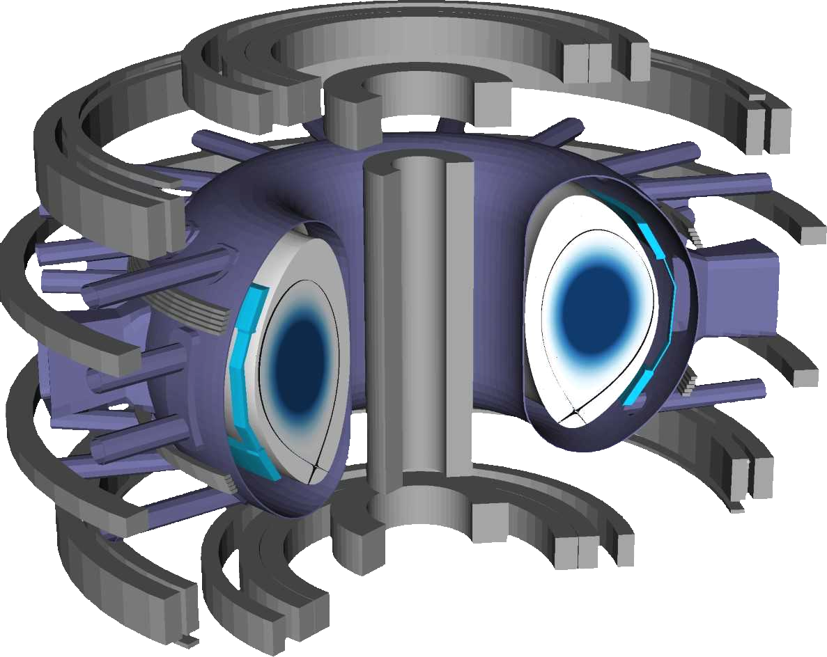
Work package structure
Work package ELMs
Work package Disruptions
Support of related work
Predictions
Reduced models
Understanding
Experiment interpretation
Validation against experiment
Models and verification
Work package Usability
Work package Numerics
Work package Kinetics
Methods

Slide 6
Work package Usability

Slide 7
Work package Usability (& management)
12% of funding
(incl. ACHs)
Selection of papers
Bold where 1st/2nd/3rd author is a project contributor
Conferences only included if no other reference available
Hoelzl M., Huijsmans G.T.A., Pamela S.J.P., Becoulet M., Nardon E., Artola F.J., Nkonga B., et al. The JOREK non-linear extended MHD code and applications to large-scale instabilities and their control in magnetically confined fusion plasmas. Nuclear Fusion 61, 065001 (2021)
Hoelzl M, Huijsmans GTA, Artola FJ, Nardon E, Becoulet M, Schwarz N, Cathey A, Pamela SJP et al. Non-linear MHD modelling of transients in Tokamaks: Recent advances with the JOREK code (to be presented at IAEA-FEC 2023 & to be submitted to Nuclear Fusion & on the pinboard)
(Various contribution to ITPA review articles)
Organize meetings
Three in person meetings including the international JOREK community – last one at ITER with 33 on site participants plus 23 remote
About ~50 meetings per year in person and remote
Coordinate code development for JOREK, STARWALL & CARIDDI_J with >>100 pull requests per year
Coordinate with int. community
Coordinate HPC access
Train new users and students
Administrate wiki, mailing lists, website
Document, report, review, …
IMASification (with ITER + ACH)
Combination of model extensions
Automatic code testing
↔ ITER, some contribution by ACH Poznan

Slide 8
Work package Numerics

Slide 9
Work package Numerics
20% of funding
(incl. ACHs)
Re-write of solver framework
New solver interfaces
BiCGstab solver
Non-linear time stepping
Grid center regularization
Compression for free boundary
Preconditioner for highly non-linear scenarios ►
Higher order FEs ►
Shock capturing ►
Holod I., Hoelzl M., Verma P.S., Huijsmans G.T.A., Nies R., JOREK Team. Enhanced preconditioner for JOREK MHD solver. Plasma Physics and Controlled Fusion 63, 114002 (2021) doi:10.1088/1361-6587/ac206b
Pamela S.J.P., Huijsmans G.T.A., Hoelzl M., JOREK Team. A Generalised Formulation of G-continuous Bezier Elements Applied to Non-linear MHD Simulations. Journal of Computational Physics , 111101 (2022) doi:10.1016/j.jcp.2022.111101
Bhole A., Nkonga B., Pamela S.J.P., Huijsmans G.T.A., Hoelzl M., JOREK Team. Treatment of polar grid singularities in the bi-cubic Hermite-Bézier approximations: Isoparametric finite element framework. Journal of Computational Physics 471, 111611 (2022) doi:10.1016/j.jcp.2022.111611
Bhole A., Nkonga B., Costa J., Huijsmans G.T.A., Pamela S.J.P., Hoelzl M. Stabilized bi-cubic Hermite Bézier finite element method with application to gas-plasma interactions occurring during massive material injection in tokamaks. Computers & Mathematics with Applications Volume 142, 225 (2023) doi:10.1016/j.camwa.2023.04.034
Symbols indicate that details are shown as highlight on one of the following slides
↔ close work with ACHs Garching & Barcelona

Slide 10
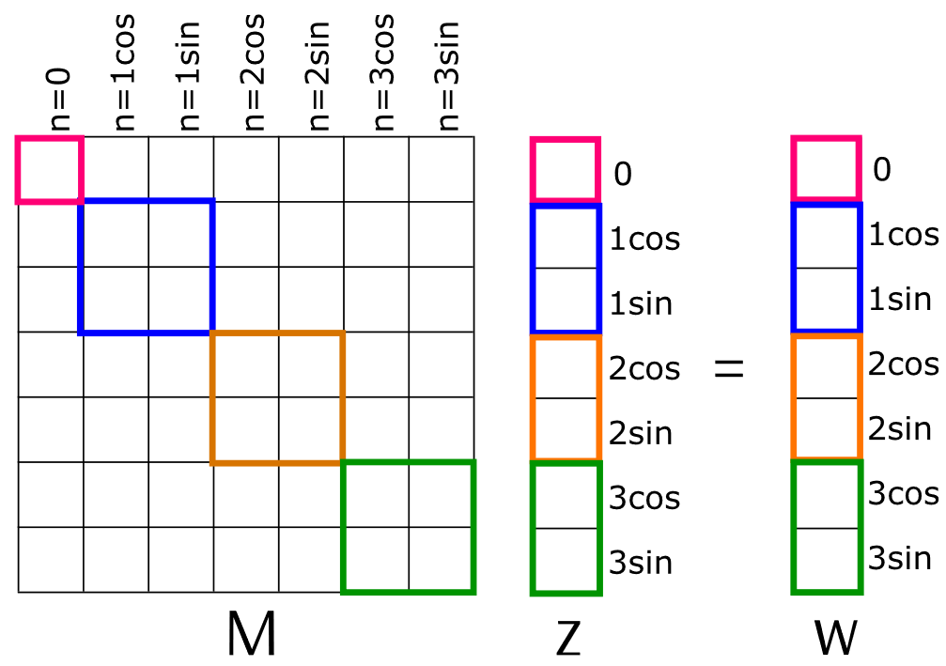
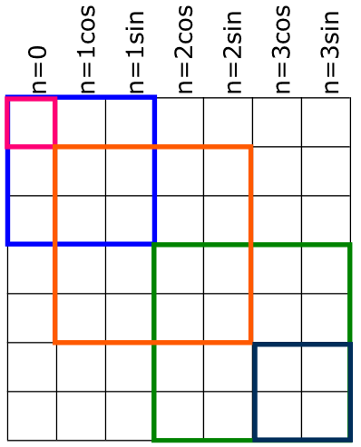
Highlight: Solver developments
Holod I., Hoelzl M., Verma P.S., Huijsmans G.T.A., Nies R., JOREK Team. Enhanced preconditioner for JOREK MHD solver. Plasma Physics and Controlled Fusion 63, 114002 (2021) doi:10.1088/1361-6587/ac206b
Implicit time stepping: Solve a sparse matrix system in every time step
Dimension ~40 million for a large problem with ~500 billion non-zero entries
Iterative solver
Preconditioner adapted to capture some of the non-linear interactions
Speed-up of ~3 for some applications, e.g., post-TQ ITER simulation with fully realistic parameters

Slide 11
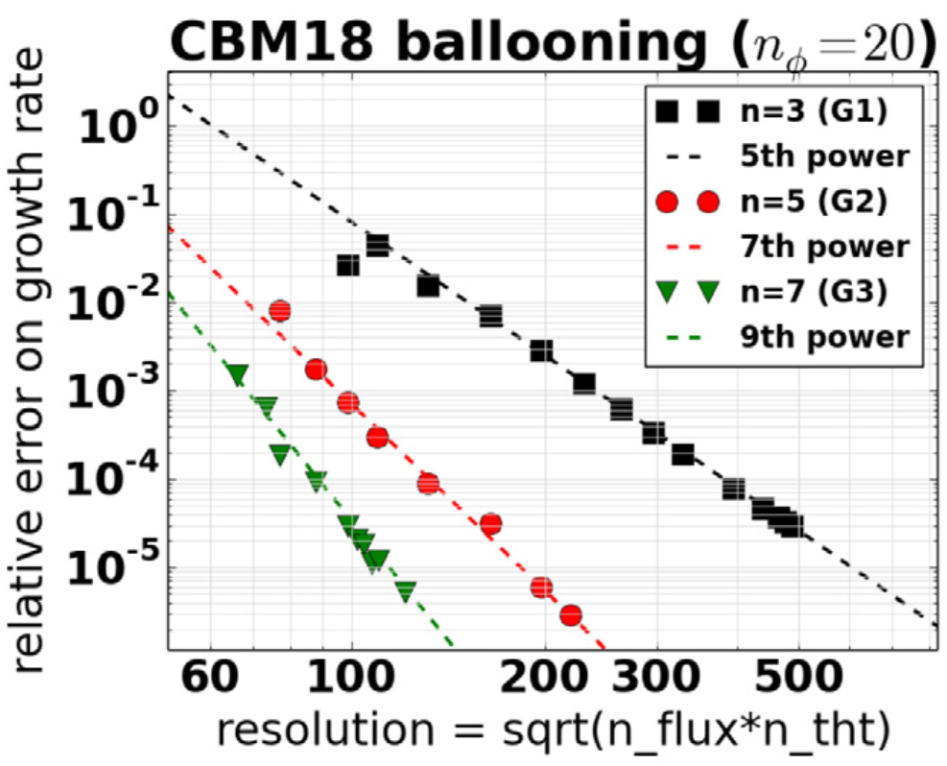
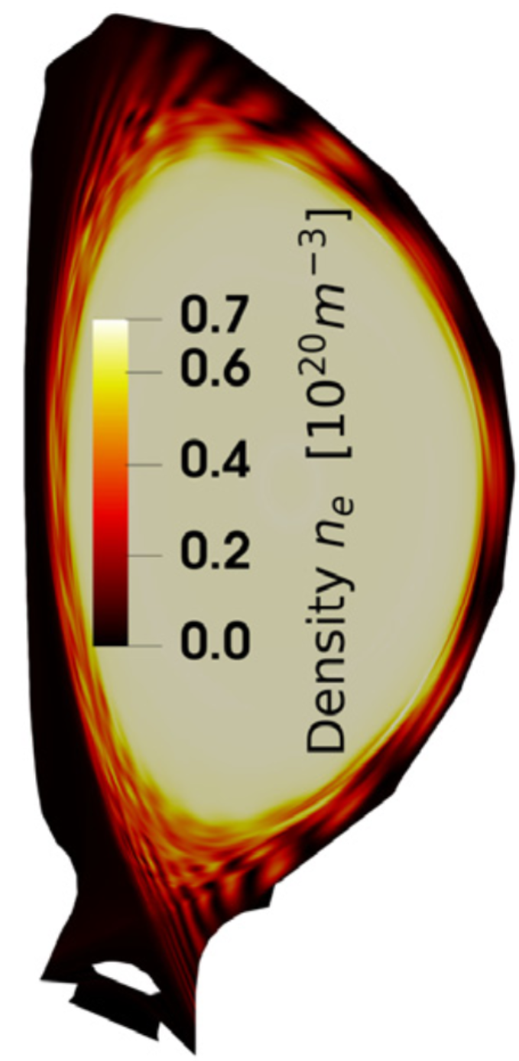
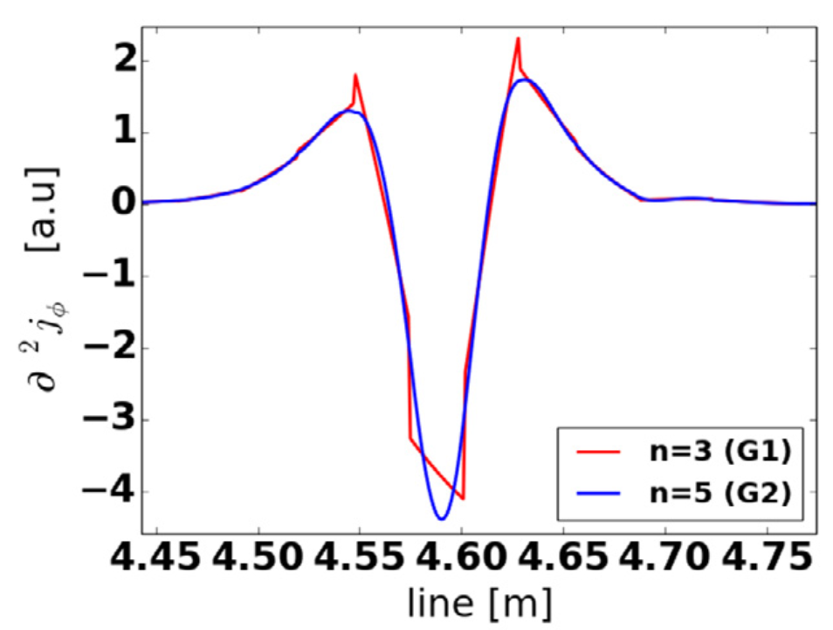
Highlight: Higher order finite elements
Pamela S.J.P., Huijsmans G.T.A., Hoelzl M., JOREK Team. A Generalised Formulation of G-continuous Bezier Elements Applied to Non-linear MHD Simulations. Journal of Computational Physics , 111101 (2022) doi:10.1016/j.jcp.2022.111101
Derivation and implementation of higher order Bezier finite elements

Slide 12
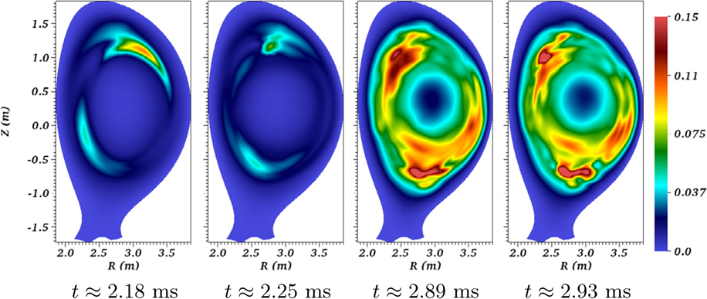
Highlight: Full MHD disruptions
Bhole A, Nkonga B, Costa J, Huijsmans GTA, Pamela SJP, Hoelzl M. Stabilized bi-cubic Hermite Bézier finite element method with application to gas-plasma interactions occurring during massive material injection in tokamaks. Computers & Mathematics with Applications Volume 142, 225 (2023) doi:10.1016/j.camwa.2023.04.034
Strongly improved full MHD including neutrals and impurities
Shock capturing for highly non-linear scenarios
Example: Mitigated disruption in JET

Slide 13
Work package
Kinetics

Slide 14
Work package Kinetics
11% of funding
Kinetic neutrals and impurities (see WG ELMs)
Kinetic MHD on the way
GK EM methods in TRIMEG ►
Electrostatic ITG and TEM ►
Energetic particle models►
Strien KA. Particle Model for Impurities in Magnetohydrodynamics Simulations of Shattered Pellet Injection. Master Thesis (2022). https://pure.tue.nl/ws/portalfiles/portal/210104346/0968579_Strien_K._MSc_thesis_report_MAP.pdf
Bogaarts TJ. Hybrid MHD-kinetic simulations of energetic particle driven instabilities in JOREK: development and applications. Master Thesis (2022). https://research.tue.nl/files/217976833/1000549_Bogaarts_T.J._MSc_thesis_Thesis_NF.pdf
Lu ZX., Meng G., Hoelzl M., Lauber Ph.The development of an implicit full f method for electromagnetic particle simulations of Alfven waves and energetic particles. Journal of Computational Physics 440, 110384 (2021)
Rosen M., Lu ZX., Hoelzl M. An E&B Gyrokinetic Simulation Model for Kinetic Alfven Waves in Tokamak Plasmas. Physics of Plasmas 29, 022502 (2022)
Bogaarts T.J., Hoelzl M., Huijsmans G.T.A., Wang X., JOREK Team. Development and application of a hybrid MHD-kinetic model in JOREK. Physics of Plasmas 29, 122501 (2022) doi:10.1063/5.0119435
Lu ZX, Meng G, Hatzky R, Hoelzl M, Lauber Ph. Full f and deltaf gyrokinetic particle simulations of Alfven waves and energetic particle physics. Plasma Physics and Controlled Fusion 65, 034004 (2023)
Rekhviashvili L., Lu ZX., Hoelzl M., Bergmann A., Lauber P. Gyrokinetic simulations of neoclassical electron transport and bootstrap current generation in tokamak plasmas in the TRIMEG code. Physics of Plasmas 30, 072103 (2023) doi:10.1063/5.0148138
Huijsmans GTA, Becoulet M, Lu ZX, JOREK Team. Comparing linear stability of electrostatic kinetic and gyro-kinetic ITG modes. EPS 2023 + to be submitted to PPCF
Becoulet M, Huijsmans GTA, Garbet X, Donnel P, Wang L, et al, Non-linear gyro-kinetic ITG and TEM turbulence modelling in X-point geometry with RMPs. EPS 2023
↔ exchange and collaboration with TSVVs 1, 4, 9, 10 & EnRs

Slide 15
Highlight: Efficient PiC methods
TRIMEG code
[1] Lu ZX, Meng G, Hoelzl M, Lauber Ph, Journal Comput. Phys. 440 (2021) 110384
[2] Rosen M, Lu ZX, Hoelzl M, Phys. Plasmas, 022502 (2022)
[3] Lu ZX, Meng G, Hatzky R, Hoelzl M, Lauber Ph, PPCF (2023)
[4] Rekhviashvili L., Lu ZX., Hoelzl M., et al, Physics of Plasmas 30, 072103 (2023)
Electromagnetic implicit full-$f$ PiC [1]
GK E&B model in torus derived & tested for challenging parameters [2]
Formulation and implementation of pullback-mixed variable scheme for $δf$ and full $f$ GK EM simulations [3]
Lorentz collisions for neoclassical electron transport & bootstrap current [4]
Ongoing: Field aligned FEs → multi-$n$ nonlinear simulations

Slide 16
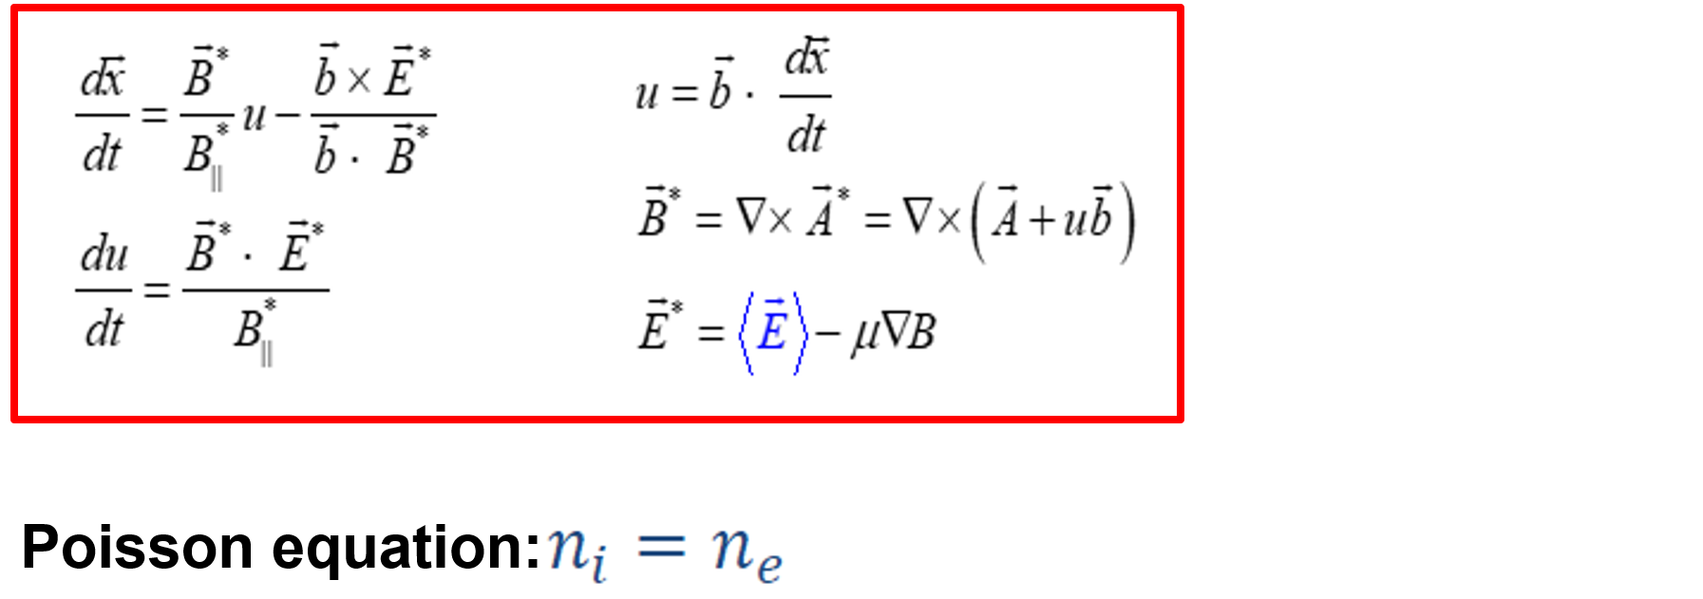
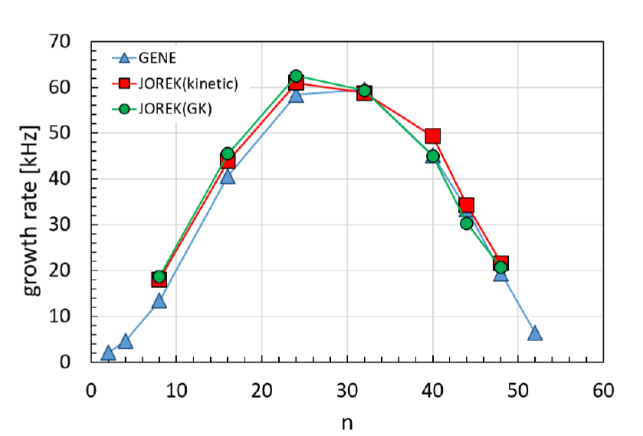
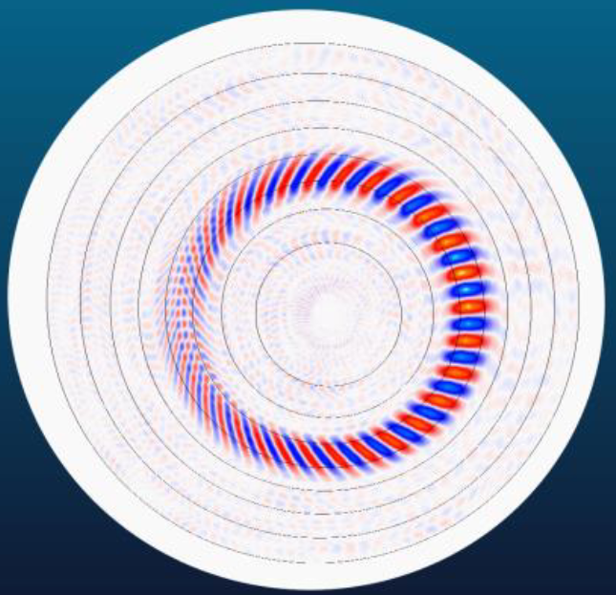
Highlight: ITG and TEM turbulence (1)
JOREK code
Huijsmans GTA, Becoulet M, Lu ZX, JOREK Team. Comparing linear stability of electrostatic kinetic and gyro-kinetic ITG modes. EPS 2023
Becoulet M, Huijsmans GTA, Garbet X, Donnel P, Wang L, et al, Non-linear gyro-kinetic ITG and TEM turbulence modelling in X-point geometry with RMPs. EPS 2023
(Heavy electrons: m_{i}/m_{e}=100)

Slide 17
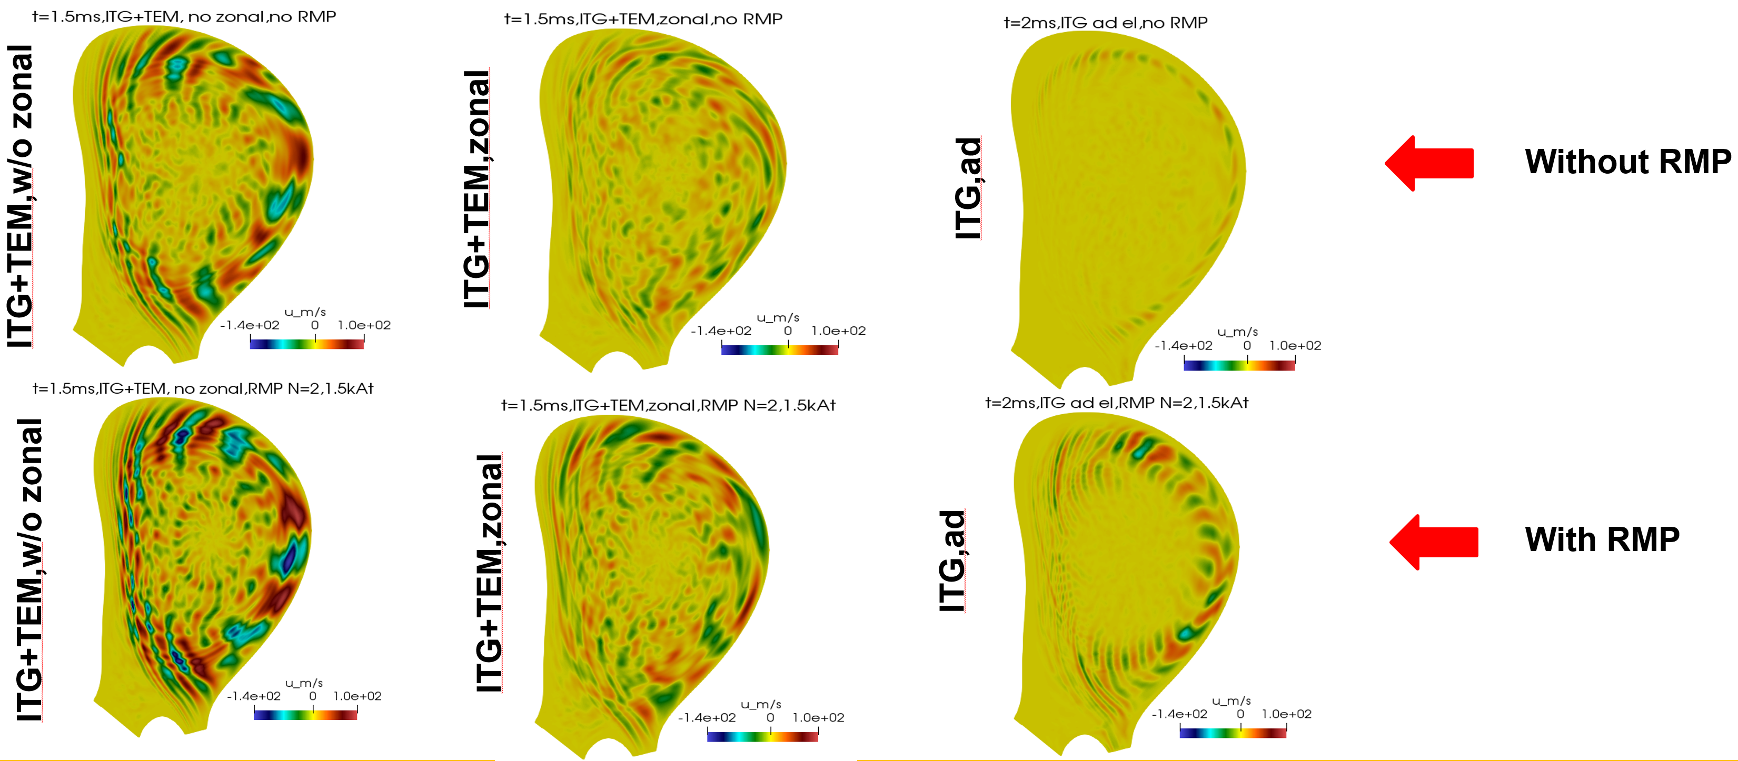
Highlight: ITG and TEM turbulence (2)
JOREK code
Huijsmans GTA, Becoulet M, Lu ZX, JOREK Team. Comparing linear stability of electrostatic kinetic and gyro-kinetic ITG modes. EPS 2023
Becoulet M, Huijsmans GTA, Garbet X, Donnel P, Wang L, et al, Non-linear gyro-kinetic ITG and TEM turbulence modelling in X-point geometry with RMPs. EPS 2023
COMPASS L-mode:
Larger turbulence in presence of RMP fields
TEM+ITG turbulence stronger than ITG only
↔ Discussed with TSVVs 1 and 4

Slide 18
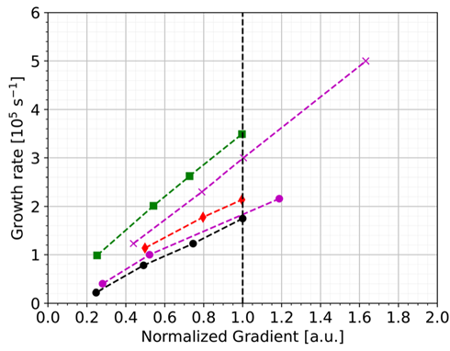
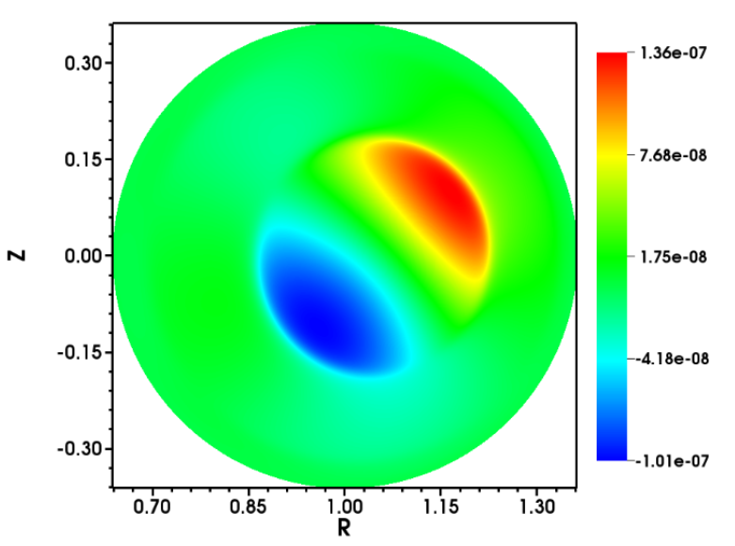
Highlight: Energetic particle model
JOREK code
Bogaarts T.J., Hoelzl M., Huijsmans G.T.A., Wang X., JOREK Team. Development and application of a hybrid MHD-kinetic model in JOREK. Physics of Plasmas 29, 122501 (2022) doi:10.1063/5.0119435
Antlitz F et al, in progress
Full-f PiC energetic particle model with anisotropic pressure coupling to reduced & full MHD
Benchmarked for TAEs (ITPA case)
Comprehensive phase-space diagnostics
AUG interpretative simulations for NLED case
Non-linear fishbone simulations on the way + New model with kinetic thermal ions in development
ORB5
JOREK (two variants due to full-f modelling)
MEGA
HYMAGYC
↔ Coordinated with TSVV 10

Slide 19
Work package ELMs

Slide 20
Work package ELMs
25% of funding
Cathey A. Non-linear magnetohydrodynamic simulations of edge localised modes (ELMs). PhD Thesis (2021). https://pure.mpg.de/rest/items/item_3344034_3/component/file_3344037/content
Mitterauer V. Non-linear simulations of the penetration of error fields into tokamak plasmas. master Thesis (2021). https://pure.mpg.de/rest/items/item_3347751_2/component/file_3347752/content
Meier L. Numerical simulations of the access to QH-Mode in ASDEX Upgrade. master Thesis (2022). https://pure.tue.nl/ws/portalfiles/portal/268417590/1498509_Meier_L.D._MSc_thesis_report_NF.pdf
Futatani S, Cathey A, Hoelzl M, et al. Transition from no-ELM response to pellet ELM triggering during pedestal build-up - insights from extended MHD simulations.. Nuclear Fusion 61, 046043 (2021) doi:10.1088/1741-4326/abdfb4
Cathey A., Hoelzl M., Futatani S., Lang P.T., Lackner K., et al. Comparing spontaneous and pellet-triggered ELMs via non-linear extended MHD simulations. PPCF 63, 075016 (2021) doi:10.1088/1361-6587/abf80b
Becoulet M., Huijsmans G.T.A., Passeron C., Liu Y.Q., Evans T.E., et al. Non-linear MHD modelling of edge localized modes suppression by resonant magnetic perturbations in ITER. Nuclear Fusion 62, 066022 (2022) doi:10.1088/1741-4326/ac47af
Cathey A., Hoelzl M., Harrer G., Wolfrum E., Lackner K., et al. MHD simulations of small ELMs at low triangularity in ASDEX Upgrade. Plasma Physics and Controlled Fusion 64, 054011 (2022) doi:10.1088/1361-6587/ac5b4b
Kim S.K., Pamela S., Logan N.C., Na Y.-S., Lee C.Y., et al. Nonlinear MHD modeling of n = 1 RMP-induced pedestal transport and mode coupling effects on ELM suppression in KSTAR. Nuclear Fusion 62, 106021 (2022) doi:10.1088/1741-4326/ac84ef
Isliker H, Cathey A, Hoelzl M, Pamela SJP, Vlahos L. Filamentary plasma eruptions and the heating and acceleration of electrons. Physics of Plasmas 29, 112306 (2022) doi:10.1063/5.0115754
Mitterauer V., Hoelzl M., Schwarz N., Artola J., Willensdorfer M., et al. Non-linear free boundary simulations of the plasma response to resonant magnetic perturbations in ASDEX Upgrade plasmas. Journal of Physics: Conference Series 2397, 012008 (2022) doi:10.1088/1742-6596/2397/1/012008
Korving S.Q., Huijsmans G.T.A., Park J.-S., Loarte A., JOREK Team. Development of the neutral model in the nonlinear MHD code JOREK: Application to ExB drifts in ITER PFPO-1 plasmas. Physics of Plasmas 30, 042509 (2023) doi:10.1063/5.0135318
Cathey A, Hoelzl M, Gil L, Dunne MG, Harrer GF, et al, EUROfusion MST1 Team. Probing non-linear MHD stability of the EDA H-mode in ASDEX Upgrade. Nuclear Fusion 63, 062001 (2023) doi:10.1088/1741-4326/acc818
Meier L, Hoelzl M, Cathey A, Huijsmans GTA, Viezzer E, et al. MHD simulations of formation, sustainment and loss of Quiescent H-mode in the all-tungsten ASDEX Upgrade. Nuclear Fusion 63, 086026 (2023) doi:10.1088/1741-4326/acd5e2
Kim S.K., Logan N.C., Becoulet M., Hoelzl M., Hu Q., Huijsmans G.T.A., Pamela S., Yu Q., Yang S.M., Kolemen E., Park J.-K. Bifurcation in particle transport under resonant magnetic perturbations in a tokamak. Nuclear Fusion (accepted) doi:10.1088/1741-4326/acef3c
Wang H H, Becoulet M, Sun Y-W, Huijsmans GTA et al. Nonlinear simulation on edge localized mode mitigation using n=1 and n=4 resonant magnetic perturbations in EAST. Physics of Plasmas (submitted)
Willensdorfer M, Mitterauer V, Hoelzl M, Suttrop W, et al. Magnetic islands in 3D tokamak plasmas during suppression of edge localised modes. Nature Physics (submitted)
RMP ELM suppression in ITER
RMP density pump-out
ITG & TEM turbulence with RMPs (see WP kinetics)
ELM electron acceleration
SOL/divertor models ►
Pellet-ELM triggering ►
Free boundary RMPs ►
Island at pedestal top ►
Small ELMs►
QH-mode ►
↔ close work with WPs TE & SA, AUG

Slide 21
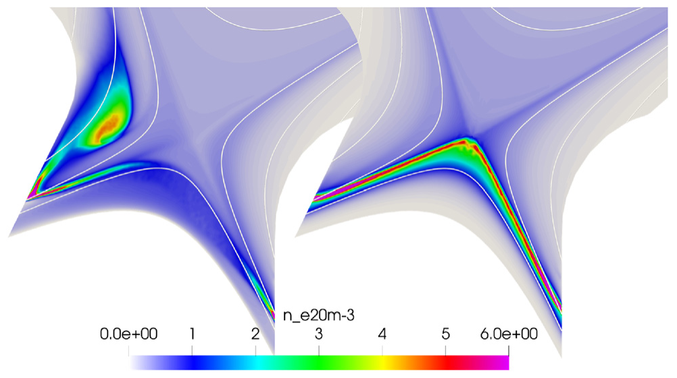
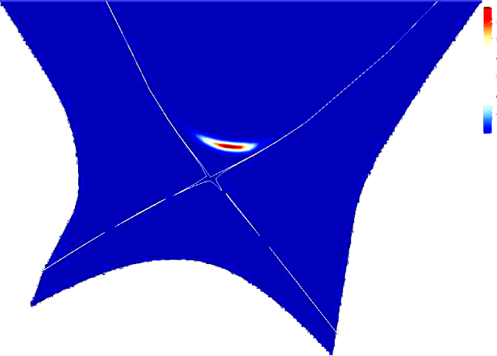
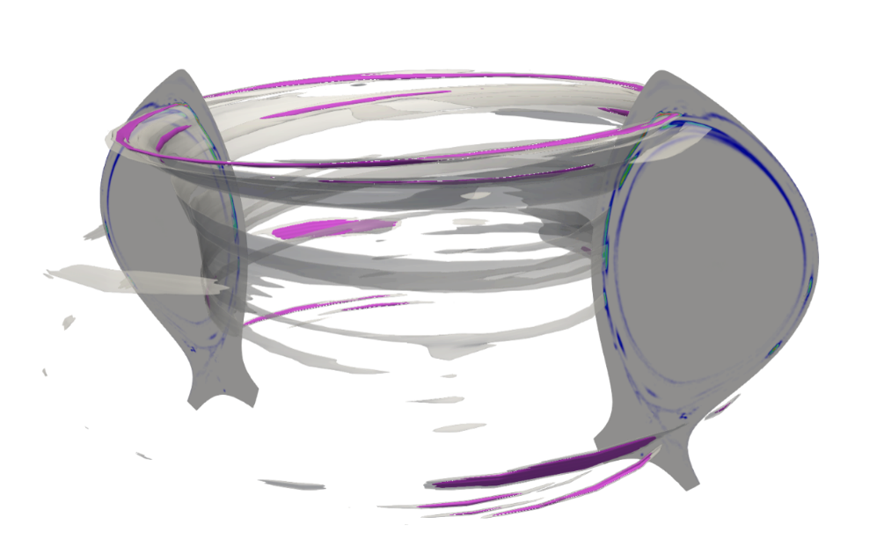
Highlight: SOL & divertor modeling
Korving SQ, Huijsmans GTA, Park J-S, Loarte A, JOREK Team. Development of the neutral model in the nonlinear MHD code JOREK: Application to ExB drifts in ITER PFPO-1 plasmas. Physics of Plasmas 30, 042509 (2023) doi:10.1063/5.0135318
Koving SQ, Huijsmans GTA, Mitterauer V, Loarte A et al. Simulation of neoclassical heavy impurity transport in AUG with applied 3D magnetic fields with the nonlinear MHD code JOREK. EPS 2023
van Tongeren J et al, master thesis (ongoing)
Kinetic neutrals and impurities implemented incl. collisions for neoclassics (molecular physics under development)
Benchmarked to SOLPS-ITER
Preliminary result
tungsten transport with RMPs in AUG
X-point radiator in AUG
HFSHD in ITER (and AUG on the way)

Slide 22
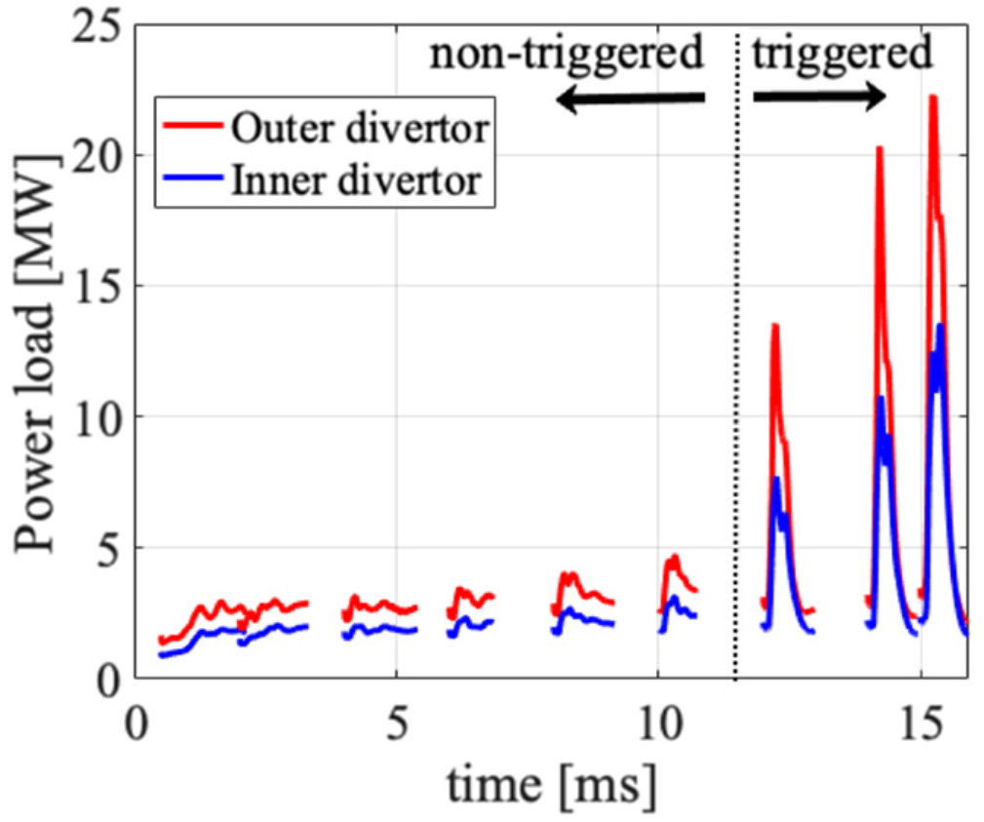
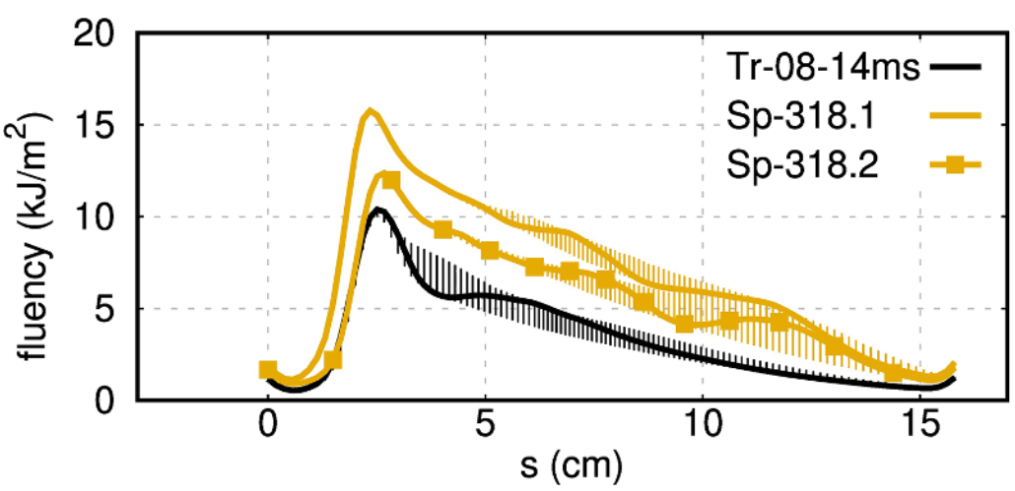
Highlight: Pellet ELM triggering
Futatani S, Cathey A, Hoelzl M, et al. Transition from no-ELM response to pellet ELM triggering during pedestal build-up - insights from extended MHD simulations.. Nuclear Fusion 61, 046043 (2021) doi:10.1088/1741-4326/abdfb4
Cathey A., Hoelzl M., Futatani S., Lang P.T., Lackner K., Huijsmans G.T.A., Pamela S.J.P., Günter S., JOREK Team, ASDEX Upgrade Team, EUROfusion MST1 Team. Comparing spontaneous and pellet-triggered ELMs via non-linear extended MHD simulations. PPCF 63, 075016 (2021) doi:10.1088/1361-6587/abf80b
AUG pellet simulations with realistic parameters and plasma flows reproduce experimental inter-ELM lag-time during which ELM triggering is not possible
Pellet-triggered ELMs are smaller, but with narrower deposition leading to moderate peak heat flux mitigation

Slide 23
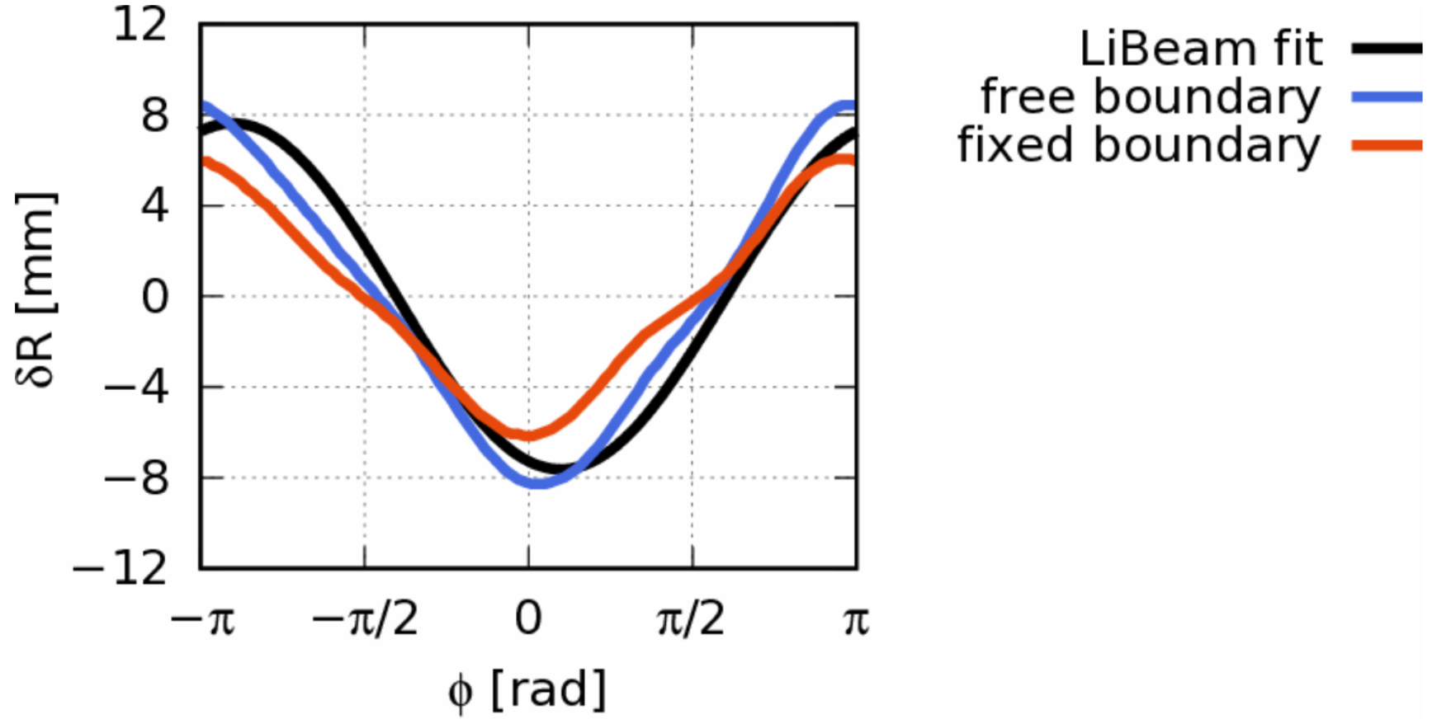
Highlight: Free boundary RMPs
Mitterauer V., Hoelzl M., Schwarz N., Artola J., Willensdorfer M., Dunne M., JOREK Team, ASDEX Upgrade Team, EUROfusion MST1 Team. Non-linear free boundary simulations of the plasma response to resonant magnetic perturbations in ASDEX Upgrade plasmas. Journal of Physics: Conference Series 2397, 012008 (2022) doi:10.1088/1742-6596/2397/1/012008
Self-consistent RMP model includes the plasma response up to the simulation boundary
Validated against AUG
Allows to capture external kink response accurately
Free boundary
Fixed boundary

Slide 24
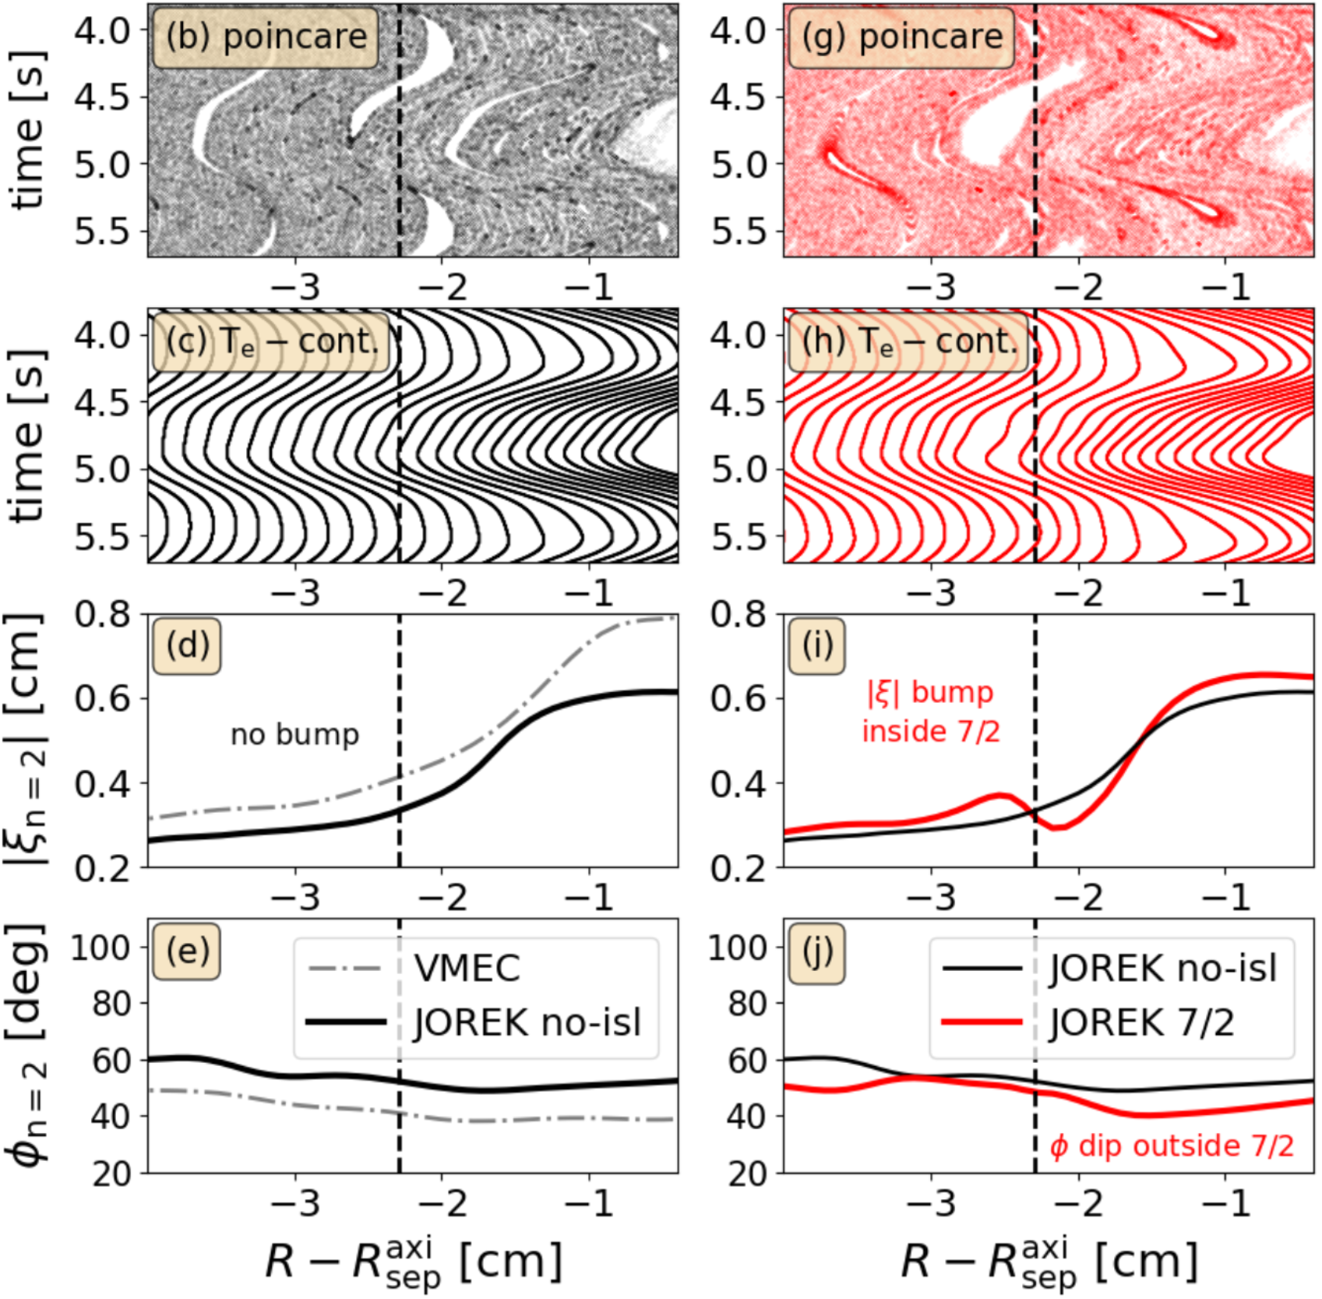
Highlight: Pedestal Island w/ RMPs
Willensdorfer M, Mitterauer V, Hoelzl M, Suttrop W, et al. Magnetic islands in 3D tokamak plasmas during suppression of edge localised modes. Nature Physics (submitted)
Not penetrated
Penetrated
First of a kind evidence for a 7/2 island at the pedestal top in RMP ELM suppression at AUG
JOREK simulations reproduce the corresponding “bump” in the displacement for penetrated islands

Slide 25
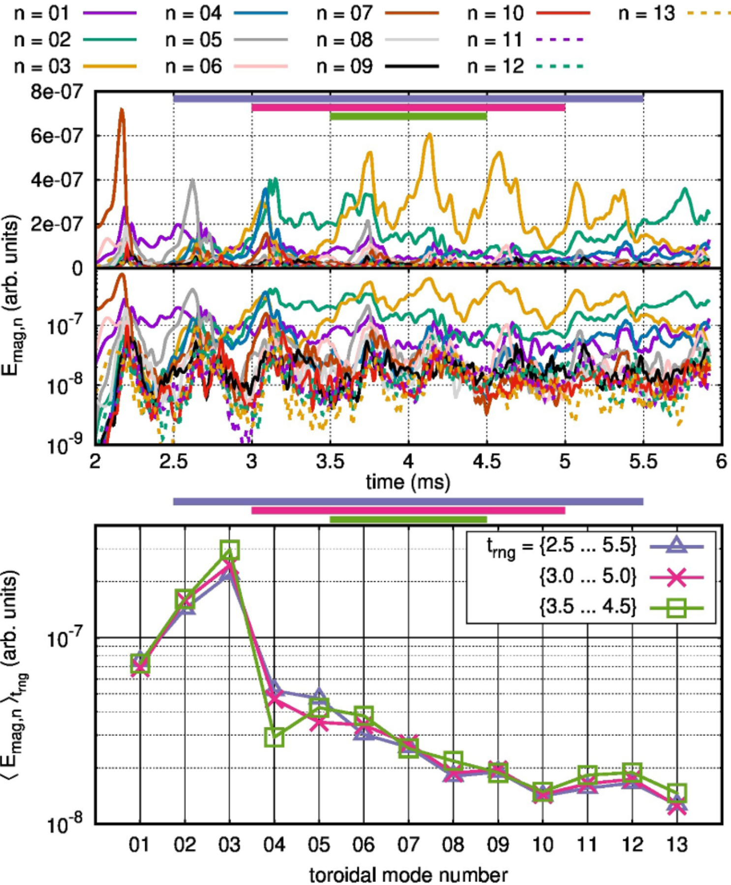
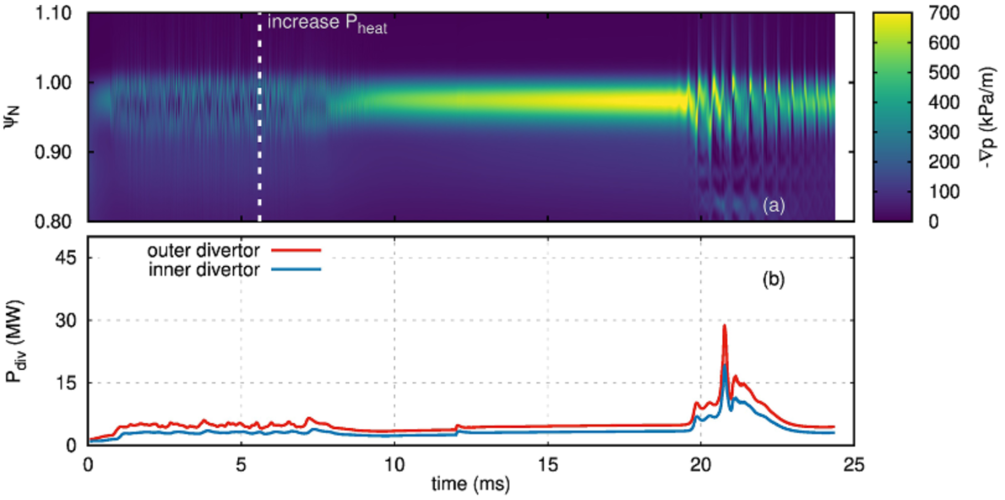
Highlight: Small-ELM regimes
Cathey A., Hoelzl M., Harrer G., Wolfrum E., Lackner K., et al. MHD simulations of small ELMs at low triangularity in AUG. Plasma Physics and Controlled Fusion 64, 054011 (2022) doi:10.1088/1361-6587/ac5b4b
Cathey A, Hoelzl M, Gil L, Dunne MG, Harrer GF,. Probing non-linear MHD stability of the EDA H-mode in ASDEX Upgrade. Nuclear Fusion 63, 062001 (2023) doi:10.1088/1741-4326/acc818
QCE in AUG: peeling-ballooning turbulence stops pedestal build-up to ELMs; transition to large ELMs at higher heating power or lower density (left)
EDA H-mode in AUG: Resistive ballooning mode turbulence; structure and rotation is comparable to experiment (right)

Slide 26
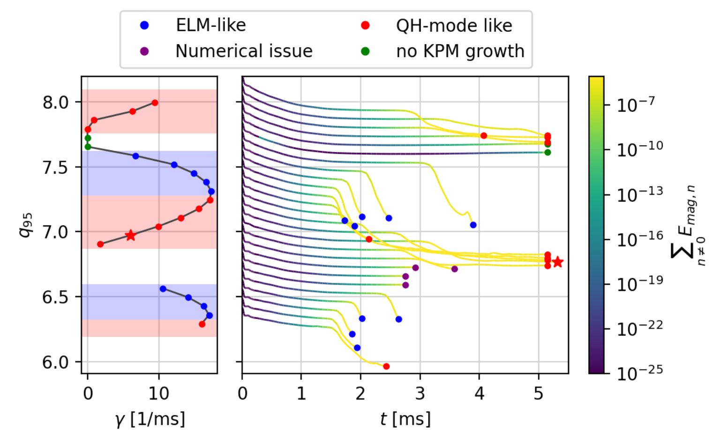
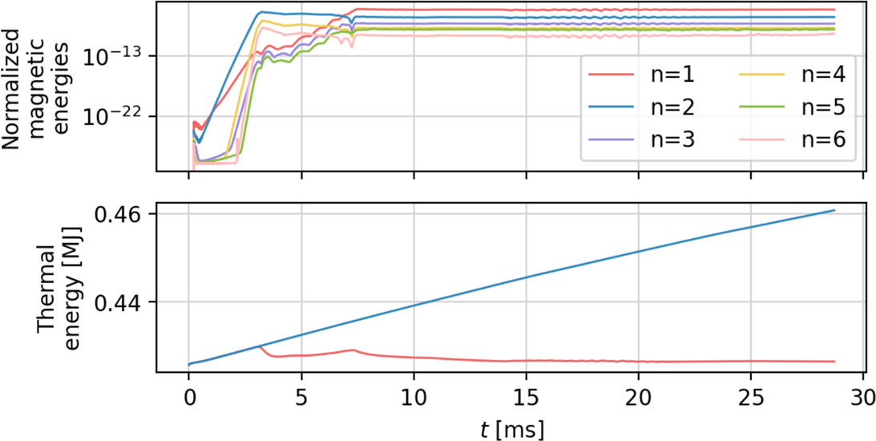
Highlight: ELM free QH-mode
Meier L, Hoelzl M, Cathey A, Huijsmans GTA, Viezzer E, Dunne M, van Dijk J. et al. MHD simulations of formation, sustainment and loss of Quiescent H-mode in the all-tungsten ASDEX Upgrade. Nuclear Fusion 63, 086026 (2023)
AUG QH-mode simulations reproduce experimental observations and provide insights into mechanisms
Saturated n=1 external kink modes
Edge harmonic oscillation in the density
q95 windows & non-linear q95 evolution contributes to saturation
Transition to ELMs at increased density & limit cycle oscillations

Slide 27
Work package Disruptions

Slide 28
Work package Disruptions
32% of funding
Wieschollek F. Non-linear Simulations of Natural and Mitigated Disruptions. PhD Thesis (subm.)
Hu D, Nardon E, Hoelzl M, Wieschollek F, Lehnen M,et al. Radiation asymmetry and MHD destabilization during the thermal quench after impurity shattered pellet injection. Nuclear Fusion 61, 026015 (2021) doi:10.1088/1741-4326/abcbcb
Bandaru V, Hoelzl M, Reux C, Ficker O, Silburn S, et al. Magnetohydrodynamic simulations of runaway electron beam termination in JET. Plasma Physics and Controlled Fusion 63, 035024 (2021) doi:10.1088/1361-6587/abdbcf
Reux C, Paz-Soldan C, Aleynikov P, Bandaru V, Ficker O, et al. Demonstration of Safe Termination of Megaampere Relativistic Electron Beams in Tokamaks. PRL 126, 175001 (2021) doi:10.1103/PhysRevLett.126.175001
Artola F.J., Loarte A., Matveeva E., Havlicek J., Markovic T., et al. Simulations of COMPASS vertical displacement events with a self-consistent model for halo currents including neutrals and sheath boundary conditions. PPCF 63, 064004 (2021) doi:10.1088/1361-6587/abf620
Artola F.J.,Sovinec C.R., Jardin S.C., Hoelzl M., Krebs I., Clauser C. 3D simulations of vertical displacement events in tokamaks: A benchmark of M3D-C1, NIMROD, and JOREK. PoP 28, 052511 (2021) doi:10.1063/5.0037115
Nardon E., Hu D., Artola F.J., Bonfiglio D., Hoelzl M., et al. Thermal quench and current profile relaxation dynamics in massive-material-injection-triggered tokamak disruptions. Plasma Physics and Controlled Fusion 63, 115006 (2021) doi:10.1088/1361-6587/ac234b
Hu D., Huijsmans G.T.A., Nardon E., Hoelzl M., Lehnen M., et al. Collisional-radiative non-equilibrium impurity treatment for JOREK simulations. Plasma Physics and Controlled Fusion 63, 125003 (2021) doi:10.1088/1361-6587/ac2afb
Wieschollek F., Hoelzl M., Nardon E., JOREK Team, ASDEX Upgrade Team, EUROfusion MST1 Team. On the role of preexisting MHD activity for the plasma response to massive deuterium injection. Physics of Plasmas 29, 032509 (2022) doi:10.1063/5.0075473
Artola F.J., Loarte A., Hoelzl M., Lehnen M., Schwarz N., JOREK Team. Non-axisymmetric MHD simulations of the current quench phase of ITER mitigated disruptions. Nuclear Fusion 62, 056023 (2022) doi:10.1088/1741-4326/ac55ba
Särkimäki K., Artola F.J., Hoelzl M. Confinement of passing and trapped runaway electrons in simulation of ITER current quench. Nuclear Fusion 62, 086033 (2022) doi:10.1088/1741-4326/ac75fd
Schwarz N, Artola FJ, Hoelzl M, Bernert M, Brida D, et al. Experiments and non-linear MHD simulations of hot vertical displacement events in ASDEX-Upgrade. Plasma Physics and Controlled Fusion 65, 054003 (2023) doi:10.1088/1361-6587/acc358
Nardon E., Särkimäki K., Artola F.J., Sadouni S.,et al. On the origin of the plasma current spike during a tokamak disruption and its relation with magnetic stochasticity. Nuclear Fusion 63, 056011 (2023) doi:10.1088/1741-4326/acc417
Hu D., Nardon E., Artola F.J., Lehnen M., Bonfiglio D., et al. Collisional-radiative simulation of impurity assimilation, radiative collapse and MHD dynamics after ITER Shattered Pellet Injection. Nuclear Fusion 63, 066008 (2023) doi:10.1088/1741-4326/acc8e9
Nardon E., Särkimäki K., Artola F.J., Sadouni S., JOREK Team, JET contributors. On the origin of the plasma current spike during a tokamak disruption and its relation with magnetic stochasticity. Physics of Plasmas 63, 056011 (2023) doi:10.1088/1741-4326/acc417
Schwarz N, Artola FJ, Vannini F, Hoelzl M, Bernert M, et al. The mechanism of the global vertical force reduction in disruptions mitigated by massive material injection. Nuclear Fusion (accepted) doi:10.1088/1741-4326/acf50a
Nardon E., Bandaru V., Hoelzl M., Artola F.J., the JOREK team, JET contributors. Non-linear dynamics of the double tearing mode. Physics of Plasmas (accepted)
Bandaru V, Hoelzl M. Tokamak equilibria with relativistic runaway electrons. Physics of Plasmas (accepted)
Isernia N, Schwarz N, Artola FJ, Ventre S, Hoelzl M, Rubinacci G, Villone F. Self-consistent coupling of JOREK and CARIDDI: On the electromagnetic interaction of 3D tokamak plasmas with 3D volumetric conductors. Physics of Plasmas (submitted)
Bandaru V, Hoelzl M, Bergstroem H, Artola FJ, Särkimäki K, Lehnen M. Assessment of runaway electron beam termination and impact in ITER. Nuclear Fusion (submitted)
Kong M, Nardon E, Hoelzl M, Bonfiglio D, Hu D et al, Interpretative 3D MHD modelling of deuterium shattered pellet injection into a JET H-mode plasma (in preparation)
Bonfiglio D et al, 3D non-linear simulations of Neon and mixed SPI in JET (in preparation)
Tang W, et al, 3D non-linear simulations of shattered pellet injection in AUG (in preparation)
3D CQ in ITER + Trapped REs
Enhanced impurity model ►
SPI in JET, ITER & AUG ►
Ion saturation current limit ►
Unmitigated VDEs in AUG ►
Vertical force mitigation ►
JOREK-CARIDDI coupling ►
Benign RE termination ►
3D ITER RE termination ►
↔ TSVV 9, WPs TE & DES, ITER, DTT, JET, AUG

Slide 29
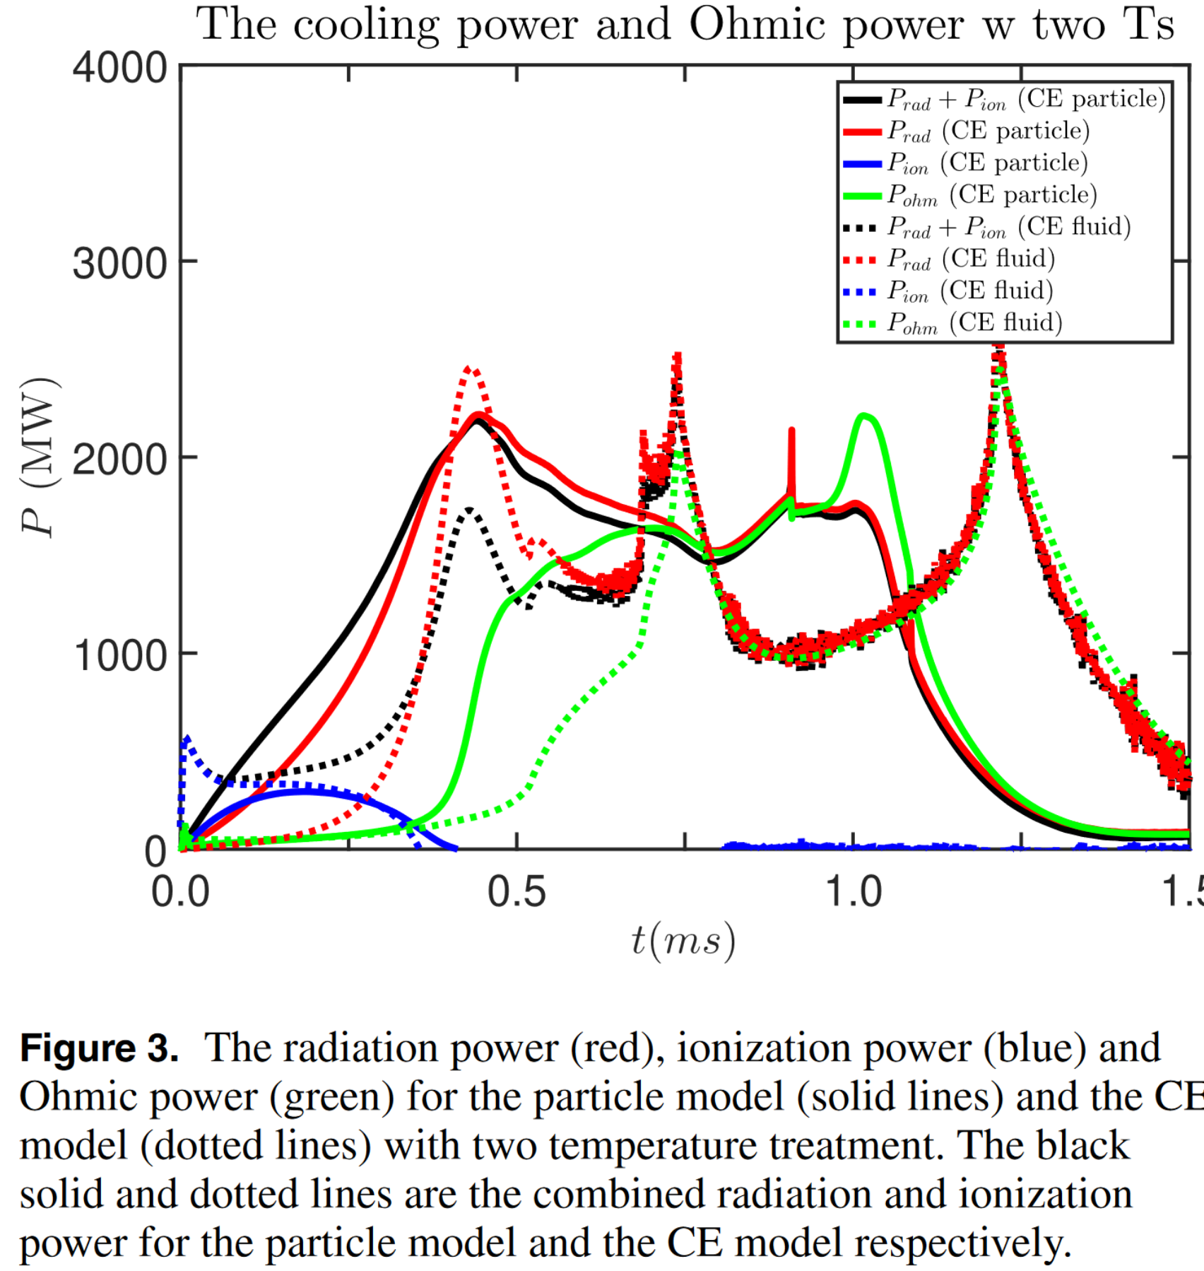
Highlight: Impurity model
Hu D, Huijsmans GTA, Nardon E, Hoelzl M et al. Collisional-radiative non-equilibrium impurity treatment for JOREK simulations. Plasma Physics and Controlled Fusion 63, 125003 (2021) doi:10.1088/1361-6587/ac2afb
Hu D, Nardon E, Artola FJ, Lehnen M et al. Collisional-radiative simulation of impurity assimilation, radiative collapse and MHD dynamics after ITER Shattered Pellet Injection. Nuclear Fusion 63, 066008 (2023) doi:10.1088/1741-4326/acc8e9
An impurity treatment without coronal equilibrium assumption was implemented and benchmarked
Captures, e.g., early radiation more accurately for ITER and other devices

Slide 30
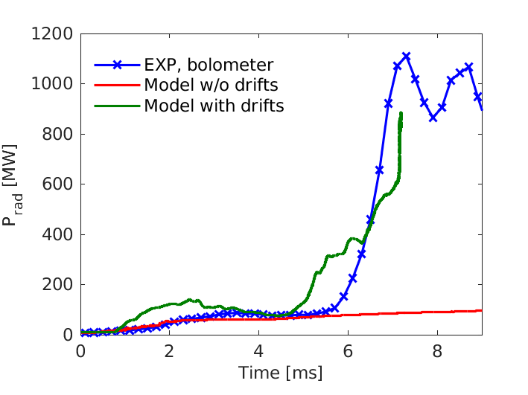
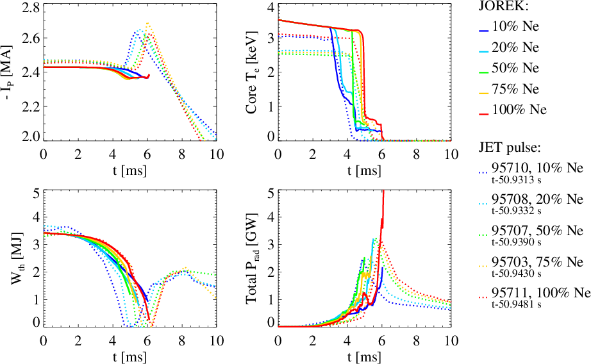
Highlight: SPI in JET
Kong M, Nardon E, Hoelzl M, Bonfiglio D, Hu D et al, Interpretative 3D MHD modelling of deuterium shattered pellet injection into a JET H-mode plasma. In preparation
Bonfiglio D et al, 3D non-linear simulations of Neon and mixed SPI in JET. In preparation
Pure D-SPI: plasmoid drift essential to reproduce experimental material assimilation and radiation (left)
Neon and mixed SPI: simulations agree well with experiments (Ip spike under investigation)

Slide 31
Highlight: SPI in AUG
Tang W, et al, 3D non-linear simulations of shattered pellet injection in the ASDEX Upgrade tokamak. In preparation
SPI with low Neon content shows a double radiation peak like experiment, originating from different locations
Detailed comparisons on the way

Slide 32
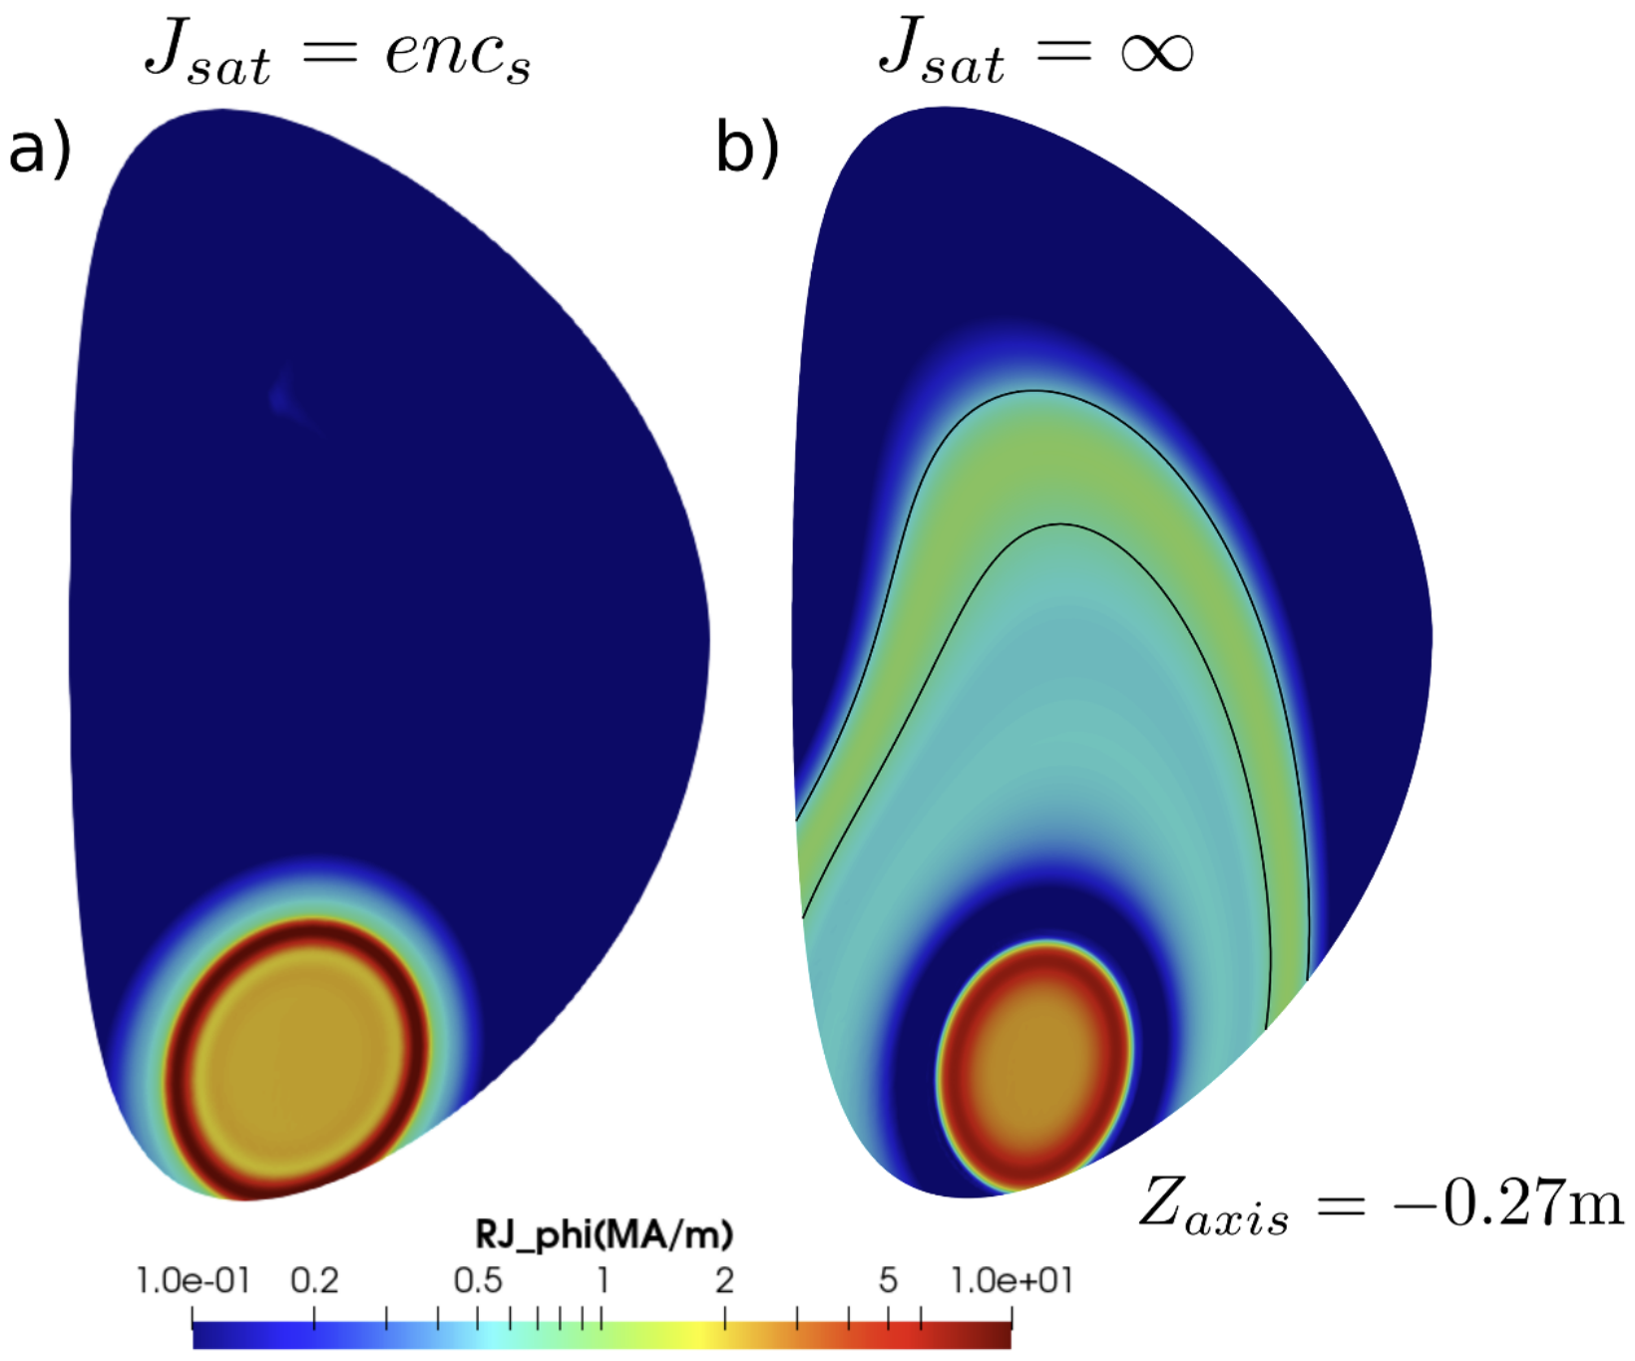
Highlight: Ion saturation current
Artola F.J., Loarte A., Matveeva E., Havlicek J., Markovic T., et al. Simulations of COMPASS vertical displacement events with a self-consistent model for halo currents including neutrals and sheath boundary conditions. PPCF 63, 064004 (2021) doi:10.1088/1361-6587/abf620
COMPASS studies show the ion saturation current is essential to capture halo current distribution (+ anisotropic heat transport, impurities, neutrals etc.)
Simulations reproduce this effect and agree well with experiments

Slide 33
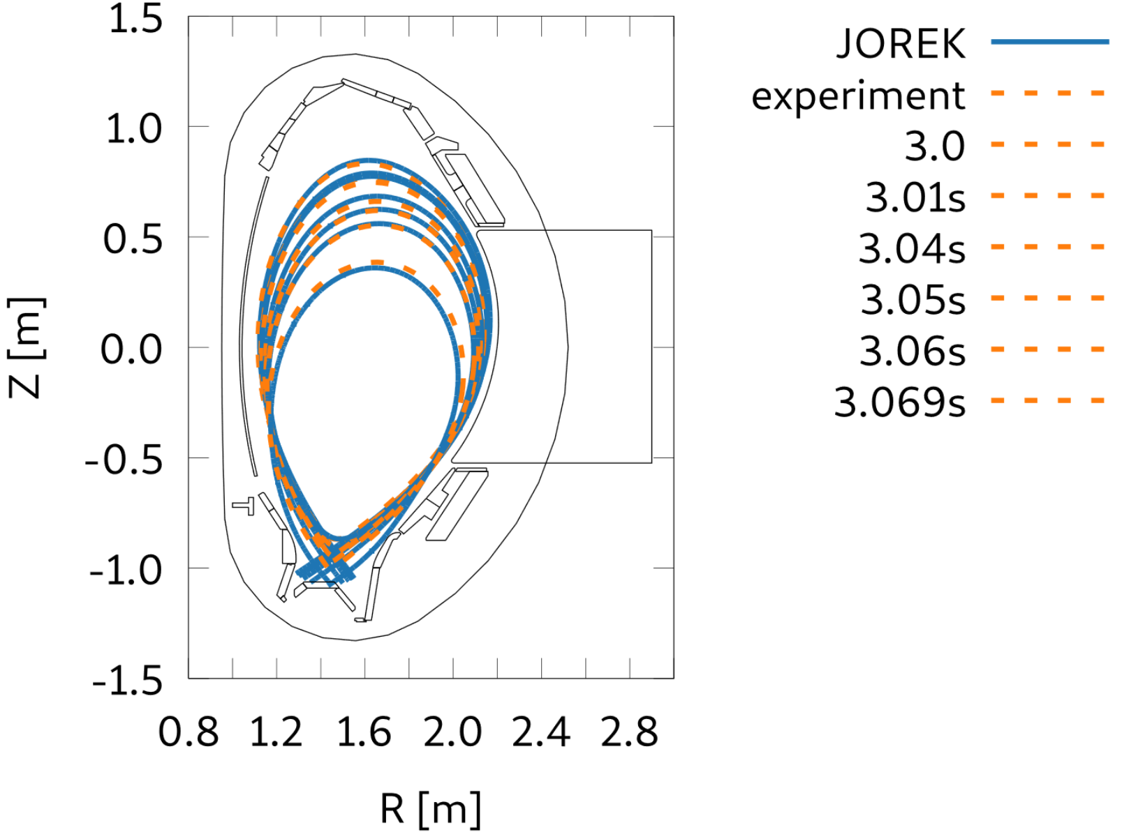
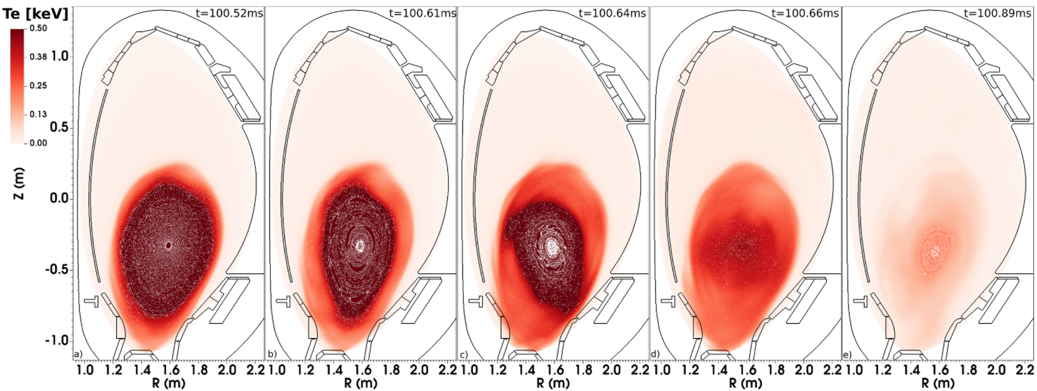
Highlight: Unmitigated VDEs in AUG
Schwarz N, Artola FJ, Hoelzl M, Bernert M, et al. Experiments and non-linear MHD simulations of hot vertical displacement events in ASDEX-Upgrade. Plasma Physics and Controlled Fusion 65, 054003 (2023) doi:10.1088/1361-6587/acc358
Dedicated AUG experiments & simulations
Simulations reproduce key aspects
Vertical plasma motion
Magnitude of halo currents
Magnitude of vertical force
TQ onset point

Slide 34
Highlight: Force mitigation
Schwarz N, Artola FJ, Vannini F, Hoelzl M, et al. The mechanism of the global vertical force reduction in disruptions mitigated by massive material injection. Nuclear Fusion (accepted)
Previously:
force reduction explained by reduction of poloidal halo currents
New theory:
Impurity injection leads to a flattening of the current profile beyond the separatrix
Current centroid decouples from axis motion reducing vertical force
$$F_{z}∝I_{p}Δz_{curr}$$
Trajectory of current centroid
Trajectory of magnetic axis

Slide 35
Highlight: JOREK-CARIDDI coupling
Isernia N, Schwarz N, Artola FJ, Ventre S, Hoelzl M, Rubinacci G, Villone F. Self-consistent coupling of JOREK and CARIDDI: On the electromagnetic interaction of 3D tokamak plasmas with 3D volumetric conductors. Physics of Plasmas (submitted)
JOREK-CARIDDI eddy current coupling completed
Enables studies of 3D plasma & 3D wall
First application: 3D VDE in AUG
Halo current coupling is future work
↔ ACH optimization ongoing

Slide 36
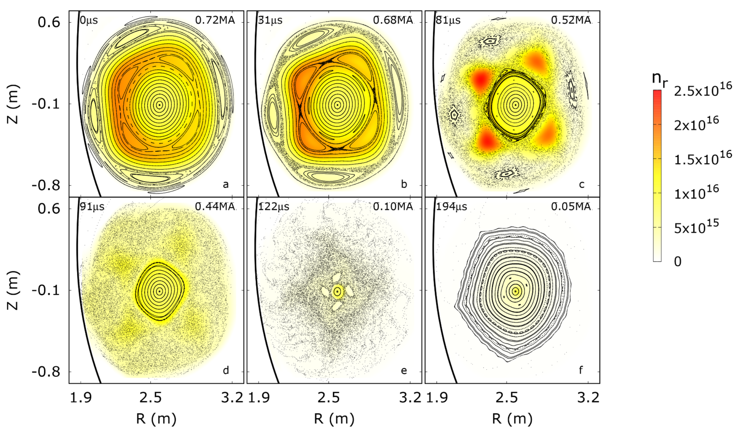
Highlight: Benign RE termination
Bandaru V, Hoelzl M, Reux C, Ficker O, Silburn S, et al. Magnetohydrodynamic simulations of runaway electron beam termination in JET. Plasma Physics and Controlled Fusion 63, 035024 (2021) doi:10.1088/1361-6587/abdbcf
Double TM instability after secondary D-SPI proposed to help with benign termination
Important role of stochastization front moving inwards from the edge towards the core
↔ Collaboration with TSVV 9

Slide 37
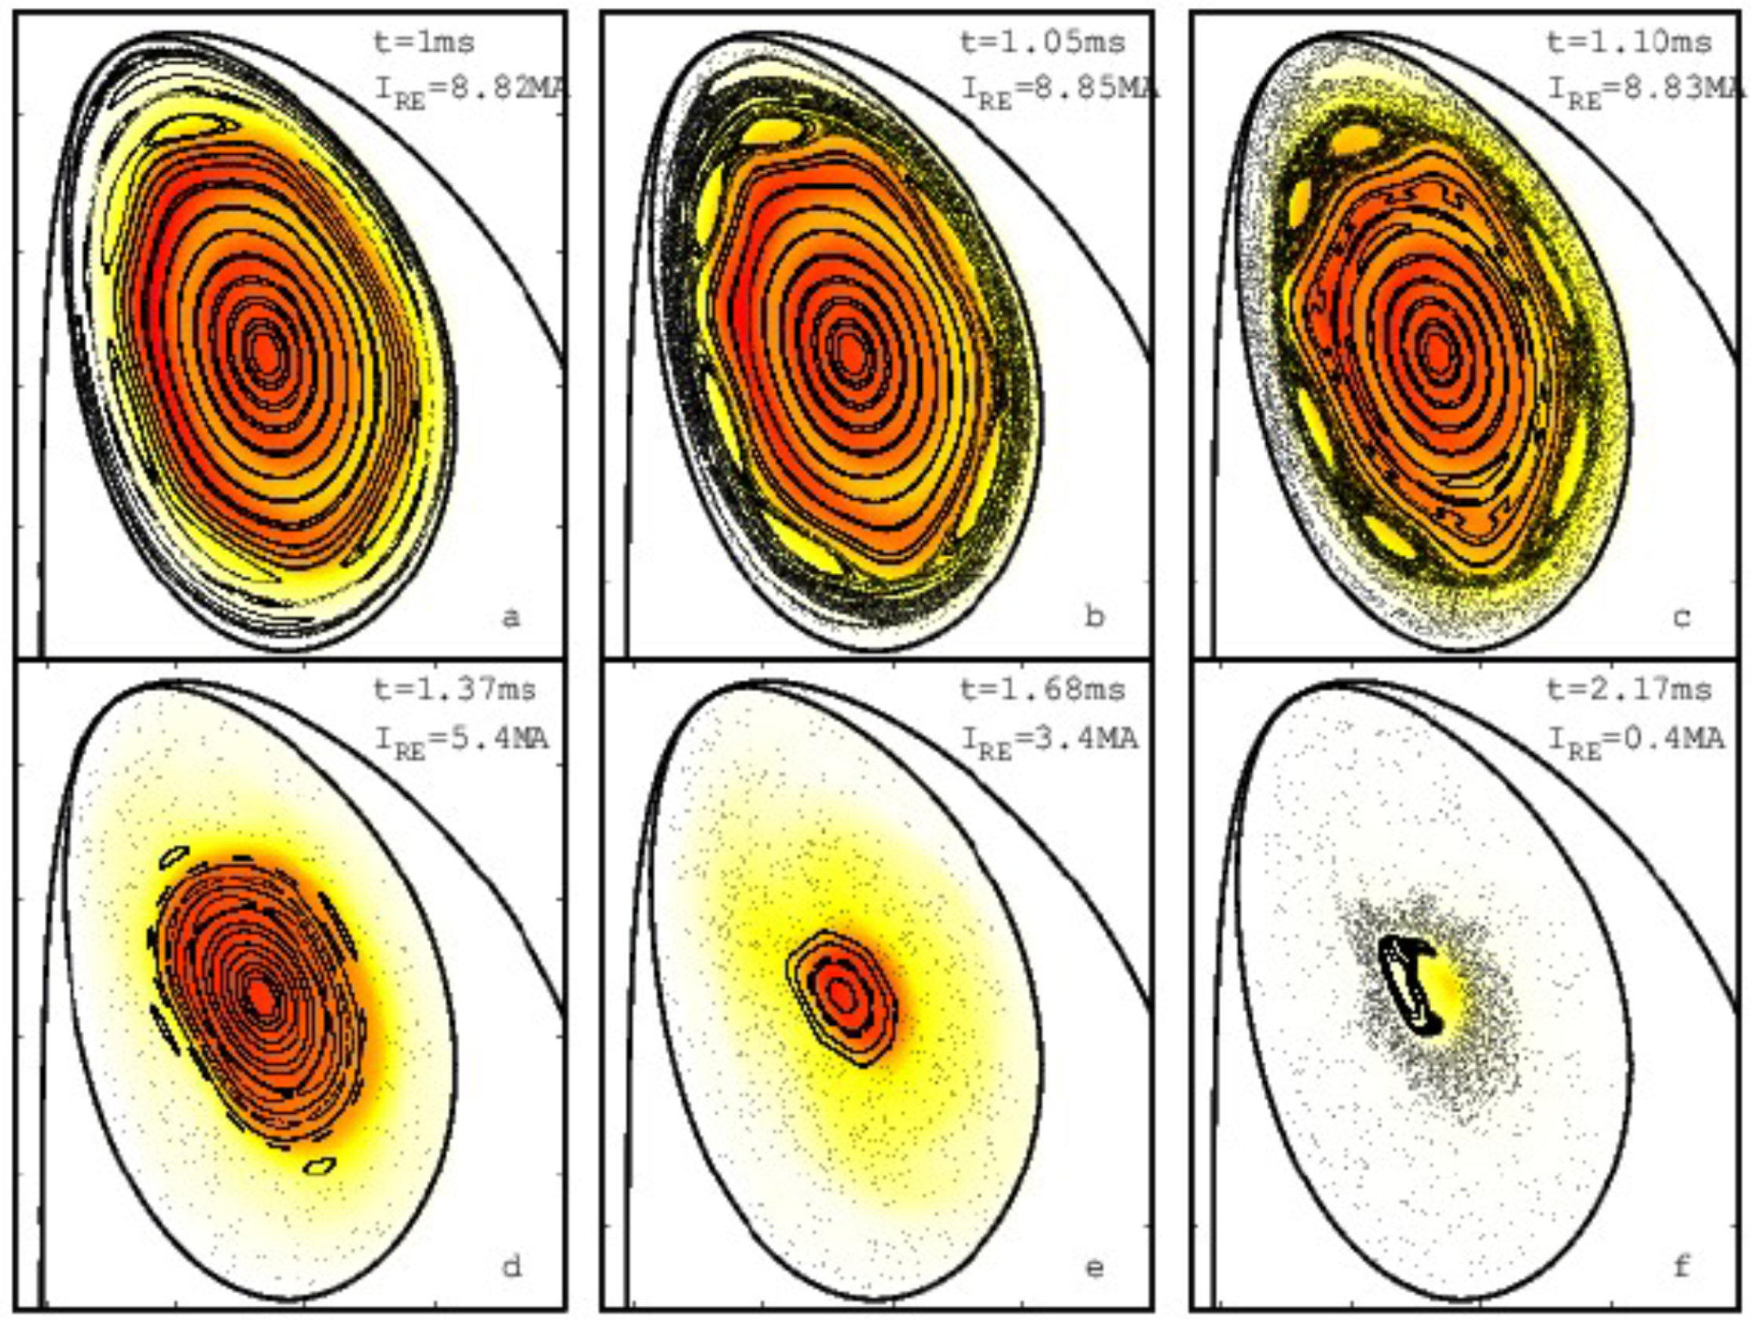
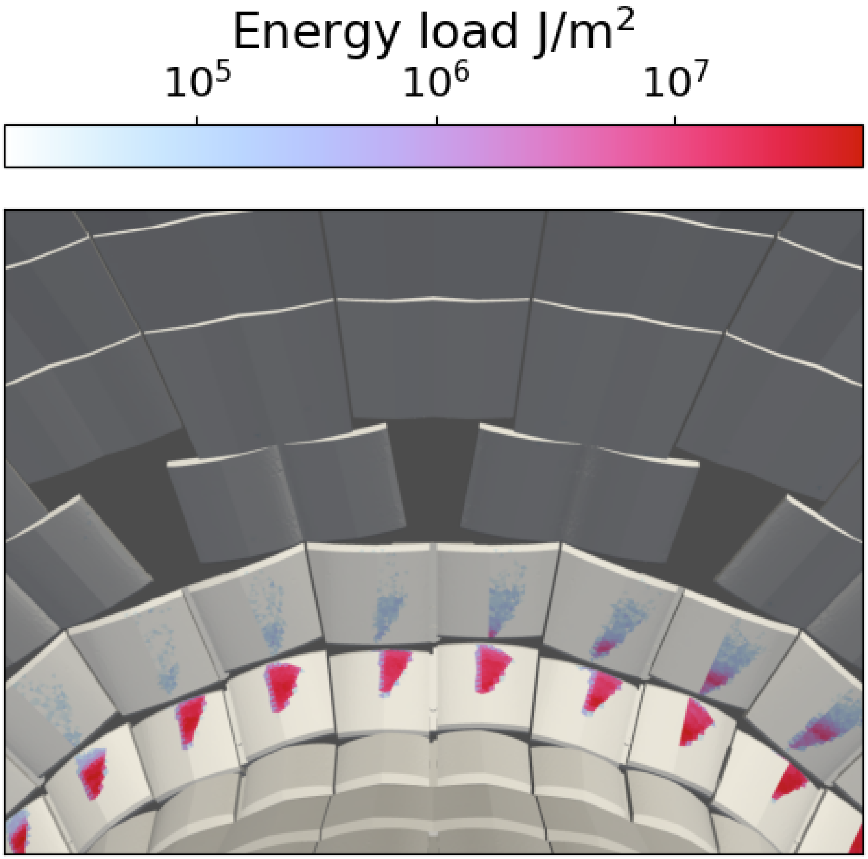
Highlight: ITER 3D RE studies
Bandaru V, Hoelzl M, Bergstroem H, Artola FJ, Särkimäki K, Lehnen M. Assessment of runaway electron beam termination and impact in ITER. Nuclear Fusion (submitted)
Bergstroem H, Saerkimaeki K, et al, in preparation
2D validation against DINA & GO
3D RE termination in ITER
Also re-formation observed
Load to 3D walls locally exceeding melt limit
Important role of high resistivity and low density (recombination)
DEMO and DTT studies started
↔ Close work with ITER and TSVV 9

Slide 38
Further activities

Slide 39
Further Activities
no TSVV funding
Supporting development of stellarator MHD ►
Flux pumping
Nikulsin N. Models and methods for nonlinear magnetohydrodynamic simulations of stellarators. PhD Thesis (2021). https://pure.mpg.de/rest/items/item_3359934_3/component/file_3359935/content
Ramasamy R. Equilibrium and initial value problem simulation studies of nonlinear magnetohydrodynamics in stellarators. PhD Thesis (2022). https://hdl.handle.net/21.11116/0000-000B-FD50-E
Nikulsin N., Hoelzl M., Zocco A., Lackner K., Günter S., JOREK Team. Testing of the new JOREK stellarator-capable model in the tokamak limit. JPP 87, 855870301 (2021) doi:10.1017/S0022377821000477
Ramasamy R., Hoelzl M., Strumberger E., Lackner K., Günter S.. Nonlinear MHD simulations of external kinks in quasi-axisymmetric stellarators using an axisymmetric external rotational transform approximation. Nuclear Fusion 61, 076017 (2021) doi:10.1088/1741-4326/abffdf
Nikulsin N., Ramasamy R., Hoelzl M., Hindenlang F., Strumberger E., et al. JOREK3D: An extension of the JOREK nonlinear MHD code to stellarators. Physics of Plasmas 29, 063901 (2022) doi:https://doi.org/10.1063/5.0087104
Ramasamy R., Bustos Ramirez G., Hoelzl M., Graves J., Suarez Lopez G., et al. Modeling of saturated external MHD instabilities in tokamaks: A comparison of 3D free boundary equilibria and nonlinear stability calculations. Physics of Plasmas 29, 072303 (2022) doi:10.1063/5.0090008
Ramasamy R., Hoelzl M., Henneberg S., Strumberger E., Lackner K., Guenter S. How well can VMEC predict the initial saturation of external kink modes in near circular tokamaks and l=2 stellarators? Physics of Plasmas 30, 062506 (2023)
Aleynikova K, Ramasamy R, Nikulsin N, Hindenlang F, Hoelzl M. Nonlinear tearing mode evolution and sawtooth crashes in a stellarators. EPS 2023
Ramasamy R, et al, in prep.
Burckhart A, Bock A, Fischer R, Krebs I, Guenter S, Gude A, Hoelzl M, Hobirk J, Igochine V, Maraschek M, Puetterich T, Reisner M, Schramm M, Stober J, Zohm H, ASDEX Upgrade Team. Experimental Evidence of Magnetic Flux Pumping in ASDEX Upgrade (submitted)
↔ future input for EUROfusion stellarator work

Slide 40
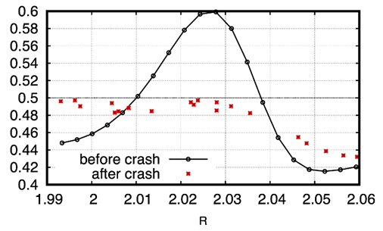
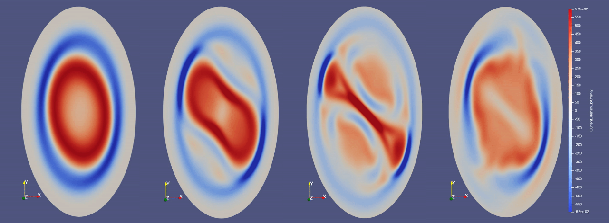
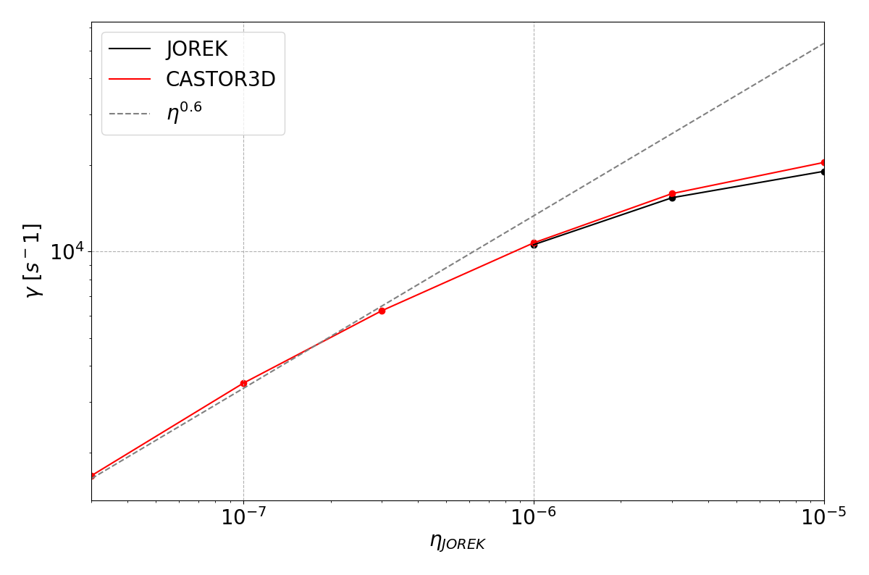
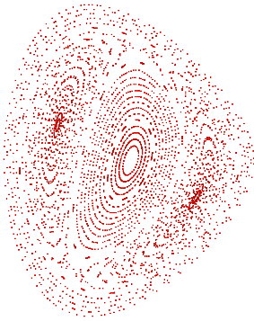
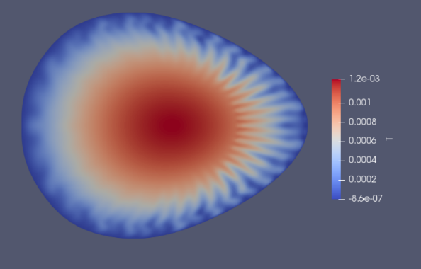
Highlight: Stellarator MHD
Aleynikova K, Ramasamy R, Nikulsin N, Hindenlang F, Hoelzl M. Nonlinear tearing mode evolution and sawtooth crashes in a stellarators. EPS 2023
Ramasamy R et al, in preparation
Non-linear dynamics of double TM instability in W7-A
Current density
Successful benchmark for TM in W7-AS geometry + ballooning mode tests (first applications to advanced stellarators)

Slide 41
Conclusions

Slide 42
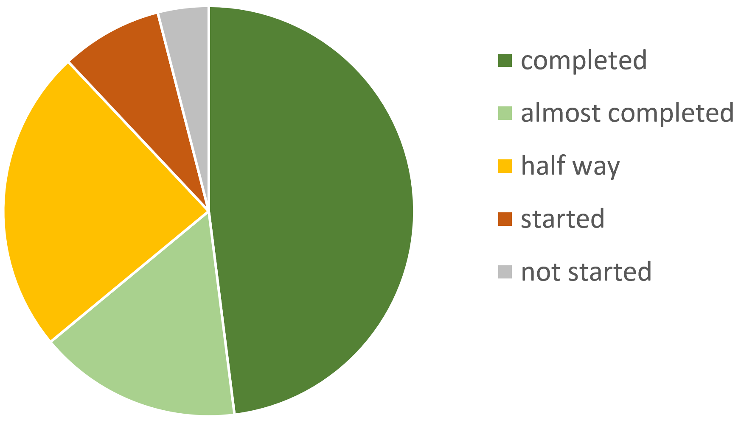
Conclusions
Excellent progress in all work packages
Documentation, IMASification, automatic testing
Major model and numerics developments
Good progress regarding experiment validation
Increasing progress with predictions
High relevance for WPs TE/SA/DES, ITER, DTT, etc.
About 50 refereed articles published, accepted or submitted, where the 1st/2nd/3rd author is a project contributor
Milestones:
48% completed
16% almost completed
24% half way
8% started
4% not started

Slide 43
Backup slides

Slide 44
ACH support
 | 2021 | 2022 | 2023
MPG | 9 pm: non-linear preconditioner | 12 pm: iterative solver & solver interfaces | 12 pm: memory optimiza-tion, solver on GPUs
 | 12 pm: GPU porting attempt
BSC |  |  | 12 pm: free boundary optimization
Poznan |  | 8 pm: Contribution to IMAS adaptations
VTT |  |  | 4 pm: simulation database
 | 12 pm | 22 pm | 32 pm
 | Strong contribution to the project | Limited outcome (so far) | Can’t be done yet as there is no EUROfusion solution

Slide 45
Code management
JOREK, STARWALL and CARIDDI_J codes are hosted in git repositories at ITER
Organized by TSVV 8
Regular developers meetings
Regular release versions
>> 100 pull requests per year
Reviewing of pull requests
>> 50 automatic regression tests
Significant progress with IMASification
Documentation in Wiki and review publications
Mailing lists for internal communication
Outreach to community via public website and LinkedIn
Access upon reasonable request to admin@jorek.eu
For details, refer to https://www.jorek.eu

Slide 46
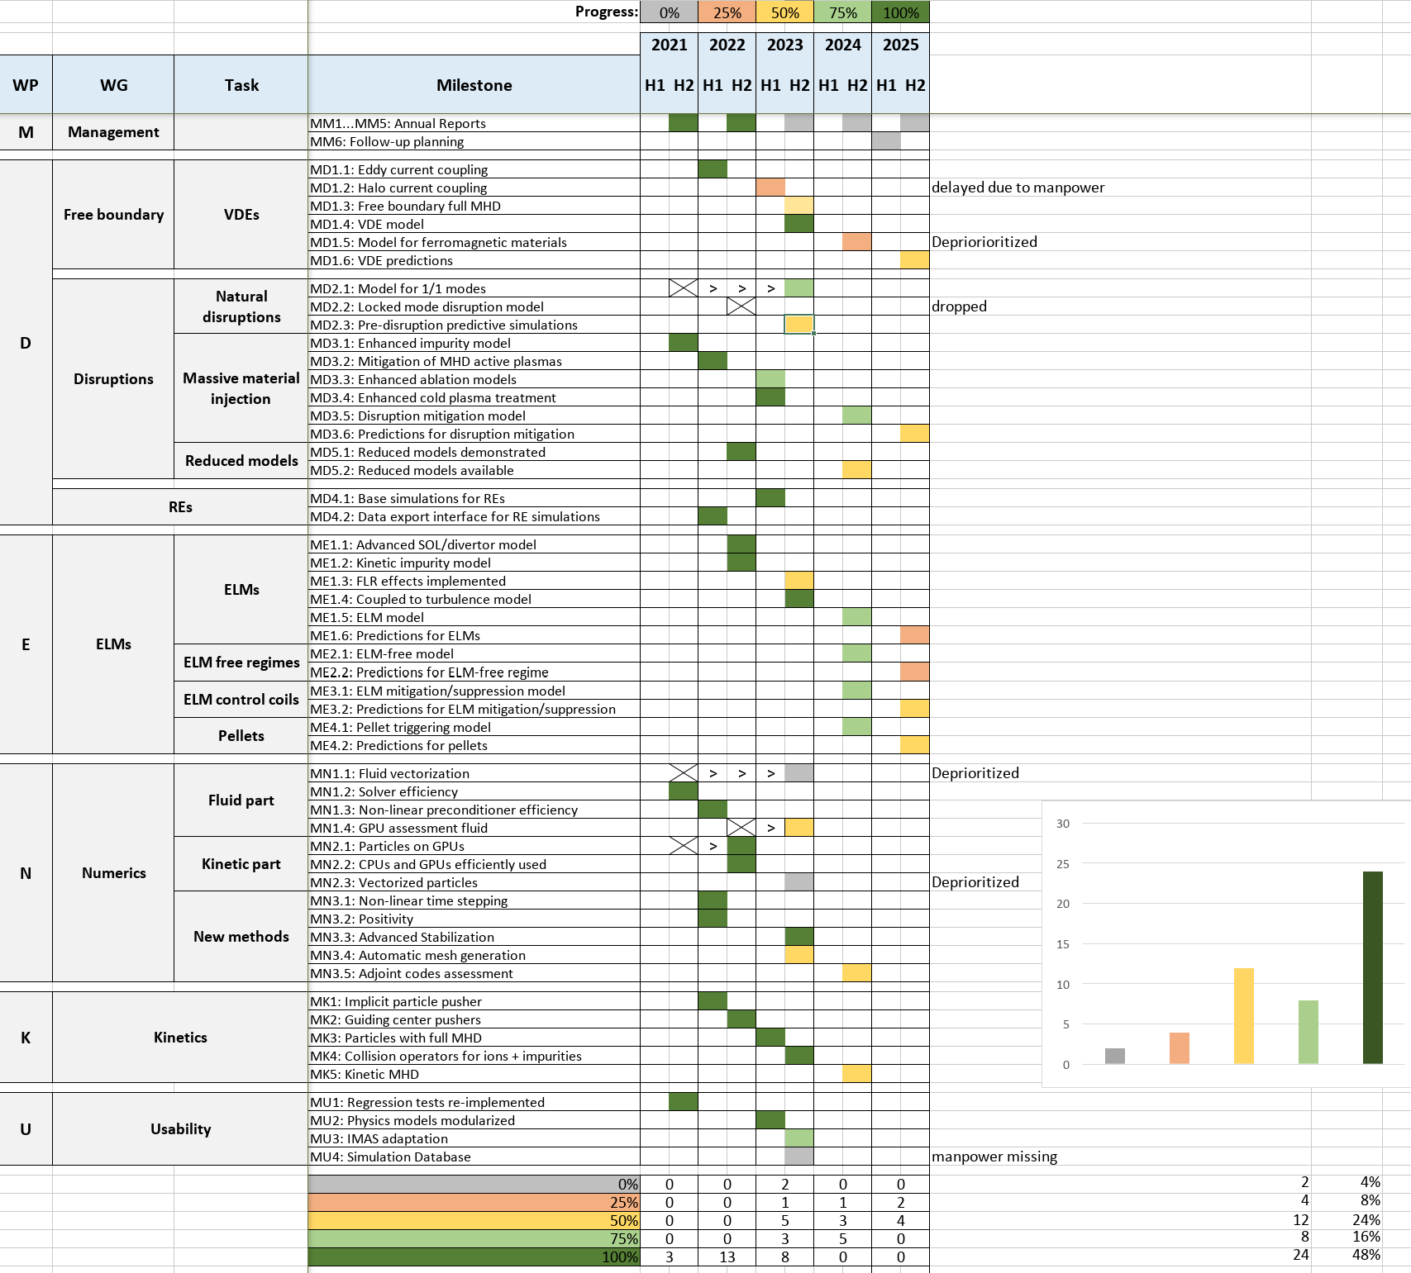

Slide 47
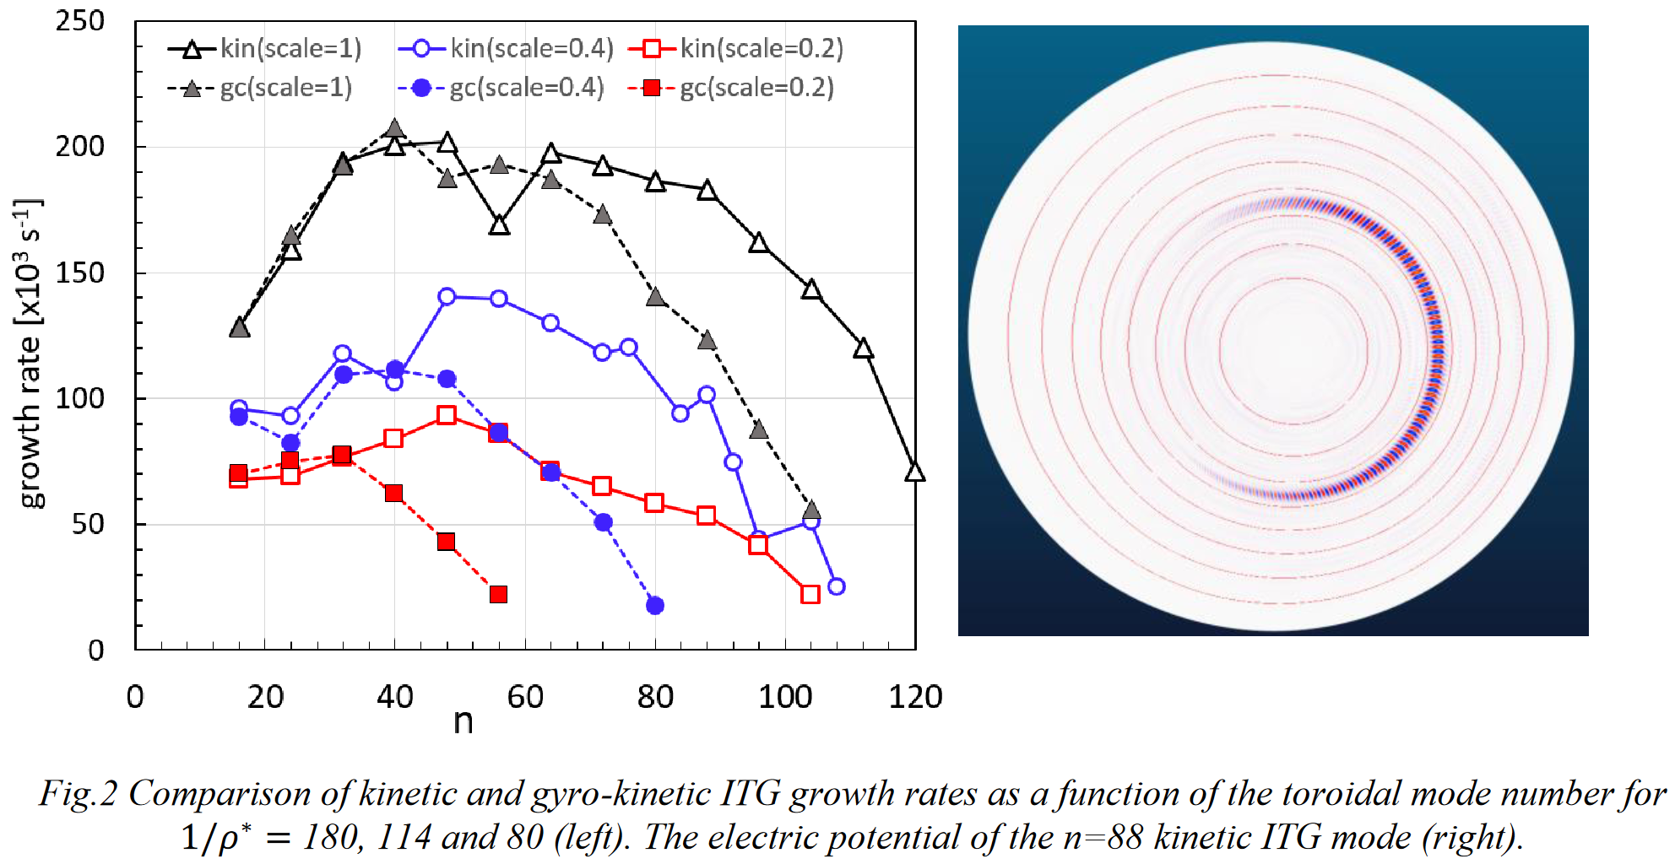
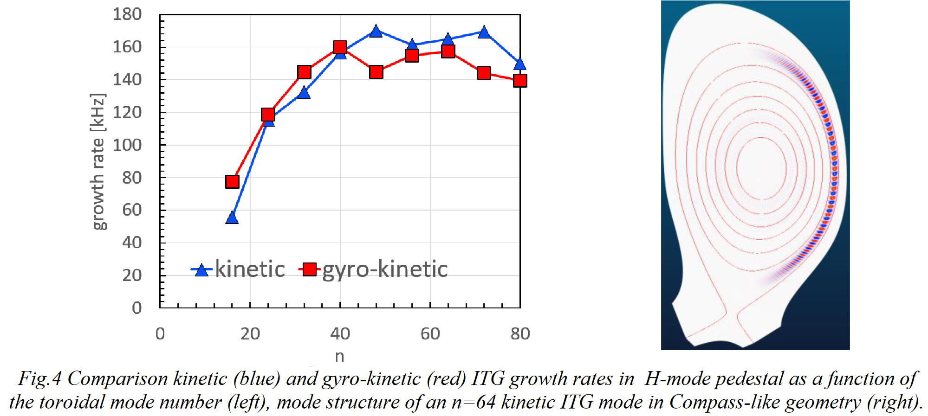
ITG GK vs. kinetic
Huijsmans GTA, Becoulet M, Lu ZX, JOREK Team. Comparing linear stability of electrostatic kinetic and gyro-kinetic ITG modes. EPS 2023

