Slide 1
On boundary conditions for temperature gradients
D. Tskhakaya
Institute of Plasma Physics of the CAS, Prague, Czech Republic

Slide 2
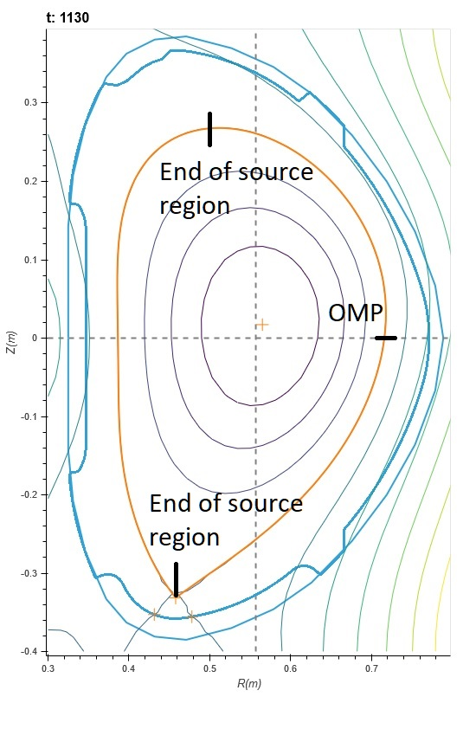
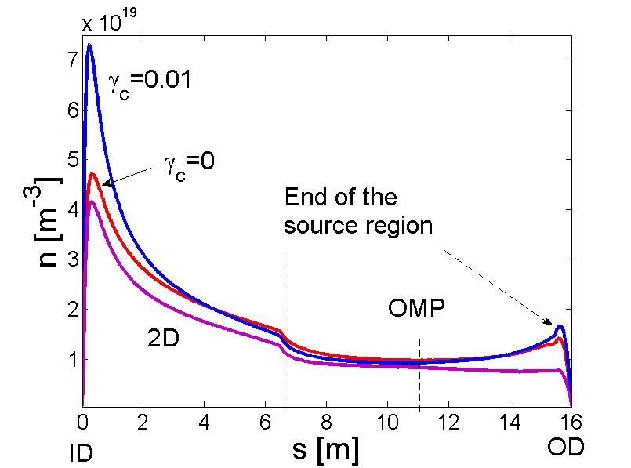
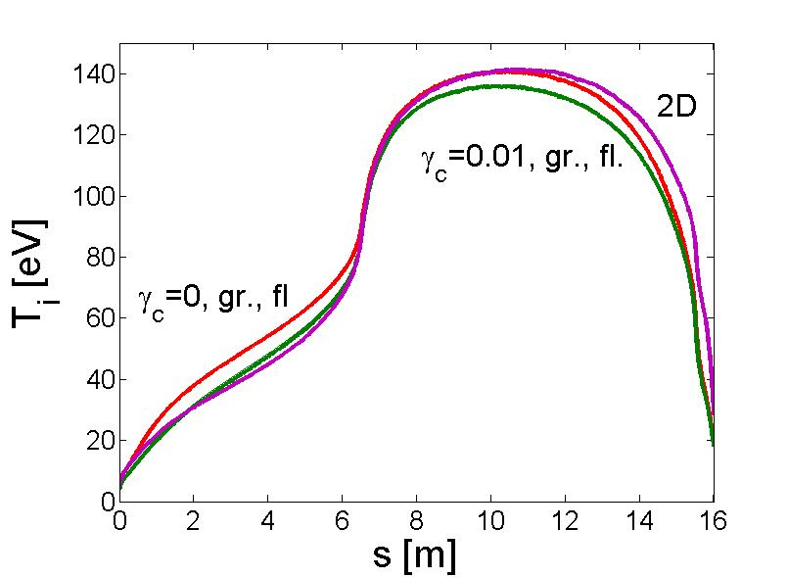
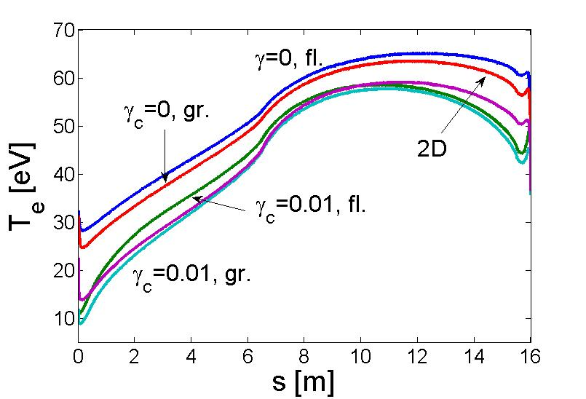
Equations
Plots are from [Tskhakaya, et al, NME, 2021]
D. Tskhakaya TSVV3 16.11.2022

Slide 3
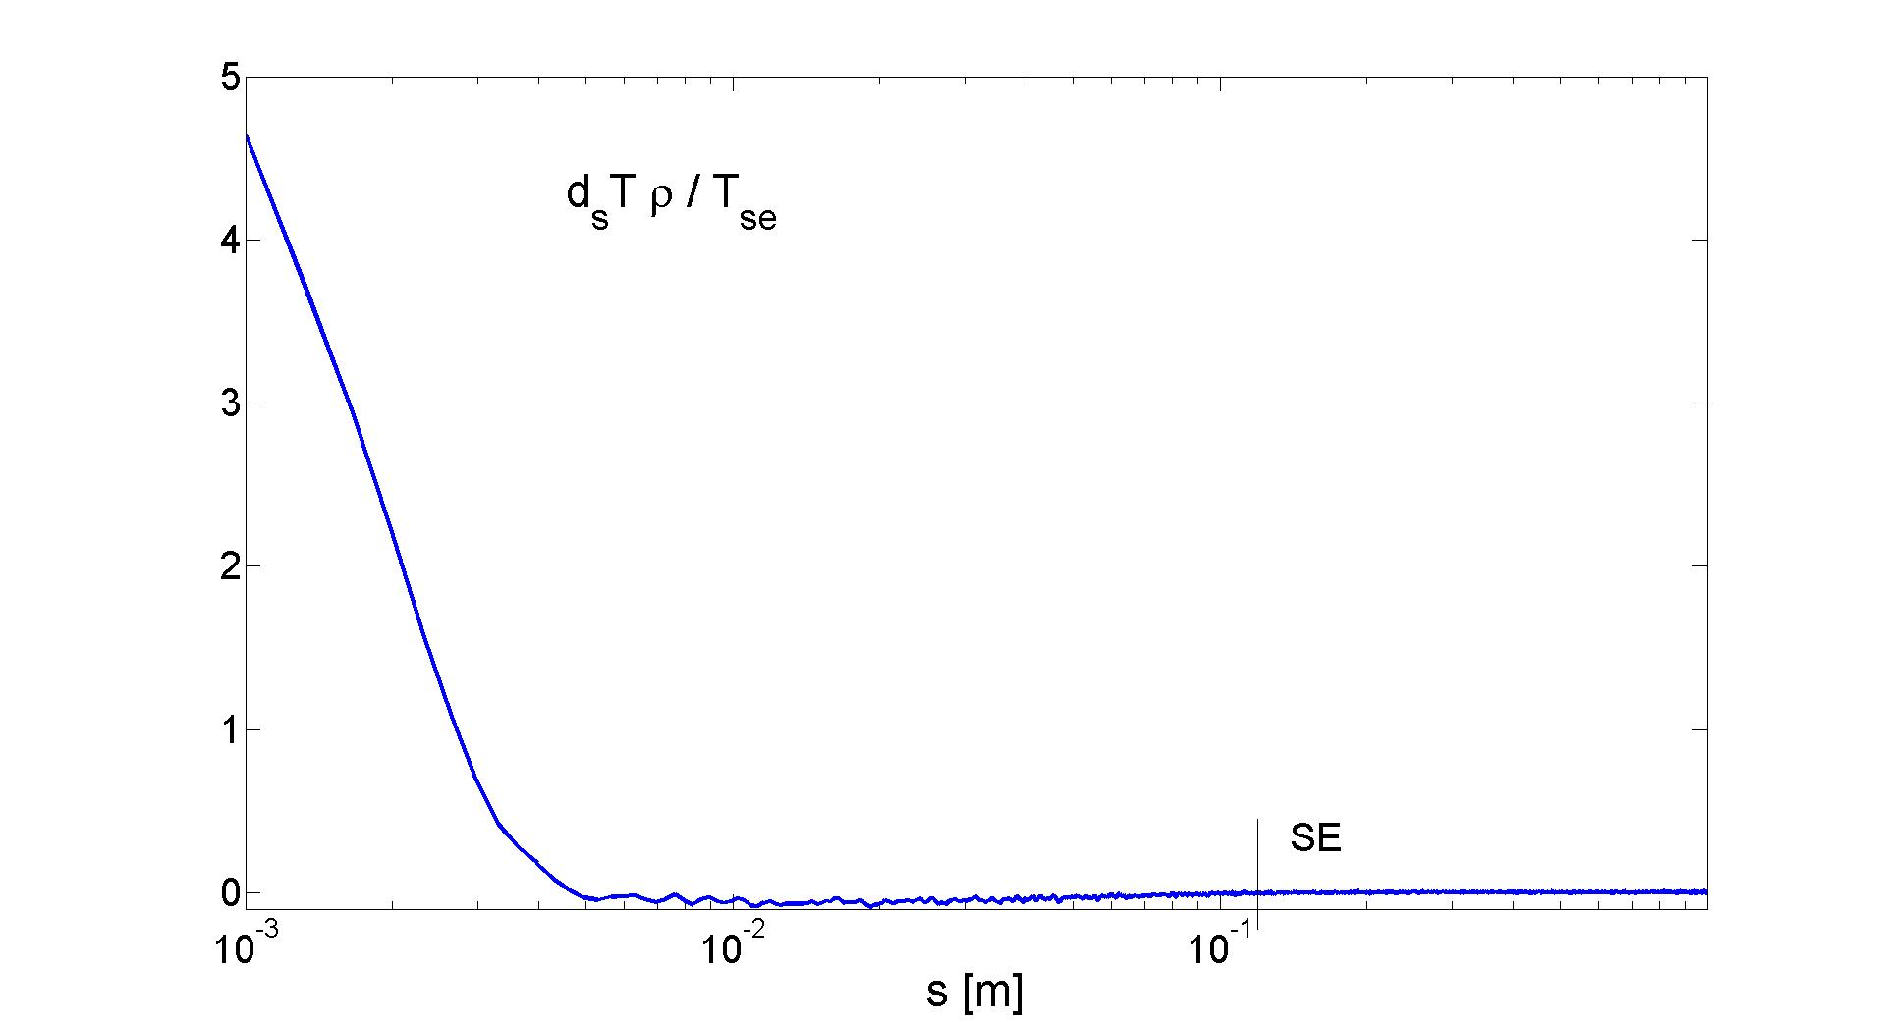
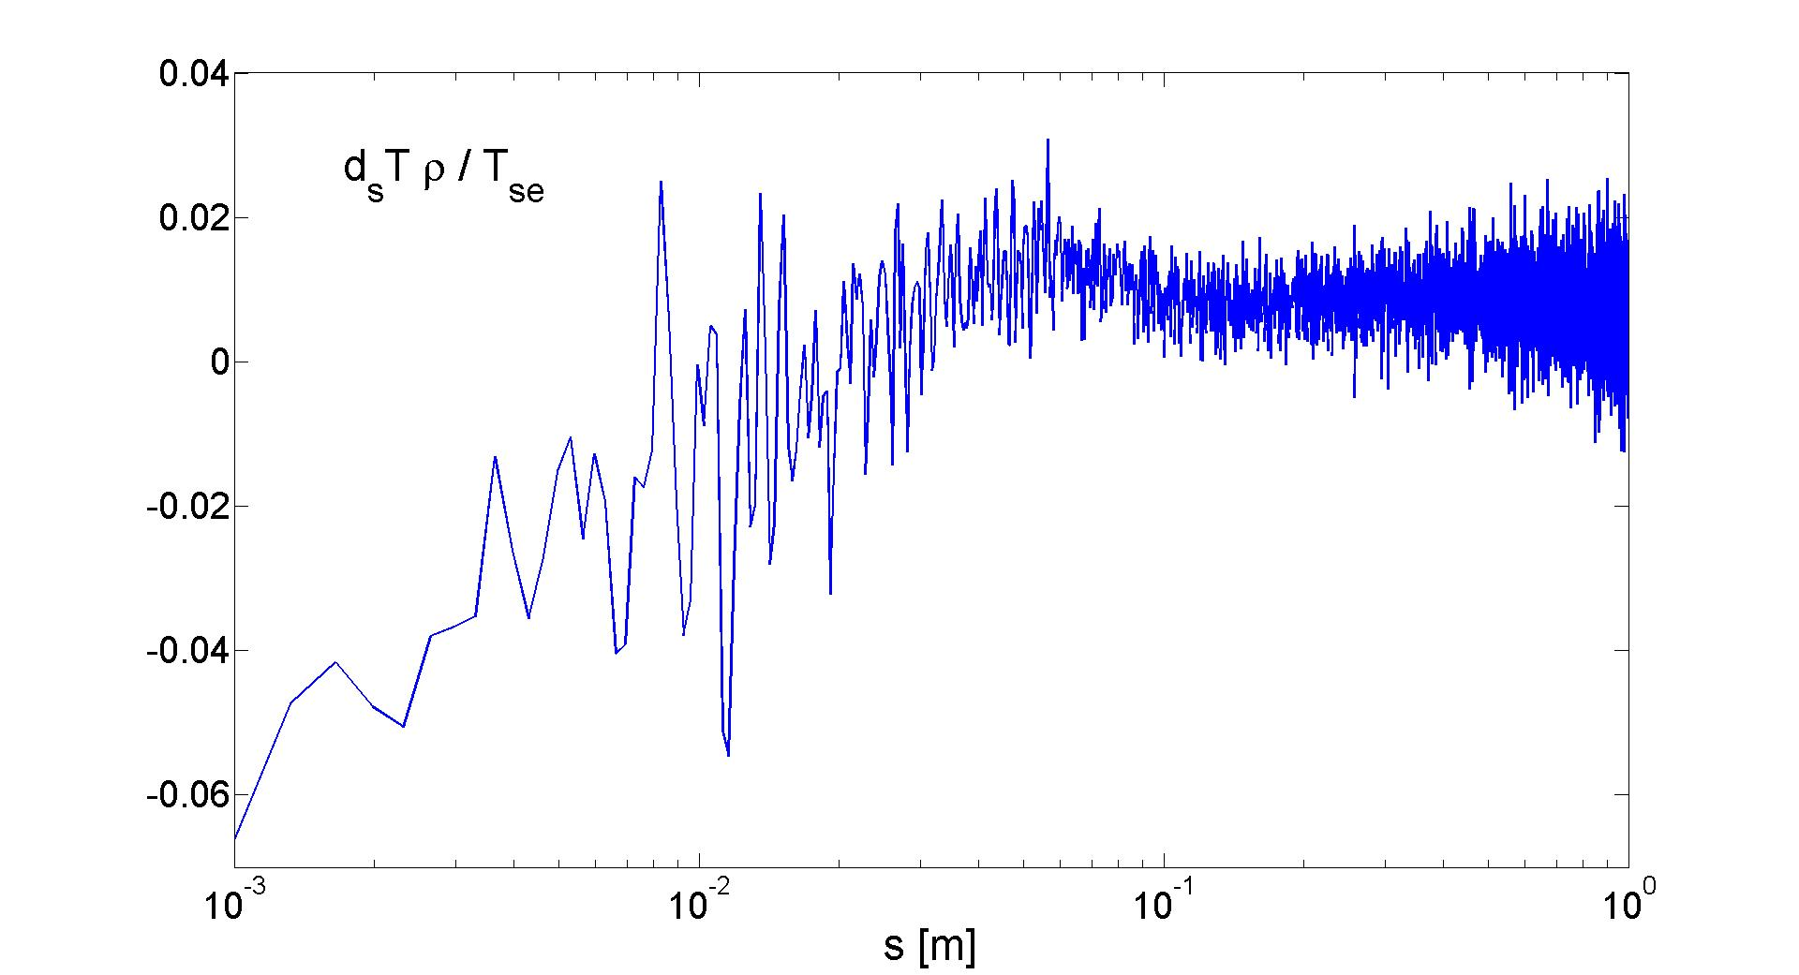
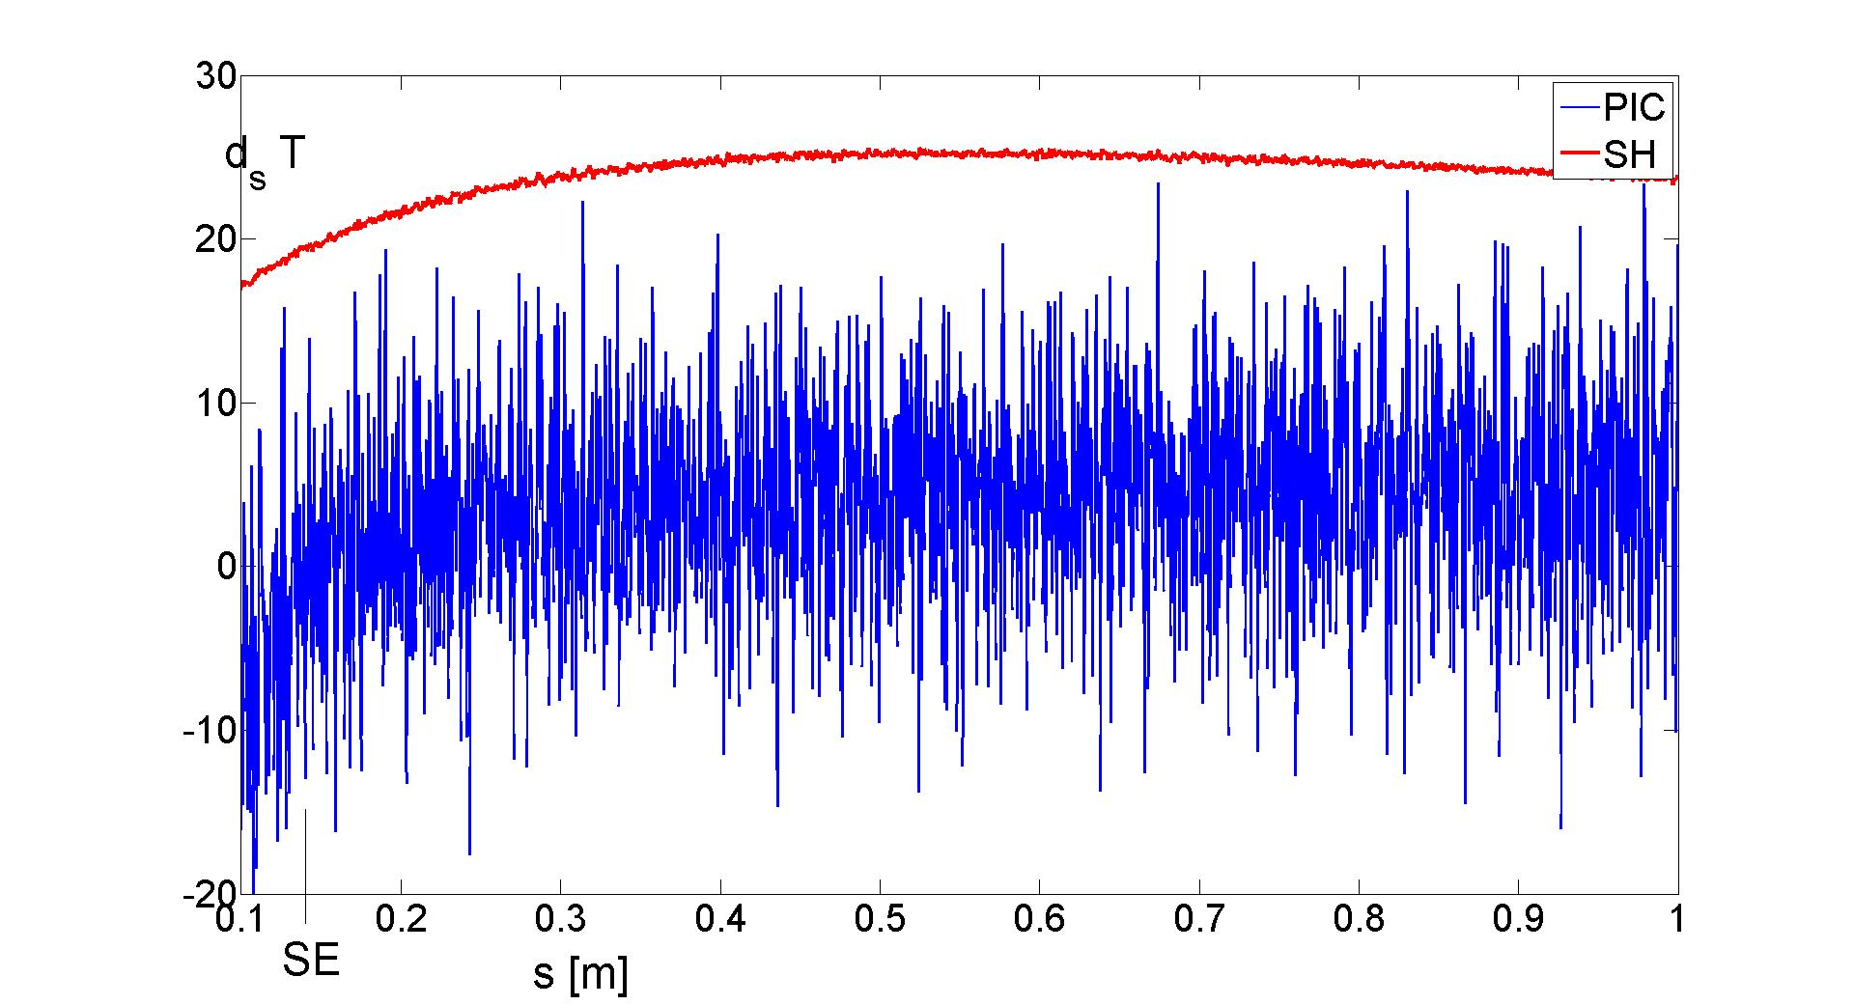
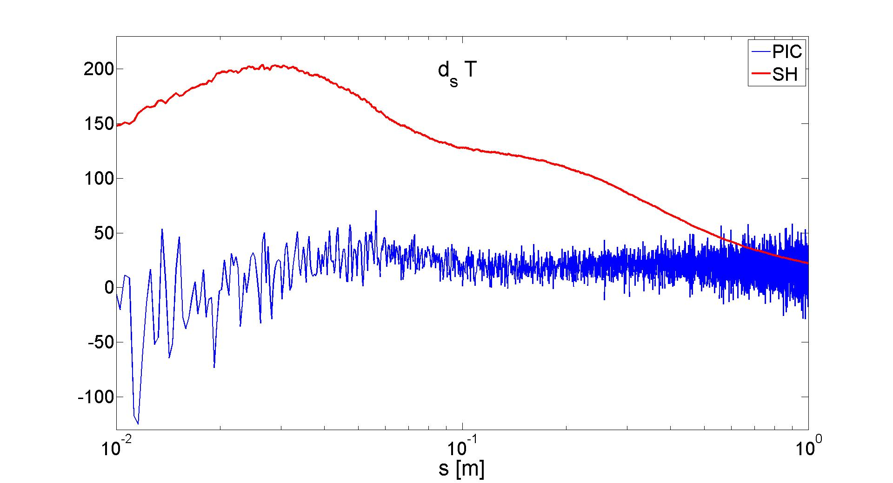
No impurity
Electrons
D⁺ ions
D. Tskhakaya TSVV3 16.11.2022

Slide 4
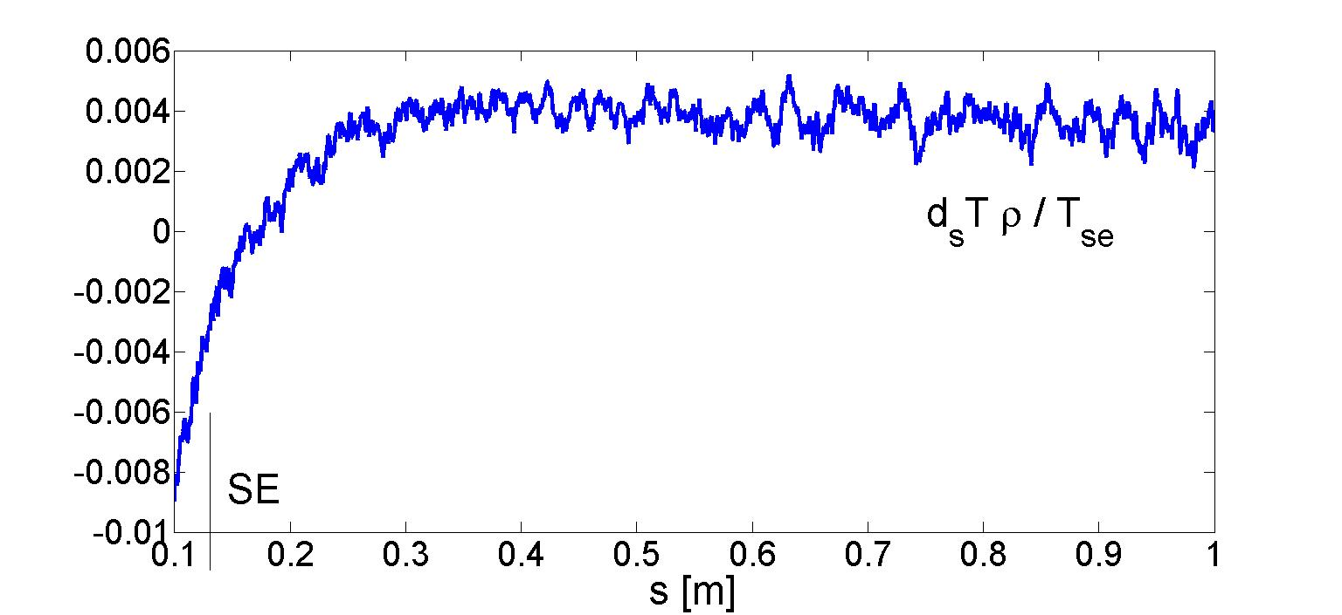
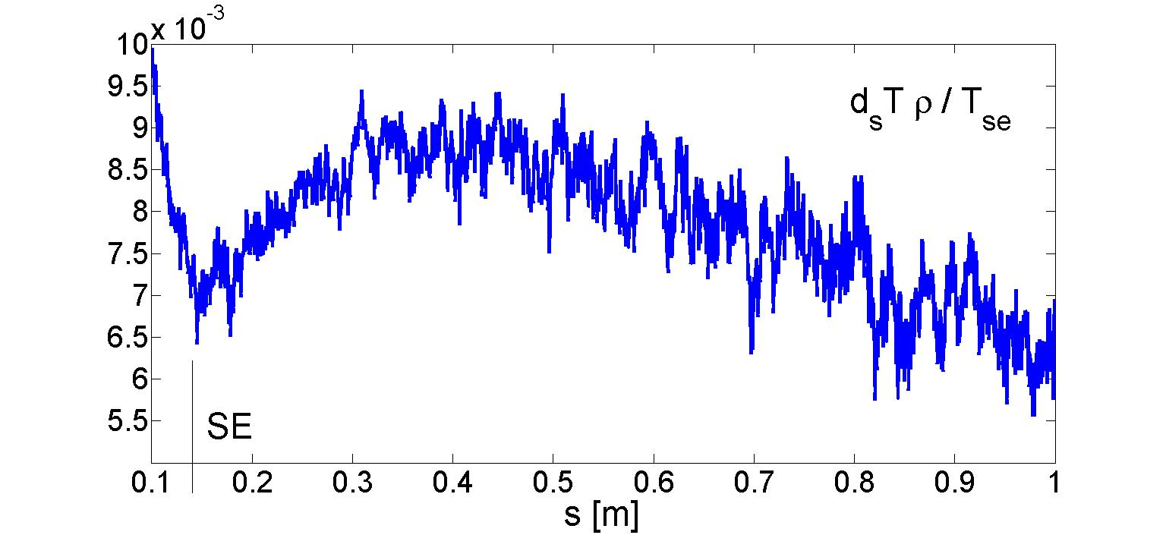
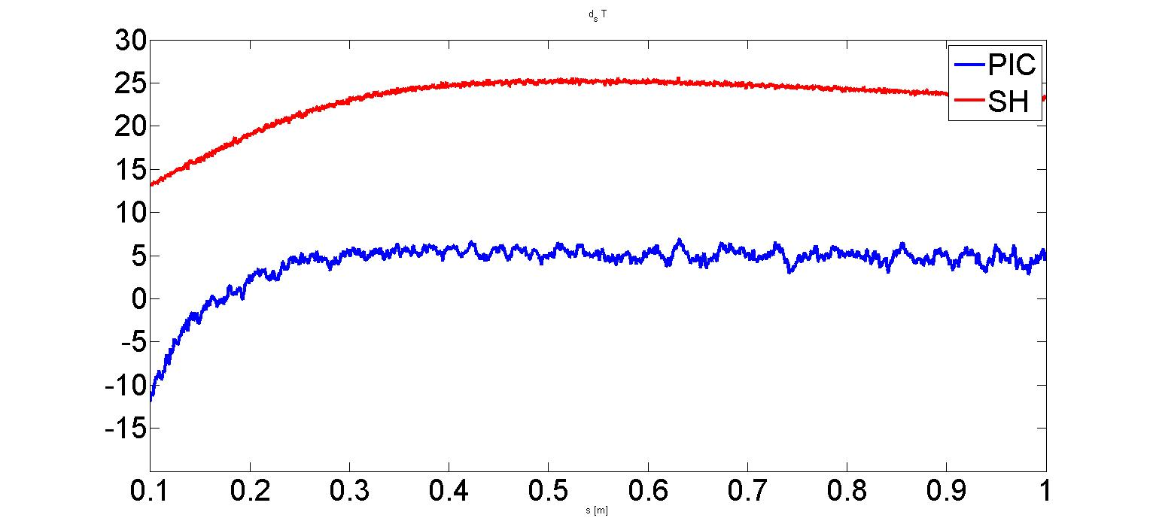
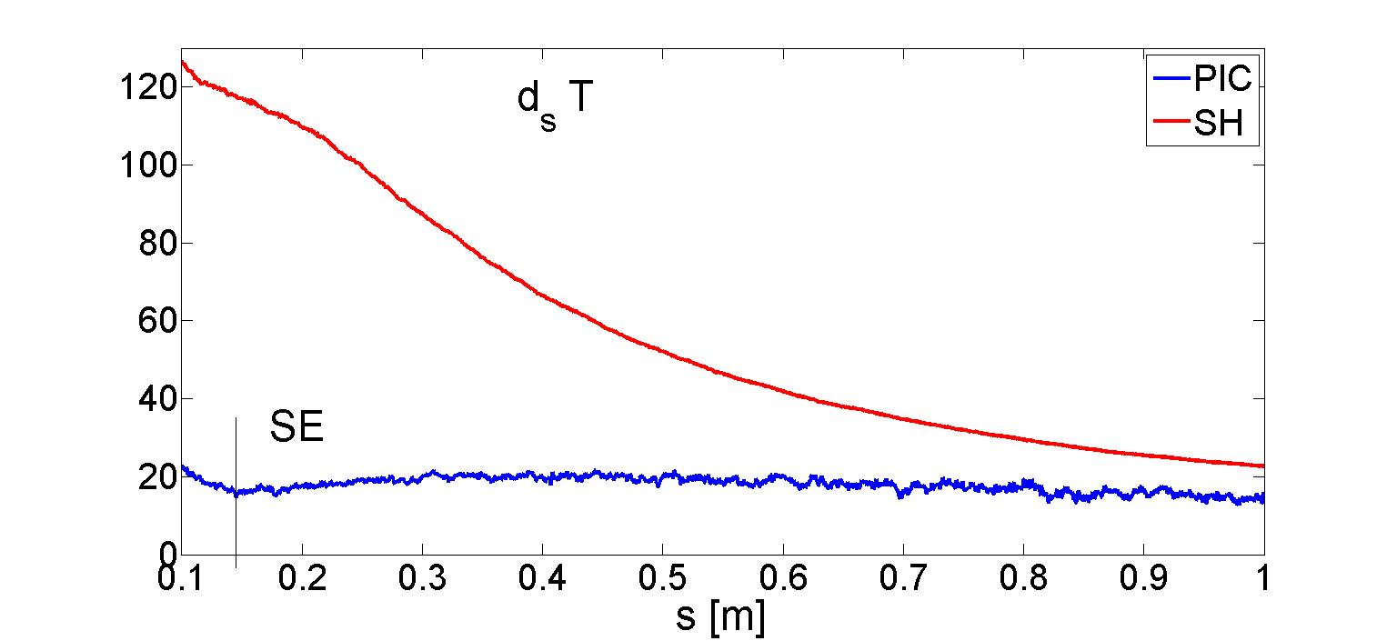
COMPASS with impurity (no chemical sput.)
Electrons
D⁺ ions
D. Tskhakaya TSVV3 16.11.2022

Slide 5
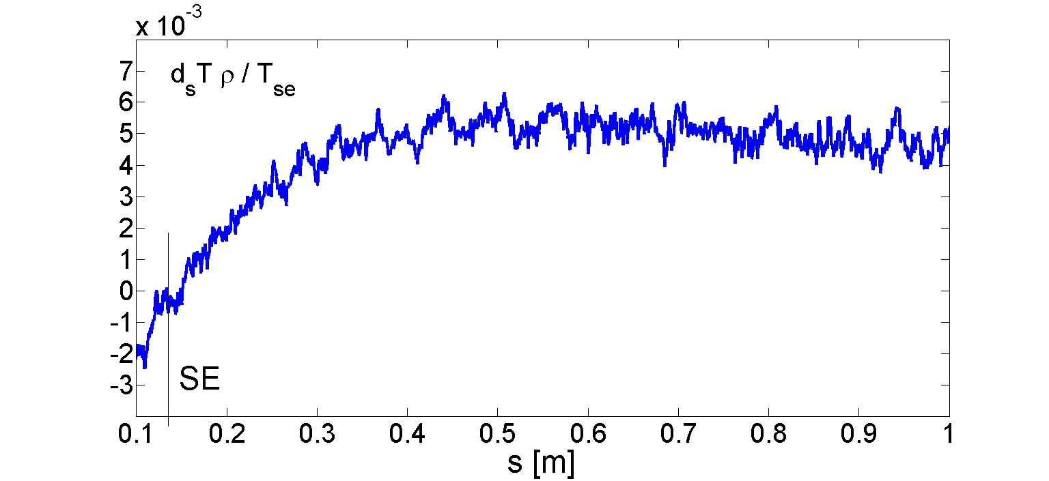
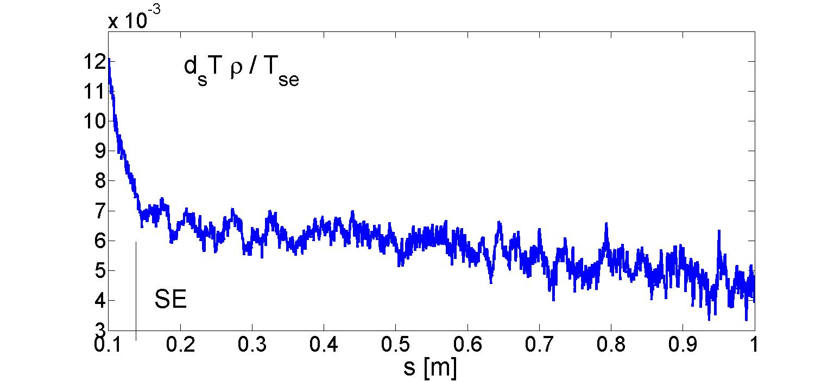
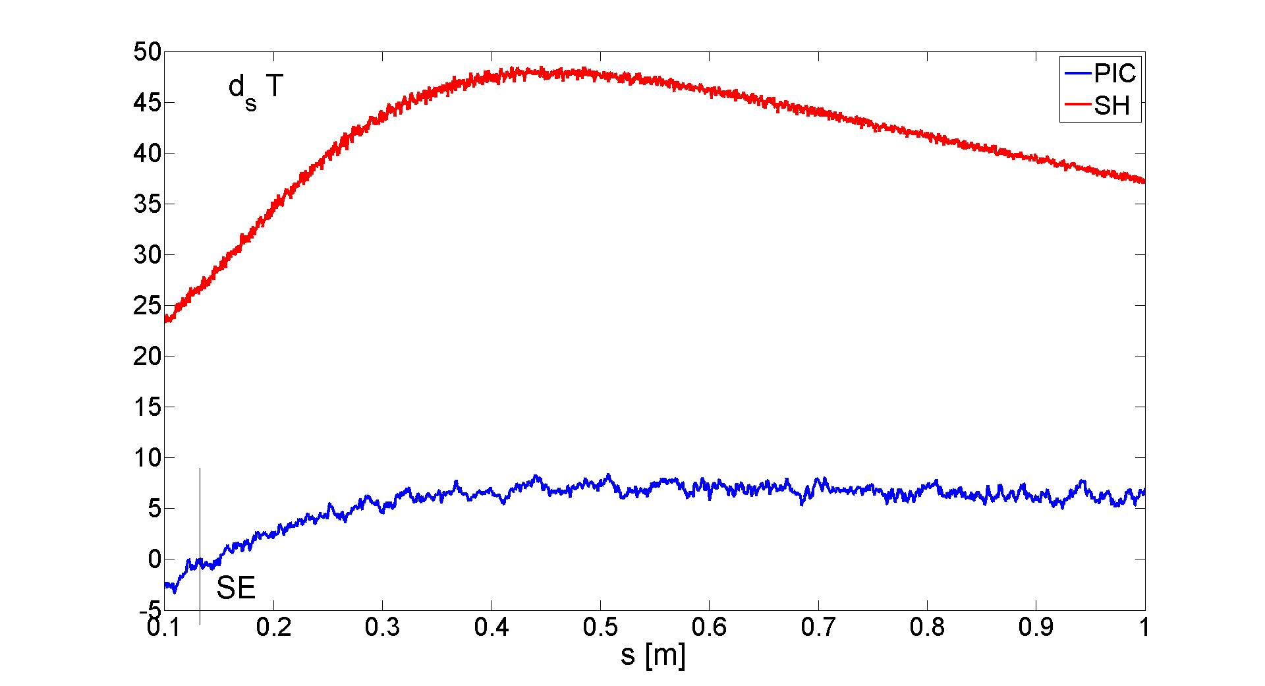
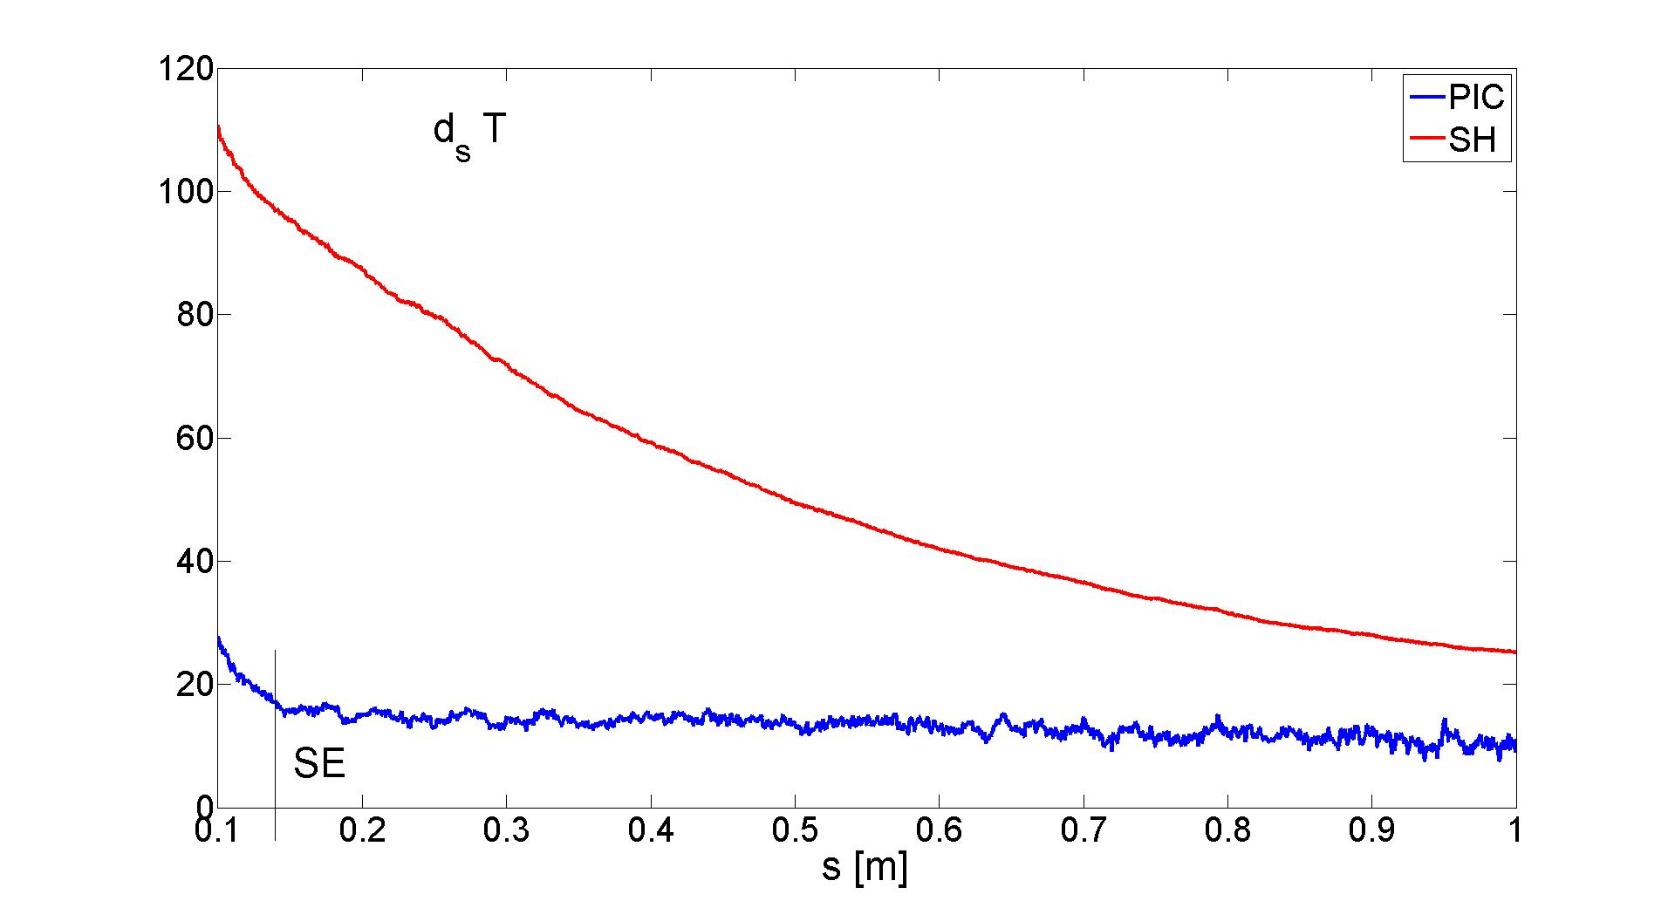
COMPASS with impurity ()
Electrons
D⁺ ions
D. Tskhakaya TSVV3 16.11.2022

Slide 6
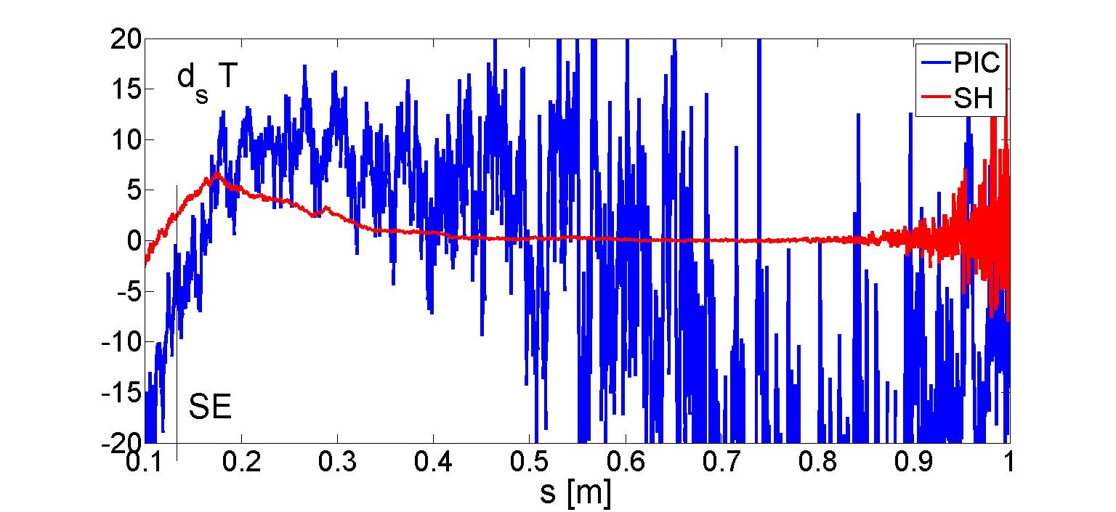
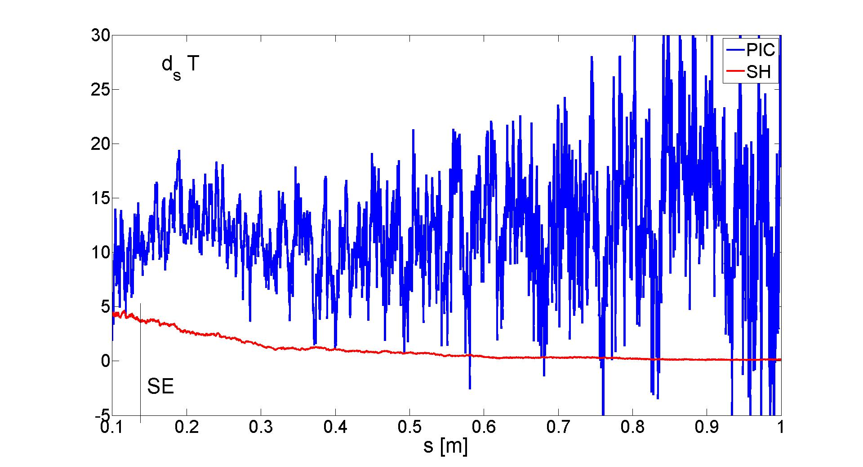
BC for C
D. Tskhakaya TSVV3 16.11.2022

