Slide 1
PIC modelling of the plasma sheath
D. Tskhakaya
Institute of Plasma Physics of the CAS, Prague, Czech Republic

Slide 2
Our tools
BIT1-3 geometry
SPICE2,3 geometry
Plasma source
Electron emission
 | Dimentionaliy / geometry | Collisions | Plasma-wall interaction | simulates | scaling | status
BIT1 | 1D / simple | Coulomb, A@M, DCSM | Plasma recycling, impurity sputtering, secondary electrons | Flux tube in the SOL | 4 – 10 kCores | active
SPIC2 | 2D / complex | - | Thermionic and secondary electrons | Plasma sheath | 100 Cores | active
SPIC3 | 3D / complex | - | Thermionic and secondary electrons | Plasma sheath | 100 Cores | active
BIT2 | 2D | Coulomb, A@M, | Plasma recycling, impurity sputtering, secondary electrons | SOL | > 10 kCores | Frosen (no manpower)
BIT3 | 3D | Coulomb, A@M | Plasma recycling, impurity sputtering, secondary electrons | divertor plasma | > 10 kCores | Slow startup
D. Tskhakaya WP-PWIE 17.11.2022

Slide 3
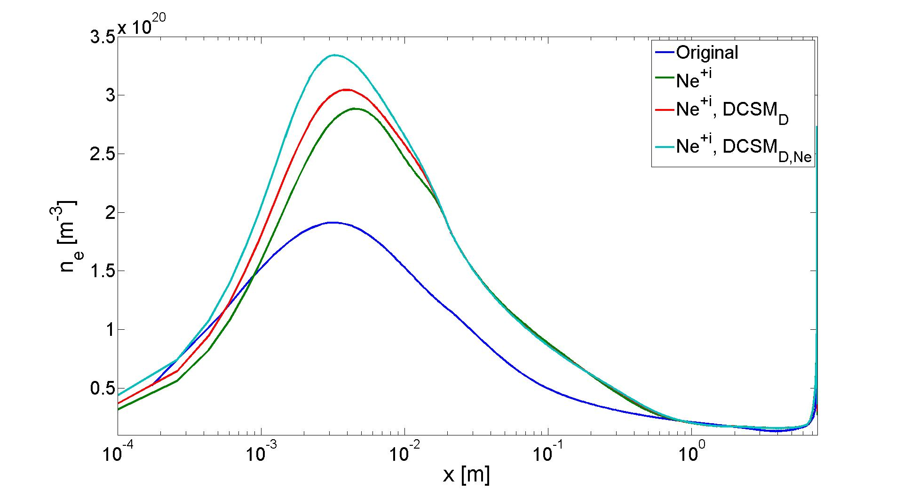
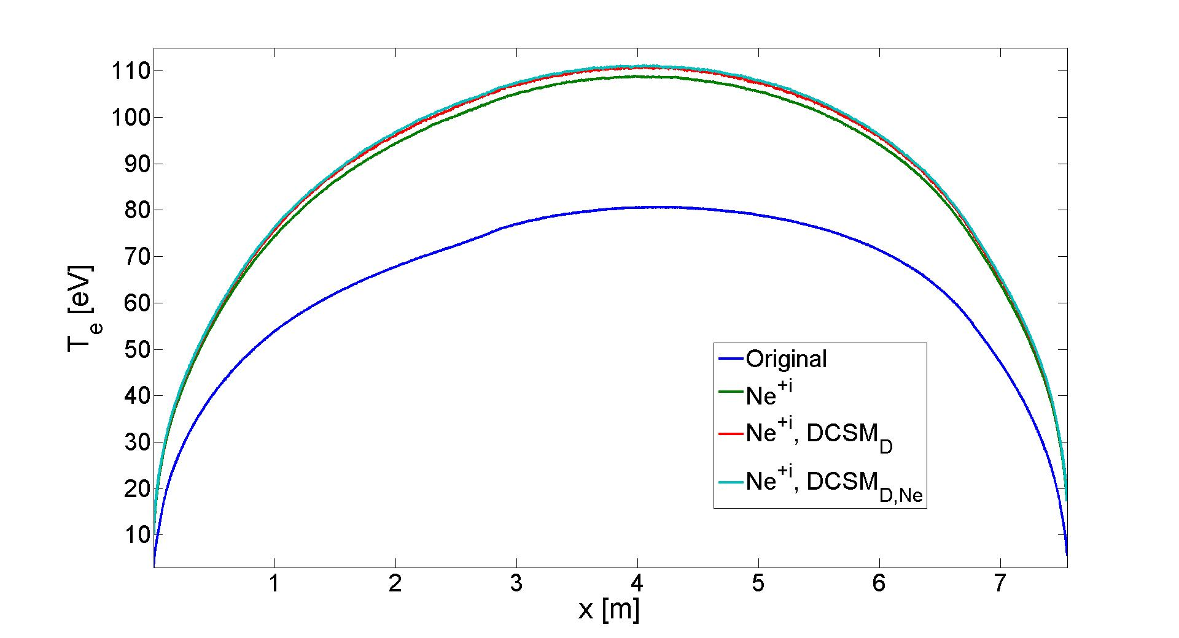
SOL modelling
Electron density and temperature profiles in the JET SOL obtaned from BIT1 with different atomic models
Original^{[1]}: only Ne⁺, ~ 10 atomic collision channels
Ne^{+i}: i= 0, ... 4, ~ 1000 atomic collision channels
Ne^{+i}, DCSM_{D}^{[2]}: RCM for D, >> 1000 atomic collision channels
Ne^{+i}, DCSM_{D, Ne}: RCM for D and Ne, >> 1000 atomic collision channels
[1] D. Tskhakaya, PPCF 2017 [2] D. Tskhakaya, 12th ICAMDATA 2022
D. Tskhakaya WP-PWIE 17.11.2022

Slide 4
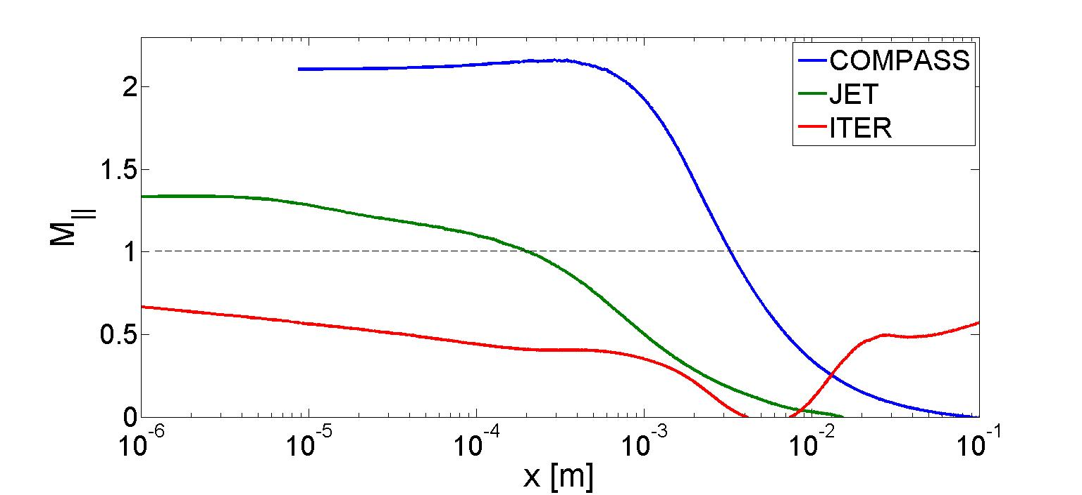
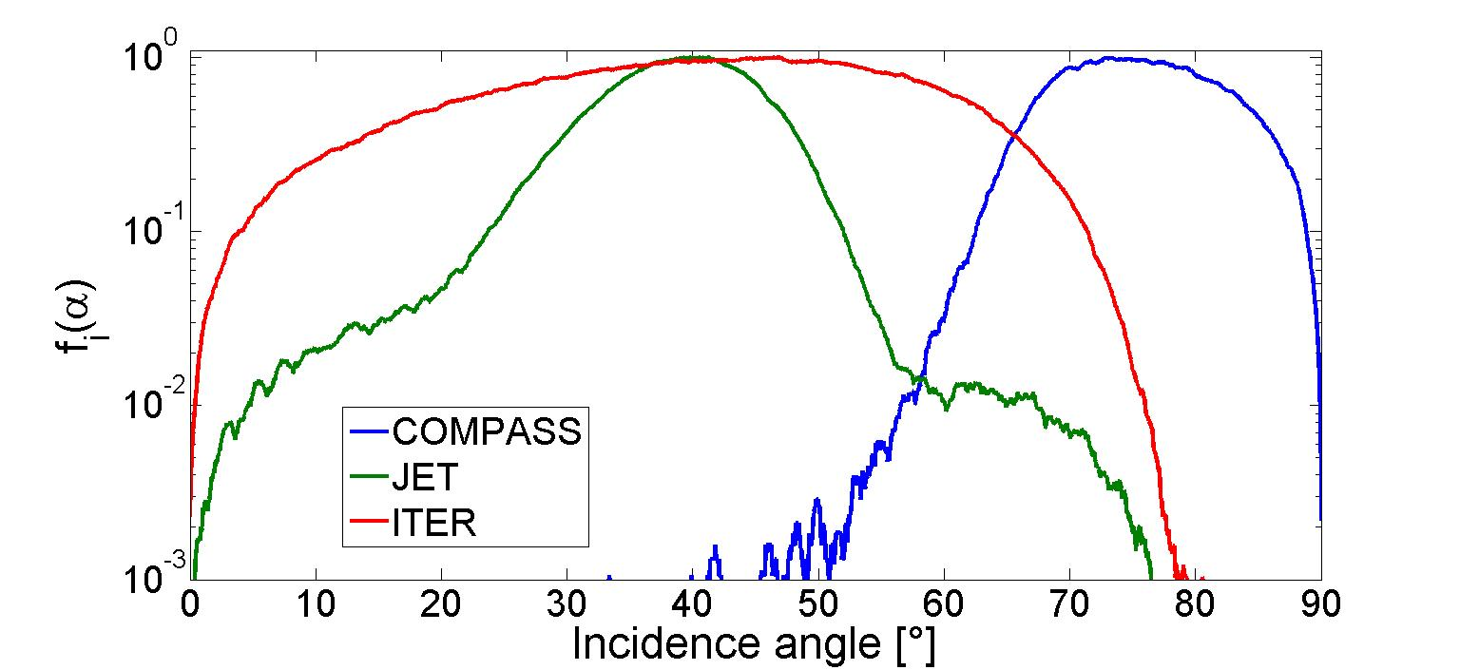
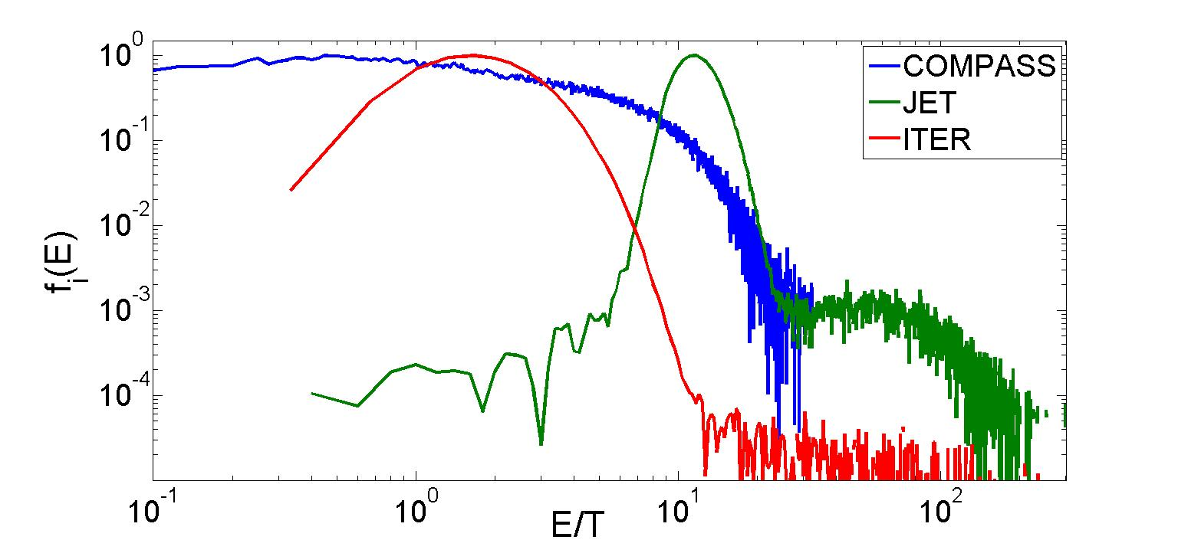
Divertor sheath in a stationary SOL
Mach number profiles in the divertor plasma
ADFs of D⁺ ions impinging on the divertor plate
JET divertor sheath is classical, except:
super-thermal non-Maxwellian electrons carry significant fraction of the heat to the divertor,
A-EDF differ from the classical one
Prompt re-deposition is influenced by exact n and T_{e} shapes
[A. Kirschner PPCF 2018, D. Tskhakaya PPCF 2017]
D. Tskhakaya WP-PWIE 17.11.2022
EDFs of D⁺ ions impinging on the divertor plate

Slide 5
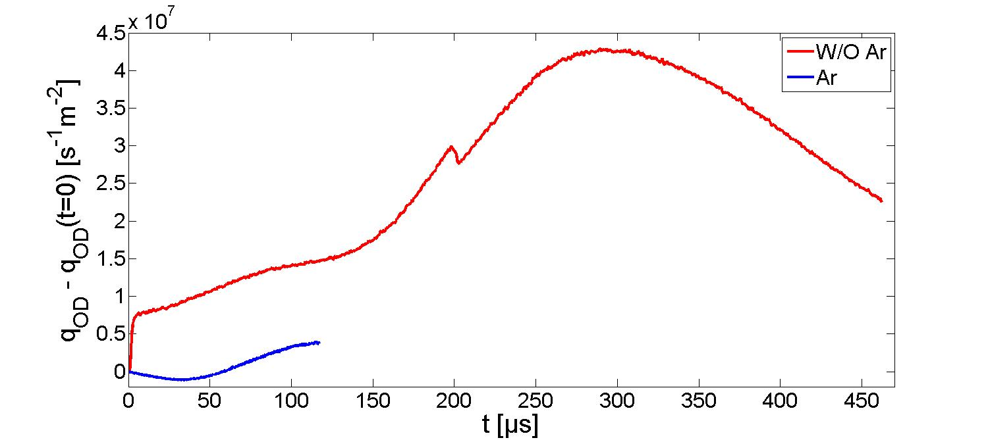
Type-I 60 kJ ELM (ASDEX)
OD power loads
Γ_{e,D+}
T_{sep}
intra-
Pre-
after-ELM
t
Schematic of the ELM modelling
Strong buffering caused by (too) high divertor Z_{eff} as well as by high density pre-ELM divertor plasma
[R.A. Pitts, NF 2007, D. Tskhakaya, JNM 2009, 2011, A. Huber, DS 2021]
D. Tskhakaya WP-PWIE 17.11.2022

Slide 6
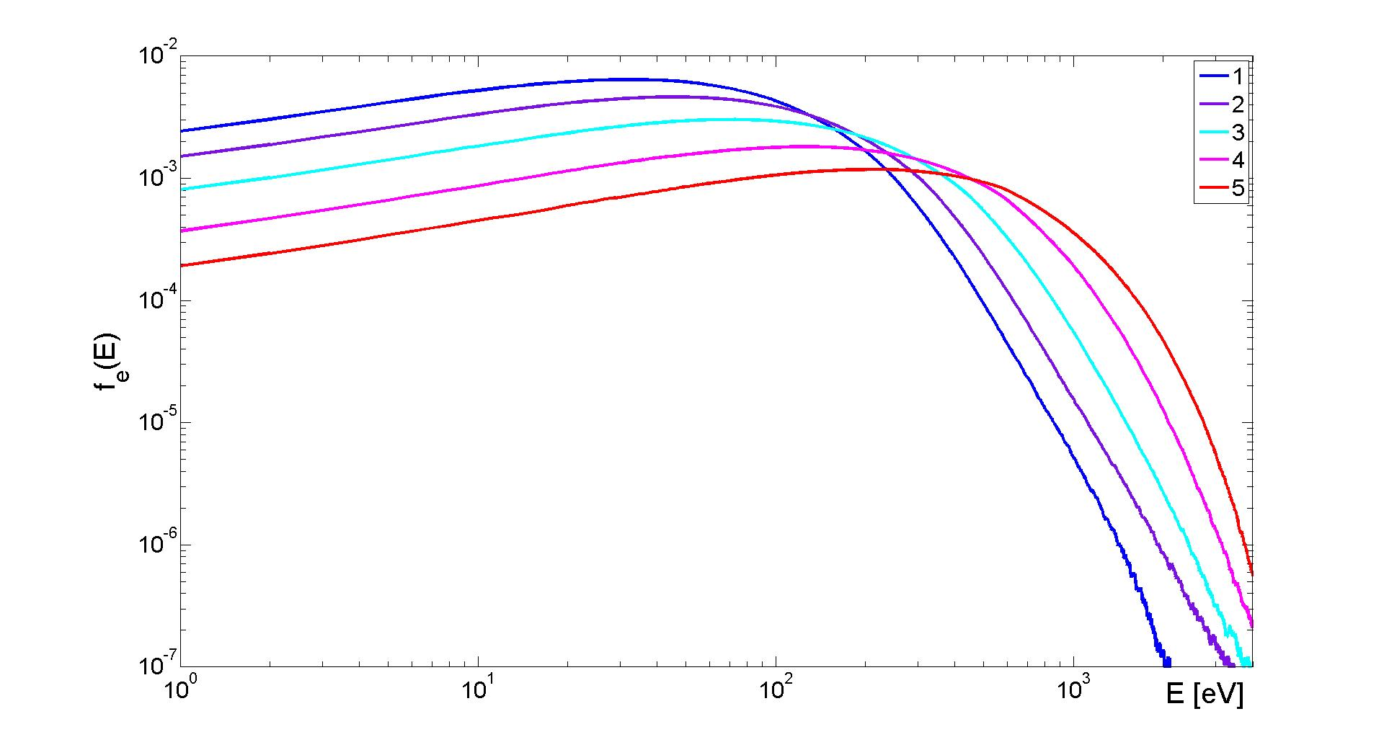
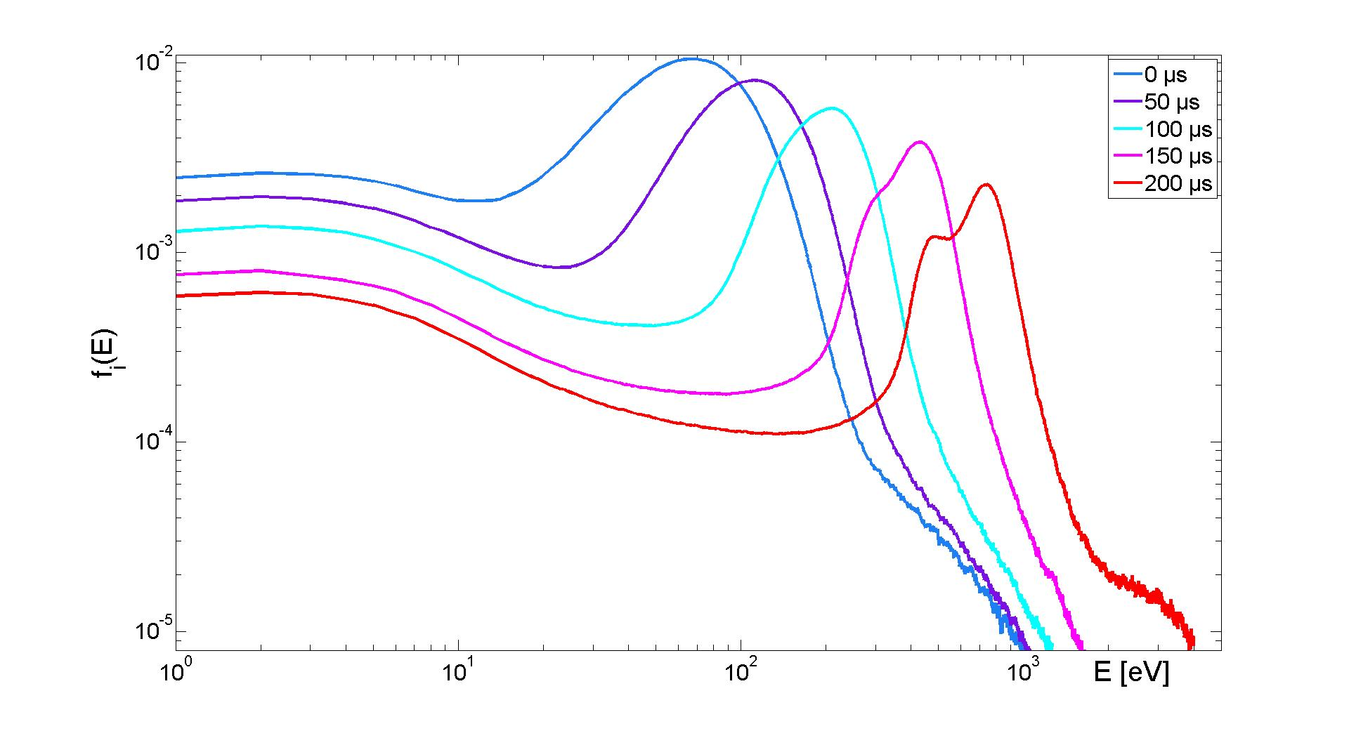
Divertor sheath in an ELM-ing SOL
EDF for electrons and ions from ELMy SOL modelling of ASDEX-tokamak SOL with Type-I 60 kJ ELM
EDFs are far from the Maxwellian at any time
D. Tskhakaya WP-PWIE 17.11.2022

Slide 7
Introduction
We run 1D SOL flux tube modelling routinely (M21-03 D-T), many kinetic effects identified
Different colisionless 2D and 3D sheath models with complex wall shape are (can be) modelled
2D kinetic SOL code is „on hold“ (no manpower)
3D divertor code – 1st runs must be completed in 2022
What we can provide: background plasma inside and outside divertor sheath, effective sputtering yields (prompt redeposition is self-consistently included)
The price we pay for full kinetic simulations: simplified SOL geometry
CPU time (~1-10 M core hours per model)
D. Tskhakaya WP-PWIE 17.11.2022

