Slide 1


+
2022 Monitoring Meeting EUROfusion ENR Project (ENR-TEC.01.KIT)
New Generation of Megawatt-Class Fusion Gyrotron Systems Based on Highly Efficient Operation at the Second Harmonic of the Cyclotron Frequency (ENR-TEC.01.KIT)
Stefan Illy on behalf of the ENR Project Team

Slide 2
Outline
Introduction / Main Objective and Approach
Studies on MW-class 2nd Harmonic Operation (w/o Injection Locking)
Mode Converting Outer Corrugations
Studies on MW-class 2nd Harmonic Operation with Injection Locking
Research on Coupling System for Injection Locking
Depressed Collector for 2nd Harmonic Gyrotron Operation
Conclusion and Outlook

Slide 3
Introduction

Slide 4
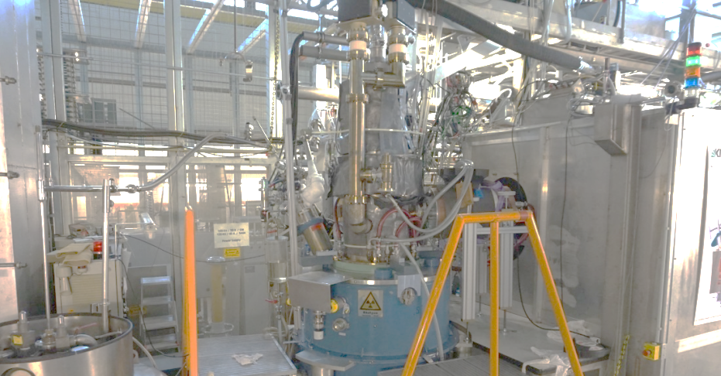
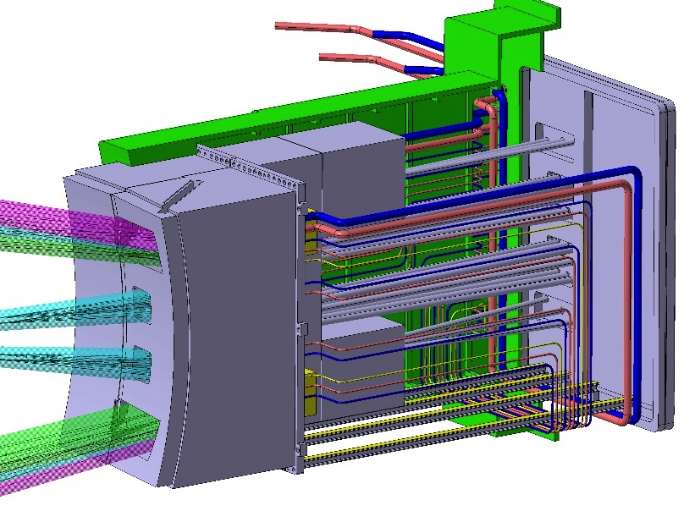
Key Components of the DEMO EC System
Gyrotron
EC equatorial launcher
4
Quasi-optical transmission line
Plasma

Slide 5
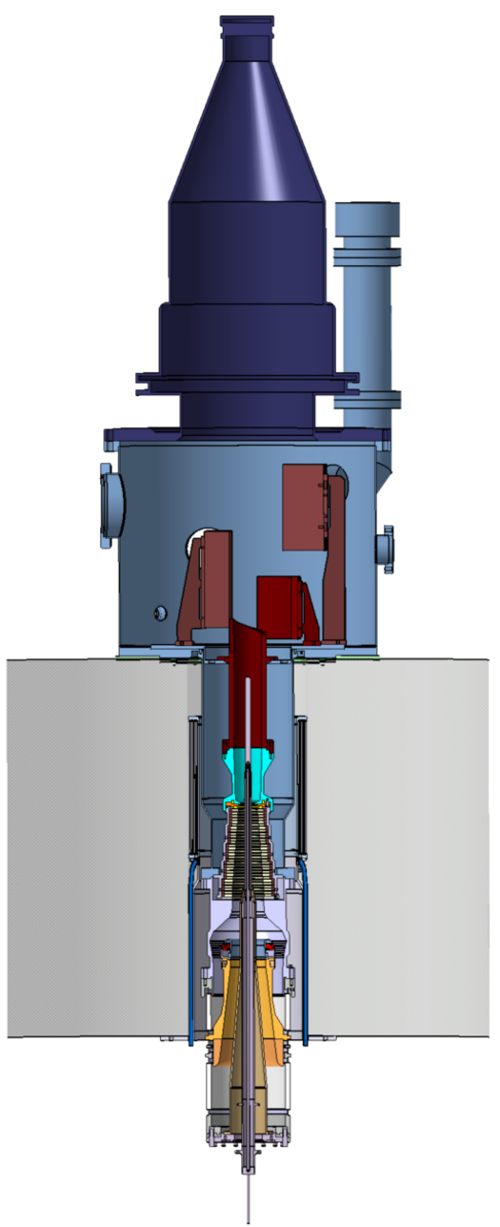
Key Components of the DEMO EC System
Gyrotron
Collector
Gaussian beam output at CVD diamond window
Height ~3 m, weight ~1 ton
EC equatorial launcher
Super Conducting Magnet (s = 1)
~6 T @140 GHz
~7 T @170 GHz
~8 T @200 GHz
~10 T @240 GHz
f [GHz] ~ s·28/γ·B [T]
Coaxial cavity
5
Cathode/Emitter (MIG)
Quasi-optical transmission line
Plasma

Slide 6
Key Components of the DEMO EC System
Gyrotron
Collector
Gaussian beam output at CVD diamond window
Height ~3 m, weight ~1 ton
EC equatorial launcher
Super Conducting Magnet (s = 1)
~6 T @140 GHz
~7 T @170 GHz
~8 T @200 GHz
~10 T @240 GHz
f [GHz] ~ s·28/γ·B [T]
Coaxial cavity
6
Cathode/Emitter (MIG)
Quasi-optical transmission line
Plasma
The required magnetic field becomes an issue for operation at > 200 GHz
→ Gyrotrons operating at 2nd Harmonic (s=2) might be the solution!

Slide 7
Main Objective and Approach
We aim for a completely new generation of highly efficient, megawatt-class fusion gyrotrons that will operate at the 2nd harmonic (s = 2) of the electron cyclotron frequency.
Three enabling technologies will be addressed:
  The coaxial-type cavity technology that is specifically adapted to the operation at
  2nd harmonics in combination with advanced inner and outer corrugations.
  Injection locking using an external driving source.
  The Multi-stage Depressed Collector (MDC) technology based on E×B drift concept.

Slide 8
T1.2.1:
Enabling research on corrugations for second harmonic operation

Slide 9
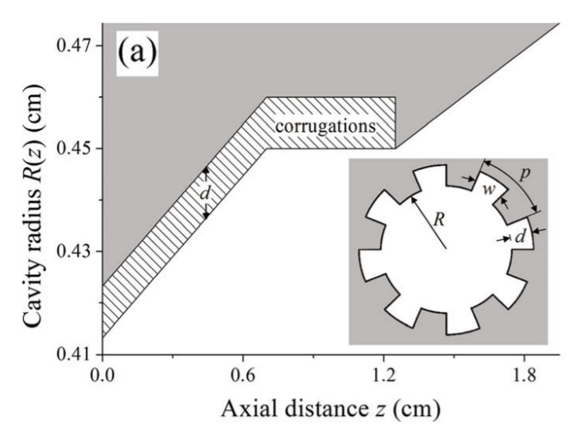
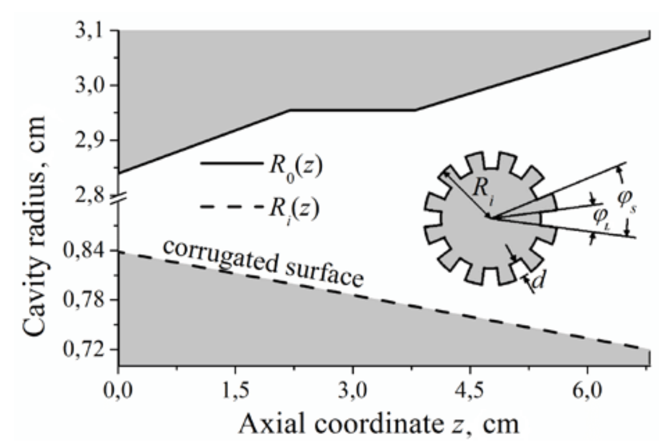
Inner and Outer Corrugations
Inner corrugations (insert)
Outer (wall) corrugations
standard
non-standard
Effect due to impedance corrugation
→ Attenuates unwanted modes
Effect due to mode conversion
→ Converts energy to other modes

Slide 10
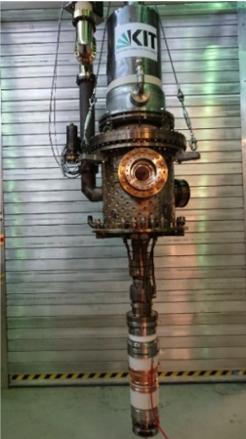
Fundamental KIT Coaxial 2 MW Gyrotron
Operating mode TE_{34,19}
Frequency 170 GHz
Output power 2 MW
Magnetic field 6.9 T
No second harmonic operation possible, because of the fundamental competitors
New cavity design for second harmonic interaction necessary
3.45 T

Slide 11
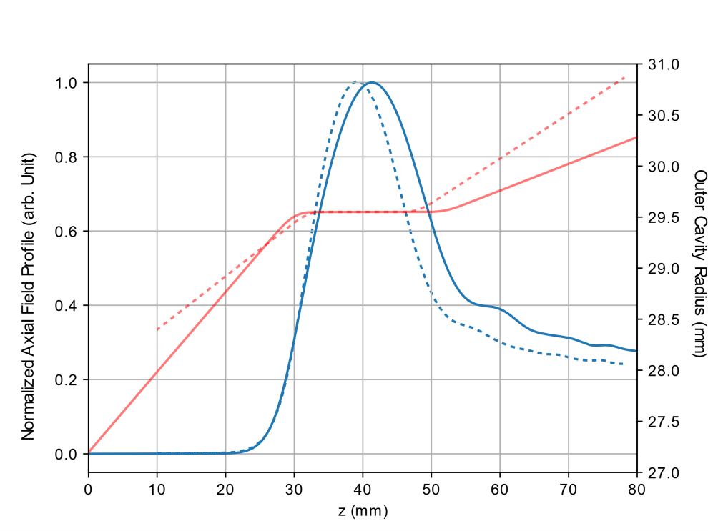
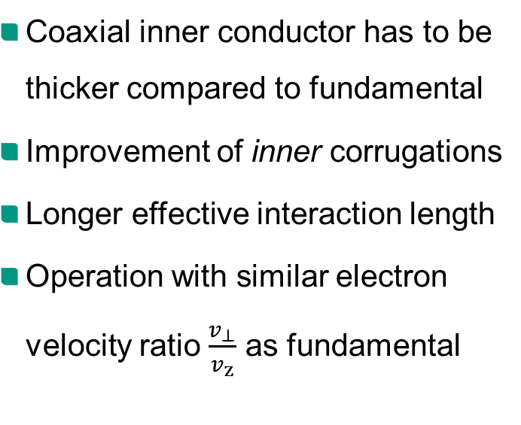
New Second Harmonic Cavity
Coaxial inner conductor has to be thicker compared to fundamental
Improvement of inner corrugations
Longer effective interaction length
Operation with similar electron velocity ratio $\frac{v_{⊥}}{v_{z}}$ as fundamental
Fundamental
Second Harmonic
Fundamental
Second Harmonic

Slide 12
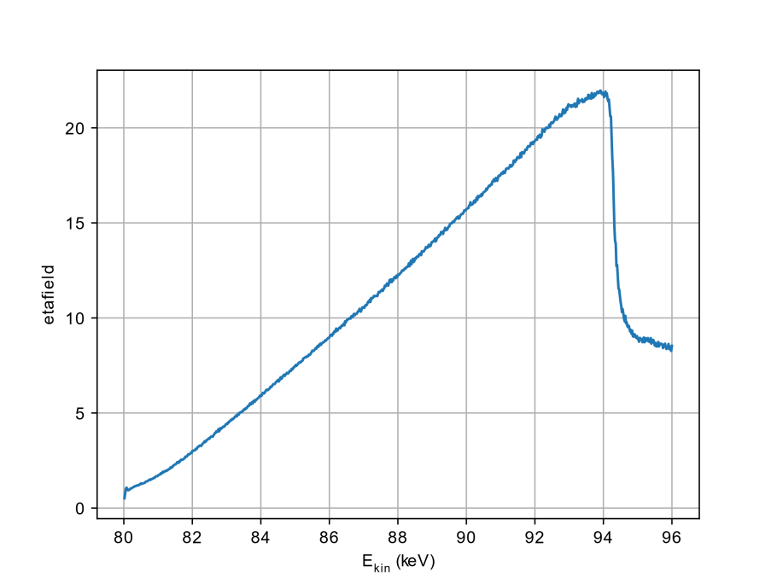
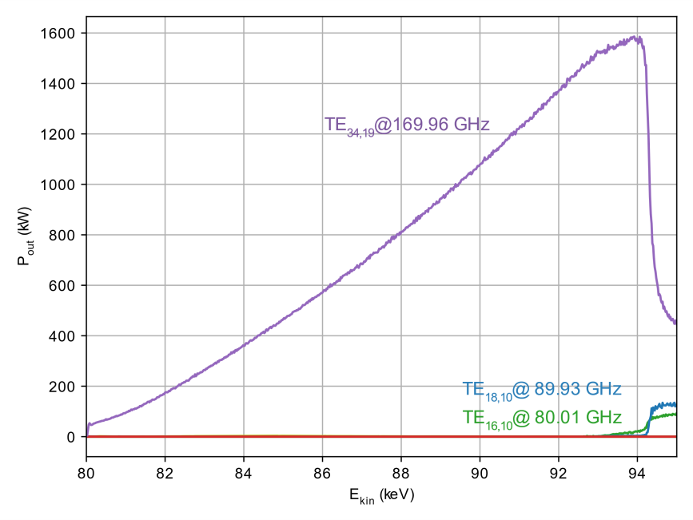



Efficiency and Output Power
$$P_{out}$$
$$η_{elec}$$
$$η_{elec}$$
Limitation: thermal loading on inner conductor (230 W/cm² / red dot)
Comfortable margin ( ) between operating point and mode loss

Slide 13
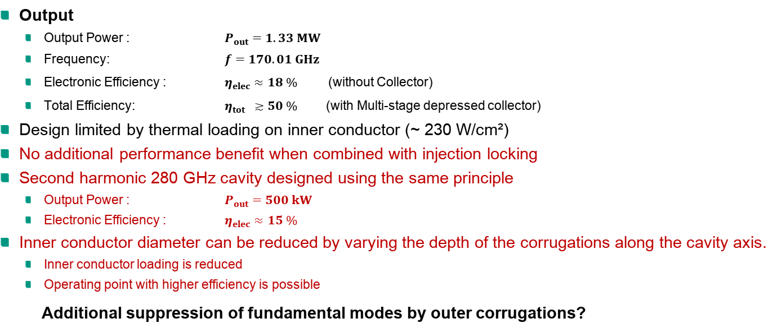
Inner Corrugation Results
Output
  Output Power : $P_{out}=1.33 MW$
  Frequency: $f=170.01 GHz$
  Electronic Efficiency : $η_{elec}≈18 \%$ (without Collector)
  Total Efficiency: $η_{tot} ≳50 \%$ (with Multi-stage depressed collector)
Design limited by thermal loading on inner conductor (~ 230 W/cm²)
No additional performance benefit when combined with injection locking
Second harmonic 280 GHz cavity designed using the same principle
  Output Power : $P_{out}=500 kW$
  Electronic Efficiency : $η_{elec}≈15 \%$
Inner conductor diameter can be reduced by varying the depth of the corrugations along the cavity axis.
  Inner conductor loading is reduced
  Operating point with higher efficiency is possible
Additional suppression of fundamental modes by outer corrugations?

Slide 14
Mode Converting Outer Corrugations

Slide 15
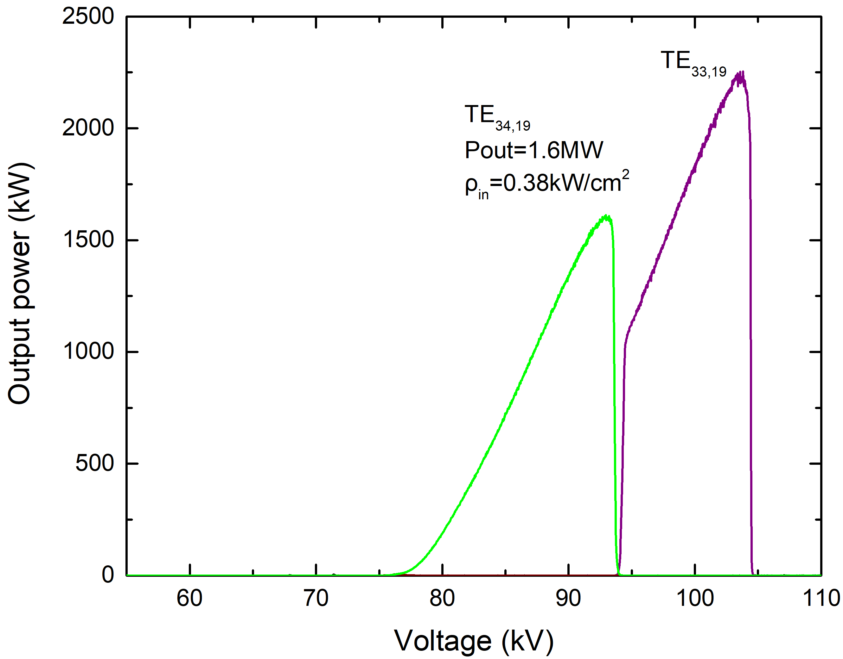
Excitation of TE_{34,19} at 170 GHz
Introduction of M=25 outer corrugations at midsection according to developed strategy on mode-coupling schemes; optimization of cavity tapers.
P=1.6 MW, η_{elec}=22% is demonstrated, increased compared to the case with inner corrugations only. Ohmic losses density within acceptable limits.
Outer corrugations can mitigate mode competition and improve the operation stability of a coaxial cavity, allowing for operation with a very high-order mode at second harmonic.
Output power of TE_{34,19} in the upgraded cavity. The operating stability range is 0.4mm in beam radius, improved compared to the case with inner corrugations only.

Slide 16
Alternative: excitation of TE_{37,18} at 170 GHz (1)
To validate the strategy of choice of the mode-coupling scheme with outer corrugations, excitation of TE_{37,18} was also pursued.
Parametric studies with respect to R_{b} and B indicated that TE_{37,18} cannot be excited with inner corrugations only due to severe mode competition.
Main competing mode TE_{17,10} was suppressed by introducing M=25 outer corrugations in the mid-section only, following generic strategies developed during this year.
To increase beam power, the beam voltage has been increased appropriately (I_{b}=80 A,V_{b}=130 kV, B=3.675 T).

Slide 17
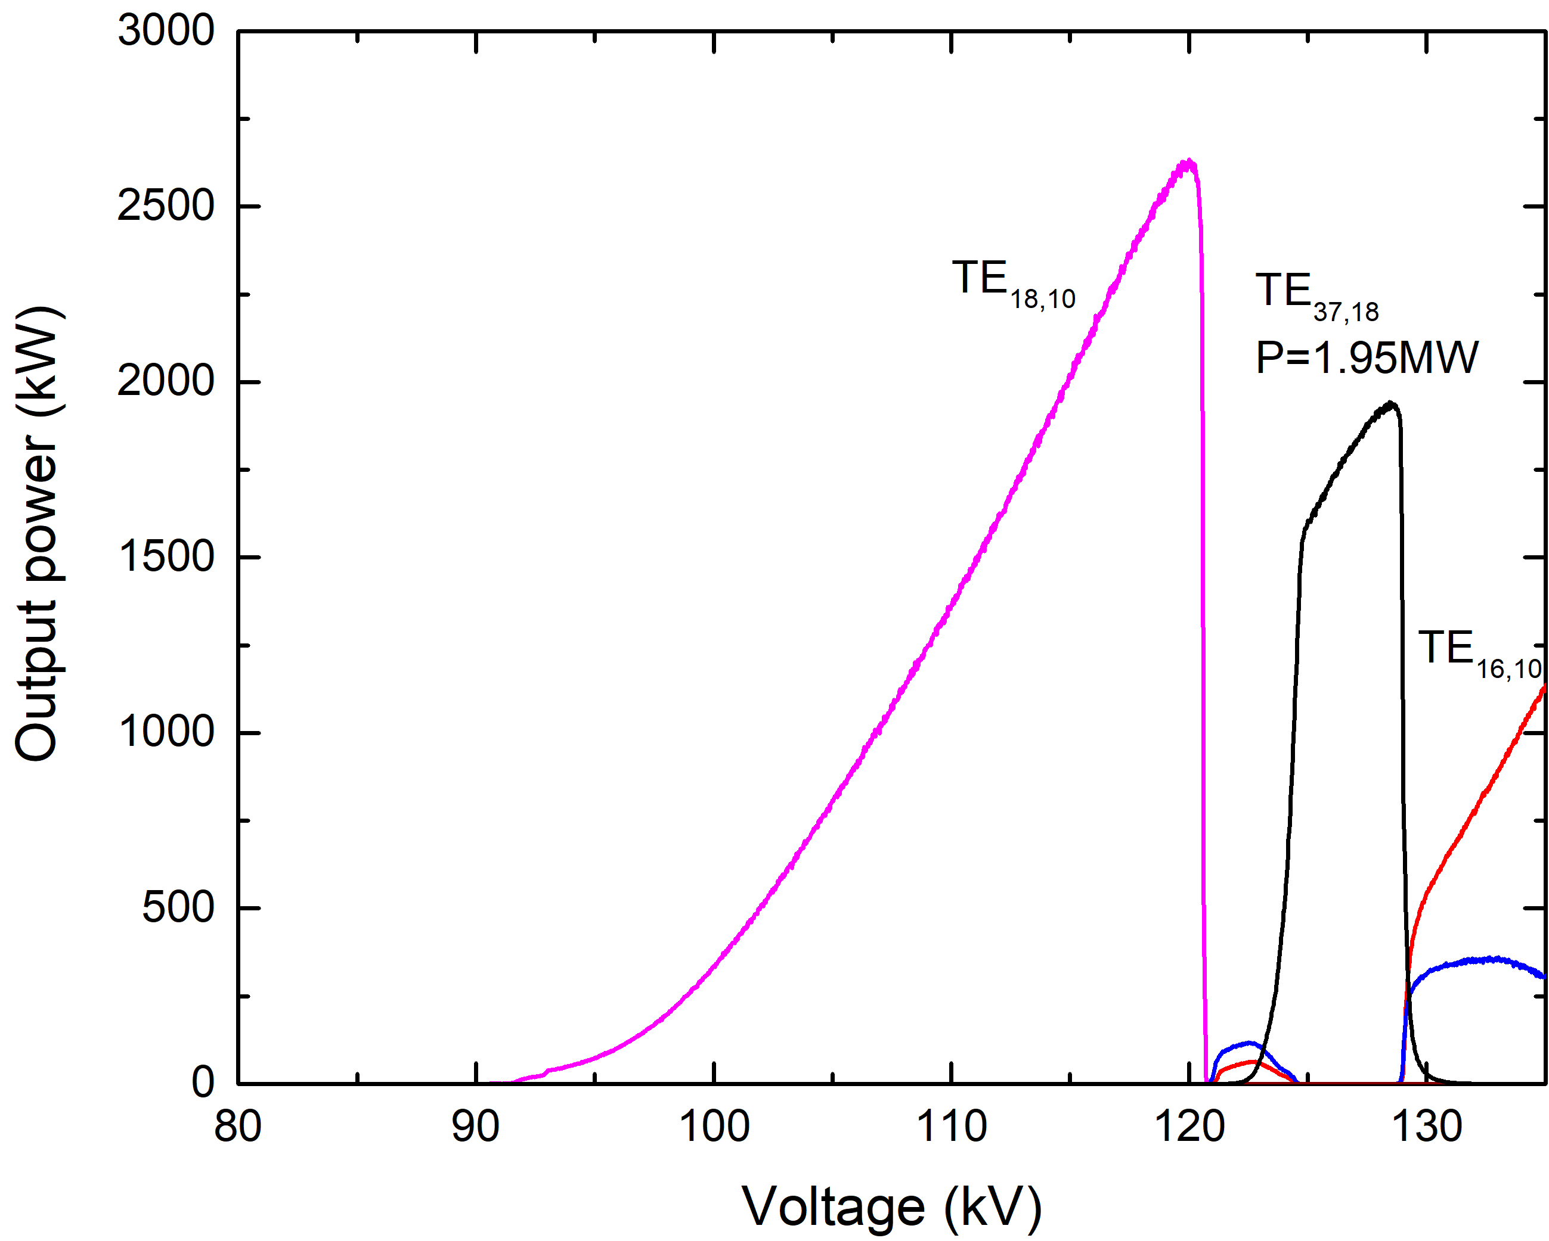
Excitation of TE_{37,18} at 170GHz (2)
TE_{37,18} is excited with P=1.95 MW, η_{elec}=20% and ohmic losses densities much lower than the acceptable limits.
Considering the previous findings, the introduction of outer corrugations can successfully mitigate mode competition and allow the excitation of a specific mode at second harmonic (which otherwise cannot be excited).
Output power of TE_{37,18} in the cavity with increased smoothing and outer corrugations.

Slide 18
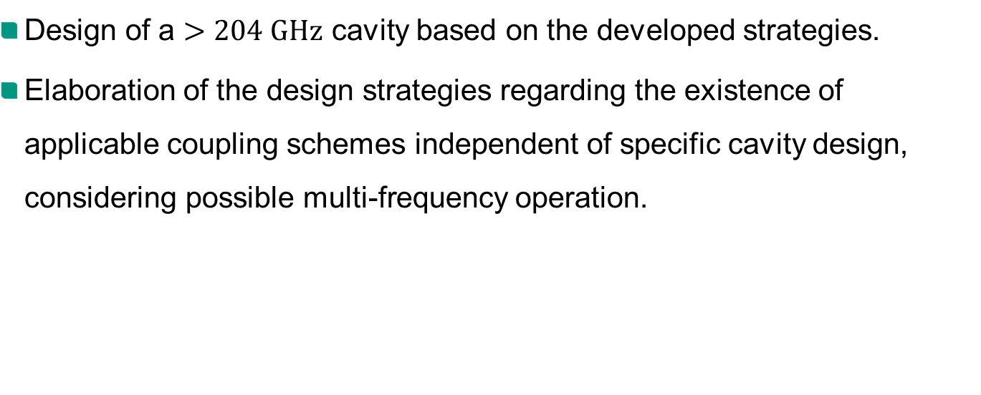
Task T1.2.2 Outlook
Design of a $>204 GHz$ cavity based on the developed strategies.
Elaboration of the design strategies regarding the existence of applicable coupling schemes independent of specific cavity design, considering possible multi-frequency operation.

Slide 19
T1.1.1:
Studies on MW-class 2nd Harmonic Operation with Injection Locking

Slide 20
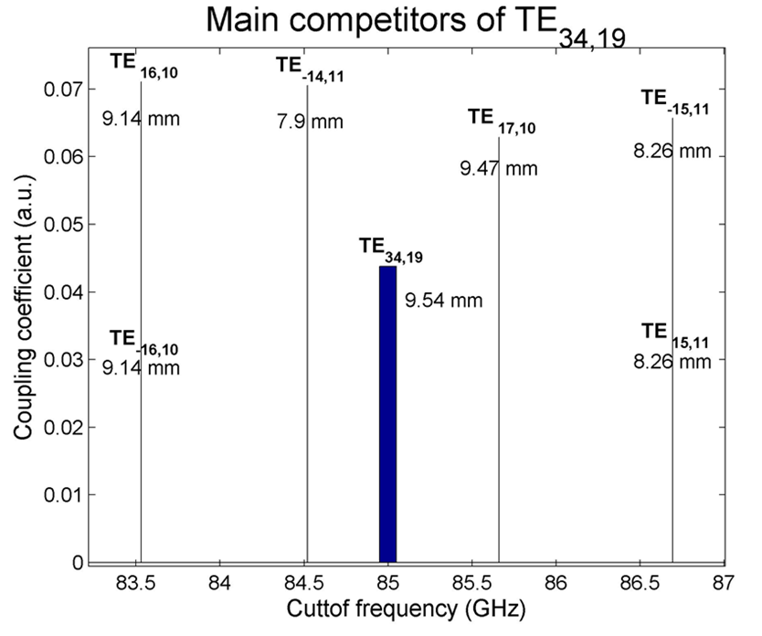
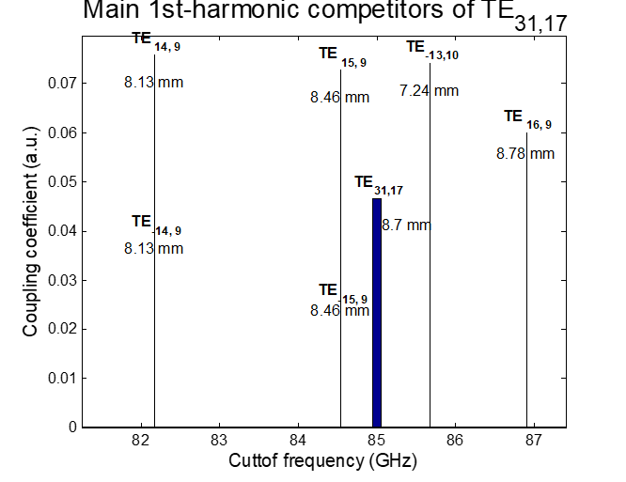
Development of a new mode-selection strategy for high-power 2nd-harmonic operation
TE_{34,19} is not suitable for 2-MW 2nd-harmonic operation since it is strongly inhibited by its 1st-harmonic competitor TE_{17,10}:
  TE_{17,10} is close to TE_{34,19} in terms of frequency and has higher coupling.
  TE_{17,10} has larger caustic radius so it is not affected by the insert.
After testing different strategies we have arrived at a new mode-selection strategy for high-power 2nd-harmonic operation:
  tolerate 1st-harmonic competitors that lie close in frequency provided that they have smaller caustic so they can be suppressed by the insert.
  a pool of candidate modes have been found to satisfy the criteria: TE_{31,17}, TE_{33,17}, TE_{31,19}, TE_{29,21}, TE_{31,21}. The initial design of 2nd-harmonic cavities at 170 GHz has given excellent results .

Slide 21

170 GHz design using injection locking
The injection of an external signal allows the excitation of modes with higher eigenvalues and the increase of output power/efficiency. Best performance was found with the use of the mode TE_{31,21} (eigenvalue ~108):
Multi-mode simulation considering 93 modes (1st- and 2nd-harmonic competitors).
  Net output power 2.35 MW, η_{elec}=21%.
  Maximum power achieved with ρ_{out}=2.2kW/cm² and ρ_{in}=0.37 kW/cm² at 96 kV, 120.5 A, α=1.3.
  Injected power 200 kW (total RF power 2.55 MW).
  Stability bandwidth with respect to injected signal frequency ~ 25 MHz.
A 2.0 MW rated 2nd-harmonic gyrotron at 170 GHz appears to be possible.

Slide 22
Tasks T1.1.1/T2.1/T2.2 Outlook
Finalize the design of the cavities operating at 170 GHz, in view of possible experimental verification in the future.
Search for pairs of modes satisfying our mode-selection criteria for
multi-frequency operation at 170/204 GHz.
Design new cavities for 280 GHz or higher starting with modes TE_{31,17} (with existing coaxial technology) and TE_{31,21} (+ injection locking).
Further studies on the influence of the mode purity of the injected signal on the operation with injection locking.
Study the possibility of pre-bunching cavities to reduce the required injected power.

Slide 23
T1.1.2:
Research on a Coupling System for Injection Locking

Slide 24
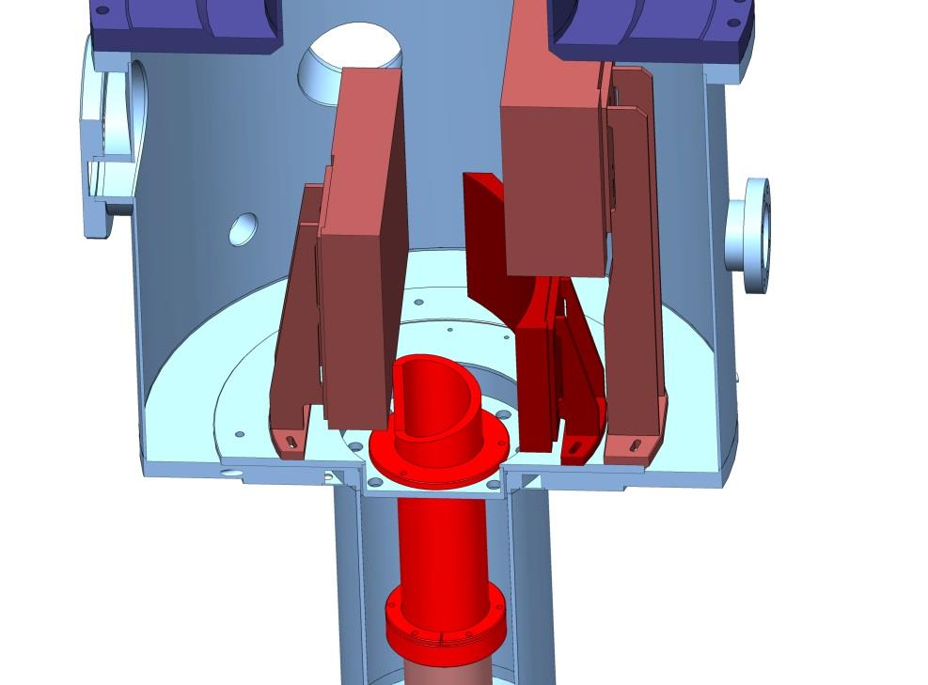
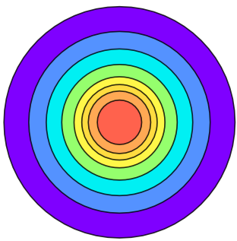
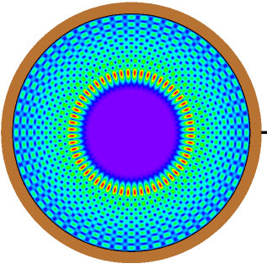
Research on Coupling System for Injection Locking
Beam shaping mirror
Output
wave
beam
Output wave beam
Output:
TEM_{0,0}
[Gaussian mode]
Input wave beam
Launcher
Quasi-parabolic mirror
Structure of conventional quasi-optical system
Launcher for co- and counter-rotation operating modes used for phase locking operation.
Input:
TE-mode

Slide 25
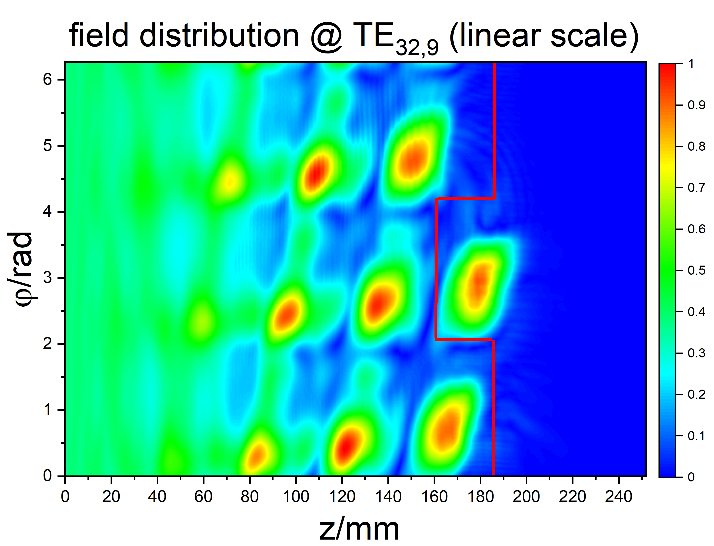
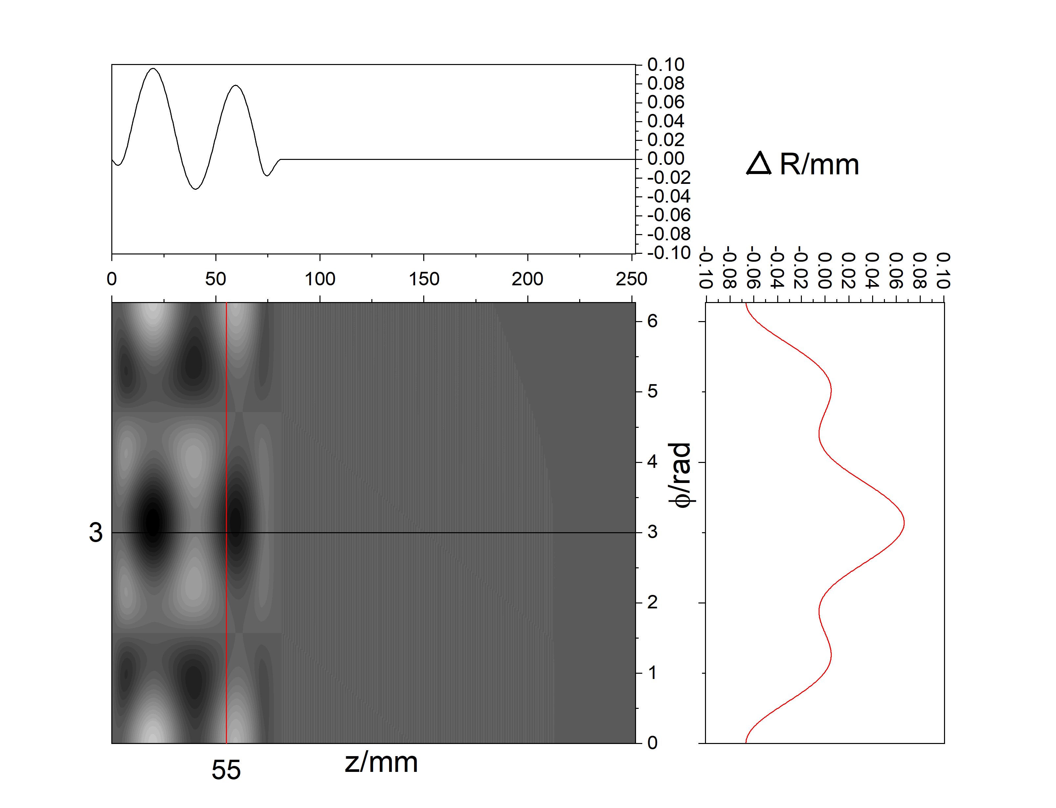
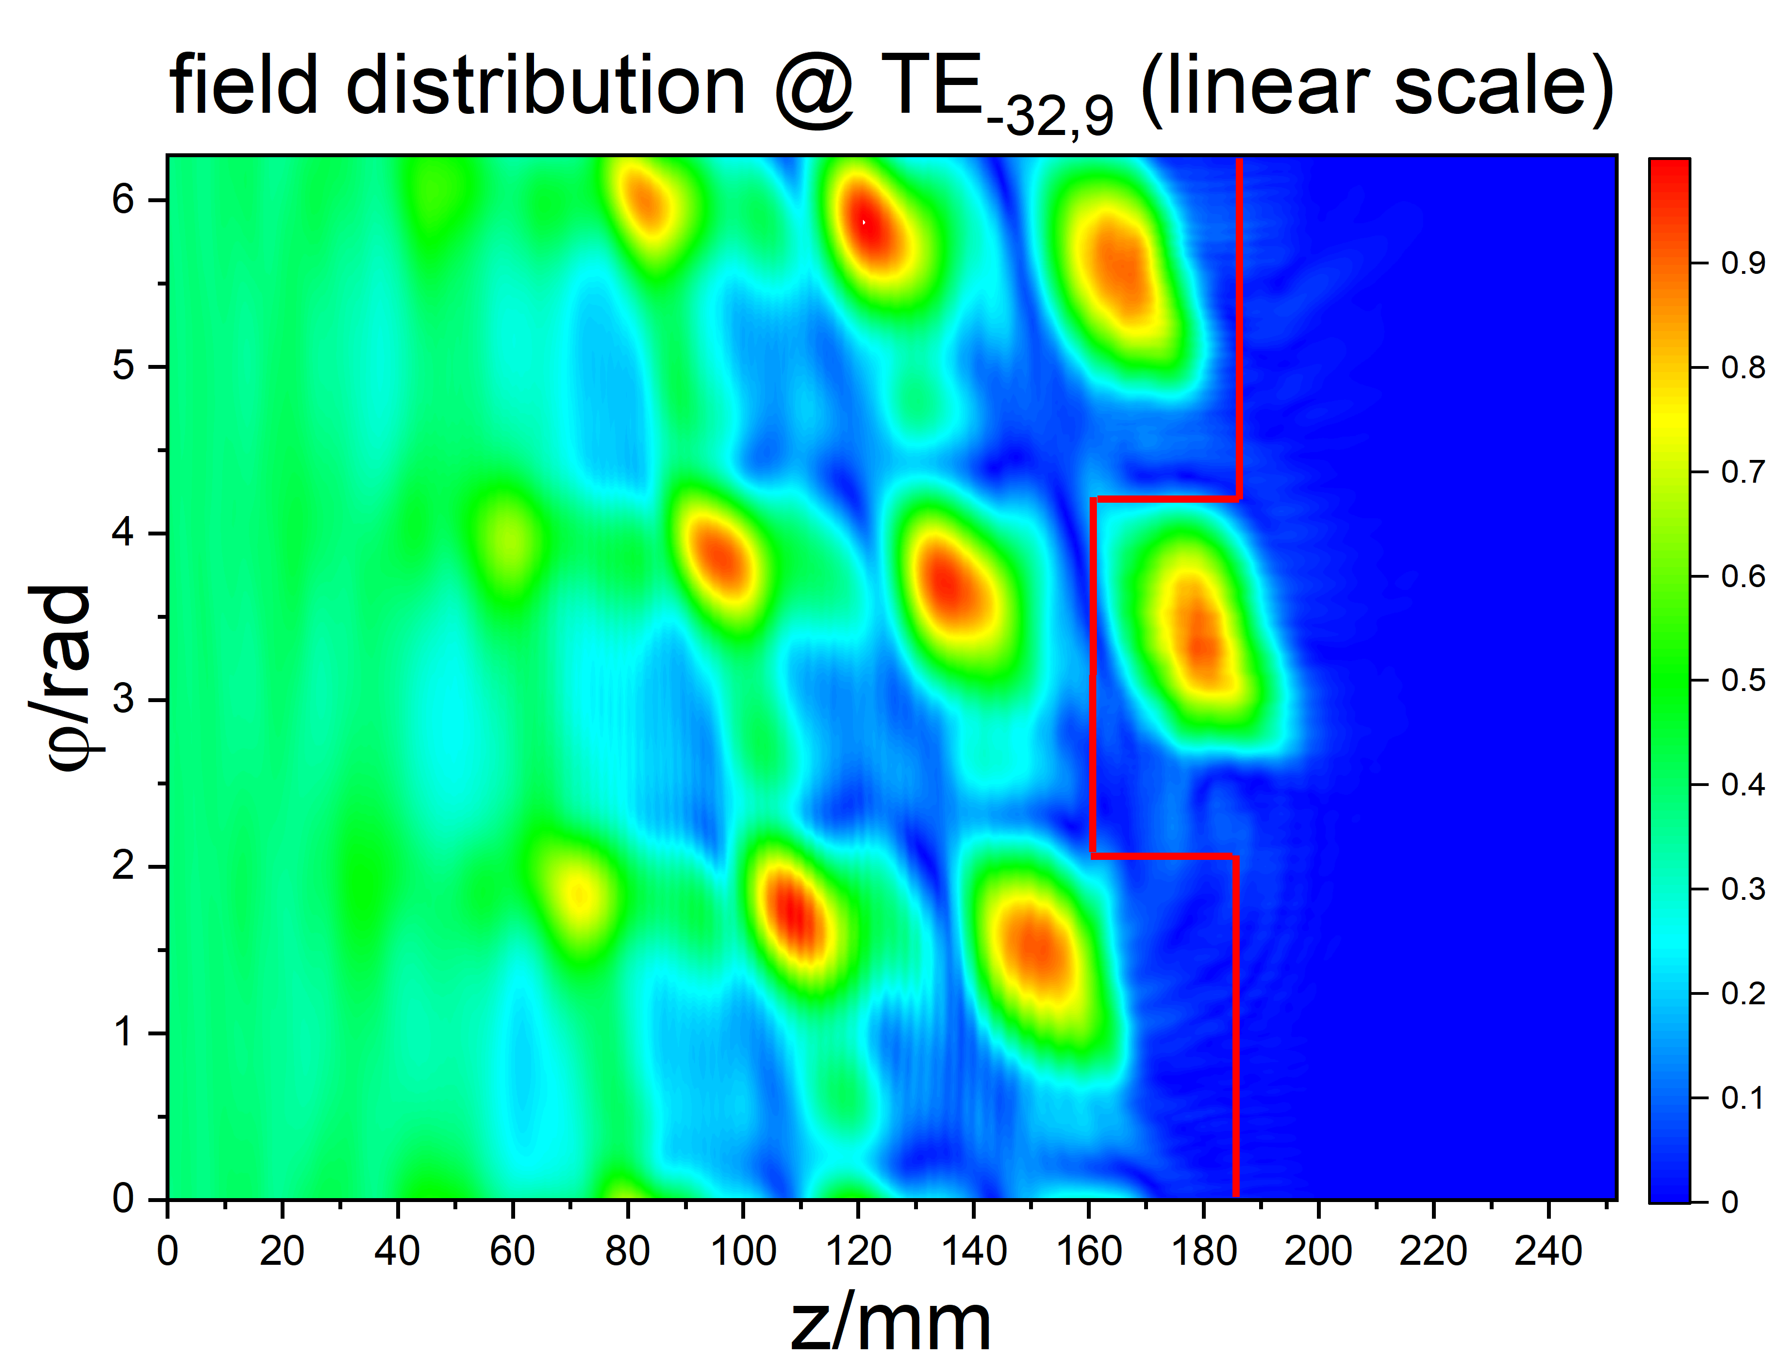
Research on Coupling System for Injection Locking
Design of a Denisov-type launcher
for co- (TE_{32,9} mode) and counter- (TE_{-32,9} mode), 170 GHz
Profile on unrolled launcher wall:
Gaussian mode content: 96.65 %

Slide 26
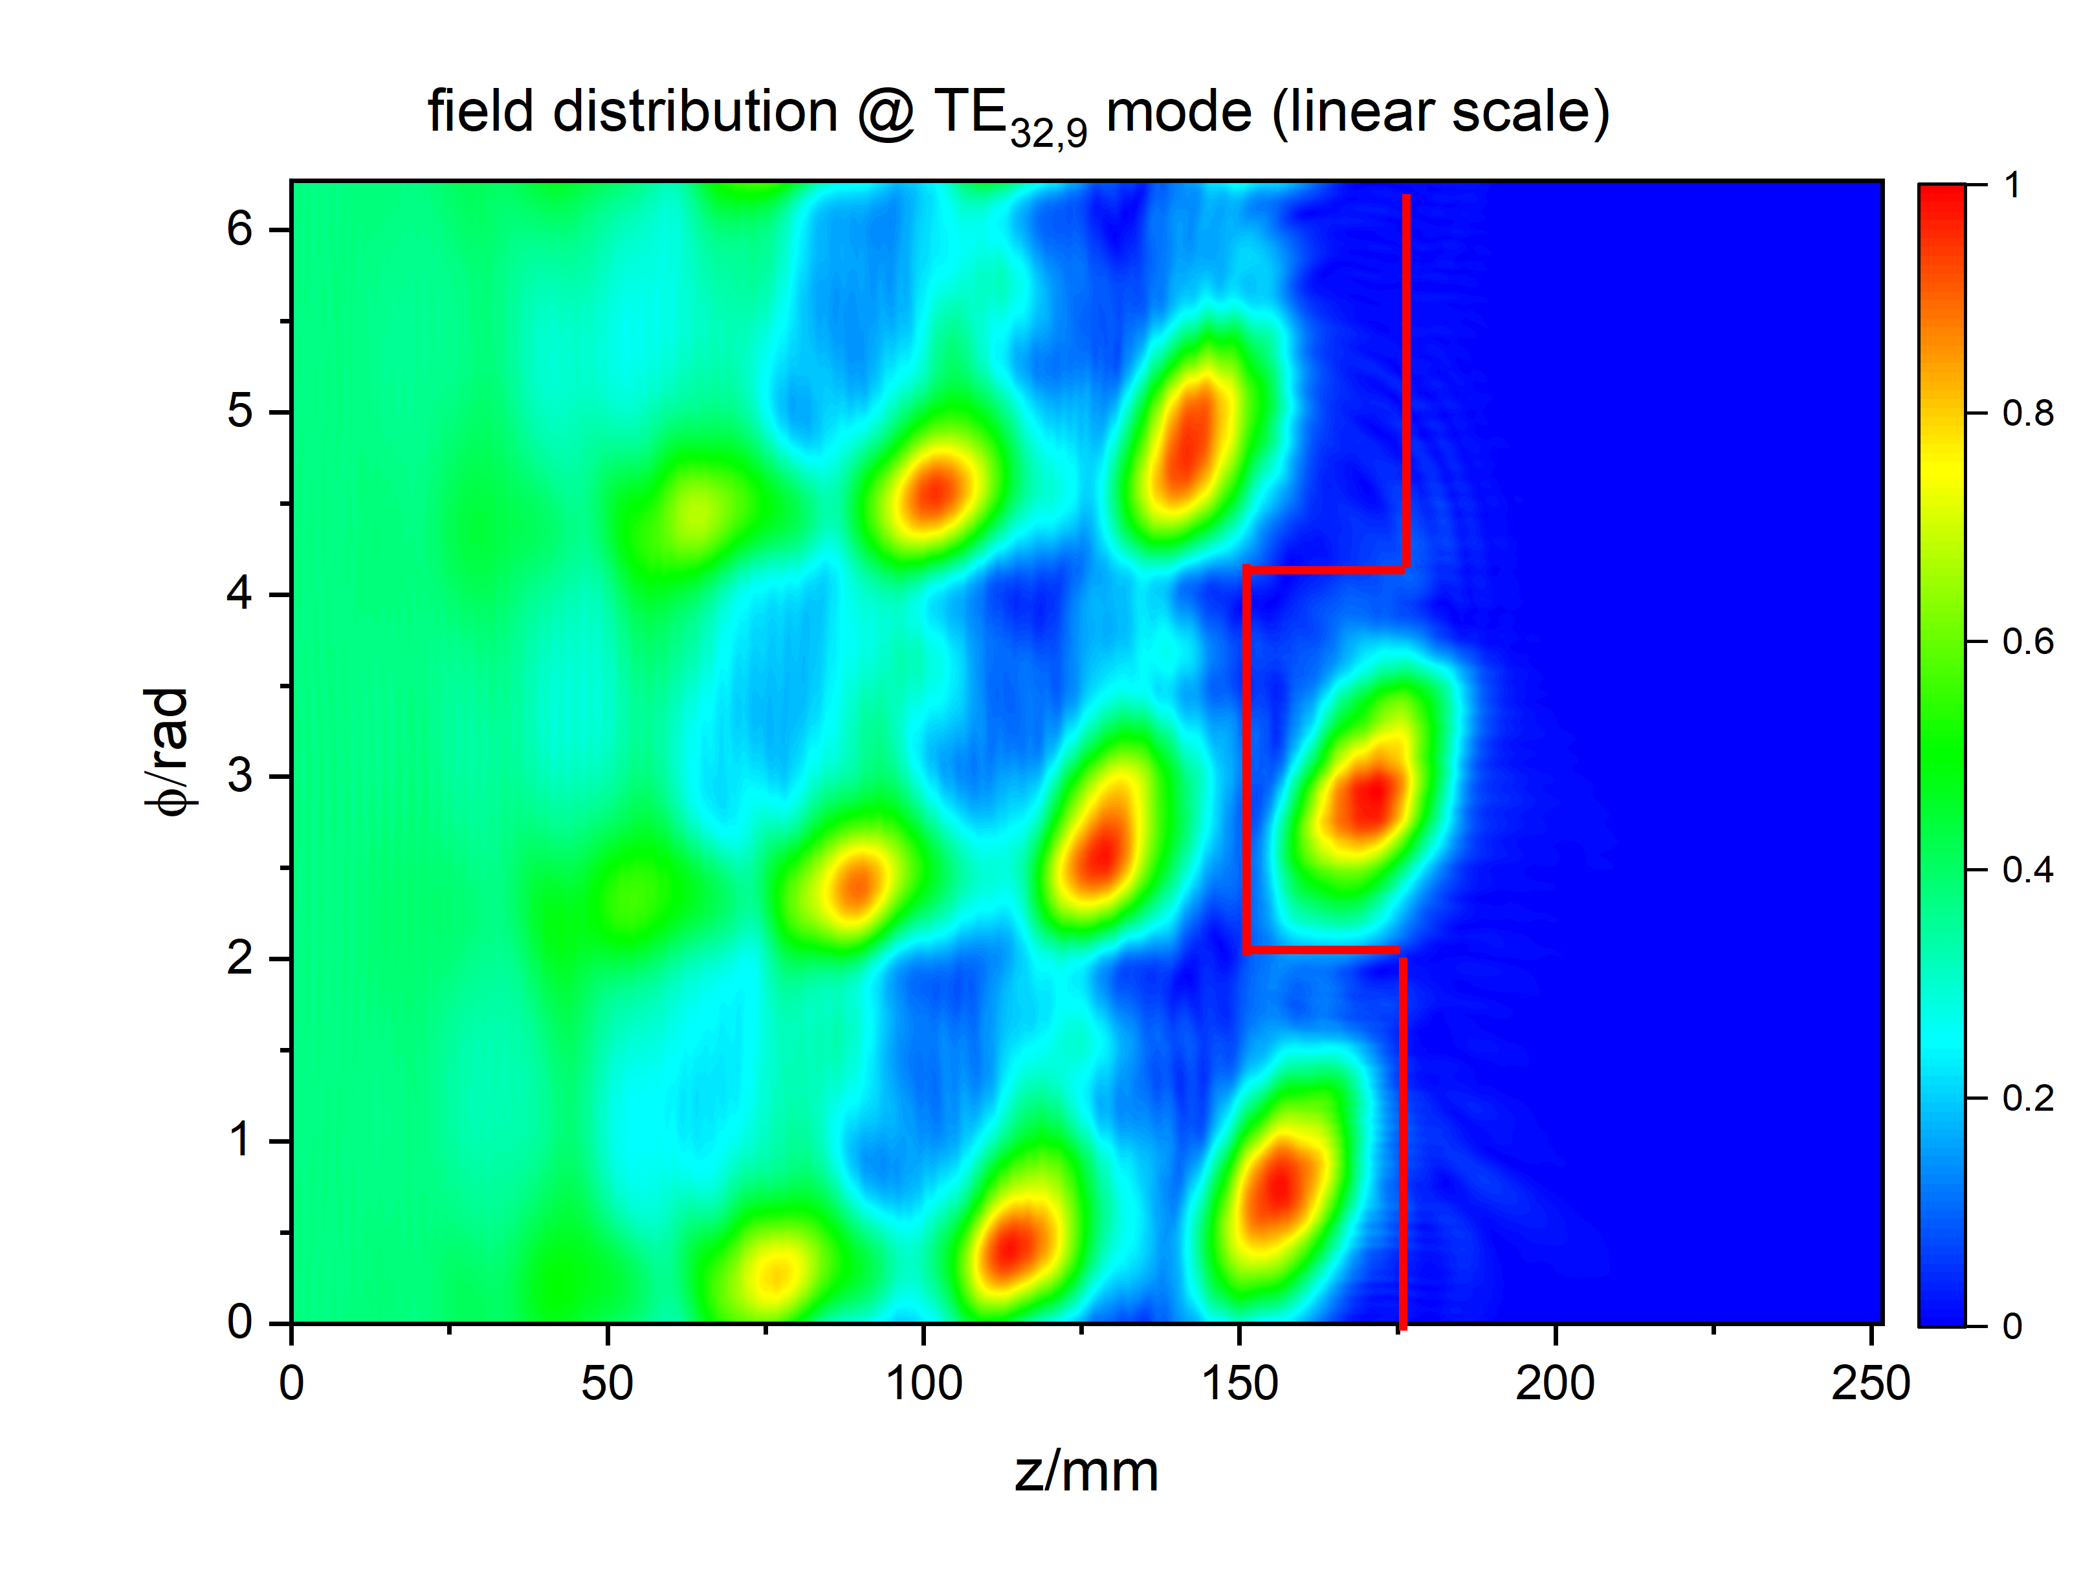
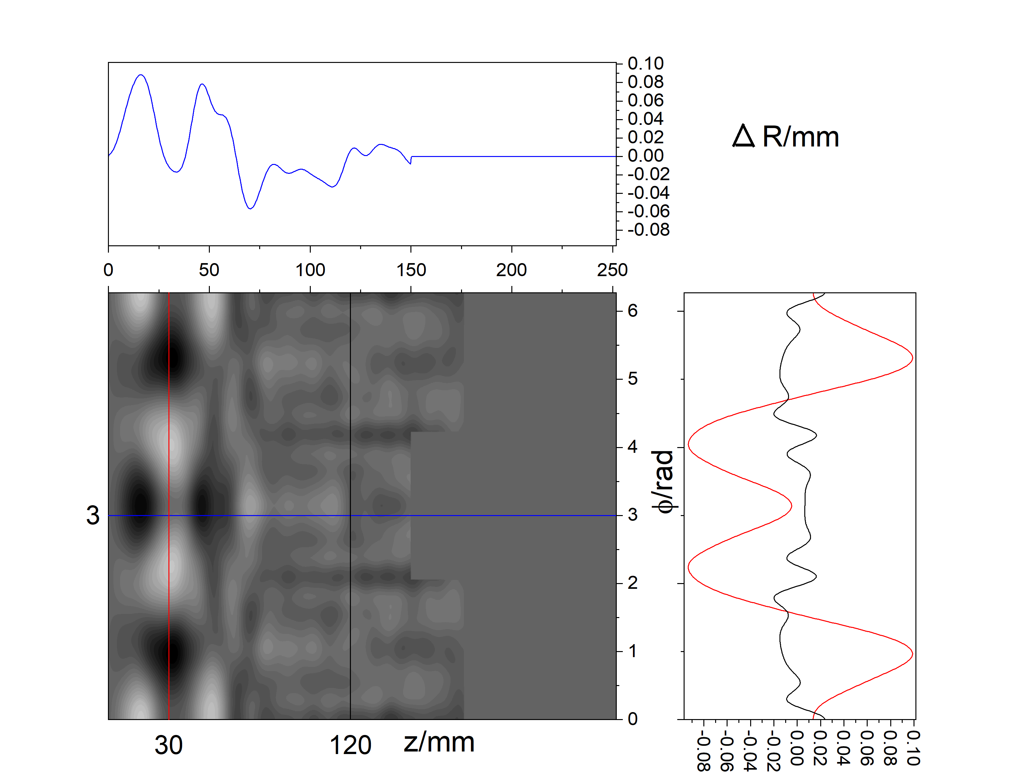
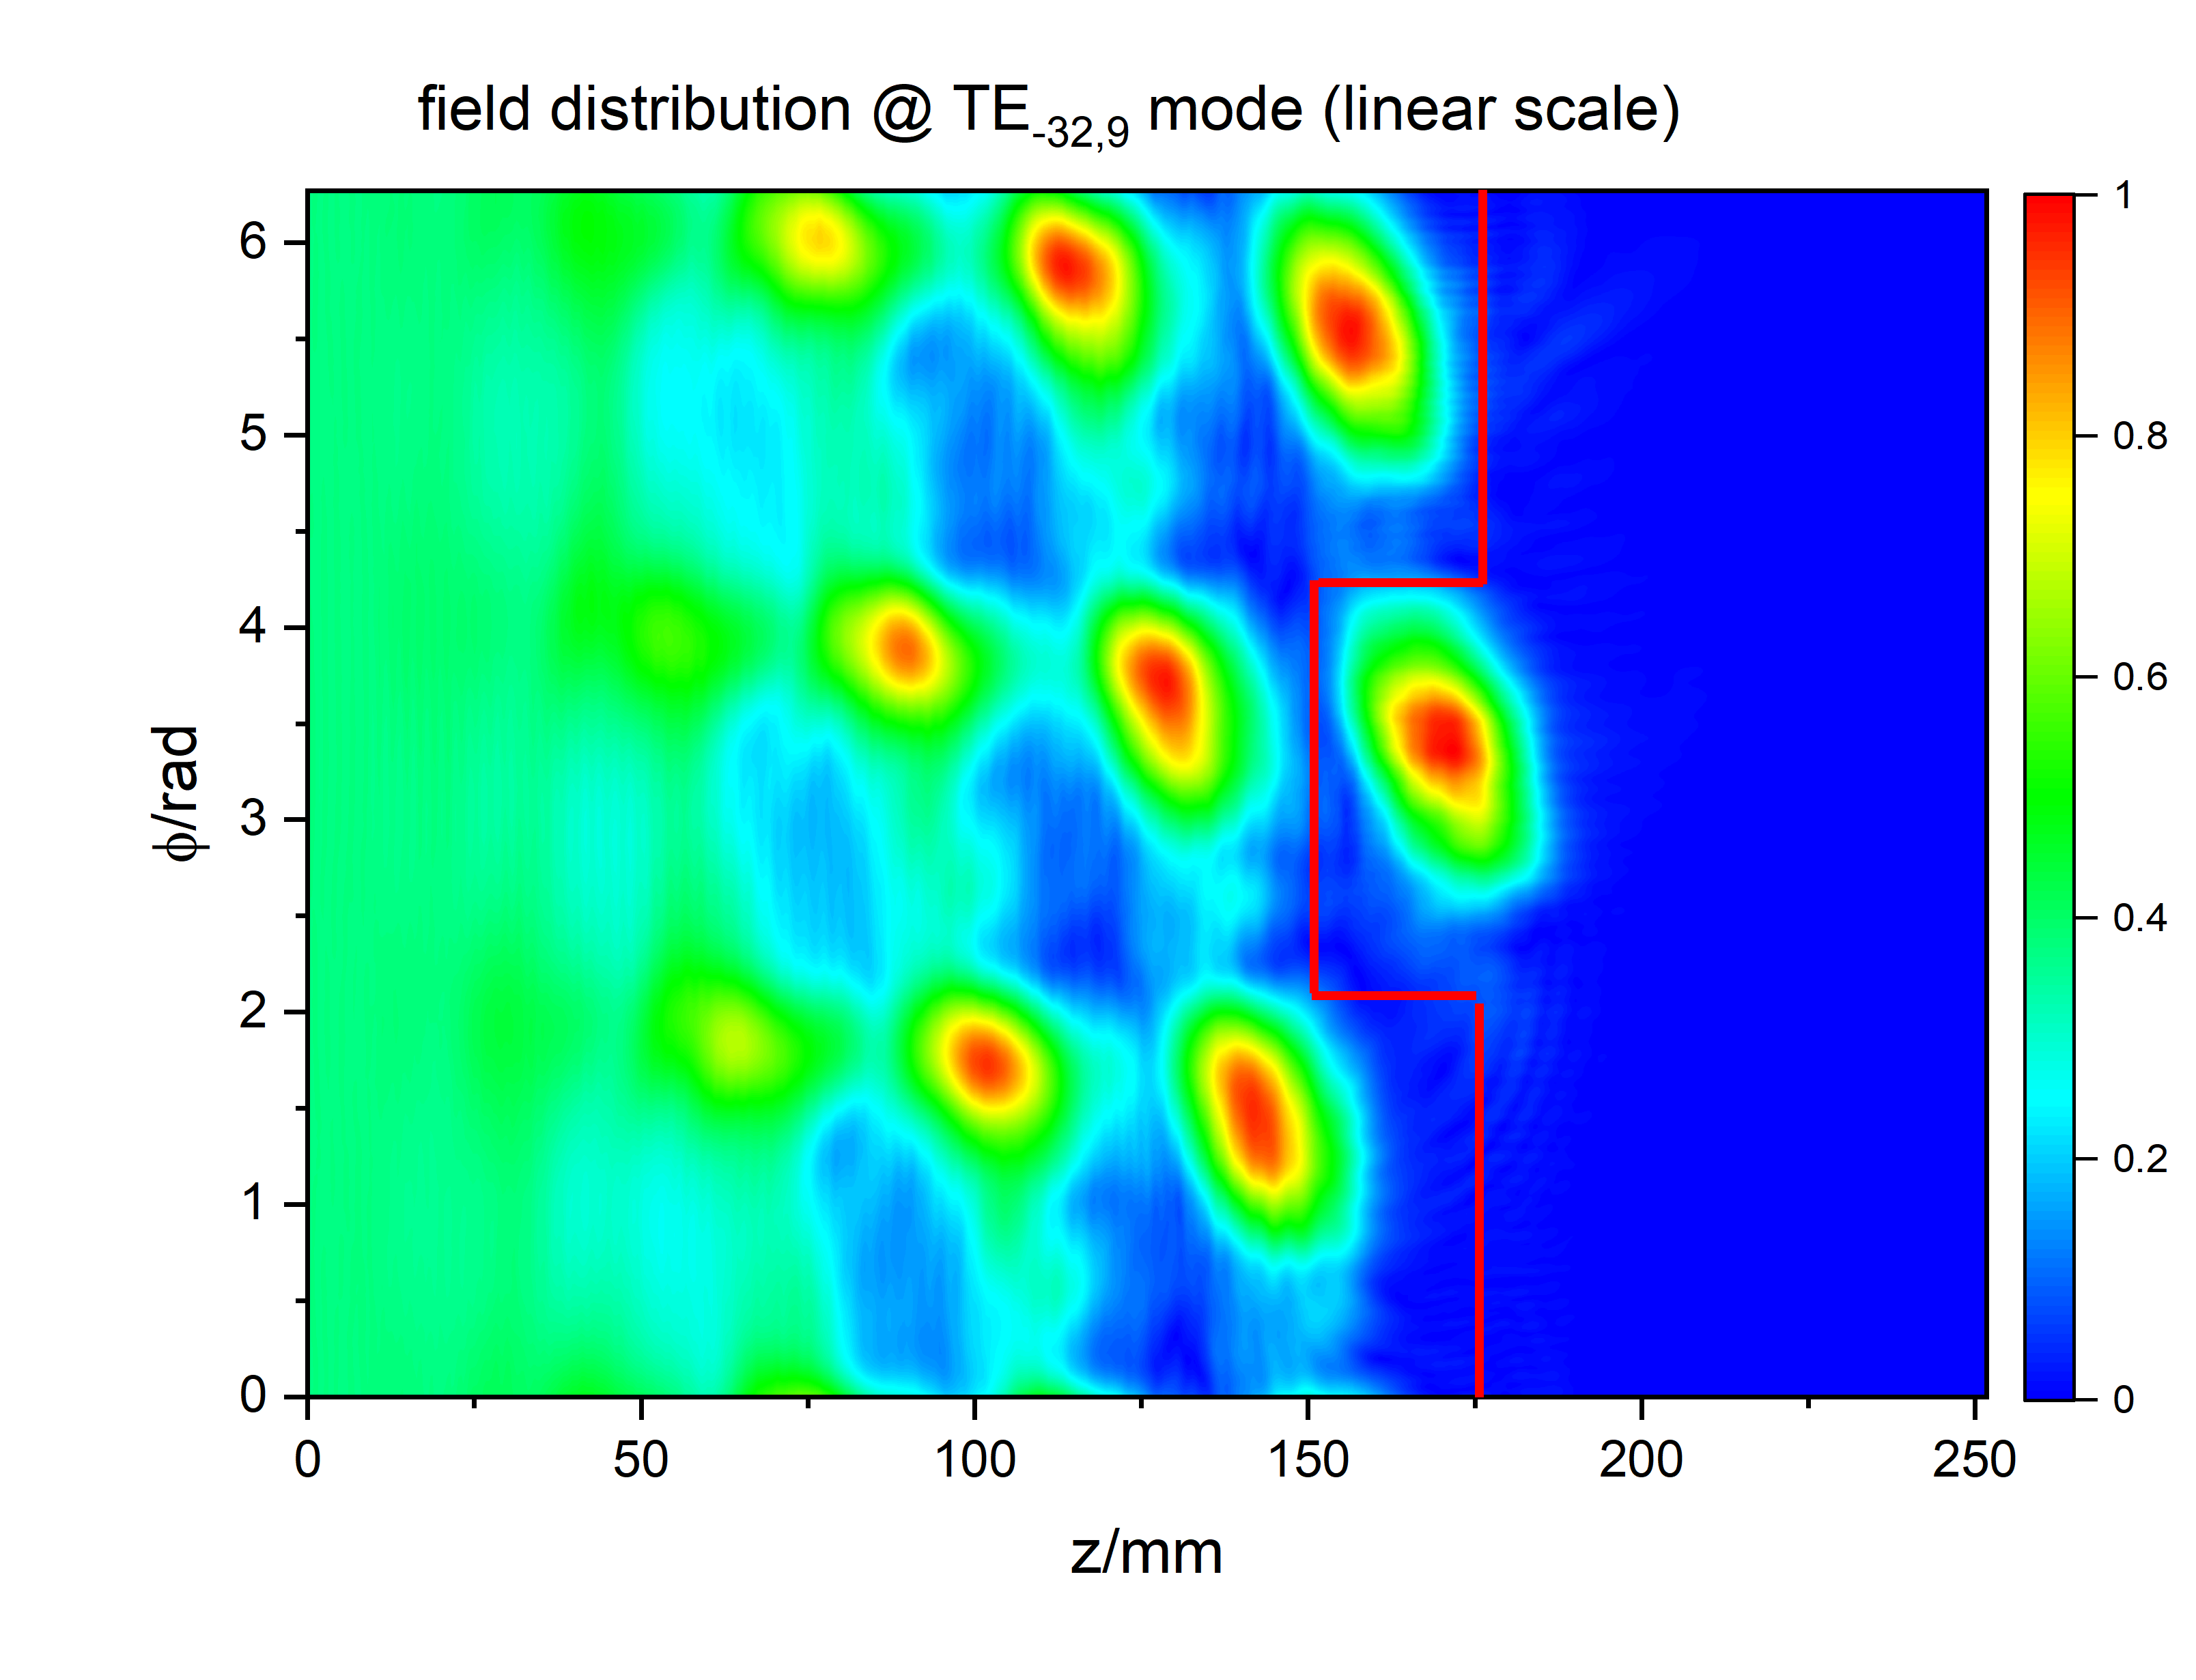
Research on Coupling System for Injection Locking
Design of a Hybrid-type launcher
for co- (TE_{32,9} mode) and counter- (TE_{-32,9} mode), 170 GHz
Profile on unrolled launcher wall:
Gaussian mode content: 98.24 %

Slide 27
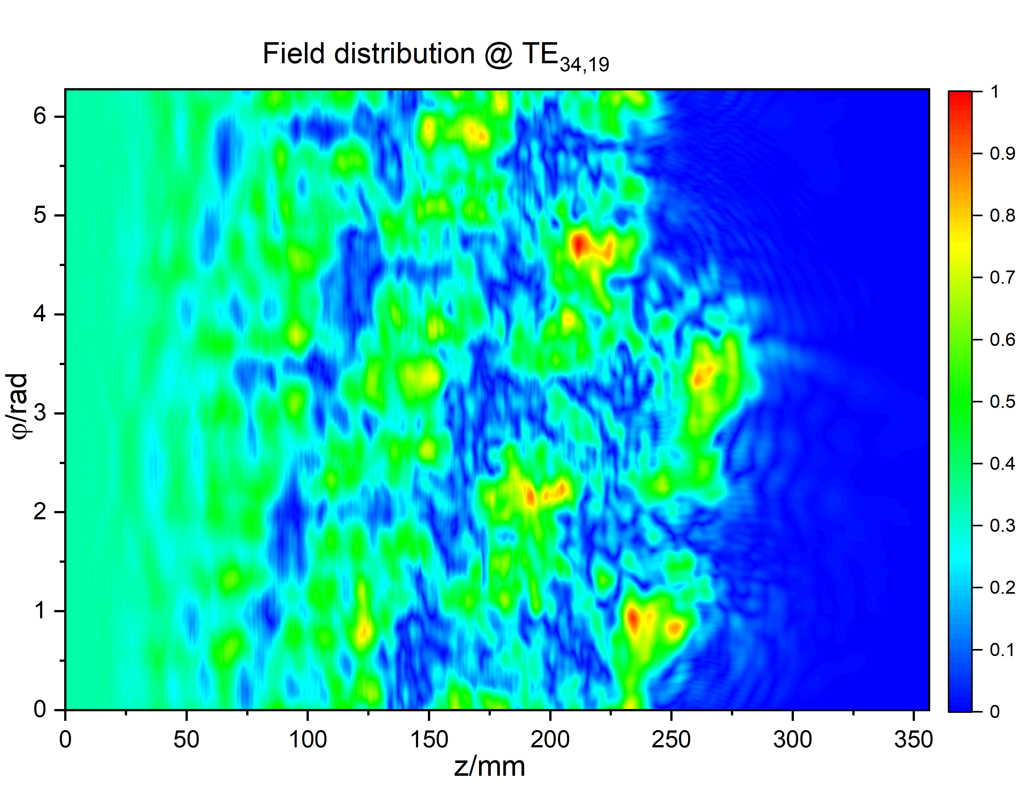
Research on Coupling System for Injection Locking
Results obtained for
Mirror-line launcher @ 170 Ghz, TE_{32,9}
(still needs optimization):
Next Steps:
Design of a Mirror-line type launcher for 204 GHz / coaxial cavity
(Denisov- and Hybrid-type launchers are not possible).
Check possibility of two-way launcher (+ mirror system) for 170 GHz / 204 GHz systems.

Slide 28
T1.3:
Multistage-Depressed Collector

Slide 29
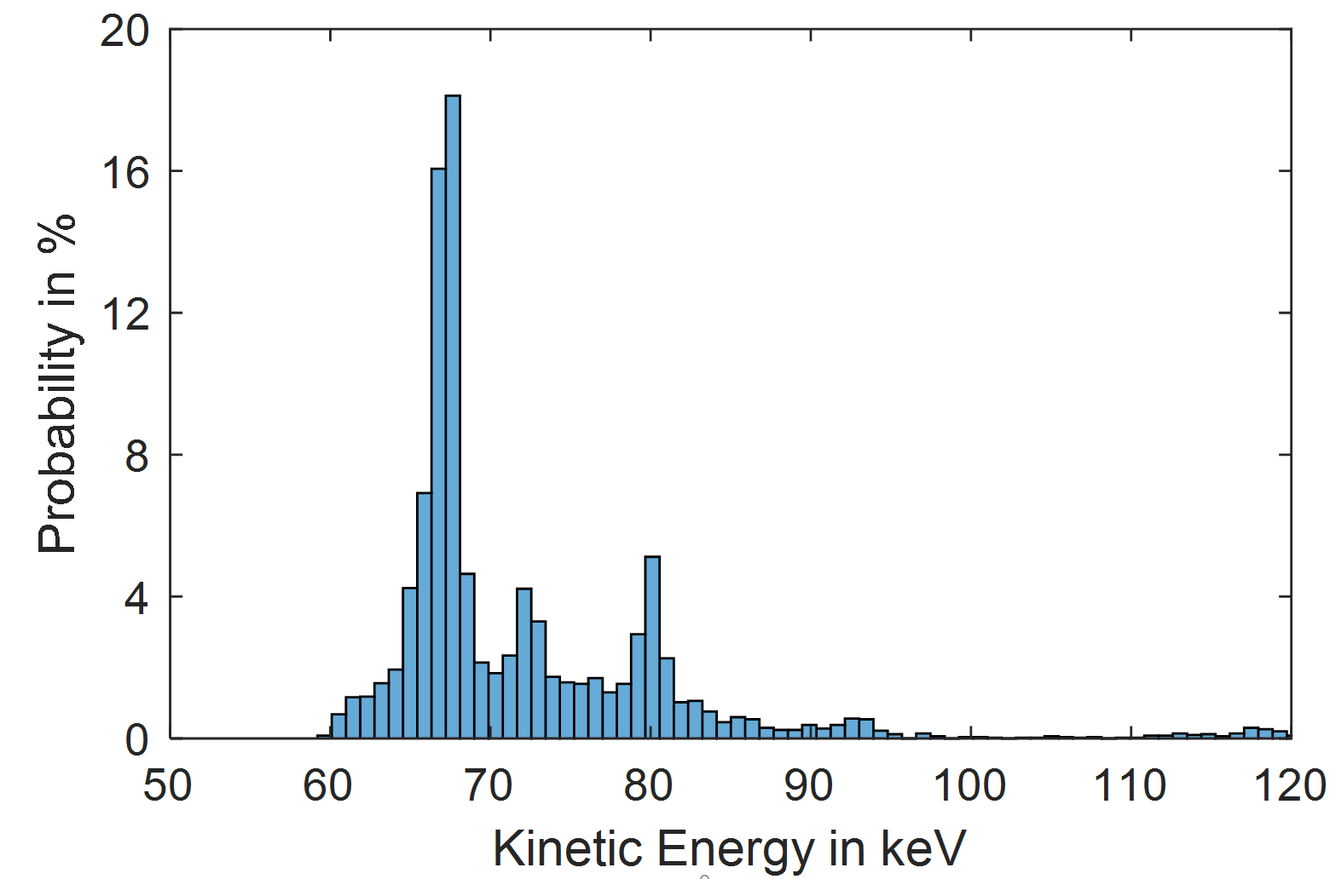
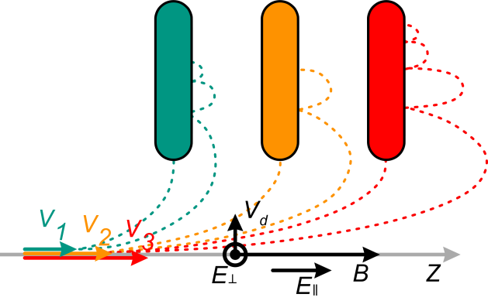
Collector Theory
Energy of the spent electron beam is recovered in depressed collectors
Electrical efficiency of the overall tube is increased
Single-stage collector efficiency is limited by:
  Slowest electron
  Widely spread energy spectrum
Multi-stage depressed collector
  Sorting electrons based on E×B drift
  Spatial separation according to the kinetic energy
  Reduced thermal losses
  Increased collector & gyrotron efficiency
$$\vec{v_{d}}=\frac{\vec{E}×\vec{B}}{B^{2}}$$
I. Gr. Pagonakis, IEEE TPS, 2008

Slide 30
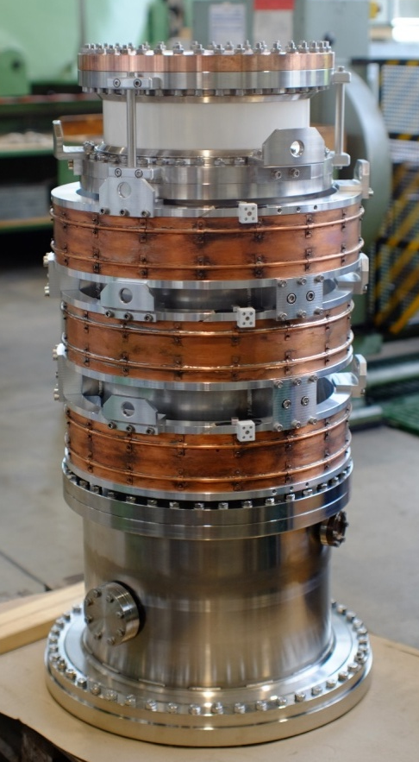
Collector Prototype
Prototype two-stage collector is built
  Validation of E×B drift concept
  Short pulse operation
  Optimized for fundamental operation
Operation possible at 2nd harmonic
  1st depression potential: 44 kV
  2nd depression potential: 63 kV
  Gyrotron efficiency enhancement:
  24 % → 67 % (without RF losses)
  Low reflected current: 0.027 %
  Power loading 1st stage: 94 kW
High voltage isolation
2nd stage
Collector coils
Total length: 1178 mm
1st stage
High voltage isolation
Vacuum envelope

Slide 31
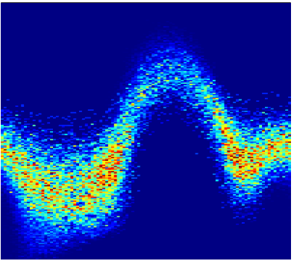
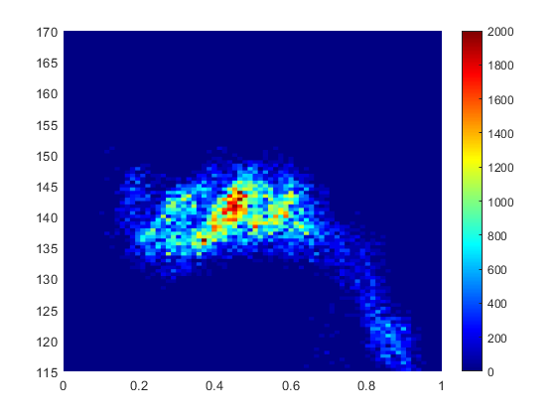
Collector Prototype Limitation
Axial Position in m
2.4
Power loading density of short pulse prototype up to 2 kW/cm²
Limit for CW at 500 W/cm²
Outlook:
New design concept for Continuous Wave (CW)
  Increased collector size
  Implementation of sweeping system for 2nd stage
  Operation point with reduced power on 1st stage
  Optimized design for harmonic operation
2.3
2
Power Loading Density in kW/cm²
2.2
0
60
120
Azimuthal Position in deg
170
1
Radial Position in mm
150
130
0
115
0
0.5
1
Axial Position of Helix

Slide 32
Conclusion and Outlook
During 2022, significant progress has been made for all defined tasks,
including the development of tools and methods.
Outlook: continuation according to task specification.
  Check feasibility of experiments with coaxial cavity (170 GHz).
  Focus on higher frequencies.
  Investigate possibility of multi-frequency operation.
  Further enhancement of numerical tools.

Slide 33
Publications of 2022 (2023)
S. Illy et al., Sounding the Possibilities of Megawatt-Class Fusion Gyrotrons Operating at the Second Harmonic of the Cyclotron Frequency, 32nd Symposium on Fusion Technology (SOFT2022), Dubrovnik, Croatia, 18-23 September 2022
J. Jin et al., Progress of the Methods for Optimum of Quasi-Optical Mode Converters at KIT, 47th International Conference on Infrared, Millimeter and Terahertz Waves (IRMMW-THz), Delft, The Netherlands, 28. Aug. – 2. Sept 2022
Submitted abstracts:
J. Jin et al., Improved Synthesis of Quasi-Optical Launchers Used in Injection Locked Gyrotrons, 24th International Vacuum Electronics Conference, Chengdu, China, 25. – 28. Apr. 2023
L. Feuerstein et al., Design of a Second Harmonic MW Level Coaxial Gyrotron Cavity, 24th International Vacuum Electronics Conference, Chengdu, China, 25. – 28. Apr. 2023
Thank you for your attention!

Slide 34
BACKUP SLIDES

Slide 35
T1.2.1 Enabling research on corrugations for second harmonic operation
“Continuation of the studies of the eigenvalues and azimuthal indices of operating modes appropriate for efficient MW-class second-harmonic operation at 170 GHz, 204 GHz, and >280 GHz”

Slide 36
T1.1.1 Fundamental theoretical studies on injection locking
“Generic studies on the possibilities for driving a gyrotron by injection of signals at fundamental and second harmonic, taking the existing DEMO-relevant gyrotron cavities (e.g. 170 GHz and/or 204 GHz operation) as starting point.”

Slide 37
170 GHz design based on the existing coaxial technology (without injection locking)
Design of a cavity at 170 GHz with TE_{31,17} (eigenvalue 95).
  Stable 2nd-harmonic excitation using only a corrugated coaxial insert (no outer corrugations, no injected signal).
  Nominal output power 1.75 MW, η_{elec}=18% with ρ_{out}=2.2 kW/cm² and ρ_{in}=0.33 kW/cm²
  at 90 kV, 114.5 A, α=1.28.
  Stability range 1.5 kV before mode loss; maximum power 2.0 MW.
A 1.5 MW rated 2nd-harmonic gyrotron at 170 GHz is possible based only on the existing coaxial technology.
Multi-mode simulation considering 43 modes (1st- and 2nd -harmonic competitors).

Slide 38
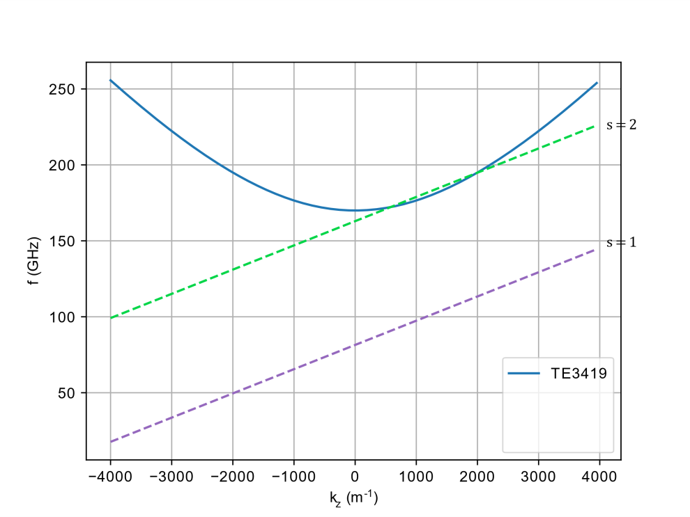
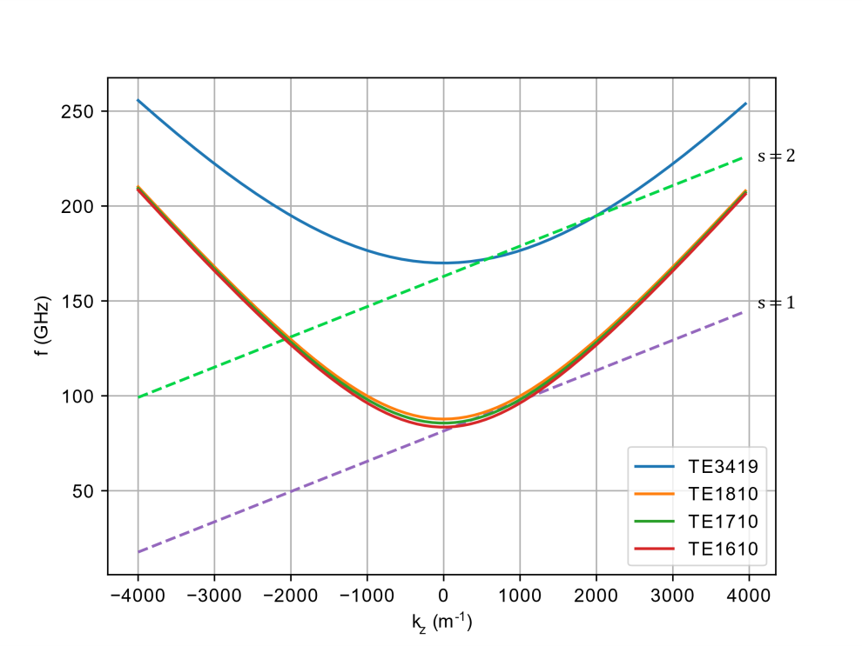
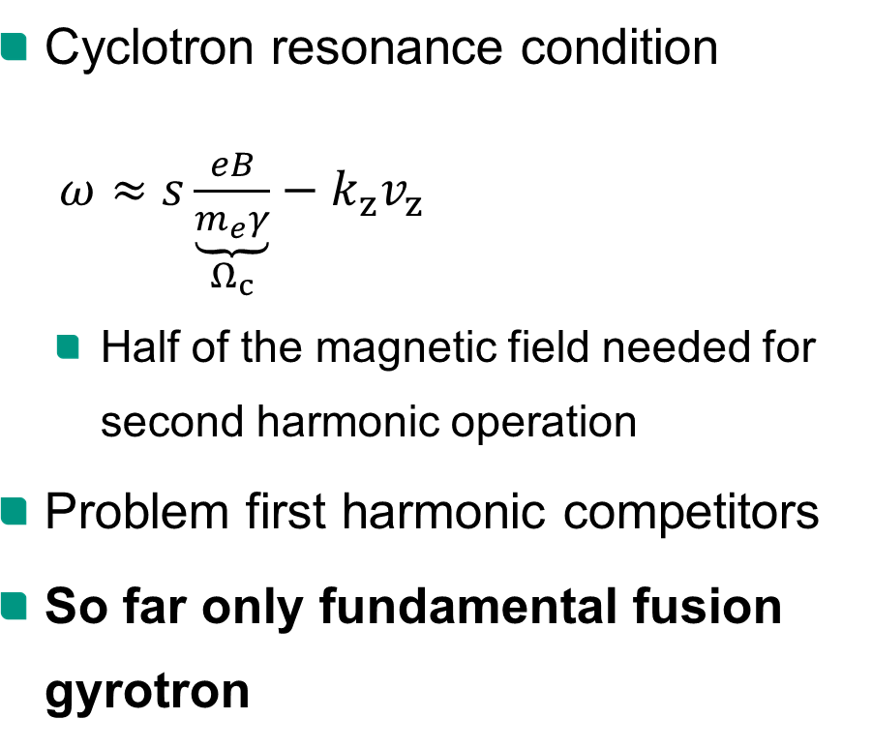
Second Harmonic Interaction
Cyclotron resonance condition
$ω≈s\underset{Ω_{c}}{\underbrace{\frac{eB}{m_{e}γ}}}−k_{z}v_{z}$
  Half of the magnetic field needed for second harmonic operation
Problem first harmonic competitors
So far only fundamental fusion gyrotron

Slide 39
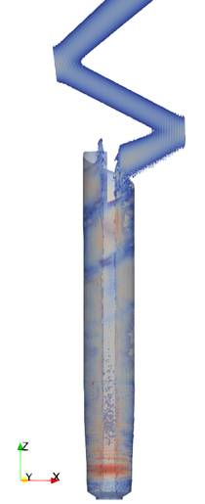
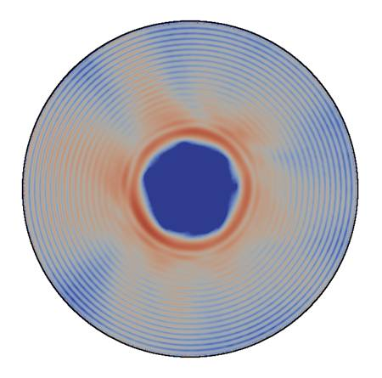
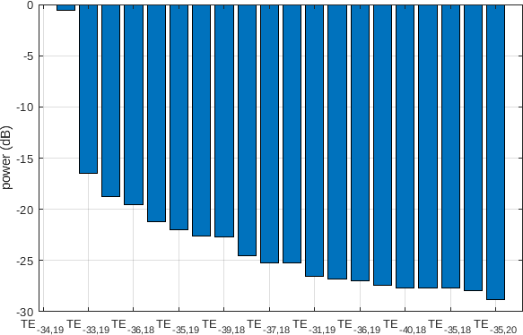
T1.1.2: Research on coupling system
TEM_{0,0}
Mode pattern at the
launcher entrance
Mode content
Launcher
Cavity

Slide 40
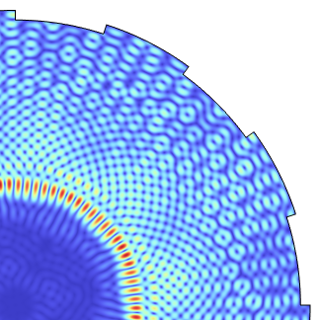
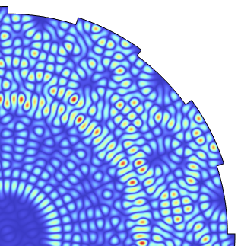
Corrugation depth:
1.0 mm
Corrugation depth: 1.5 mm
Mode patterns in
a resonator with different outer corrugations (exemplary)

Slide 41
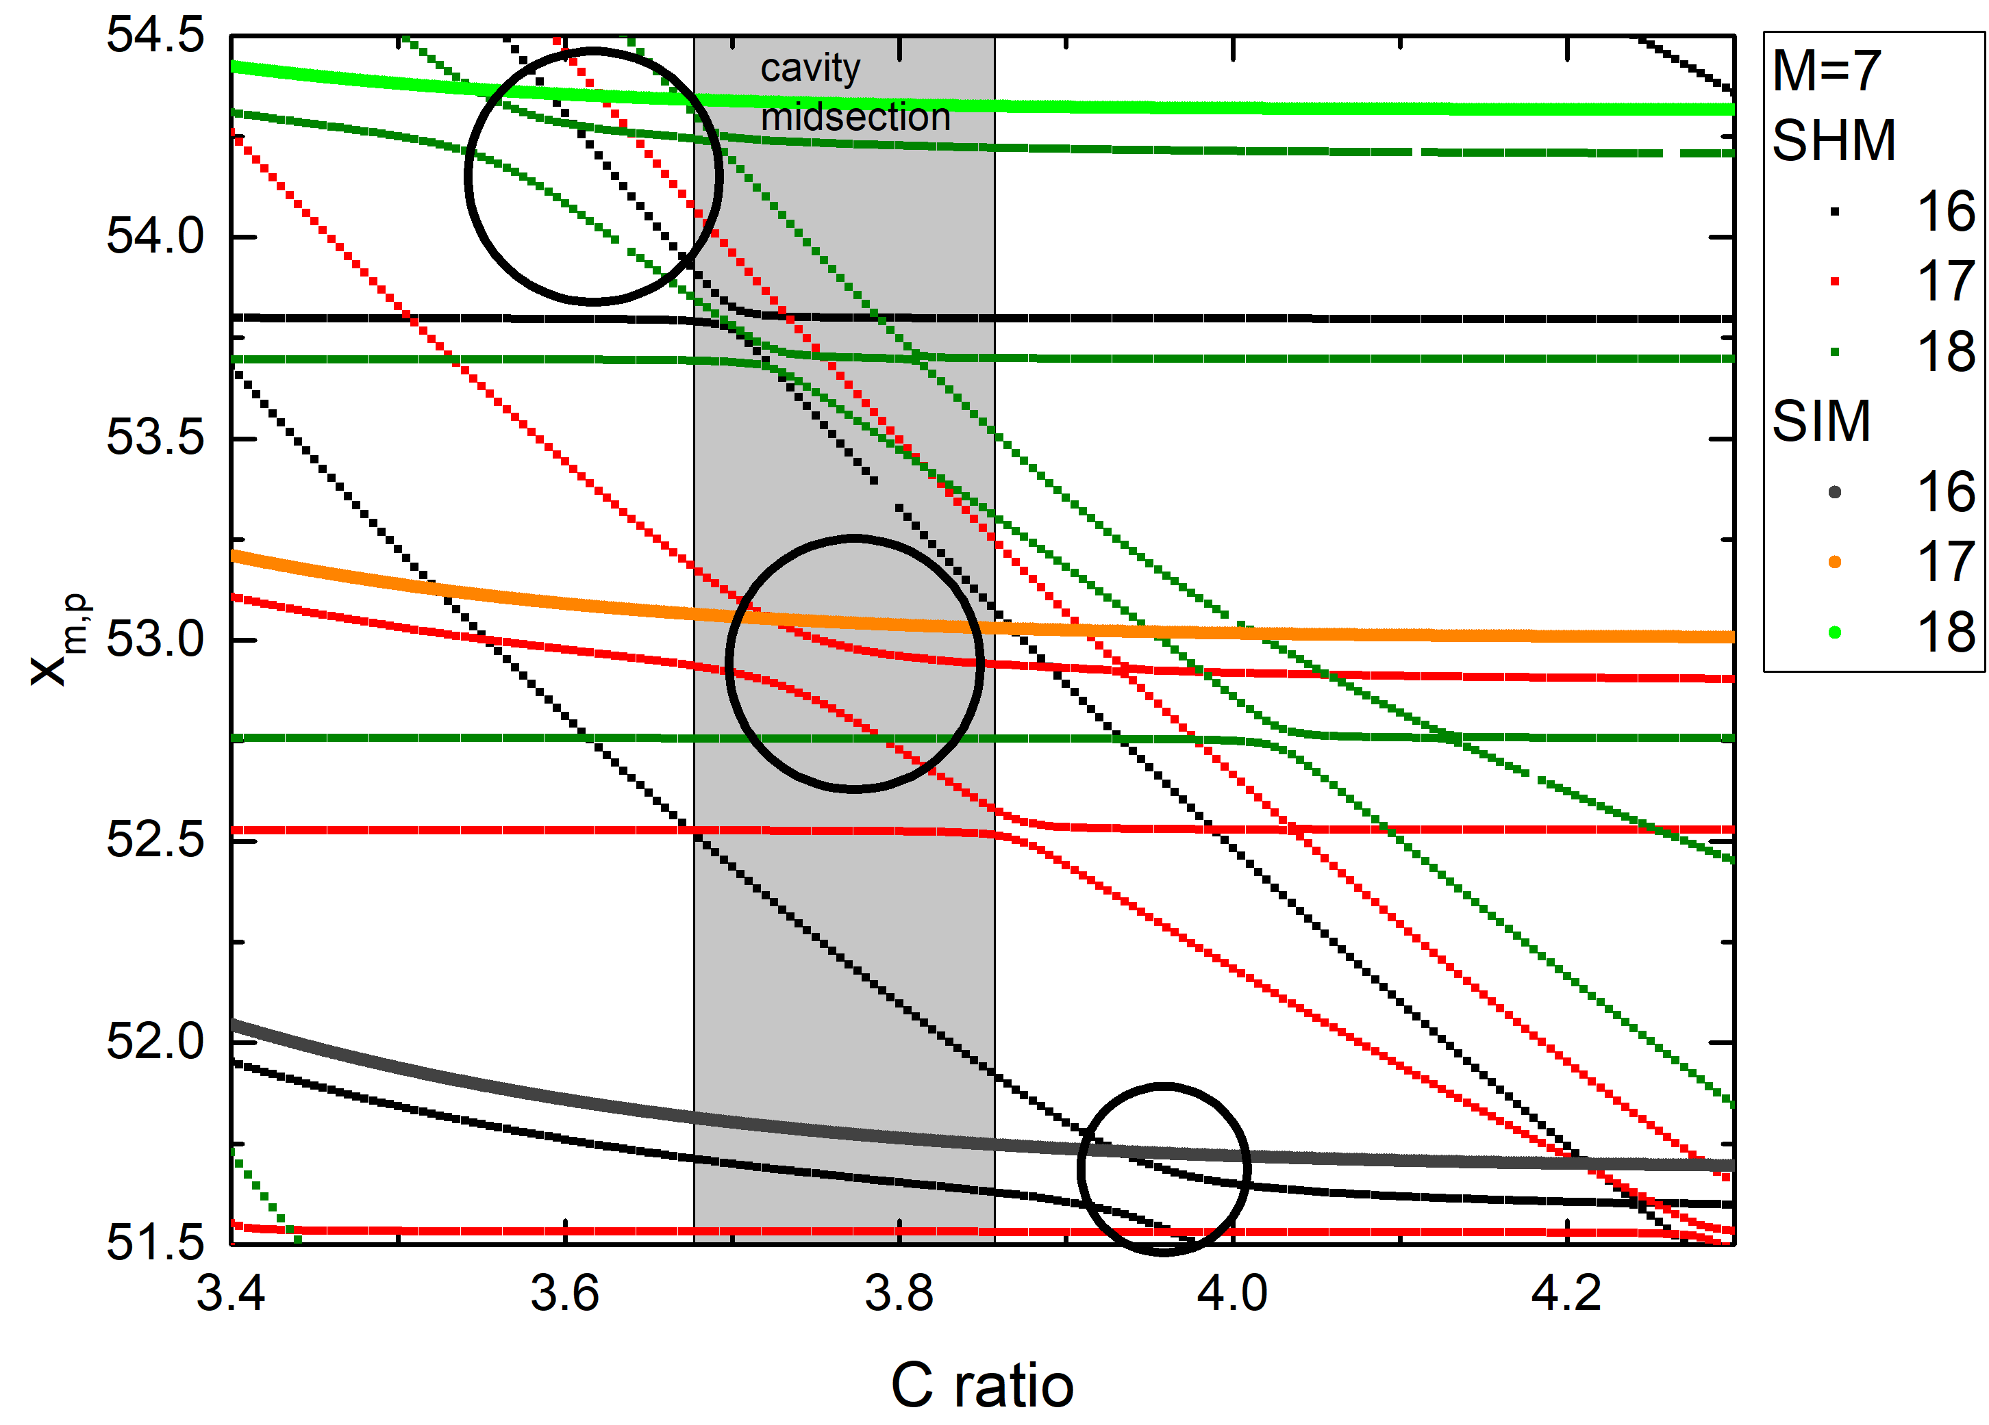
T1.2.1: Mode converting azimuthal corrugations
Eigenvalues versus C ratio (outer to inner diameter) of the case with inner corrugations only (SIM) and when M=7 outer corrugations are introduced. The coupling regions are also visible (encircled areas).
Work already performed
Identification of the competing modes of the first and second harmonic.
Investigation of various coupling schemes.
It was found that only the first harmonic competitors should be coupled and the coaxial insert geometrical properties should be appropriately changed.

Slide 42
Project Roadmap
The three elements (injection locking, advanced corrugated cavity, MDC)
will be comprehensively studied aiming at the development of the
theoretical background and the required tools.
A high-frequency, high-power and high-efficiency gyrotron operating at second-harmonic will be designed based on the theory and tools developed in the first part.
The possibility to design a gyrotron operating at very high frequency (above 280 GHz) for future Electron Cyclotron Heating (ECH) systems and Collective Thomson Scattering (CTS) diagnostics will be investigated.
Preparation of the first worldwide experiments of a high-power gyrotron operating in second harmonic with the support of injection locking technique. The presence of two operational high-power gyrotron test stands at KIT is an important advantage for that purpose.

Slide 43
ENR-TEC.01.KIT-T001 2021-06-01 – 2021-12-31
Task 1 - Fundamental theoretical research on individual methods
T1.1 Injection locking
  T1.1.1 Fundamental theoretical studies on injection locking (K. Avramidis)
    Generic studies on the possibilities for driving a gyrotron by injection of signals at fundamental and second harmonic, taking the existing DEMO-relevant gyrotron cavities (e.g. 170 GHz and/or 204 GHz operation) as starting point.
  T1.1.2 Enabling research on coupling system (J. Jin)
    Development of the TWLDO code for the synthesis of Denisov-type launchers for the conversion of the co- and counter-rotating mode in the same design.
    Development of the TWLDO code for the synthesis of hybrid-type launchers for the conversion of the co- and counter-rotating mode in the same design.
    Improvement of KARLESSS code for the simulation of the quasi-optical (q.o.) system with ideal Gaussian mode injection from the launcher, forward and backward propagation of the wave beam in the Q.O. system.
T1.2 Corrugated cavity
  T1.2.1 Enabling research on corrugations for second harmonic operation (D. Peponis, K. Avramidis, A. Marek)
    Investigation of the second harmonic operation of the existing 2 MW coaxial gyrotron at KIT, operating at 170 GHz with the TE_{34,19} mode, with the same mode at 170 GHz. The updated cavity design will incorporate mode converting corrugations on the outer wall and impedance corrugations on the coaxial insert.
    Initiation of the studies of the eigenvalues and azimuthal indices of operating modes appropriate for efficient MW-class second-harmonic operation at 170 GHz, 204 GHz, and >280 GHz.

Slide 44
ENR-TEC.01.KIT-T001 2021-06-01 – 2021-12-31
Deliverables
The first-year deliverable will include the results of the tasks performed in 2021, such as the fundamental theoretical studies on injection locking and on advanced corrugated cavities for second harmonic operation.

Slide 45
ENR-TEC.01.KIT-T002 2022
Task 1 - Fundamental theoretical research on individual methods
T1.1 Injection locking
  T1.1.1 Fundamental theoretical studies on injection locking (K. Avramidis)
    Systematic research on the influence of major design parameters, concerning the cavity geometry and the electron beam properties, on the performance of an injection-locked gyrotron at fundamental and second harmonic operation.
    Studies on the influence of mode purity of the external signal on gyrotron operation.
  T1.1.2 Enabling research on coupling system (J. Jin)
    Design a Denisov-type launcher for the co- and counter-rotating mode, investigate the change of the field distribution due to the influence of the perturbation corresponding to the anti-rotating mode.
    Design a hybrid-type launcher for the co- and counter-rotating mode to achieve a higher conversion efficiency in comparison to the Denisov-type launcher as much as possible.
    Investigation of the possibility for mirror-line launchers to be used for the conversion of the co- and counter-rotating mode, the possibility for a mirror-line launcher to provide a higher conversion efficiency in comparison to the Denisov-type and hybrid-type launchers.
    Design of mirror systems, and analysis of the q.o. system.

Slide 46
ENR-TEC.01.KIT-T002 2022
Task 1 - Fundamental theoretical research on individual methods
T1.2 Corrugated cavity
  T1.2.1 Enabling research on corrugations for second harmonic operation
  (D. Peponis, K. Avramidis, A. Marek)
    Investigation of the second harmonic operation of the existing coaxial gyrotron design by KIT, which allows for
    2 MW operation at 204 GHz with the TE_{40,23} mode, with the same mode at 204 GHz. The updated cavity design will incorporate mode converting corrugations on the outer wall and impedance corrugations on the coaxial insert.
    Continuation of the studies of the eigenvalues and azimuthal indices of operating modes appropriate for efficient MW-class second-harmonic operation at 170 GHz, 204 GHz, and >280 GHz.
  T1.2.2 Enabling research on multi-frequency operation (I. Chelis, A. Marek)
    Search for suitable mode pairs/triplets for multi-frequency operation, based on the sets of suitable modes found in T1.2.1.
    Investigation of possible compromises on the design strategies to achieve the best possible performance of the same design in two/three frequencies.

Slide 47
ENR-TEC.01.KIT-T002 2022
Task 1 - Fundamental theoretical research on individual methods
T1.3 Multistage depressed collector (B. Ell, G. Latsas)
  Fundamental research on different MDC design approaches based on E×B concept for gyrotron operation at higher harmonics. Such design approaches are the coaxial and cylindrical helical MDCs, MDC approaches based on the transformation of the annular beam to sheet beam, MDC approach based on helicoid magnetic field, and novel/alternative design approaches.
  The most appropriate design approach will be chosen considering the manufacturing complexity and the operational efficiency. A MDC will be optimized for a typical spent beam of the second-harmonic gyrotron operation.
  Fundamental research on the influence of secondary electrons on MDC operation and comparison with the fundamental harmonic results will be performed.
  The influence of stray magnetic field and misalignments on the MDC operation and comparison with the corresponding results obtained in older WP for the fundamental harmonic will take place.

Slide 48
ENR-TEC.01.KIT-T002 2022
Deliverables
The annual deliverable will include the results of the tasks performed in 2022: the continuation of the fundamental theoretical studies on injection locking and advanced corrugated cavities, as well as the theoretical investigation on the multistage depressed collector for second harmonic operation.

Slide 49
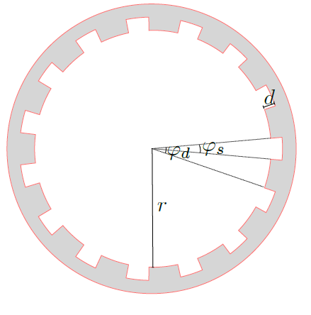
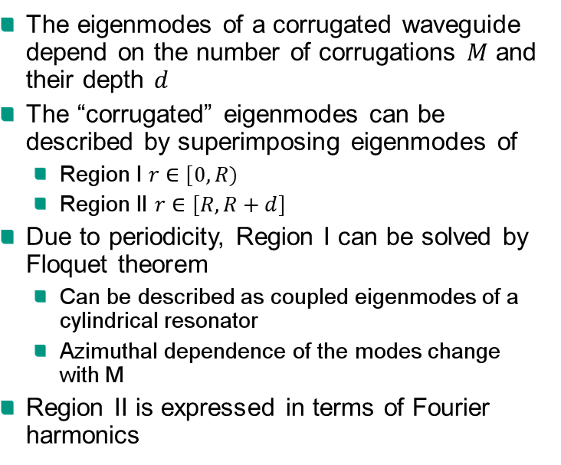
Surface Harmonic Model
The eigenmodes of a corrugated waveguide depend on the number of corrugations $M$ and their depth $d$
The “corrugated” eigenmodes can be described by superimposing eigenmodes of
  Region I $r∈[0,R)$
  Region II $r∈[R,R+d]$
Due to periodicity, Region I can be solved by Floquet theorem
  Can be described as coupled eigenmodes of a cylindrical resonator
  Azimuthal dependence of the modes change with M
Region II is expressed in terms of Fourier harmonics
Region II
Region I

Slide 50
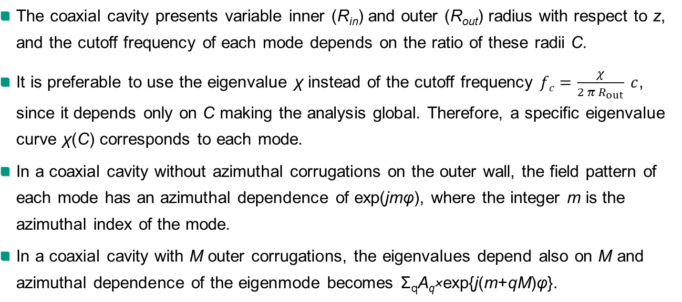
About coupling (1)
The coaxial cavity presents variable inner (R_{in}) and outer (R_{out}) radius with respect to z, and the cutoff frequency of each mode depends on the ratio of these radii C.
It is preferable to use the eigenvalue χ instead of the cutoff frequency $fc=\frac{χ}{2 π R_{out}} c$, since it depends only on C making the analysis global. Therefore, a specific eigenvalue curve χ(C) corresponds to each mode.
In a coaxial cavity without azimuthal corrugations on the outer wall, the field pattern of each mode has an azimuthal dependence of exp(jmφ), where the integer m is the azimuthal index of the mode.
In a coaxial cavity with M outer corrugations, the eigenvalues depend also on M and azimuthal dependence of the eigenmode becomes Σ_{q}Α_{q}×exp{j(m+qM)φ}.

Slide 51
About coupling (2)
In other words, the outer corrugations introduce additional modes with azimuthal index m+qM. These modes are related (coupled) with the mode under consideration (m).
The coupling results in modified eigenvalue curves χ(C). By choice of M, we can couple the unwanted competing modes with lower order ones resulting in eigenvalue curves with increased negative slopes.
The negative slopes correspond to lower Quality factors, because of the increasing group velocity of the wave towards the cavity output. The lower the Q-factor, the more difficult for the competing mode to be excited.

Slide 52
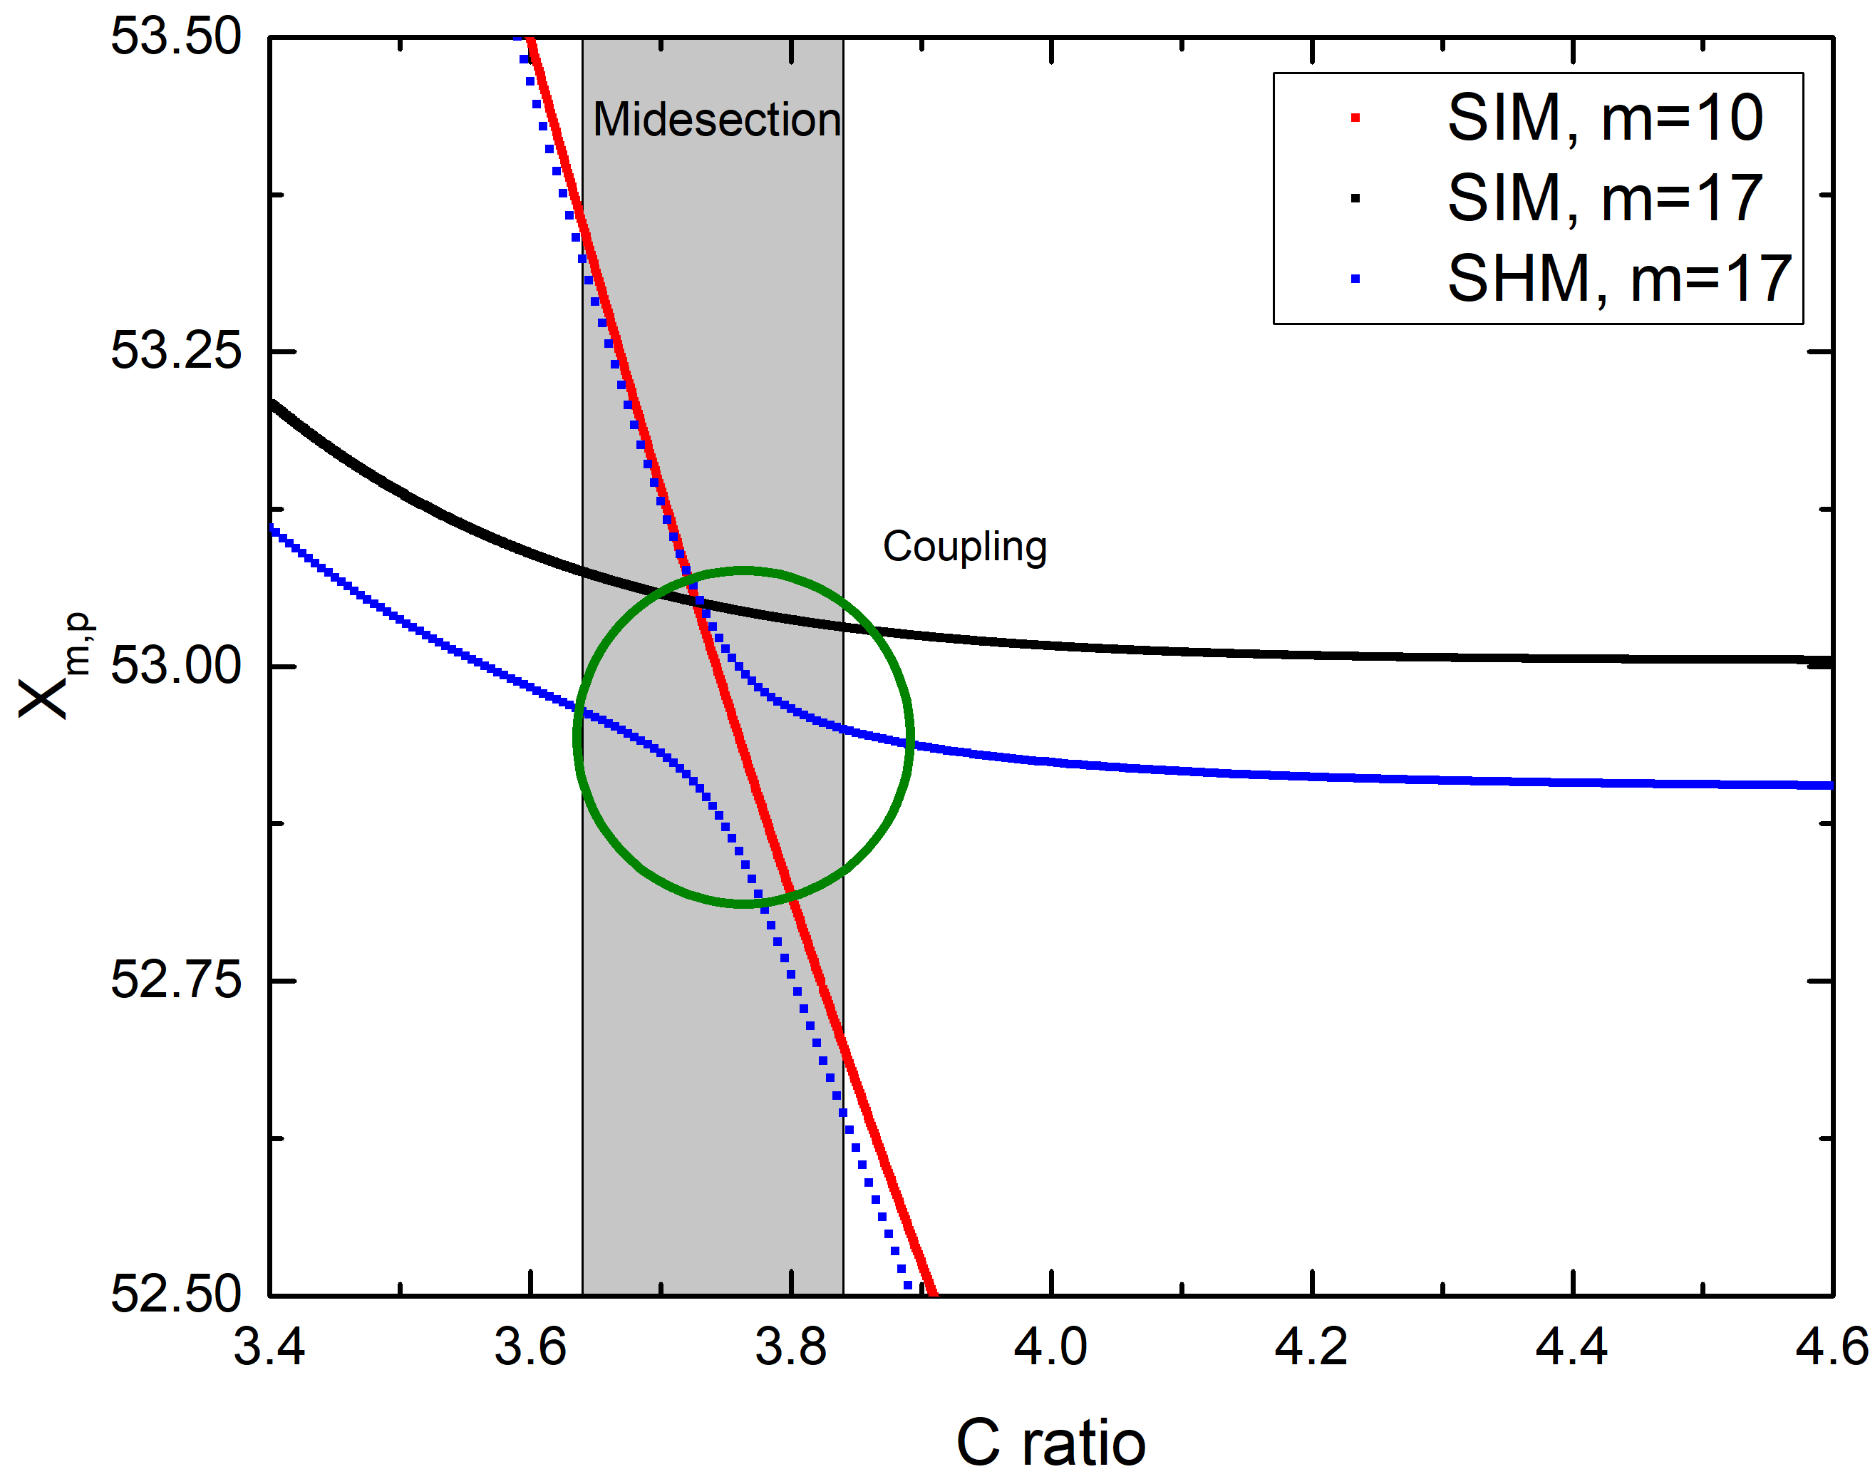
Derivation of the appropriate coupling scheme (1)
The eigenvalue curves versus C for the case without outer corrugations (SIM) are calculated.
We find the eigenvalue curve with m_{c} smaller than that of the competitor (m) which intersects the curve of the latter. Here, TE_{17,p} curve is intersected by TE_{10,p} curve at C≈3.76.
According to the SHM criterion, m_{c}=|m±qM|, we calculate the number of corrugations needed for such coupling. For q=1, M=27 or M=7.
Eigenvalues versus C ratio of the TE_{17,p}, TE_{10,p} modes (without corrugations, SIM) and TE_{17,p} with corrugations (SHM)

Slide 53
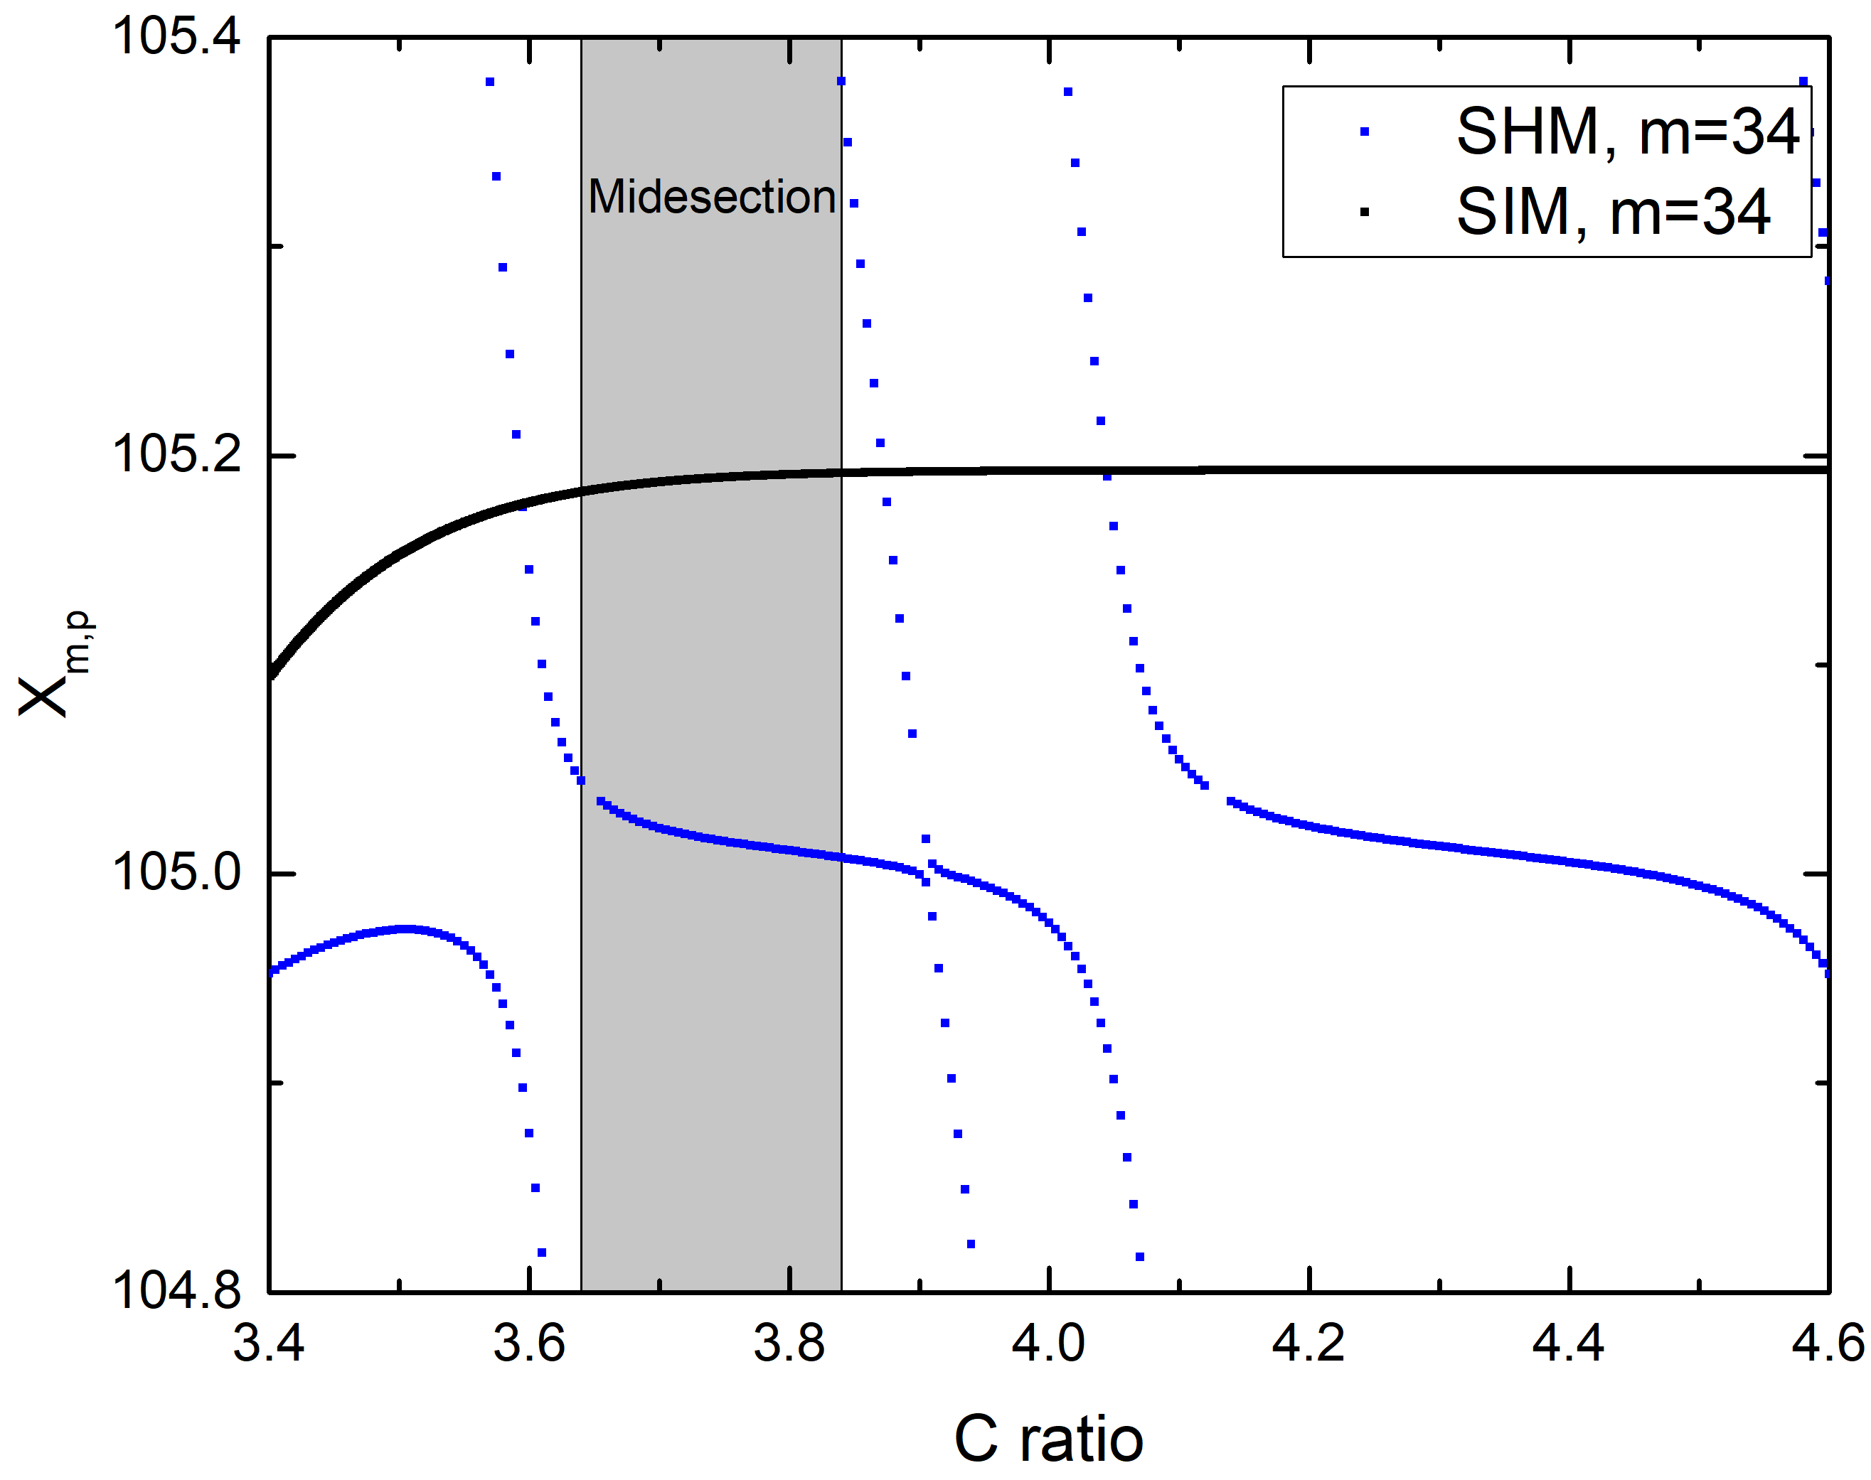
Derivation of the appropriate coupling scheme (2)
Next, we check whether this number of corrugations introduces unwanted lower order modes that couple with the operating mode TE_{34,19}.
We adjust the C interval of the midsection in order to avoid possible unwanted couplings of the operating mode.
As it can be seen, by introducing M=27 outer corrugations, TE_{17,10} is coupled and degenerated whereas TE_{34,19} remains almost unaffected.
Comparison of eigenvalue spectra versus z, without (SIM) and with (SHM) N=27 outer corrugations for TE_{34,19}.

