Slide 1
Report 2022
4D and 5D tomography of fast ion
velocity distribution function in
stellarators and tokamaks
Dmitry Moseev on behalf of the team

Slide 2
Motivation and goals of the project
Importance of fast ions in fusion plasmas
Plasma heating
Drive and suppression of instabilities
Machine protection
Etc
Challenges:
Distribution function is non-Maxwellian, generally more or less arbitrary
Plasma is underdiagnosed for fast ions
Goal of the project:
Develop a new type of regularization that allows multi-dimensional reconstruction with few data
Develop tool(s) that would allow strategic placement of fast ion diagnostics

Slide 3
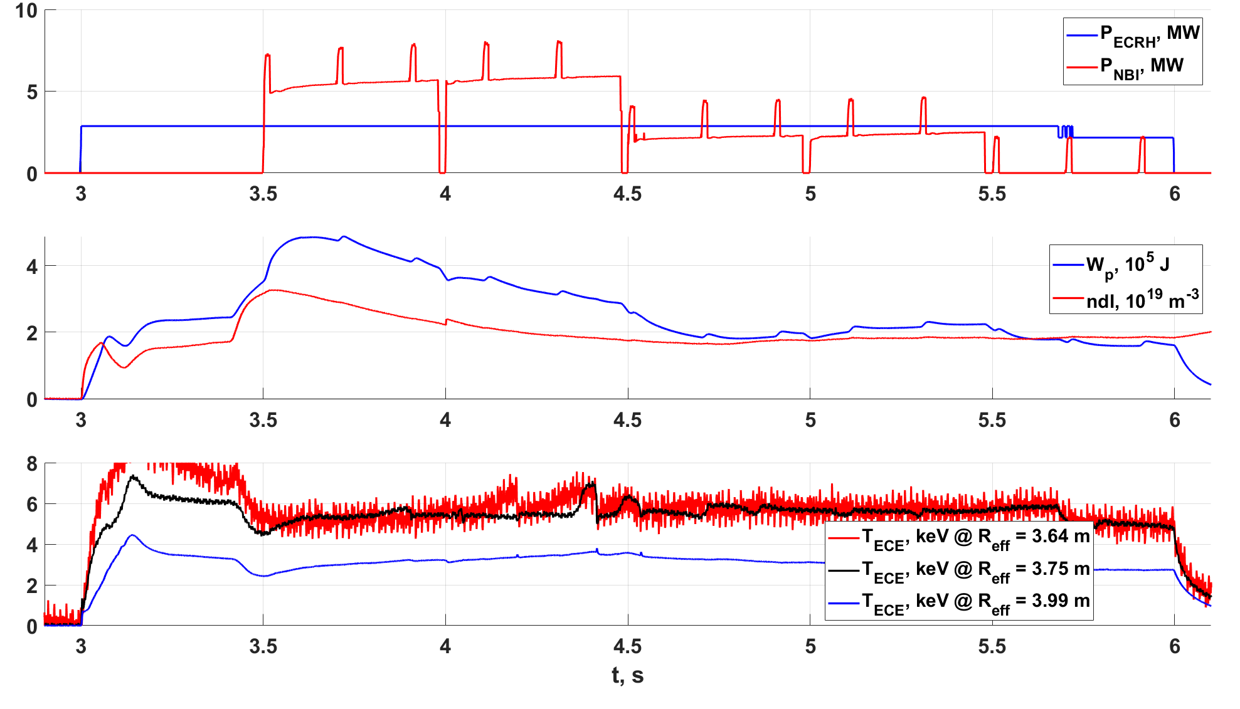
Example of importance: sawteeth in stellarators
Moseev, Zanini, Kasahara et al., to be presented at FEC2023

Slide 4
Example of importance: sawteeth in stellarators
Inversion
radius
Crash
Moseev, Zanini, Kasahara et al., to be presented at FEC2023

Slide 5
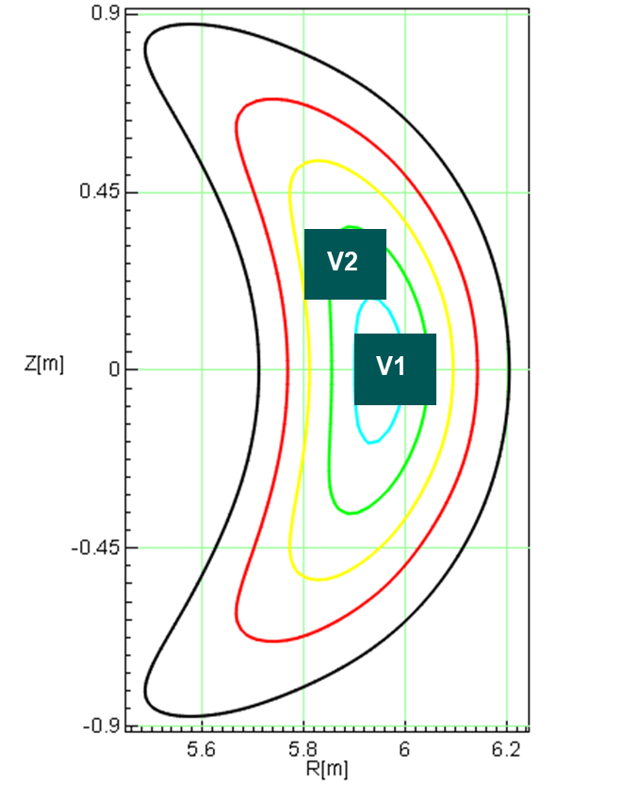
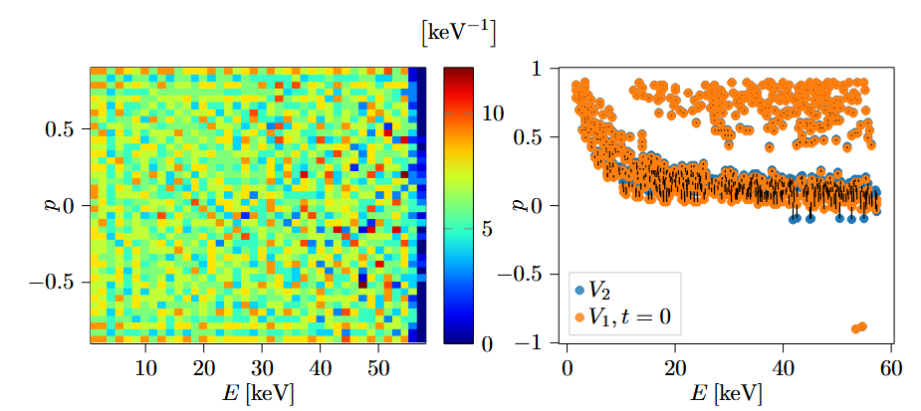
Improvement of the diagnostic coverage
Diagnostics are very scarce when you need to cover 4 or 5-dimensional space.
Beneficial: every new installed fast ion diagnostic should measure different fast ions than those which are already installed.
J.E. Mencke et al., subm. to RSI

Slide 6
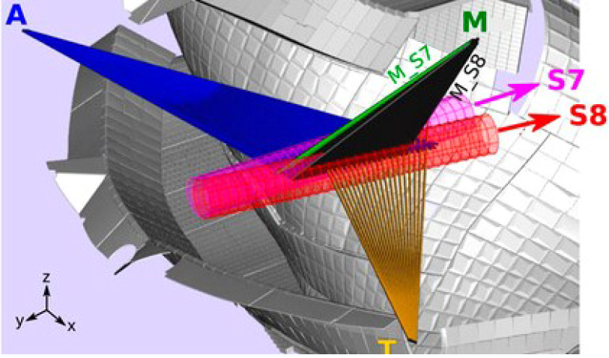
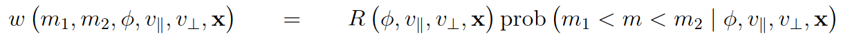
Improvement of the diagnostic coverage
O. Ford et al., RSI 91 (2020)

Slide 7
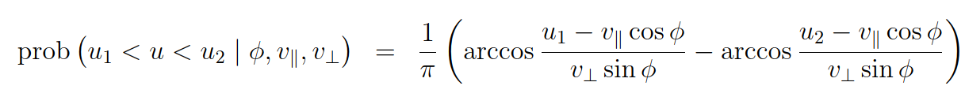

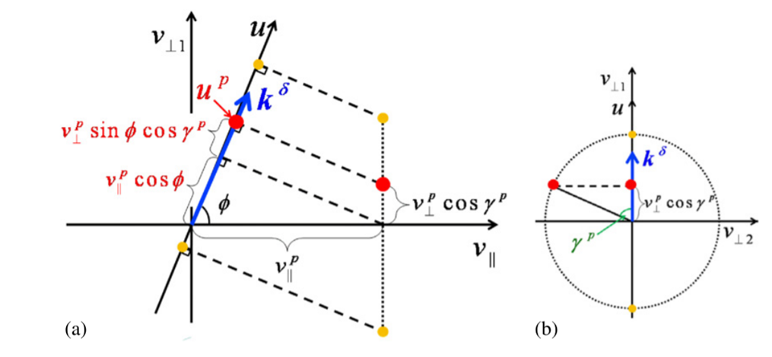
Improvement of the diagnostic coverage
M. Salewski et al, NF 2012

Slide 8
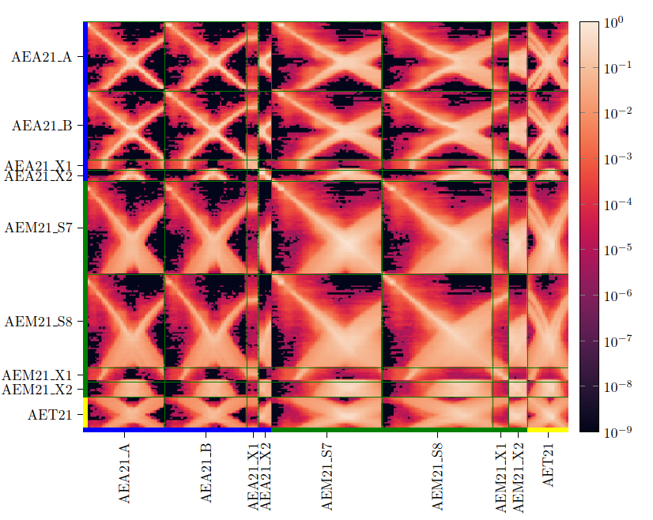
Improvement of the diagnostic coverage
Correlation between measurement volumes in W7-X FIDA system
J.E. Mencke et al., RSI 2022

Slide 9
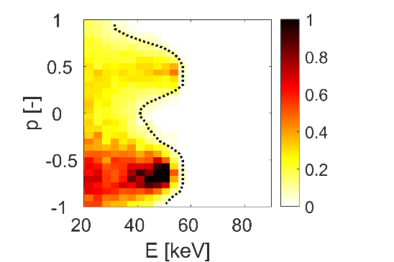
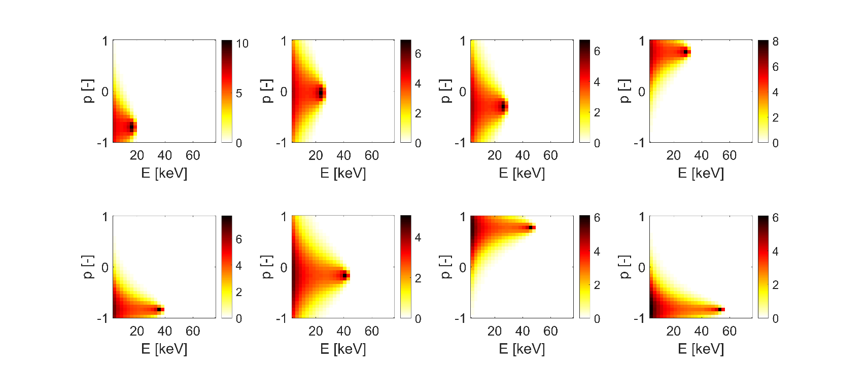
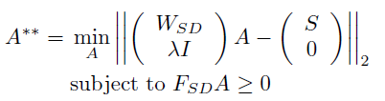

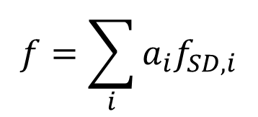





Idea of the new regularization
EAST distribution
$$fSD1$$
$$fSD2$$
$$fSD3$$
a₁×
a₂×
a₃×
$$f=\sum_{i}{a_{i}f_{SD,i}}$$
Expansion coefficient vector
$$S=WF$$
$$F=∑a_{i}f_{SDi}=F_{SD}A$$
$$S=WF=WF_{SD}A=W_{SD}A$$
Slowing-down basis matrix
Slowing-down weight matrix
B Madsen et al, PPCF 2020

Slide 10
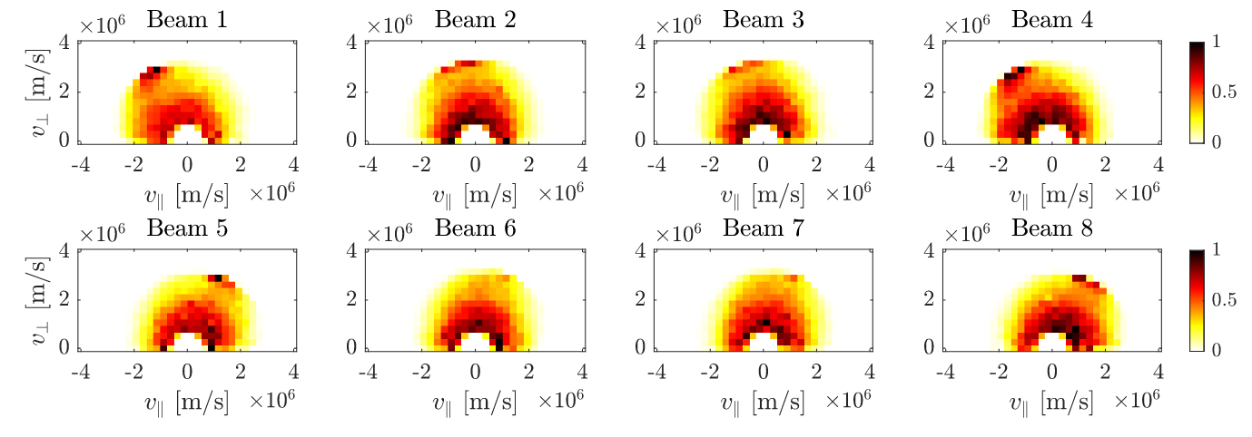
Idea of the new regularization
Credit: S. Lazerson
Full beam energy components of the slowing down FI velocity distribution function in W7-X

Slide 11
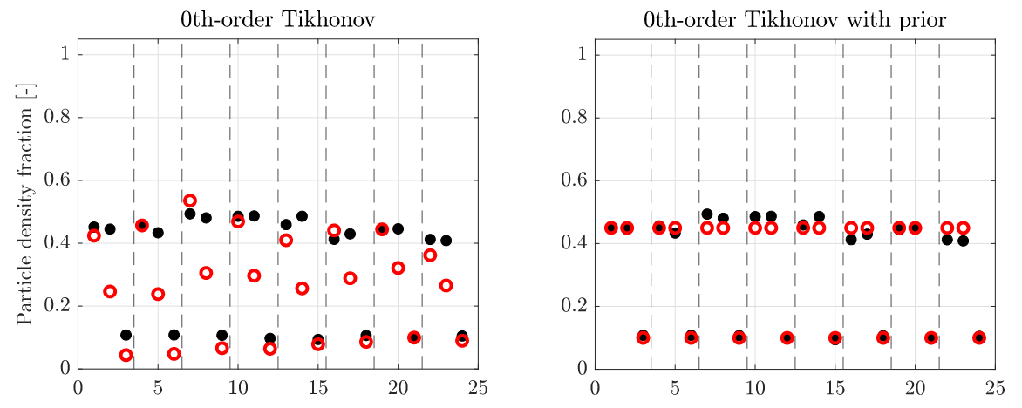
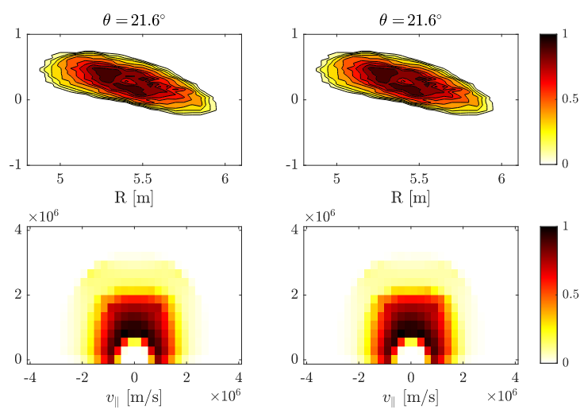
Reconstruction of the velocity distribution function in W7-X
TRUE RECONSTRUCTION
B.S. Schmidt et al., to be submitted to NF

Slide 12
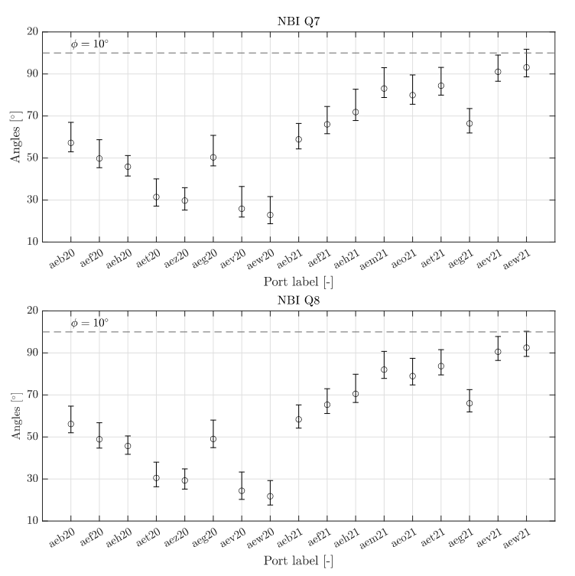
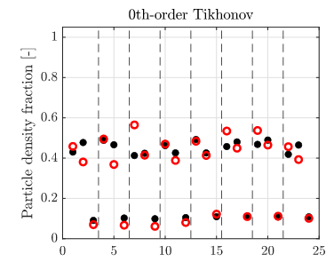
Reconstruction of the velocity distribution function in W7-X
B.S. Schmidt et al., to be submitted to NF
B.S. Schmidt et al., subm. to NF

Slide 13
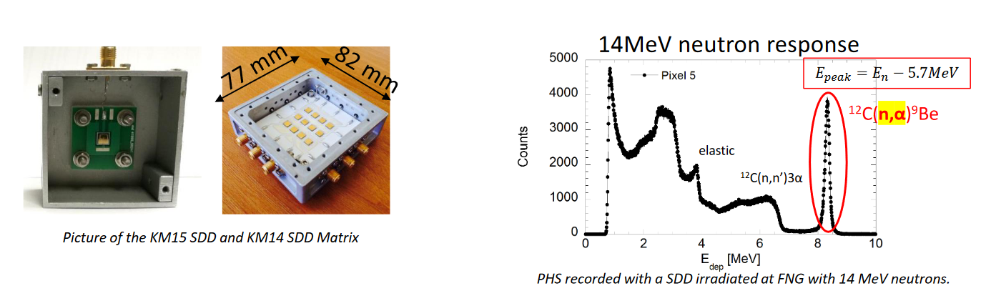
Inferring the velocity distribution function at JET in the DT experiments
ASCOT5 is used for generation of the basis functions.
Signal of fast ions: three (two) neutron diamond detectors

Slide 14
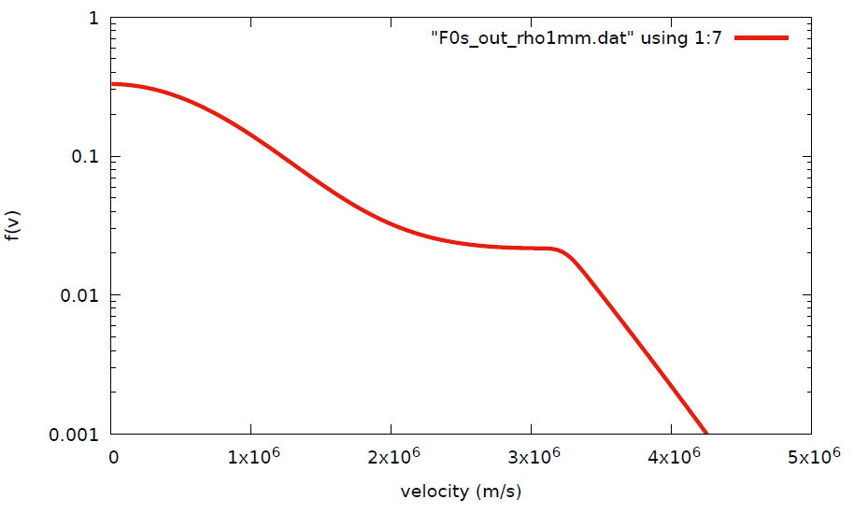
Energy distribution of D in the JET‘s plasma center
ETS-FoPla #99971 @ t = 49s
Credit: E. Lerche

Slide 15
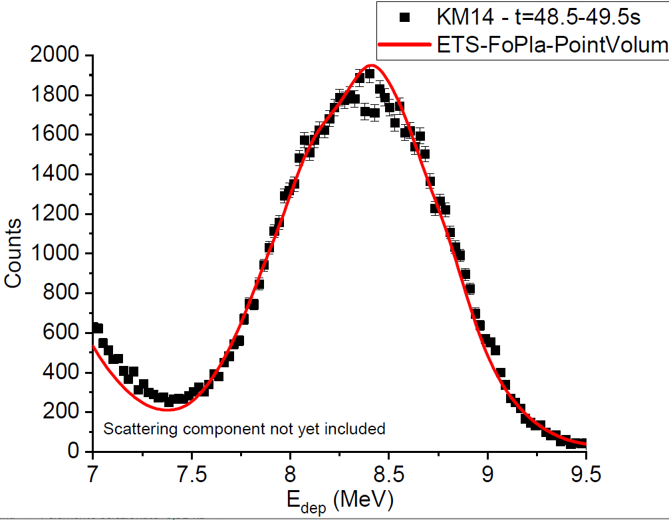
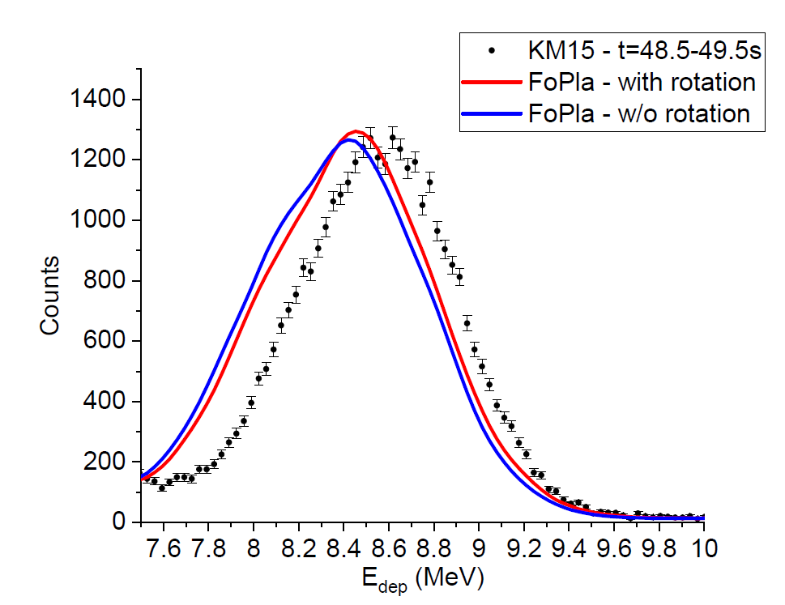
Measured neutron spectra in the diamond detectors
Credit: M. Noccente
90 degrees to magnetic field
45 degrees to magnetic field

Slide 16
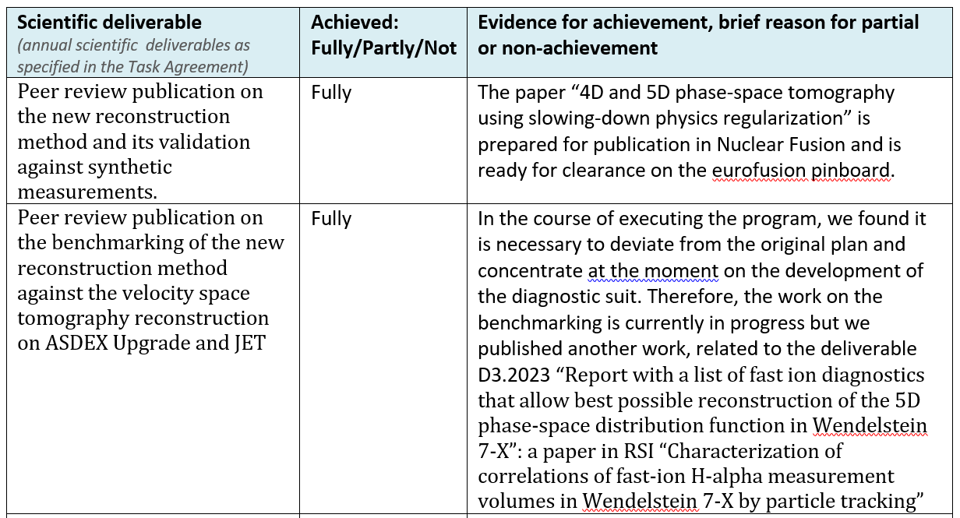
Conclusions

