Slide 1
ML/AI methods in edge plasma physics
Development of machine learning methods and integration of surrogate model predictor schemes for plasma-exhaust and PWI in fusion
(ENR-MOD.01.FZJ - theory)
S. Wiesen (PI) & ENR Team
Feb 8th 2023 – 2022 annual report

Slide 2
Rationale of ENR
Enable and facilitate optimized and improved modelling that allows a more flexible integration of physics models in the light of extrapolations towards future fusion devices.
Demonstrate the applicability of Machine-Learning (ML) and Artificial Neural Network (ANN) methods in fusion with a special focus on plasma-exhaust (scrape-off layer and pedestal region) and PWI.
This ENR project elaborates on the conceptual basis for an improved model predictor scheme involving new methods and computational technologies based on ML/ANN for exploitation in fusion device design studies
How much of an algorithmic model can be transformed into an accurate ML based data model?
Include uncertainty quantification (UQ) to enable an efficient selection of the numerical data, i.e. its cardinality, on which the training must be based and how reduced models are efficiently and quantifiably calibrated
This ENR project aims at expanding and disseminating new expertise & knowledge in the field of ML/ANN into the fusion community → advice on best practices
S. Wiesen | ENR-MOD.01.FZJ – theory 2022 report | Zoom | Feb 8th 2022 | Page 2

Slide 3
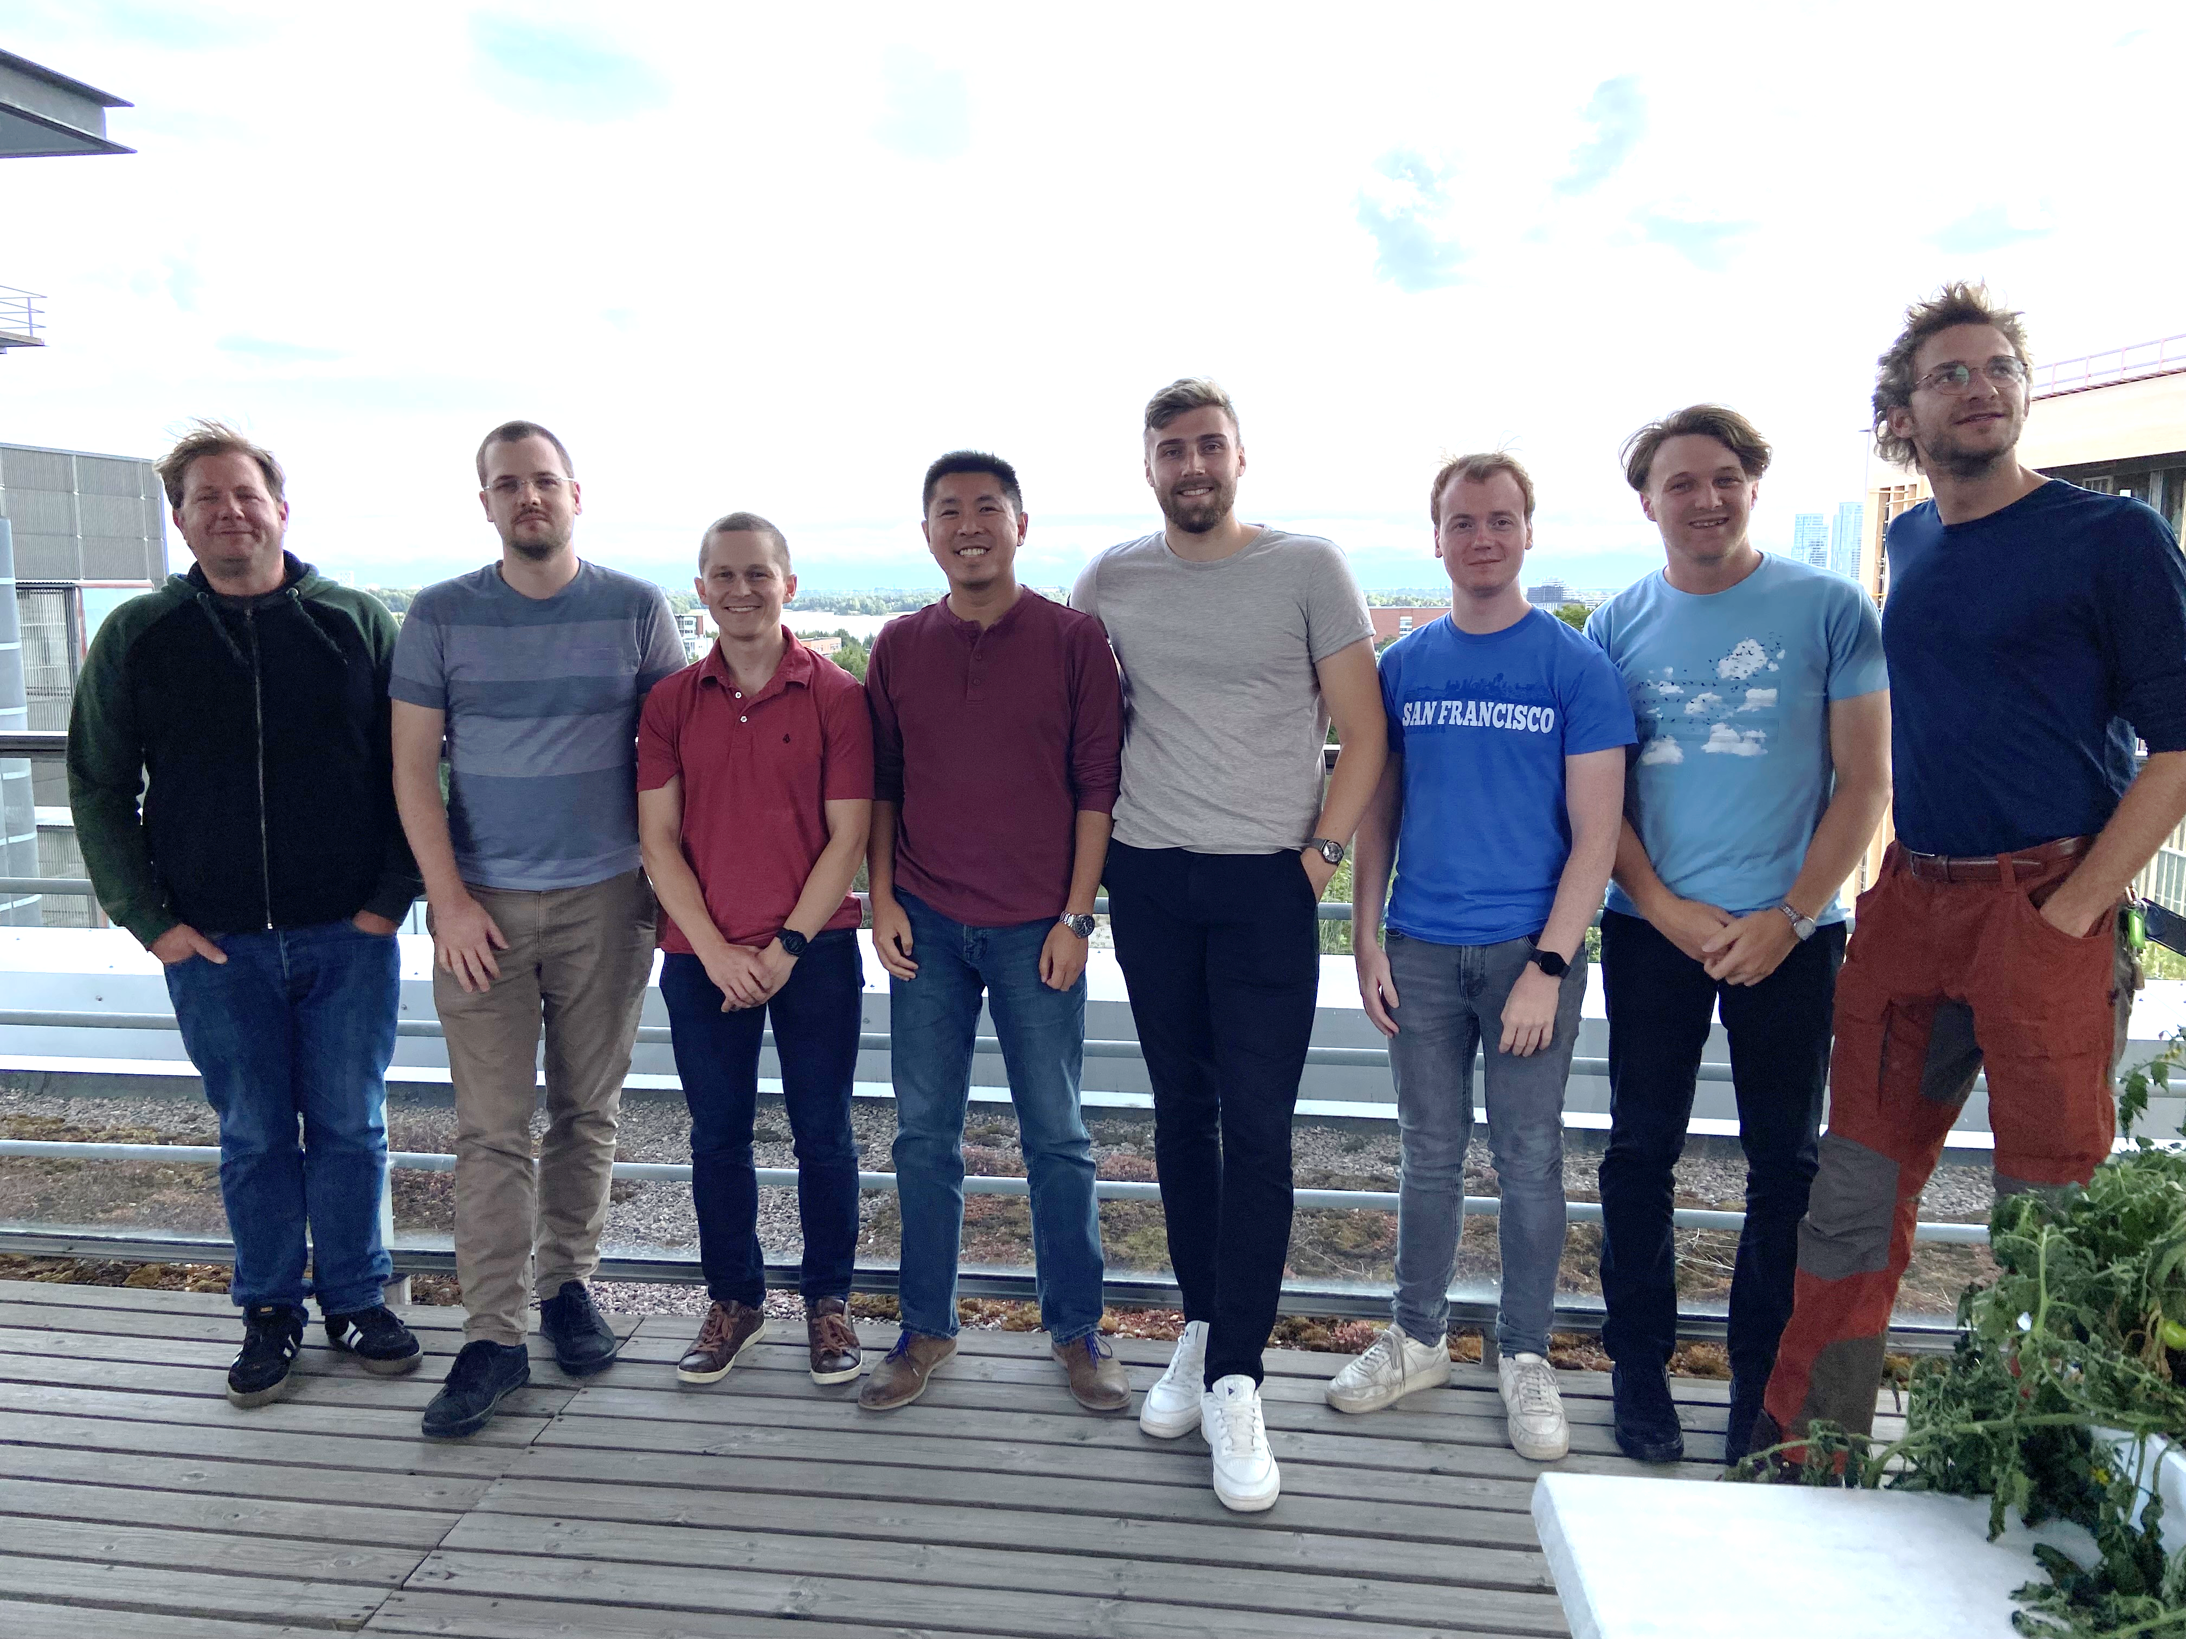
Smile ☺
Mid-term Progress meeting at ACH-05 Helsinki/Finland September 2022
S. Wiesen | ENR-MOD.01.FZJ – theory 2022 report | Zoom | Feb 8th 2022 | Page 3

Slide 4
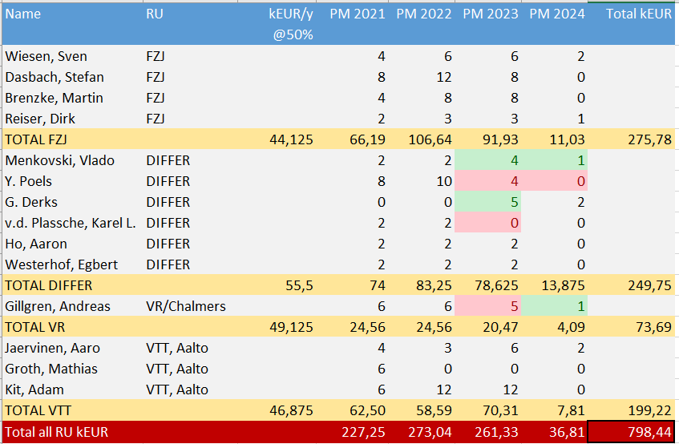
Recent change of resources
No change in overall budget and scope of project
S. Wiesen | ENR-MOD.01.FZJ – theory 2022 report | Zoom | Feb 8th 2022 | Page 4

Slide 5
Collaboration with ACH-05
The scope of ACH-05 is very well suited to provide support in developing professional management workflows for big data applications
The ENR collaborates with the EF ACH-05 that is focused on Data Management as well as aspects of AI & VVUQ
ENR generates large database of simulation data, as well as databases of experimental data preprocessed to be suitable for ML and ANN algorithms
Exchange on best practices in the field of ML/AI and data processing & storage → this ENR is a use case for ACH-05
Since the ENR work has been initiated in 2021, plans and ideas have progressed with the ACH-05 team to find the appropriate data management solutions → White papers in preparation
S. Wiesen | ENR-MOD.01.FZJ – theory 2022 report | Zoom | Feb 8th 2022 | Page 5

Slide 6
Conferences 2022 & 2023 (selection)
PSI2022 (inkl peer reviewed paper in NME)
  Dasbach: Towards fast surrogate models for interpolation of tokamak edge plasmas
  Kit: Developing Deep Learning Algorithms for Inferring Upstream Separatrix Density at JET
  Jaervinen: Parameteric scaling of power exhaust in EU-DEMO alternative divertor simulations
ICDDPS4
  Wiesen (invited): Data-driven models in fusion exhaust: methods and perspectives
  Dasbach: Development of surrogate models for tokamak exhaust
  Gillgren: Methods to investigate non-linearity of parameter dependencies in the pedestal models
  Kit: Latent dynamics on the pedestal representation learning
  Järvinen: Inferring machine independent latent features in pedestal representation learning
  Jurinec & Kit: Feature storage framework for ML workflows in fusion (collaboration with ACH-05)
  Clarte & Kit: Bayesian optimization for maximizing pedestal pressure height (collaboration with UH)
  Poels: Fast Divertor Plasma Simulation using Deep Learning-based Surrogate Modeling
IAEA-FEC 2023:
  Wiesen: Data-driven models in fusion exhaust: AI methods and perspectives
  Gillgren: Interpretable supervised learning methods for pedestal prediction
  Kit: Developing generative semi-supervised learning models for pedestal plasmas
  Järvinen: Bayesian methods for uncertainty quantification and parameter optimization in fusion energy applications
  … and other national physics conferences
S. Wiesen | ENR-MOD.01.FZJ – theory 2022 report | Zoom | Feb 8th 2022 | Page 6

Slide 7
Publications 2022 & 2023 (selection)
Other journal publications:
Panera, Ho: Uncertainty aware surrogate model for EPED/EUROPED established through BNN-NCP
Poels, Kit: Paper(s) on learning profile/tokamak state dynamics in data space vs latent space; Datasets (AUG, JET, TCV, WEST); Neural PDEs; Latent space dynamics
Work published in 2022 / early 2023
Wiesen et al, Nucl. Fusion 2023 (IAEA-FEC)
Dasbach Nucl Fusion 2023 or PPCF
Gillgren et al. Nucl. Fusion 2022: NN-based adaptive pedestal for transport simulations
Kit et al. PPCF 2023: ML model for ne,PED regression beyond the standard log-linear
Kit et al. NME 2023: DIVA-like model for generating pedestal profiles at JET for given machine control configuration. Application for n_{e,SEP} prediction.
Reiser/Brenzke: PWI model discovery (tbc)
S. Wiesen | ENR-MOD.01.FZJ – theory 2022 report | Zoom | Feb 8th 2022 | Page 7

Slide 8
Further Remarks
Broadcast event in Sep 2022 triggered interaction with following groups
ACH-05
TSVV-11
ENR on plasma control (M. v. Berkel)
IAEA CRP „AI 4 Fusion“
Munich Inst for Astro- Particle- and Biophysics (MIAPbP)
cross-topic AI in Astrophysics & MC Fusion (L. Zanisi)
U Helsinki, IPP.CR, CEA, U Aix Marseille
Center for Atomic and Molecular Technologies (CAMT), Japan (S. Hamaguchi)
PiAI seminar series
fusion-ai@helsinki.fi mailinglist has been established
S. Wiesen | ENR-MOD.01.FZJ – theory 2022 report | Zoom | Feb 8th 2022 | Page 8

Slide 9
Overview of sub-projects
SP1 Development of a surrogate model for power & particle exhaust
S. Dasbach, S. Wiesen (FZJ)
SP2 Development/improvement of ML/ANN methods for training based on experimental data for pedestal physics
A. Jaervinen, A. Kit (VTT/U Helsinki),
A. Gillgren (VR/Chalmers)
A. Ho, A. Panera, K. L. v.d. Plassche (DIFFER)
SP3 Model discovery for erosion yields through ML methods
M. Brenzke, D. Reiser (FZJ)
SP4 Towards time-dependent surrogate models for exhaust
Y. Poels, E. Westerhof, V. Menkovski, G. Derks (DIFFER)
S. Wiesen | ENR-MOD.01.FZJ – theory 2022 report | Zoom | Feb 8th 2022 | Page 9

Slide 10
SP1 Development of a surrogate model for power & particle exhaust
S. Wiesen | ENR-MOD.01.FZJ – theory 2022 report | Zoom | Feb 8th 2022 | Page 10

Slide 11
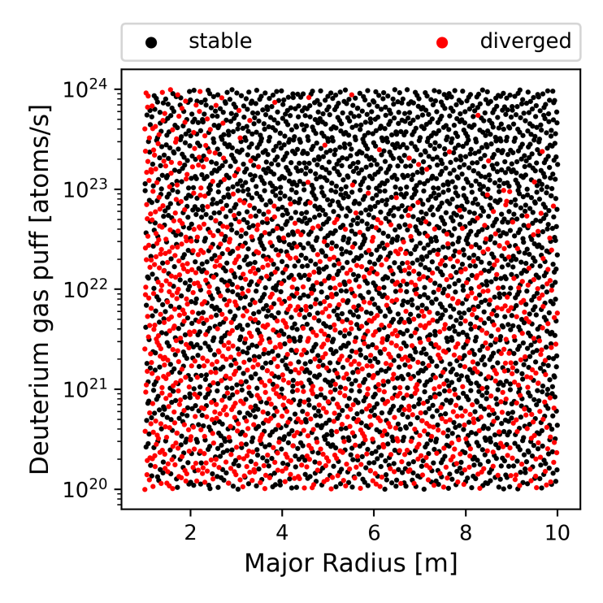
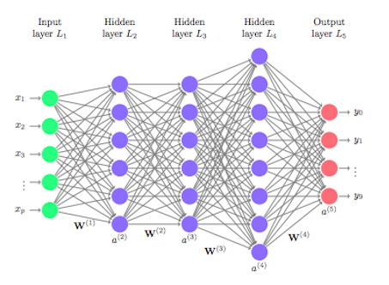
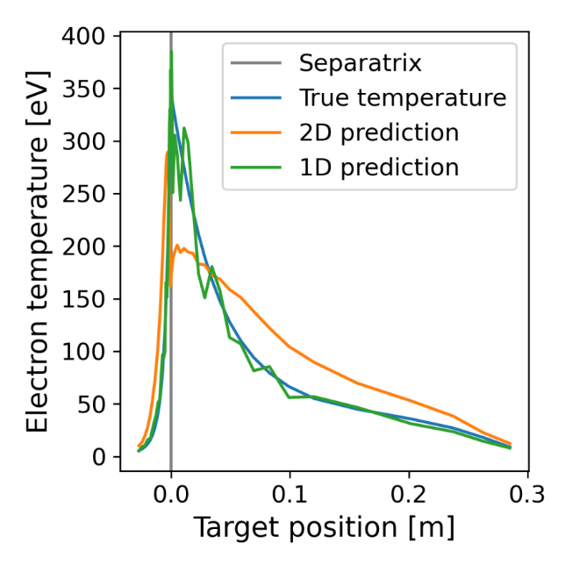
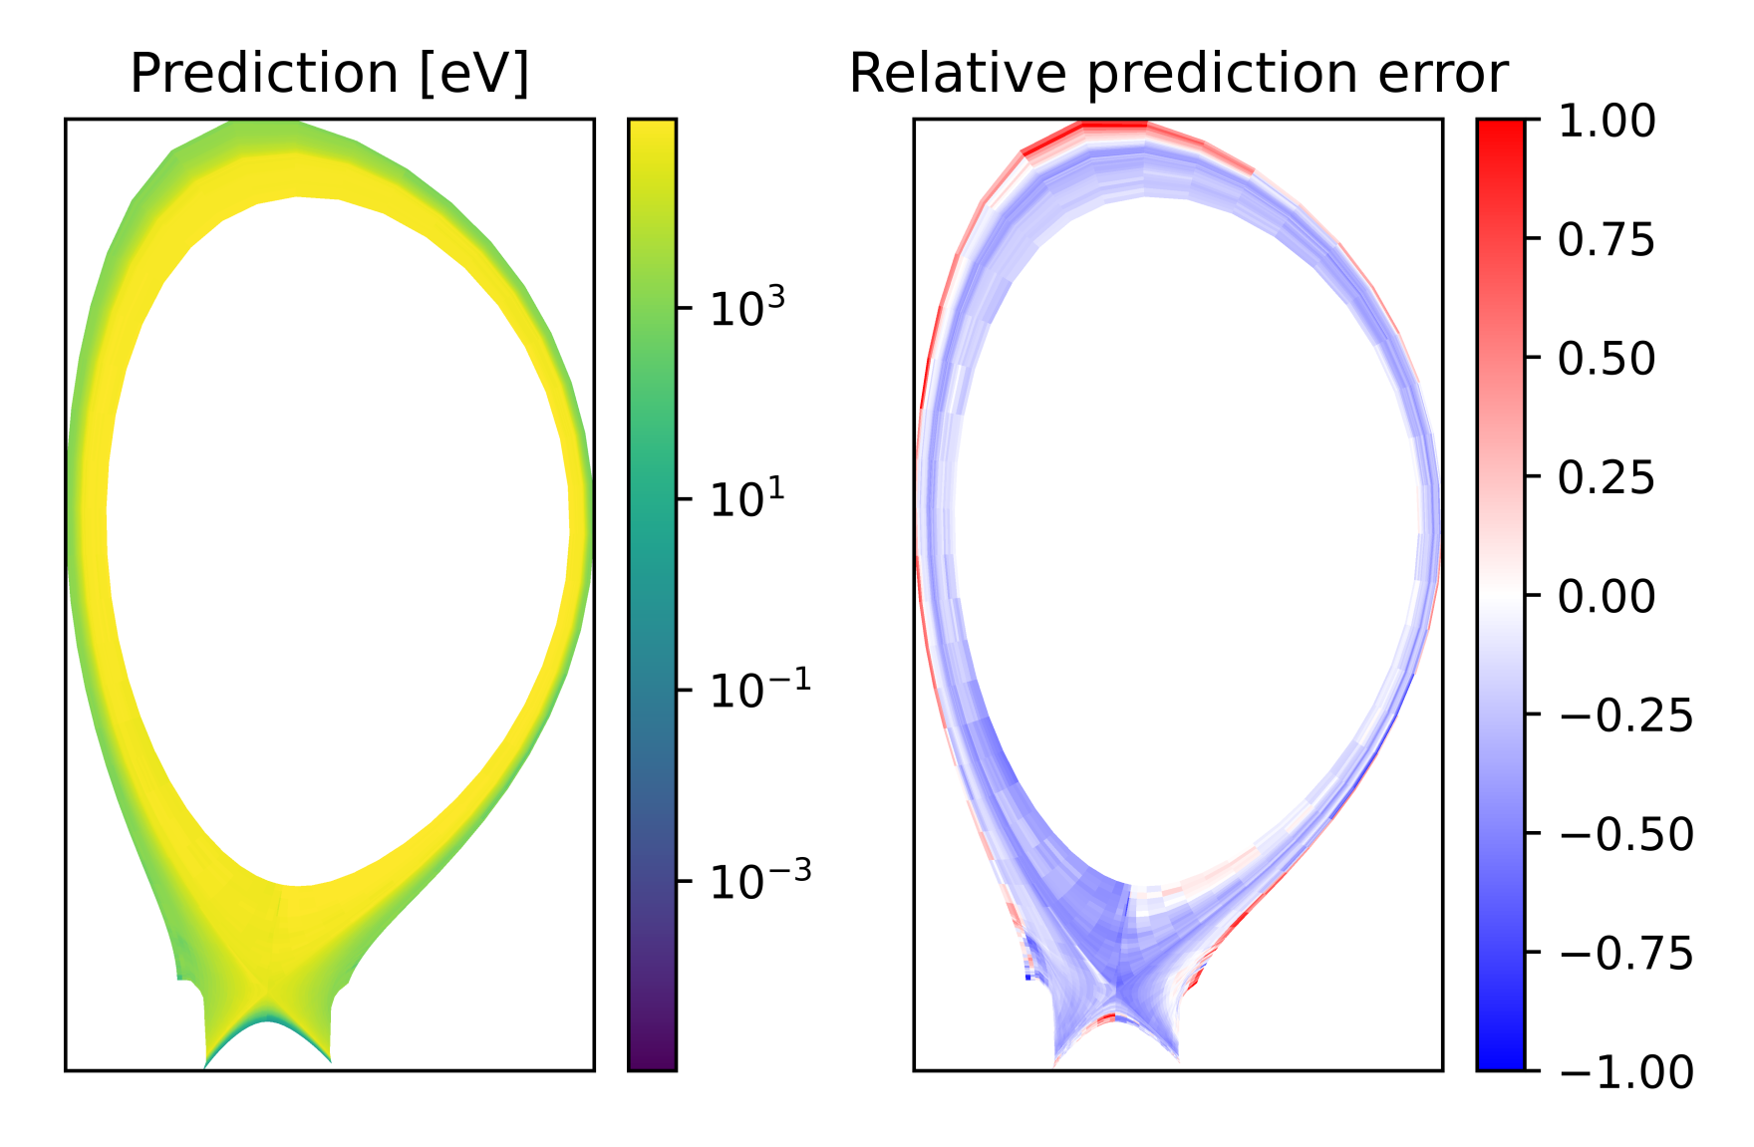
SP1 Speeding up the SOL: fast model based deep learning models
Convolutional Neural Network
SOLPS-ITER
full 2D profiles
NN trained by using
data from SOLPS-ITER
baseline simulations with
fluid neutrals
S. Dasbach et al, PSI2022
S. Wiesen | ENR-MOD.01.FZJ – theory 2022 report | Zoom | Feb 8th 2022 | Page 11

Slide 12
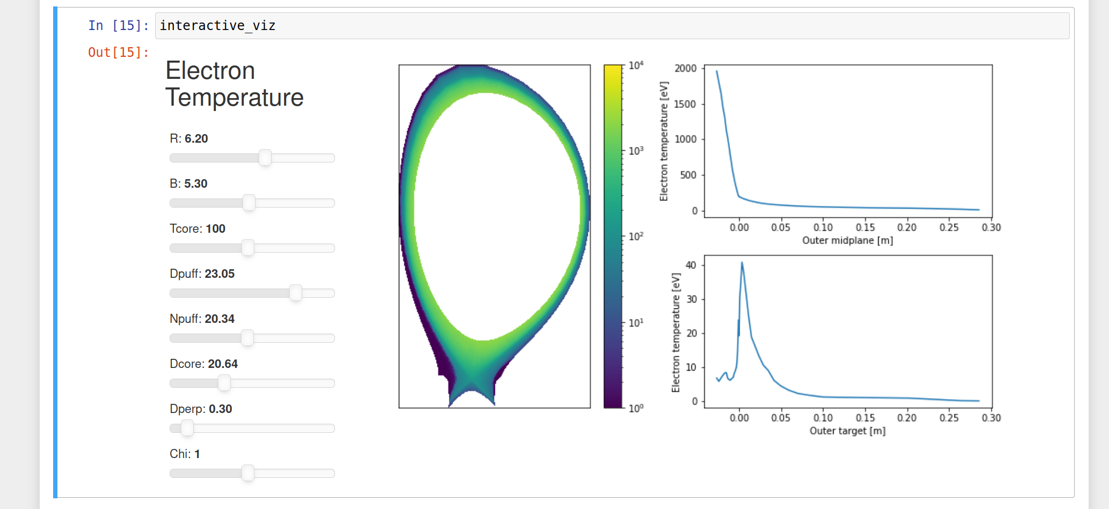
SP1 Towards interactive exploration
S. Wiesen | ENR-MOD.01.FZJ – theory 2022 report | Zoom | Feb 8th 2022 | Page 12

Slide 13
SP1 Towards inverse problems
S. Wiesen | ENR-MOD.01.FZJ – theory 2022 report | Zoom | Feb 8th 2022 | Page 13

Slide 14
SP2 Development/improvement of ML/ANN methods for training based on experimental data for pedestal physics
S. Wiesen | ENR-MOD.01.FZJ – theory 2022 report | Zoom | Feb 8th 2022 | Page 14

Slide 15
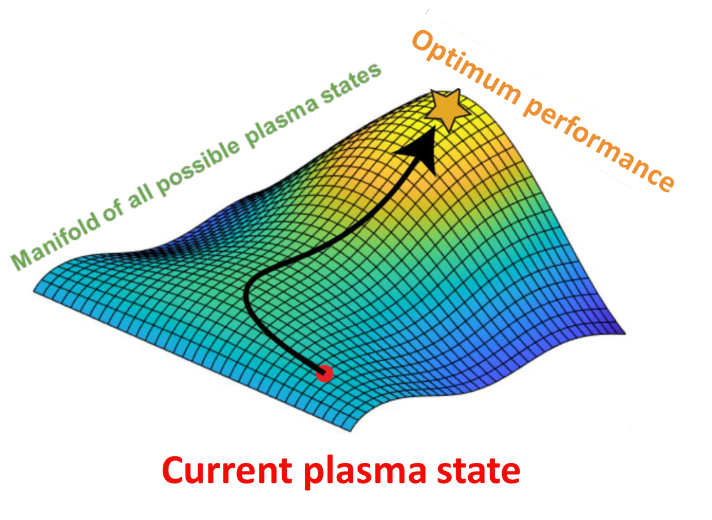
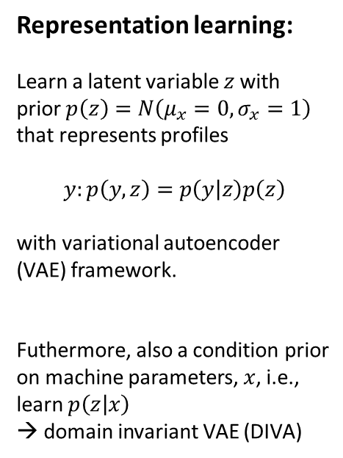
SP2 Exploiting deep learning algorithms for controling n_{e,ped}/n_{e,sep}
Representation learning:
Learn a latent variable $z$ with
prior $p\left(z\right)=N\left(μ_{x}=0,σ_{x}=1\right)$
that represents profiles
$$y:p\left(y,z\right)=p\left(y | z\right)p\left(z\right)$$
with variational autoencoder
(VAE) framework.
Futhermore, also a condition prior
on machine parameters, $x$, i.e.,
learn $p\left(z | x\right)$
→ domain invariant VAE (DIVA)
NN Trained by using
Data from JET
Pedestal database
Frassinetti NF2021
A. Kit et al, PSI2022
S. Wiesen | ENR-MOD.01.FZJ – theory 2022 report | Zoom | Feb 8th 2022 | Page 15

Slide 16
SP2 Learning machine independent latent features using JET and AUG databases

Slide 17
SP4 Towards time-dependent surrogate models for exhaust
S. Wiesen | ENR-MOD.01.FZJ – theory 2022 report | Zoom | Feb 8th 2022 | Page 17

Slide 18
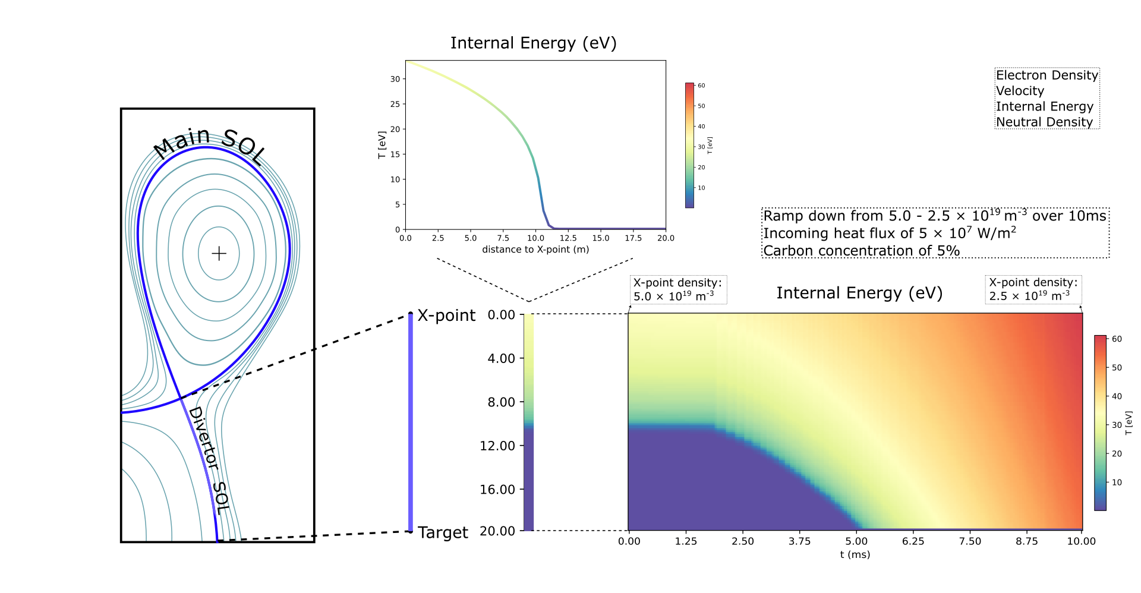
SP4 Problem Setting
S. Wiesen | ENR-MOD.01.FZJ – theory 2022 report | Zoom | Feb 8th 2022 | Page 18

Slide 19
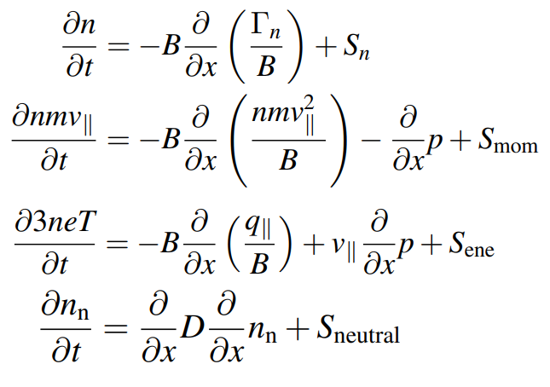
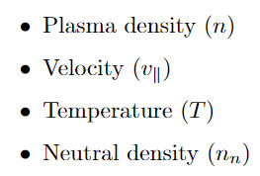
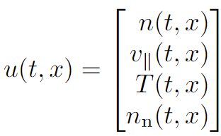
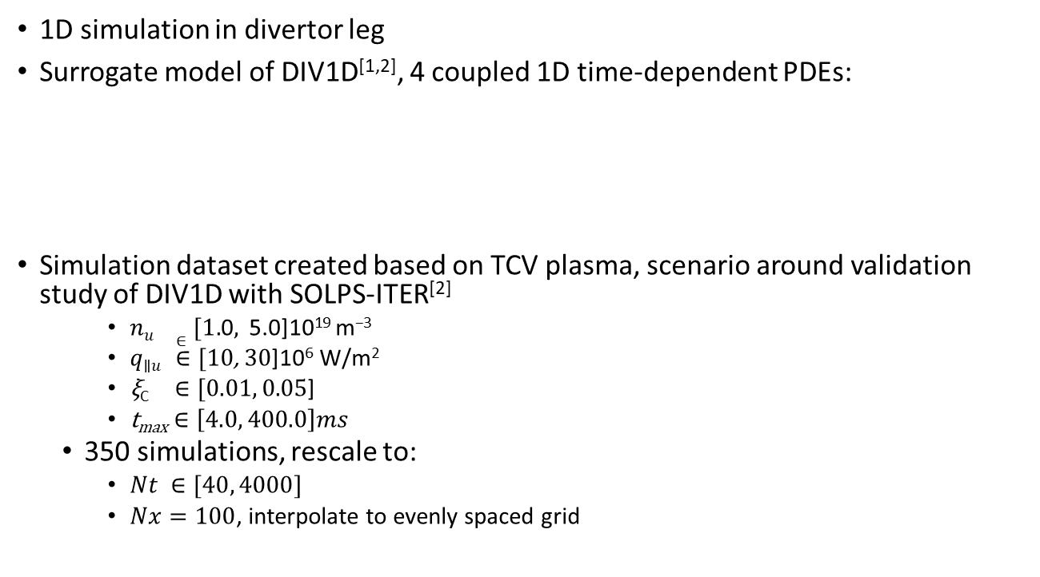
SP4 Simulating Divertor Plasmas
1D simulation in divertor leg
Surrogate model of DIV1D^{[1,2]}, 4 coupled 1D time-dependent PDEs:
Simulation dataset created based on TCV plasma, scenario around validation study of DIV1D with SOLPS-ITER^{[2]}
    $nu ∈[1.\text{0},\text{ 5.}\text{0}\text{]}\text{10}\text{19} \text{m}\text{−3}$
    $q\text{∥}u ∈[10\text{, }3\text{0}\text{]}\text{10}\text{6} \text{W}\text{/}\text{m}\text{2}$
    $\text{ξ}\text{C} ∈[0.01, 0.05\text{]}$
    t_{max} $∈\left[4.0, 400.0\right]ms$
  350 simulations, rescale to:
    $Nt ∈[40, 4000]$
    $Nx=100$, interpolate to evenly spaced grid
[1] Westerhof, E., et al. "A 1D code for studies of divertor detachment dynamics." EPS 2021.
[2] Derks, G. et al. “Benchmark of a self-consistent dynamic 1D divertor model DIV1D using the 2D SOLPS-ITER code.” PPCF 64, 2022.
S. Wiesen | ENR-MOD.01.FZJ – theory 2022 report | Zoom | Feb 8th 2022 | Page 19

Slide 20
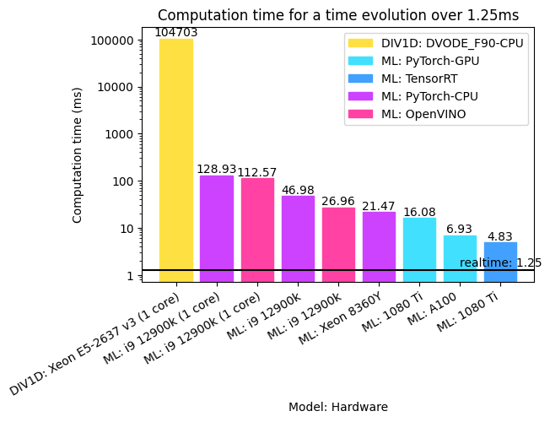
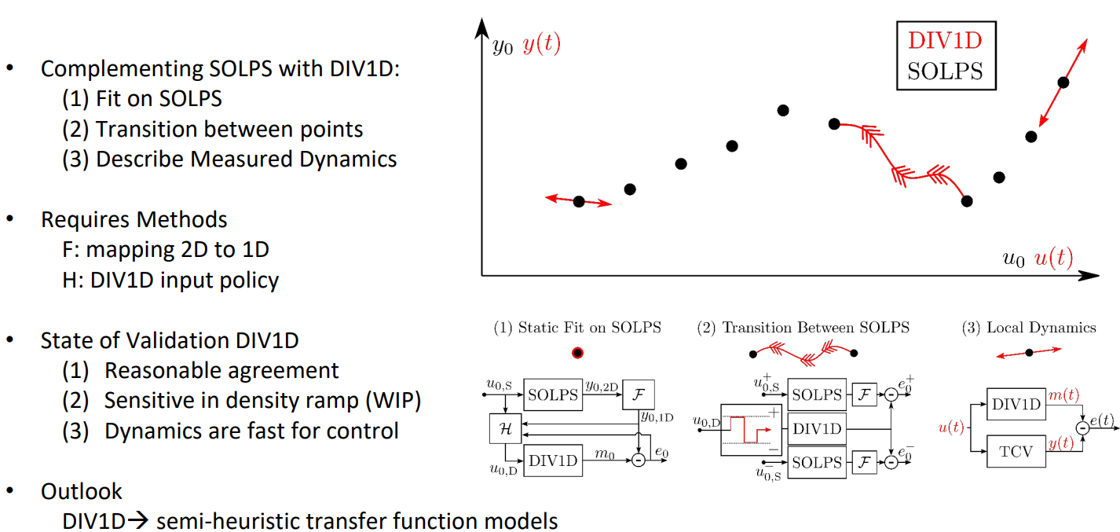
SP4 Detachment dynamic modelling for control
ENR ML project Y. Poels et al
courtesy M. van Berkel et al
S. Wiesen | ENR-MOD.01.FZJ – theory 2022 report | Zoom | Feb 8th 2022 | Page 20

Slide 21
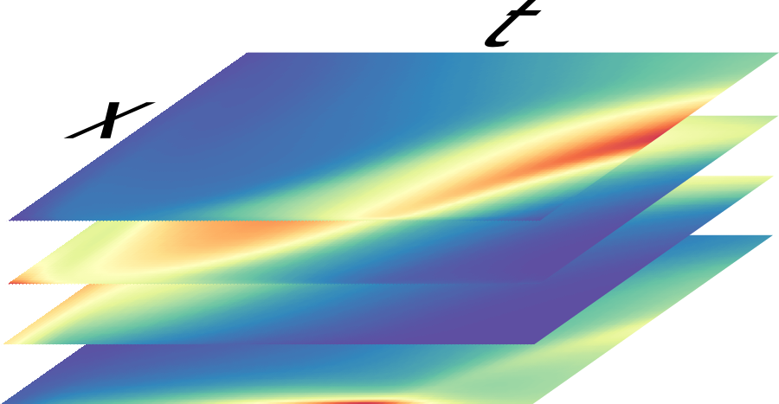
SP4 Simulating with Neural PDE surrogates
Generate new PDE solutions with Neural Networks
Train with data generated by classical numerical method: Surrogate model
Initial-Boundary Value Problem (IBVP)
  Values at t=0 (initial conditions)
  Conditions at boundaries x=0 and x=5 (boundary conditions)
S. Wiesen | ENR-MOD.01.FZJ – theory 2022 report | Zoom | Feb 8th 2022 | Page 21

Slide 22
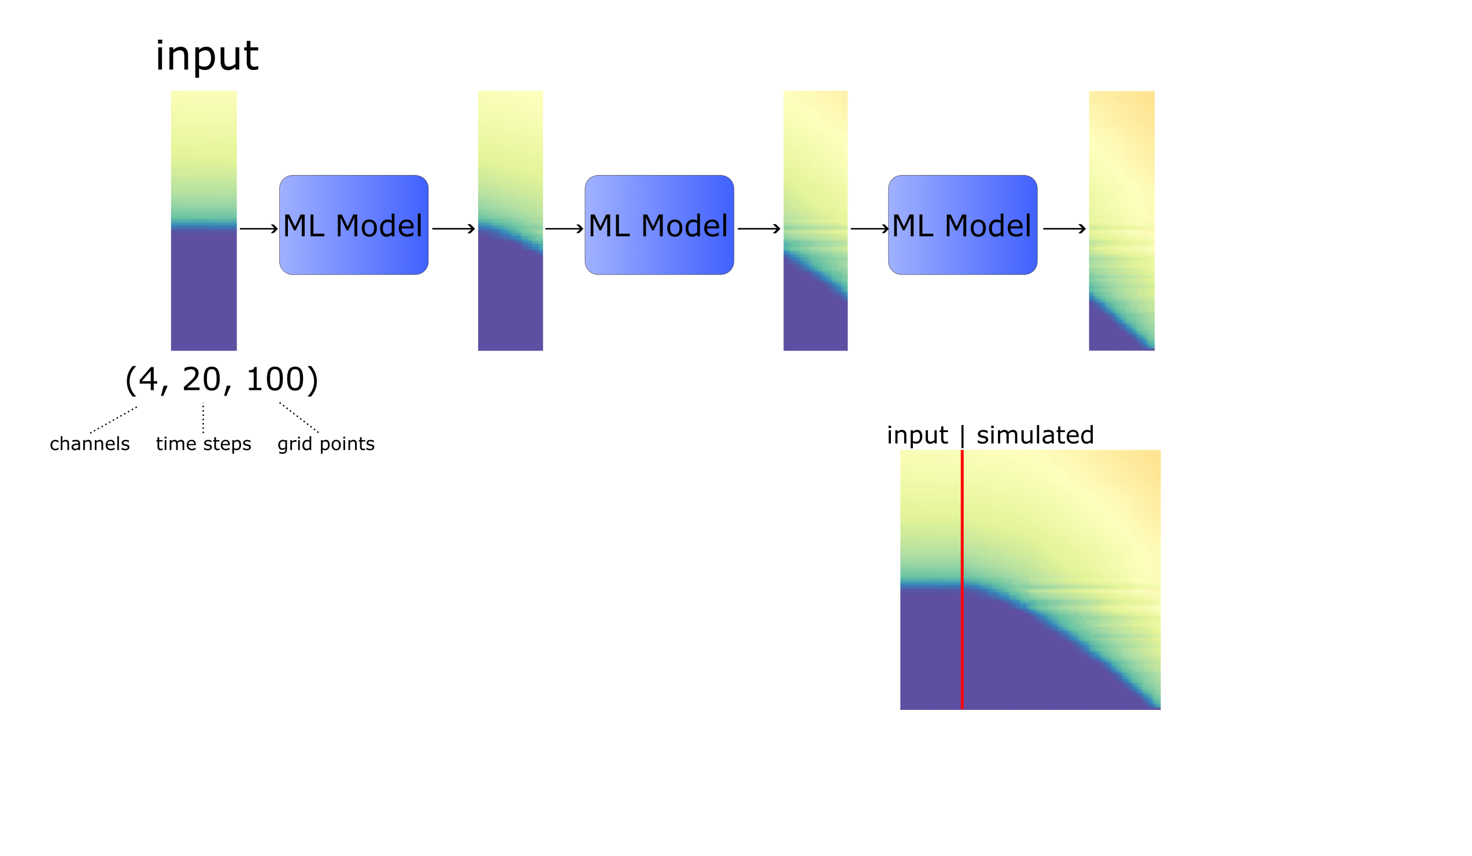

SP4 Simulating with Neural PDE surrogates
4 Channels
$∆t=0.1ms$, 20 timesteps per block (=2$ms$)
Simulations ranging from $Nt=40$ to $Nt=4000$ (4$ms$ to 400$ms$)
$L≈5m,$ evenly spaced grid with $dx=0.05m$, $Nx=100$
S. Wiesen | ENR-MOD.01.FZJ – theory 2022 report | Zoom | Feb 8th 2022 | Page 22

Slide 23
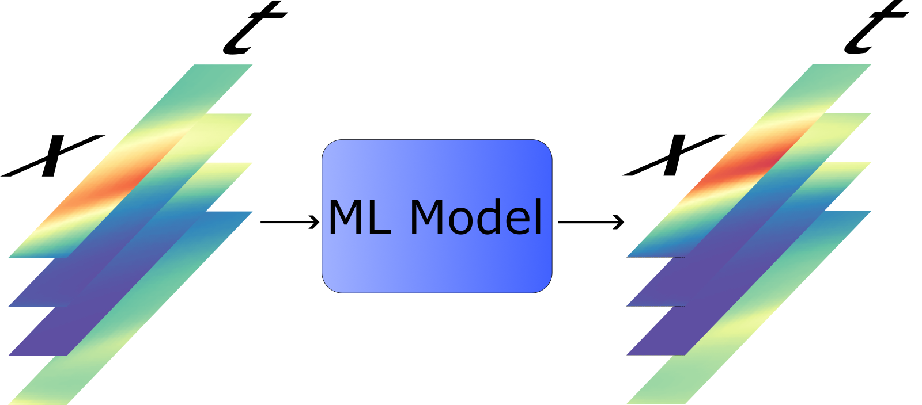
SP4 Simulating with Neural PDE surrogates
S. Wiesen | ENR-MOD.01.FZJ – theory 2022 report | Zoom | Feb 8th 2022 | Page 23

Slide 24
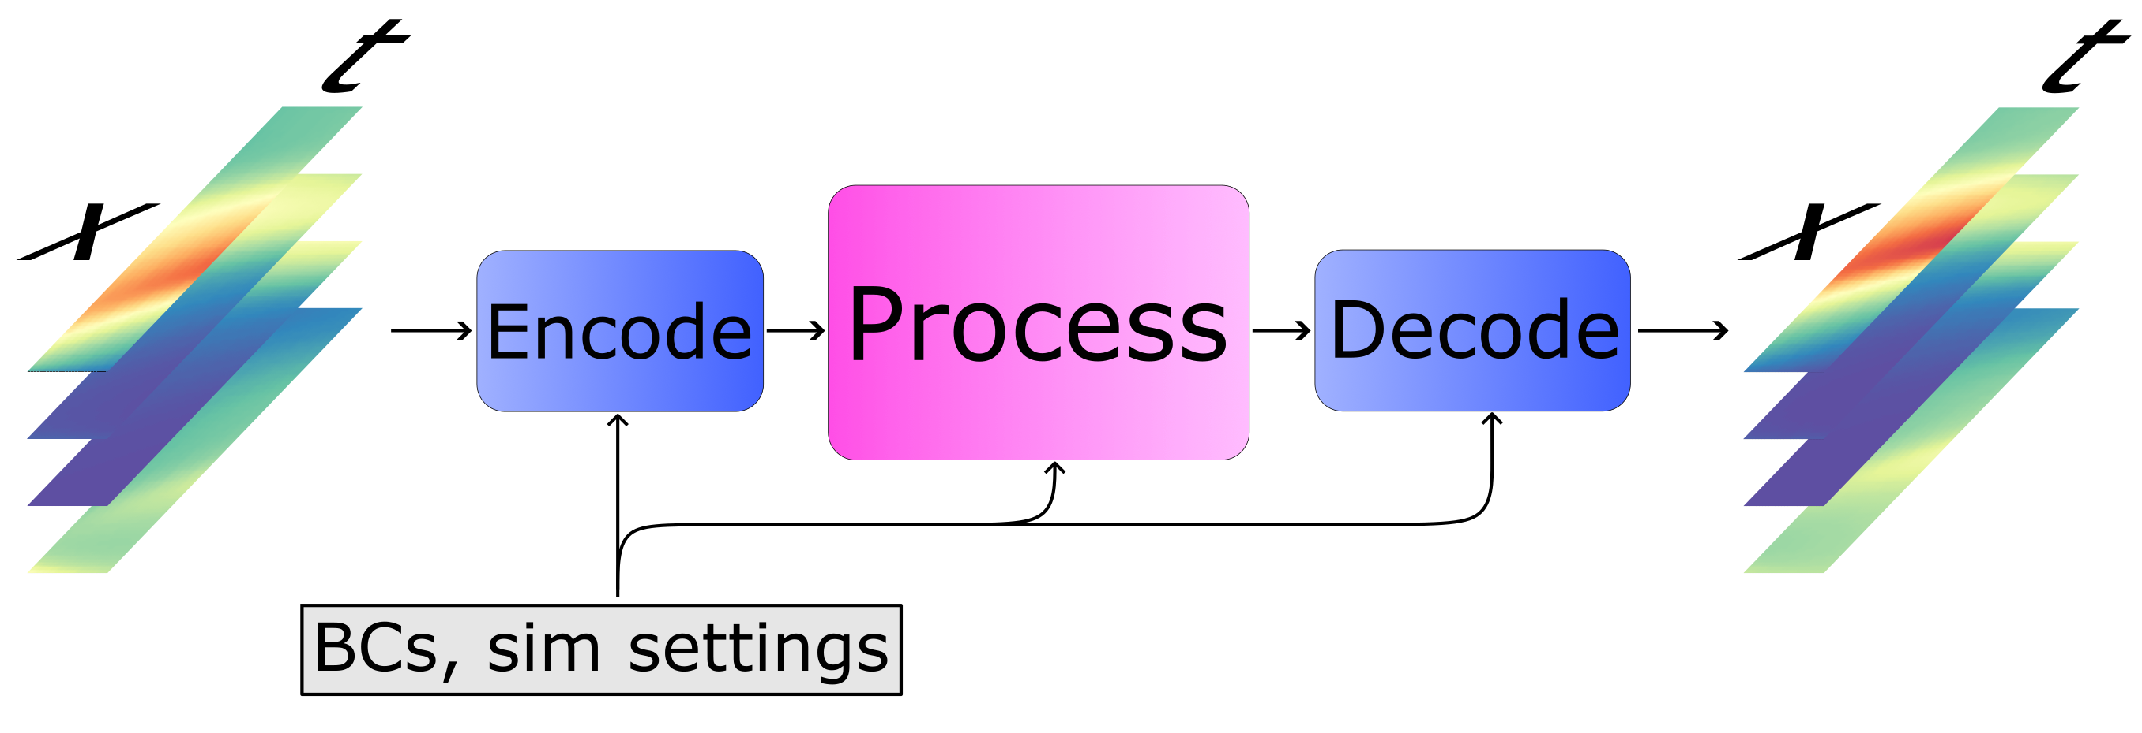
SP4 Simulating with Neural PDE surrogates
S. Wiesen | ENR-MOD.01.FZJ – theory 2022 report | Zoom | Feb 8th 2022 | Page 24

Slide 25
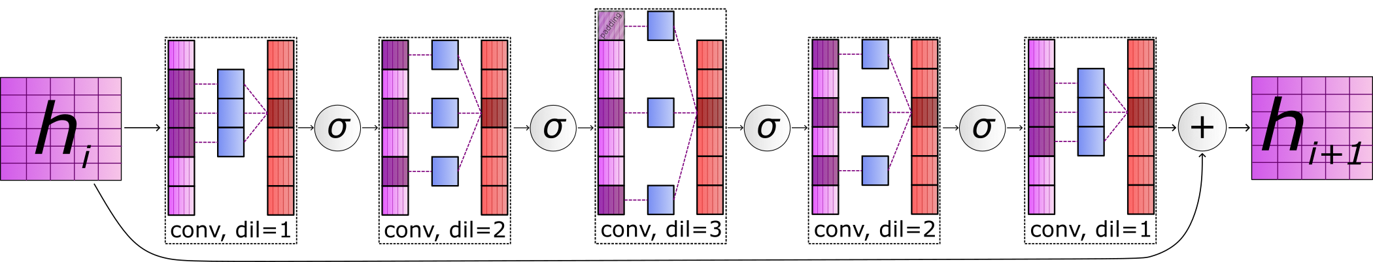
SP4 Simulating with Neural PDE surrogates
[5] Stachenfeld, K., et al. “Learned Simulators for Turbulence” ICLR 2022.
[5]
S. Wiesen | ENR-MOD.01.FZJ – theory 2022 report | Zoom | Feb 8th 2022 | Page 25

Slide 26
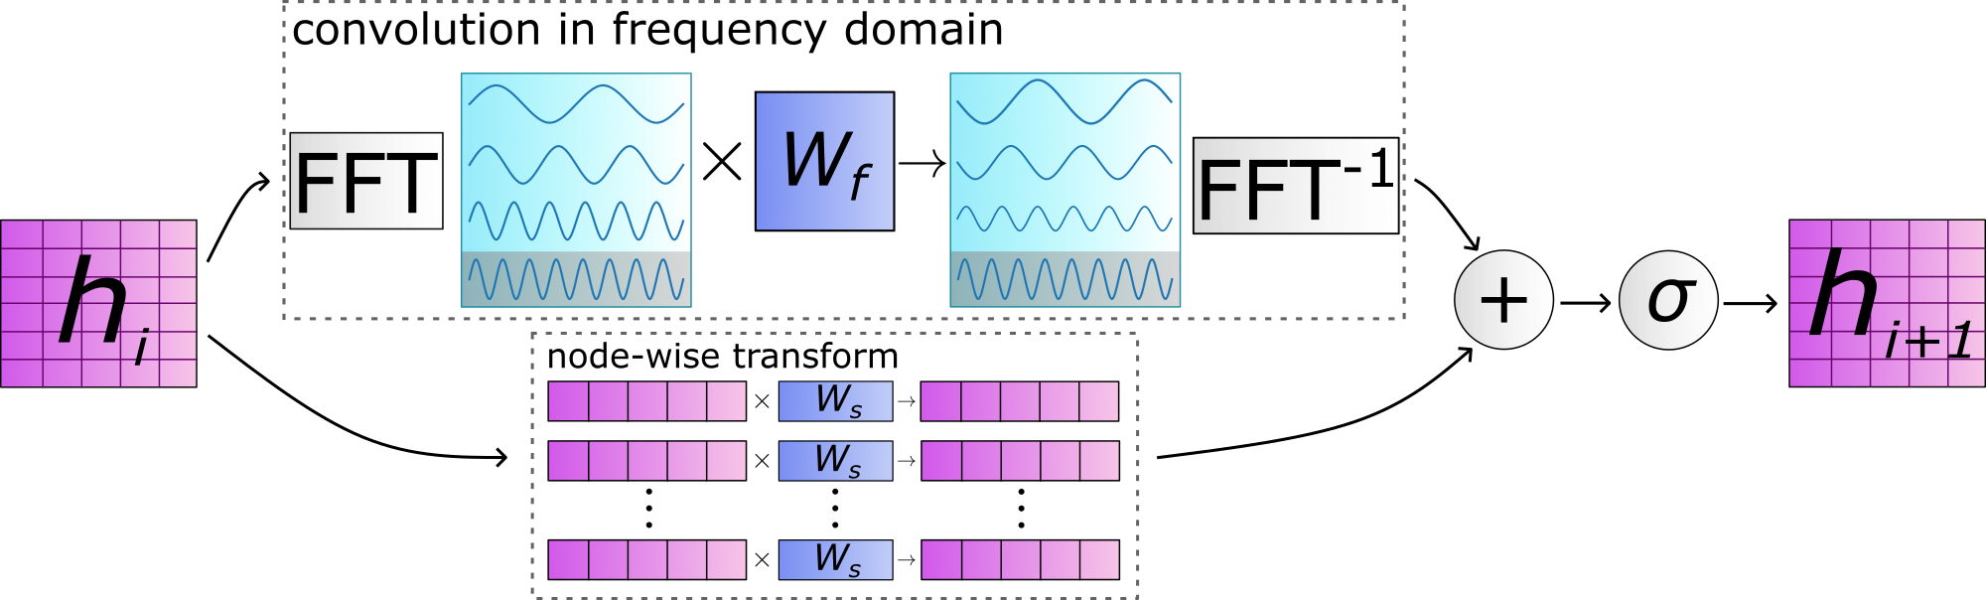
SP4 Simulating with Neural PDE surrogates
[6] Li, Z., et al. “Fourier Neural Operator for Parametric Partial Differential Equations” ICLR 2021.
[5]
[6]
S. Wiesen | ENR-MOD.01.FZJ – theory 2022 report | Zoom | Feb 8th 2022 | Page 26

Slide 27
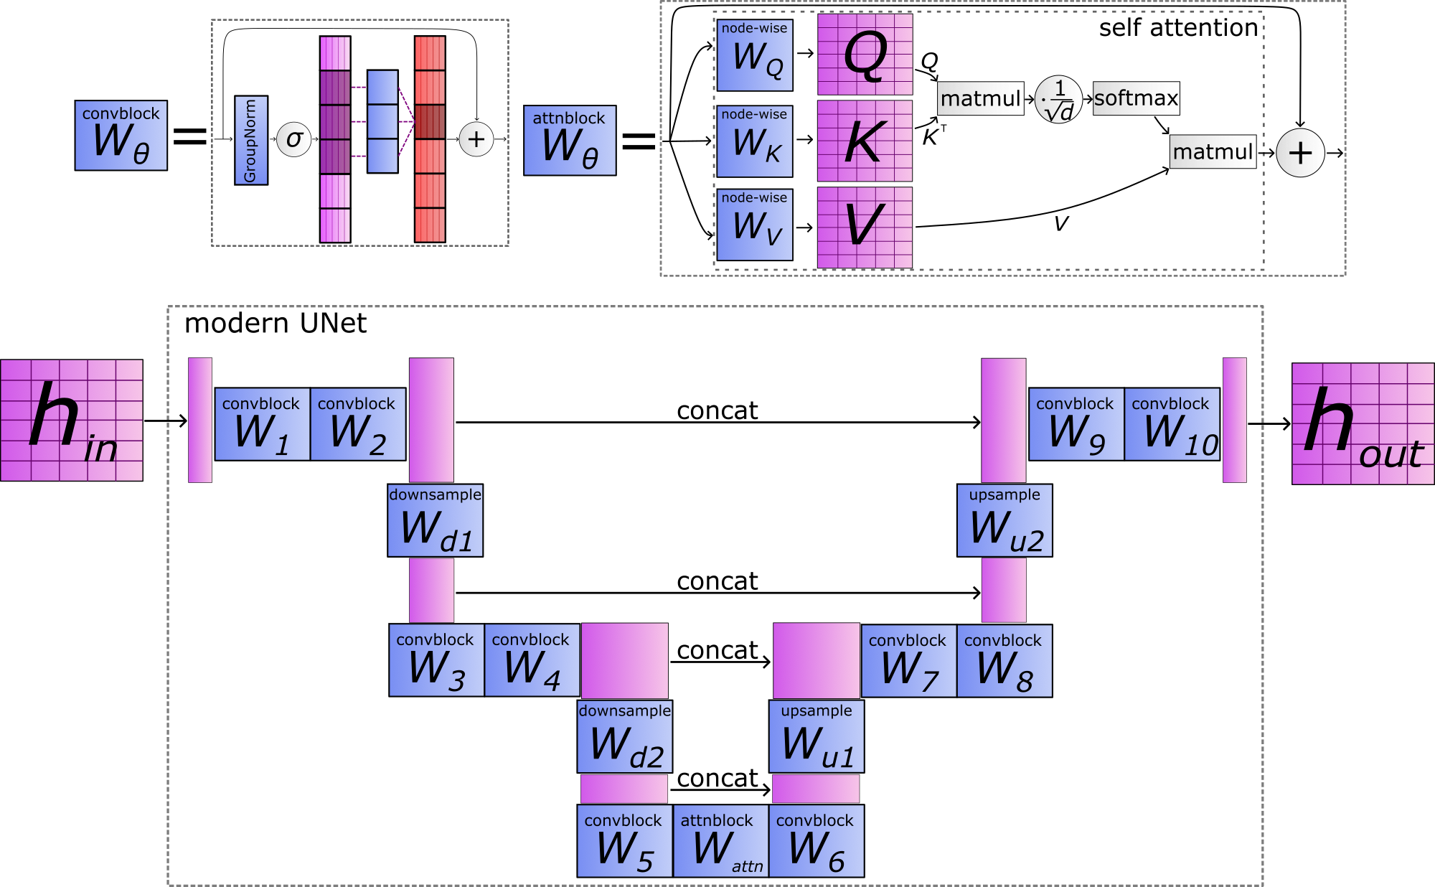
SP4 Simulating with Neural PDE surrogates
[7] Gupta, J. K., et al. “Towards Multi-spatiotemporal-scale Generalized PDE Modeling” arXiv:2209.15616.
[5]
[6]
[7]
S. Wiesen | ENR-MOD.01.FZJ – theory 2022 report | Zoom | Feb 8th 2022 | Page 27

Slide 28
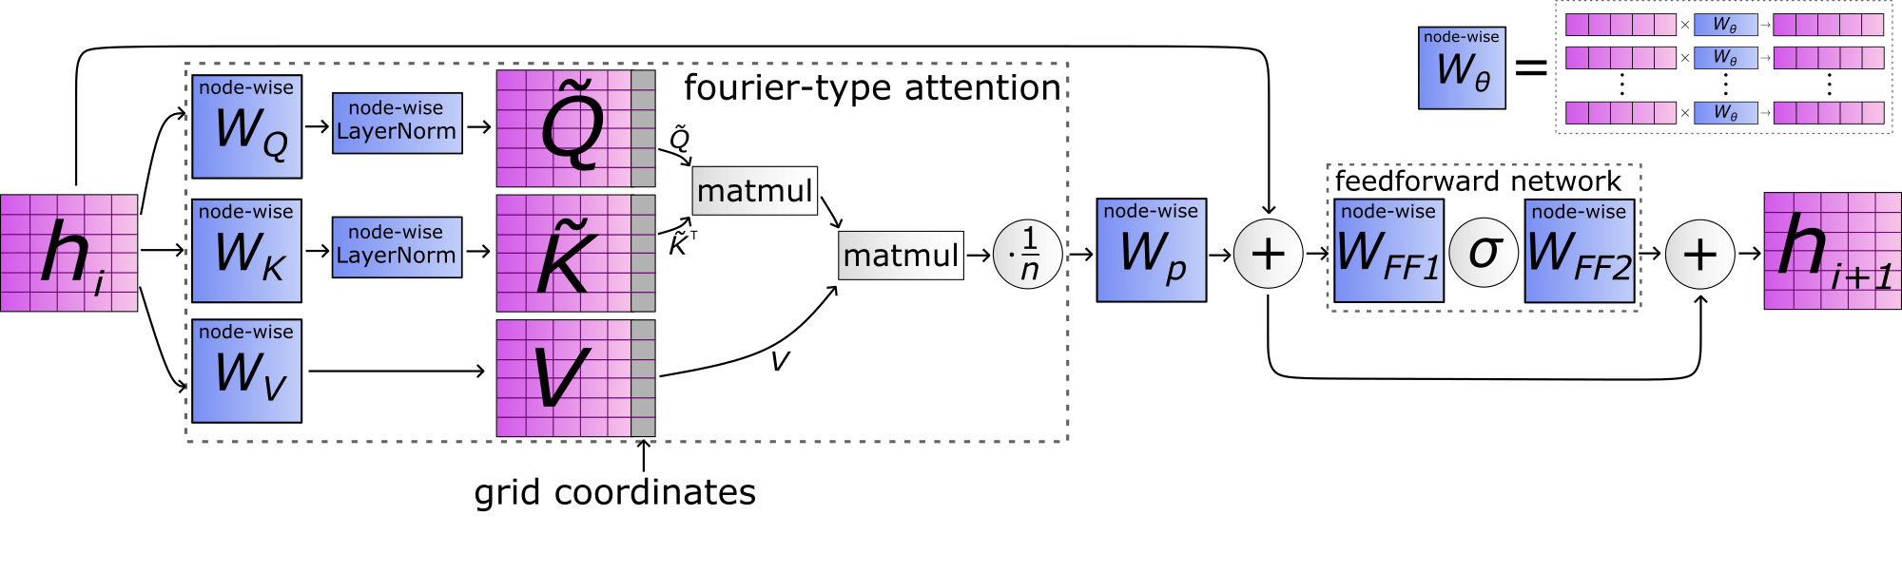
SP4 Simulating with Neural PDE surrogates
[8] Cao, S. “Choose a Transformer: Fourier or Galerkin” NeurIPS 2021.
[5]
[6]
[7]
[8]
S. Wiesen | ENR-MOD.01.FZJ – theory 2022 report | Zoom | Feb 8th 2022 | Page 28

Slide 29
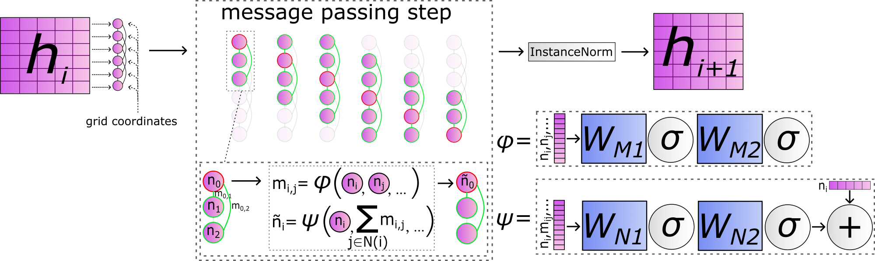
SP4 Simulating with Neural PDE surrogates
[4] Brandstetter, J., et al. “Message Passing Neural PDE Solvers." ICLR 2022.
[5]
[6]
[7]
[8]
[4]

Slide 30
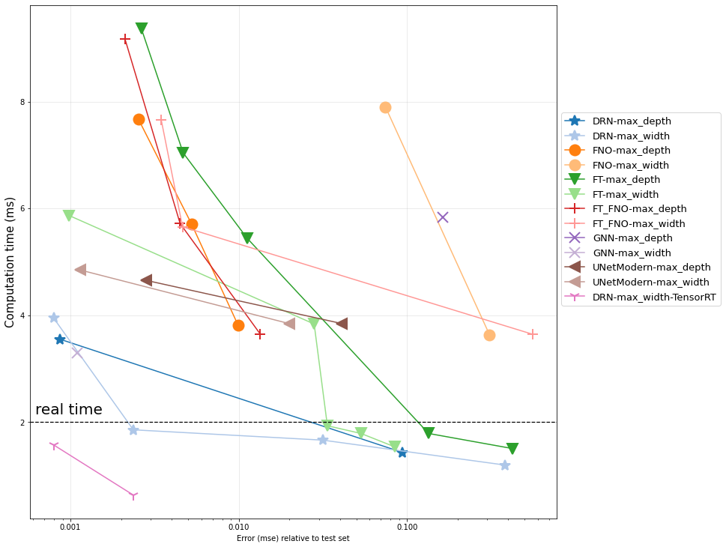
SP4 Results
Work-precision for MSE on test set, full simulation rollouts
(NVIDIA A100)
Optimize best model + compile with TensorRT
For each processor architecture, search settings for different inference speeds →Goal: find the fastest architecture with good performance
Search both in ‘width’ (many features per layer) and ‘depth’ (many layers)
Plot pareto front of models with MSE < 1 (standardized data)
(Compare to DIV1D speed)
MSE:
Inference:
0.002365
0.6321ms

Slide 31
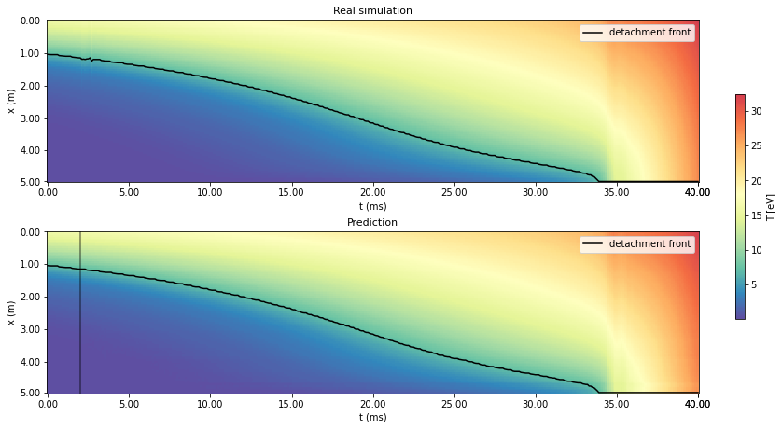
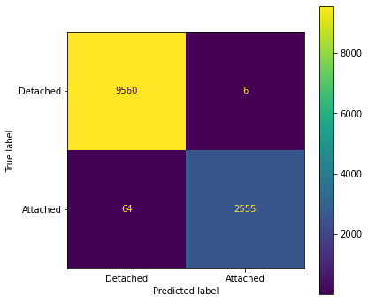

SP4 Results
Predicted detachment ($T<7eV$ at target) (Accuracy: 99.4%)
Detached
Attached
S. Wiesen | ENR-MOD.01.FZJ – theory 2022 report | Zoom | Feb 8th 2022 | Page 31

Slide 32
SP3 Model discovery for erosion yields through ML methods
S. Wiesen | ENR-MOD.01.FZJ – theory 2022 report | Zoom | Feb 8th 2022 | Page 32

Slide 33
SP3 Setup of Problem
S. Wiesen | ENR-MOD.01.FZJ – theory 2022 report | Zoom | Feb 8th 2022 | Page 33

Slide 34
SP3 Setup of Problem
S. Wiesen | ENR-MOD.01.FZJ – theory 2022 report | Zoom | Feb 8th 2022 | Page 34

Slide 35
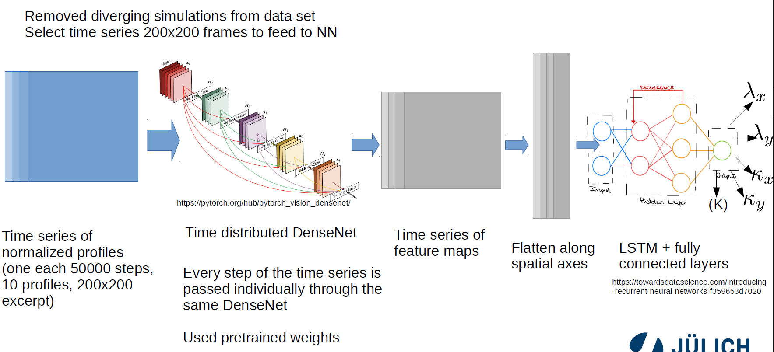
SP3 NN Architecture
S. Wiesen | ENR-MOD.01.FZJ – theory 2022 report | Zoom | Feb 8th 2022 | Page 35

Slide 36
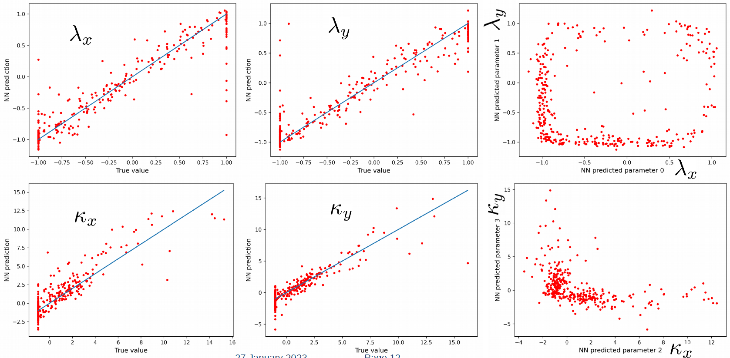
SP3 NN results
S. Wiesen | ENR-MOD.01.FZJ – theory 2022 report | Zoom | Feb 8th 2022 | Page 36

Slide 37
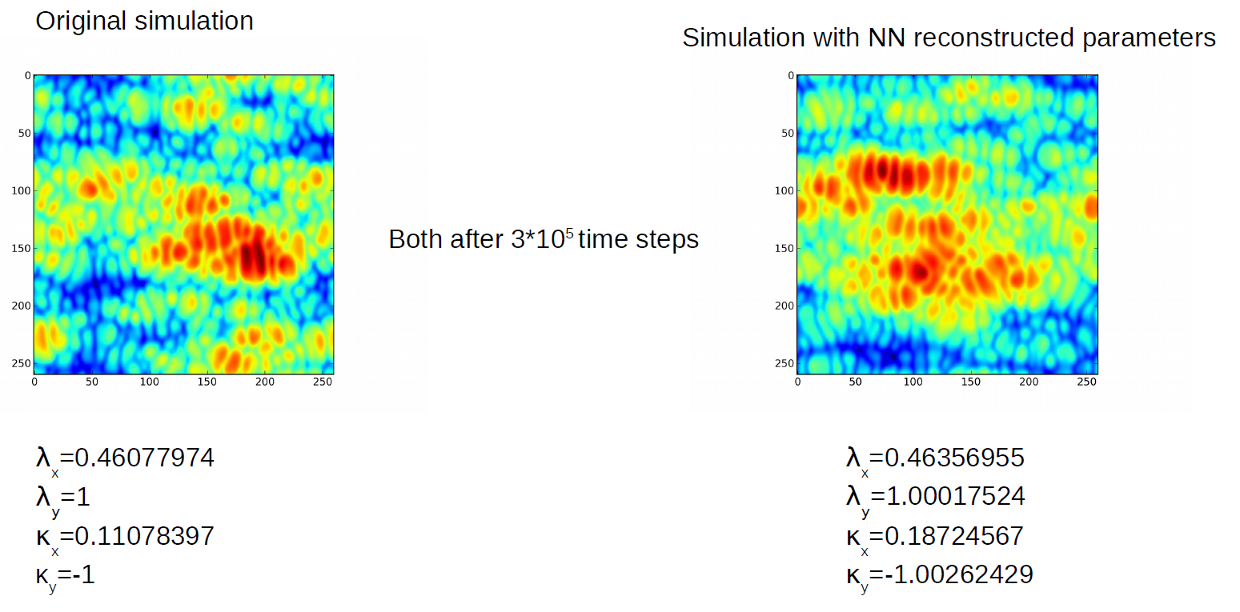
SP3 NN results
S. Wiesen | ENR-MOD.01.FZJ – theory 2022 report | Zoom | Feb 8th 2022 | Page 37

Slide 38
SP3 Identification of surface structures
Up to now:
Good reproduction of model parameters using several time points
But experimental data are not sufficiently denoised
New goal: What can be found using a single snapshot? → Appropriate features are needed!
How to measure similarity of snapshots?
Mutual information (e.g. KL divergence)
Covariance
SVD decomposition
None of them worked well! → Snapshots from the same time series seem to be “different”.
S. Wiesen | ENR-MOD.01.FZJ – theory 2022 report | Zoom | Feb 8th 2022 | Page 38

Slide 39
SP3 Identification of surface structures
New Idea!
Combination of various methods, taken from Face-recognition techniques
Prepare a large number of snapshots, one for each parameter set
Fourier Transformation + Contrast Enhancement Agent
Feed this into SVD decomposition to find “Eigenprofiles” or “Eigenfaces”
S. Wiesen | ENR-MOD.01.FZJ – theory 2022 report | Zoom | Feb 8th 2022 | Page 39

Slide 40
SP3 Identification of surface structures - Examples
Results are promising !
Only a few “Eigenprofiles” are needed to identify test data
The number of significant Eigenprofiles is similar to the number of model parameters
Further tests are ongoing with a larger number of training profiles
Later: derive “macro” model parameters, erosion yield, flux dependence → ERO
S. Wiesen | ENR-MOD.01.FZJ – theory 2022 report | Zoom | Feb 8th 2022 | Page 40

Slide 41
Plans beyond
S. Wiesen | ENR-MOD.01.FZJ – theory 2022 report | Zoom | Feb 8th 2022 | Page 41

Slide 42
Towards fast, high fidelity SOL-pedestal module for integrated plasma scenario prediction → Enabling plasma scenario digital twinning
A. Jaervinen
S. Wiesen | ENR-MOD.01.FZJ – theory 2022 report | Zoom | Feb 8th 2022 | Page 42

Slide 43
backup
S. Wiesen | ENR-MOD.01.FZJ – theory 2022 report | Zoom | Feb 8th 2022 | Page 43

