Slide 1
TSVV-5: DIFFER 2022 report
J. Gonzalez, E. Westerhof; 23-12-2022

Slide 2
Coupled comparison between SOLPS-ITER and B2.5-Eunomia in detachment situations

Slide 3
Comparison with experimental data (High Density case)
SOLPS-ITER (solid lines) and B2.5-Eunomia (dashed lines) seems to agree with experimental data.
Discrepancies in density for high neutral pressures.
SOLPS-ITER seems to show a better trend in the pressure scan.
Disparate plasma axial distributions.
Fig. 1. Axial electron density.
Fig. 2. Radial electron density at TS target position
Fig. 3. Peak electron density for a range of pressures
3
Fig. 4. Axial electron temperature.
Fig. 5. Radial electron temperature at TS target position
Fig. 6. Peak electron temperature for a range of pressures

Slide 4
Comparison with experimental data (Low Density case)
SOLPS-ITER (solid lines) and B2.5-Eunomia (dashed lines) seems to agree with experimental data.
Discrepancies in density for high neutral pressures.
SOLPS-ITER seems to show a better trend in the pressure scan.
Disparate plasma axial distributions.
Fig. 7. Axial electron density.
Fig. 8. Radial electron density at TS target position
Fig. 9. Peak electron density for a range of pressures
<number>
Fig. 10. Axial electron temperature.
Fig. 11. Radial electron temperature at TS target position
Fig. 12. Peak electron temperature for a range of pressures

Slide 5

Missing processes in Eirene standard collision set
Eunomia implements a collision process that is missing from the standard set of reactions in Eirene:
Although the cross section is small, it might become relevant for high pressure-low temperature scenarios.
AMJUEL 2.2.17
AMJUEL 7.2.3a
Fig. 13. B2.5-Eunomia simulations with MAR via H⁻ and without it for the High Density case at 4.40Pa. SOLPS-ITER solution shown in dashed black line as reference.
Fig. 14. Rate coefficients of the main molecule collision processes.
5

Slide 6
Effect of MAR via H⁻ in SOLPS-ITER simulations
Larger impact on plasma density than in Eunomia.
Possible due to Eunomia solving vibrational states => more accurate.
This needs to be properly addressed in Eirene and in reduced models not accounting for transport. Already discussed with F. Cianfrani.
Fig. 15. Peak electron density and temperature when MAR via H⁻ is incorporated (red data) respect to standard case (blue data).

Slide 7
Future works
Simulation of new experiments for validation of SOLPS-ITER.
  Provide reference cases for TSVV-5 repository.
Time-dependent simulations.
Study of relevance of vibrational states in Eirene.
7

Slide 8
Refactorization of Eirene

Slide 9
MODCOL
Analysis of the meaning of MODCOL performed in collaboration with P. Börmer and Y. Marandet.
Decided to move the information in MODCOL and MOCLF into REACDAT.
New variables being defined.
9

Slide 10
Undoing the spaghetti code
Study of the subroutine FOLNEUT to eliminate the number of GOTOs statements and divide the main tasks in subroutines.
Try to incorporated grouped variables.
Done with P. Börmer and Y. Marandet.
10

Slide 11
Future works
Full development of new REACDAT variables.
Testing.
11

Slide 12
Coupling SOLPS-ITER with Finite Element Wall Model
<number>

Slide 13
Progress in coupling SOLPS-ITER to a Target Model
Issue: obtaining relevant target properties for the simulation of Magnum-PSI (surface temperature, evaporation flux of LM...) in a self-consistent way.
Solution: Coupling SOLPS-ITER with a Finite Element model (based on FreeFem++).
First version of interface between the two codes is complete.
  SOLPS-ITER sends plasma heat flux to target model.
  Target model returns surface temperature and particle sources fluxes to (possible) overwrite strata in Block 7 via userfluxparam.
  All configured in B2.5 input.
  Multiple target models possible (currently testing).
Communication is done via text files.
New fort.32 file in Eirene: Contains information about surface temperature and which surface to overwrite the temperature.
The interface created is quite general and easy to extend for future cases.
13

Slide 14
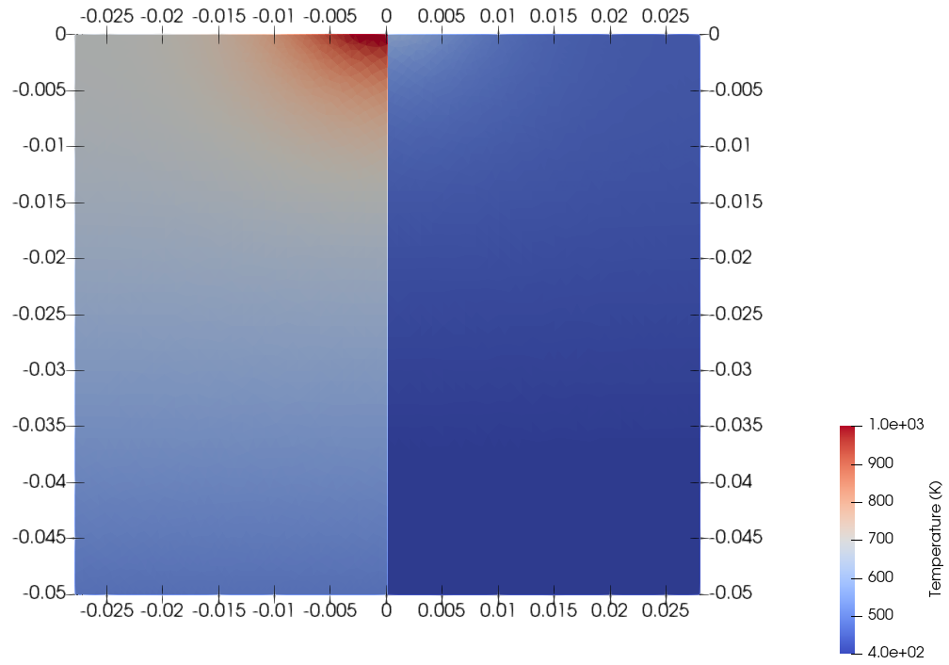
Tungsten target in detachment scenarios
Increasing gas pressure in target chamber => reduces heat flux towards the target.
Calculation of temperature on the surface self-consistently.
Bottom surface has a BC that represents Magnum-PSI cooling system.
Comparison with pyrometer measurements.
Fig. 16. Surface temperature from SOLPS-FEM (solid line) and pyrometer measurements at the target centre (dashed line) for different neutral pressures in the target chamber.
14
Fig. 17. Temperature distribution for the 0.46Pa (left) and the 4.30Pa (right).

Slide 15
Future works
Improve the interface to account for possible neutral fluxes.
Increase the amount of information exchanged.
Allow to couple with Eirene in standalone mode.
Extend the coupling options so other target models can be applied.
15

Slide 16
Thank you for your attention
J. Gonzalez, E. Westerhof | TSVV-5 2022

