Slide 1
EUROfusion TSVV-5 Report 2022, Contributions Aalto University, Espoo, Finland
Andreas Holm, Ray Chandra, Mathias Groth
Notes:
1

Slide 2
Plans for 2022
Re-investigation of impact of H₂ vibrational excitation on dissociation, ionisation and recombination rates, isotope effect
Assessment of H_COLRAD (He_COLRAD, H2_COLRAD) in EIRENE
Re-implementation of EIRENE photon tracing and opacity model
Assessment of isotope effect in JET-ILW EIRENE benchmark case

Slide 3
Plans for 2022 - achievements
Re-investigation of impact of H₂ vibrational excitation on dissociation, ionisation and recombination rates, isotope effect (Andreas Holm)
Different CR processes cause up to 60% difference in dissociation rates
Impact strongest in the T_{e} = 0.5 – 4 eV range, for which molecular processes strongest
Molecular-convergent close-coupling (MCCC) data predicts an isotope effect on dissociation for T_{e} = 0.7-3 eV
Assessment of H_COLRAD (He_COLRAD, H2_COLRAD) in EIRENE (Ray Chandra)
Resurrect ability to run Sawada 1995 and 2004 models standalone
Effective ionization rate of H_COLRAD agrees perfectly with AMJUEL data
Proposed H_COLRAD, H2_COLRAD (and He_COLRAD)
Re-implementation of EIRENE photon tracing and opacity model (Ray Chandra)
Cylindric test case for Ly-a and Ly-b opacity ⇒ population escape factor and Planck test
Assessment of isotope effect in JET-ILW EIRENE benchmark case (Mathias Groth)
Higher div. densities for T than for H plasmas observed in JET-ILW L-mode plasmas, both experimentally and in EDGE2D-EIRENE simulations

Slide 4
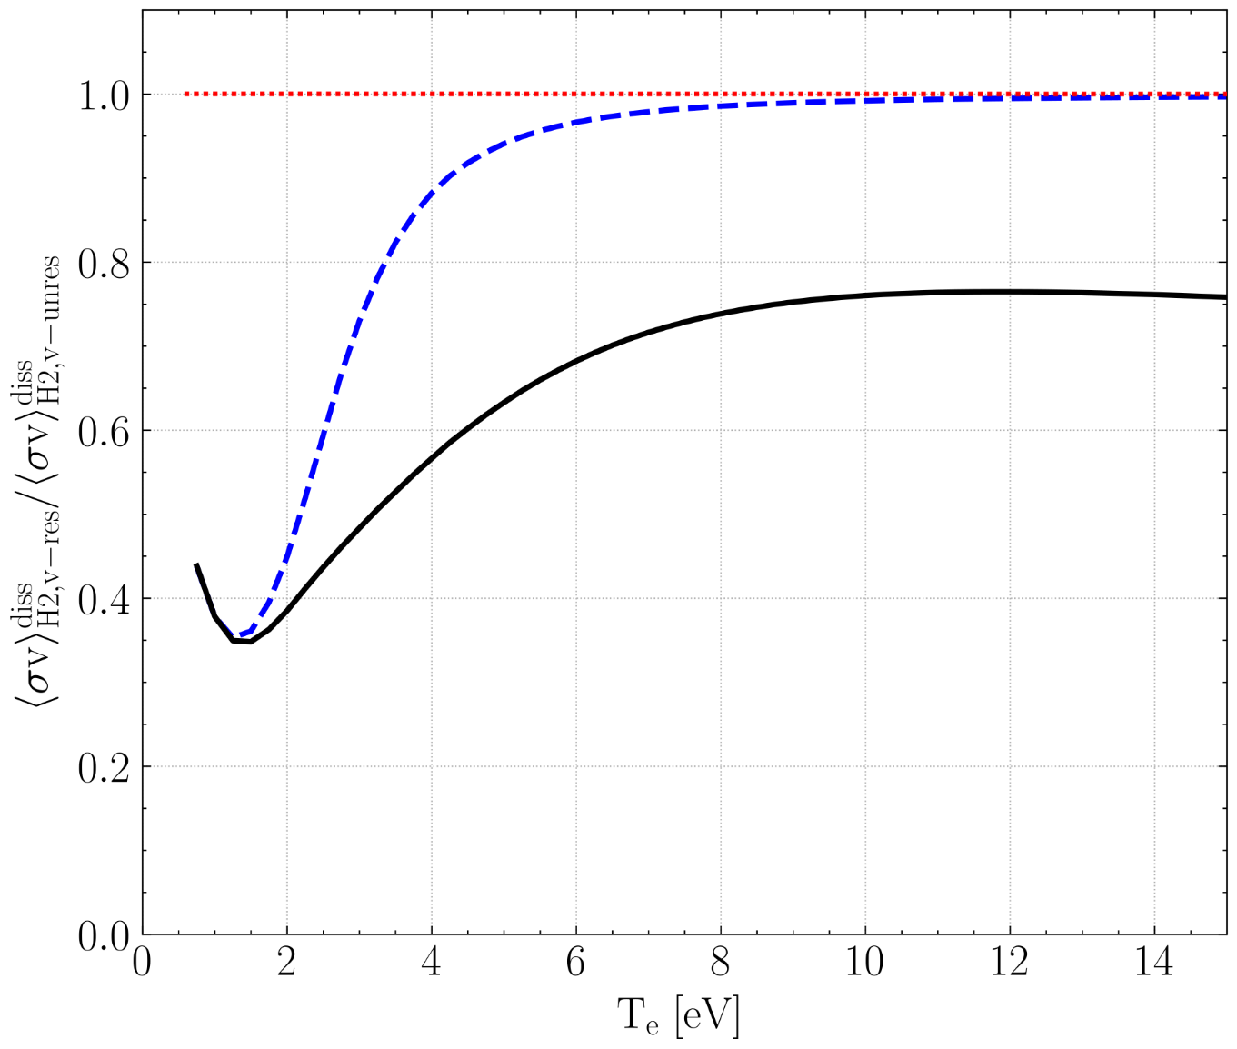
Vib. resolved EIRENE data considers different collisional-radiative (CR) processes than vib. unresolved data
No H₂ molecular electronic or vibrational transitions
Different CR processes cause up to 60% difference in dissociation rates
Impact strongest in the T_{e} = 0.5–4 eV range, where molecular processes strongest
Electronic transitions affect T_{e} > 4 eV
Vibrational transitions affect T_{e} < 4 eV
No electronic H₂ molecular transitions
Holm CPP 2022 10.1002/ctpp.202100189

Slide 5
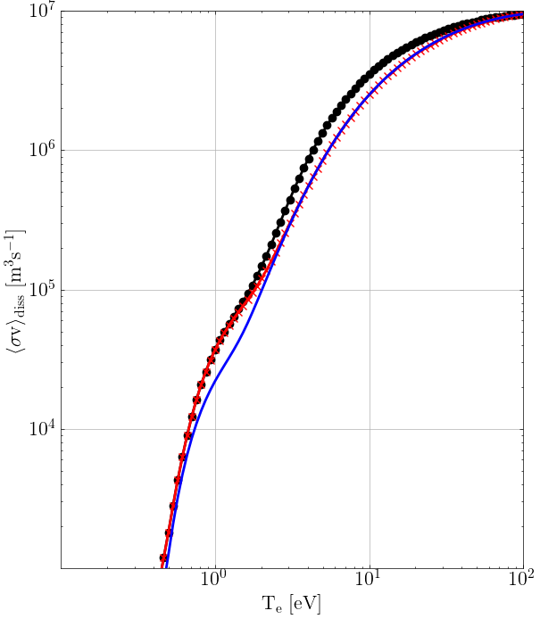
Molecular-convergent close-coupling (MCCC) data [1] predicts an isotope effect on dissociation for T_{e}=0.7-3 eV
n_{e}=n_{i}=10²⁰ m⁻³
Predicted isotope effect strongest for temperatures associated with detachment onset and detached conditions
MCCC data indicates weaker dissociation of both H₂ and D₂ for T_{e} > 3 eV compared to EIRENE data (AMJUEL, HYDHEL, H2VIBR)
EIRENE rates
Deuterium - MCCC
Hydrogen
MCCC
Holm PSI 2022, submitted to NME
[1] mccc-db.org, accessed July 6th 2022

Slide 6
Assessment of H_COLRAD (He_COLRAD and H2_COLRAD) in EIRENE
H_COLRAD (and H2_COLRAD) based on the collisional radiative model by Sawada (1995) ⇒ used to built AMJUEL and H2VIBR databases
Resolve population coefficients for each EIRENE cell
Derive effective rates such as effective ionization and recombination rates to be used in EIRENE
Provide population densities of excited species as a bulk ion species for the Photon tracing module
Resurrect ability to run Sawada 1995 and 2004 models standalone

Slide 7
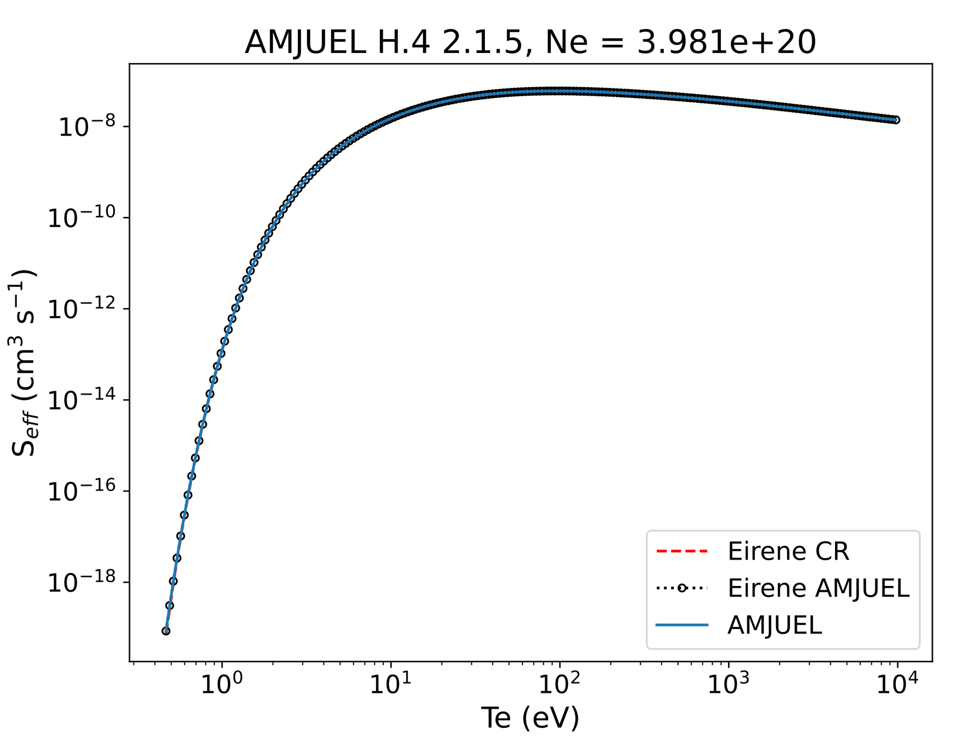
The effective ionization rate of H_COLRAD agrees perfectly with AMJUEL data
Effective ionization rate S_{eff} :
$$S_{eff}=S_{(1)}+\sum_{p}{\left(C_{(1,p)}−R_{1\left(p\right)}(F_{\left(p,1\right)}+\frac{A_{1}}{n_{e}})\right)}$$
EIRENE CR = H_COLRAD
EIRENE AMJUEL = using AMJUEL rates within EIRENE
AMJUEL – last update entry: May 2018

Slide 8
Proposed CRM structure in EIRENE (H_COLRAD)
Rates (Sawada 95 model)
EIRENE_H_colrad (T,n)
Output:
Effective ion. and rec. rates
Effective ion. and rec. energy loss rates
Population coeff. of H(n) (for photon sources)
PHOTON ($Γ_{ext}$)
Output:
$Γ_{ext}$ as CRM source terms
Cross-sections and rate coefficients (Johnson 1972, Vriens 1980, Bethe 1957)
Rates (Yacora)
Cross-sections and rate coefficients (Yacora dataset)
Reaction input (Block 4)
EIRENE_rate_coeff (icell)
Rate coefficient for EIRENE calculations
EIRENE_colrad (icrm)

Slide 9
Proposed H2_COLRAD structure in EIRENE (currently non-existent)
EIRENE_H2_colrad (T,n,Ti?)
Output:
Effective ion. and rec. rates
Effective ion. and rec. energy loss rates
Effective dissociation rates
Pop. Coefficients of H₂(n)
Pop. Coefficients of H₂(v)
?
PHOTON ($Γ_{ext}$)
?
Rates (Sawada 2005 model)
Cross-sections and rate coefficients (Janev 2003, Miles 72, Celiberto, etc)
Rates (Yacora)
Cross-sections and rate coefficients (Yacora dataset)
Reaction input (Block 4)
Tabulated data?
EIRENE_rate_coeff (icell)
res
EIRENE_colrad (icrm)

Slide 10
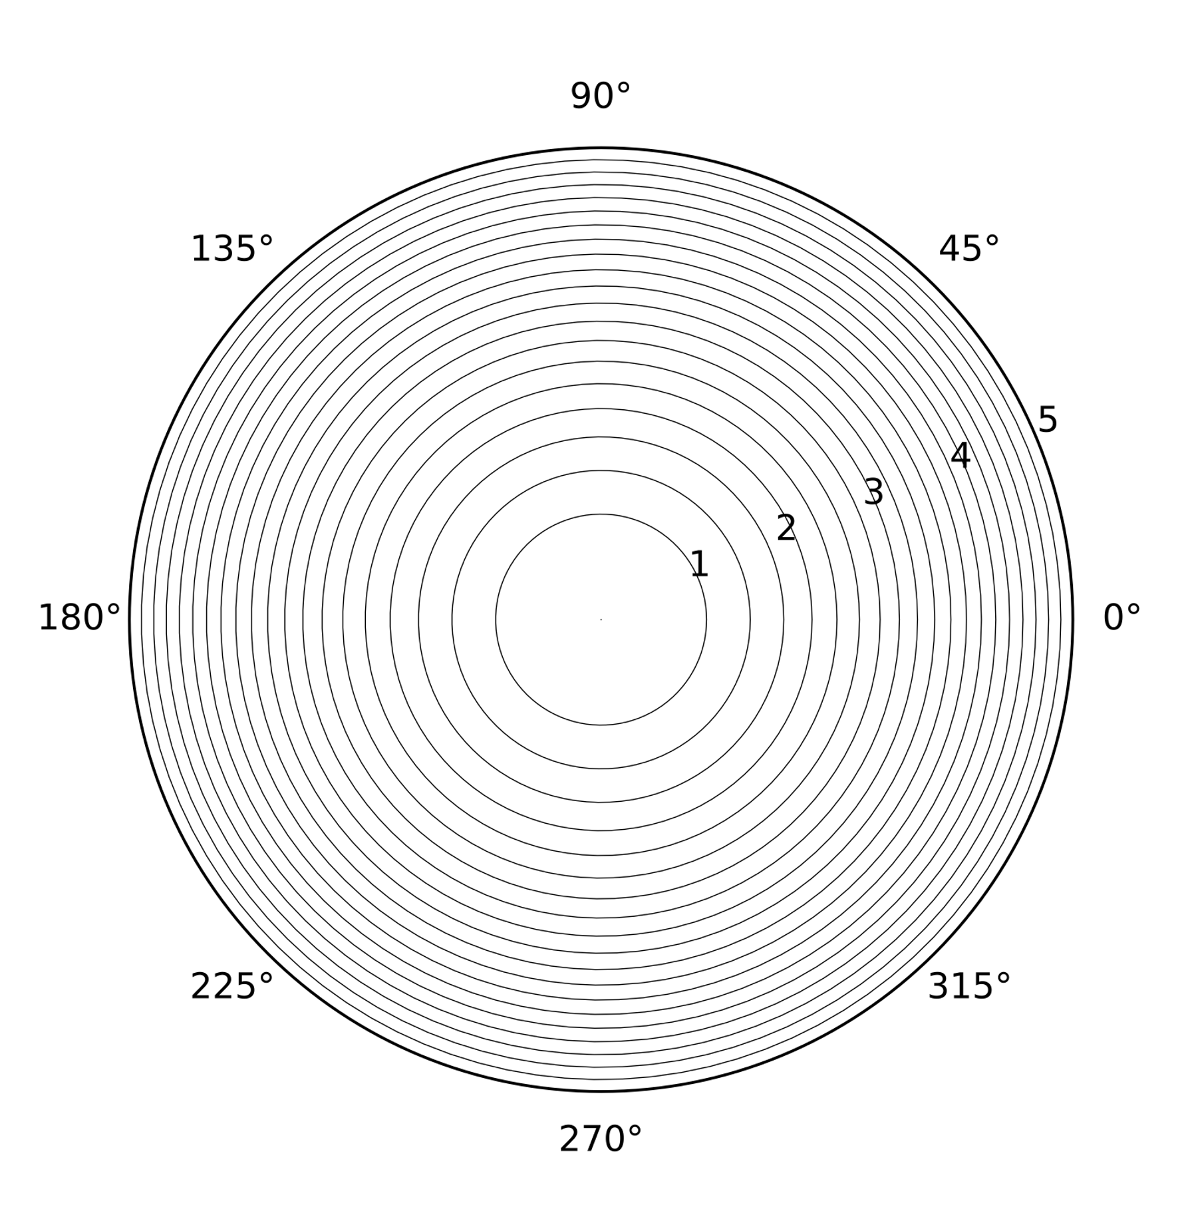
Development of photon tracing test case in simplified geometry
Cylindrical test case, 20 radial points
Homogeneous plasma and atomic density
T_{H} = 1 eV, n_{H} = 10¹⁴ cm⁻³, b = 5 cm
Simulated Ly-a and Ly-b photons (2x10⁶) with volumetric sources (H(n=2,3) as bulk ions)
Line shape only doppler broadening

Slide 11
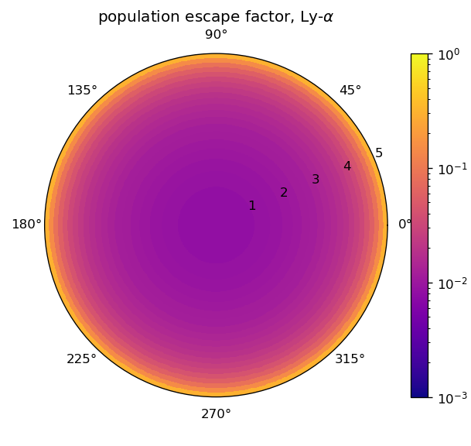
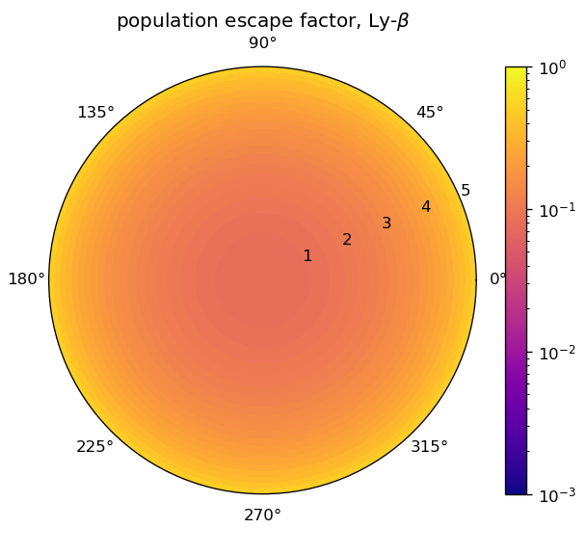
Photon tracing test case: 2D (or 1D) profiles of the population escape factor: Ly-𝜶 and Ly-𝜷 opaque at the center
Text

Slide 12
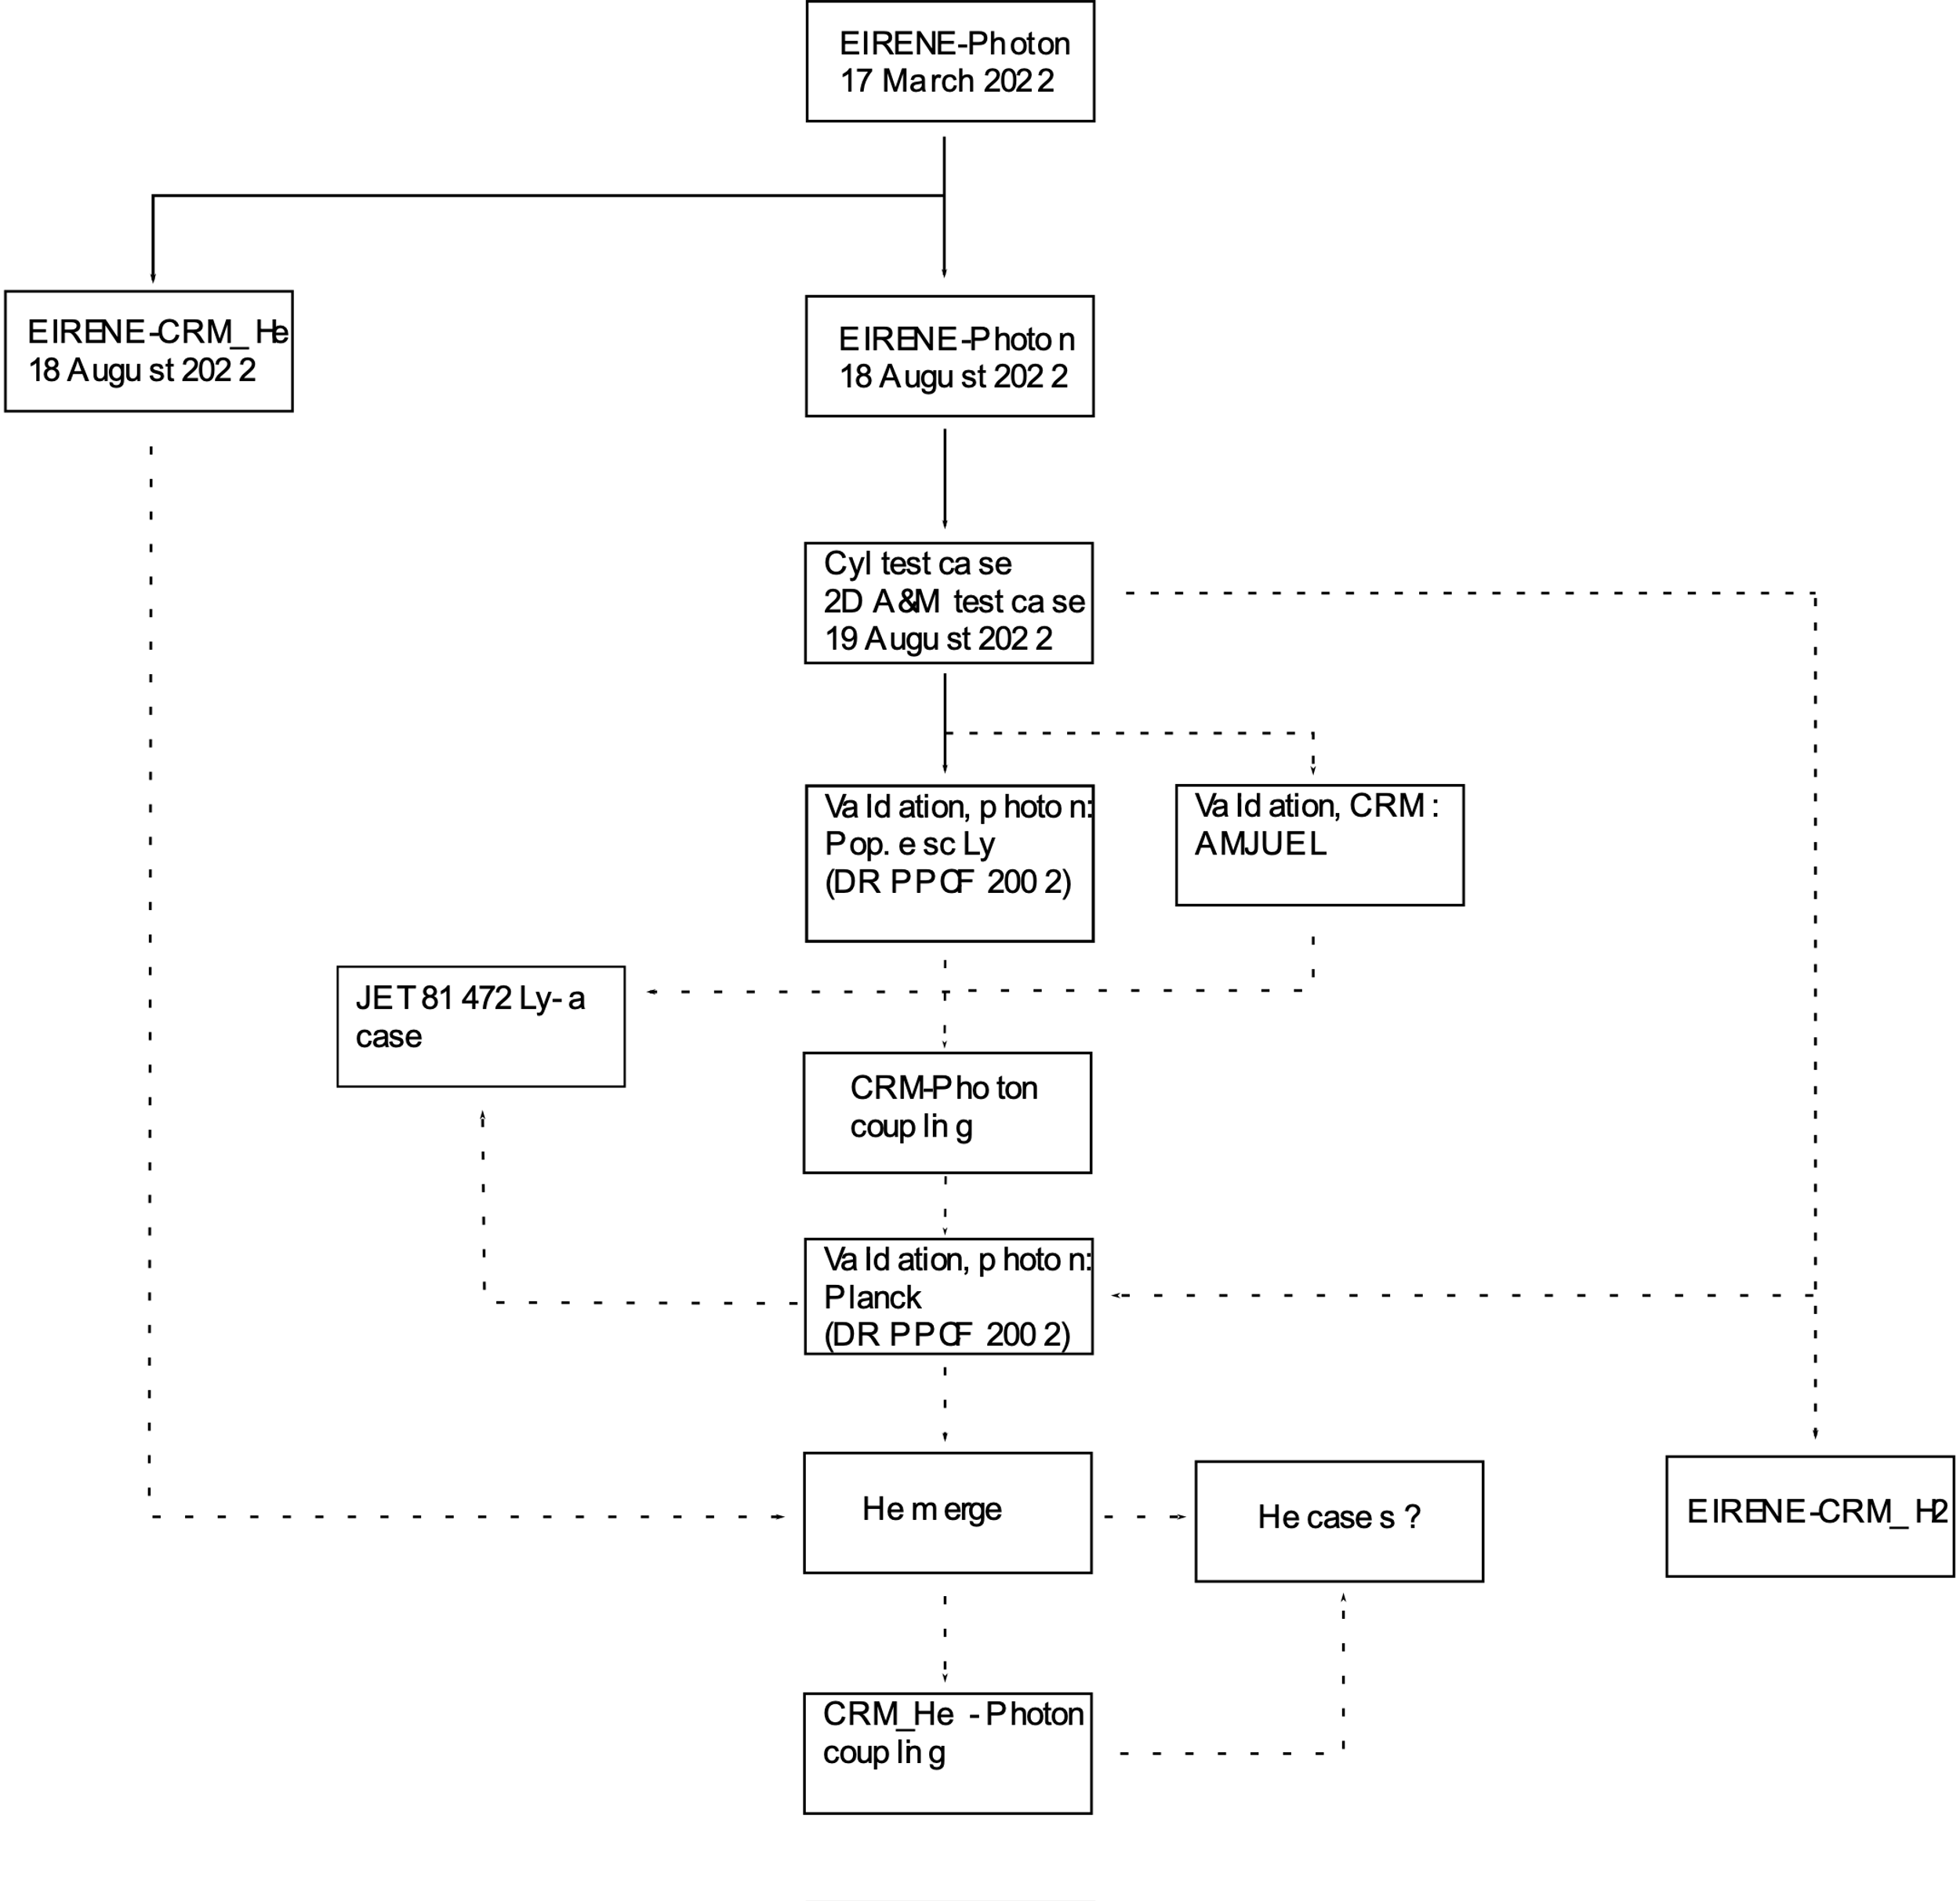
Workflow and timetable for inclusion of CRM and photon opacity in EIRENE
Currently existing:
H colrad, He colrad
Photon module
A&M and photon cylinder test cases
Planned for 2023:
CRM-photon coupling (for Planck test)
Application of model to full geometry (JET 81472)
H_COLRAD data update
He_COLRAD testing
H2_COLRAD creation

Slide 13
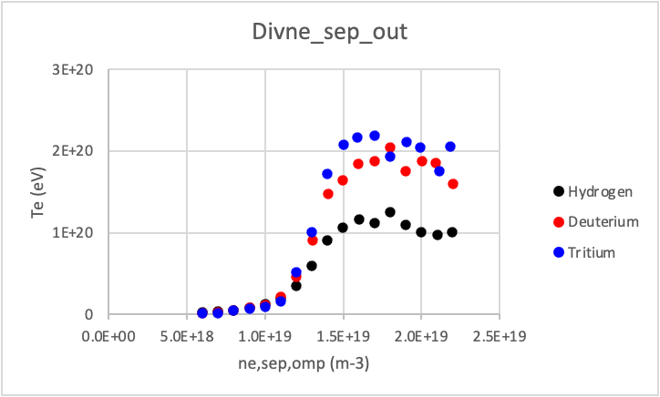
Higher div. densities for T than for H plasmas observed in JET-ILW L-mode plasmas, both exp. and in EDGE2D-EIRENE
Generic density scan with identical transport coeffs., models
Strong reduction in ion current to outer plate not yet reproduced ⇒ likely to require changes to transport coefficients
T_{e,OT} least affected by isotope species
n_{e,OT} [m⁻³]
n_{e,sep,omp} [m⁻³]

Slide 14
Plans for 2023
Complete development, implementation and verification of H_COLRAD, He_COLRAD and H2_COLRAD in EIRENE (Ray Chandra: PPCF paper and EPS 2023)
Front-end development of H2_COLRAD for fundamental data, including hydrogenic isotopes, parameter dependencies (in collaboration with YACORA team)
Complete development, implementation and verification of photon tracing and opacity model (Ray Chandra: PPCF paper and EPS 2023)
Application of H2_COLRAD to JET-ILW L-mode plasmas for three primary SOL regimes: D₂ → H₂, T₂
Coupling EIRENE CRM and photon module to B2.5 in SOLPS-ITER
Re-run SOLPS-ITER cases for H and T (Mathias Groth: IAEA-FEC 2023)

