Slide 1

FSD Tasks and Strategy 2023
Volker Naulin, Sara Moradi, Joao Figueiredo, David Douai, Denis Kalupin, Botond Mezsaros
6/02/2023

Slide 2
Fusion Science Department
Mission
Role
  In support of the PM, oversees, facilitates and guides the implementation of the CWP, and ensures
    Roadmap is followed, specifically towards achieving the Roadmap missions 1, 2, and 8.
    Balance and synergies between work-packages
    A dynamic response in view of progress in the programme
    Resources shall meet deliverables/scope
    Review, monitor and deliver results & ensure formal reporting to EC
  Supports ITER & DEMO R&D needs, and interacts with F4E
  Ensures a fair inclusion of EUROfusion members in the programme towards progress in their proposed contributions.
Answering concrete plasma and materials science questions necessary to achieve fusion power/operate a fusion power plant

Slide 3
Towards ITER and DEMO
ITER will provide final information on DEMO
Most of FSD work is towards derisking ITER and supporting ITER decisons
  He campaigns
  SPI work
  And erosion,detention studies
Specific DEMO questions are already being answered in the FSD programme
DEMO questions will be increasingly important, eventually preparing also ITER work for DEMO

Slide 4
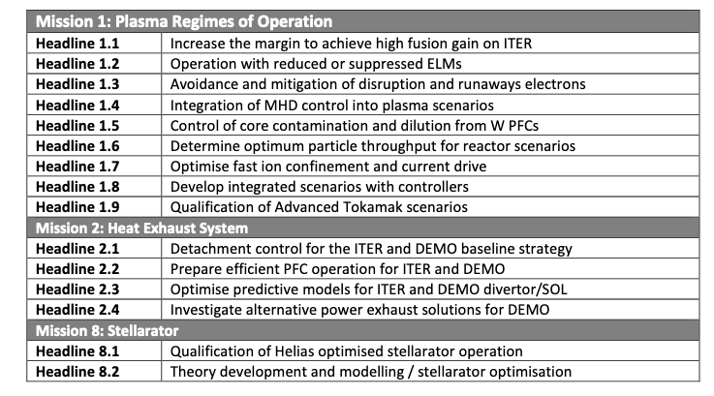
Objectives/Headlines

Slide 5
WPs
WP TE:
  Provide the physics basis for ITER and DEMO operational scenarios in a Europe
  wide unique integrated approach utilizing machines of different capabilities, sizes and parameters.
WP PWIE:
  Implement and coordinate EUROfusion’s strategy on particle, and power exhaust as well as on plasma material interactions in view of plasma-facing components lifetime, tritium retention and dust production.
WP PrIO:
  Integration and coordination of the relevant EUROfusion activities to provide coordinated EUROfusion’s input to ITER and to position the EU laboratories to obtain maximum benefits from ITER operation.
WP JT 60SA:
  Ensure European participation in JT 60SA is effective, and aligned to the EUROfusion programme.
WP W7X:
  Provide a substantial physics basis for the assessment of optimized stellarators as an alternative line in magnetic confinement fusion.
WP AC:
  Build a solid suite of numerical tools with prediction and control capabilities. (Output!)
ENR, EEGs, ERGs

Slide 6
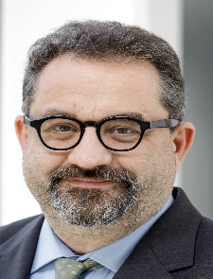
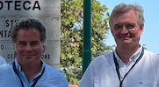
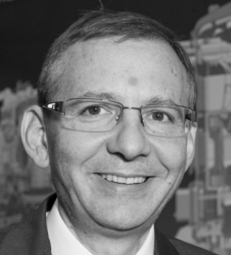
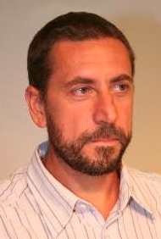
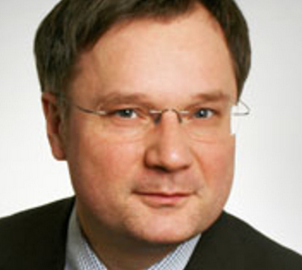

Organisation
Volker Naulin
Head of Dep.
Sara Moradi
(Deputy HoD,
TE & W7-X)
Denis Kalupin
(AC)
Joao Figueiredo
(Enhancements,
PrIO & JT60-SA)
David Douai
(PWIE)
Botond Meszaros
(PM&C)
Fernanda Rimini
(JET SEM)
WP TE
M. Wischmeier (TFL)
E. Joffrin (TFL)
+ 7 deputies
WP PWIE
S. Brezinsek
(PL)
WP PrIO
X. Litaudon
(PL)
WP JT60-SA
C. Sozzi
(PL)
WP W7-X
An. Dinklage
(PL)
WP AC
14 TSVV PIs
5 ACH

Slide 7
Coordination of activities
Internal:
  Biweekly management and information meetings PMU/TFLs/PLs
  Science coordination meetings to identify cross WP topics and actions
  Planning meetings on development of AWPs (two general meetings per year)
  Coordination meetings on operational aspects with devices
  …
External:
  Biweekly joint meetings with DCT to assess the DEMO science needs and eventual inclusion of those into the programme
  Input of recent results to DCT to guide their activities
  WPs Planning & Review meetings
  Conference rehearsals, and participations
  …

Slide 8
Relation to ITER and F4E
Inclusion of ITER and F4E into the Project Board
Invitation to parts of the programmatic discussions, where their input is crucial:
  Coordination meetings with BA, F4E
  He campaign on JET, AUG
  SPI on JET, AUG
  ….
Workprogramme meetings are open to outside participation, transparent organisation

Slide 9
Ensure progress on Roadmap missions
Measuring progress not only along formal GA deliverables
  TSVVs code developments uses a traffic light approach
  WPTE RTs use a 6 level adopted Scientific readiness approach
  FSD to adopt a standard 9 levels Scientific readiness approach for a list of high-level objectives
Focus and prioritize the programme
Allow topics to “finish”, answer research questions
Motivation of the participants
Outreach and dissemination of progress to the public

Slide 10
Ensure progress in TE Research Topics
Subjective levels, development over time shall be tracked for RTs….more in TE

Slide 11
Longer term items
Focus on answering science questions (in a good enough way)
Transition as much as possible from qualitative to quantitative
Answer for ITER and extend to DEMO (important PWIE)
Software/modelling capabilities are a crucial focus (TSVVs):
  Reach a first readiness, eg simulations in limited parameter space, for ITER (quantify errors on predictions)
  From this enhance on errors/capabilities
  Enhance to include DEMO
  Robustness of solutions
Post shutdown activities on JET (mainly related to PWIE)
Facilities review (including PWIE facilities)
iDTT research plan (important PWIE input)
Collect Divertor activities (f.x. ADC, PEX upgrade exploitation)

Slide 12
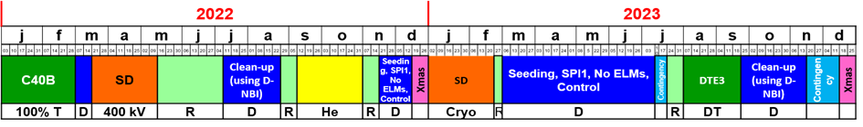

JET
Mission 1 – Record fusion energy performance in JET
We have achieved fusion performance well beyond that of DTE1.
Notes:
We expect the uncertainty in the neutron calibration to come down. But note that we quoted 7% in DTE1.

Slide 13
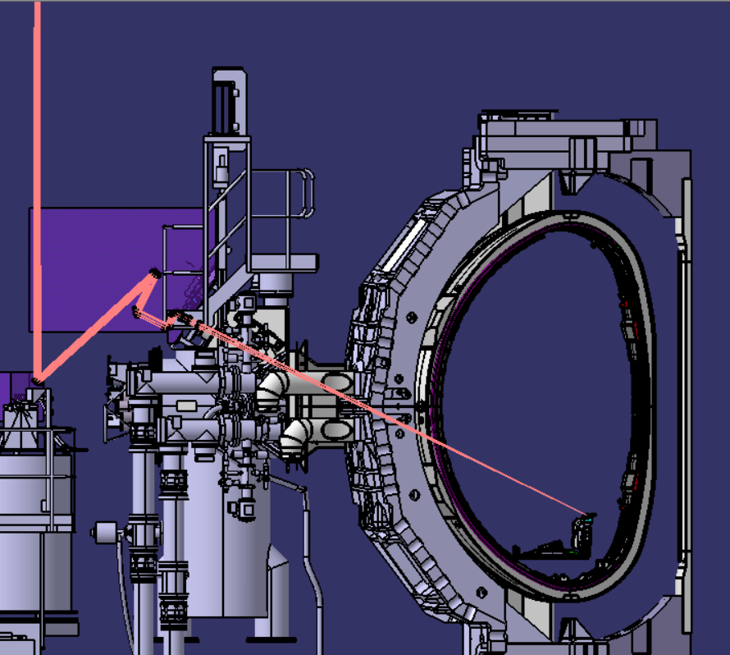
Laser-Induced Desorption system on JET
In-situ T retention measurement. Developed to provide information on assessing tritium surface inventory measurement for ITER. JET is replicating technology for ITER.
Installation, commissioning and scientific exploitation planned for this year

Slide 14
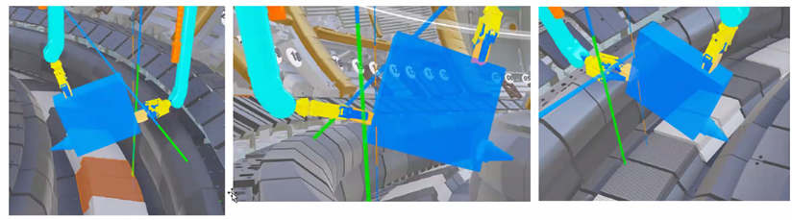
Laser-induced breakdown spectroscopy, on JET remote handling arm
  At JET a compact LIBS system is being developed to be mounted on the JET Remote Handling System. The goal of diagnostic is to measure fuel retention and concentration of contaminations on the surface of PFCs at JET.

Slide 15
Dedicated samples for post-mortem anlysis (installed in 2017)
Number of dedicated samples installed in the case
that there will be access after DT or end of operation!
The samples will have seen H, D, T, DT and He!
Some have temporal information!
Remote divertor and under the wedge:
Rotating collectors
Mirror-finished deposition monitors
Deposition-sticking monitors
Louvre clips
Quartz micro-balance
Spatial blocks
Main chamber :
Rotating collectors (outer wall)
Mirrors: ion damaged (outer wall)
Wall inserts (inner wall cladding)
Dust monitors/collectors
Remote handling equipment with dust collectors
(test of systems from ITER)

Slide 16
JET: Ensure DTE3 PWIE activities, LIBS, LID-QMS
Extend of DTE3 depends on
  KPIs/Milestones reached in 2023
  KPIs and Milestones still under design
  Extend of Cleanup (shortest possible to ensure longest possible exploitation of the device. Hard deadline 31.12.2023)
  All milestones/KPIs to be evaluated at latest possible deciuson point for two cycles/one cycle/1/2 cycle of DT operation
Gas balance study finalisation will be executed
LIBS still neeeds arrangements with UK on modalities, budget (which is being secured…)
LIDS should be ready in 2023

Slide 17
ITER Like Wall?
ITER research plan is under revision
Options to regain time after delays due to faulty weldings/cracks in thermal shield
  Water cooled First Wall to be installed after FP+PFPO-1 q
  Change of first wall material from Be to W (to avoid Be-related licensing issues)
  ??????
Once options have been chosen we need to react fast to these boundary conditions

Slide 18
          Facilities Review
          Roadmap revison

Slide 19
Questions for template
FACILITY
UNIQUE CONTRIBUTIONS TO THE ROADMAP | Indicate for the relevant roadmap missions which unique contributions will be given (see Chapter 5 of the Roadmap) (how does the present (future/upgraded) facility addresses the 8 R&D Missions and the fusion roadmap and uniquely contribute to the development of basic understanding in support of the Missions) Five year perspective: 10 year perspective (if applicable): Longer term perspective (if applicable):
IMPORTANT CONTRIBUTIONS TO THE ROADMAP | Indicate for the relevant roadmap missions which important (but not unique) contributions will be given (see Chapter 5 of the Roadmap) (how does the present (future/upgraded) facility addresses the 8 R&D Missions and the fusion roadmap and give important contributions to the development of basic understanding in support of the Missions) Five year perspective: 10 year perspective (if applicable): Longer term perspective (if applicable):
PRESENT TECHNICAL CAPABILITIES | With focus on capabilities relevant to the roadmap
FUTURE TECHNICAL CAPABILITIES | Described planned future upgrades and the time they come available
FORWARD PLANNING | Summary of the key elements of timetable and planning (if not already adequately addressed above)

Slide 20
Questions for template
PROGRAMME: ACHIEVEMENTS | Brief summary of key scientific achievements (if applicable)
RESOURCES INVOLVED | RESOURCES NEEDED FOR OPERATION average number of operation days/year (over the past 4 or 5 years – if applicable): yearly cost of operation in 2023 euros: yearly manpower for operation:
USE OF FACILITY | Number of facility users Yearly integrated FTE of facility users Number of PhD/MSc theses using experimental data from facility in last 5 years Number of peer-reviewed publications based on experimental results from facility (specify for the years 2020-2022) Number of patents as spin-off from the facility
COLLABORATIONS | Collaborations outside EU: Number of experimental contributions to ITPA (if applicable) : Sharing facility with other fields of research (if applicable):

Slide 21
Panel composition
  Non-EU fusion people
    Jiangang Li – ASIPP, CN
    Rich Hawryluk – DoE, US
    Chuck Greenfield – GA, US
    David Campbell – ITER, retired
    Indranil Bandyopadhyay – IPR,IN
    Sehila Gonzalez – IAEA, AU
    Dan Brunner – CWF, US
  EU non-fusion people
    Rolf-Dieter Heuer – CERN, CH (chair)
    Thomas Mull – Framatome, DE
    Vincent Boudry - LLP, FR
    Caterina Biscari – ALBA-synchrotron, ES
    Christa Hooijer – TNO, NL (TBC)
    Ingeborg Hagenlocher – Kraftanlagen Heidelberg, DE, retired (TBC)

Slide 22
Roadmap update
ITER delays as well as increased activities of private companies give rise to an update of theEuropean Fusion Roadmap
Timing, better definition of ITER input to DEMO
Better view on priorities
Bureau has set up a workgroup

Slide 23
Back to general items…..

Slide 24
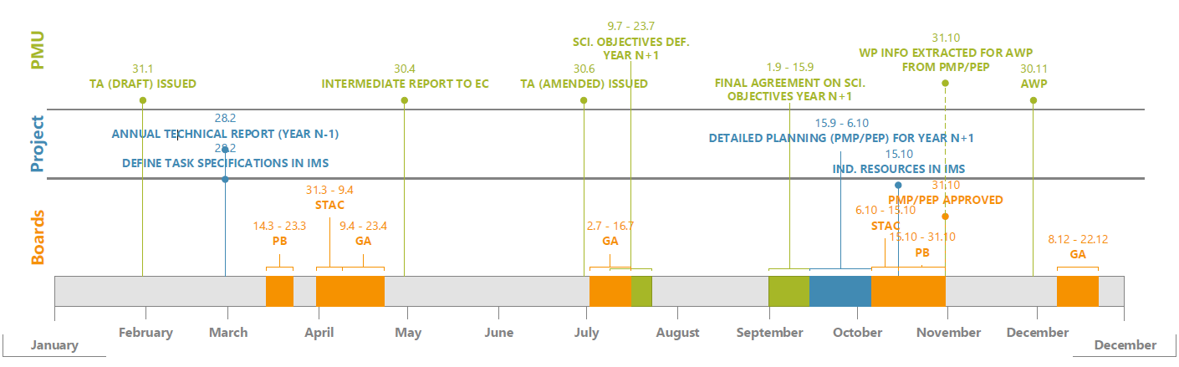
Timeline – upcoming actions
IDM: Annual WP project management cycle (2P56W9)
WIKI: EUROfusion MediaWiki (euro-fusion.org)

Slide 25
The question of reporting
Technical reports (level 3)
  Are EUROfusion internal
  Should be concise
  Report work done
  DO NOT make many nice words…..
  Ensure there is a sort of conclusion
Reports on Grant Agreement Deliverables
  Go the the Commission
  Report on our achievements

Slide 26
Issues
Delays in device operation
Unclear status of UK, CH
Risk due to aggression in Ukraine
Rising costs (Missions, operation, materials….)
Structure does not allow for fast reaction to problems
All funding already in WPs
Risk loosing innovation, project finances rigid in interaction with beneficiaries
Need in ability to react to near future budget demands to not loose investments

