Slide 1
3rd Project Meeting PWIE Results 2022 / Plan 2023
Sebastijan Brezinsek
J.W. Coenen, A. Hakola, K. Schmid, A. Kirschner,
H. v. d. Meiden, J. Likonen, G. Calabro, M. Reinhart

Slide 2
Contributions to ITER
WPPWIE strongly supports ITER with experimental studies and modelling related to Roadmap Mission 2
Regular inclusion of high priority topics according to ITER Research Plan, ITPA DivSOL, and IO interaction
WP PWIE supports ITER with experimental studies and modelling related to EUROfusion Mission 2
Identification of topics according to ITER Research Plan, ITPA DivSOL, and direct interaction with IO
Support ITER in lifetime estimations for the W divertor and Be first wall components [budget approach]
Plasma (He, D) and high heat flux exposure of reference / pre-damaged / re-crystallised W materials
High fluence experiments (MAGNUM-PSI, WEST) / repetitive loads (JUDITH, GLADIS) / fatigue of W PFCs
Operation with damaged materials and damage evolution
Support ITER in fuel retention estimations and fuel recovery schemes [housekeeping approach]
Tritium monitor diagnostic: retention location identification and quantification (e.g. LID-QMS and LIBS)
ITER tool box: baking, ICWC and ECWC, GDC including laboratory experiments (e.g. TOMAS) and modelling
Support ITER in material migration, fuel retention and dust production estimations
Modelling of global material migration and transport to remote areas and ducts (e.g. JET mirror stations and cladding)
He-Be and He-W interaction and its impact on erosion and deposition pattern including W fuzz formation (with WPTE)

Slide 3
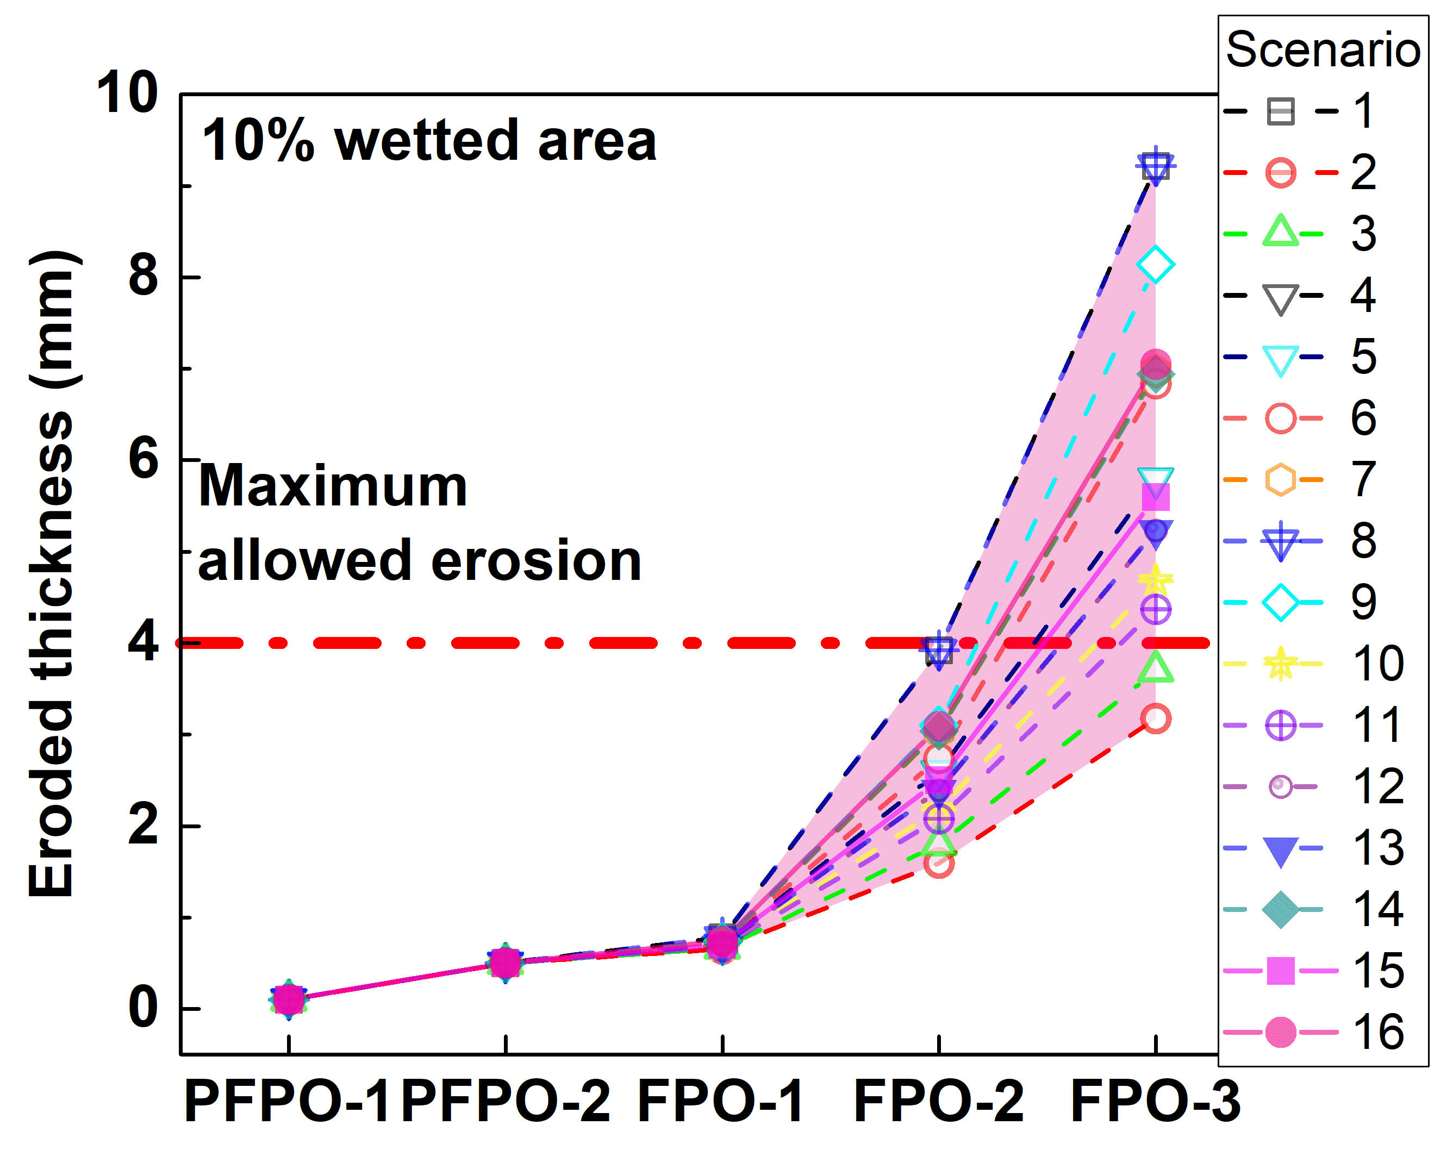
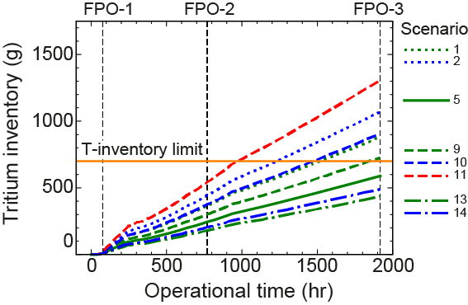
Example of joint activity resulting in ITER predictions
Different plasma backgrounds
Different plasma backgrounds
ITER start is delayed by 3-5 years => goal remains Q=10 and DT in 2035
Reorganization of start sequence and plasma operation foreseen (option model => Loarte EFPW)
Combine first plasma operation phase with initial exploration phase
Abandon Be as first wall material in order to have access to machine / save money / hot cell
Abandon pure He plasma operation and focus on H with more ECRH power
Consider combine PFPO-2 and “simple FPO-1” plasma (short Q=10 DT phase with DD and DT)
R.A. Pitts et al. PSI 2022
G. De Temmerman, et al., in preparation for Nuclear Fusion
Joint IO + Labs + EUROfusion activity: => ITER predictions based on WallDYN and ERO2.0 with SOLPS-ITER
including WPPFC/PWIE laboratory results + JET results + WallDYN and ERO modelling benchmark over years
Open issue => uncertainties in plasma background => first wall particle fluxes + energies (CXN) => SP B/D/E
Open issue => fuel removal technique at low ITER FW baking temperature => SP C/D/E/X

Slide 4
Contributions to DEMO
WPPWIE works hand in hand with the DCT and WPs MAT/PRD/BB in the general area of PWI and Exhaust
Joint exploration and assessment of PEX solutions for DEMO with WPDES and WPTE
Supports DEMO baseline scenario via WPDES: vital input to the conceptual design
Testing of DEMO PFCs solution (FW and Divertor) on plasma and combined plasma and transient heat load
PSI modelling regarding first wall erosion under steady-state conditions and transients
Re-deposited W layer stability and corresponding dust conversion factors for W
Fuel inventory predictions based on implantation and neutron damage in W-based PFCs
Recommends alternative DEMO-compatible plasma exhaust solutions:
Physics basis for alternative power exhaust solutions (highly radiative LSN divertor as reference / WPDES)
Predictive plasma edge and neutral modelling for alternative divertor solutions (PEX)
Technical realisation within the DEMO boundary conditions (together with WPDES)

Slide 5
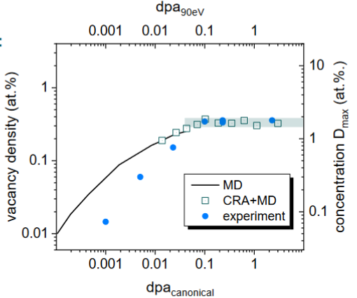
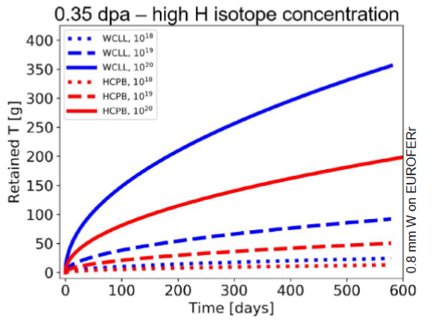
Example studies of joint activities for DEMO
Input to DEMO safety case regarding “retention and dust” has high priority
Sustainable T cycle in danger if T content in first wall can’t be limited => impact on components?
Permeation barriers in W?
T. Schwarz-Selinger et al.
PSI2022
R. Arrendo et al.
Joint FSD and FTD work incl. EEG => DEMO predictions based on ad-hoc FW fluxes
and dedicated laboratory experiments regarding (self-)damage in W and synergistic effects with plasma
Open issue => uncertainties in plasma background => first wall particle fluxes + energies (CXN)
=> uncertainties in damaged Eurofer behavior (permeation / H content) => TSVV7 + SP C/B/D + FTD
Open issue => uncertainties in erosion of vs. retention in FW materials => TSVV7 + SAE + BB + JULE-PSI

Slide 6
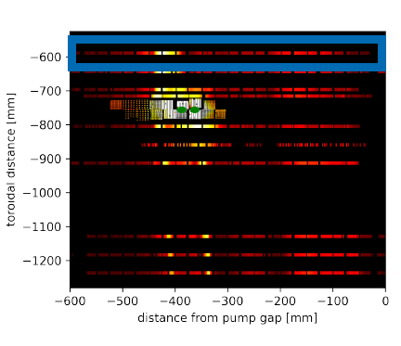
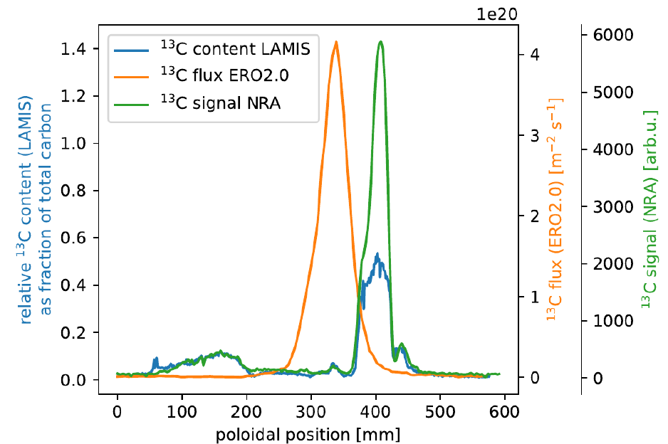
Contributions to W7-X / HELIAS
S. Brezinsek et al.
NF2021
E. Wüst et al.
PSI2022
Joint WPW7X and WPPWIE activities in plasma boundary modelling of W7-X in view of PWI needs
Post-mortem analysis of graphite TDU unit under WPPWIE well progressed: principle understanding of C-migration
Open issue: mismatch in plasma by ExB drifts or flows (not in code included) => SP D , TSVV6/7, WPW7X
Open issue: configurations suitable for long pulse operation and full-W scenarios (seeding) => SP B/D/X, WPW7X

Slide 7
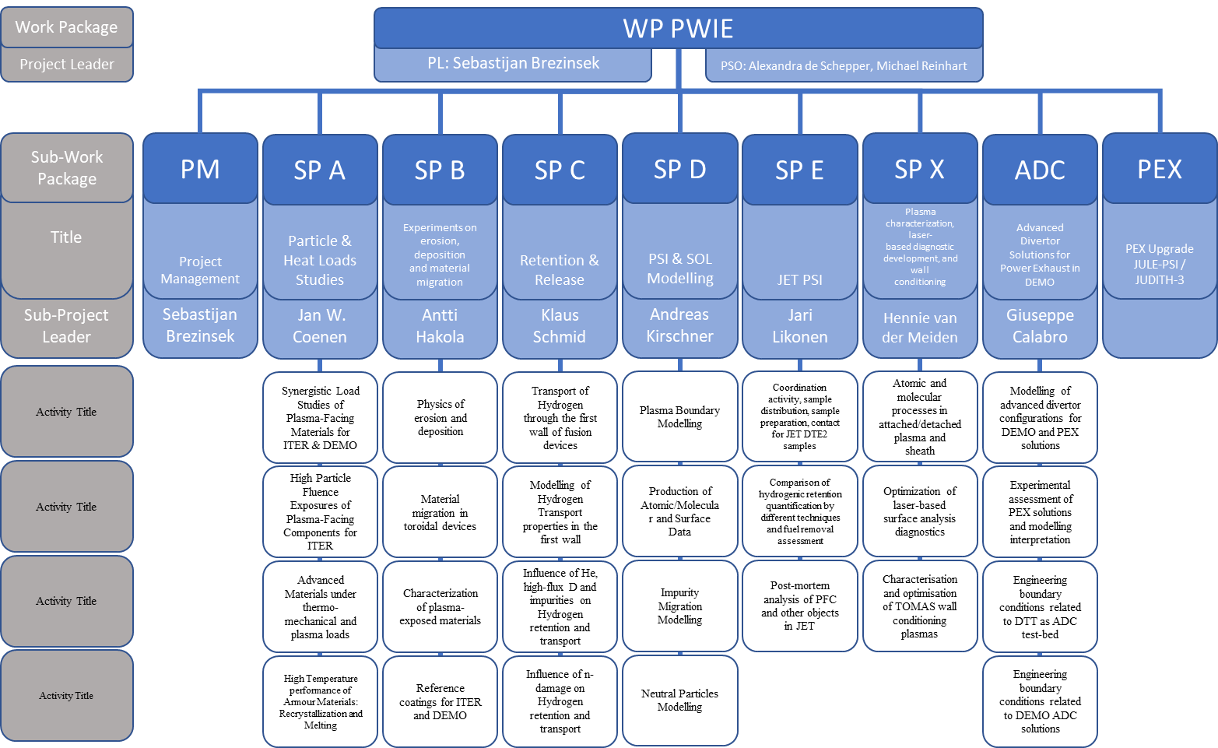
WPPWIE Structure 2022/2023
DPL for ADC: Giuseppe Calabro
Bernhard
Unterberg
In general for 2023:
SP A. SP B, SP C, SP D, SP X structure and activities remain largely as in 2022
New tasks and deliverables largely along the indicative plan for PWIE
Moderate modifications: high priorities (IO, FSD), Corona or technical delays, etc.
Dust activities now strengthen (SP B5) linked to SAW
LIBS at JET transferred from WPTE into WPPWIE (SP X4) linked to SP E
Facility usage in 2023 comparable to 2022 activities (LMD, HHF, ion beam, others)
ADC closed in 2023 => Request for resources to complete residual work not successful
KIPT: keep personal constant, but no new machine time to QSPA in 2023 / OLMAT replacement

Slide 8
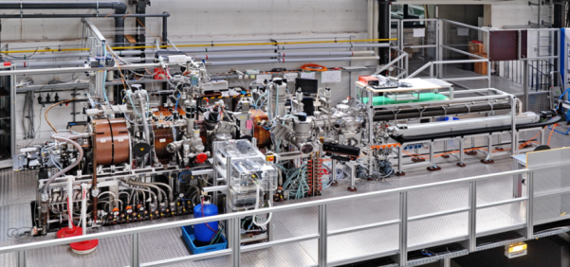
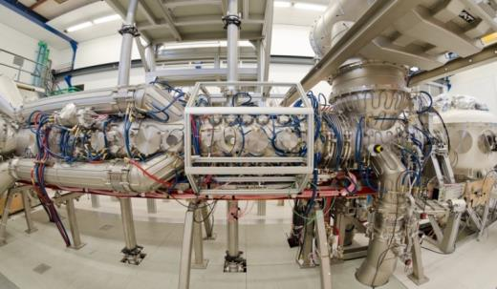
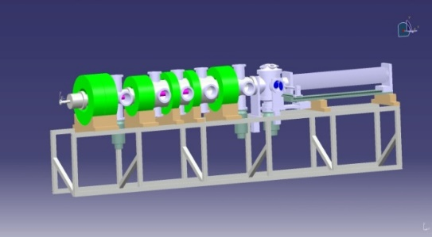
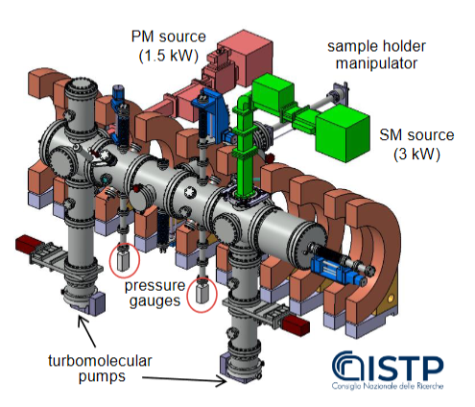
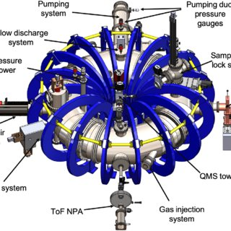
Plasma facilities: 2023 resource allocation
PSI-2:
Medium flux and fluence
(70 days )
MAGNUM-PSI
and UPP:
High flux and
fluence
(40 and 15 days)
JULE-PSI:
Medium flux and fluence
[Be and T
In HML / PEX 2024]
(10 days => D start-up
experiments)
GyM:
Low flux and fluence
(20 days)
TOMAS:
Wall conditioning and fuel removal
(20days)

Slide 9
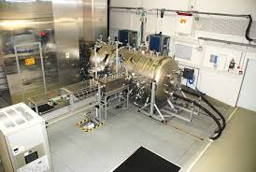
High heat flux facilities: 2023 resource allocation
JUDTIH 2 / 3 (PEX: Be & n)
E-beam:
Steady-state and transient loads
(20 days)
GLADIS
(Neutral Beam):
Steady-state load
(10 days)
QSPA / QSPA-m
Plasma Gun:
Transient loads
(0 days in 23)
MAGNUM and PSI-2:
pulsed or laser for transients
OLMAT (at TJ-II)
(Neutral Beam):
Transient loads
(~6 days*)
* Higher cost

Slide 10
Analysis facilities: 2022/2023 resource allocation
Internal facility review (SP B) regarding capabilities, techniques, materials, sample sizes, availability done
Distribution of work with inclusion of interest of labs in topic as much as possible done
Focus on ion beam facilities in financial support (accelerators and associated analysis stations)
Not enough funding to support other techniques TDS, PALS, Microscopy, FIB etc.
T-lab in Saclay in 2023/2024 gets same human resources as in 2022
WEST post-mortem analysis funding from 2022 shifted partially into 2023
RUs | Facility | Days | Days
DIFFER | Accelerator | 15 | ~14
FZJ | Accelerator | 12 | ~12
IST | Accelerator | 12 | ~10
JSI | Accelerator | 20 | ~20
MPG | Accelerator | 57 | ~52
NCSRD | Accelerator | 8 | ~6
RBI | Accelerator | 12 | ~10
VR | Accelerator | 18 | ~17
VTT | Accelerator | 5 | ~5
Final allocation depends on availability of facility and samples
Details in next presentations by SPL => IMS entry completed

Slide 11
SP A - Update
Particle and heat load studies in preparation of the exploitation of ITER and DEMO
SPL: J.W. Coenen
Focus on damage evolution of ITER-like MBs
(including WEST MBs)
Recrystallisation evolution in W (incl. modelling)
Focus on ITER-like MBs testing under multiple seeding, species, ELMs, and He
Plasma qualification of new materials for DEMO and other toroidal facilities (e.g. W7-X)
Disruption-like loading for DEMO (incl. OLMAT)
Melting of MBs => MEMETO modelling (+6PM)
KIPT PM remain the same
SP A.1 Synergistic Load Studies of Plasma-Facing Materials for ITER & DEMO
SP A.2 High Particle Fluence Exposures of Plasma-Facing Components for ITER
SP A.3 Advanced Materials under thermo-mechanical and plasma loads
SP A.4 High Temperature performance of Armour Materials: Recrystallization and Melting
Participants: CEA, CIEMAT, DIFFER, DTU, FZJ, JSI, KIPT, LPP-ERM-KMS, MPG, VR
EEG: W properties after WEST exposure
EEG: W-coatings (VPS) technique

Slide 12
SP B - Update
Experiments on erosion, deposition and material migration
SPL: A. Hakola
SP B.1 Physics of erosion and deposition
New: Focus on He experiment analysis
W erosion/redeposition and roughness studies
Post-mortem analysis (service) for toroidal devices
LIBS is now in portfolio of analysis techniques
Limited number of reference samples with “deposits” simulating JET and expected ITER and DEMO coatings
Metallic dust survey and compilation for DEMO
SP B.2 Material migration in toroidal devices
SP B.3 Characterization of plasma-exposed materials
SP B.4 Reference coatings for ITER and DEMO
SP B.5 Dust compilation in view of DEMO
Participants: CEA, CIEMAT, DIFFER, ENEA, FZJ, IAP, IPPLM, IST, JSI, MPG, OEAW, RBI, VR, VTT
Note: Collaboration experiments
with WPTE and WPW7X

Slide 13
SP C - Update
Retention and Release
SPL: K. Schmid
Focus on first principle understanding of H,D, T in W and co-deposits (increase of complexity)
Permeation in ITER and DEMO-like materials and full components (FTD not yet adapting)
New: Neutron damage of Eurofer and impact on retention (experiment + modelling)
T-retention of dedicated W samples (incl. titriated water) in CEA Saclay with increase resources
Damaged (n, p, W ion) W material, fuel retention, fuel recovery and diagnosis by LIBS and LID-QMS
SP C.1 Transport of Hydrogen through the first wall of fusion devices
SP C.2 Modelling of Hydrogen Transport properties in the first wall
SP C.3 Influence of He, high-flux D and impurities on Hydrogen retention and transport
SP C.4 Influence of n-damage on Hydrogen retention and transport
Participants: CEA, DIFFER, ENEA, FZJ, IPPLM, JSI, MPG, OEAW, VR, UKAEA
ERG J. Denis linked to JET simulations
EEG T retention in DEMO FW

Slide 14
SP D - Update
Plasma-edge and Plasma-wall Interaction Modelling
SPL: A. Kirschner
Plasma-boundary modelling for PWI experiments
with focus on He plasmas and campaigns (based on TE
work with focus on PWIE needs)
Atomic/molecular and surface data (expansion e.g. to T and heavy seeding gases Kr)
PWI and transport studies in linear plasmas and toroidal devices (incl. TE facilities and W7-X)
Local erosion/deposition/surface roughness modelling
Divertor performance studies for DEMO ADC solutions
JT-60SA divertor optimisation with KU Leuven to be included (with WPDIV) (perspective)
SP D.1 Plasma Boundary Modelling
SP D.2 Production of Atomic/Molecular and Surface Data
SP D.3 Impurity Migration Modelling
SP D.4 Neutral Particles Modelling
Participants: CEA, DIFFER, ENEA, FZJ, IPP.CR, KIT, MPG, OEAW, VR, VTT

Slide 15
SP E - Update
PWI with Be, T and neutrons: focus on JET post-mortem analysis and its interpretation
SPL: J. Likonen
Only existing (stored) samples from pre-DT operation to be analysed and interpreted
Focus on first wall and recessed samples (assess CX fluxes, mirrors and erosion)
Be damage studies
Modelling in connection with SPD of transport to recessed areas and fuel retention
Request to prolong project into 2024+2025
Preparation of post-DT analysis (strategy + test)
JET LIBS experiment under PWIE
Complementary LIBS studies of existing JET samples within the stock
Post-DT sample analysis in 2025-2030?
SP E.1 Coordination activity, sample distribution, sample preparation, contact for JET DTE2 samples
SP E.2 Comparison of hydrogenic retention quantification by different techniques and fuel removal assessment
SP E.3 Post-mortem analysis of PFC and other objects in JET
SP E.4 LIBS on the RH at JET
Participants: VTT, CU, FZJ, IAP, IPPLM, ISSP-UL, IST, MPG, NCSRD, VR, UKAEA

Slide 16
SP X - Update
Plasma characterization, laser-based diagnostic development, and wall conditioning
SPL: H. van der Meiden
SP X.1 Atomic and molecular processes in attached/detached plasma and sheath
Atomic and molecular data benchmark in linear plasmas (for TSVV 5) with novel diagnostics
LIBS optimisation and interpretation for ITER and beyond
Wall conditioning optimisation with focus of fuel removal and in-operando diagnosis
LIBS for JET on RH
JULE-PSI in 2024/2025: in-situ LIBS with Be and plasma complementary to JET LIBS for ITER
SP X.2 Optimization of laser-based surface analysis diagnostics
SP X.3 Characterisation and optimisation of TOMAS wall conditioning plasmas
Participants: CEA, CIEMAT, CU, DCU, DIFFER, ENEA, FZJ, IPPLM, ISSP-UL, KIPT, LPP-ERM-KMS, UT, VR

Slide 17
Summary
WPPWIE key contributor to Mission 2: THANK YOU ALL!!!
WPPWIE PMP and overall program aligned along the high priorities for ITER, DEMO and HELIAS including
Behaviour of (mild damaged) tungsten monoblocks under further loading
He-W and He-Be behavior with focus on He operation in linear plasma and tokamaks
Assessment of tritium retention in neutron damaged first wall (W and Eurofer)
Experiment and modelling related to W prompt re-deposition in view of DEMO first wall erosion
Determination and calculation of CX fluxes from JET post-mortem analysis of existing samples
Laser-based diagnostic development for ITER to measure T-retention and material composition
Reflects high priorities in the AWP2023 under EUROfusion Mission 2
Funding and human resource issues in some areas will lead in view of the long-term plans
Changes in ITER start sequence and materials choice possible
Internal priorities to be reassessed
Input from IO regarding revised needs expected
Notes:
560 PM

Slide 18
Role of WP PWIE in EUROfusion
Works hand in hand with FTD (DCT) in the area of DEMO exhaust solutions, PWI, and safety
Supports WPDIV in DTT divertor selection (modelling) and PFC qualification on plasma (DEMO, W7-X, etc.)
TSVV
Fusion Technology Department
Neutral Gas Dynamics
in the Edge
TSVV
WP MAT
WP DIV
WP DES
WP SAE
Plasma Exhaust:
Fluid/Gyrofluid Edge Codes
Impurity Sources,
Transport, and Screening
WP PWIE
Plasma Exhaust:
Gyrokinetic/Kinetic Edge Codes
Plasma-Wall Interaction
in DEMO
WP PrIO
WP TE
WP W7X
WP SA
Fusion Science Department
(Thrust 1)
(Thrust 2)
Works hand in hand with WPTE and WPW7X in the areas of PWI and PFC-compatible exhaust solutions
Executes post-mortem analysis of PFCs (WEST, AUG, W7-X, JET etc.) and associated interpretation

Slide 19
Request for W-Dust Compilation
Past dust studies in PWIE focused on ITER (Be dust) and basic dust processes (durst adhesion/release/ nucleation/collection in JET) covering Be, C, and W
Current durst studies involve modelling (release, splashing, disruptions) and determination conversion factors for W from deposits
Why more money now?
DEMO team request urgent input to estimate safety limits
Only relevant dust is TUNGSTEN (need to separate from W-C, W-Be)
Need to revisit current available information about pure W dust in JET and AUG
Need to assess the strength of different dust sources (arcing) and their relevance for DEMO (24/7 operation) with large material migrations
Provide initial number for DEMO from different sources and identify needs for new experiment early in 2023
Metallic dust survey and compilation for DEMO

Slide 20
Request for ADC support
ADC or Power Exhaust in DEMO
Additional funding request
Complete DEMO ADC plasma modelling in particular for hybrid configurations in SP-ADC-F
Assessment of all PEX modelling and experimental preparation => Physics report and outcome
SP-ADC.F / Modelling of advanced divertor configurations for DEMO and PEX solutions
SP-ADC.G / Experimental assessment of PEX solutions and modelling interpretation
SP-ADC.H / Engineering boundary conditions related to DTT as ADC test-bed
closed
Why more money?
FSD and FTD agreed in 2021 to 2-3 new “hybrid” configurations into ADC without adding funding to PWIE
Within PWIE several ppy were internally transferred in 2022 to support activities, but we are limited in transfer
Estmations to complete residual tasks from WPADC (FP8)
were too optimisitic (e.g. snowflake), they have been
completed now, but on cost of hybrid configurations
Hybrid equilibria were just obtained mid 2022
SP-ADC.I / Engineering boundary conditions related to DEMO ADC solutions
SP-ADC.J / Modelling of standard and advanced divertor configurations for DTT
DEMO technology part closed
=> Transfer to FTD and DCT
DTT technology part closed
=> Transfer to WP DIV

