Slide 1
WPPWIE Status 2022 + 2023 WP PWIE 2022 Reporting Meeting / 2023 Planning Meeting (3rd Project Meeting)
M. Reinhart
FZJ Project Support Office (PSO)

Slide 2
Contents
Reporting + status of 2022 deliverables
Transfer of Resources from 2022 to 2023
Review of 2023 Task Specifications on IMS
Important links

Slide 3
Reporting of 2022 deliverables
The 2022 deliverables are due on 31/12/2022.
Reporting will be done via the Subproject Leader with the documents/presentations of this meeting.
Additional short status updates from each deliverable owner have been collected, in order to get an overview of the progress of the work.

Slide 4
Status of 2022 deliverables
90 % of the deliverables are ready for reporting or dont require a report.
Delayed deliverables have in most cases resources transferred to 2023,
therefore 2022 part is also ready for reporting.
Cancelled deliverables have been transferred completely to 2023.

Slide 5
2022 resources transferred to 2023
Transferring resources into another year has consequences on the reimbursement of your institute by EUROfusion.
Contact the administration contact person (ACP) of your institute if your deliverable is delayed
ACPs can request transfer of resources at the EUROfusion admin department (deadline: ~ mid Nov.)
Deliverable ID | Beneficiary | PM @ 40% | PM @ 50% | Costs Eq./OGS @ 40% [k€] | Costs Eq./OGS @ 70% [k€] | Total Cons. Contr. [k€]
PWIE-SP A.1.T-T002-D005 | KIPT | 13.98 | 15 | 8.5 | 0 | 15.432
PWIE-SP A.4.T-T002-D003 | VR | 0 | 1 | 0 | 0 | 4.156
PWIE-SP A.4.T-T002-D004 | KIPT | 6.99 | 5 | 4.25 | 0 | 6.648
PWIE-SP B.2.T-T002-D009 | IPPLM | 0 | 2 | 0 | 0 | 3.760
PWIE-SP C.1.T-T002-D006 | IPPLM | 0 | 2 | 0 | 0 | 3.760
PWIE-SP E.3.T-T001-D004 | IPPLM | 0 | 3 | 0 | 0 | 5.640
PWIE-PM.1.T-T004-D001 | FZJ | 0 | 0 | 21.529 | 0 | 10.764
PWIE-SP A.1.T-T002-D002 | DIFFER | 0 | 4 | 2 | 49,5 | 63.104
PWIE-SP A.3.T-T002-D003 | LPP-ERM-KMS | 0 | 0 | 10 | 0 | 5.000
PWIE-SP X.1.T-T002-D004 | DCU | 0 | 3 | 0 | 0 | 12.422
PWIE-SP X.1.T-T002-D005 | DCU | 0 | 2.96 | 0 | 0 | 12.256

Slide 6
WPPWIE 2023
Current Status:
Tasks and deliverables (including resources) for 2023 have been entered in IMS.
This version of the resource allocation (from IMS) will be approved by the General Assembly in April 2023.
2024-2025 Resources are allocated as „Indicative Resources“ and are also approved by the General Assembly.

Slide 7
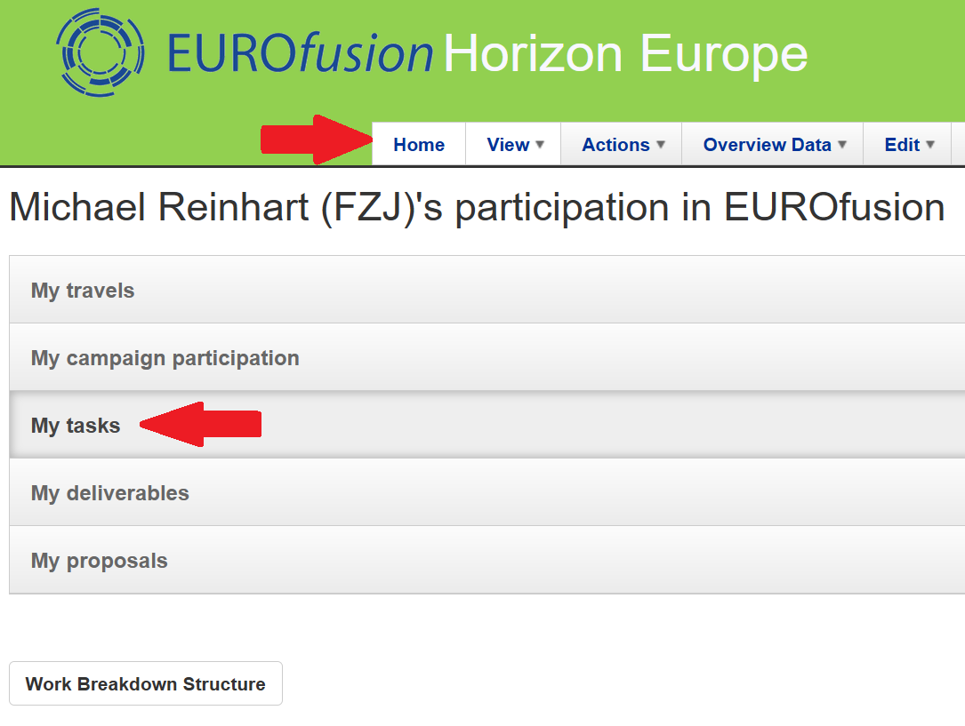
IMS Review of task specifications
Task definitions on IMS need to be reviewed and approved.
Reviewers include the deliverable owners. Please check any automated emails which are coming from IMS, and periodically check your tasks on IMS (table under „Home“-“My tasks“).

Slide 8
IMS Review of task specifications
Deliverable owners need to check if the title of their deliverable (description of their work) is correct and if they are the correct person to be deliverable owner (=person responsible for the completion of this work, not neccessarily the only person actually doing the work)
If all is OK, press „Recommend“.
If there is any issue, do nothing on IMS, instead contact the (Sub)Project Leader and the PSO.

Slide 9
IMS Review of task specifications
Once a task is approved, it can only be modified by having the EUROfusion Admin department reset the task to draft status.
This also resets all reviews of the task (= you will get again emails from IMS)
In agreement with the EUROfusion admin department, such modifications after approval need to be reviewed again only by reviewers affected by the modification.
Reviewers from other RUs can, but do not need to, review aswell.

Slide 10
Important links
IMS: https://ims.euro-fusion.org/fp9/ (also for IMS+IDM account application!)
WPPWIE Project Documents: https://idm.euro-fusion.org/default.aspx?uid=2PBXPU
WPPWIE Reporting: https://idm.euro-fusion.org/default.aspx?uid=2PLQPF
WPPWIE Meetings: https://indico.euro-fusion.org/category/210/
Thank you for your attention!

