Slide 1
Report on WP-PWIE ADC.F Results
Fabio Subba (G. Rubino, O. Pan, T. Lunt, A. Järvinen, P. Chmielewski, W. Dekeyser, L. Aho-Mantila, S. Carli, H. Reimerdes, ...)
WP-PWIE Project Meeting| 2023-02-06

Slide 2
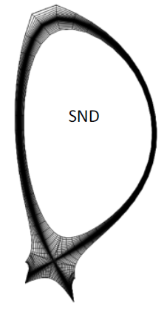
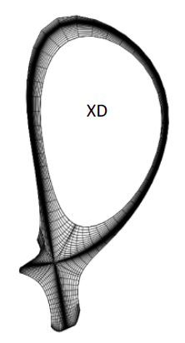
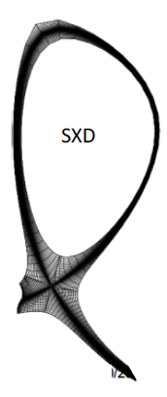
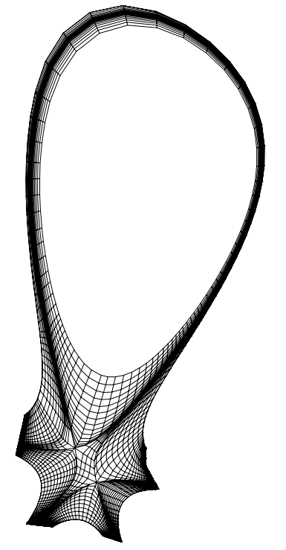
Introduction
SN
XD
SX
SF₋
Several alternative divertor configurations studied: XD, SX, SF₋, DN
Aim: estimate how promising they are as possible alternatives to SN, as quantitatively as possible
Used: SOLPS-ITER + semi-analytical models

Slide 3
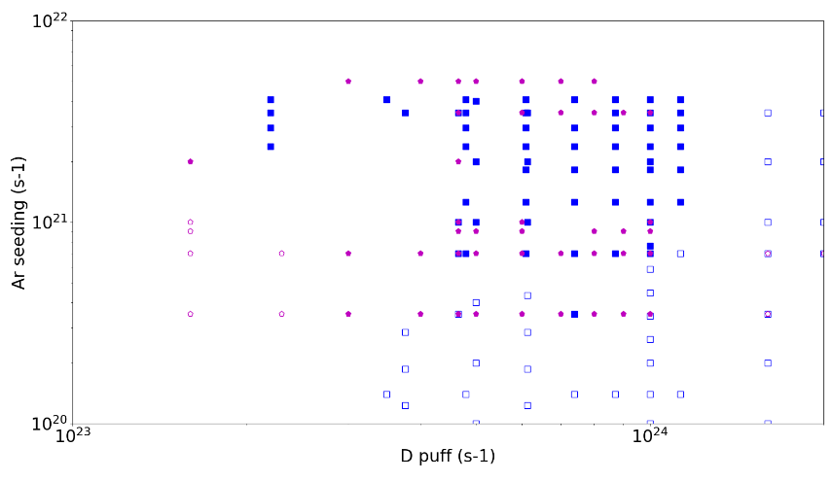
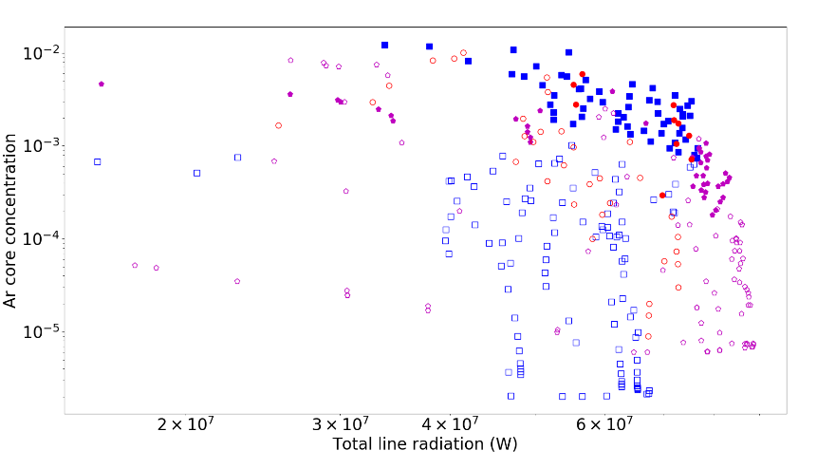
SN vs. XD
X-Divertor
First study using fluid neutrals
Explore a parameter space defined in terms of D fueling and Ar puff
Rough (divertor only) acceptability criteria:
n_{e,omp} < 4.2e19 m⁻³ (fraction of Greenwald density)
T_{e, target} < 5 eV (proxy for detachment)
Take home: XD can operate at lower Ar concentration, roughly 50%
Reason: larger connection length / radiative volume.
Single Null

Slide 4
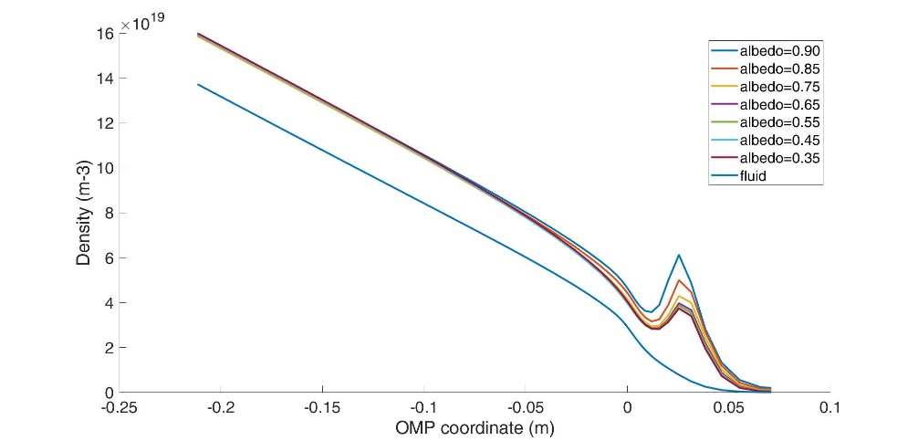
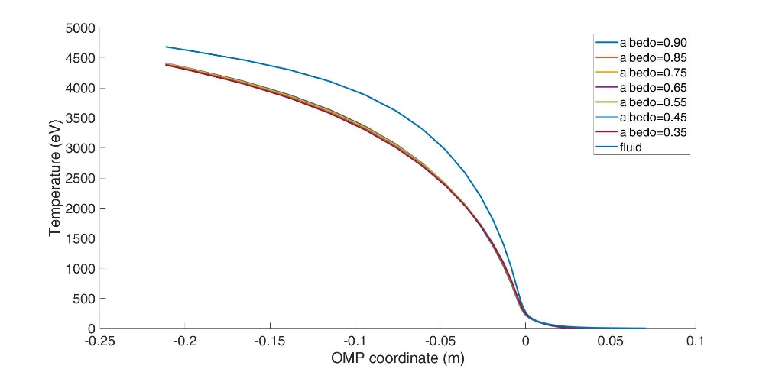
XD Modelling with Kinetic Neutrals
More detailed modeling started, including kinetic neutrals.
Single preparatory case:
Convert from fluid to kinetic neutrals
Scan over pump albedo to match the neutral pressure divertor (~2.4 Pa)
Matching simultaneously core and divertor parameters not possible.
Natural development: repeat at least the most representative cases with kinetic neutrals.

Slide 5
SX Modelling
Previous experience with fluid-neutral show the possibility to find a wider operational window for SX wrt SN:
Now need to extend to the kinetic-neutrals model:
Assessment of the effect of kinetic neutral models
Introduce molecular physics (Kotov’s model)
Better coverage of the wall geometry
Applicable for large Kn
Allows decoupling neutrals from ion temperatures
2. Study the influence of the outer leg divertor geometry, that is baffling

Slide 6
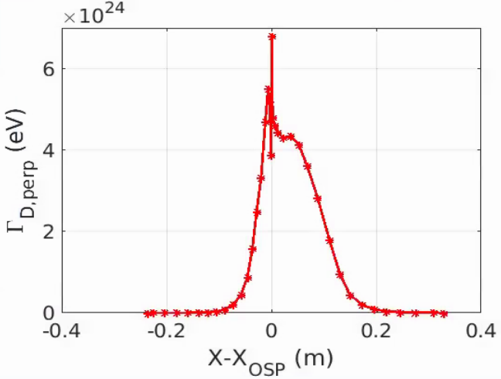
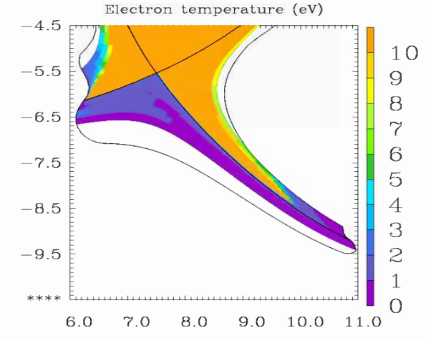
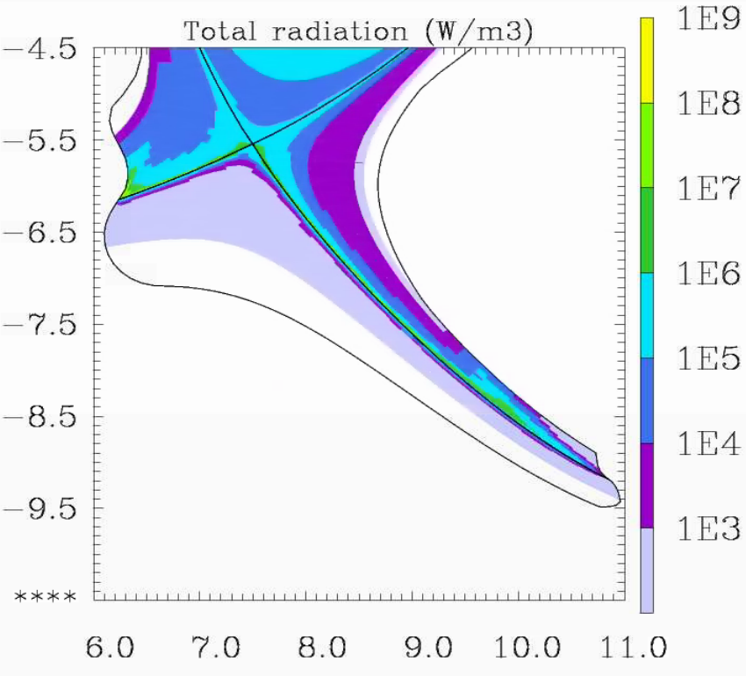
SX – Kinetic Neutrals
Preliminary operation: optimize the mesh to get rid of un-physical elements in the numerical solution (e.g. spikes)
Runs small time steps are required dt < 2e-6 s
It is possible to obtain solutions with both targets detached
Typical parameters example:
n_{e,omp} = 3e19 m⁻³
λ_{q} = 4.3 mm
P_{rad} ⁼ 122 MW (30 MW from core)
Relatively large main plasma pollution: Z_{eff,core} > 3

Slide 7
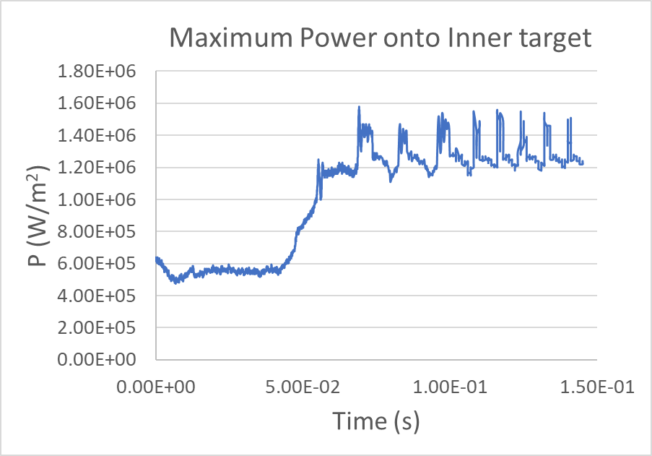
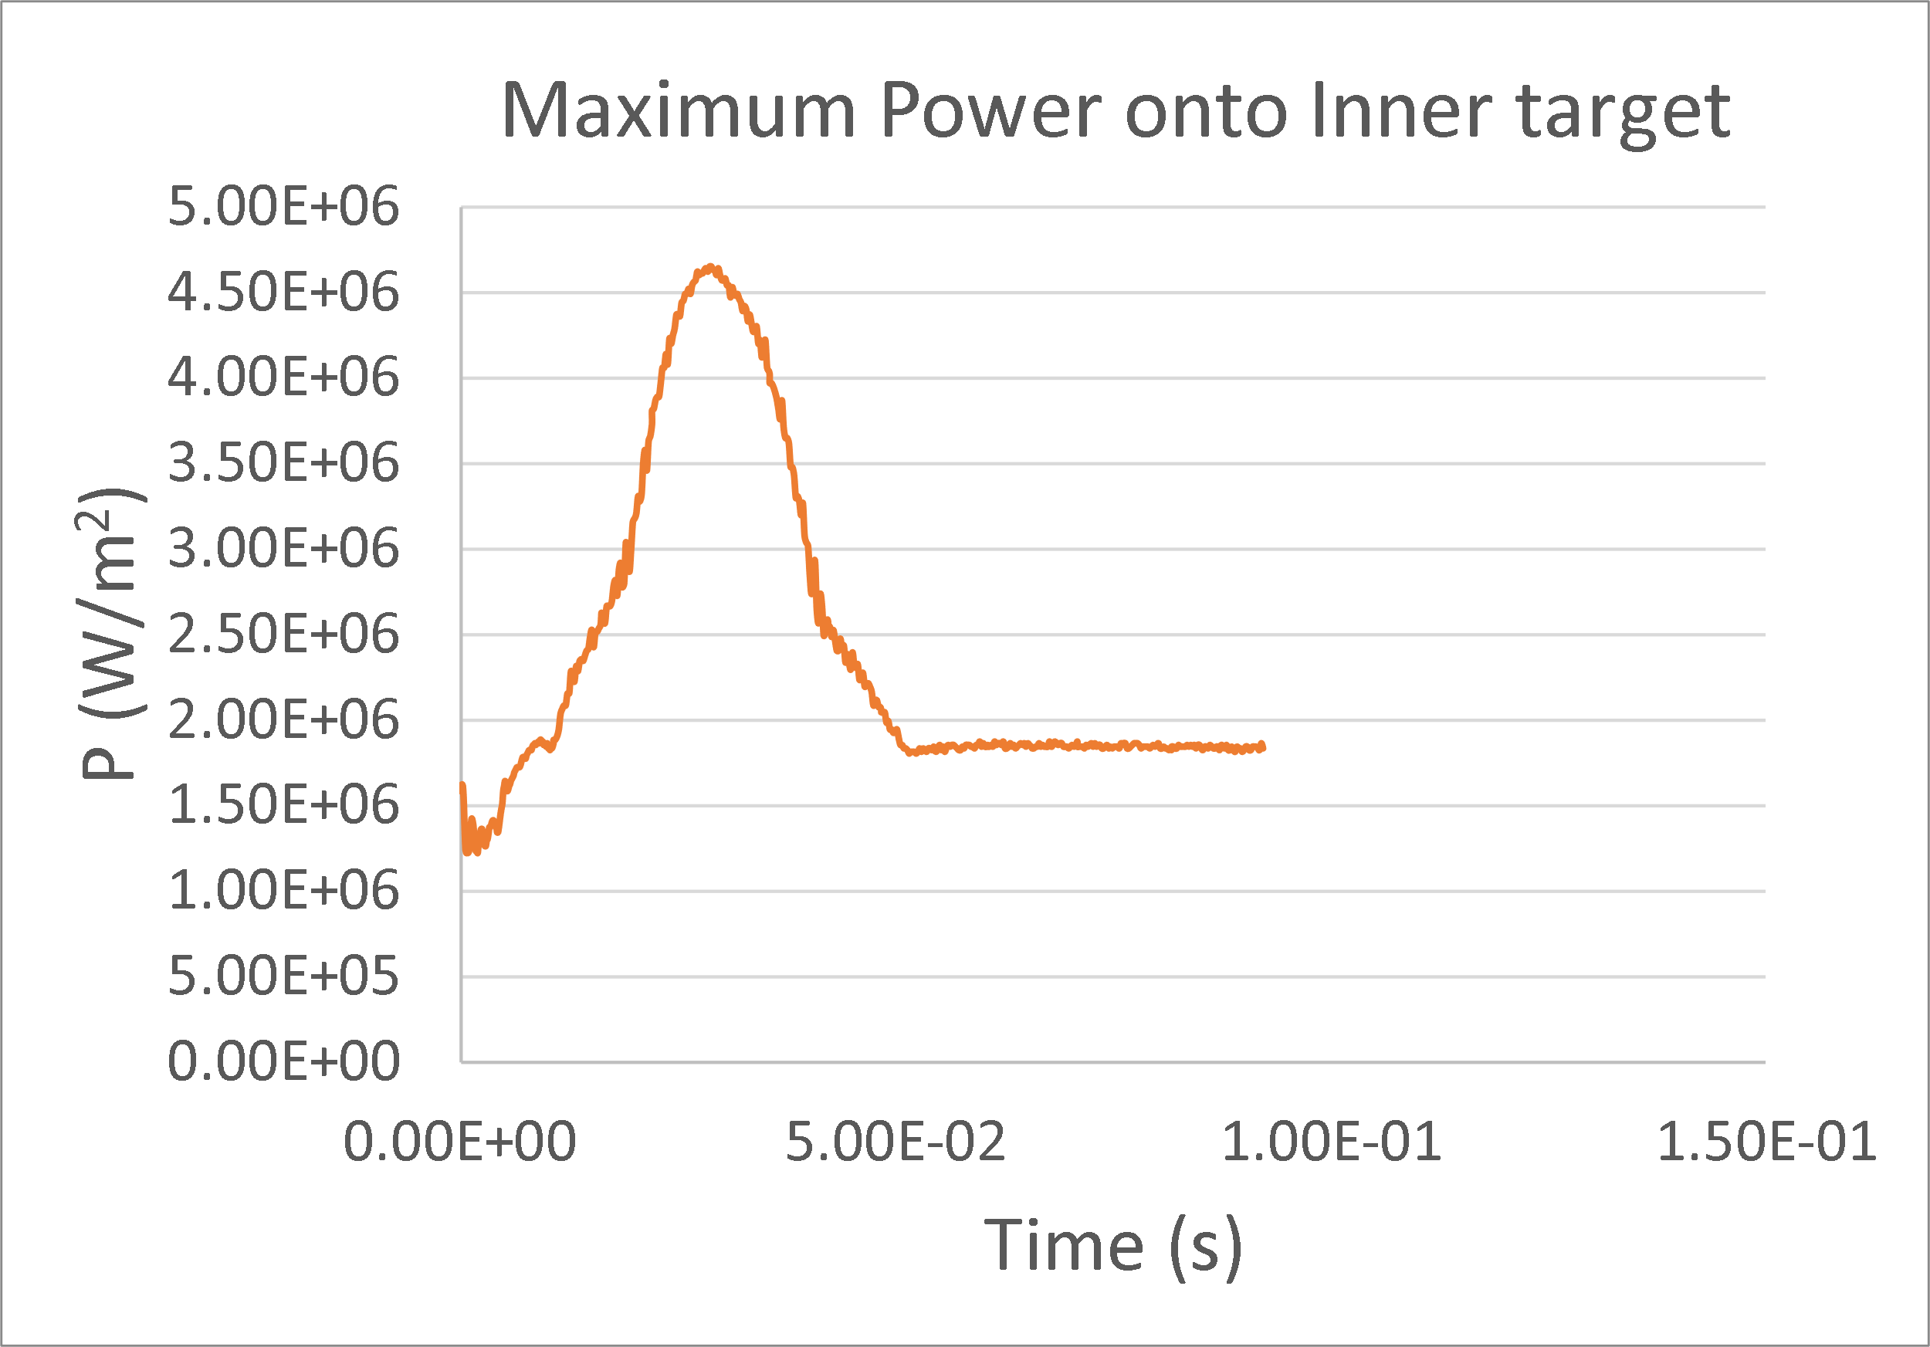
Possible Intrinsically Non-steady SX Scenarios
Γ = 6.4e23 D/s, n_{eomp} ≈ 3.1e19 m⁻³
Varying puffing (to vary Te,max,IT)
Oscillation in the peak power and Te at the inner target
Independent on the selected time step ➔ probably physical?
Can be eliminated by, e.g., changing the puff level.
Seem to be related to selected temperature range ➔ role of impurities?

Slide 8
Snow Flake (SF₋)
Two Xpts in the lower divertor.
Distance between separatrices: 4 mm at OMP
Setup common to other configurations:
Input power: 150 MW (electron 75 MW, ion 75 MW)
Core boundary particle in-fluxes
D flux 3.5e22/s (e.g. pellet fuelling),
He flux 7.0e20/s
Transport coefficients:
$D=0.1{m^{2}}/s;$
$χ_{i}=χ_{e}=0.1\left(core\right), 0.3(SOL) {m^{2}}/s$
Relatively large SOL:
$$λ_{T_{e},omp}≈6 mm$$

Slide 9
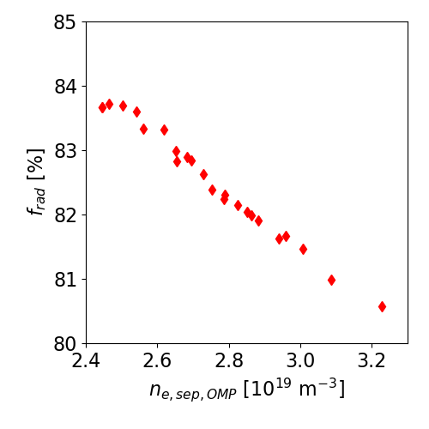
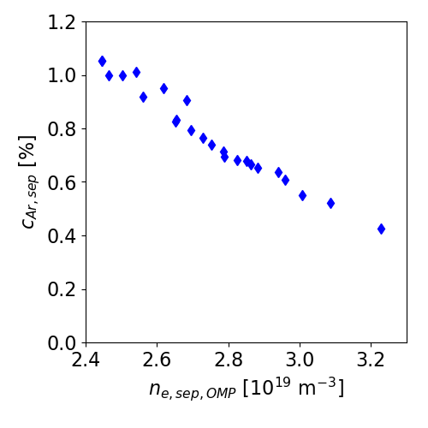
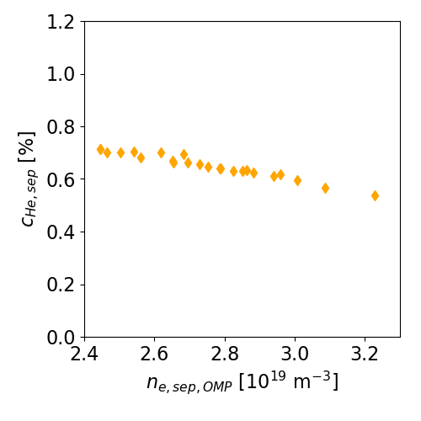
SF- Parametric Scan (Fluid Neutrals)
Parameter scan:
D puffing range ~factor 4: 1.6e23-6.0e23 atom/s
Ar puffing range ~factor1.5: 7.0e20-1.1e21 atom/s
Select cases with the maximum target temperature $≈5$ eV
Line radiation fraction
Impurity concentration at the separatrix

Slide 10
SF - Simulation with Kinetic Neutrals
SP1
SP4
SP2
SP3
Fully detached targets
X-point radiator with a total radiative fraction > 90 %
Radiation | SP1 | SP2 | SP4
139 MW | 1.2 MW | 0.1 MW | 1.8 MW

Slide 11
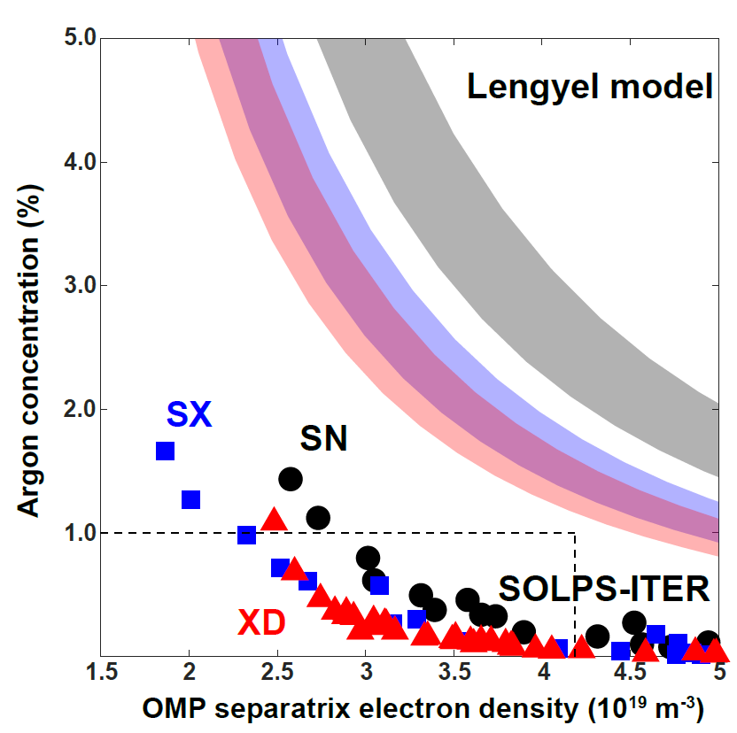
Full SOLPS-ITER vs. Simplified Models
Data from SN, XD and SX were collected and compared against Lengyel model predictions.
The Lengyel model consistently over-predicts the impurity concentration needed to obtain detached targets.
Numerical values may vary across different configurations, but qualitative trend shared by all.
Similarly to SOLPS-ITER, the Lengyel model suggests lower c_{Ar} to be needed by ADC wrt. SN. However, different physical mechanisms might play a role.
Lengyel model: different connection length
SOLPS-ITER modeling ... ?

Slide 12
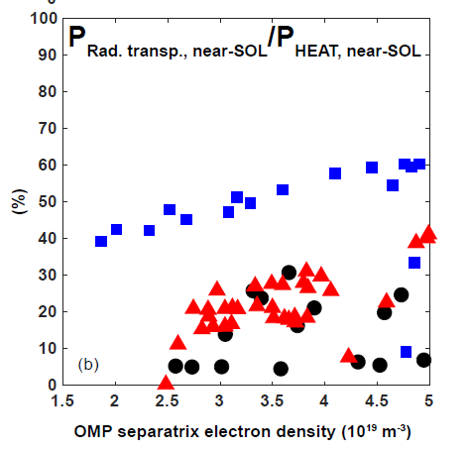
Radial Transport Importance: SX Example
SX is predicted to have two times larger cross-field transport heat loss than the XD and SN
Similar to the ratio of the total area of the SOL - PFR interface at LFS
Large temperature on the SOL side: ~20 eV
Large surface area and temperature gradient lead to significant heat transport to PFR in SX
Recycling processes provide the remaining heat loss of about 20%
Many possible uncertainties:
Radial tepmerature profiles
Transport coefficients

Slide 13
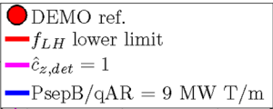
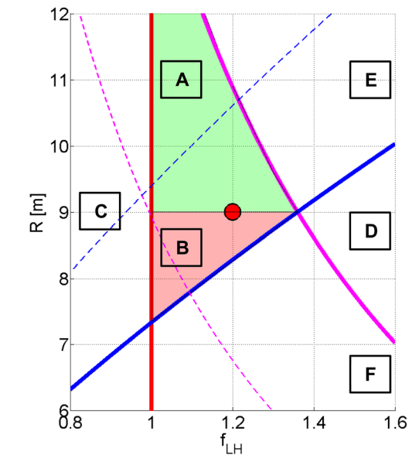
Possible Influences on Reactor Design
Figures of merit are often introduce to define a possible reactor parameter space
The impurity concentration needed for detachment is one of such parameters
A refinement over the Lengyel model can lead to a different reactor-relevant area
Would it be worth trying inserting ad-hoc parameters in the Lengyel model to account for it keeping its semi-analytical nature?
M. Siccinio et al. Nucl. Fusion 59 (2019) 106026
https://doi.org/10.1088/1741-4326/ab3153

Slide 14
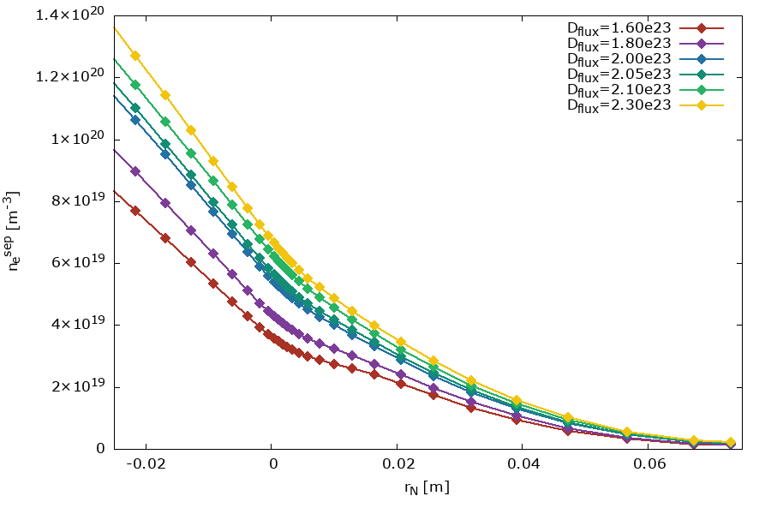
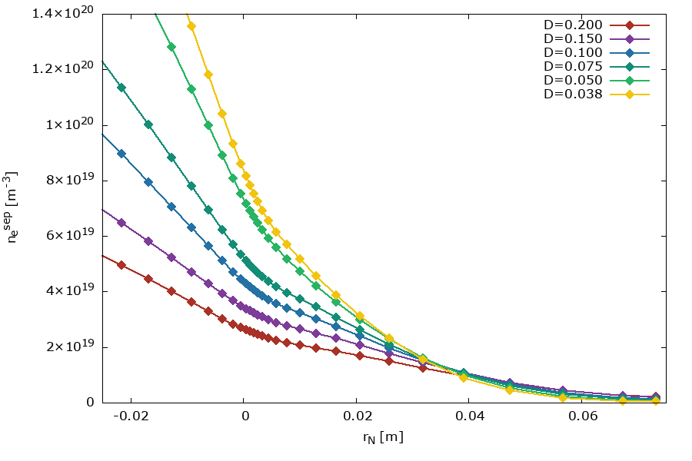
Sensitivity Studies
A weak point in all edge codes is the modeling of turbulent transport.
Most often, user-selected radial transport coefficients are adopted, with large uncertainties
We started systematic scans to at least roughly assess the expected induced uncertainty
Work in progress...

Slide 15
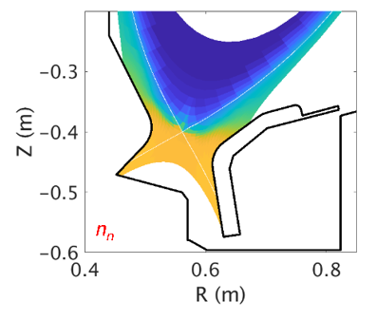
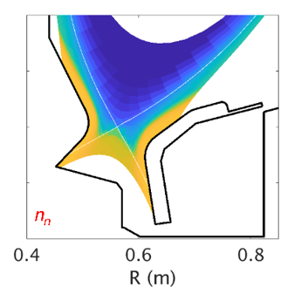
Numerical Enhancements
Several new/improved tools developed by WPPIE-ADC community members.
Examples:
Better models for neutral physics
Better representation of geometrical details
Automatic optimization tools for more efficient divertor design
9 pt
5 pt
Currently moving from the developing to the deploying phase

Slide 16
Conclusions
ADC.F worked on the modeling of several alternative divertor configurations.
From a purely divertor physics point of view, many of them show noticeable advantage over standard X-point (more easy detachment).
Warning: engineering constraints not necessarily considered in ADC.F ➔ need to merge results with other sub-projects.
A few questions still evolving, especially when moving from qualitative to quantitative configurations comparison.

Slide 17
THANK-YOU FOR ATTENTION

