Slide 1

WP PWIE: SP ADC-H
Final Meeting
SP ADC-H: Roberto Ambrosino

Slide 2
SP ADC-H Milestones and Tasks 2021-2022
Sequential WP-M ID | Related WBS ID | WP Milestone Title | Due Date [mm/yyyy] | Related GA D/M No. | Criticality of Relation to the GA D/M (high/low)
WM18* | SP ADC | Engineering compatibility assessment of potential best promising DEMO ADC solutions with the DTT facility completed (DEMO) | 31.12.2022 | PWIE.M.02
WM19* | SP ADC | Engineering DEMO evaluation of most favourable ADC solutions in terms of VDE and disruption events compatibility completed (DEMO) | 31.12.2022 | PWIE.M.02
Activity | Deliverable ID(s) | Task Title | Start date | End date
SP ADC-H | D001 | Engineering compatibility of best promising configurations described in WP ADC-DTT’s final report for DTT facility: recommendations for control and equilibria design | 01/2021 | 12/2022
SP ADC-H | D002 | Engineering compatibility of best promising configurations described in WP ADC-DTT’s final report for DTT facility: recommendations for VDE and disruption consequences | 01/2021 | 12/2022

Slide 3
SP ADC-H: Overview of the activity
Goal: Electromagnetic modelling of alternative configurations for the DTT device and controllability analysis of the alternative configurations
X-divertor
Negative Triang
Electromagnetic modelling
Support to the DTT physic activities under WPWIE in terms of definition of additional DTT plasma configurations
Magnetic control
Design of the preliminary shape and VS controllers for SN and alternative configurations for the analysis of disturbances and transients (LH and HL).
VDE and Disruptions
Analysis of the effects of VDE and MD of the plasma facing components
Single Null
Double Null
Snowflake
Low
priority
Low
priority
Resources:
Involved RU: CREATE, ENEA, TUSCIA
Linked WP: WPDIV-DTT
Deliverable: SP ADC-H.T001.D001, D002
Status: completed / partially done / in progress / delayed / cancelled
Facilities: e.g. PD # days, TOMAS or Modelling: Code name
Modelling: CREATE-NL, CREATE-L, MAXFEA, FIXFREE

Slide 4
SP ADC-H – D001 - Goals reached in 2021-22
Activity | Deliverable ID(s) | Goals reached in 2021-22
SP ADC-H | D001 | Analysis of the vertical stability performance of the DTT configurations (SN, XD, NT) Shape sensitivity of the DTT configurations (SN, XD, NT) Design of a vertical stability controller and testing on nonlinear sim. codes (SN, XD) Shape controller for SN and XD configuration and testing on the HL transition
CREATE – ENEA
R. Ambrosino, E. Acampora, A. Castaldo, G. Ramogida

Slide 5
SP ADC-H: Passive stability performance 2021
Growth rate and stability margin
Single null reference scenario
Phases | Ipl [MA] | betapol | li | Growth rate [s^-1] | Stability Margin
RAMP-UP | 3 | 0.1 | 0.9 | 58.44 | 0.63
RAMP-UP | 4.3 | 0.1 | 0.8 | 92.35 | 0.48
RAMP-UP | 5.5 | 0.1 | 0.8 | 61.84 | 0.59
FLAT TOP | 5.5 | 0.65 | 0.8 | 36.42 | 0.74
FLAT TOP | 5.5 | 0.1 | 1.2 | 106.78 | 0.42
RAMP-DOWN | 4.5 | 0.1 | 0.89 | 34.38 | 0.78
RAMP-DOWN | 3.5 | 0.1 | 0.98 | 40.77 | 0.70
RAMP-DOWN | 2.5 | 0.1 | 1.07 | 64.04 | 0.57
Alternative configurations
Config. | Ipl [MA] | betapol | li | Growth rate [s^-1] | Stability Margin
XD | 4.5 | 0.65 | 0.8 | 71.04 | 0.50
XD | 4.5 | 0.1 | 0.8 | 77.57 | 0.56
SN-NT | 4 | 0.4 | 0.8 | 76.80 | 0.48
SN-NT | 4 | 0.1 | 0.8 | 83.90 | 0.46
The upgraded definition of the in-vessel components has been developed in 2022 under DIV-IDTT.S.07-T005-D001-D002 with a copper stabilizing plate of smaller dimension

Slide 6
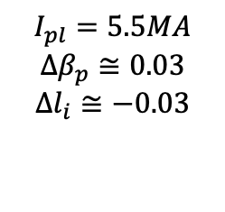
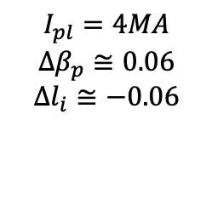
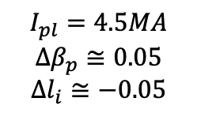
SP ADC-H: Shape sensitivity of DTT configurations
A big ELM (ΔWj=-1 MJ), simulated as a step in β_{p} and li, with Δβ_{p}=8ΔWj/(3μ₀R₀Ip²) and Δli=-Δβ_{p}, namely, for the X Δβ_{p} =-0.03 and Δli=0.03, has been considered.
XD
Possible criticality in the divertor region and at 11 o’clock
NT
Possible criticality in the inner equatorial plane
SN
(robustly stable)
Additional disturbancies need to be considered
$$I_{pl}=5.5MA$$
$$Δβ_{p}≅0.03$$
$$Δl_{i}≅−0.03$$
$$I_{pl}=4.5MA$$
$$Δβ_{p}≅0.05$$
$$Δl_{i}≅−0.05$$
$$I_{pl}=4MA$$
$$Δβ_{p}≅0.06$$
$$Δl_{i}≅−0.06$$

Slide 7
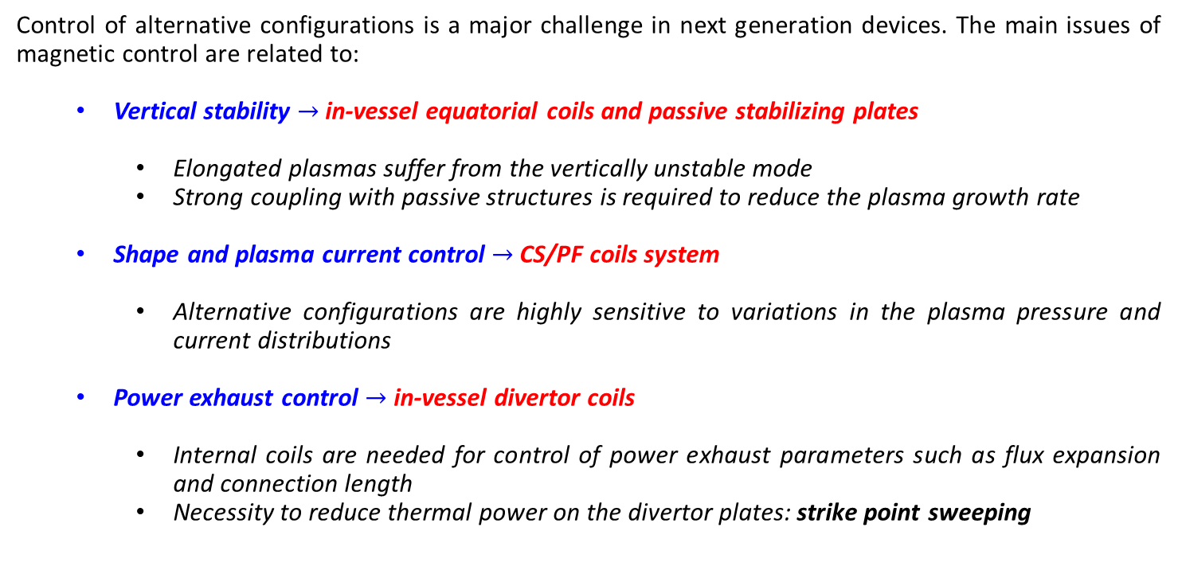
DTT magnetic control system
Control of alternative configurations is a major challenge in next generation devices. The main issues of magnetic control are related to:
  Vertical stability $→$ in-vessel equatorial coils and passive stabilizing plates
    Elongated plasmas suffer from the vertically unstable mode
    Strong coupling with passive structures is required to reduce the plasma growth rate
  Shape and plasma current control $→$ CS/PF coils system
    Alternative configurations are highly sensitive to variations in the plasma pressure and current distributions
  Power exhaust control $→$ in-vessel divertor coils
    Internal coils are needed for control of power exhaust parameters such as flux expansion and connection length
    Necessity to reduce thermal power on the divertor plates: strike point sweeping

Slide 8
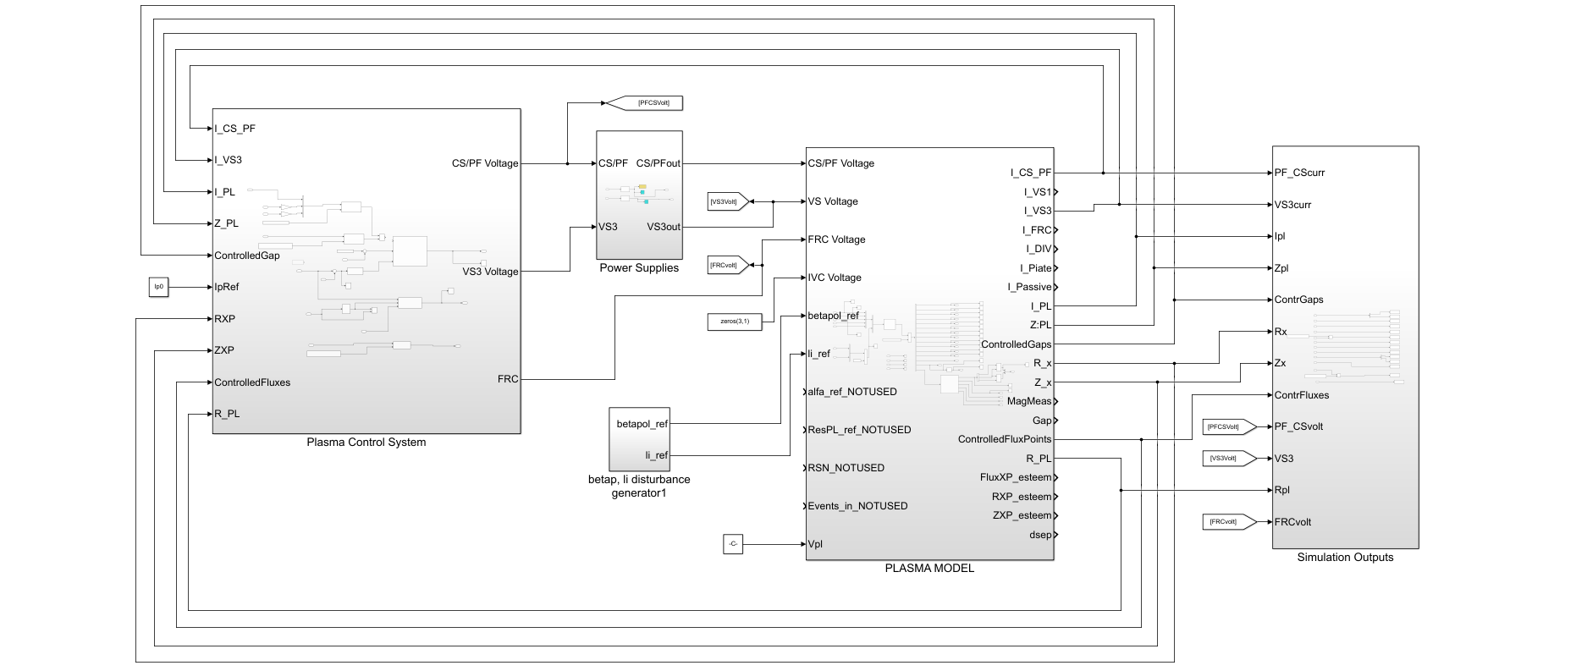
DTT magnetic controller design
Starting from 2022, the WP PWIE activities has been executed in collaboration with WPDIV-IDTT.S. CODAC and PCS for the requirements definition and assessment of the single null configuration.
PLANT
Plasma Magnetic Control System

Slide 9
Shape controller design
Shape control is based on the XSC (eXtreme shape Controller) strategy, conveying the current references required for the control of desired geometrical descriptors
Shape control through virtual gap sensors has been successfully validated on the SN configuration
Alternative configurations (such as the XD) share extreme sensitivity towards disturbance in the divertor area, due to secondary x-points
Shape control through gap sensors can be cumbersome, therefore a more robust control strategy is required → Isoflux control

Slide 10
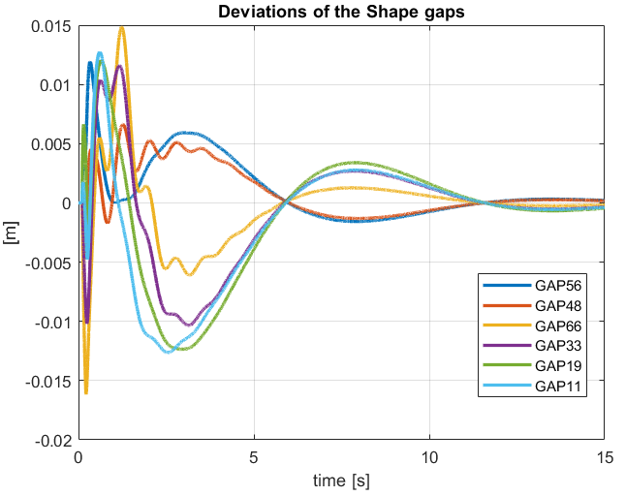
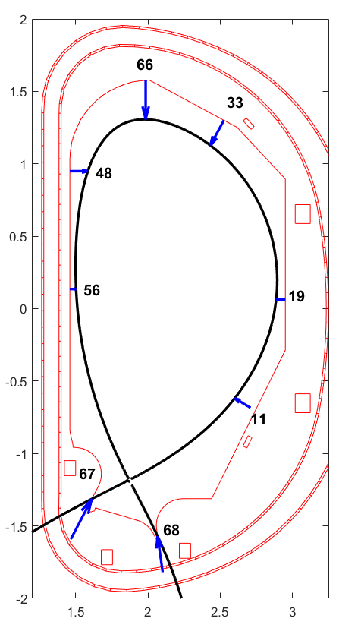
Shape controller design: SN configuration
ITER like model of the HL transition

Slide 11
Shape controller design: XD configuration
66
29
48
21
56
65
9
77
74

Slide 12
SP ADC-H – D002 - Goals reached in 2021-22
Activity | Deliverable ID(s) | Goals reached in 2021-22
SP ADC-H | D002 | A disruptions analysis considering the different DTT plasma configurations (SN, NT, XD) and different disruption scenarios (upper and lower VDE) by using MAXFEA code
CREATE – ENEA
R. Lombroni, G. Calabrò, P. Fanelli, G. Ramogida

Slide 13
SP ADC-H – D002 – Description of the activity
A set of Downward and Upward Vertical Displacement Events (DVDEs - UVDEs) were simulated considering SN, XD and NT configurations and exploring different durations of CQ
The main assumptions of the VDEs:
  Destabilizing kick of 10 ms to simulate the loss of position control;
  TQ at a given critical safety factor (=2) as betapol drop in 1 ms;
  Different CQ durations (~4 and ~40 ms);
  Halo currents growth during CQ.
Produced output:
  Induced currents and forces in the VV and the Stabilizing Plates
  Induced currents, voltages and forces in the in-vessel coils
  Plasma filaments (to be used as source term in possible future 3D analysis)
  Evolution of the plasma main parameters (Ipla, Zj, Rj, ecc)

Slide 14
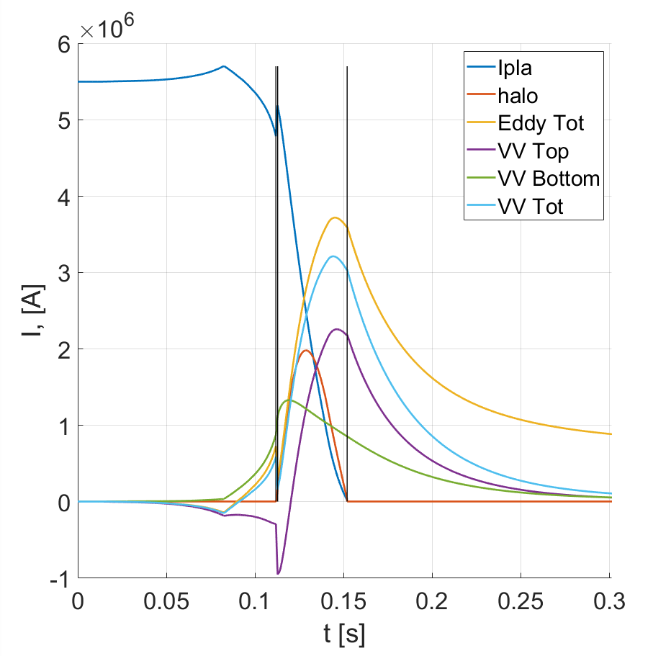
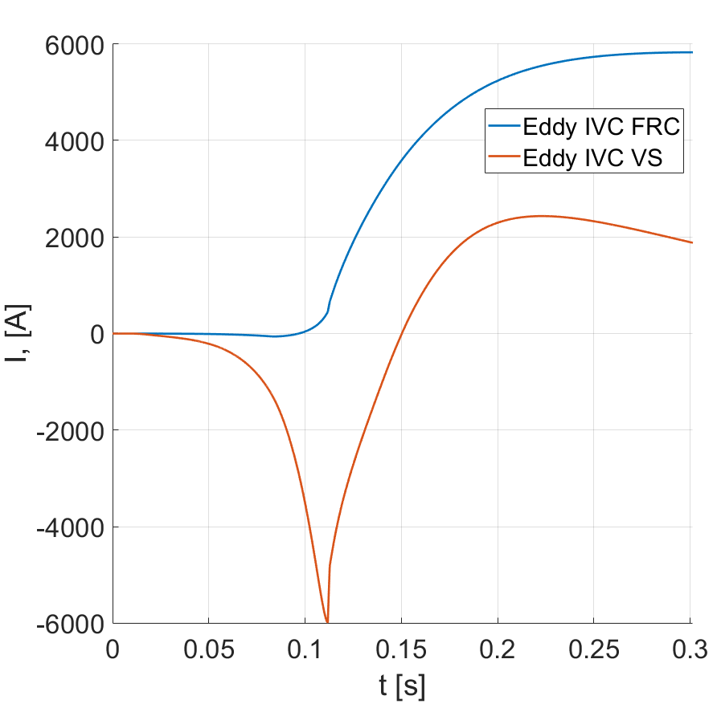
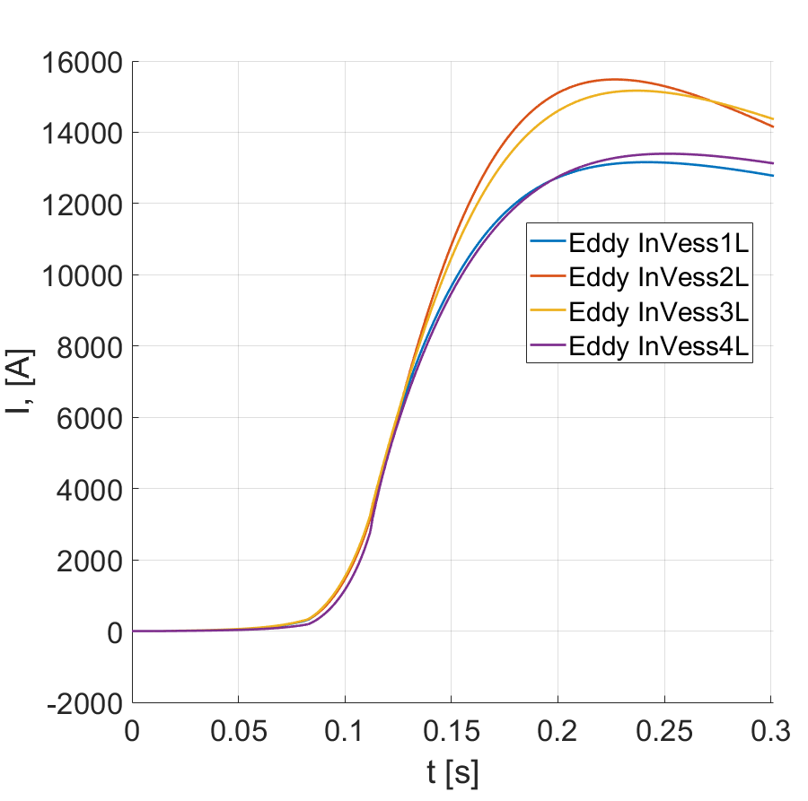
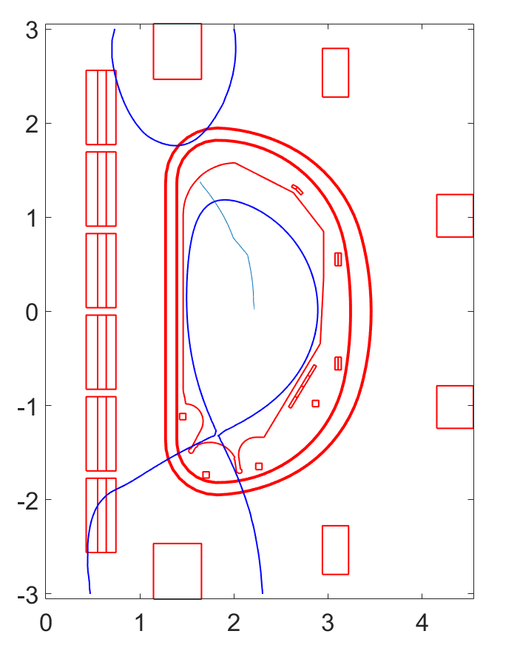
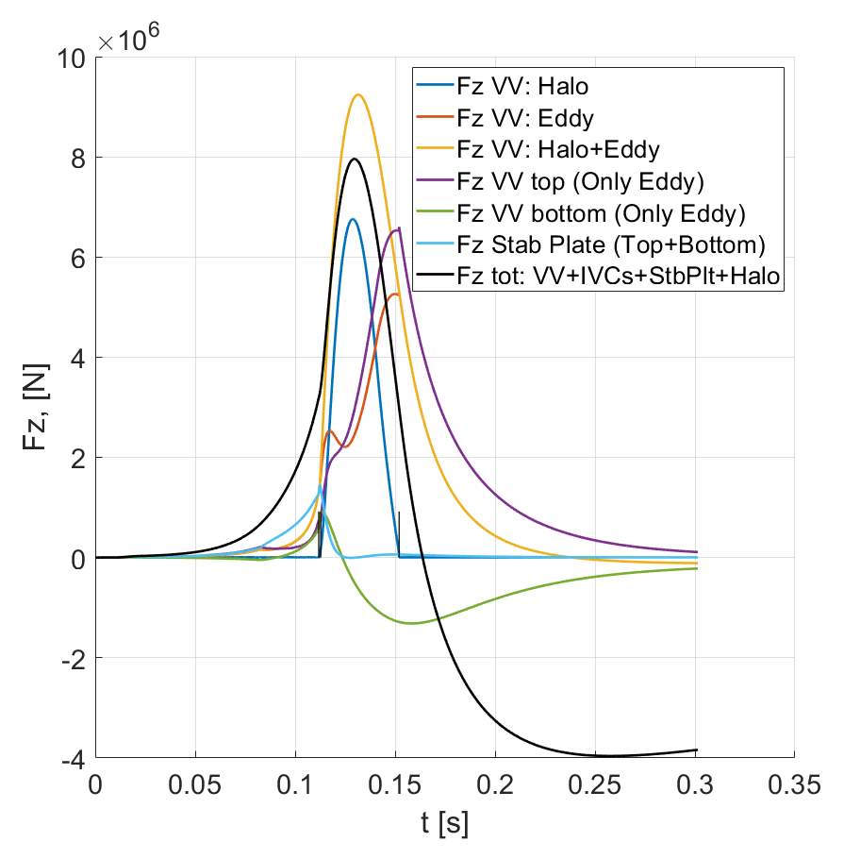
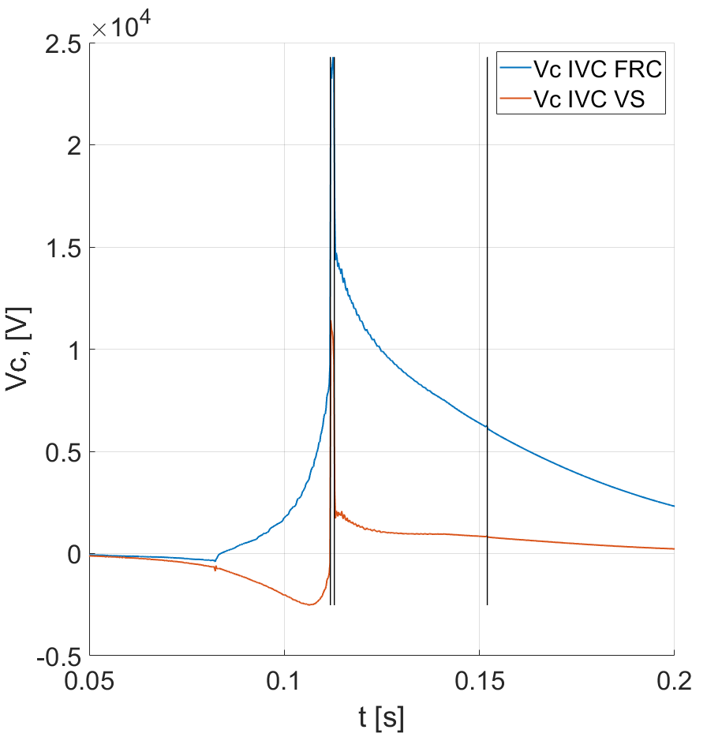
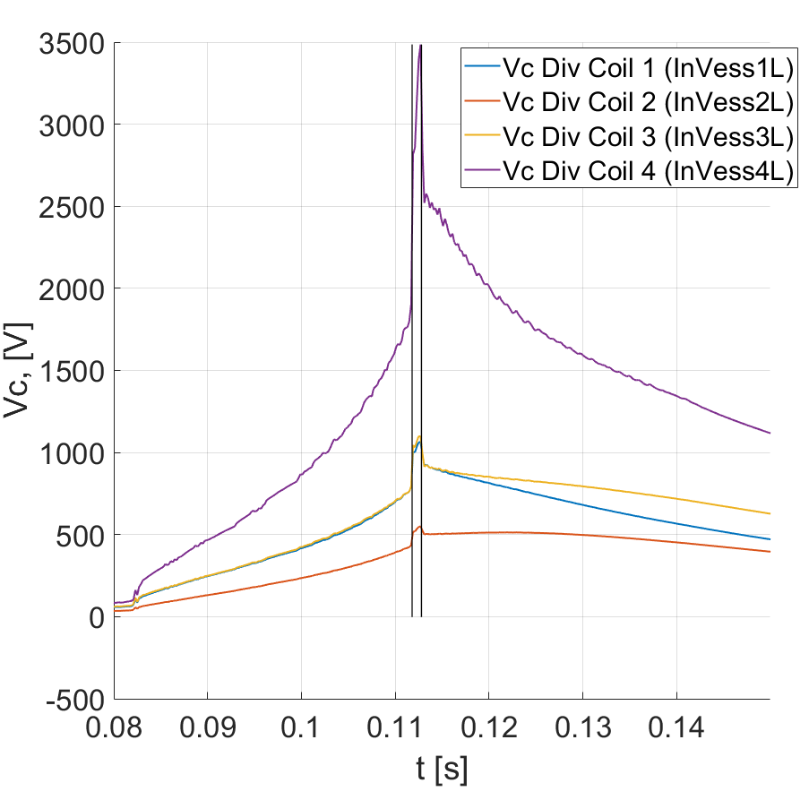
SP ADC-H – D002 – Upward VDE
SN @SOF UVDE slow
Fz VV ~ 8 MN during CQ

Slide 15
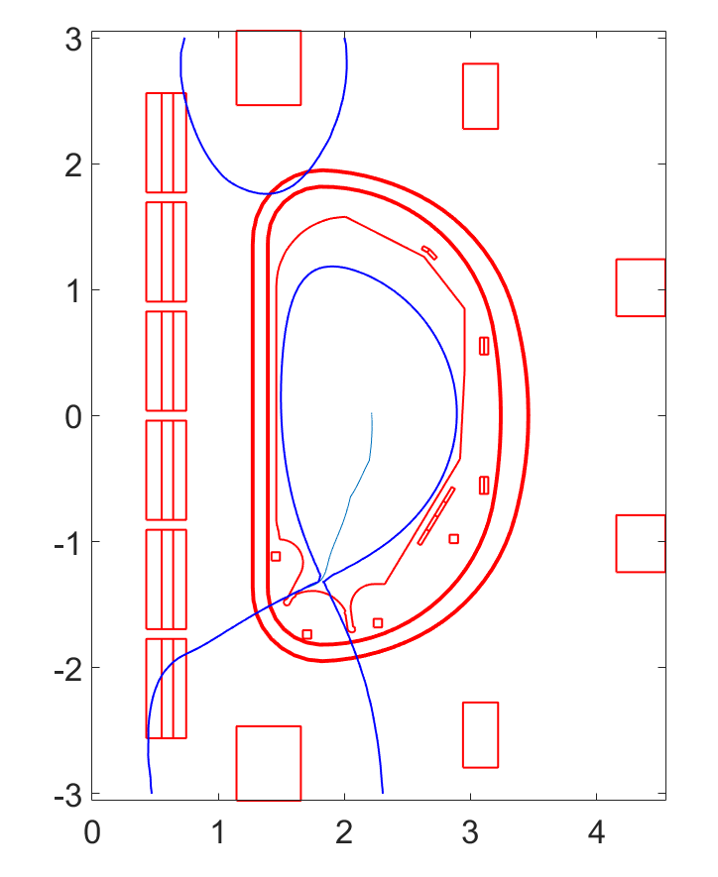
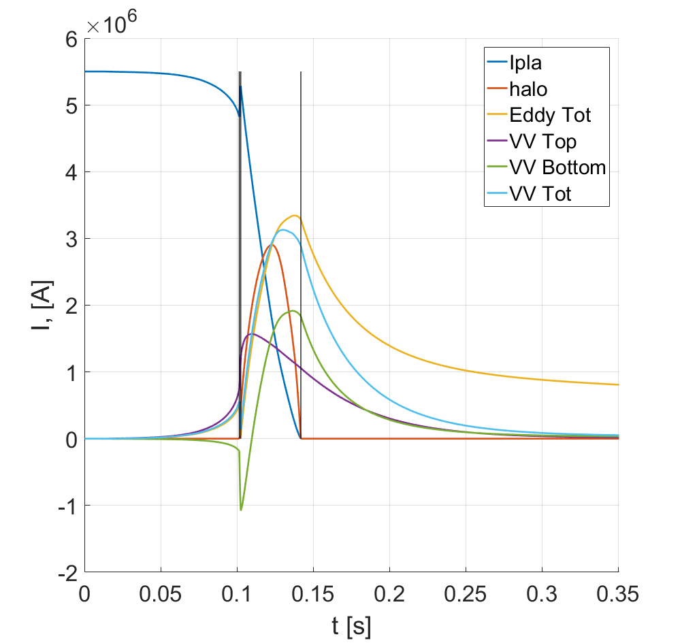
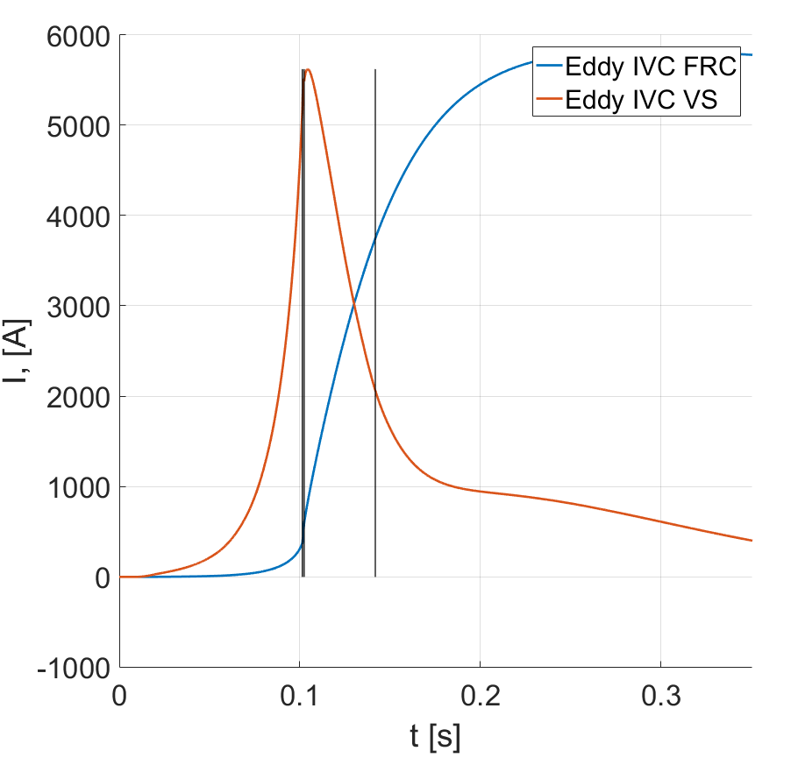
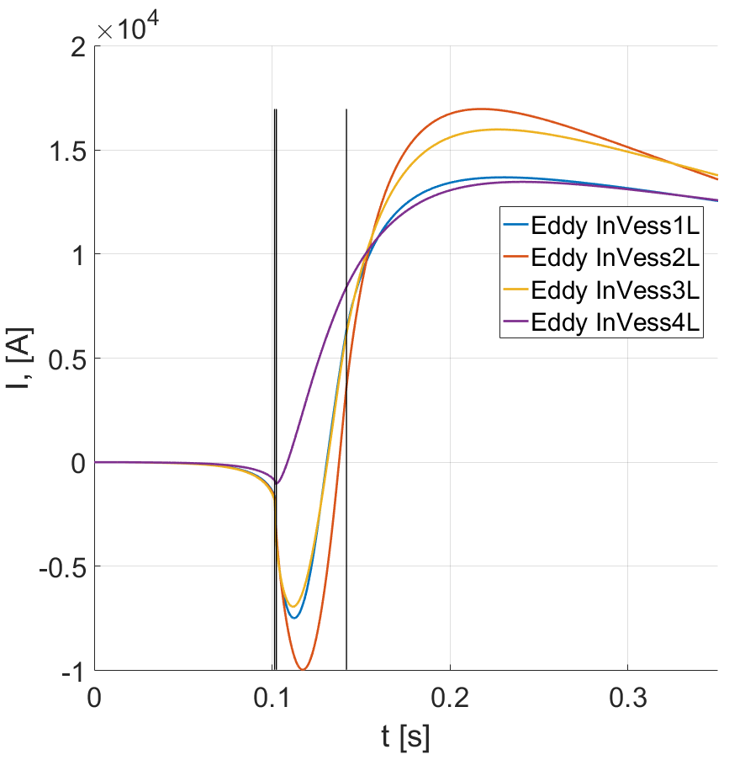
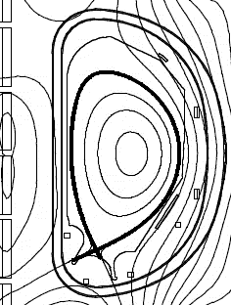
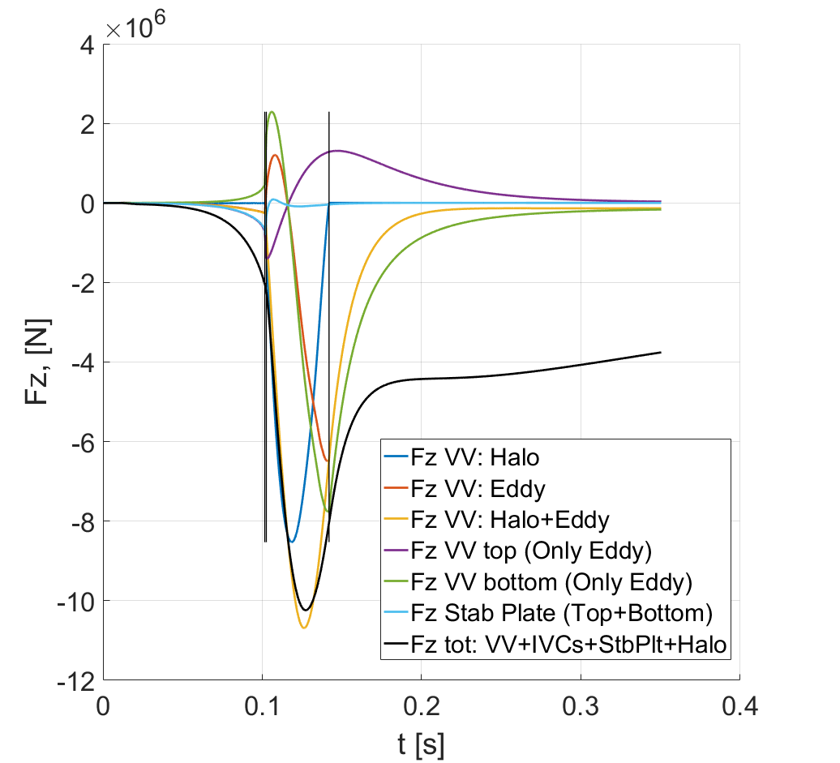
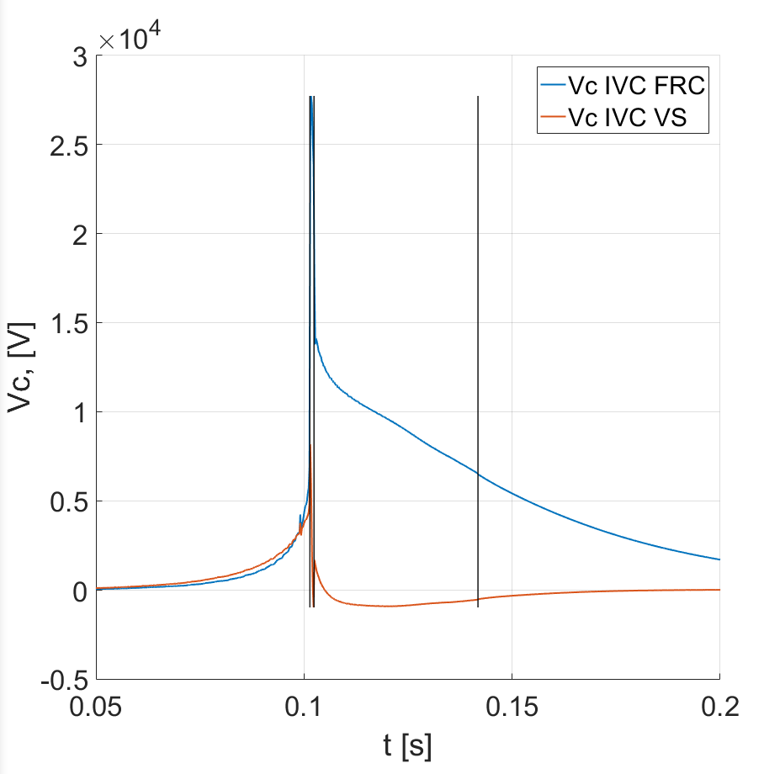
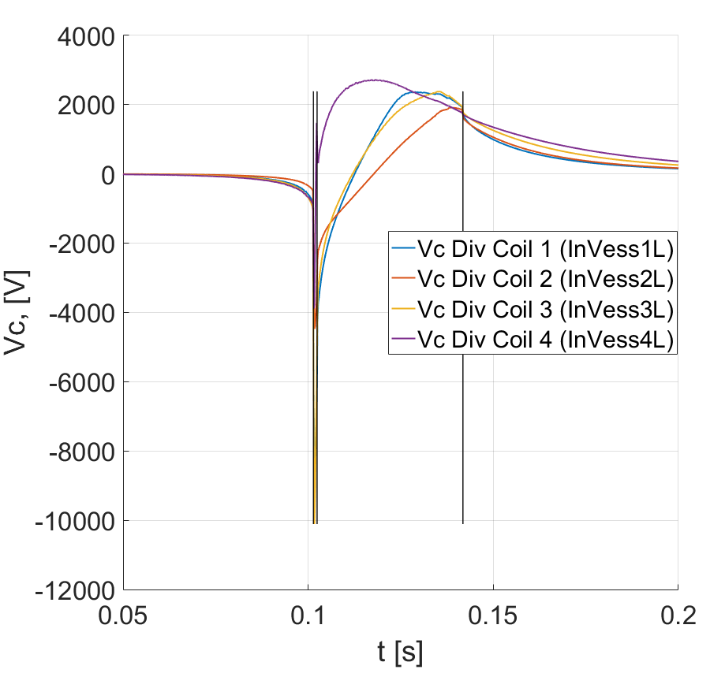
SP ADC-H – D002 – Downward VDE
SN @SOF DVDE slow
Fz VV ~ -10MN during CQ

Slide 16
SP ADC-H – D002 – Table of the results
Class of event | CQ [ms] | TQ init event | Halo onset | Axi-sim halo factor | Ihalo [MA] | Ip at TQ [MA] | Fz max on VV - [MN]
SN
DVDE FAST | ~4 | q95 = 2 | CQ | 0.3 | 1.7 | 4.8 | -4.3 (near the end of CQ)
DVDE SLOW | ~40 | q95 = 2 | CQ | 0.53 | 2.9 | 4.8 | -10.2 (during the CQ)
XD
DVDE FAST | ~4 | q95 = 2 | CQ | 0.38 | 1.7 | 4.3 | -4.4 (near the end of CQ)
DVDE SLOW | ~40 | q95 = 2 | CQ | 0.45 | 2.0 | 4.3 | -10.3 (during the CQ)
NT
DVDE FAST | ~4 | q95 = 2 | CQ | 0.35 | 1.4 | 3.7 | -2.7 (after the CQ)
DVDE SLOW | ~40 | q95 = 2 | CQ | 0.51 | 2.0 | 3.7 | -6.5 (during the CQ)
Class of event | CQ [ms] | TQ init event | Halo onset | Axi-sim halo factor | Ihalo [MA] | Ip at TQ [MA] | Fz max on VV - [MN]
SN
UVDE FAST | ~4 | q95 = 2 | CQ | 0.18 | 0.97 | 4.8 | 4.5 (near the end of CQ)
UVDE SLOW | ~40 | q95 = 2 | CQ | 0.36 | 1.98 | 4.8 | 7.9 (during the CQ)
XD
UVDE FAST | ~4 | q95 = 2 | CQ | 0.16 | 0.7 | 3.8 | -2.6 (after the CQ)
UVDE SLOW | ~40 | q95 = 2 | CQ | 0.31 | 1.4 | 3.8 | 3.0 (during the CQ)
NT
UVDE FAST | ~4 | q95 = 2 | CQ | 0.16 | 0.63 | 3.5 | -2.3 (after the CQ)
UVDE SLOW | ~40 | q95 = 2 | CQ | 0.41 | 1.6 | 3.5 | -2.2 (after the CQ)

Slide 17
SP ADC-H – D002 – Conclusions
An updated DTT MAXFEA model has been set up and the reference SN, XD and NT
configurations have been reproduced showing a very good agreement with CREATE-NL code
The MAXFEA model has been benchmarked against CREATE-NL code considering a simplified disruption case with a filamentary representation of the plasma
In 2021, a set of different disruptions scenarios (DVDEs) were simulated using the reference plasma configurations and exploring different CQ durations (fast 4ms, slow 40ms)
In 2022, the list of disruptions has been expanded by including UVDEs
SN and XD DVDE slow scenario generate the highest vertical force on the VV, about -10MN during the CQ phase

Slide 18
Additional slides

Slide 19
SP ADC-H: DTT poloidal field coils system
DTT will be equipped with:
a CS stack composed by 6 independent elements
6 PF coils up down symmetric
2 in-vessel equatorial coils will be used in DTT both for vertical stabilization and fast radial control
  Vertical stabilization connected in antiseries
  Radial control connected in series
4 in-vessel divertor coils used for:
  Local modification of the plasma divertor region
  Sweeping control
Stabilizing plates are also needed to improve the passive stability performance of the DTT scenarios
Stabiliz. plates
VS coils
Div. coils

Slide 20
DTT magnetic control system
Starting from 2022, the WP PWIE: SP ADC-H activities has been executed in collaboration with DIV-IDTT.S. 09b-T002 – CODAC and PCS for the requirements definition and assessment of the single null configuration.
In-vessel circuit voltage
Power Exhaust quantities
VS and
Power Exhaust
Notes:
PD: Plasma Devices as in PEP listed
HHF: High Heat flux as in PEP listed
IBF: Ion beam Facility as in PEP listed
Other facilties as in PEP listed

Slide 21
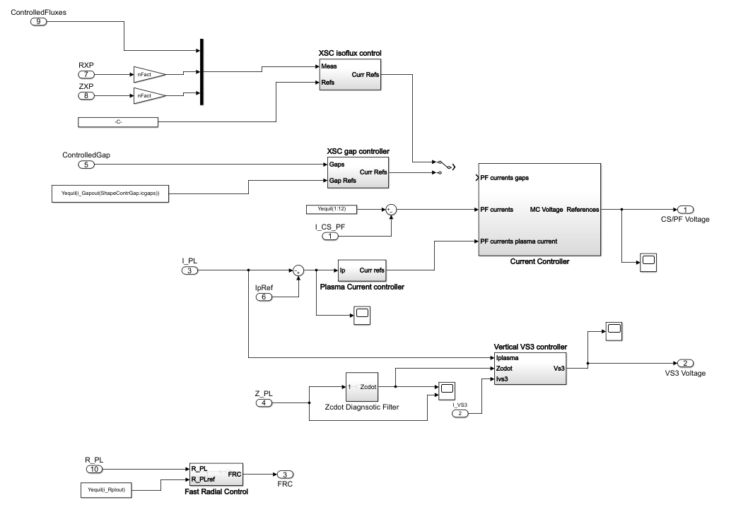
Plasma magnetic control system

Slide 22
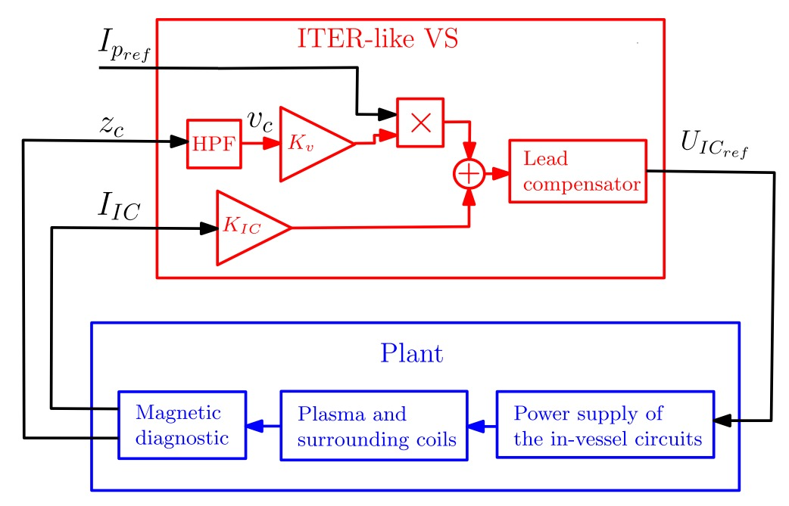
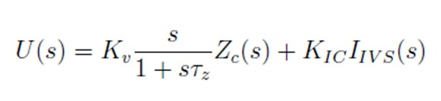
Vertical stability (VS) controller
VS control is ensured by IVC1 and IVC2 when connected in anti-series
An ITER-like voltage-driven vertical controller has been designed for DTT device
The VS controller has been tested successfully on non-linear simulation code for both the SN and the XD configurations, also with new passive stabilizing plates.
IVC1
Delivered to CODAC
IVC2
Notes:
PD: Plasma Devices as in PEP listed
HHF: High Heat flux as in PEP listed
IBF: Ion beam Facility as in PEP listed
Other facilties as in PEP listed

Slide 23

Plasma current controller
A current-driven control strategy allows to generate the current references in the CS-PF coils required for the plasma current control
Current references are proportional to a set of currents providing a transformer field in order to reduce coupling with the shape controller
The current references are sent to a current controller conveying the required control voltages
The control transfer function C(s) is designed to ensure a time constant of 1s
$$δI_{PF}=I_{trans}C\left(s\right)(I_{plref}−I_{pl}(t))$$
Delivered to CODAC

Slide 24
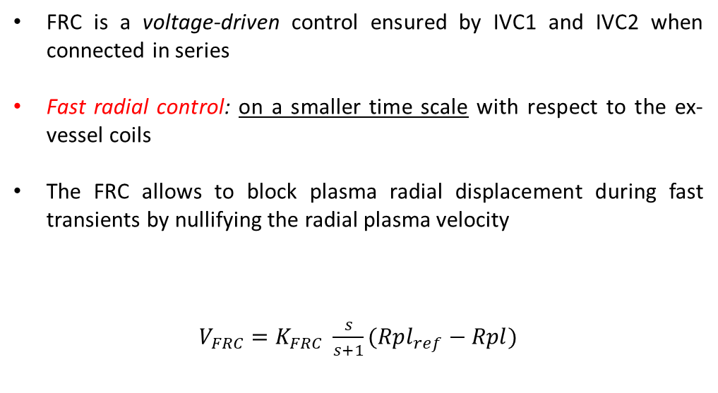
Fast radial controller (FRC)
FRC is a voltage-driven control ensured by IVC1 and IVC2 when connected in series
Fast radial control: on a smaller time scale with respect to the ex-vessel coils
The FRC allows to block plasma radial displacement during fast transients by nullifying the radial plasma velocity
$V_{FRC}=K_{FRC} \frac{s}{s+1}(Rpl_{ref}−Rpl)$
IVC1
IVC2
Notes:
Please mark your Subproject in

Slide 25




Shape controller design: Isoflux control
The isoflux strategy is based on feedback control of flux measurements in fixed control points on the reference plasma boundary
By controlling the measured fluxes to the value in the reference x-point position, the LCFS is forced to pass through the chosen control points
Isoflux control is less intuitive than gap control, however it is more robust towards disturbances
5
6
4
7
3
2
8
$$ψ_{i}−ψ_{xp}→0 i∈[1,…,9]$$
1
XP
$${\overline{r}}_{xp}−r_{xp}→0$$
9
$${\overline{z}}_{xp}−z_{xp}→0$$
XP_2
$$ψ_{xp1}−ψ_{xp2}→\overline{Δψ}$$

Slide 26
Conclusions
SN
XD
Alternative configurations are heavily affected by disturbances in the divertor region
Future implications:
  Validation on the nonlinear dynamic code (CREATE-NL)
  Development of a strategy for fine control of the strike points with the in-vessel divertor coils

