Slide 1
WP PWIE: SP ADC.I final meeting
SPL ADC.I: Pierluigi Fanelli
Contributors: R. Lombroni, M. Scarpari, S. Carusotti, F. Vivio
Notes:
Please Indicate your subproject

Slide 2
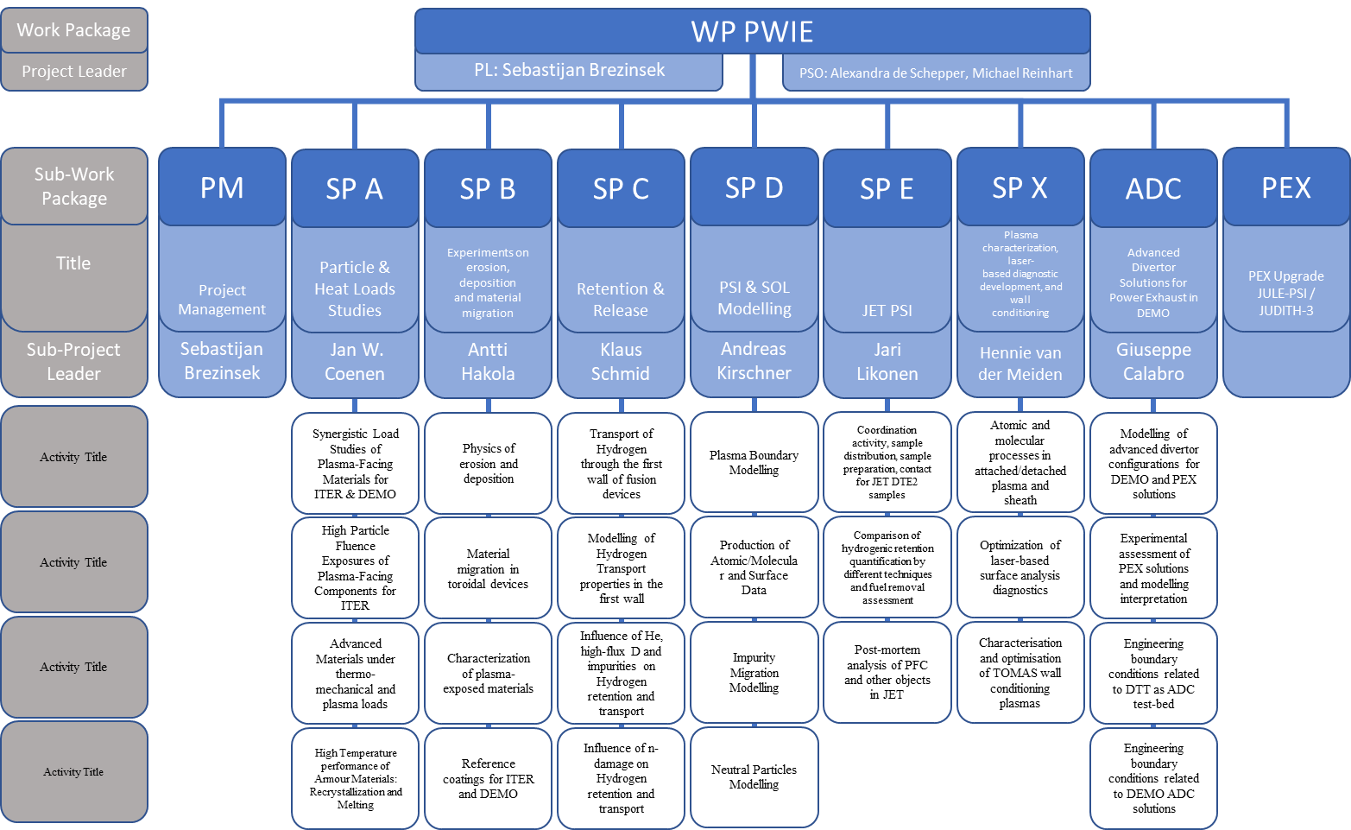
PWIE 2021/2022: SP ADC.I
DPL for ADC: Giuseppe Calabro
Modelling of standard
and advanced divertor
configurations for DTT
Notes:
Please mark your Subproject in

Slide 3
Milestones
Relevant Work Package Milestones for SP ADC.I extracted from WPPWIE PEP 2021
WM19 | Engineering DEMO evaluation of most favorable ADC solutions in terms of VDE and disruption events compatibility (DEMO) | 31.12.2021
Relevant Work Package Milestones for SP ADC.I extracted from WPPWIE PMP 2022
WM19* | Engineering DEMO evaluation of most favourable ADC solutions in terms of VDE and disruption events compatibility completed (DEMO) | 31.12.2022

Slide 4
SP ADC.I Tasks
Activity | Deliverable ID(s) | Task Title
PWIE-ADC.I.T- | T002-D001 | Plasma-Wall contact points during disruptions and initial evaluation of ADC transients for the heat flux impact point of view (ENEA)
PWIE-ADC.I.T- | T002-D002 | Definition of required size and configuration of ADCs divertor including the baffle (ENEA)
Notes:
This is just a summary table – Michael will provide it.

Slide 5
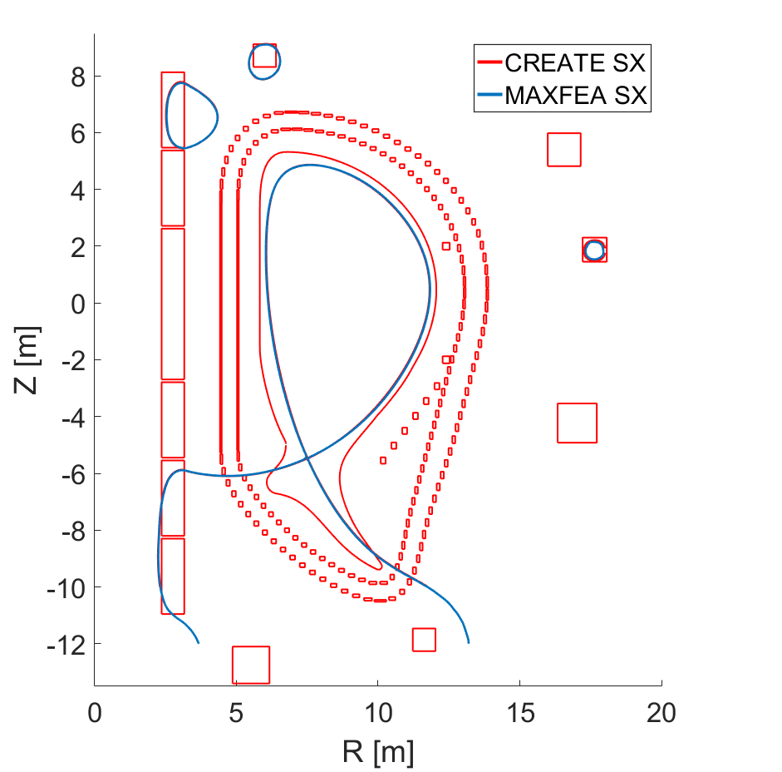
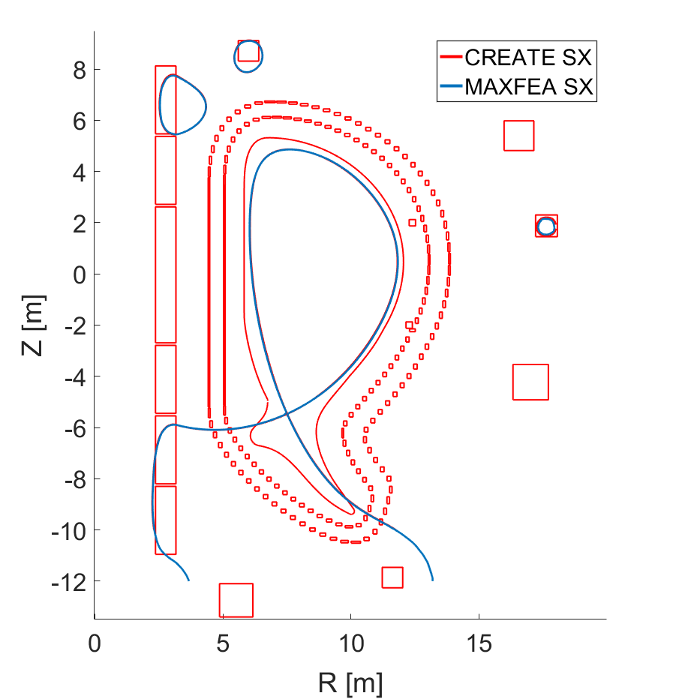
SP ADC.I.1: Engineering boundary conditions related to DEMO ADC solutions
Plasma-Wall contact points during disruptions and initial evaluation of ADC transients for the heat flux impact point of view
A disruptions analysis has been performed considering the different DEMO hybrid SN-SX plasma reference configurations* and different disruption scenarios by using MAXFEA code
Two MAXFEA models have been developed and the reference configurations have been reproduced and compared with CREATE-NL showing very good agreement
The model includes:
CS and PF coils
VV
The Stabilizing Plate (only in Model 1)
In-vessel coils:
2 VS coils connected in anti-series with 9 turns each
*(https://idm.euro-fusion.org/default.aspx?uid=2NN28R)
Deliverable: PWIE-ADC.I.T-T002.D001
Status: completed
Facilities: - or Modelling: MAXFEA
Human Resources: 8 PM
Involved RU: UniTuscia
Linked WP or TSVV:
Notes:
PD: Plasma Devices as in PEP listed
HHF: High Heat flux as in PEP listed
IBF: Ion beam Facility as in PEP listed
Other facilties as in PEP listed

Slide 6
SP ADC.I.1: Engineering boundary conditions related to DEMO ADC solutions
Reference disruption events. For each model:
4 Major Disruptions (MDs)
4 Up-ward Vertical Displacement Events (VDEs)
The main assumptions adopted to model the different VDEs in MAXFEA are the following:
Destabilizing kick 10 ms after the start of simulation to simulate the loss of position control;
TQ at a given critical safety factor (=2) as betapol drop in 1 ms;
Different CQ durations (~74 and ~300 ms);
Halo currents growth during CQ.
For the MDs:
TQ occurring 10 ms after the start of simulation as betapol drop in 1 ms;
Loss of position control after the TQ;
Different CQ durations (~74 and ~300 ms);
Halo currents growth during CQ.
In order to evaluate the effect of the presence of the IVCs on the plasma evolution, each disruption scenario has been modelled considering two different assumption:
Top and Bottom coils connected in anti-series with a short circuit (Closed Loop (CL) case)
Top and bottom coils connected in anti-series but the terminale is open (Open Loop (OL) case)
Deliverable: PWIE-ADC.I.T-T002.D001
Status: completed
Facilities: - or Modelling: MAXFEA
Human Resources: 8 PM
Involved RU: UniTuscia
Linked WP or TSVV:
Notes:
PD: Plasma Devices as in PEP listed
HHF: High Heat flux as in PEP listed
IBF: Ion beam Facility as in PEP listed
Other facilties as in PEP listed

Slide 7
SP ADC.I.1: Engineering boundary conditions related to DEMO ADC solutions
Class of event | CQ [ms] | TQ init event | Halo onset | IVCs circuit | Axi-sim halo factor | Ihalo [MA] | Ip at TQ [MA] | Fz max on VV - during CQ (after CQ) [MN]
MODEL 1
MD FAST | ~74 | @10 ms | limiter | Open | ≈0.11 | 2.02 | 19.07 | 3.99 (-54.86)
MD FAST | ~74 | @10 ms | limiter | Closed | ≈0.11 | 2.02 | 19.07 | 4.05 (-57.12)
MD SLOW | ~300 | @10 ms | limiter | Open | ≈0.19 | 3.60 | 19.07 | 11.71 (-46.59)
MD SLOW | ~300 | @10 ms | limiter | Closed | ≈0.19 | 3.57 | 19.07 | 11.42 (-48.69)
UVDE FAST | ~74 | @q95=2 | limiter | Open | ≈0.13 | 2.52 | 16.82 | 19.80 (-46.85)
UVDE FAST | ~74 | @q95=2 | limiter | Closed | ≈0.14 | 2.60 | 16.88 | 25.74 (-48.96)
UVDE SLOW | ~300 | @q95=2 | limiter | Open | ≈0.23 | 4.36 | 16.84 | 31.47 (-39.42)
UVDE SLOW | ~300 | @q95=2 | limiter | Closed | ≈0.23 | 4.45 | 16.89 | 36.14 (-41.77)
MODEL 2
MD FAST | ~74 | @10 ms | limiter | Open | ≈0.10 | 1.99 | 19.07 | 3.08 (-45.83)
MD FAST | ~74 | @10 ms | limiter | Closed | ≈0.10 | 1.98 | 19.07 | 2.79 (-46.88)
MD SLOW | ~300 | @10 ms | limiter | Open | ≈0.19 | 3.53 | 19.07 | 18.82 (-38.37)
MD SLOW | ~300 | @10 ms | limiter | Closed | ≈0.19 | 3.52 | 19.07 | 18.85 (-39.42)
UVDE FAST | ~74 | @q95=2 | limiter | Open | ≈0.13 | 2.48 | 16.90 | 21.22 (-38.50)
UVDE FAST | ~74 | @q95=2 | limiter | Closed | ≈0.14 | 2.59 | 16.98 | 27.36 (-39.30)
UVDE SLOW | ~300 | @q95=2 | limiter | Open | ≈0.22 | 4.29 | 16.91 | 39.68 (-31.88)
UVDE SLOW | ~300 | @q95=2 | limiter | Closed | ≈0.23 | 4.43 | 16.97 | 44.79 (-33.09)
Deliverable: PWIE-ADC.I.T-T002.D001
Status: completed
Facilities: - or Modelling: MAXFEA
Human Resources: 8 PM
Involved RU: UniTuscia
Linked WP or TSVV:
Notes:
PD: Plasma Devices as in PEP listed
HHF: High Heat flux as in PEP listed
IBF: Ion beam Facility as in PEP listed
Other facilties as in PEP listed

Slide 8
SP ADC.I.1: Engineering boundary conditions related to DEMO ADC solutions
For each of the simulations different data has been saved:
Time evolution of plasma filaments (to be used as source term in possible future 3D analysis)
Evolution of the plasma main parameters (Ipla, Zj, Rj, ecc)
Induced currents and forces in the VV and in the Stabilizing Plate
Induced currents, voltages and forces in the VS coils
EQDSK files at characteristic time instants of the evolution (to be used as inputs in possible Heat Flux analyses)
Evolution of the plasma contact points with the FW
Deliverable: PWIE-ADC.I.T-T002.D001
Status: completed
Facilities: - or Modelling: MAXFEA
Human Resources: 8 PM
Involved RU: UniTuscia
Linked WP or TSVV:
Notes:
PD: Plasma Devices as in PEP listed
HHF: High Heat flux as in PEP listed
IBF: Ion beam Facility as in PEP listed
Other facilties as in PEP listed

Slide 9
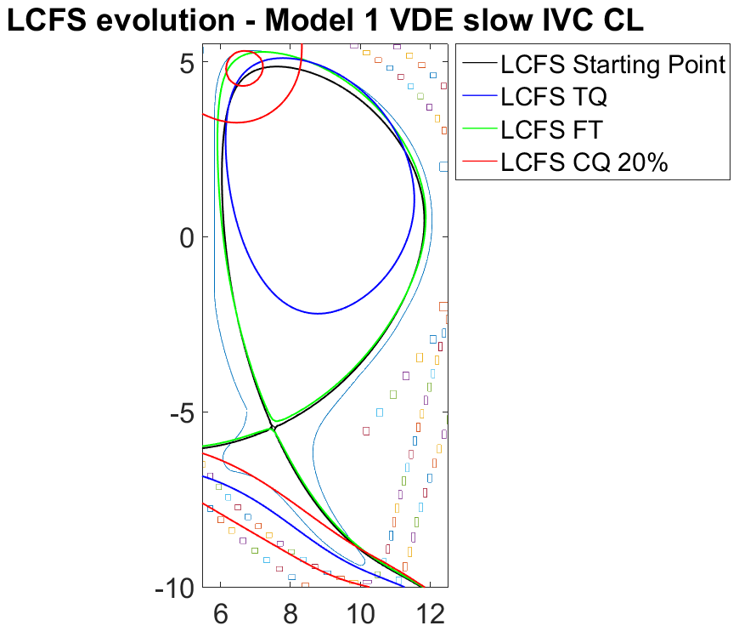
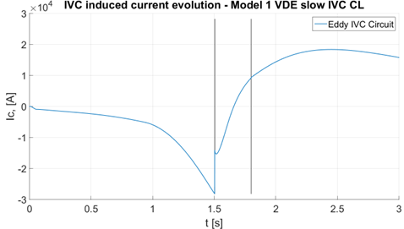
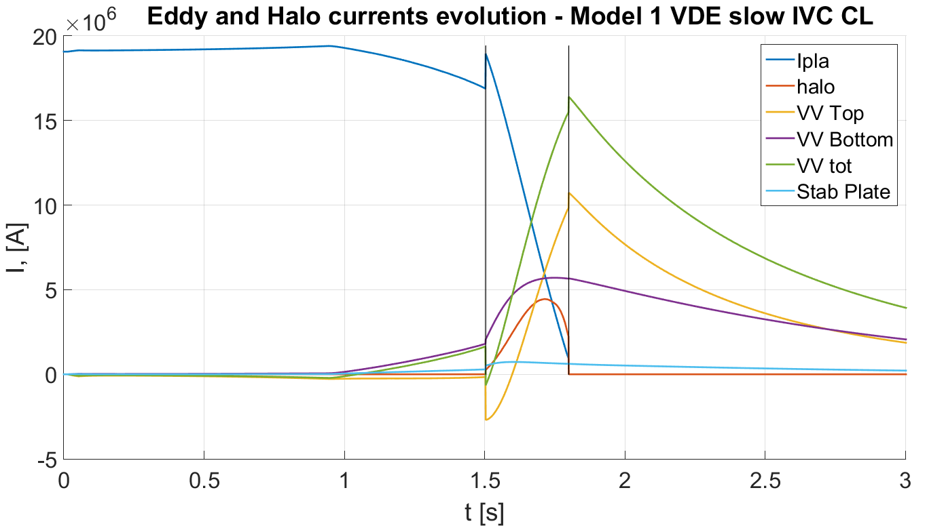
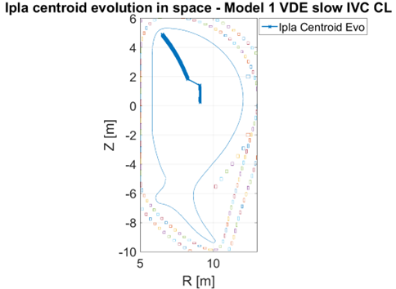
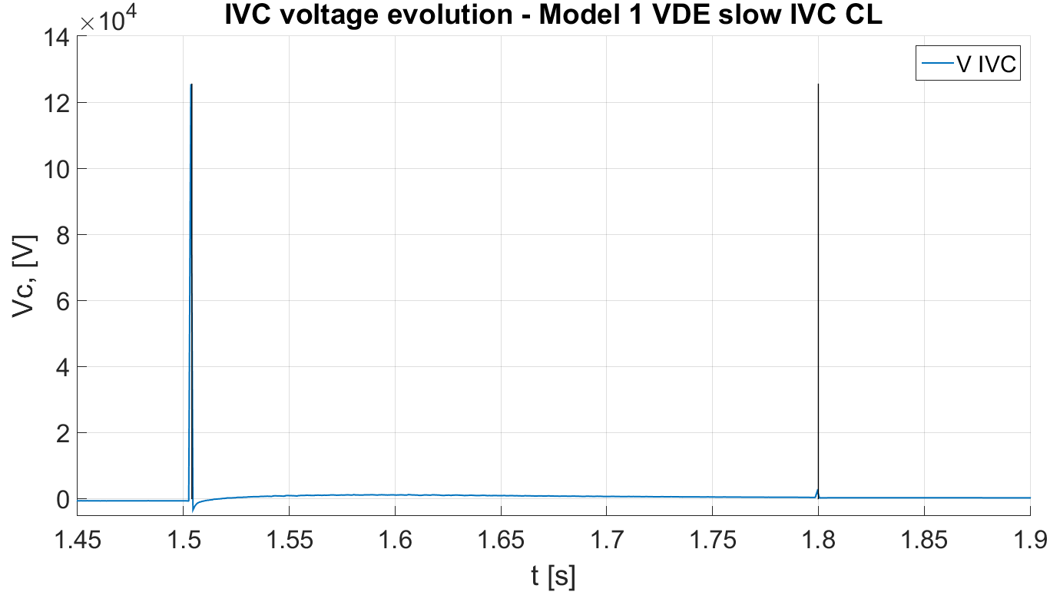
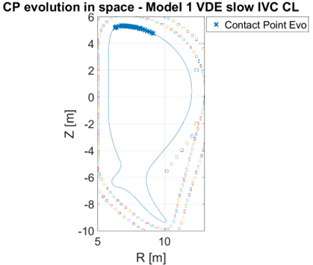
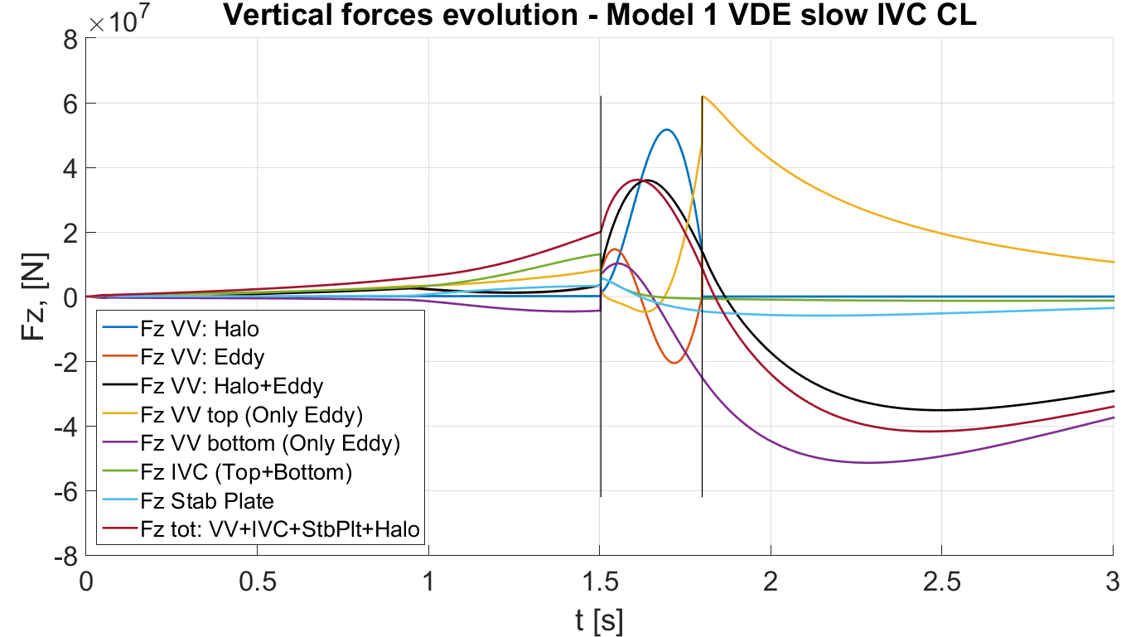
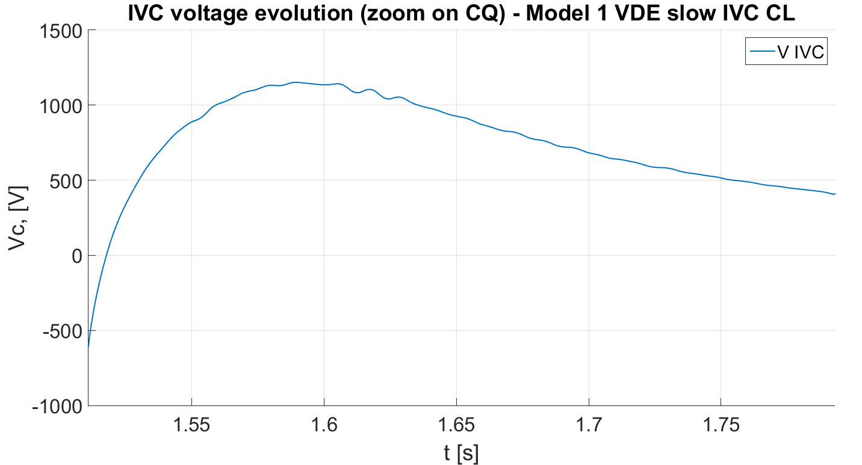
SP ADC.I.1: Engineering boundary conditions related to DEMO ADC solutions
MODEL 1 UVDE slow CL case
UVDE Model 1 Highest Fz on VV:
~ 36,1MN during CQ (X)
~ -41,8MN after CQ (X)
Deliverable: PWIE-ADC.I.T-T002.D001
Status: completed
Facilities: - or Modelling: MAXFEA
Human Resources: 8 PM
Involved RU: UniTuscia
Linked WP or TSVV:
Notes:
PD: Plasma Devices as in PEP listed
HHF: High Heat flux as in PEP listed
IBF: Ion beam Facility as in PEP listed
Other facilties as in PEP listed

Slide 10
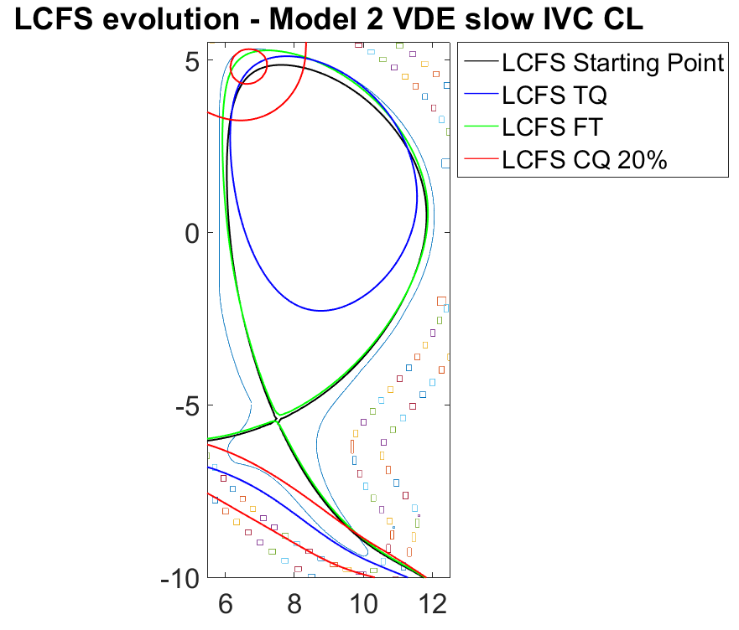
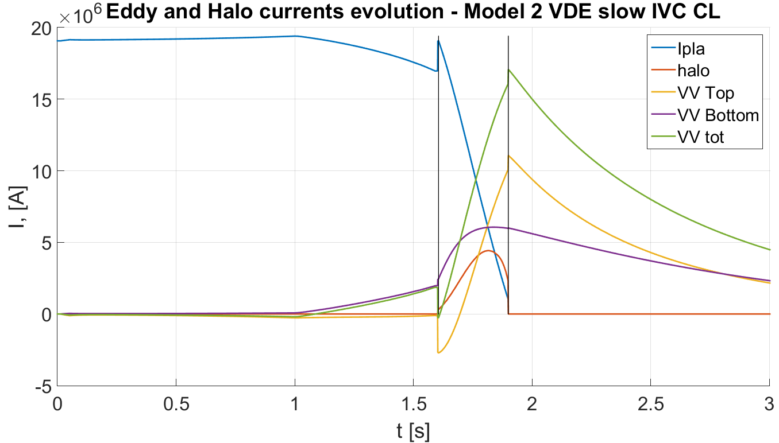
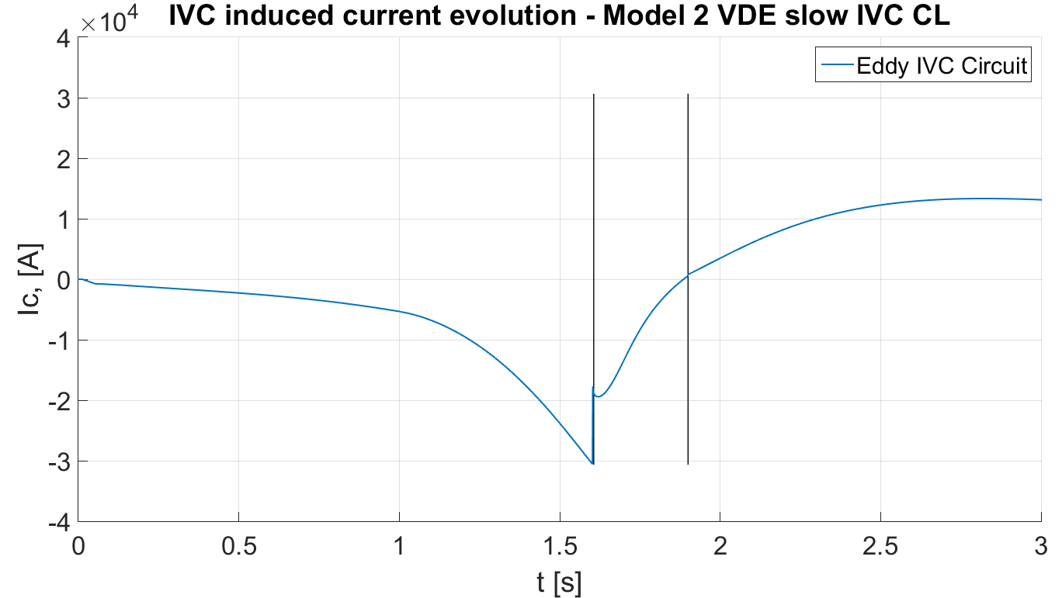
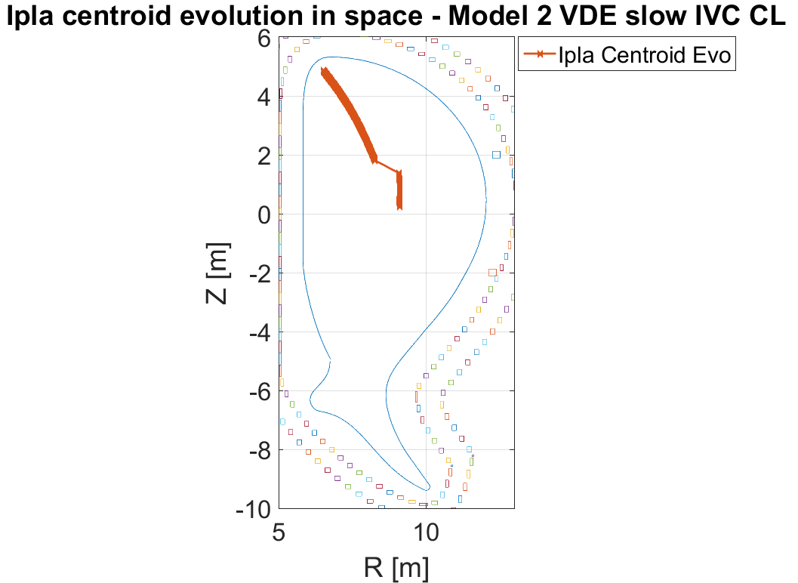
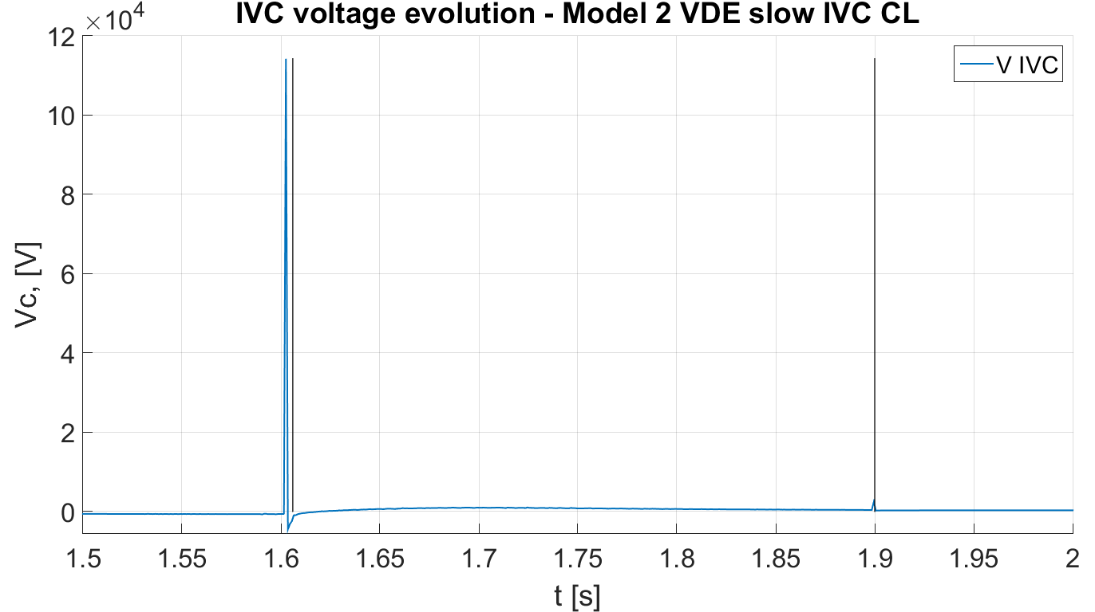
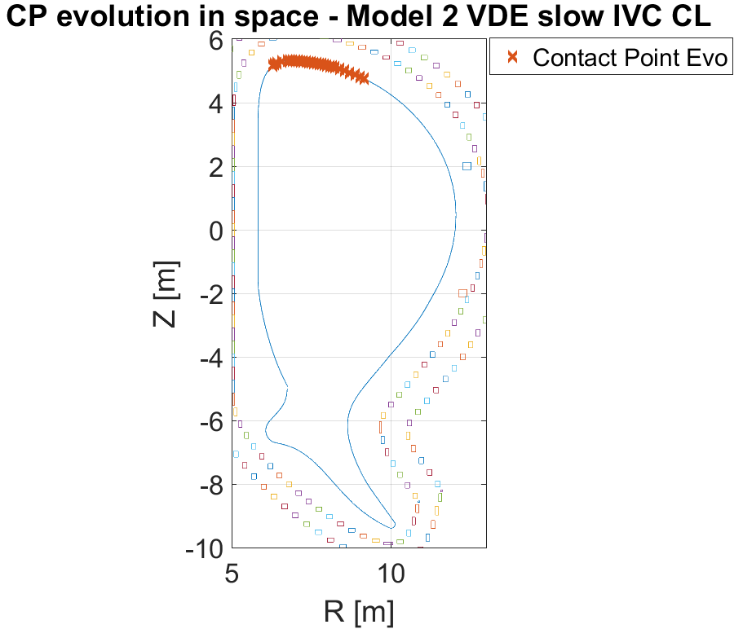
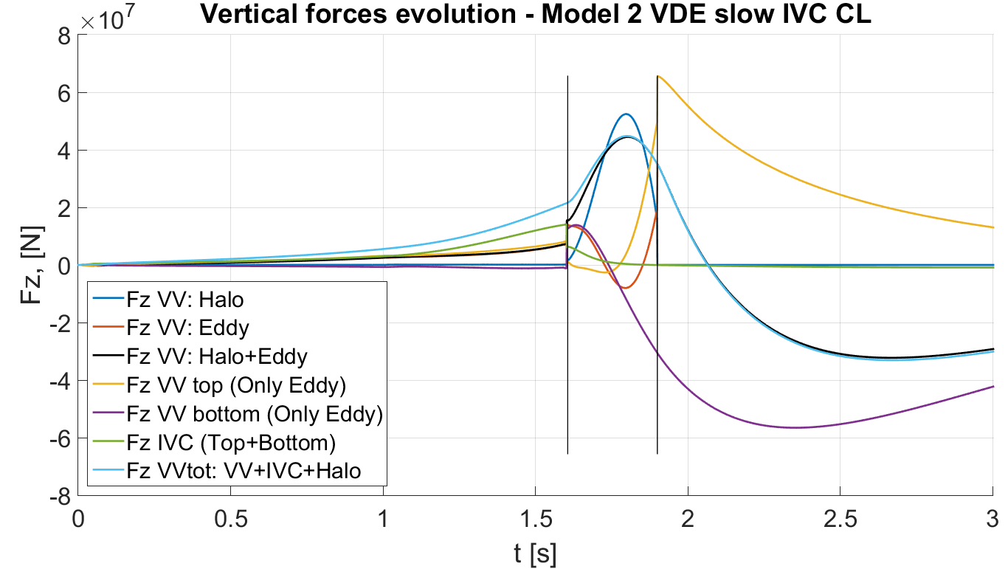
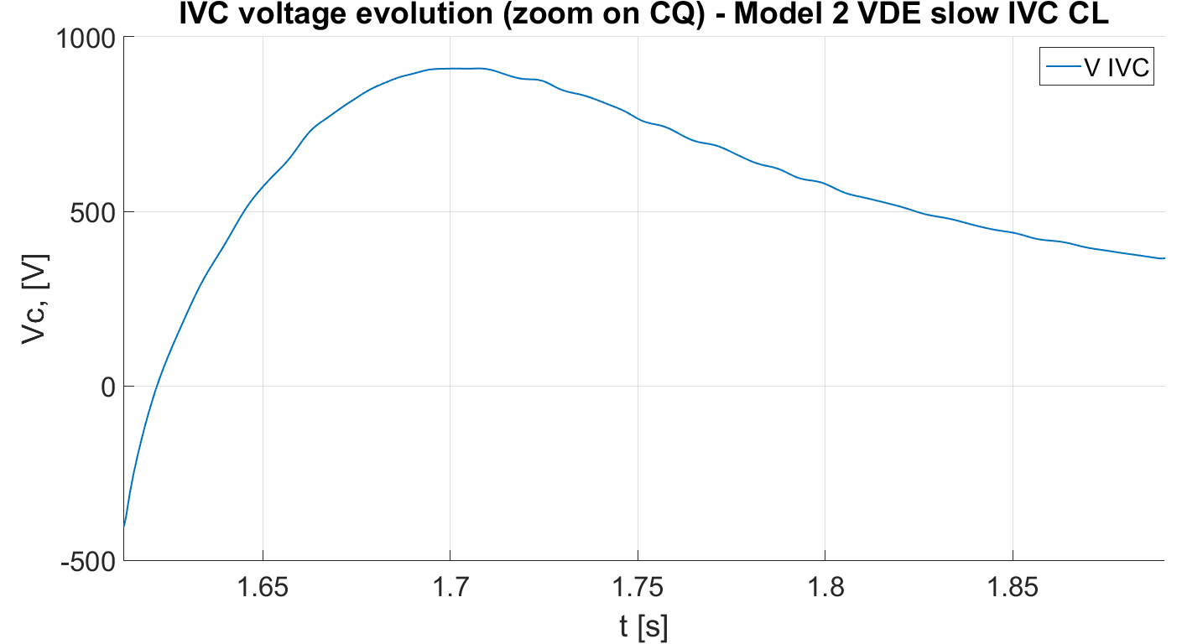
SP ADC.I.1: Engineering boundary conditions related to DEMO ADC solutions
MODEL 2 UVDE slow CL case
UVDE Model 2 Highest Fz on VV:
~ 44,8MN during CQ (X)
~ -33,1MN after CQ (X)
Deliverable: PWIE-ADC.I.T-T002.D001
Status: completed
Facilities: - or Modelling: MAXFEA
Human Resources: 8 PM
Involved RU: UniTuscia
Linked WP or TSVV:
Notes:
PD: Plasma Devices as in PEP listed
HHF: High Heat flux as in PEP listed
IBF: Ion beam Facility as in PEP listed
Other facilties as in PEP listed

Slide 11
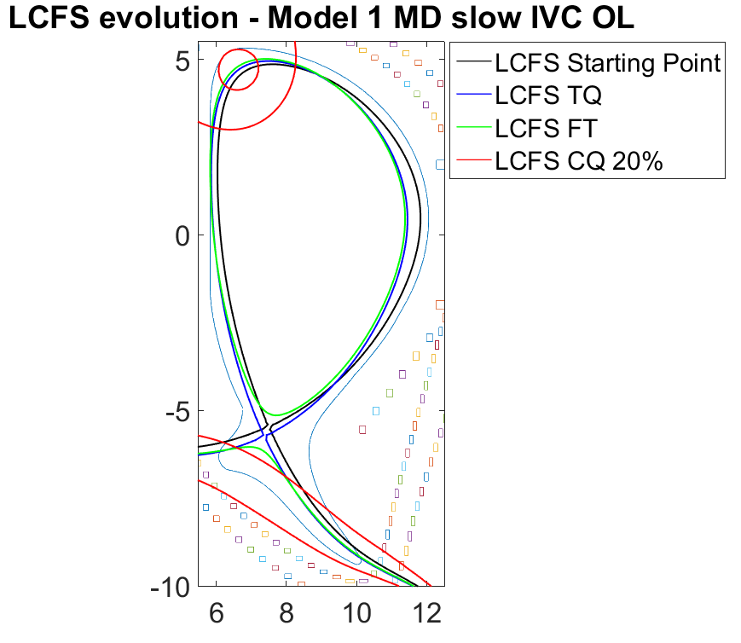
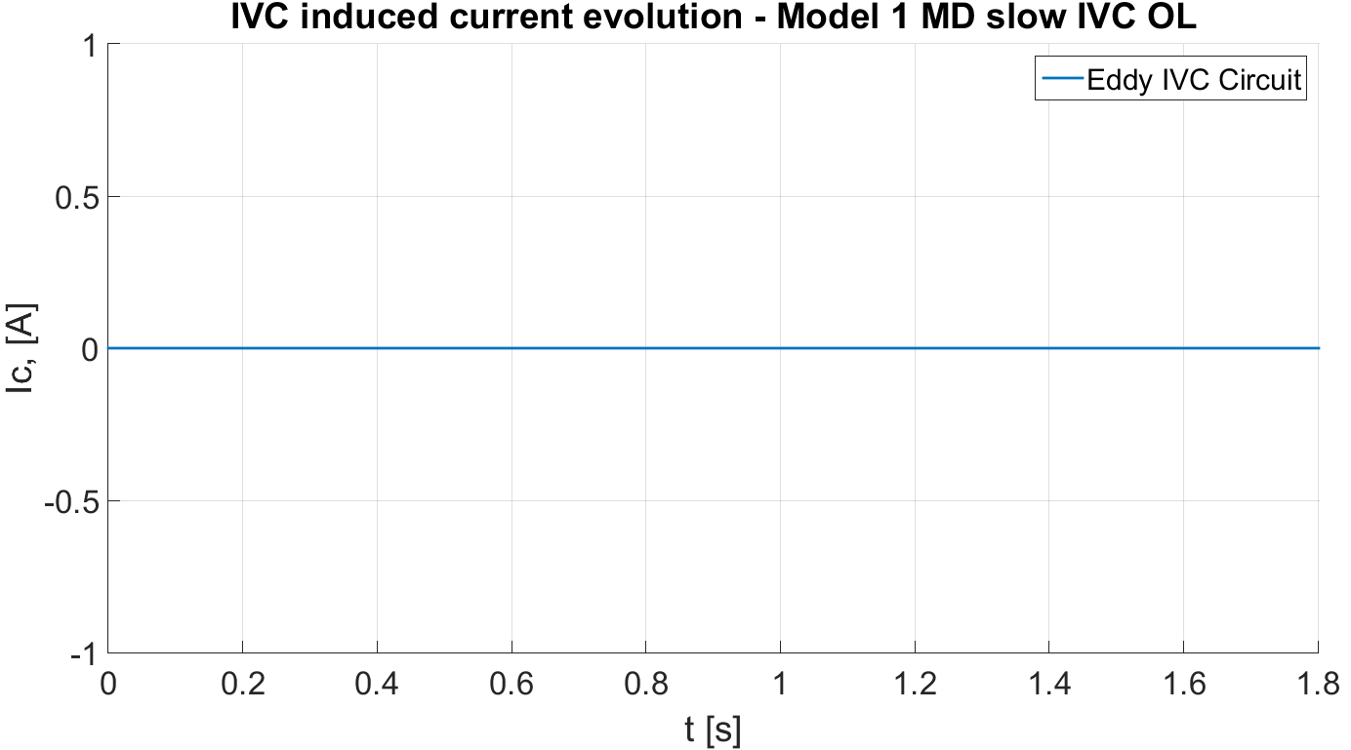
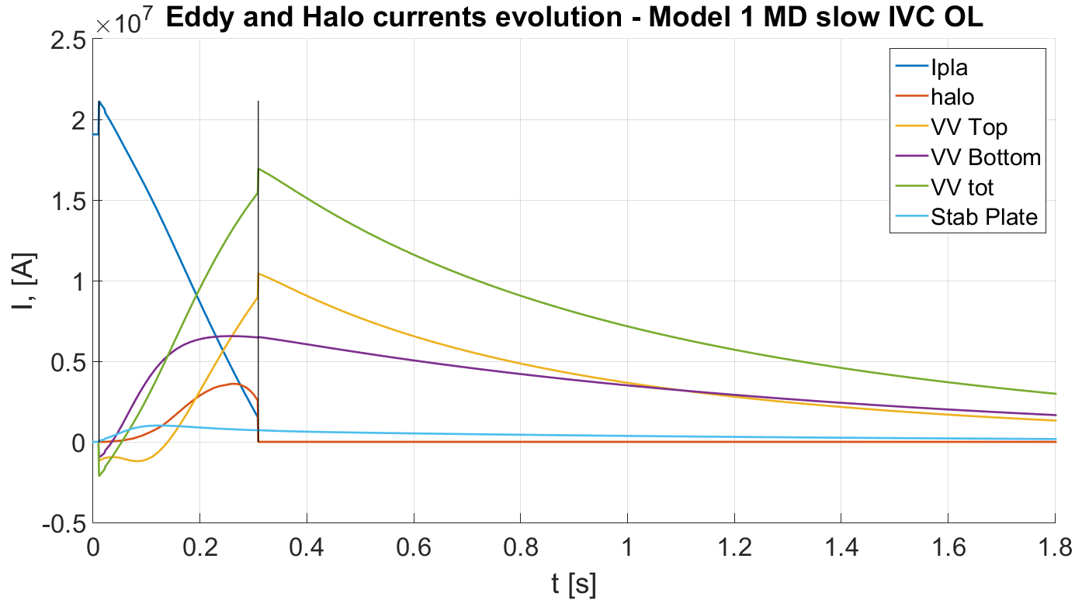
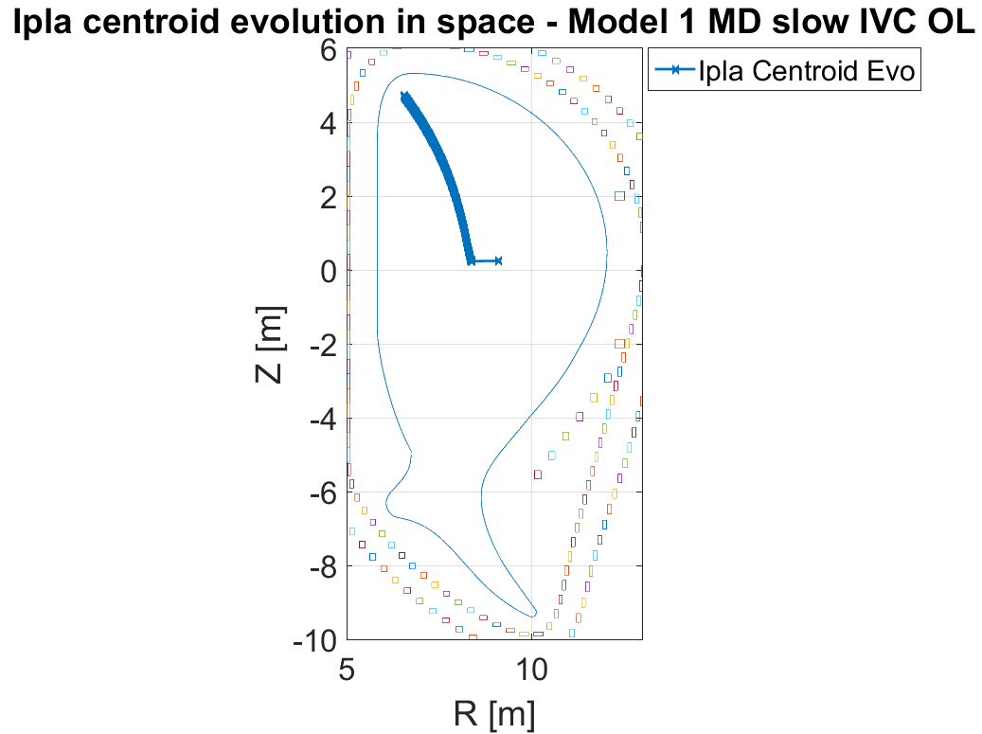
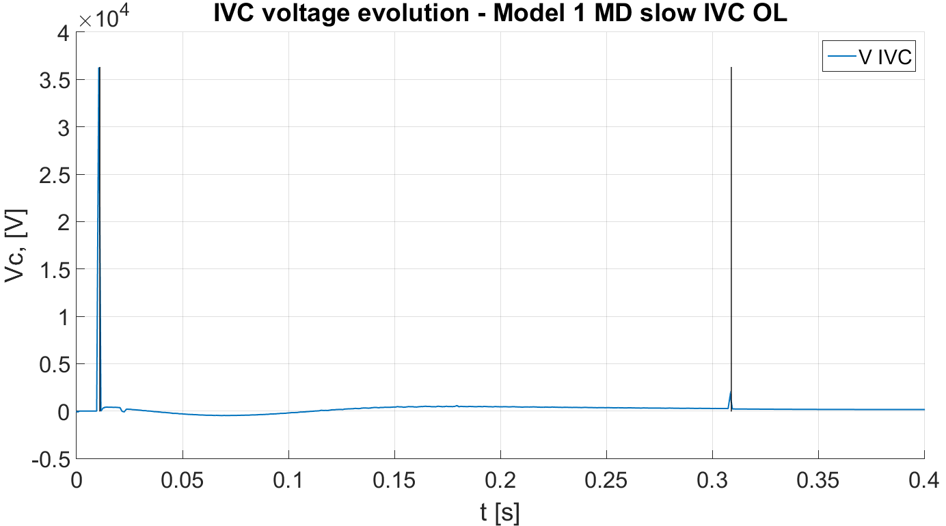
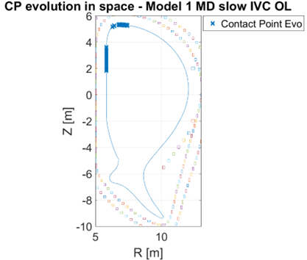
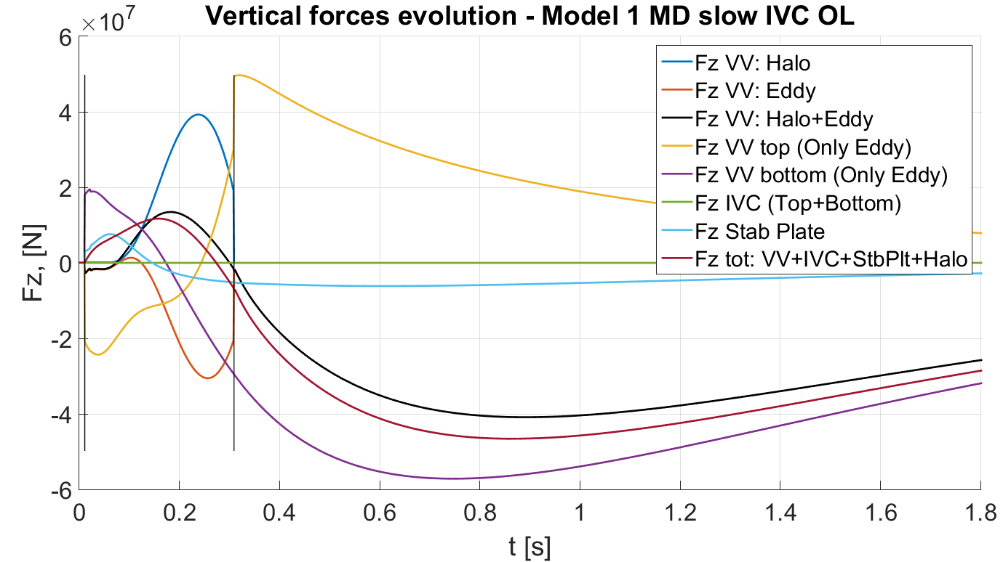
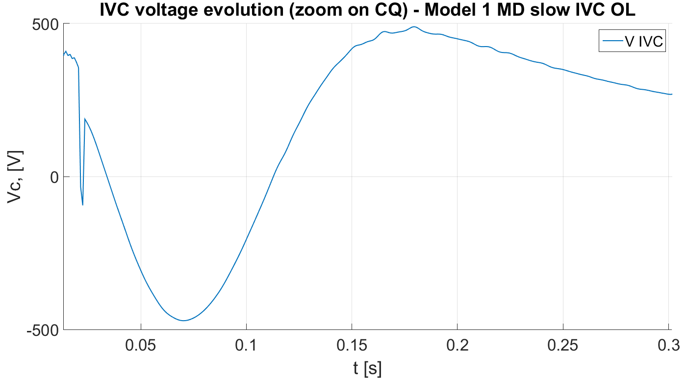
SP ADC.I.1: Engineering boundary conditions related to DEMO ADC solutions
MODEL 1 MD slow OL case
MD Model 1 Highest Fz on VV:
~ 11,7MN during CQ (X)
~ -46,6MN after CQ (X)
Deliverable: PWIE-ADC.I.T-T002.D001
Status: completed
Facilities: - or Modelling: MAXFEA
Human Resources: 8 PM
Involved RU: UniTuscia
Linked WP or TSVV:
Notes:
PD: Plasma Devices as in PEP listed
HHF: High Heat flux as in PEP listed
IBF: Ion beam Facility as in PEP listed
Other facilties as in PEP listed

Slide 12
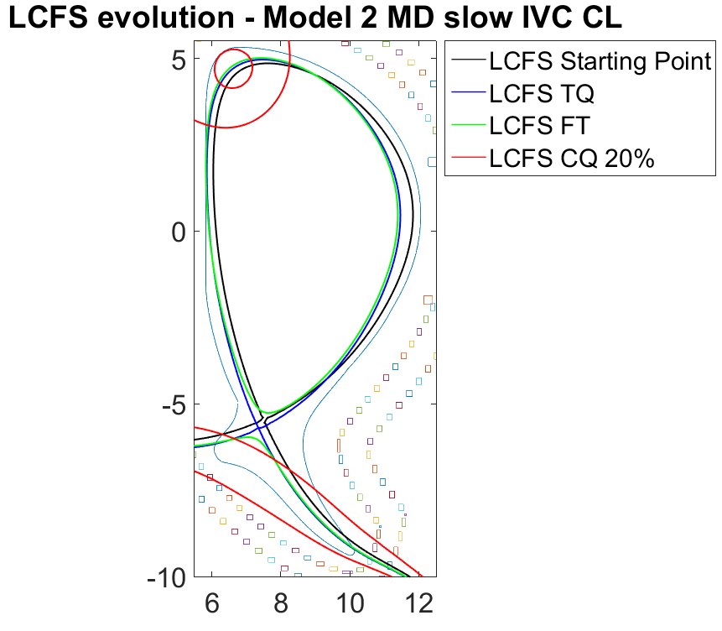
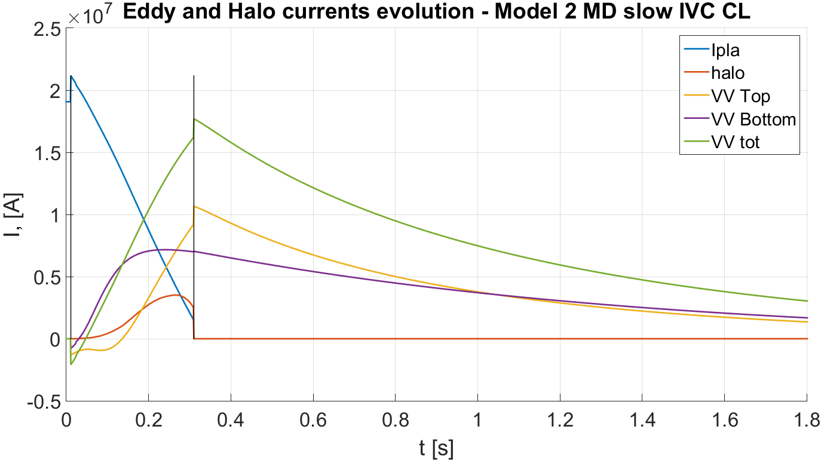
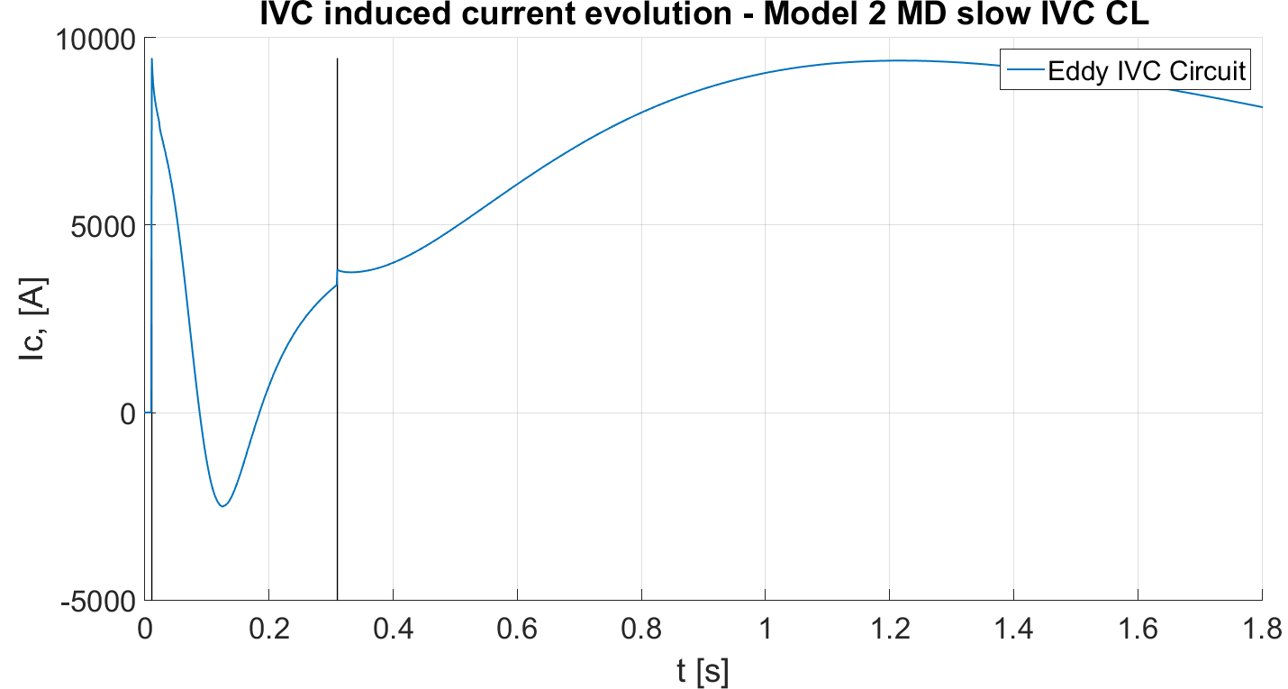
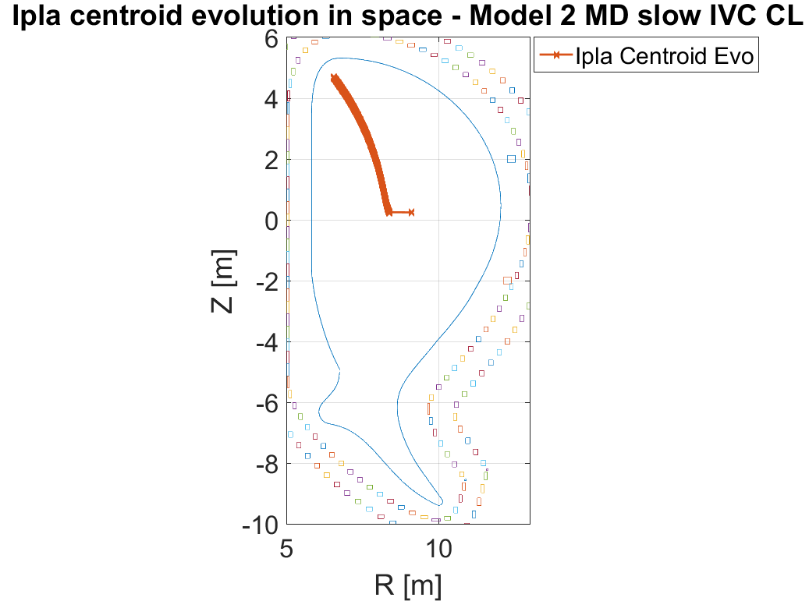
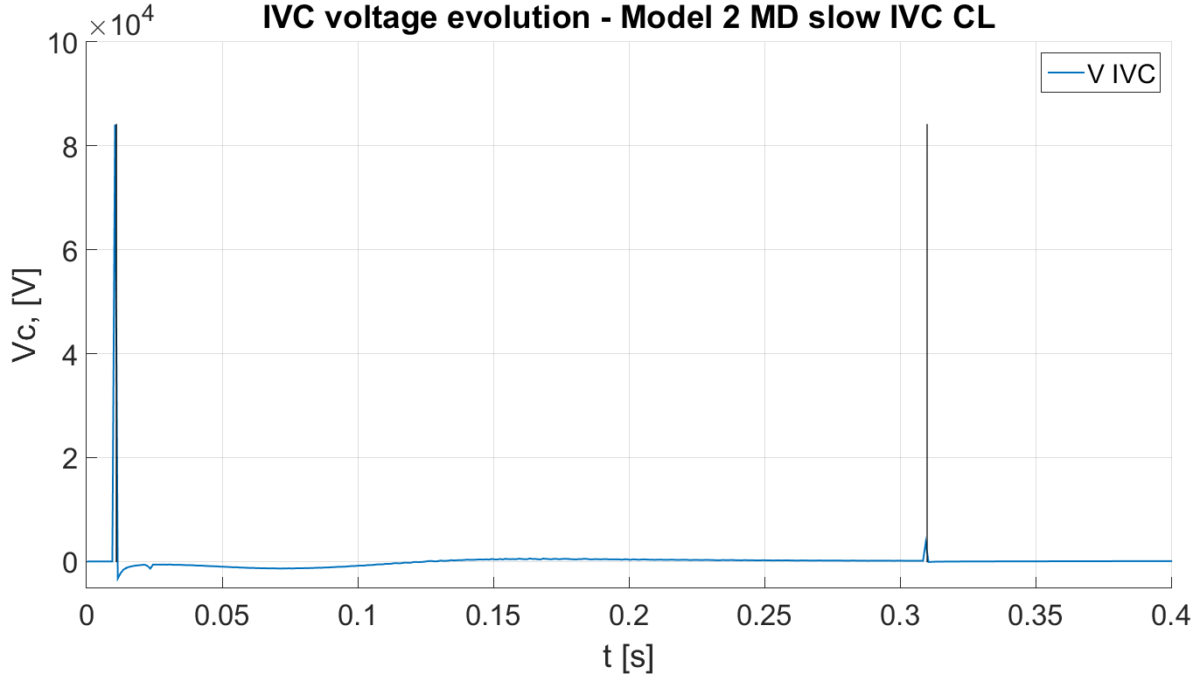
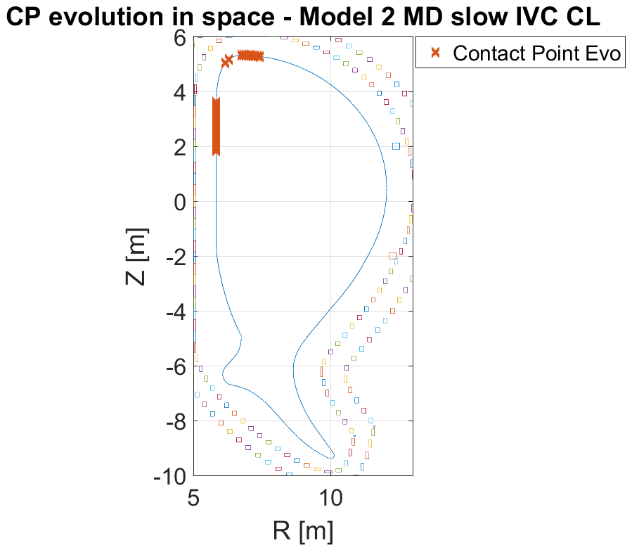
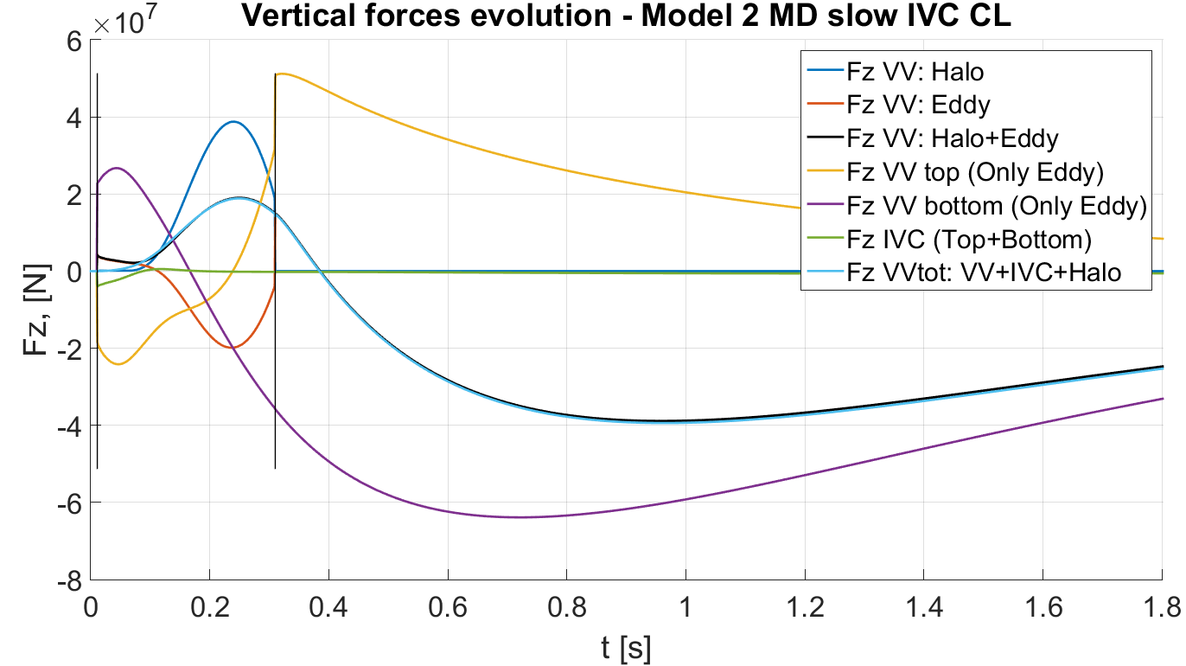
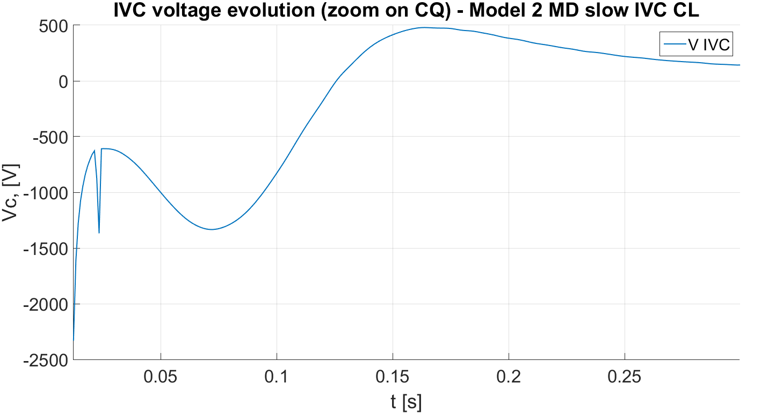
SP ADC.I.1: Engineering boundary conditions related to DEMO ADC solutions
MODEL 2 MD slow CL case
MD Model 2 Highest Fz on VV:
~ 18,9MN during CQ (X)
~ -39,4MN after CQ (X)
Deliverable: PWIE-ADC.I.T-T002.D001
Status: completed
Facilities: - or Modelling: MAXFEA
Human Resources: 8 PM
Involved RU: UniTuscia
Linked WP or TSVV:
Notes:
PD: Plasma Devices as in PEP listed
HHF: High Heat flux as in PEP listed
IBF: Ion beam Facility as in PEP listed
Other facilties as in PEP listed

Slide 13
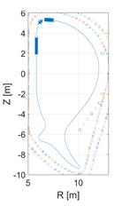
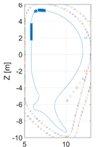
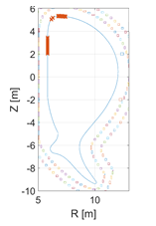
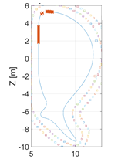
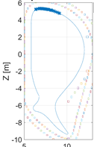
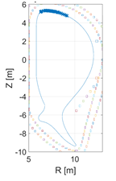
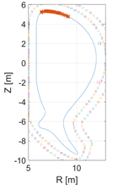
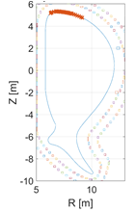
SP ADC.I.1: Engineering boundary conditions related to DEMO ADC solutions
Plasma contact points evolution
MODEL 1 MD FAST
MODEL 1 MD SLOW
MODEL 2 MD FAST
MODEL 2 MD SLOW
No appreciable differences between OL and CL cases
No significative differences between Fast and Slow Events
No significative differences between Model 1 and Model 2
MODEL 1 VDE FAST
MODEL 1 VDE SLOW
MODEL 2 VDE SLOW
MODEL 2 VDE FAST
Deliverable: PWIE-ADC.I.T-T002.D001
Status: completed
Facilities: - or Modelling: MAXFEA
Human Resources: 8 PM
Involved RU: UniTuscia
Linked WP or TSVV:
Notes:
PD: Plasma Devices as in PEP listed
HHF: High Heat flux as in PEP listed
IBF: Ion beam Facility as in PEP listed
Other facilties as in PEP listed

Slide 14
SP ADC.I.1: Engineering boundary conditions related to DEMO ADC solutions
Conclusions:
Two MAXFEA Models have been set up and the reference hybrid SN-SX configurations have been reproduced showing a very good agreement with CREATE-NL code
A set of different disruptions scenarios (4 MDs and 4 UVDEs) has been simulated for each model exploring different CQ durations (fast 74ms, slow 300ms) and with the IVCs circuit considered in CL or OL configuration
Different data has been saved for each simulations
The evolution of the plasma contact points have been reported and different observations emerge as reported in the previous slide
In terms of forces on the components, the different plasma scenarios proved to be very similar between two models (the only difference between the two models is in the VV geometry, same reference equilibrium, same PF coils system, same limiting surface, ecc) with Model 2 shows the highest positive forces during CQ, about 44.8MN (UVDE Slow CL scenario) and the highest negative forces after CQ is about -57.1 MN observed in Model 1 (MD Fast CL scenario)
Deliverable: PWIE-ADC.I.T-T002.D001
Status: completed
Facilities: - or Modelling: MAXFEA
Human Resources: 8 PM
Involved RU: UniTuscia
Linked WP or TSVV:
Notes:
PD: Plasma Devices as in PEP listed
HHF: High Heat flux as in PEP listed
IBF: Ion beam Facility as in PEP listed
Other facilties as in PEP listed

Slide 15
SP ADC.I.1: Engineering boundary conditions related to DEMO ADC solutions
Definition of required size and configuration of ADCs divertor including the baffle (ENEA)
ACTIVITY
Definition of the parameters for dimensioning an ADCs divertor
Collaboration PWIE.ADC – DES for engineering limits for ADCs divertor – Sven Wiesen
EEG21-07: Numerical optimization for advanced divertor design with SOLPS-ITER – Sander Van den Kerkhof - KU Leuven
Definition of engineering constraints for cost functions in an optimization tool for 2D dimensioning of divertor
Deliverable: PWIE-ADC.I.T-T002.D002
Status: completed
Facilities: - or Modelling: ANSYS
Human Resources: 2 PM
Involved RU: UniTuscia - UniTorVergata
Linked WP or TSVV: WPDES
Notes:
PD: Plasma Devices as in PEP listed
HHF: High Heat flux as in PEP listed
IBF: Ion beam Facility as in PEP listed
Other facilties as in PEP listed

Slide 16
SP ADC.I.1: Engineering boundary conditions related to DEMO ADC solutions
Definition of required size and configuration of ADCs divertor including the baffle
Which is the level of parameters is needed for cost functions?
Engineering design level
Dimensions
Interaction with components
Grazing angles with target
Thermal fluxes
...
Technological level
Welds
Junctions
Coolant choice and design
Materials and tooling
…
Maintenance level
Mounting and Remote access
Maintenance operations scheduling
…
Somehow available for DTT machine
Deliverable: PWIE-ADC.I.T-T002.D002
Status: completed
Facilities: - or Modelling:
Human Resources: 2 PM
Involved RU: UniTuscia - UniTorVergata
Linked WP or TSVV: WPDES
Notes:
PD: Plasma Devices as in PEP listed
HHF: High Heat flux as in PEP listed
IBF: Ion beam Facility as in PEP listed
Other facilties as in PEP listed

Slide 17
SP ADC.I.1: Engineering boundary conditions related to DEMO ADC solutions
Definition of required size and configuration of ADCs divertor including the baffle
Parameter | DTT indicative values
Psep/R : Psep is the power flowing through the last closed magnetic surface and R is the plasma major radius. Required to be DEMO relevant | ≥ 15 MW/m
Pulse length | 100 s
Minimum distance between X-point and targets | 300 mm (outboard) 200 mm (inboard)
Minimum distance between last closed flux surface (LCFS) and wall | > 30 mm
Heat flux on the divertor target in a normal plasma scenario (tungsten monoblocks) | 10 MW/m² (1000 cycles) 20 MW/m² (300 cycles)
Heat flux on wall at rump-up, flat-up and ramp-down | < 1 MW/m²
Plasma temperature at divertor targets to avoid sputtering and consequent plasma contamination | < 20 eV
Power flowing throug the LCFS Psep | > PLH
Z_{eff} at the top of pedestal | < 3
Deliverable: PWIE-ADC.I.T-T002.D002
Status: completed
Facilities: - or Modelling:
Human Resources: 2 PM
Involved RU: UniTuscia - UniTorVergata
Linked WP or TSVV: WPDES
Notes:
PD: Plasma Devices as in PEP listed
HHF: High Heat flux as in PEP listed
IBF: Ion beam Facility as in PEP listed
Other facilties as in PEP listed

Slide 18
SP ADC.I.1: Engineering boundary conditions related to DEMO ADC solutions
Definition of required size and configuration of ADCs divertor including the baffle
Parameter | DTT indicative values
Maximum heat flux on the divertor target in an off-normal plasma scenario (including the time)
Grazing angle at the divertor target | > 1.51°
Volume limits for remote handling
Remote handling equipment payloads | up to 200 kg
Coolant type and operating temperature and pressure | Coolant: water Inlet temperature: 10 °C Mass flow rate: 12.4 kg/s Maximum temperature increase: 10 °C Maximum pressure drop: 0.4 MPa Pipe diameter: 60 mm (Inner) 65 mm (Outer) Pipe number: 6 Maximum water speed: 4.5 m/s
Deliverable: PWIE-ADC.I.T-T002.D002
Status: completed
Facilities: - or Modelling:
Human Resources: 2 PM
Involved RU: UniTuscia - UniTorVergata
Linked WP or TSVV: WPDES
Notes:
PD: Plasma Devices as in PEP listed
HHF: High Heat flux as in PEP listed
IBF: Ion beam Facility as in PEP listed
Other facilties as in PEP listed

Slide 19
SP ADC.I.1: Engineering boundary conditions related to DEMO ADC solutions
Definition of required size and configuration of ADCs divertor including the baffle
Parameter | DTT indicative values
Limit of current density, magnetic field and position for the PF coils | Maximum current density = 25-30 MA/m² Maximum field on any PF coils = 5 T Maximum field for the CS = 12.5 T
Capability to sustain electromagnetic loads connected with vertical disruption at the plasma current of 6 MA
Cassette body material | AISI 316L
Pumpind speed | > 50 m³/s
Deliverable: PWIE-ADC.I.T-T002.D002
Status: completed
Facilities: - or Modelling:
Human Resources: 2 PM
Involved RU: UniTuscia - UniTorVergata
Linked WP or TSVV: WPDES
Notes:
PD: Plasma Devices as in PEP listed
HHF: High Heat flux as in PEP listed
IBF: Ion beam Facility as in PEP listed
Other facilties as in PEP listed

Slide 20
WP PWIE: SP ADC.I final meeting
SPL ADC.I: Pierluigi Fanelli
Contributors: R. Lombroni, M. Scarpari, S. Carusotti, F. Vivio
Notes:
Please Indicate your subproject

