Slide 1
WP PWIE: SP ADC.J Final report
SPL ADC.J: P. Innocente, C. Meineri, G. Rubino, A. Uccello, L. Balbinot

Slide 2
SP ADC.J Tasks 2021/2022
Deliverable ID(s) | Task Title
D001 | SOLEDGE2D-EIRENE modelling of DTT XD configuration (P1), DN XD: (P3)) (RFX)
D002 | SOLEDGE2D-EIRENE modelling of DTT XD configuration (P1), DN XD: (P3))(UNITUS)
D003 | SOLEDGE2D-EIRENE modelling of DTT in SN and DN with the longest outer leg configurations (hybrid configuration between SN and SXD “SNhybSXD” (P1) and between DN and SXD “DNhybSXD” (P3)) (POLITO)
D004 | SOLEDGE2D-EIRENE modelling of DTT with inner divertor adaption (hybrid configuration between SN and XD “SNhybXD” (P2) and between DN and XD “DNhybXD” (P3)) (ENEA)
D005 | SOLEDGE2D-EIRENE modelling of open divertor geometry in a subset of promising shapes (shape tbd from list of modelled SOLEDGE2D-EIRENE runs) (P2) (POLITO)
D006 | SOLEDGE2D-EIRENE modelling of open divertor geometry in a subset of promising shapes (shape tbd from list of modelled SOLEDGE2D-EIRENE runs) (P2) (ENEA)
D007 | SOLPS-ITER modelling of DTT SN (closed) divertor with and without dome with drifts activated (using EIRENE) (P1) (CNR)
D008 | SOLPS-ITER modelling of DTT DN (closed) divertor with and without dome with drifts activated (using EIRENE) (P3) (UNITUS)

Slide 3
SP ADC Tasks 2021/2022
Tasks have been summarized in three different topics:
Selection of the best divertor shape for SN, XD (and their long legs variants) between narrow (closed) and wide (open) divertor
Analysis of single null configuration without and with dome using SOLPS-ITER with kinetic neutrals and activating drifts
Analysis of DN configurations with the divertor shapes resulting from previous activity symmetrized up/down

Slide 4
Selection of the best divertor shape for SN, XD (and their long legs variants) between narrow (closed) and wide (open) divertor

Slide 5
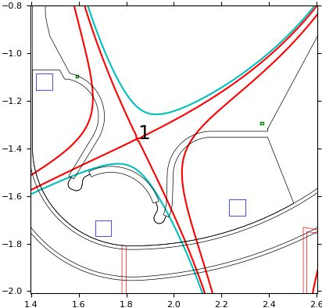
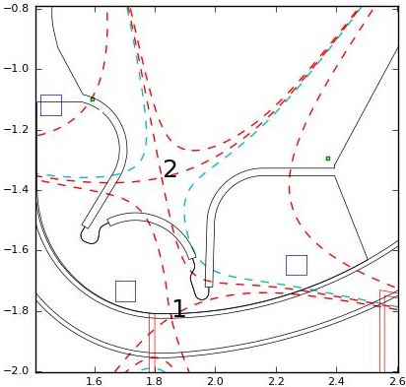
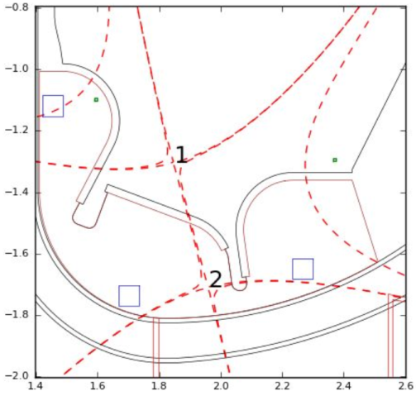
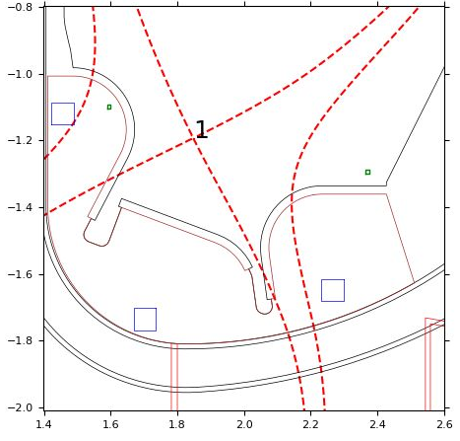
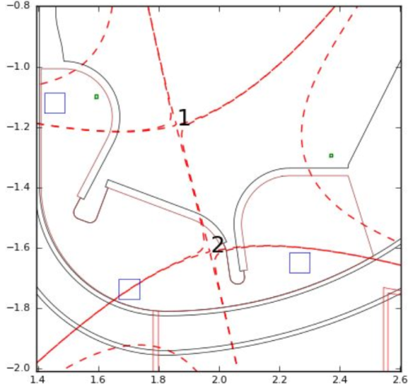
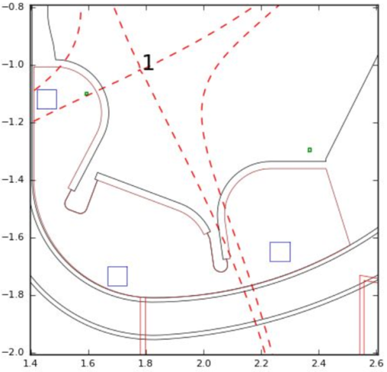
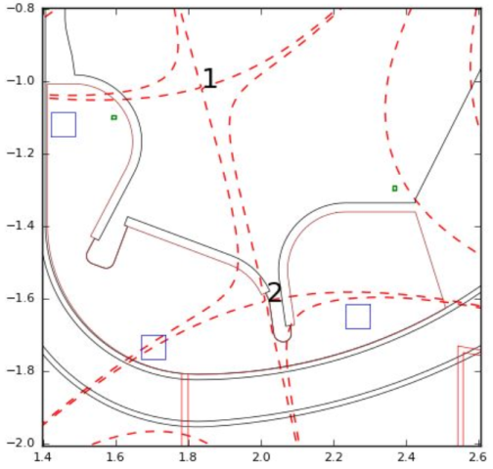
Magnetic equilibria for different divertor shapes
ND
A set of magnetic configurations have been produced for all divertor shapes using coils external to the vessel
The ND has parameters similar to present DEMO divertor design
The WFD allows configurations with long external legs (LSN & SXD)
The WFD with an appropriate wall allows negative triangularity configurations
SN – 5.5 MA
XD – 4.5 MA
WFD
LXD – 4.5 MA
SN – 5.5 MA
XD – 4.5 MA
XD – 4.5 MA
LSN – 5.5 MA
SXD – 4.5 MA

Slide 6
Divertor parameters
Device | L_{IT}/Rx | L_{OT}/Rx | α_{IT} | α_{OT}
DTT (ND) | 0.09-0.15 | 0.15-0.17 | 2.0° | 1.9°
DTT (WFD) | 0.07-0.14 | 0.24-0.34 | 1.6°-2.0° | 2.0°-2.3°
DEMO | 0.15 | 0.21 | 1.5° | 1.6°
ITER | 0.19 | 0.20 | 3.2° | 2.7°
JT-60SA | 0.21 | 0.29 | 5.6° | 3.5°
SN configuration
Narrow divertor is similar to (present) DEMO divertor in terms of legs length and grazing angle
Wide divertor can test a wide range of leg lengths
In general grazing angle is in between ITER and DEMO
Divertor | L_{IT}/Rx | L_{OT}/Rx | α_{IT} | α_{OT}
DTT (ND) | 0.09-0.11 | 0.11-0.14 | 0.6° | 0.0-0.2°
DTT (WFD) | 0.10-0.11 | 0.10-0.25 | 1.1°-1.2° | 0.3°-0.6°
XD configuration

Slide 7
Assessment of divertor performance
Edge modeling of a representative set of magnetic configuration:
SN in pure D power scan with P_{SOL}=3.5÷25 MW with five different divertors and different transport parameters and with sub-divertor modeling
XD in pure D power scan with P_{SOL}=3.5÷8 MW with five different divertors
SN scan in neon and argon seeding at full power P_{IN}=30 MW with four different divertors and different transport parameters (a few cases), with sub-divertor and variation in transport parameters
XD scan in neon seeding at full power P_{IN}=30 MW with four different divertors
Comparison of performance with the narrow divertor
Gas puffing and top pedestal density estimation – core/edge integration

Slide 8
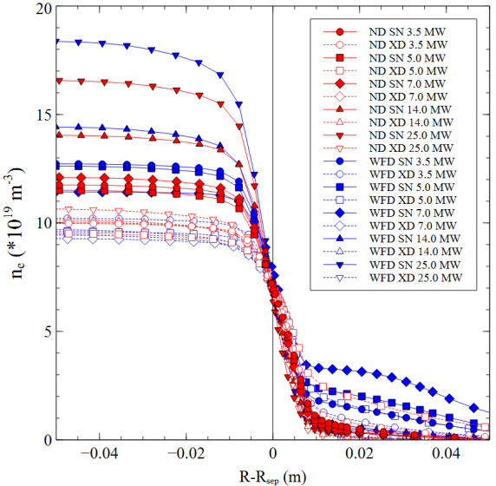
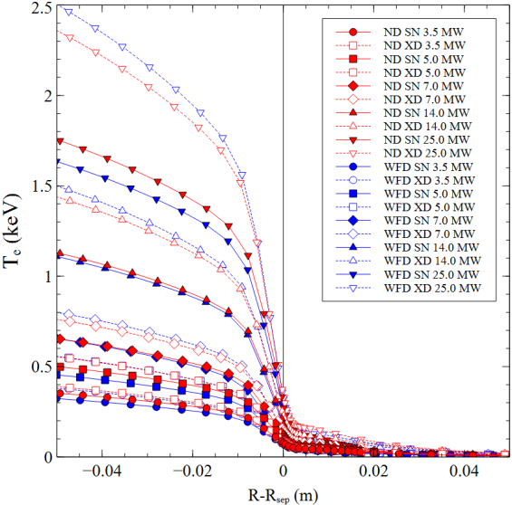
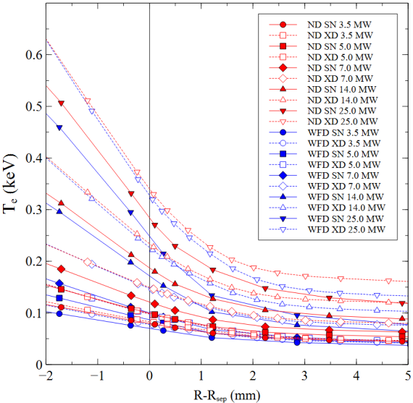
D modeling: profiles at outer mid-plane P_{SOL}=3.5-25 MW
Same separatrix density
Different top pedestal density (higher/lower pumping efficiency ➔ higher/lower gas-puffing)
Highest top density in SN
Lowest density in XD (open markers) ➔ low pumping efficiency due to strike points far from pumps slots
Higher top temperature in XD due to lower density
Higher separatrix temperature in XD due to longer connection length

Slide 9
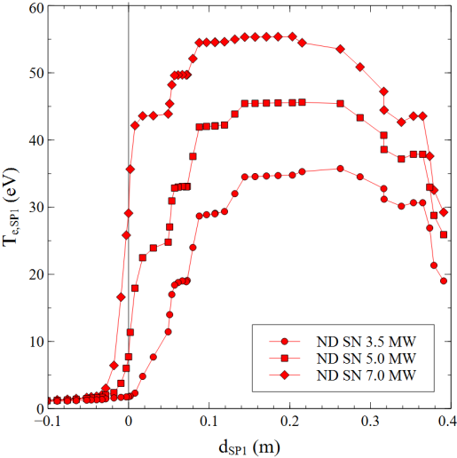
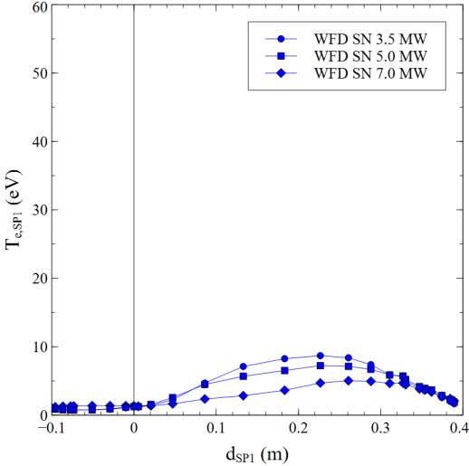
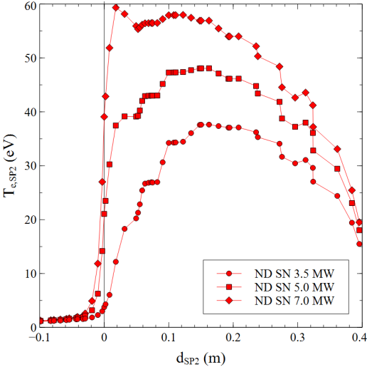
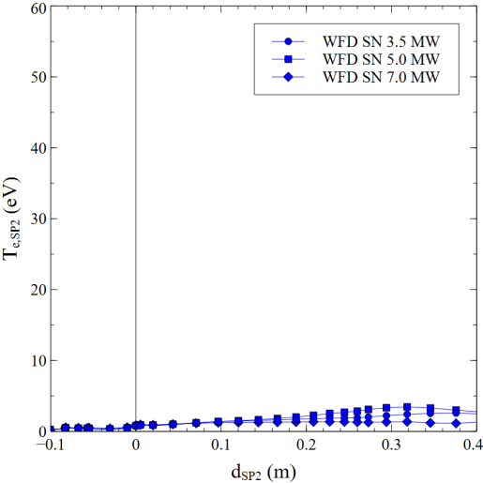
D modeling: SN profiles at targets / temperature
In pure D with the wide divertor detachment is obtained below P_{SOL}≈7 MW at n_{sep}=7·10⁹ m⁻³
The narrow divertor is still attached at the same P_{SOL}
Inner target
Inner target
Outer target
Outer target
Detachment threshold

Slide 10
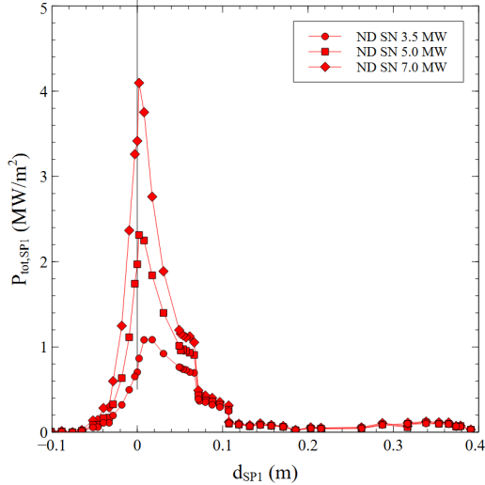
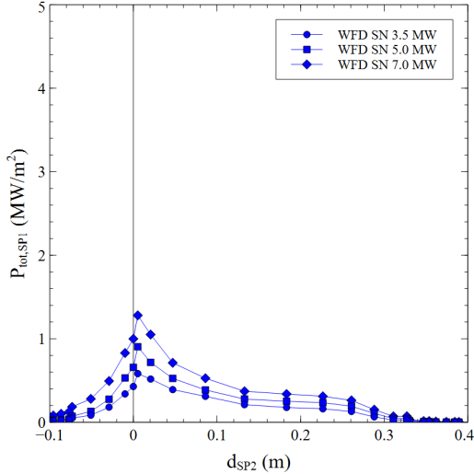
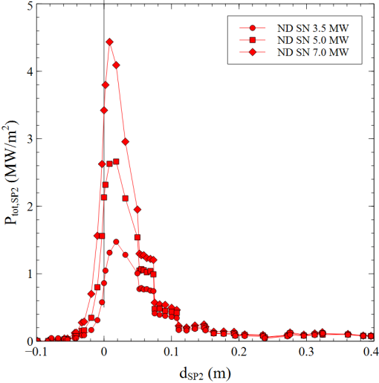
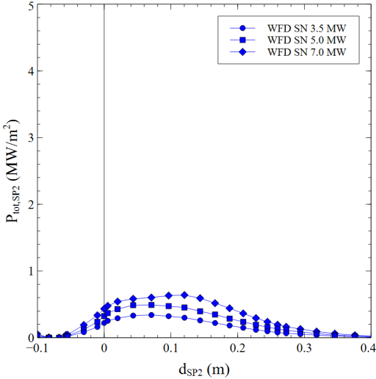
D modeling: SN profiles at targets / heat flux
In pure D with the wide divertor detachment is obtained below P_{SOL}≈7 MW at n_{sep}=7·10⁹ m⁻³
Peak heat flux is well below 10 MW/m²
Similar conditions at both targets (but drifts not included)
The standard divertor provides worst performance ➔ higher temperatures and peak heat fluxes
Inner target
Inner target
Outer target
Outer target

Slide 11
Operation at full power with seeding
Evaluate minimum requested contamination to achieve detachment
Evaluate operative window in impurity content
Configuration stability against operating condition

Slide 12
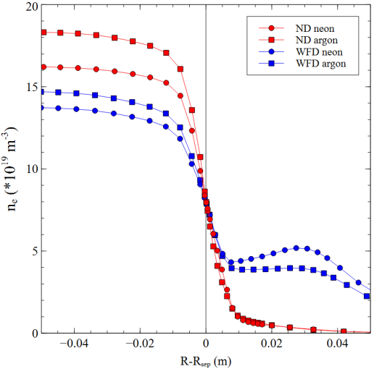
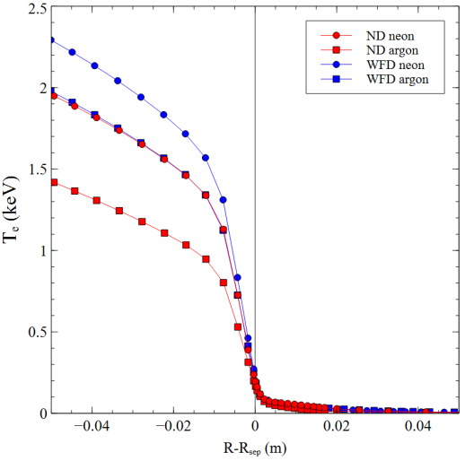
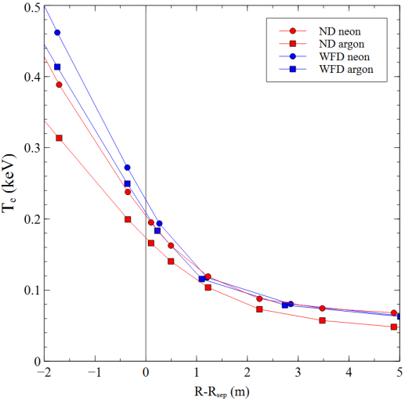
Full power: profiles at outer mid-plane
P_{IB} = 30 MW (10 MW rad. in the inner core, 5 MW ELMs)
P_{IB} splitted between e and D to achieve similar temperatures
n_{sep}=8∙10¹⁹ m⁻³
P_{SOL}=P_{IB}-P_{rad,in} (must be > 18-20 MW to access H-mode)
SN
Higher core density with argon
Higher core temperature with neon
Higher temperature at separatrix with neon (related to Ne⬄Ar cooling properties)
SN

Slide 13
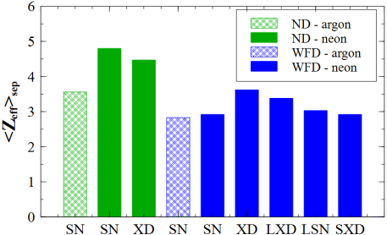
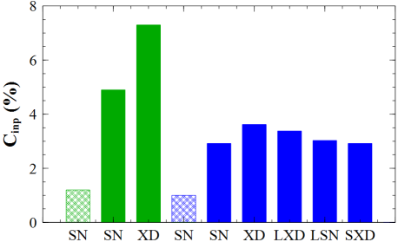
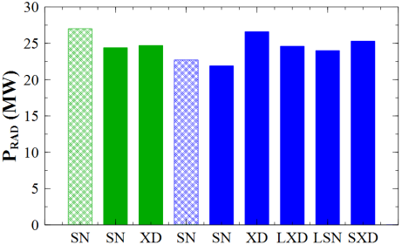
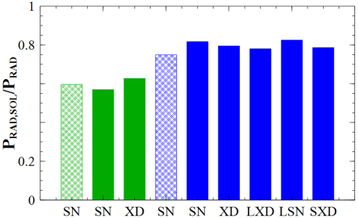
Full power: summary of results
Full power modeling with P_{IB}=30 MW at fixed separatrix density n_{sep}=8·10⁹ m⁻³ with neon (and argon) seeding to achieve detachment
The wide flat divertor performs better (lower Z_{eff} and C_{inp}) than the standard narrow divertor in SN and XD
Argon performs better than neon in terms of <Z_{eff}>_{sep} and impurity concentration (C_{imp}) for both divertors
In the wide flat divertor SXD provides similar result than SN
The wide flat divertor performs relatively well for all configurations

Slide 14
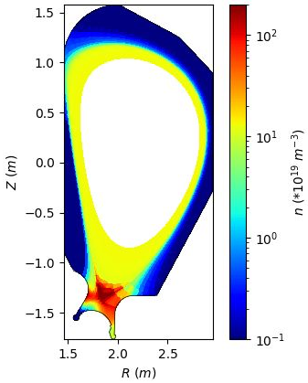
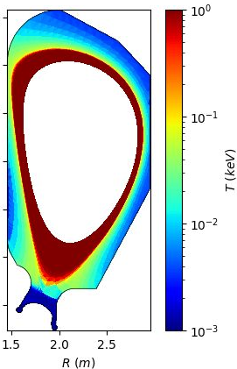
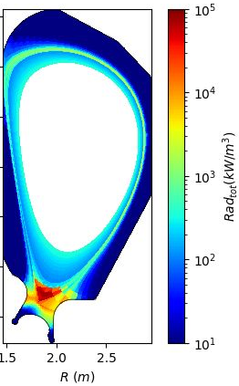
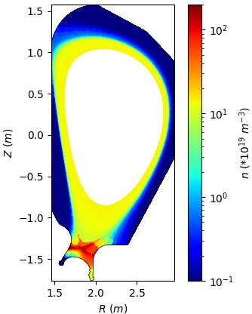
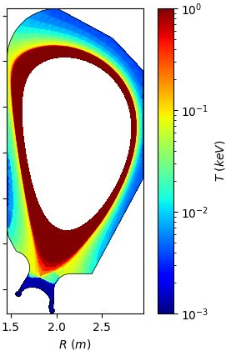
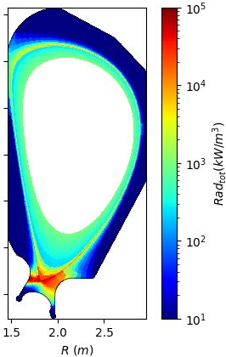
Standard/narrow divertor – XD with neon
<Z_{eff}>_{sep}=2.4
P_{rad,tot}=28 MW
P_{SOL}=8 MW
C_{Ne}=3.6%
Fast cooling of legs
Radiation localize at the x-point
Most radiation inside separatrix
Seems unable to sustain H-mode
XD configuration easily falls down to X-point radiator
<Z_{eff}>_{sep}=4.5
P_{rad,tot}=25 MW
P_{SOL}=21 MW
C_{Ne}=7.3%
H-mode condition can be recovered but at high impurity concentration
Can sustain H-mode

Slide 15
Conclusions
A divertor shape able to accept many magnetic divertor configuration has been studied and optimized by the edge code SOLEDGE2D
The wide divertor can provide reliable operation for SN and XD configurations in pure deuterium at reduced power and with seeding at full power
The wide divertor provides better exhaust performance than a standard narrow divertor
With the designed pumping aperture it provides a high pumping capability for the SN configuration, less for the XD one
Results depend on transport parameters, different values for impurities or at different density can affect final conclusion
Fine tuning on magnetic configurations (strike point position, separatrix distances) can also affect results

Slide 16
Analysis of single null configuration without and with dome using SOLPS-ITER with kinetic neutrals and activating drifts

Slide 17
Dome studies
SOLPS-ITER with EIRENE (two different fluid meshes)
Drift and currents considered
EIRENE mesh extends in the subdivertor region
Neutral – neutral collision
Fixed albedo to get S = 120 m³/s at the Port 5 entrance (S = 100 m³/s at the at the subdivertor entrance)
D puff (from equatorial plane) and Ne puff (from Private region) adjusted to get n_{e,sep}=8·10¹⁹ m⁻³ and desired outer target conditions

Slide 18
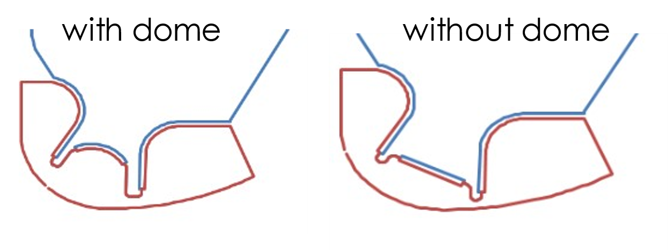
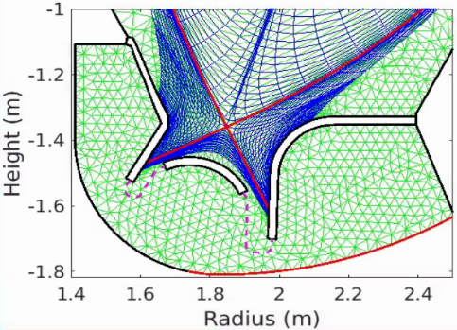
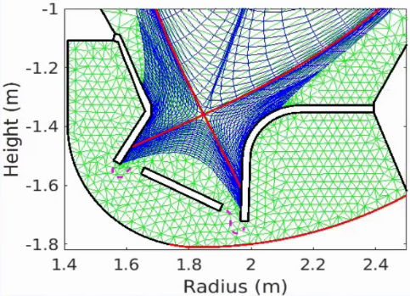
Dome studies objectives
Assessment of the effect of dome in DTT reference scenario with drift activated
Previous studies on ITER without drifts (Kukuskhin 2002,2007) have shown the dome effect on neutral compression and of the connection between inner and outer target
Dome
Flat plate
Evaluation of the inner and outer divertor conditions (drifts on)
Evaluation of inner/outer power asymmetry
Effect on impurities retention
Estimate of neutral pressure (neutral-neutral collision)
Effect on the pumping capability
p_{plenum}

Slide 19
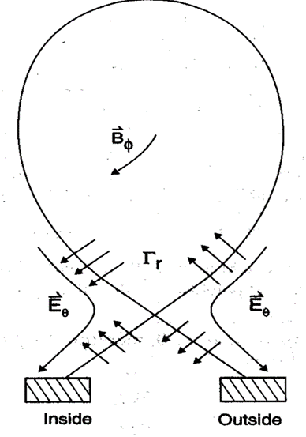
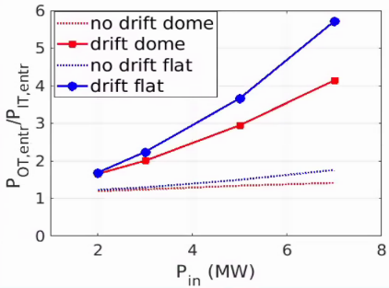
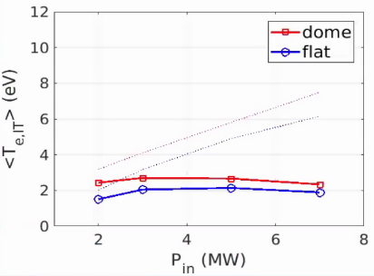
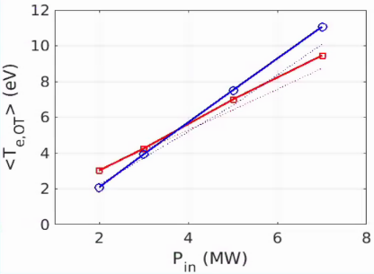
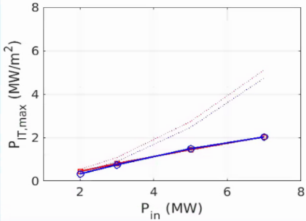
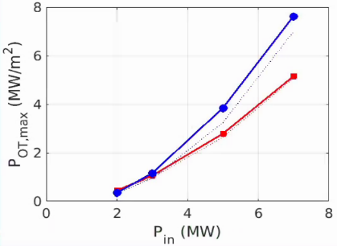
D modelling: effect of drifts
Drifts tends to increase the asymmetry between LFS and HFS
Net flux of particles from outer to inner target → n_{e,IT} T_{e,IT}
In attached condition the difference is more pronounced since the inner-outer neutral connection is less important
Most important effect on IT, negligible on OT
Small effect of the drifts on the general trends difference between flat and dome
Inner target
Outer target

Slide 20
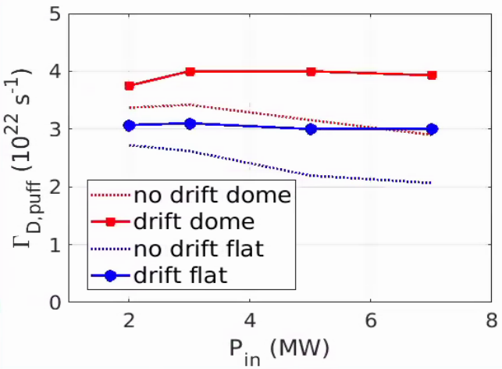
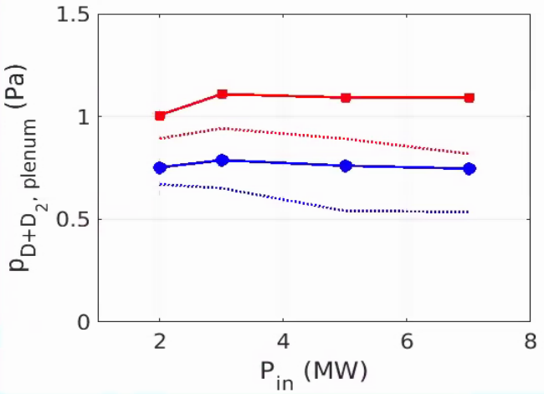
D modelling: pumping without/with dome
Increased neutral trapping w/ dome
Higher D throughput in case of dome by 30%
Increased sub divertor neutral pressure by < 2
Same trends in power scan both w/ and w/o drifts
Slight increase in the pressure estimate in drift simulations

Slide 21
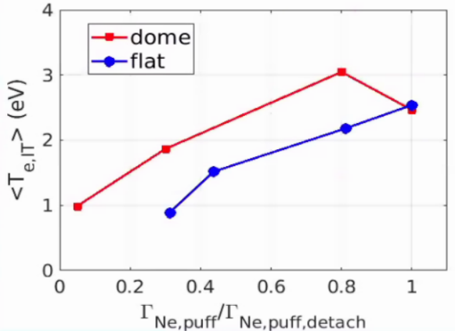
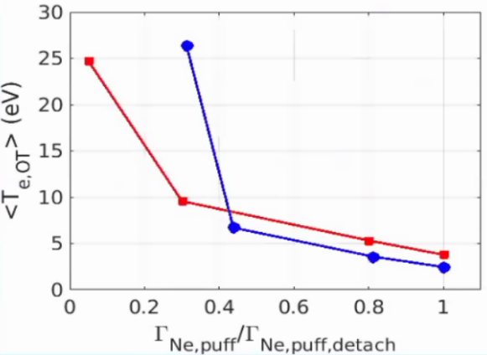
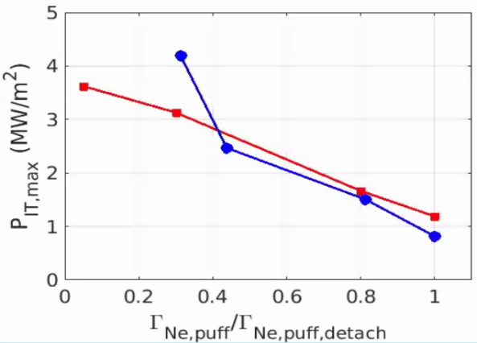
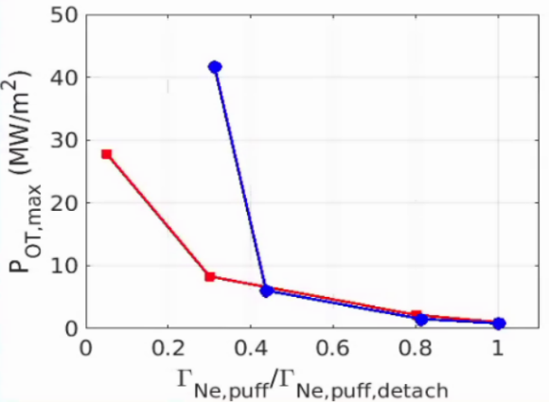
Dome effect on divertor with Ne
Inner target
Outer target
The effect of dome is small in terms of detachment achievement
The increased connection between inner and outer target with the flat plate slightly improves the divertor performance
Most stringent limit related to temperature

Slide 22
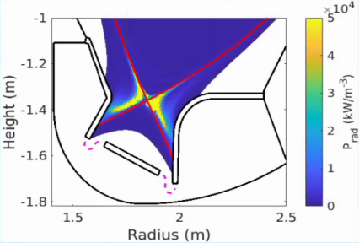
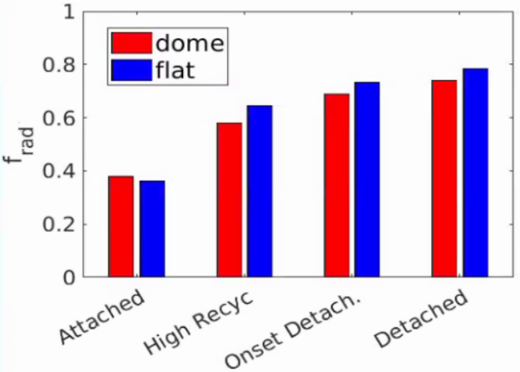
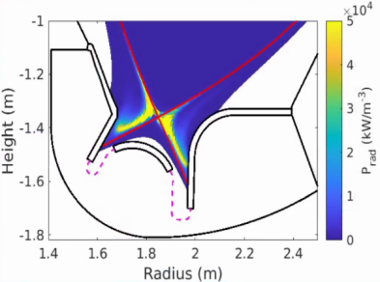
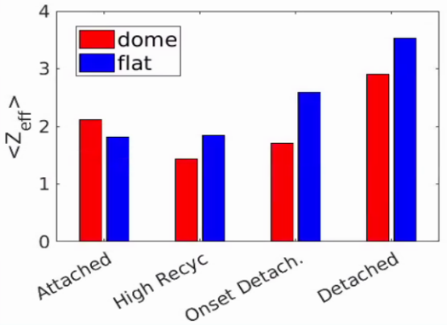
Full power: Ne seeding
The power radiated in the dome and flat is similar to get the same outer target conditions (few % slightly higher with flat plate)
In detached condition the radiation front moves towards the X-point
The dome moderately improves the performance in terms of main plasma pollution
Ne leakage is underestimated without drifts (ExB poloidal velocity)
+21%
+51%
+29%

Slide 23
Full power: pumping
Similar trends for Deuterium puff and pressure as in pure D cases (slightly increase in dome geometry)
Strong effect on the Ne neutral due to the better trapping:
Increase in the pressure by a factor 5
Increase in the Ne puff by 10
Dome considerably outperforms neutral Ne impurity confinement in the subdivertor region
→Better controllability and Ne pumping capability with the dome

Slide 24
Conclusions
Dome studies show (in accordance with previous ITER studies):
Small impact on the performance in terms of divertor performance
Strong effect is seen on the impurity pumping capability suggesting the need to ensure a good trapping of the Ne (keep the subdivertor slots close to the Outer strike point)

Slide 25
Analysis of DN configurations with the divertor shapes resulting from previous activity symmetrized up/down
(preliminary due to a delayed starting of the activity)

Slide 26
DN equilibria
#6 | DN | DXD | DN with long Leg (DNLL)
$I_{p}$[MA] | 3.8 | 2.5 | 3.5
$B_{T}$ [T] | 6 | 6 | 6
$P_{SOL}$ [MW] (Electron/Ion, total) | 18 (e), 12 (i) | 18 (e), 12 (i) | 18 (e), 12 (i)
Core D (part/s) | 1.1e20 | 1.1e20 | 1.1e20
Puffing D (part/s) | 8.3e22 | 1.1e22 | 17.5e22
Puffing Ne (part/s) | 9.5e20 | 5.3e20 | 9.0e20
Pumping(D,Ne) ($m^{3}/s$) | 200. (50 per slot) | 200. (50 per slot) | 200. (50 per slot)
Ne
SP4
Ne
SP3
DN
DXD
DNLL
$$D$$
Ne
SP2
SP1
Ne

Slide 27
Full power: Ne seeding (not stationary)
Ne
$$Density (m^{−3})$$
$$Temperature (eV)$$
DN
DXD
DNLL
OMP
$$D$$
0.8
D-new
Ne

Slide 28
Full power: Ne seeding (not stationary)
sp3
DN
sp4
DNLL
sp3
sp4
The DN Ne concentration is reducing
Stable radiation around the x-point
High radiation along the long leg
# | DN | DNLL
$P_{rad}$ (MW) | 25 | 23
$${<Z}_{eff,in sep}>$$ | 4.3 | 3.2
$${<Z}_{eff,out sep}>$$ | 3.6 | 1.9
sp1
sp2
sp1
sp2

Slide 29
Conclusions
The three cases are still running, they need time to convergence, cause by the low time step.
It necessary to define criteria to compare this case with the SN reference, cause by different plasma current $I_{p}$.

Slide 30
Thanks

Slide 31
Modelling methods and edge code
Transport parameters [*]:
based on heat flux decay length λ_{q,u}≈1.5 mm for the SN in attached condition in agreement with Eich scaling;
Profiles from JET/C-Mod experiments modelling;
Two options for divertor region
Equal for SN, XD and all divertor shapes
Seeding with neon and argon
Fixed pumping speed S=100 m³/s ➔ gas-puffing adjusted to achieve target separatrix density
Not considered drifts and neutrals-neutral collisions
SOLEDGE2D-EIRENE 2D edge fluid/kinetic code
Targets:
same separatrix density
about same radiation (with seeding)
H-mode condition ➔ P_{SOL}≥18 MW
Transport profiles
[*] L. Balbinot et al., NME 34 (2023)

Slide 32
Wide flat divertor - SN
Neon seeding
<Z_{eff}>_{sep}=2.9
P_{rad,tot}=22 MW
P_{SOL}=26 MW
C_{Ne}=2.8%
Radiation is concentrated on divertor legs
Longer legs provide larger radiative volume, better performance
Argon seeding
<Z_{eff}>_{sep}=2.8
P_{rad,tot}=23 MW
P_{SOL}=24 MW
C_{Ar}=1.0%
Argon provide better results than neon with similar radiation in the core

Slide 33
Wide flat divertor - XD (short and long leg)
Short leg XD
<Z_{eff}>_{sep}=3.6
P_{rad,tot}=27 MW
P_{SOL}=24 MW
C_{Ne}=4.6%
H-mode operation is possible with a reasonable impurity content
Longer leg LXD
<Z_{eff}>_{sep}=3.4
P_{rad,tot}=25 MW
P_{SOL}=24 MW
C_{Ne}=3.4%
A Longer leg provide better results

Slide 34
Long leg configurations with neon
Long leg SN
< Z_{eff}>_{sep}=3.0
P_{rad,tot}=24 MW
P_{SOL}=26 MW
C_{Ne}=2.3%
Long external legs provides a bigger radiative volume reducing request on impurity
But top wall must be moved upward (or equilibrium must be improved)
Long leg XD (SXD)
<Z_{eff}>_{sep}=2.9
P_{rad,tot}=25 MW
P_{SOL}=25 MW
C_{Ne}=1.9%
SXD provides less impurity content in the core thanks to a higher top pedestal density

Slide 35
2D transport parameters map
Transport parameters have been normalized to B_{t} - Two options for the divertor region:
Value as in the OMP far SOL (as in the JET/C-Mod modeling)
Values like at OMP
Transport in divertor region as at the OMP far SOL
Transport in divertor region like at OMP

