Slide 1

WP PWIE: SP E reporting for 2022
SP E plans for 2023
SPL E: Jari Likonen
Notes:
Please Indicate your subproject

Slide 2
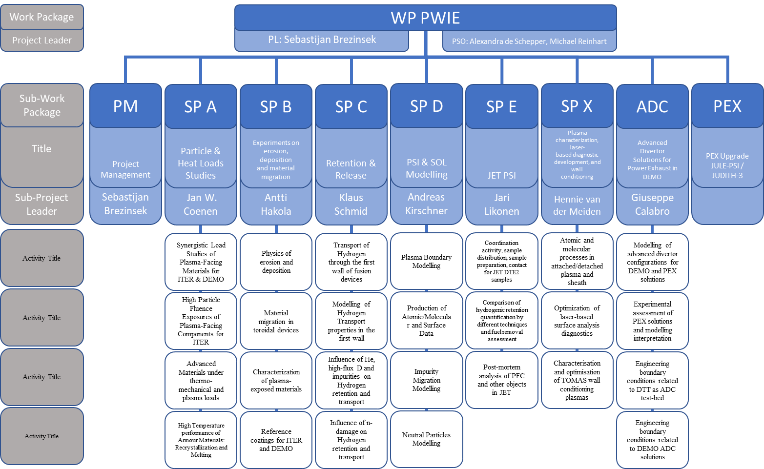
PWIE 2022/2023: SP E
DPL for ADC: Giuseppe Calabro
Modelling of standard
and advanced divertor
configurations for DTT
Notes:
Please mark your Subproject in

Slide 3
SP E Milestones 2022
WM43 | SP E | JET Be and W sample preparation for post-mortem analysis in 2021 and 2022 performed (ITER) | 31.12.2022
WM44 | SP E | Comparison of hydrogenic retention quantification by different post-mortem analysis techniques completed (ITER + DEMO) | 31.12.2022
WM45 | SP E | Post-mortem analysis of Be limiters molten due to runaway electron beams impact completed (ITER) | 31.12.2022
WM49** | SP D, SP E | Experiment, interpretation and initial modelling of WP PWI experiments in JET-ILW He plasmas carried out. First wall Be erosion by He impact and W nanostructure formation by He impact assessed. | WM49 only with WPTE possible
Relevant Work Package Milestones for SP E extracted from WPPWIE PMP 2022
Notes:
Repalce by your SPX

Slide 4
SP E Tasks 2022
Activity | Deliverable ID(s) | Task Title
SP E.1 | D001 | Sectioning and preparation of samples from CFC divertor tiles. Distribution of samples to other laboratories (VTT)
SP E.1 | D002 | Sectioning and preparation of samples from metallic and diagnostics components. Distribution of samples to other laboratories. (IAP)
SP E.1 | D003 | Sectioning and preparation of samples from metallic components (FZJ)
SP E.2 | D001, D002 | Characterization of JET divertor tiles 0 and 1 with LIBS, LID-QMS, TDS and metallography (FZJ, CU)
SP E.2 | D003 | Analysis of samples from JET divertor tiles 0 and 1 with TDS and GDOES (IAP)
SP E.2 | D004 | Analysis of samples from JET divertor tiles 0 and 1 with TDS, FC and dissolution method (ISSP-UL)
SP E.2 | D005, D006, D007, D008 | Characterization of JET divertor tiles 0 and 1 using ion beam analysis RBS, NRA, HIERDA, μbeam NRA (IST, MPG, NCSRD, VR)
SP E.2 | D009 | Sectioning and preparation of samples from JET divertor tiles 0 and 1. Characterization of samples from JET divertor tiles 0 and 1 using SIMS, optical microscopy and TDS jointly with CCFE (VTT)
SP E.3 | D00, D002 | Characterization of JET plasma facing components with LIBS, LID-QMS, TDS and metallography (FZJ, CU)
SP E.3 | D003 | Sectioning and preparation of samples from metallic JET components. Analysis of JET plasma facing components with TDS and GDOES (IAP)
SP E.3 | D004 | Electron microscopy (SEM, TEM, FIB) of JET plasma facing components (IPPLM)
SP E.3 | D005 | Analysis of JET plasma facing components with TDS, FC and dissolution method (ISSP-UL)
SP E.3 | D006, D007, D008, D009 | Characterization of JET plasma facing and diagnostics components using ion beam analysis RBS, NRA, HIERDA, μbeam NRA (IST, MPG, VR, NCSRD)
SP E.3 | D010 | Characterization of JET plasma facing components using SIMS, optical microscopy and TDS jointly with CCFE (VTT)
Notes:
This is just a summary table – Michael will provide it.

Slide 5
SP E.1 - Coordination activity – selected results from 2022
Notes:
PD: Plasma Devices as in PEP listed
HHF: High Heat flux as in PEP listed
IBF: Ion beam Facility as in PEP listed
Other facilties as in PEP listed

Slide 6
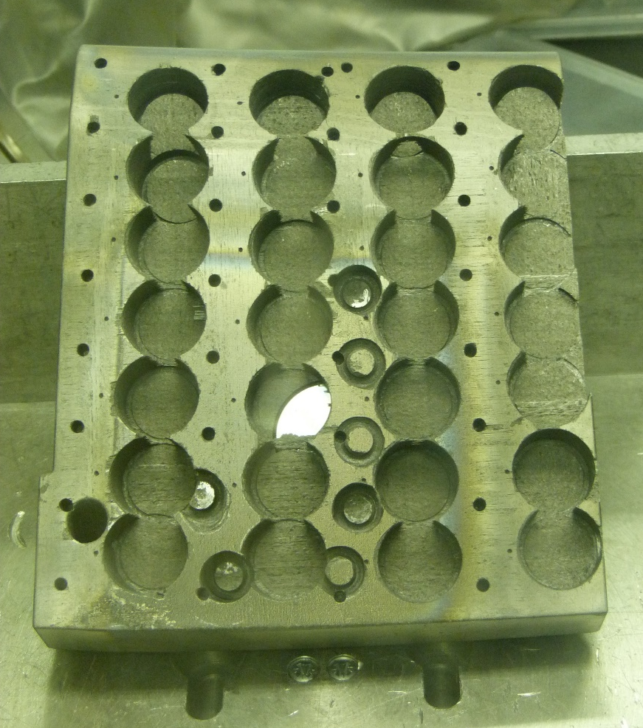
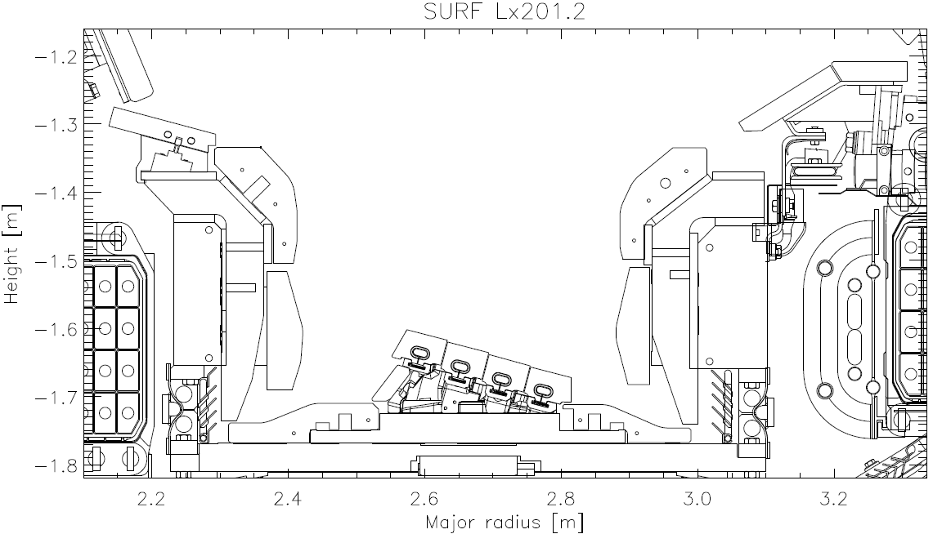
SPE.1: Coordination activity (VTT)
HFGC 14NRH (2011-2016)
Task will concentrate on coordination, sample preparation and distribution of remaining JET ILW3 samples (no new ones available before end of JET operations)
Sectioning and preparation of samples from CFC divertor tiles 0 and 1. Distribution of samples to other laboratories
Coring of tiles 0 and 1 completed
Four poloidal sets of samples prepared
Samples distributed to various RUs.
7c
7b
7a
7
6c
6b
6a
6
5
5c
5b
5a
4c
4b
4a
4
3c
3b
3a
3
2c
2b
2a
2
1c
1b
1a
1
0
1
CCFE
IST
VTT
MPG
VR
ISSPUL
NCSRD
ISSPUL
IAP
3
5
4
Deliverable: PWIE.SPE.1.T001.D001
Status: Completed
Facilities: Hot cells at VTT
Human Resources: 2 PM
Involved RU: VTT and CCFE as a collaborator
Linked WP or TSVV: WPTE
Notes:
PD: Plasma Devices as in PEP listed
HHF: High Heat flux as in PEP listed
IBF: Ion beam Facility as in PEP listed
Other facilties as in PEP listed

Slide 7
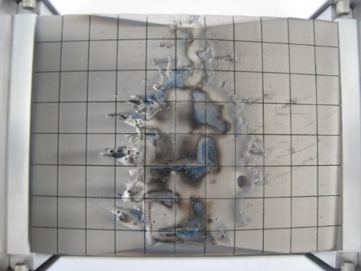
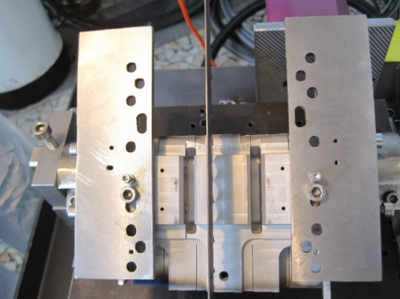
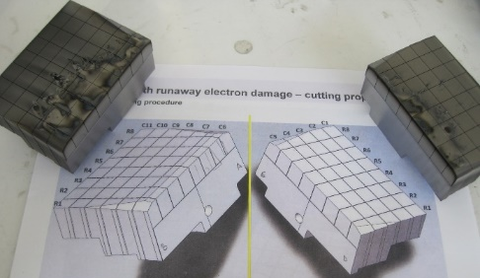
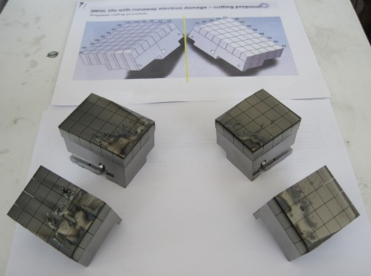
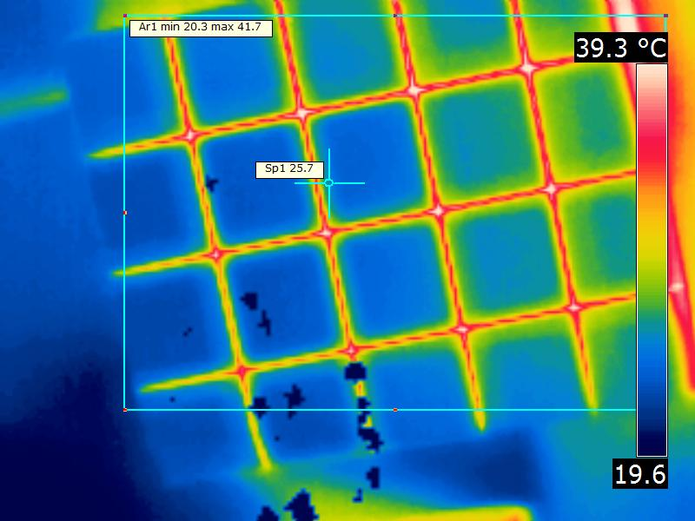
SPE.1: Coordination activity (IAP)
Using the beryllium processing facility, cutting of IWGL tile 1XR18 with runaway electron damage was performed
Typical sample sizes: 10 mm x 10 mm x 10-12 mm or 10 mm x 10 mm x 2.5 mm
Preliminary images acquired
Microscopy measurements from top and side surfaces have been made
Cutting of W lamellae: stack B to completed in 2022, ILW1+3 and ILW3
Samples shipped to FZJ, CCFE, HR, UoL and VTT
For temperature monitoring in real time a FLIR® E-Series Advanced Thermal Imaging Camera, (+/- 1 ºC ; 20-900 ºC) was used
Deliverable: PWIE.SPE.1.T001.D002
Status: Completed
Facilities: Hot cells at IAP
Human Resources: 2 PM
Involved RU: IAP and CCFE as a collaborator
Linked WP or TSVV: WPTE
Notes:
PD: Plasma Devices as in PEP listed
HHF: High Heat flux as in PEP listed
IBF: Ion beam Facility as in PEP listed
Other facilties as in PEP listed

Slide 8
SPE.1: Coordination activity (FZJ)
Sent out samples (W lamellae B12 and B13) from FZJ storage to other labs for characterization before cutting
Langmuir probes 15W: 1, 3, 5 to be cut
Deliverable: PWIE.SPE.1.T001. D003
Status: In progress (to be completed by 31.12.2022)
Facilities: Hot cells at FZJ
Human Resources: 1 PM
Involved RU: FZJ, IAP, VTT and CCFE as a collaborator
Linked WP or TSVV: WPTE
Notes:
PD: Plasma Devices as in PEP listed
HHF: High Heat flux as in PEP listed
IBF: Ion beam Facility as in PEP listed
Other facilties as in PEP listed

Slide 9
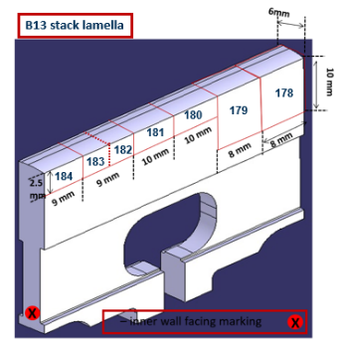
SPE.1: Coordination activity (UKAEA - EUROfusion)
W-CFC tiles (multiple campaign exposure) to VTT for coring – complete (reported in Oct 2022)
Bulk W-lamellae shipments (stack B: B2, B12, B13, B17, B23, B24 – ILW3 & ILW1+2+3)
  W_154; 155; 161; 162; 168; 169; 175; 176; 182; 183; 189; 190 – to FZJ for LIDS and metallography
  W_185; 192 – 1st to HR for D-NRA; 2nd to IAP for TDS
  W_157; 164 – to IPPLM for microstructure analysis
  W_186; 187 – to UoL for TDS and Total combustion
  W_160; 167; 174; 181; 188; 195 to VTT for SIMS analysis
Langmuir probes: 15W-probes 1; 3; 5 to VR/IPPLM; 16W-probes 1; 3; 5
to FZJ
Be samples (ILW3) from tiles 2XR10 (ILW1, ILW2) and 4D14 (ILW3) to IAP for TDS
1XR18 C3 – Bulk Be tile (RE damage) – shipment to IAP for cutting, optical microscopy, castellation extraction
  Tile cut in 4 sections (A; B; C; D), Section B castellations cut; sample distribution
  R1C6, R2C6 – to FZJ for metallography
  R3C6, R4C6 and section D to IST for IBA
Deliverable:
Status: Completed
Facilities:
Human Resources:
Involved RU: FZJ, IAP, VTT and CCFE as a collaborator
Linked WP or TSVV: WPTE
Notes:
PD: Plasma Devices as in PEP listed
HHF: High Heat flux as in PEP listed
IBF: Ion beam Facility as in PEP listed
Other facilties as in PEP listed

Slide 10
SP E.2: Comparison of hydrogenic retention quantification- selected results from 2022
Notes:
PD: Plasma Devices as in PEP listed
HHF: High Heat flux as in PEP listed
IBF: Ion beam Facility as in PEP listed
Other facilties as in PEP listed

Slide 11
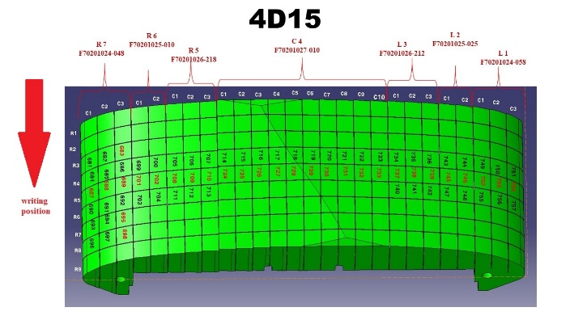
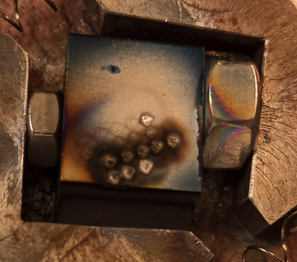
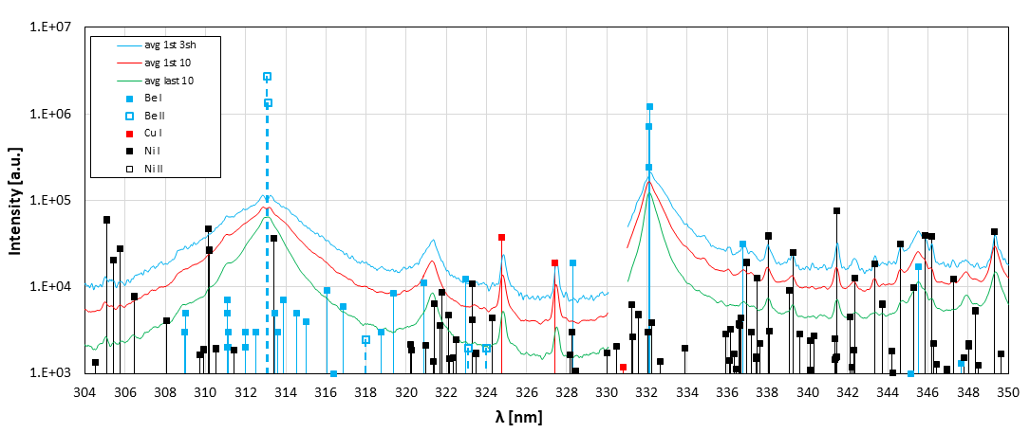
SPE.2: LIBS measurement of JET Be limiter samples (CU)
Joint LIBS measurement campaign of Be limiter samples in May (VTT, CU, UT, IPPLM, ENEA)
Samples analysed with LIBS: 4D15-686, 4D15-755, 2XR11-641
Same samples analysed also with SIMS at VTT
LIBS spectrum for sample 4D15-686
100 shots, 10 mbar Ar
Be, O, H/D and impurities (Cu, Ni, Ca….) detected in whole depth profile
Detailed results will be presented in P. Veis’ talk
Deliverable: PWIE.SPE.2.T001.D001
Status: In progress
Facilities:
Human Resources: 3 +1 PM
Involved RU: CU, UT, IPPLM, ENEA,VTT
Linked WP or TSVV: PWIE SPB
P. Veis et al. (CU)
Notes:
PD: Plasma Devices as in PEP listed
HHF: High Heat flux as in PEP listed
IBF: Ion beam Facility as in PEP listed
Other facilties as in PEP listed

Slide 12
SPE.2: Characterization of JET divertor tiles 0 and 1 with LIBS, LID-QMS, TDS and metallography (FZJ)
Main work on TDS and LID-QMS delayed due to nuclear licensing issue of the FREDIS setup: Sudden increase in requirements/expectations regarding leak tightness of the glovebox system by external inspectors.
Technical acceptance tests passed in October 2022 but still waiting on OK from nuclear licensing authorities.
Shipping of tile pieces from tiles 0 and 1 from VTT to FZJ in 2023?
Deliverable: PWIE.SPE.2.T001.D002
Status: in progress/delayed
Facilities:
Human Resources: 4 PM
Involved RU: FZJ
Linked WP or TSVV: PWIE SPB
T. Dittmar et al. (FZJ)
Notes:
PD: Plasma Devices as in PEP listed
HHF: High Heat flux as in PEP listed
IBF: Ion beam Facility as in PEP listed
Other facilties as in PEP listed

Slide 13
SPE.2: Analysis of samples from JET divertor tiles by GDOES (IAP)
Task: Determine erosion, deposition, and fuel retention profiles on samples cored from JET divertor tiles
Main results:
Samples cored from Tile 1 (IWG1A - W620 51 101) exposed in JET during ILW1+ILW2+ILW3 campaigns (2011-2016).
GDOES depth profile for Tile 1 (14IWG1A) (before exposure in ILW1+ILW2+ILW3)
(a)
(b)
0
1
4
2
GDOES depth profiles for samples cored from Tile 1 at (a) s=395 (14IWG1A-2d) (a) and at s=365 (b) (14IWG1A-4d)
Be has a peak near the surface of about 25 at.% and penetrates into the coating up to about 15 μm
D depth profiles for samples after all three campaigns is quite uniform (concentration~5 at.%), compared with D profile from a single campaign exposure (where the concentration drops from the near surface to almost zero)
Deliverable: PWIE.SPE.2.T001.D003
Status: Completed
Facilities:
Human Resources: 2 PM
Involved RU: IAP
Linked WP or TSVV: WPTE
E. Grigore et al. (IAP)

Slide 14
SPE.2: Analysis of samples from JET divertor tiles by GDOES (IAP)
GDOES depth profiles for samples cored from Tile 1 at (a) s=275 (14IWG1A-8d) and at (b) s=251 (14IWG1A-9d)
(a)
0
9
Strong Be deposition → a distortion of W and Mo profiles can be noticed
Relatively uniform D concentration ~5 at.%, with a penetration depth ~35-50 μm
1
8
(b)
Comparison between D amounts measured by GDOES on samples exposed in JET in ILW1+ILW2+ILW3 campaigns and those measured by NRA
Deliverable: PWIE.SPE.2.T001.D003
Status: Completed
Facilities:
Human Resources: 2 PM
Involved RU: IAP
Linked WP or TSVV: WPTE
E. Grigore et al. (IAP)

Slide 15
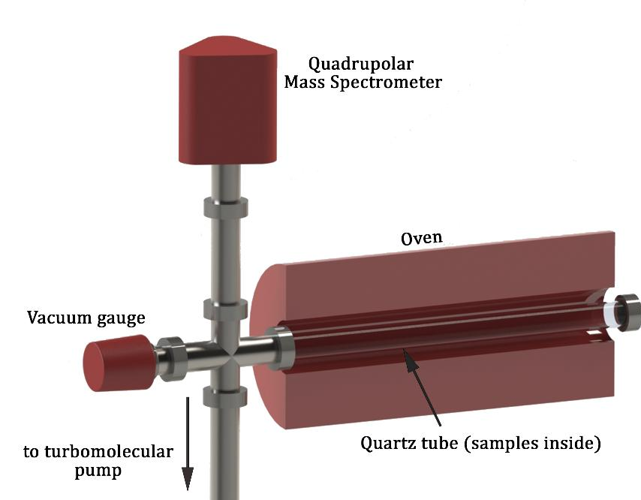
SPE.2: Analysis of samples from JET divertor tiles by TDS (IAP)
Deuterium thermo-desorption spectra for the designated samples
Schematic representation of the TDS set-up
Sample | Desorbed D (at/cm²) | CCFE D (at/cm²)
2d | 1.402 E18
4d | 5.494 E18
8d | 5.036 E18
9d | 5.871 E18 | 3.0 E18
TDS parameters:
Maximum temperature: 1325 K
10K/min ramp, 1 hour HOLD
CCFE: max temp ~1120 K
Deliverable: PWIE.SPE.2.T001.D003
Status: Completed
Facilities:
Human Resources: 2 PM
Involved RU: IAP
Linked WP or TSVV: WPTE
E. Grigore et al. (IAP)

Slide 16
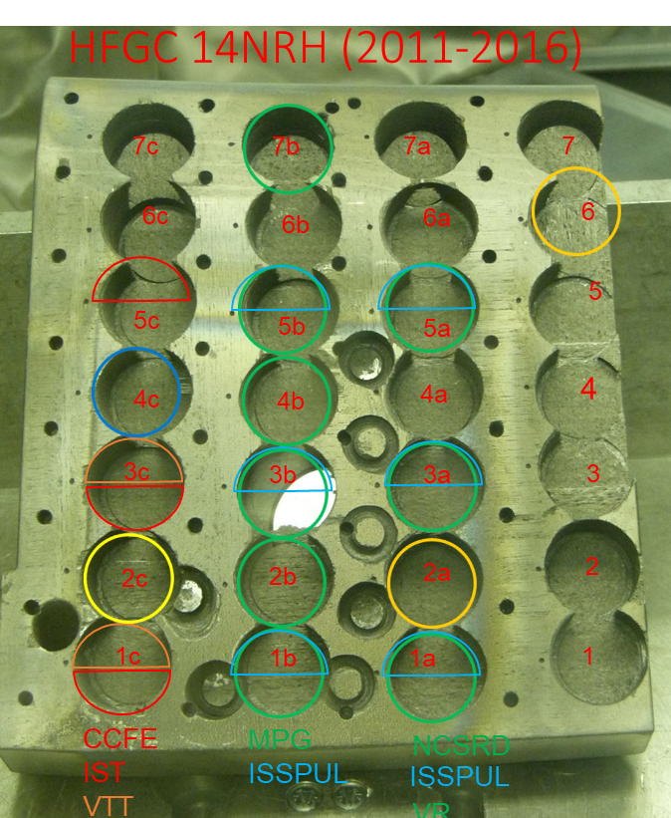
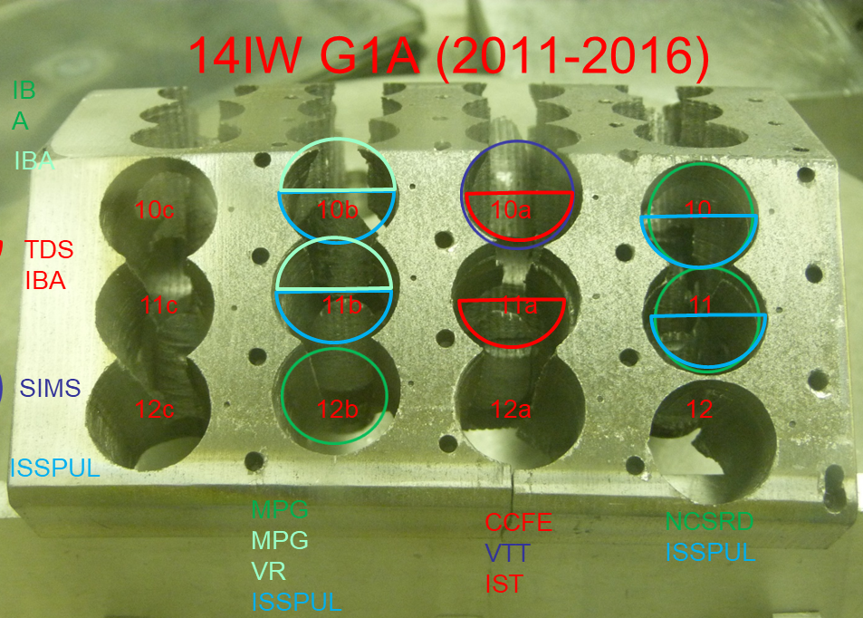
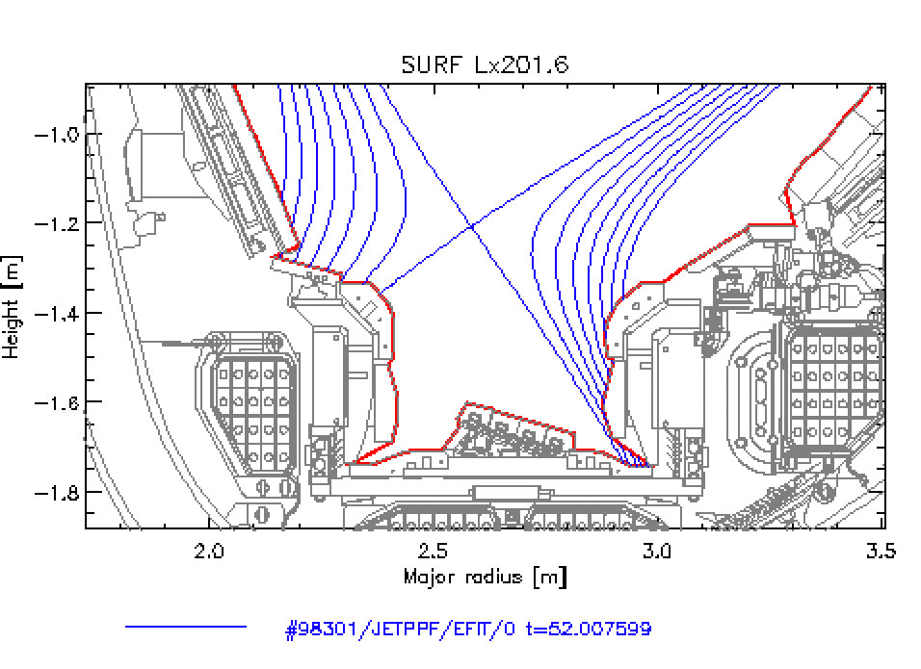
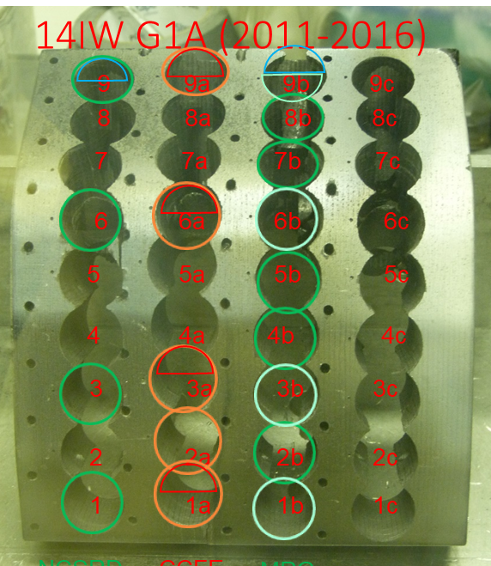
SPE.2: Analysis of samples from JET divertor tiles 0 and 1 with TDS, FC and dissolution method (ISSP-UL)
In 2022 two sets of samples had been received from divertor tiles HFGC and 14ING1A. Main focus: tritium concentration and thermal desorption spectra
Characteristics | TDS | Full combustion
Information obtained | Tritium total amount Desorption spectra | Tritium total amount
Tritium release method | Heating in a furnace, ~5ºC/min up to 1300K and held 1h at this temperature | Heating in a furnace in a moistened air, up to 1223K and held for 4-6 h at this temperature, HT and T₂ oxidized in CuO furnace
Carrier gas | Helium + 0,1% H₂(must be dicussed) | Moistened air
Tritium measurement | Proportional counter | Liquid scintillation
Deliverable: PWIE.SPE.2.T001.D004
Status: In progress
Facilities:
Human Resources: 6 PM
Involved RU: ISSP-UL
Linked WP or TSVV:
E. Pajuste et al. (ISSP-UL)
Notes:
PD: Plasma Devices as in PEP listed
HHF: High Heat flux as in PEP listed
IBF: Ion beam Facility as in PEP listed
Other facilties as in PEP listed

Slide 17
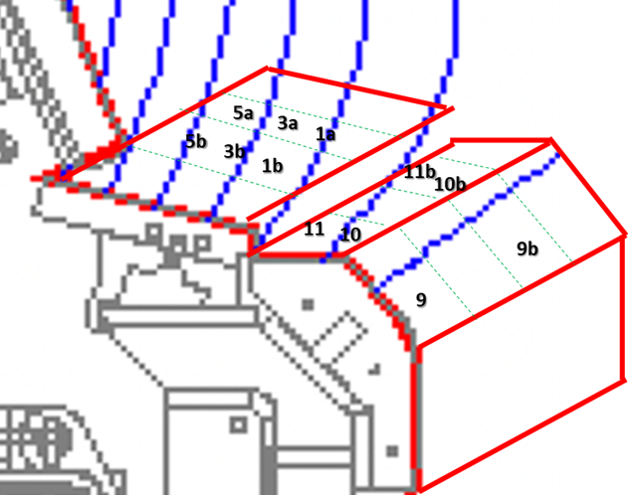
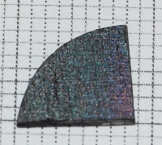
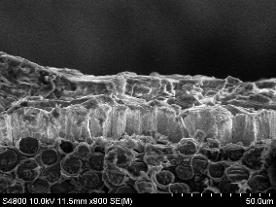
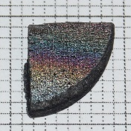
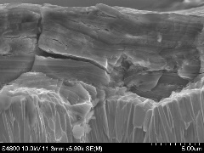
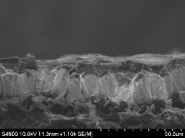
SPE.2: Analysis of samples from JET divertor tiles 0 and 1 with TDS, FC and dissolution method (ISSP-UL)
Results
HFGC 1a_1
Deposition layer thickness: 18±2 μm
Tritium concentration (TDS): 1.5×10¹³ atoms/cm²
2 mm
HFGC 1a_2
2 mm
Deposition layer thickness: 10±3 μm
Tritium concentration (TDS): 1.1×10¹³ atoms/cm²
Deliverable: PWIE.SPE.2.T001.D004
Status: In progress
Facilities:
Human Resources: 6 PM
Involved RU: ISSP-UL
Linked WP or TSVV:
E. Pajuste et al. (ISSP-UL)
Notes:
PD: Plasma Devices as in PEP listed
HHF: High Heat flux as in PEP listed
IBF: Ion beam Facility as in PEP listed
Other facilties as in PEP listed

Slide 18
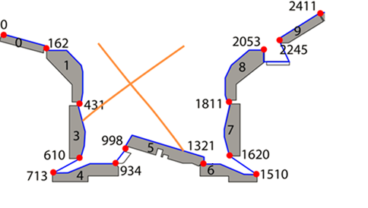
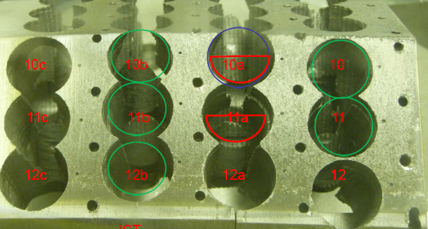
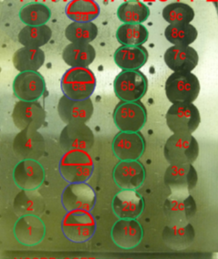
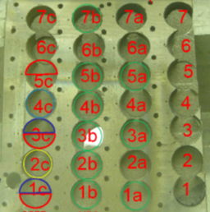
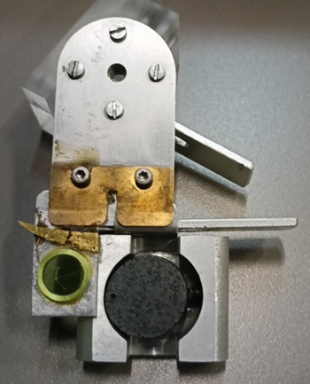
SPE.2: Investigation of ILW 1-3 JET Tokamak Tile 0 and 1 using Deuteron micro-beam (NCSRD)
Exp. Campaign | Tile | Sample No | S - coordinates
2011-16 | HFGC 14NRH (Tile 0) | 1a | 132
 |  | 3a | 90
 |  | 5a | 50
 | 14IW G1A (Tile 1) | 1 | 405
 |  | 3 | 363
 |  | 6 | 301
 |  | 9 | 240
 |  | 10 | 217
 |  | 11 | 195
HFGC
14IW G1A (2011-16)
G1A
10
11
9
HFGC 14NRH (2011-2016)
6
D beam energy: 1.62 MeV
⁹Be(d, p)¹⁰Be
Detection angle: 170º
Beam spot < 30 μm
Kapton film: 15 μm
5a
3
3a
1
1a
Deliverable: PWIE.SPE.2.T001.D007
Status: Completed
Facilities: 5 days accelerator (NCSRD)
Human Resources: 1 PM
Involved RU: NCSRD
Linked WP or TSVV: WPTE
A. Lagoyannis et al. (NCSRD)

Slide 19
SPE.2:Tile 0 (2011-16): Summary of depth profiles & material deposition (NCSRD)
Experimental & simulated spectra
Elemental Quantification
Elemental depth profile
Deliverable: PWIE.SPE.2.T001.D007
Status: Completed
Facilities: 5 days accelerator (NCSRD)
Human Resources: 1 PM
Involved RU: NCSRD
Linked WP or TSVV: WPTE
A. Lagoyannis et al. (NCSRD)

Slide 20
SPE.2: Tile 0 (2011-2016) – Sample 1a (NCSRD)
Carbon agglomerates
High W
Low Be
Low W - High Be
Nitrogen
almost homogeneous
The axes units in μm
Deliverable: PWIE.SPE.2.T001.D007
Status: Completed
Facilities: 5 days accelerator (NCSRD)
Human Resources: 1 PM
Involved RU: NCSRD
Linked WP or TSVV: WPTE
A. Lagoyannis et al. (NCSRD)

Slide 21
SPE.2: Tile 1 (2011-16): Summary of depth profiles & material
Deposition (NCSRD)
Elemental depth profile (14IWG1A)
Elemental quantification
Deliverable: PWIE.SPE.2.T001.D007
Status: Completed
Facilities: 5 days accelerator (NCSRD)
Human Resources: 1 PM
Involved RU: NCSRD
Linked WP or TSVV: WPTE
A. Lagoyannis et al. (NCSRD)

Slide 22
SP E.2 ToF-ERDA beam analyses of Divertor tiles after ILW1-3 (VR)
Relative amount of D, Be, and isotopes of O and N in the apparent top of the sample (5x10¹⁸ at./cm²)
Analysed with 44 MeV I
Other elements found: H,C, N, ~Ni(Inconel components), W
Very clear traces of ¹⁵N and ¹⁸O that were injected at the end of ILW3
More ¹⁵N and ¹⁸O at inner part of HFGC tile and top of tile 1
Difficult to quantify because of roughness (ratios more reliable)
Difference between surface deposits from last shots and “bulk” from whole campaign makes values for the injected isotopes more difficult
HFGC |  |  | 2H | 14N | 15N | 16O | 18O | Be
 | 1b |  | 0,02 | 0,04 | 0,10 | 0,09 | 0,02 | 0,61
 | 3b |  | 0,02 | 0,04 | 0,11 | 0,09 | 0,02 | 0,61
 | 5b |  | 0,02 | 0,05 | 0,03 | 0,19 | 0,01 | 0,59
 | 7b |  | 0,01 | 0,01 | 0,02 | 0,16 | 0,00 | 0,21
Tile1A
 | 1b |  | 0,02 | 0,03 | 0,02 | 0,27 | 0,01 | 0,53
 | 3b |  | 0,02 | 0,02 | 0,04 | 0,20 | 0,01 | 0,63
 | 6b |  | 0,02 | 0,02 | 0,03 | 0,17 | 0,02 | 0,65
 | 9b |  | 0,02 | 0,03 | 0,03 | 0,11 | 0,02 | 0,51
 | 10b |  | 0,02 | 0,03 | 0,06 | 0,13 | 0,02 | 0,59
 | 11b |  | 0,02 | 0,04 | 0,07 | 0,12 | 0,02 | 0,58
Deliverable: PWIE.SPE.2 D008
Status: Completed
Facilities: None
Human Resources: 2 PM
Involved RUs: VR
Linked WP or TSVV:
D. Primetzhofer et al. (VR)
Jari Likonen | WPPWIE Review Meeting | FZJ Jülich | 7.2.2023 | Page 22

Slide 23
SP E.2 Total thickness with NRA (VR)
Total amount of D and Be (10¹⁸ at./cm²)
HFGC |  |  | D | Be
 | 1b |  | 2 | 82
 | 3b |  | 3 | 27
 | 5b |  | 6 | 34
 | 7b |  | 0.4 | 11
Tile1A
 | 1b |  | 2 | 95
 | 3b |  | 3 | 14
 | 6b |  | 3 | 16
 | 9b |  | 3 | 83
 | 10b |  | 2 | 77
 | 11b |  | 4 | 85
Measured with 2.8 MeV ³He
Looking at ⁹Be(3He,p0)¹¹B and ²D(³He,p)⁴He
Most of D found at the surface in some cases the D goes deeper than the analysis depth (migration into tungsten)
For most samples part of the W substrate is visible in the spectra but for a full Be analysis some points (the thickest) would be good to run at higher energies
Deliverable: PWIE.SPE.2 D008
Status: Completed
Facilities: None
Human Resources: 2 PM
Involved RUs: VR
Linked WP or TSVV:
D. Primetzhofer et al. (VR)
Jari Likonen | WPPWIE Review Meeting | FZJ Jülich | 7.2.2023 | Page 23

Slide 24
SPE.2: SIMS analysis of divertor samples (VTT)
Fuel retention in tiles 0 and 1 exposed during ILW1-ILW3
Comparison with single campaign results
HFGC (2011-2016): co-deposited layer > 30µm
14IWG1A (2011-2016) apron: co-deposited layer, thickness ~30µm
14IWG1A (2011-2016) apron: D~ 4.8*10¹⁸ cm⁻²
Fuel retention not necessarily higher for multiple
campaign tiles
SIMS depth profiles, sample 14IWG1A-10a
10
analysis | sample | D amount (x1e¹⁸cm⁻²) (ILW3) | D amount (x1e¹⁸cm⁻²) (ILW1-3)
SIMS | 14ING1C-8 | 7.1 | 1.5
TDS | 14ING1C-8 | 5.4 | 3.1
0
8
1
3
5
4
Deliverable: PWIE.SPE.2.T001.D009
Status: Completed
Facilities:
Human Resources: 7 PM
Involved RU: VTT
Linked WP or TSVV:
J. Likonen et al. (VTT)
Notes:
PD: Plasma Devices as in PEP listed
HHF: High Heat flux as in PEP listed
IBF: Ion beam Facility as in PEP listed
Other facilties as in PEP listed

Slide 25
SPE.2: JET C39 baking cycle simulations (CCFE)
JET: D (and T) removal using baking + ICWC + GDC @ 320ºC
Experiment performed in Oct 2020 (C39) and Mar 2022 (C40)
Samples: HFGC (ILW1-3 and ILW3)
Samples sent from CCFE to IST for pre-TDS IBA
Pre-TDS IBA done (IST)
Long-duration TDS done (CCFE). Measurements of D release at constant T=350ºC for up to 72 hrs were performed, mimicking ITER baking cycle
Time traces of D release, including at constant temperature 350 ºC. Preliminary analysis suggests that these traces can be well described by power law, R = At^{α}, with a constant α between -0.75 and -1.03 (best fits shown)
max.T
temperature
dwell temp.
β
-β
β
time
Deliverable:
Status: In progress
Facilities:
Human Resources:
Involved RU: VTT, CCFE
Linked WP or TSVV:
A. Widdowson et al. (CCFE)
Notes:
PD: Plasma Devices as in PEP listed
HHF: High Heat flux as in PEP listed
IBF: Ion beam Facility as in PEP listed
Other facilties as in PEP listed

Slide 26
SP E.3: Post-mortem analysis of PFC and other objects in JET - selected results from 2022
Notes:
PD: Plasma Devices as in PEP listed
HHF: High Heat flux as in PEP listed
IBF: Ion beam Facility as in PEP listed
Other facilties as in PEP listed

Slide 27
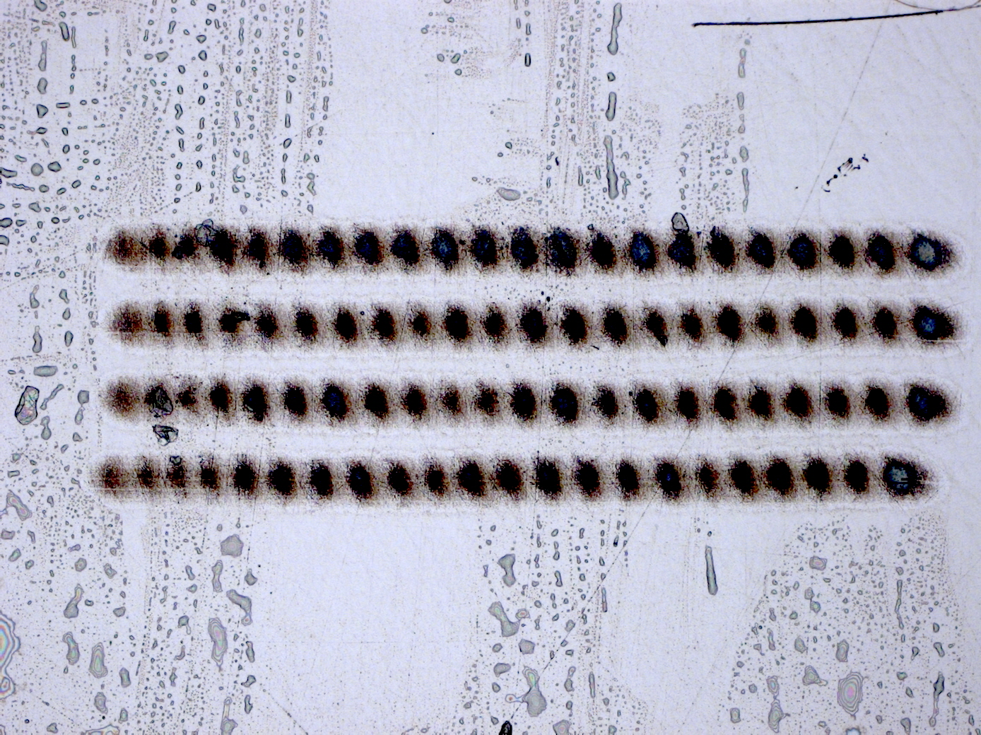
SPE.3 Characterization of JET plasma facing components with LIBS, LID-QMS, TDS and metallography (FZJ)
D2: Characterization of JET plasma facing components with LIBS, LID-QMS, TDS and metallography (other JET components)
Same issue as for Task SPE.2
Development of multi spot raster LIBS with improved sensitivity:
  Increase LIBS signal due to increased ablation area
  Increase of QMS signal measured during
  ablation (LIA-QMS method)
  in spot overlap mode: crater spot edge effect
  negligible due to large ratio of scanning
  area to edge
3 ps pulse length, 1030 nm wavelength,
25 µJ per Pulse, 100 kHz repetition rate
Deliverable: PWIE.SPE.3 D002
Status: in progress / delayed
Facilities: None
Human Resources: 10 PM
Involved RUs: FZJ
Linked WP or TSVV:
T. Dittmar et al. (FZJ)
Jari Likonen | WPPWIE Project Meeting | FZJ Jülich | 7.2.2023 | Page 27

Slide 28
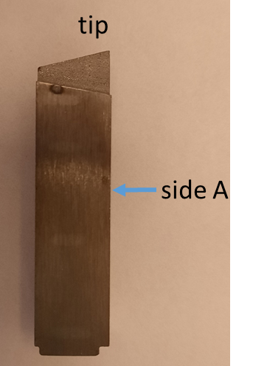
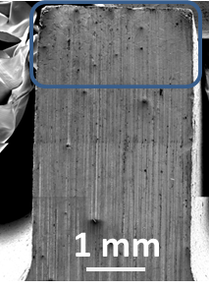
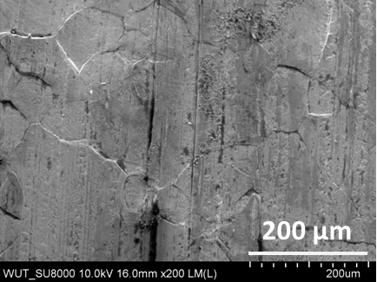
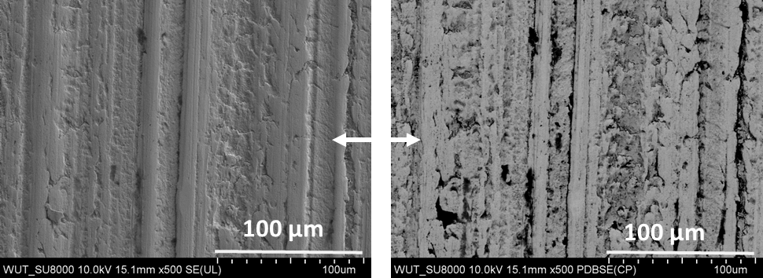
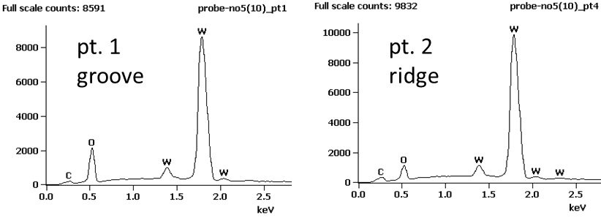
SPE.3 Surface morphology, Langmuir probe 5 (IPPLM)
Material:
Three probes designated as LP 1,3,5 removed from Tile 5 (Mod 16W), exposed in ILW1-2 (probe 1 mounted at stack A, probes 3 and 5 at stack B)
a)
b)
side B
Results:
Tip
  Large re-crystalized zone near the tip end, ˜1.3 mm.
  Overheated material with visible pores below the re-crystallized part. Locally re-solidified droplets were found.
Base
  No signs of re-melting
  Re-deposition present (contrast changes visible in the images registered in the BSE mode; darker contrast areas cover/overlap with the grooves).
SEM images of the tip (a) and the tip end morphology (b), side A. Grain boundaries are well visible. Recrystallized zone.
a)
b)
c)
d)
SEM images of the base morphology (a-b) together with the corresponding EDX spectra (c-d). Contrast differences visible in the images registered in the BSE mode indicate redeposition in the grooves.
Deliverable: PWIE.SPE.3 D004
Status: in progress
Facilities: None
Human Resources: 6 PM
Involved RUs: IPPLM
Linked WP or TSVV:
E. Fortuna-Zaleśna et al. (IPPLM)
Jari Likonen | WPPWIE Project Meeting | FZJ Jülich | 7.2.2023 | Page 28

Slide 29
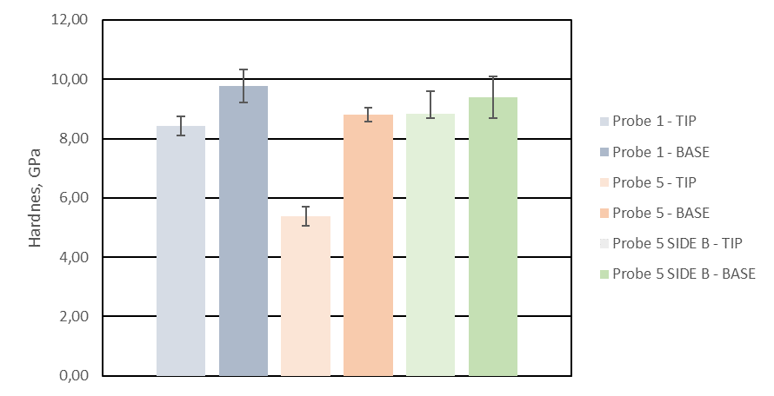
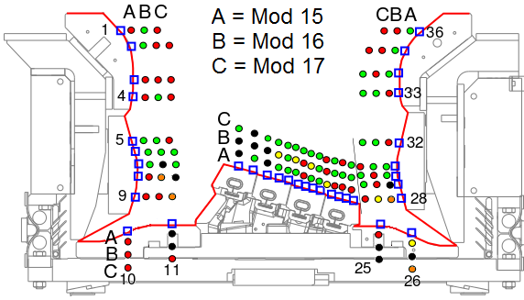
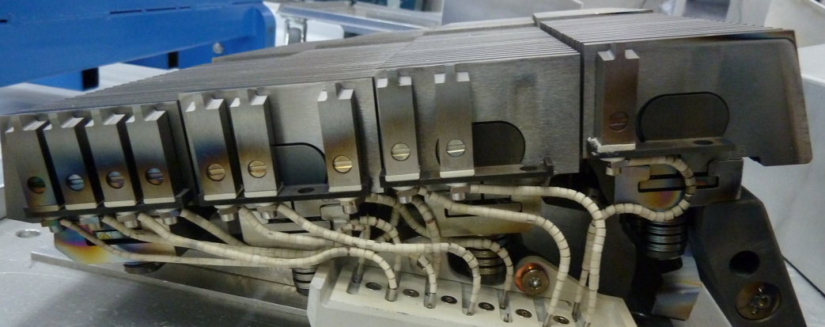
SPE.3 Nanomechnical properties, Langmuir probe 5 (IPPLM)
Mechanical properties were determined by nanoindentation using a Hysitron Ti-900 triboindenter
a)
b)
Nanohardness measurements of LP-5 and LP-1 :
Large difference in hardness value in tip and base of LP-5 at side A.
Hardness values measured on base and tip on the B-side were similar to those measured on base (A-side).
Differences in hardness on base and tip of probe 1 (A-side) were small which is expected considering the fact that the probe was placed next to stack A (i.e in PFR).
side B
B
A
D
C
1
4
3
2
9
8
7
6
5
13
12
11
10
Deliverable: PWIE.SPE.3 D004
Status: in progress
Facilities: None
Human Resources: 6 PM
Involved RUs: IPPLM
Linked WP or TSVV:
E. Fortuna-Zaleśna et al. (IPPLM)
Jari Likonen | WPPWIE Project Meeting | FZJ Jülich | 7.2.2023 | Page 29

Slide 30
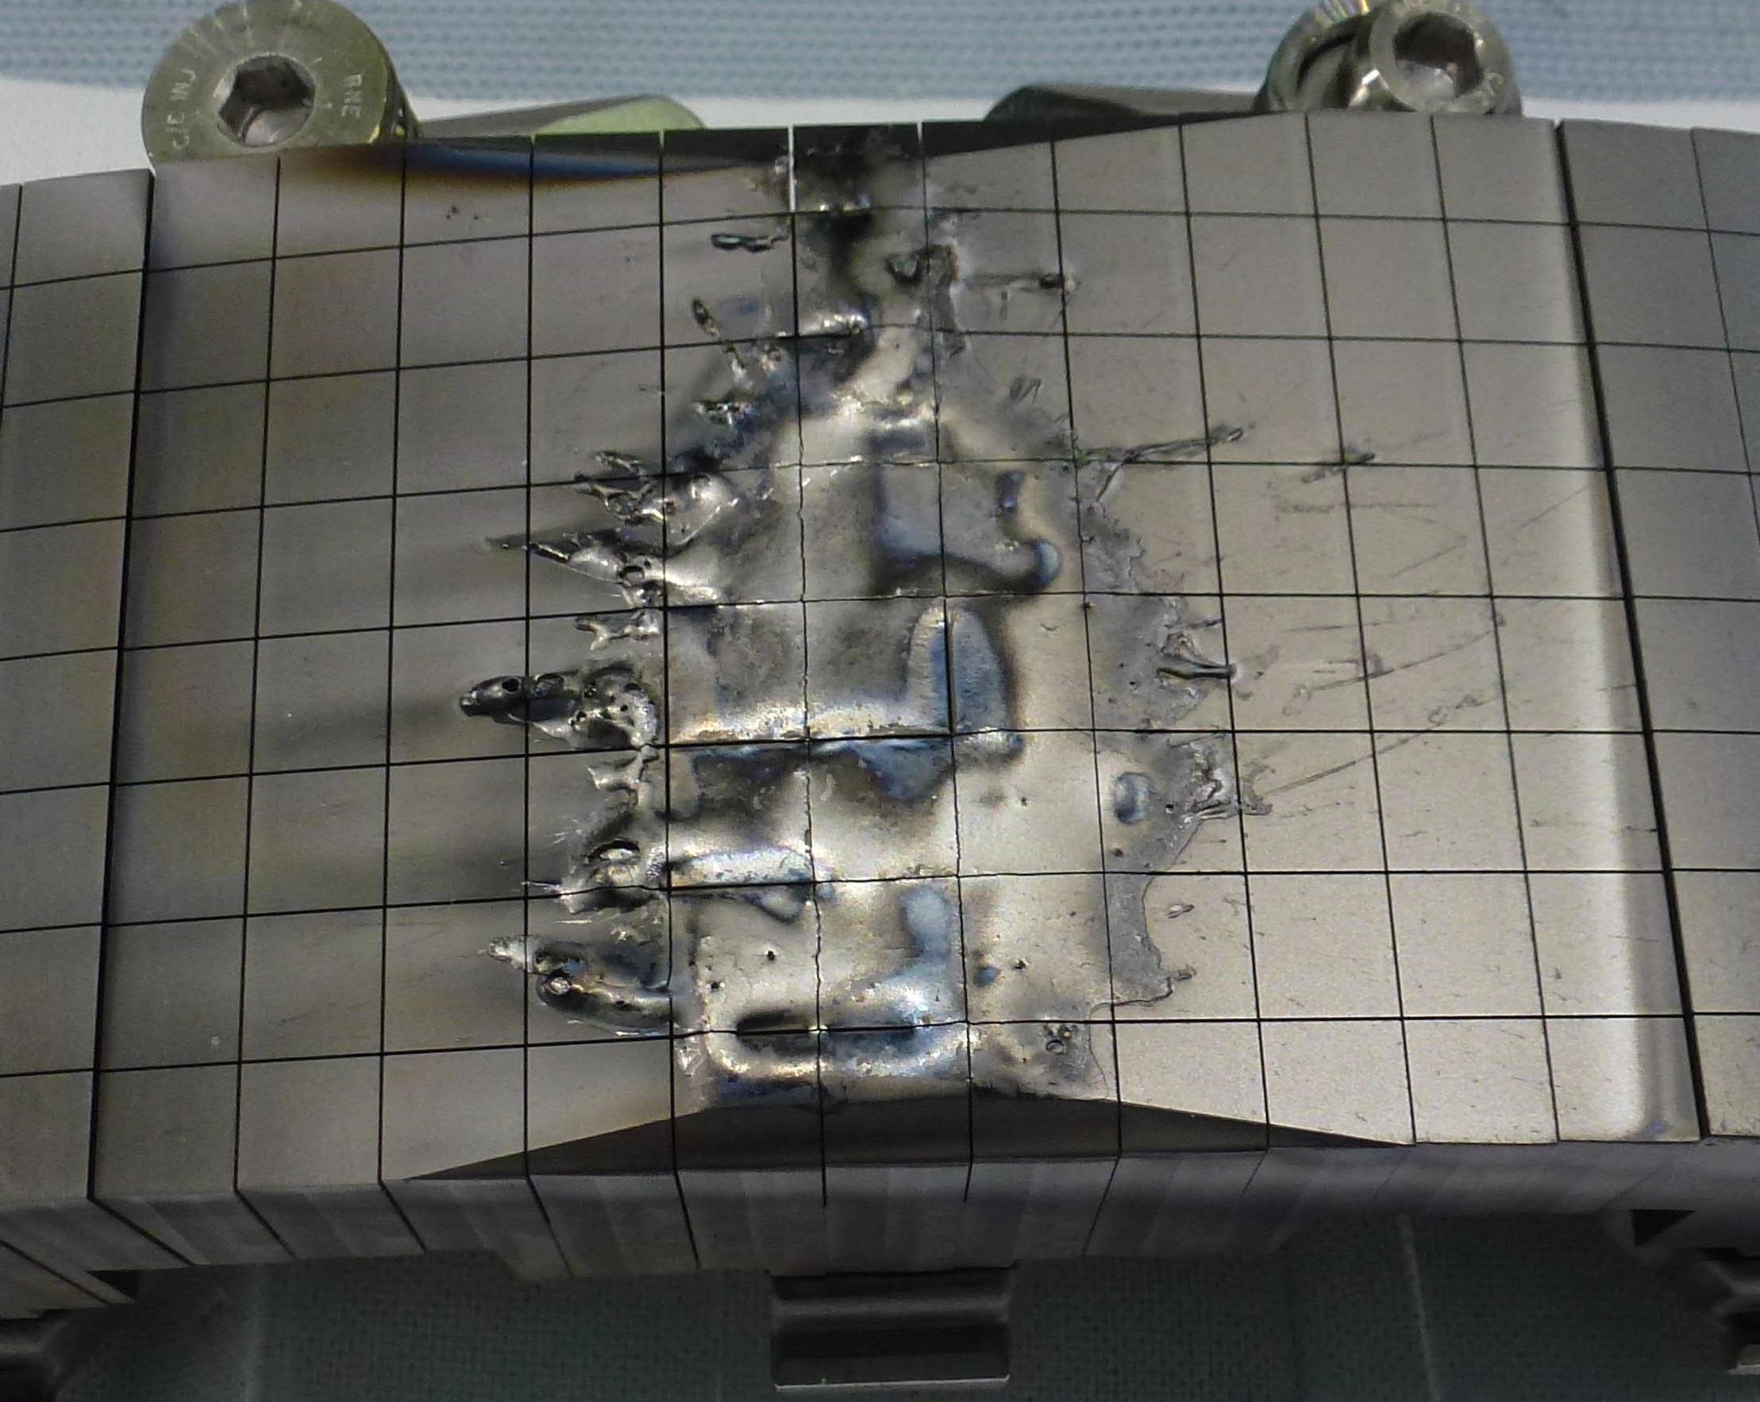
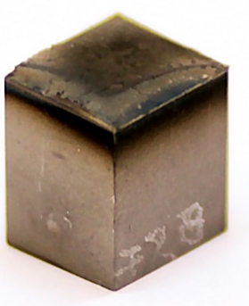
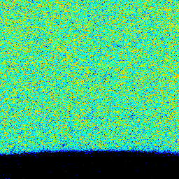
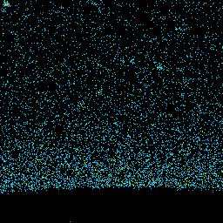
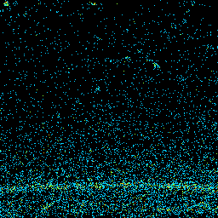
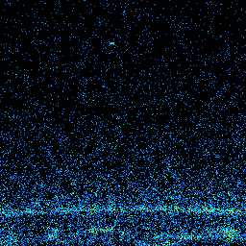
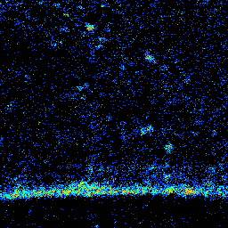
SPE.3 IWGL tile with runaway electron damage (IST)
1XR18
0
━ scan 1 (microbeam)
━ scan 2 (microbeam)
━ scan 3 (JET chamber)
Be RBS
W RBS
2.64mm
W PIXE
Ni PIXE
Ca PIXE
PIXE
Fe
Ni
RBS
Cr
W
Be
Ca
counts
Ni
C
O
W
Deliverable: PWIE.SPE.3 D006
Status: Completed
Facilities: None
Human Resources: 5 PM
Involved RUs: IST
Linked WP or TSVV:
E. Alves et al. (IST)
Jari Likonen | WPPWIE Project Meeting | FZJ Jülich | 7.2.2023 | Page 30

Slide 31
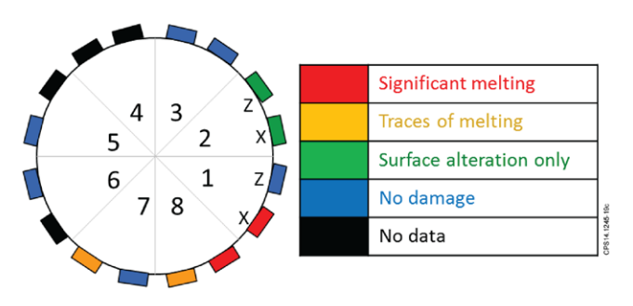
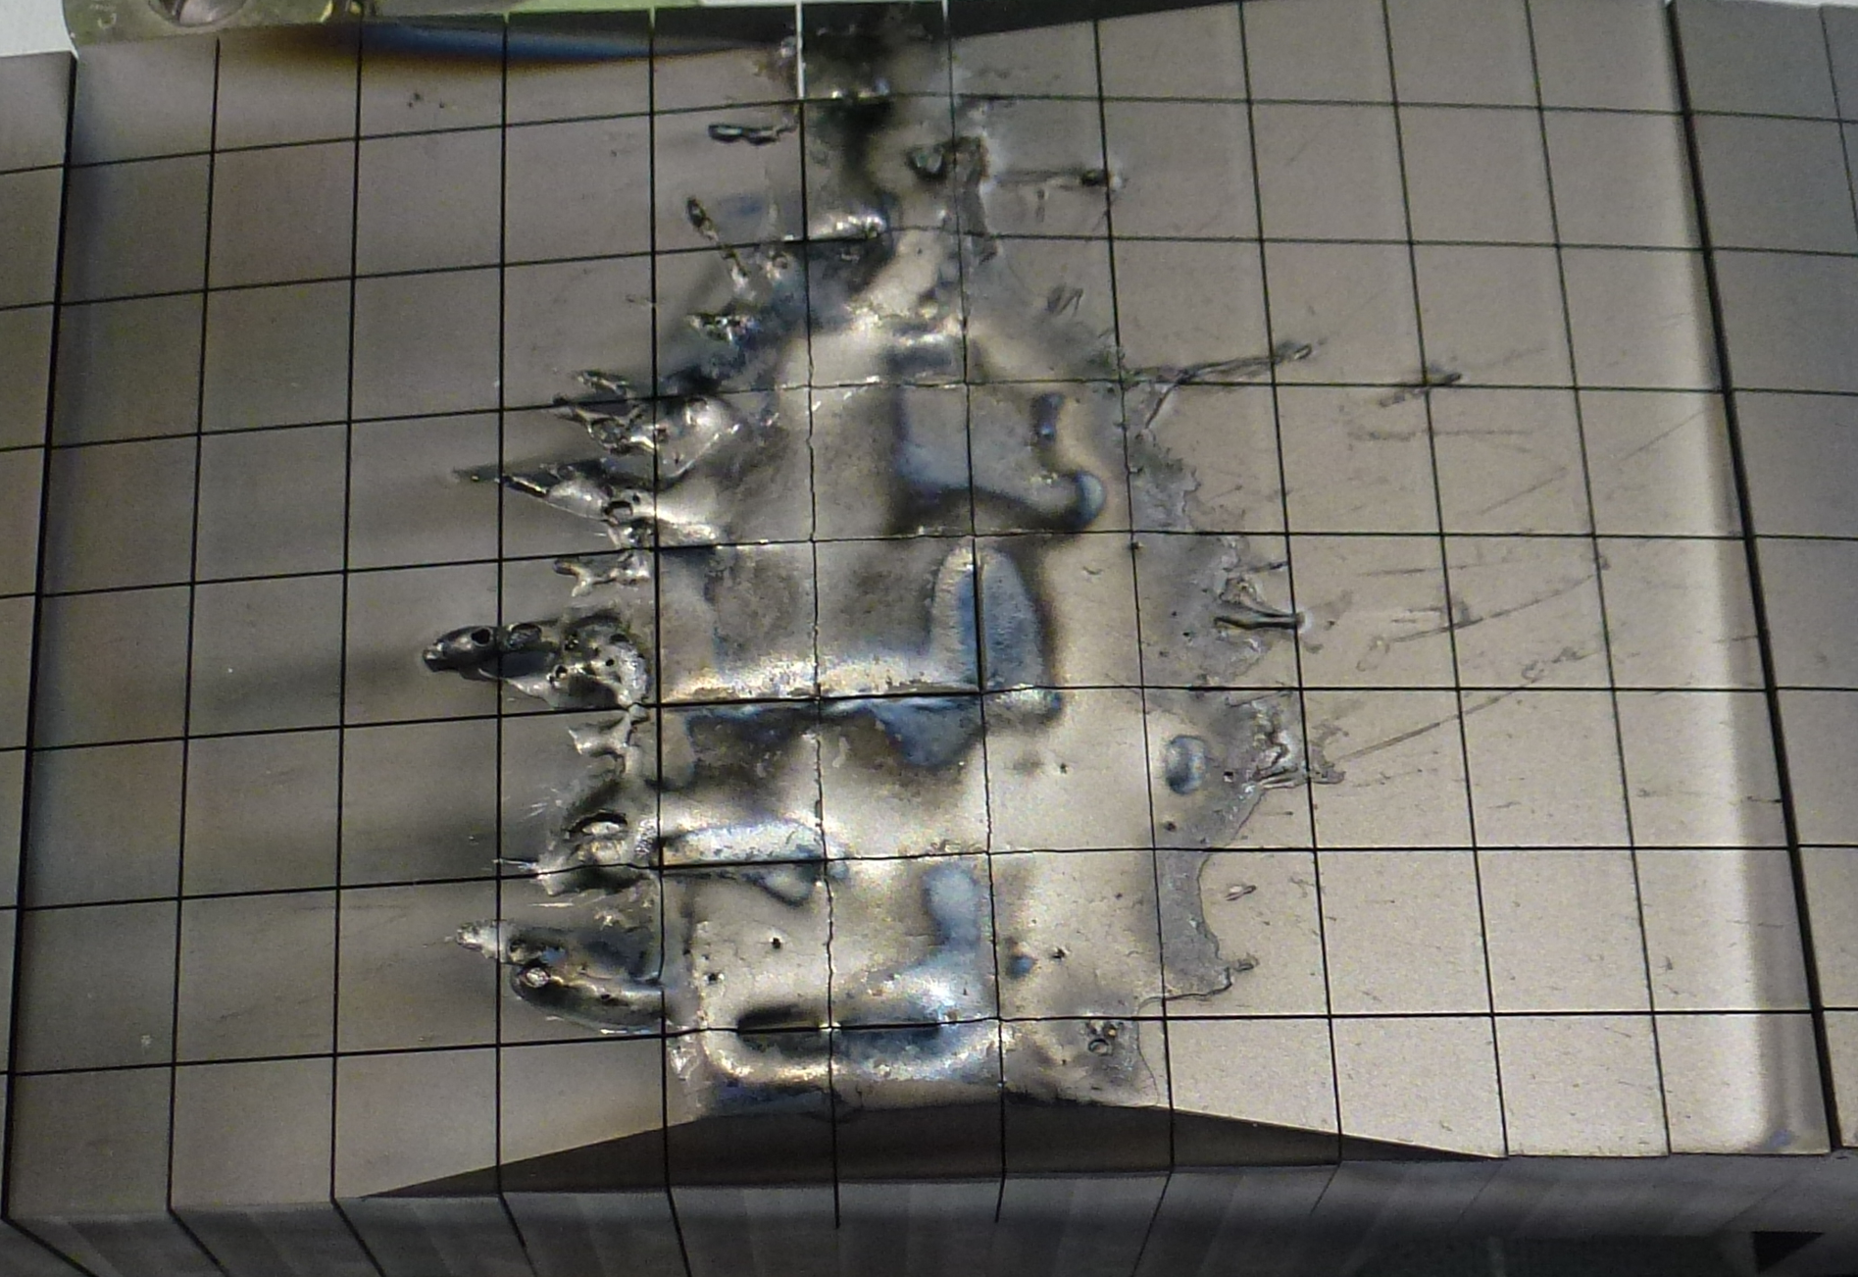
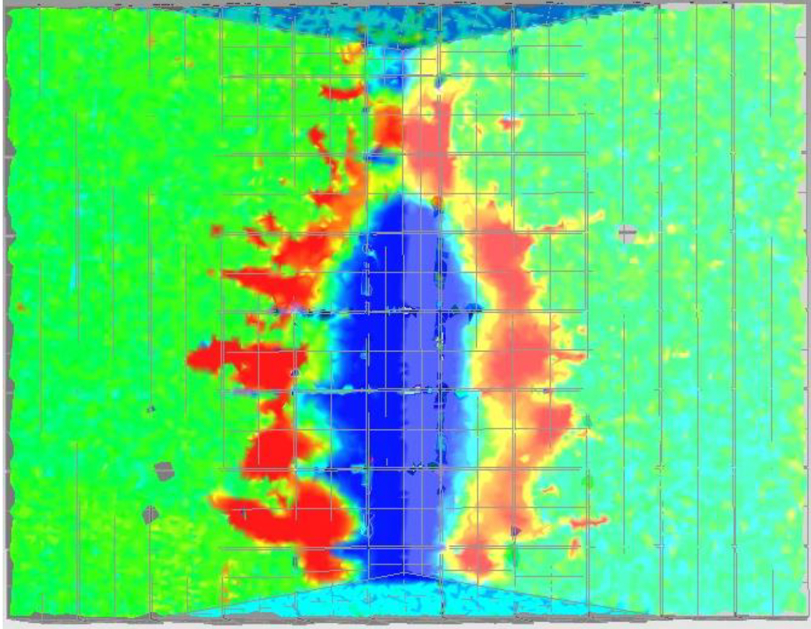
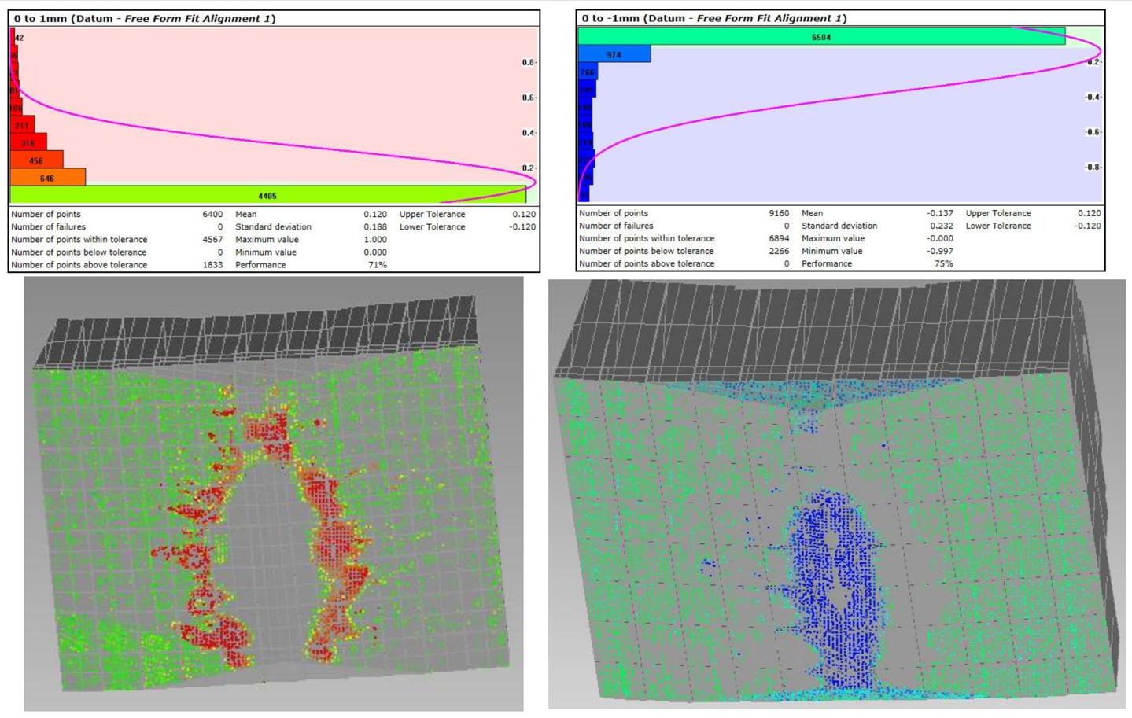
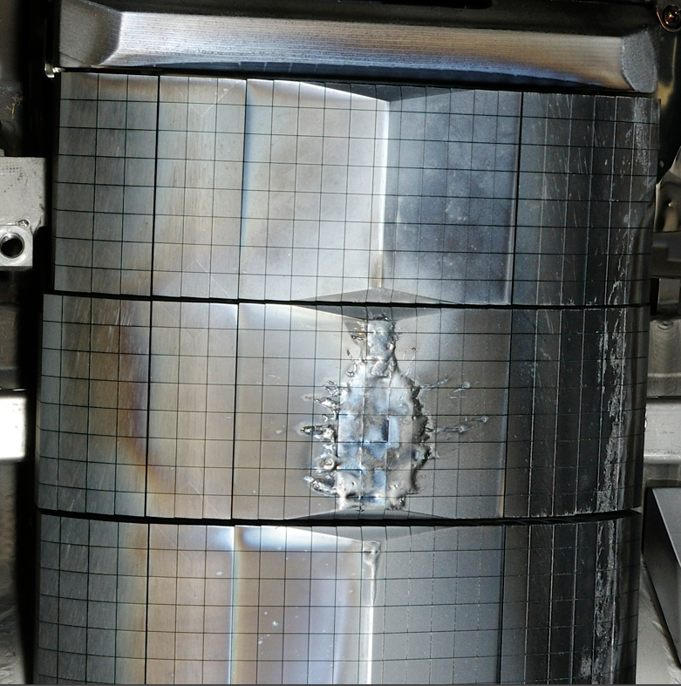
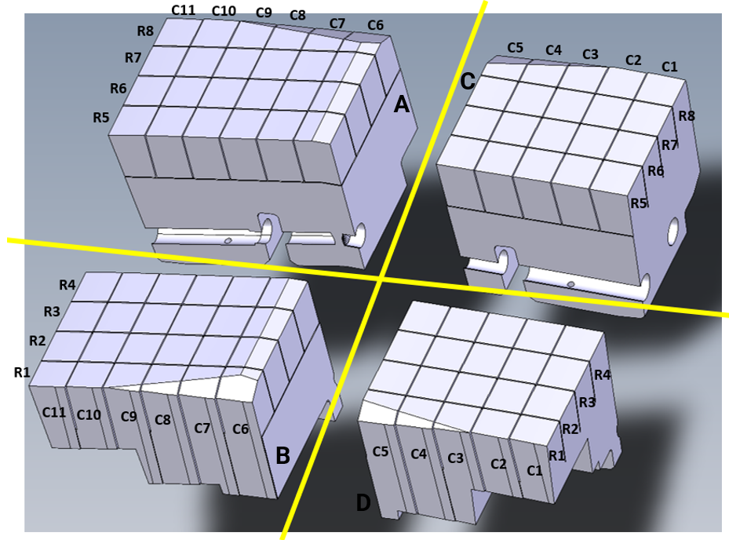


SPE.3:Molten Be tile (Runaway Electron damage) (CCFE+IAP)
Based on 3D profiling, modelling
of the RE induced damage to PFC
L. Chen, R.A. Pits, M. Lehnen, C. Reux, S. Ratynskaia et al.
Tile removal
Laser 3D profiling
IWGL - 1X beam
Tile cutting for further post-mortem analysis
Optical microscopy in poloidal and toroidal directions
Completed activities 
- 3D tile profiling 
- Melt modelling 
- Cutting of 1XR18 C3 tile in 4 quarters 
- Optical microscopy in poloidal and toroidal direction 
- Cutting of selected castellations 
Section B
Height difference assessment in poloidal direction across C6 row
Deliverable:
Status: In progress
Facilities:
R1C6
R2C6
R3C6
R4C6
A. Widdowson (CCFE), E. Grigore et al. (IAP)

Slide 32


SPE.3: Post-mortem analysis of PFC in JET (CCFE)
Microscopy and micromechanics on W Langmuir probes
Langmuir probe 26 from tile 6 showed significant grain growth from 33 µm to 570 µm
Negligible change in hardness
Voids up to 50 µm in diameter formed at GBs near the exposed surface.
NRA confirmed there was no deuterium present.
Microscopy and micromechanics on W Tile 5 Lamellae
Indentation of 3 lamellae showed no change in hardness after exposure in ILW3.
A shadowed lamella was covered in over 20 droplets of molten W.
EELS showed Be diffused to droplet-lamella interface, formed BeO which was decorating void-like structures and had formed layers of up to 200 nm.
Underneath every droplet there were bubbles up to 100 nm in diameter which extended a few microns into the surface of the lamella.
Bubbles/voids of a similar size and distribution were seen in the as received, likely due to the evaporation of impurities during manufacture.
Molten droplets are likely responsible for introducing impurities and sufficiently high temperatures to create voids.
Hydrogen may be diffusing into the voids from the plasma.
Figure 1. EBSD images showing the grain size and orientation from (a) The as received Langmuir probe (b) Probe 26 that was placed by tile 6 in the JET divertor.
Deliverable:
Status: In progress
Facilities:
Figure 2. EELS map of beryllium signal showing the BeO layer at the droplet-lamella interface.
A. Widdowson et al. (CCFE)

Slide 33










SPE.3: JET’s divertor PFCs in He environment (CCFE)
Motivation
C43
tile C
1st scenario – Fuzz formation
Temperature ~ 900 - 1000 ⁰C
Fluence ~ 1.5 × 10²⁵ m⁻²
2nd scenario – JET’s He campaign conditions 700 ⁰C
Temperature ~ 700 ⁰C
Fluence ~ 1.5 × 10²⁶ m⁻²
0
tile B
1
8
3
5
7
4
6
W-tile 5 lamellae
PSI-2
1st scenario – Fuzz formation
Clear W-fuzz formation
Fuzz growing in all directions
Fuzz dimension ~ up to 1.5 μm
JET’s He campaign simulation
NO W-fuzz formation
Multi-layer strata revealed
Predominantly erosion ~ 200-400 nm

Slide 34
SP E plans for 2023
Notes:
PD: Plasma Devices as in PEP listed
HHF: High Heat flux as in PEP listed
IBF: Ion beam Facility as in PEP listed
Other facilties as in PEP listed

Slide 35
SP E Milestones 2023
WM69 | SP E | JET Be and W sample preparation for post-mortem analysis in 2022 and 2023 performed (ITER) | 31.12.2023
WM70 | SP E | Comparison of hydrogenic retention quantification by different post-mortem analysis techniques completed. Considers NRA, TDS and upcoming LIBS and LIDQMS techniques at JET. (ITER + DEMO) | 31.12.2023
WM71 | SP E | Post-mortem analysis of main wall tiles, recessed wall components exposed to CX neutrals and diagnostic components completed.(ITER) | 31.12.2023
WM75 | SP D, SP E | Experiment, interpretation and initial modelling of WP PWI experiments in JET-ILW He plasmas and comparison with ASDEX Upgrade experiments focusing on erosion deposition and assessing parameters determine W nanostructure formation in the divertor. | 31.12.2023
Relevant Work Package Milestones for SP E extracted from WPPWIE PMP 2022
Notes:
Repalce by your SPX

Slide 36
SP E Tasks 2023
Activity | Deliverable ID(s) | Task Title
SP E.1 | D001 | Sectioning and preparation of samples from CFC divertor tiles. Distribution of samples to other laboratories (VTT)
SP E.1 | D002 | Sectioning and preparation of samples from metallic and diagnostics components. Distribution of samples to other laboratories (IAP)
SP E.2 | D001, D002 | Characterization of JET divertor tiles 0 and 1 with LIBS, LID-QMS, TDS and metallography (FZJ, CU)
SP E.2 | D003 | Analysis of samples from JET divertor tiles 4, 6, 7 and 8 with TDS and GDOES (IAP)
SP E.2 | D004 | Analysis of samples from JET divertor tiles 0 and 1 with TDS, FC and dissolution method. Simulation of C39 JET baking experiment (ISSP-UL)
SP E.2 | D005, D006, D007, D008 | Characterization of JET divertor tiles 4, 6,7 and 8 using ion beam analysis RBS, NRA, HIERDA, μbeam NRA (IST, MPG, NCSRD, VR)
SP E.2 | D009 | Sectioning and preparation of samples from JET divertor tiles 4, 6, 7 and 8. Characterization of samples from JET divertor tiles 4, 6, 7 and 8 using SIMS, optical microscopy and TDS (jointly with CCFE) (VTT)
SP E.3 | D001 | Characterization of JET plasma facing components with LIBS, LID-QMS, TDS and metallography (FZJ)
SP E.3 | D002 | Analysis of JET plasma facing components with TDS and GDOES (IAP)
SP E.3 | D003 | Electron microscopy (SEM, TEM, FIB) and nanoindentation of JET plasma facing components (IPPLM)
SP E.3 | D004 | Analysis of JET plasma facing components with TDS, FC and dissolution method (ISSP-UL)
SP E.3 | D005, D006, D007, D008 | Characterization of JET plasma facing and diagnostics components using ion beam analysis RBS, NRA, HIERDA, μbeam NRA (IST, MPG, VR, NCSRD)
SP E.3 | D009 | Characterization of JET plasma facing components using SIMS, optical microscopy and TDS (jointly with UKAEA) (VTT)
Notes:
This is just a summary table – Michael will provide it.

Slide 37
SPE Quick overview for 2022-2023
No new tiles and components available before shutdown in 2023-2024
Post-mortem analysis of JET tiles (divertor, limiters) typically a 2 year programme
Shipment of divertor tiles from CCFE to VTT in 3/2022
Shipment of metallic components from CCFE in 4-5/2022
Coring of divertor tiles completed in 6/2022
First shipments of divertor samples to RUs in 7/2022
Some delays in IBA analyses → further delays to other analyses
Many of tasks in 2023 will be smooth continuation of 2022 activities
If SPE continues beyond 2023:
  Re-evaluation of capabilities for handling samples from the JET DT campaigns
  Radiation safety course for RUs participating in analysis of DT
Notes:
PD: Plasma Devices as in PEP listed
HHF: High Heat flux as in PEP listed
IBF: Ion beam Facility as in PEP listed
Other facilties as in PEP listed

Slide 38
SPE: Tasks 2023
SP E1
Coordination activity, sample distribution, sample preparation, contact for JET DTE2 samples
Continuation of activities
Samples from divertor tiles 4, 6, 7 and 8 (exposed either in ILW1-3 or ILW2-3)
Distribution of samples from DP tile 3A8
Cutting of mirror cassettes, louvre clips
SP E2
Comparison of hydrogenic retention quantification by different techniques and fuel removal assessment
Continuation of activities
Post-mortem analysis of tiles 4, 6, 7 and 8 (IBA,SIMS,TDS,FC…)
Lab experiments to simulate C39 baking experiment
LIBS, LID-QMS analysis of JET PFCs
SP E3
Post-mortem analysis of PFC and other objects in JET
Continuation of activities
Characterisation of wall tiles, DP 3A8, 1XR18
Characterisation of W lamellae and Langmuir probes
Analysis of mirror cassettes, louvre clips, sticking monitors, deposition monitors (for validation of modelling)
Notes:
PD: Plasma Devices as in PEP listed
HHF: High Heat flux as in PEP listed
IBF: Ion beam Facility as in PEP listed
Other facilties as in PEP listed

Slide 39
SP E1
IAP
Cutting of 1XR18
Cutting of mirror cassettes, need to discuss with modellers
VTT
Sampling of divertor tiles 4, 6, 7 and 8
CCFE
Shipping of mirror cassettes, louvre clips, sticking monitors, deposition monitors and DP tile 3A8 samples
Shipping of additional limiter tiles from top and bottom of limiters, for SPE in 2024-2025
Notes:
PD: Plasma Devices as in PEP listed
HHF: High Heat flux as in PEP listed
IBF: Ion beam Facility as in PEP listed
Other facilties as in PEP listed

Slide 40
SP E2
CU
Continuation of work
LIBS, LID-QMS analysis of JET divertor samples from tiles 0, 1, 4, 6 jointly with FZJ, IPPLM, UT and VTT (preparations for JET LIBS experiment in 2024)
Quantitative analysis by CF-LIBS
FZJ
Continuation of work
Characterization of JET divertor tiles 0, 1, 4, 6 with LIBS, LID-QMS, TDS and metallography of JET PFCs
Quantitative analysis by CF-LIBS
IAP
Continuation of work
Analysis of samples from JET divertor tiles 4, 6, 7 and 8 with TDS and GDOES
Notes:
PD: Plasma Devices as in PEP listed
HHF: High Heat flux as in PEP listed
IBF: Ion beam Facility as in PEP listed
Other facilties as in PEP listed

Slide 41
SP E2
ISSP-UL
Continuation of work
Analysis of samples from JET divertor tiles 0,1, 4, 6, 7 and 8 with TDS, FC and dissolution method
Simulation of C39 JET baking experiment
IST, MPG
Continuation of work
Characterization of JET divertor tiles 0, 1, 4, 6, 7 and 8 with RBS and NRA
NCSRD
Continuation of work
Further analysis of samples from tiles 0 and 1: ³He beam, SEM/EDX, XRD
Analysis of samples from JET divertor tiles 4, 6, 7 and 8 with µbeam NRA
Notes:
PD: Plasma Devices as in PEP listed
HHF: High Heat flux as in PEP listed
IBF: Ion beam Facility as in PEP listed
Other facilties as in PEP listed

Slide 42
SP E2
VR
Continuation of work
Characterization of samples from JET divertor tiles 4, 6, 7 and 8 using ion beam analysis (HIERDA)
VTT
Continuation of work
Sectioning and preparation of samples from JET divertor tiles 0,1, 4, 6, 7 and 8
Characterization of samples from JET divertor tiles 4, 6, 7 and 8 using SIMS, optical microscopy and TDS (jointly with CCFE)
CCFE
Continuation of work
Post-TDS IBA at IST
Determination of baking efficiency of ITER baking cycle by comparison of pre-TDS and post-TDS IBA.
Notes:
PD: Plasma Devices as in PEP listed
HHF: High Heat flux as in PEP listed
IBF: Ion beam Facility as in PEP listed
Other facilties as in PEP listed

Slide 43
SP E3
FZJ
Continuation of work
LID-QMS, TDS on JET Langmuir probe tips and metallography on IWGL tile with runaway electron damage
IAP
Continuation of work
Analysis of JET plasma facing components with TDS and GDOES
IPPLM
Continuation of work
Nanoindentation of Langmuir probe 3
FIB cross-sections to assess the grain size in individual zones of LPs.
Study of W-lamellas from stack B (Tile 5)
ISSP-UL
Continuation of work
Analysis of JET plasma facing components with TDS, FC and dissolution method
Notes:
PD: Plasma Devices as in PEP listed
HHF: High Heat flux as in PEP listed
IBF: Ion beam Facility as in PEP listed
Other facilties as in PEP listed

Slide 44
SP E3
IST, MPG
Continuation of work
Characterization of JET plasma facing and diagnostics components using ion beam analysis (RBS, NRA)
NCSRD
Continuation of work
Analysis of JET plasma facing components with µbeam NRA
VR
Continuation of work
Characterization of JET plasma facing and diagnostics components using ion beam analysis (HIERDA)
Notes:
PD: Plasma Devices as in PEP listed
HHF: High Heat flux as in PEP listed
IBF: Ion beam Facility as in PEP listed
Other facilties as in PEP listed

Slide 45
SP E3
VTT
Continuation of work
Characterization of JET plasma facing components (W lamellae) using SIMS, optical microscopy and TDS (jointly with CCFE)
CCFE
Continuation of work
IBA analysis in poloidal, toroidal and “depth” direction (IWGL tile with RE damage)
Metallography measurements for IWGL tile with RE damage
Main pulse assessment responsible for RE damage
Notes:
PD: Plasma Devices as in PEP listed
HHF: High Heat flux as in PEP listed
IBF: Ion beam Facility as in PEP listed
Other facilties as in PEP listed

Slide 46
Extra slides

Slide 47
Erosion-deposition diagnostics in JET-ILW
Marker tiles
Divertor
Main wall
Probes
Rotating collectors
W sticking monitors
Mirrors, cassettes
W lamellae
Langmuir probes
QMB covers
Notes:
PD: Plasma Devices as in PEP listed
HHF: High Heat flux as in PEP listed
IBF: Ion beam Facility as in PEP listed
Other facilties as in PEP listed

Slide 48
EU-Japan collaboration
Topics in 2023
IC09 SP E.2: EU-Japan (Rokasho/Broader Approach F4E), 2022 - 2023
Tritium depth profiling in bulk W tiles (lamellae) from the JET divertor
  ILW1, ILW3
  TIPT, LSC, possibly TDS, SEM, EDX
  Expose surface to T gas to see any re-saturation (at Toyama university?)
Fuel desorption from Be limiter tiles and re-saturation of co-deposits
  Fuel accumulation in gaps
Samples from ILW1 and ILW3 analysed in the past → ILW2 samples (divertor, Be) to be shipped to Japan

