Slide 1
Langmuir probes from the JET tungsten divertor: Surface composition from hydrogen to tungsten by IBA
Per Petersson

Slide 2
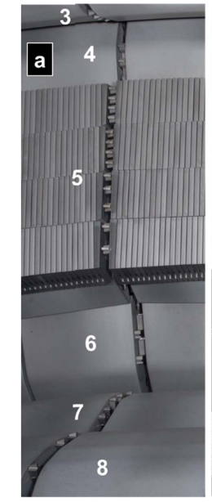
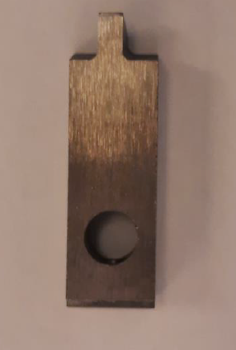
Background
From section 14 IW
Left side
Front
Right side

Slide 3
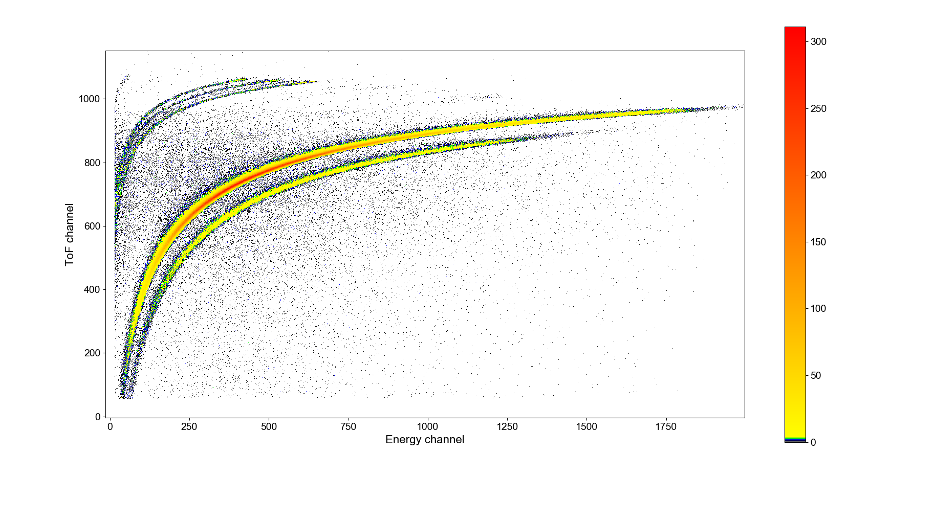
ToF ERDA analysis
H D BeC N O Fe Ni Crc
W

Slide 4
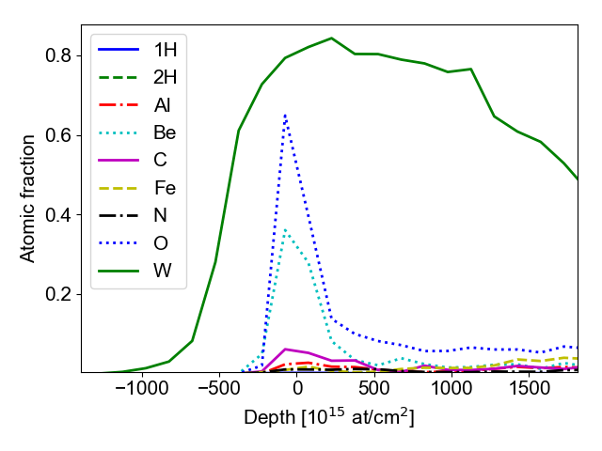
ToF ERDA analysis

Slide 5
Right hand side

Slide 6
Right hand side
1
5
3

Slide 7
Left hand side
1
5
3

Slide 8
Left hand side
1
5
3

Slide 9
Back side
1
5
3

Slide 10
Back side
1
5
3

Slide 11
Front side
1
5
3

Slide 12
Front side
1
5
3

Slide 13
Helium
Probe 5 Left hand side
Probe 3 Left hand side
Single point at front of probe 5 and left side of probe 1

Slide 14
Summary
W sample analysed in 4 different directions
Be and O amounts are similar in most co-deposits.
He (helium-3 and 4)in a few points mostly on sides
Not much D found on the samples (probes were taken out after ILW-2 campaign ended in hydrogen).
Be and O more further down on sides and front.
C found in greater amount closer to the tip

